Slide 1
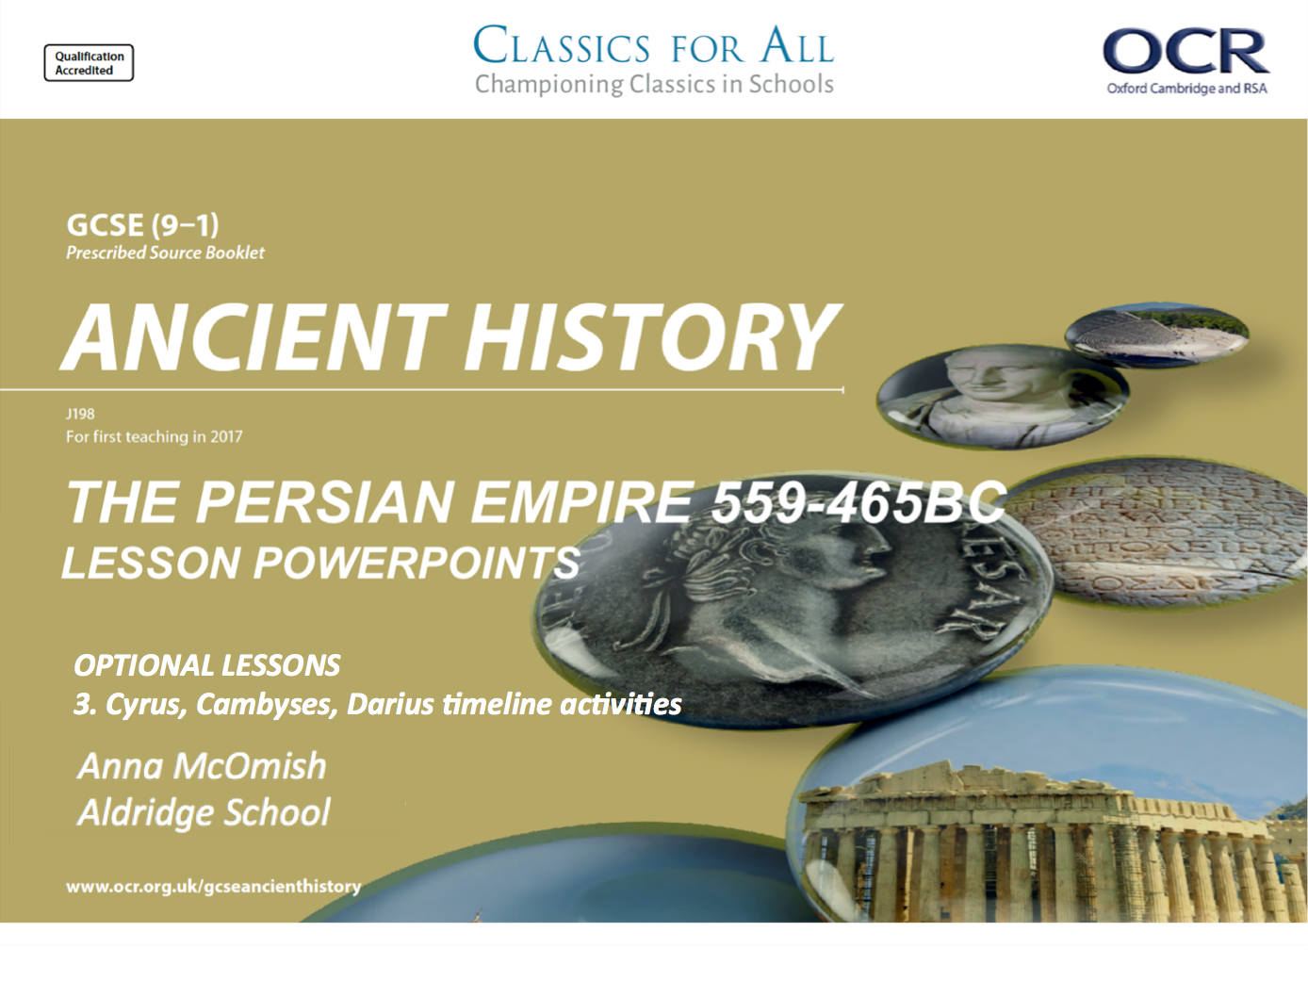
OPTIONAL LESSONS
3. Cyrus, Cambyses, Darius timeline activities

Slide 2
Starter:
Who attempted to kill Cyrus as a child?
Which Mede advisor did Cyrus rely on?
How did Cyrus take the city of Babylon according to Herodotus?
Which royal city did Cyrus build?
What name was given to the Persian gardens?
According to Herodotus, which tribe was Cyrus killed fighting?
Which sea faring peoples did Cambyses bring into the empire?
At which major battle did Cambyses defeat the Egyptians?
Which Egyptian wrote positively about the reign of Cambyses?
Against which shrine did Cambyses send an army?
In what year did Darius become king of Persia?
How many “liar kings” are there on the Bisitun inscription?
Who led the Ionian revolt against the Persians?
In which sea battle were the Ionians defeated in 494BC?
What tokens of surrender did the Persians expect?

Slide 3
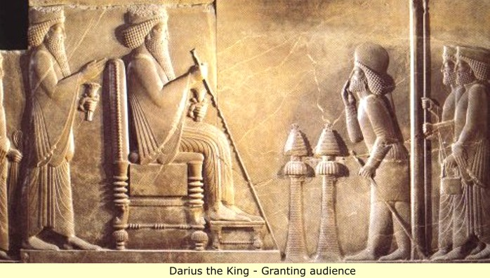
Persian Kings - Timeline
Lesson Objectives:
To test factual recall on the reigns of Cyrus, Cambyses and Darius.
To construct a timeline on the 3 main themes of the Persian Empire unit.

Slide 4
Revision Task
Complete an A3 timeline of the 3 Persian Kings we have covered so far; CYRUS, CAMBYSES II and DARIUS.
Use the timeline dates on p of the OCR textbook to help you.
Colour code using the 4 main themes of the force;
Conquering and expanding the empire
Treatment of people they controlled
Attitudes to religion
Building projects
FINISH FOR HOMEWORK!

Slide 5
The Reigns of Cyrus, Cambyses II and Darius
King Cyrus
King Darius
King Cambyses II
Conquering and expanding the empire
Treatment of people they controlled
Attitudes to religion
Building projects

