Slide 1
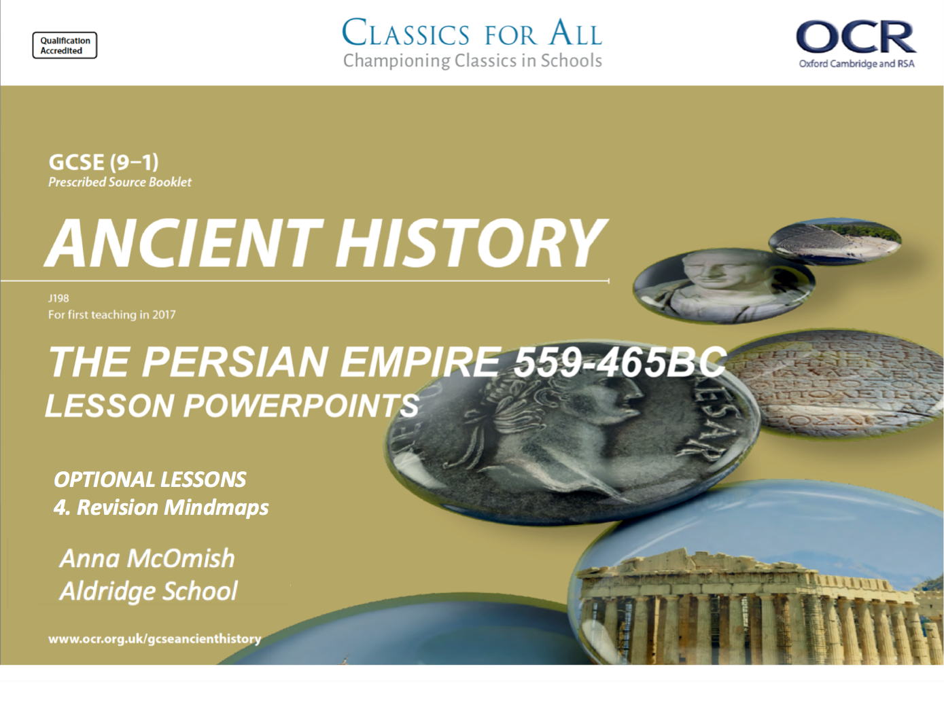
OPTIONAL LESSONS
4. Revision Mindmaps

Slide 2
Starter:
Which words are the ODD ONES OUT and why?
1 | Apis Bull | Cambyses | Cyrus
2 | Pelusium | Pteria | Pasargadae
3 | Harpagus | Croesus | Darius
4 | Cyrus Cylinder | Bisitun Inscription | Nabonidus Chronicle
5 | Drauga | Ahuramazda | Marduk

Slide 3
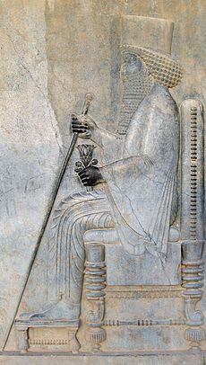
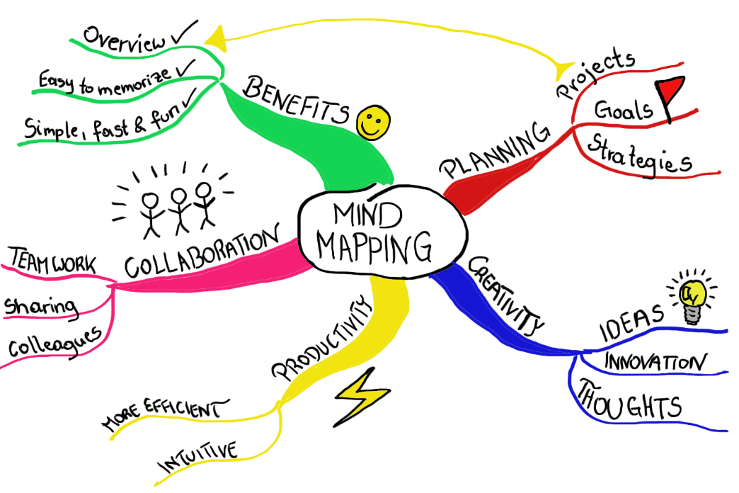
Revision Techniques: Mindmaps
Lesson Objectives:
To understand what mindmaps are and how to produce a good one.
To apply your knowledge of mindmaps to a topic that you want to revise.

Slide 4
Task 1
Revision Recap;
What makes effective revision?
What methods do you use to revise and why?
Do you use Flash Cards? Why?

Slide 5
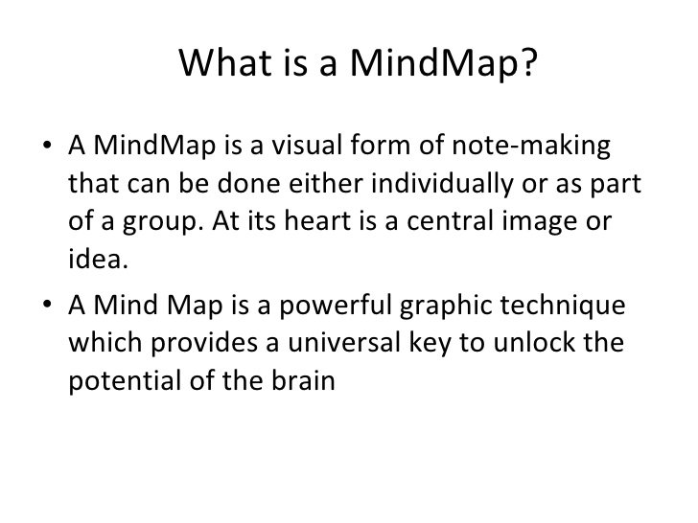

Slide 6
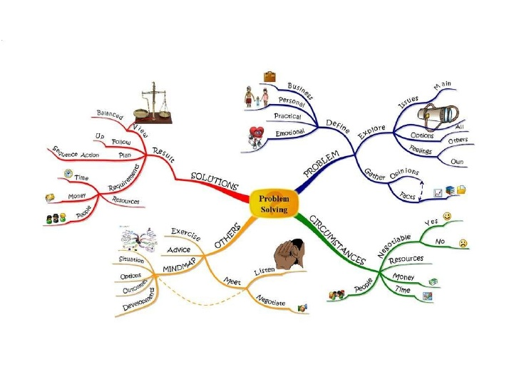

Slide 7
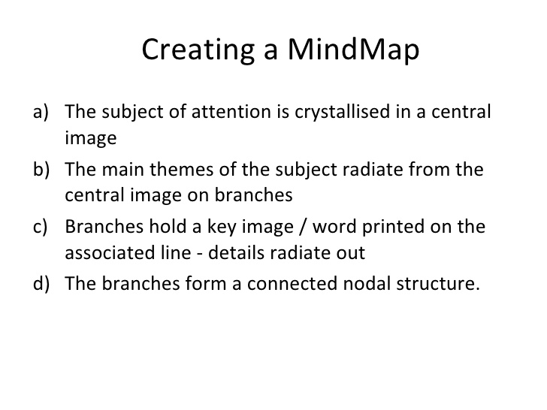

Slide 8
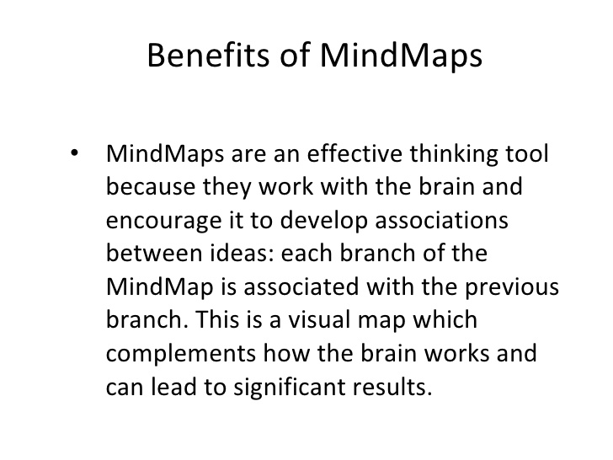

Slide 9
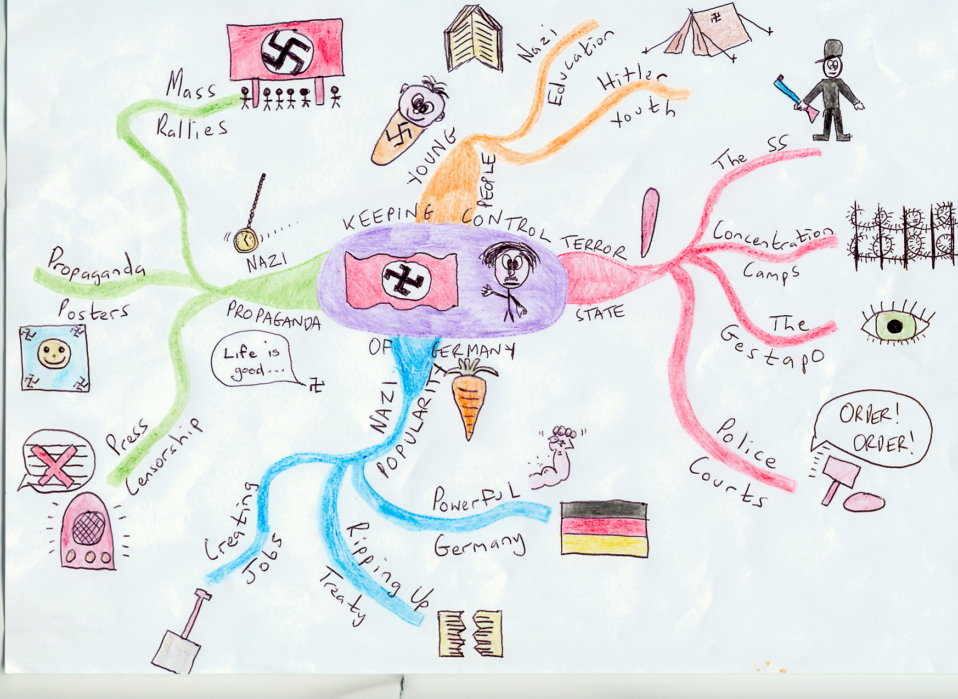
What is good about this mind map? What could be improved?

Slide 10
Task 3
Pick a topic or a king that you feel you need to revise.
Create a mind map on the topic or king.
Finish mind map for H/W!

Slide 11
Plenary
Are mind maps a way of revising that you could use? Why?

