Slide 1


Slide 2
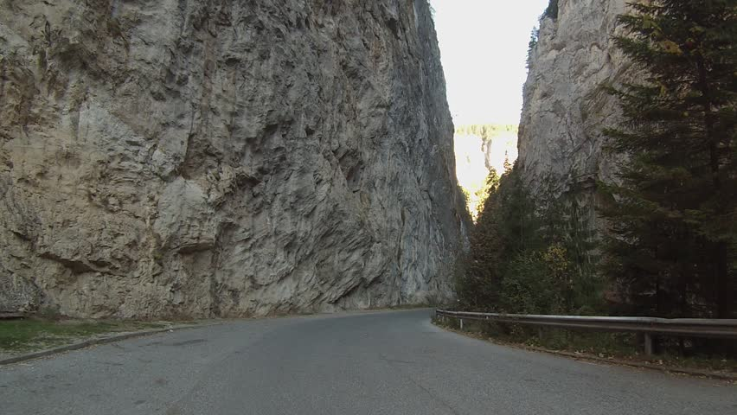
What happened at the Battle of Salamis?
Prepare For Learning
Do it now: Above is a mountain pass similar to the one the Spartans would have used at Thermopylae.
TASK: What are the benefits and negatives of using this terrain?
KEY WORDS: THERMOPYLAE PERSIANS XERXES SALAMIS THEMISTOCLES BAY OF SALAMIS

Slide 3
Objective:
Agree Learning Outcomes
  Outcomes:
  To review key information about the Battle of Thermopylae
  To find out about the events of the Battle of Salamis
  To evaluate the sources who tell us about the Battle of Salamis
KEY WORDS: THERMOPYLAE PERSIANS XERXES SALAMIS THEMISTOCLES BAY OF SALAMIS

Slide 4
Construct Meaning
The Battle of Salamis
KEY WORDS: THERMOPYLAE PERSIANS XERXES SALAMIS THEMISTOCLES BAY OF SALAMIS
Notes:
Live model a paragraph – I – we - you

Slide 5
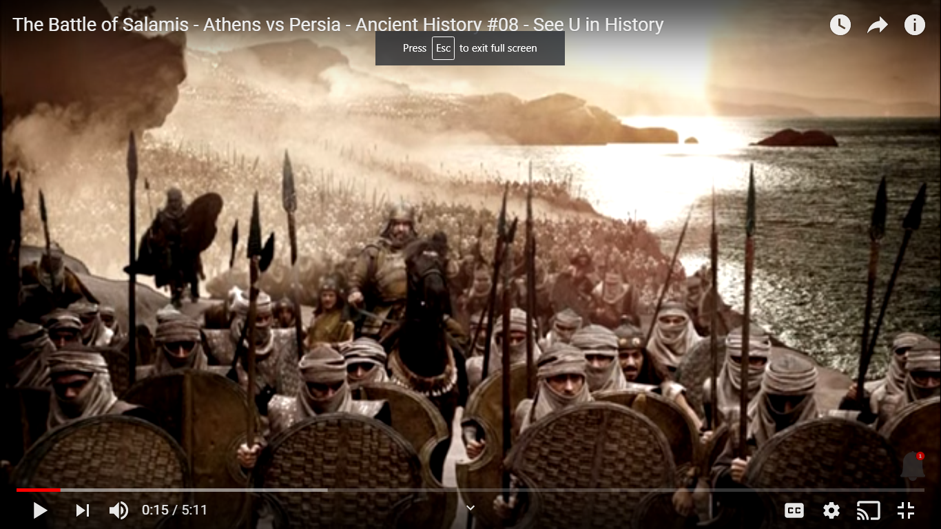
Present New Information
KEY WORDS: THERMOPYLAE PERSIANS XERXES SALAMIS THEMISTOCLES BAY OF SALAMIS
Notes:
https://www.youtube.com/watch?v=UlCUFGBJNMQ

Slide 6
TASK: Create a flowchart of the Battle of Salamis
Construct Meaning
Event. What happened?
Challenge: “This is important/significant because…”
“This led to…”
Event. What happened?
Challenge: “This is important/significant because…”
“This led to…”
Event. What happened?
Challenge: “This is important/significant because…”
“This led to…”
Event. What happened?
Challenge: “This is important/significant because…”
KEY WORDS: THERMOPYLAE PERSIANS XERXES SALAMIS THEMISTOCLES BAY OF SALAMIS

Slide 7


Present New Information
Sources:
Herodotus,
Diodorus Siculus
Reading
KEY WORDS: THERMOPYLAE PERSIANS XERXES SALAMIS THEMISTOCLES BAY OF SALAMIS
Notes:
https://www.youtube.com/watch?v=UlCUFGBJNMQ

Slide 8
Construct Meaning
Herodotus | Diodorus Siculus
STEP 1: Summarise each source briefly in its own column.
STEP 2: Use two highlighters. Highlight in your columns where each source says something similar and highlight where it says something different.
Ext: Which account do you think is the most accurate? Why?
KEY WORDS: THERMOPYLAE PERSIANS XERXES SALAMIS THEMISTOCLES BAY OF SALAMIS

Slide 9
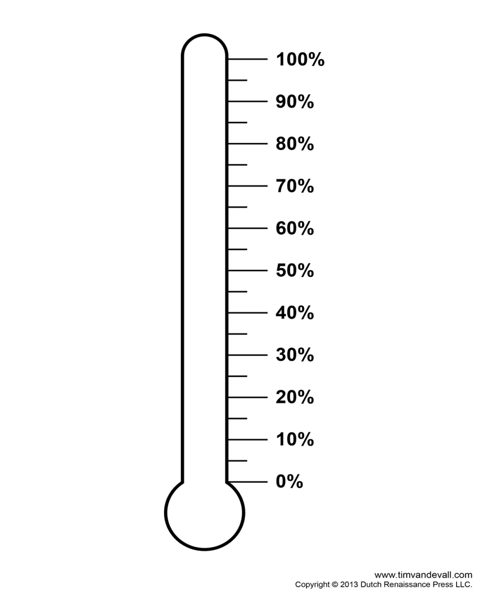
TASK: ‘The Victory at Salamis for the Greeks was only down to Themistocles’ leadership and strategy’. How far do you agree?
Apply To Demonstrate
How far do you agree?
Totally
Strongly
Quite strongly
Undecided
Some extent
Slightly
Not at all
STEP 1: Decide how far you agree with the statement and mark it on your agree-o-meter.
STEP 2: Write reasons on either side why you think that.
Can you argue from the opposite side of your argument? Write these ideas down in a different colour.
KEY WORDS: THERMOPYLAE PERSIANS XERXES SALAMIS THEMISTOCLES BAY OF SALAMIS
Notes:
Agree-o-meter? How far do you agree?
Totally
Strongly
Quite strongly
Undecided
Some extent
Slightly
Not at all

