Slide 1
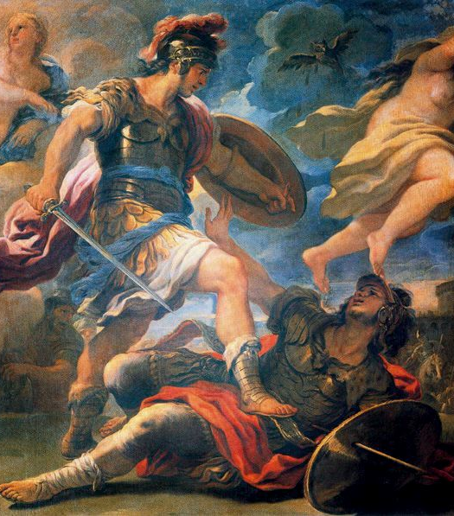
Virgil’s Aeneid
Dr Emily Pillinger
emily.pillinger@kcl.ac.uk

Slide 2
2 halves: Odyssey (1-6) + Iliad (7-12)
Begins by going in medias res – ‘into the middle of things’
Horace’s Art of Poetry:
‘He [a great epic poet] always presses on to the outcome and hurries the reader into the middle of things [in medias res] as though they were quite familiar.’
Second half: ‘I’m introducing a greater work’ (Aen. 7.45)
TELEOLOGY – goal-focused

Slide 3
3 thirds: Dido’s tragedy (1-4) – no future
Roman future (5-8)
Turnus’ tragedy (9-12) – no future
3 thirds: Carthage (1-4)
Otherworldly wanderings (5-8)
Italy (9-12)
Each third ends with a demonstration of the power of Aeneas’ weapons: his sword (4, 12) and his shield (8)

Slide 4
Ring composition
condere – ‘to found / bury’, Aen. 1.5, 1.33, 12.950
Heroes’ limbs loosening in fear: 1.92, 12.951
Anger of Juno

Slide 5
Troy
Who could translate into words that night’s disaster and killings?
Who could shed tears that express those oceans of pain that engulfed us?
That day an old city died after so many years of dominion…
Virg. Aen. 2.361-3

Slide 6
Carthage
3 Punic Wars against Rome (264-146BCE)
Dido as Cleopatra: civil war between Octavian (to be Augustus) and Mark Antony (32-31BCE)
Dido’s curse:
No love must ever exist between our two peoples, no treaties.
Rise from my bones, my avenger – and there will be an avenger! –
So you can hound these Dardan settlers with hot fire and cold steel,
Now, or some day in the future, whenever that strength coalesces.
Virg. Aen. 4.624-7

Slide 7
Carthage as exemplary city-foundation
Awed by the massive construction, where once there were rickety hovels,
Awed by the gates, by the noise, the paved roadways, Aeneas just marvels.
Fired-up Tyrians work at their tasks; some extend the defence walls,
Strengthen the castle and, with bare hands, lever masonry uphill.
Some decide housing-sites, mark boundary lines with a furrow.
Magistrates, legal codes, and a sacred senate are chosen.
Others excavate ports, still others are laying foundations,
Deep in the ground, for a theatre. Some chisel out from the cliff-sides
Tall columns, massive in size: décor for a stage in the future.
Virg. Aen. 1.421-29

Slide 8
Pallanteum
… in the distance, they saw a town’s fortress and walls, and some scattered
Buildings – a place Rome’s dominant power raises high as the heavens
Now, but in those days no more than Evander’s impoverished holdings.
Virg. Aen. 8.98-100

Slide 9
Trojans go home!
‘Dardanus’ rugged sons: the first land that nurtured your parents’
Roots will, on your return, take you back to her welcoming bosom.
Go, then, in careful search of your ancient, original mother!’
Virg. Aen. 3.94-6

Slide 10
Trojans and Troy
Aeneas to Dido:
If fate’s orders allowed me to live out the life of my choosing,
Putting my anguish to rest as I myself would have wanted,
Troy is the city where I’d be now, looking after my own folk’s
Relics and remnants…
Virgil. Aen. 4.340-43
Italy: ‘this is my love and my homeland’
Virg. Aen. 4.347

Slide 11
Trojans as caricatured ’others’
Iarbas:
‘Here is a woman who wandered within our borders, and founded,
Cash down, a very small city. We gave her a few coastal ploughlands,
Leased on a contract. And then she rejected our offer of marriage,
Took in Aeneas, and made him her master and lord of her kingdom.
Helped by his eunuch entourage, this latter-day Paris,
Chin kept in place by Maeonian bows, and his hair by conditioning
Perfumes, controls what he’s raped…’
Virg. Aen. 4.211-17
Numanus Remulus:
‘We are a species tough from the roots. We carry our new-borns
Straight to the rivers to toughen them up in the cold and the water…
… Old age, as it slows us,
Can’t either lessen our strength or diminish our vigour of spirit.
We hide our grey hairs with our helmets…
You, with your needleworked saffron and gleamingly purpled apparel,
You take delight in inertia, indulging yourselves in your dances.
Tunics for you come with sleeves, and your bonnets have nice little ribbons.
Phrygian women, not Phrygian men…’
Virg. Aen. 9.602-17

Slide 12
Aeneas’ father’s advice from the underworld
You, who are Roman, recall how to govern mankind with your power.
These will be your special “Arts”: the enforcement of peace as a habit,
Mercy for those cast down and relentless war upon proud men.’
Virg. Aen. 6.851-3

Slide 13
Trojans become Romans
Juno to Jupiter:
When, as so be it, they settle their peace in fulfilment of marriage,
When they shape treaties and laws in their confederation together,
Don’t require those who were born here, the Latins, to alter their ancient
Name, become ‘Trojans’, be known as ‘The Teucrians’, or alter their language.
Don’t make them change their traditional dress. Let Latium continue,
Let there be Alban kings who will span all the centuries. And let
Roman stock get its strength from Italian concepts of courage.’
Virg. Aen. 12.821-27
Jupiter to Juno:
Italy’s people will keep both native language and culture…
I’ll ensure that they’ll all be collectively known as ‘the Latins’.
Out of this blend with Ausonian blood you will see a new nation
Rise…
Virg. Aen. 12.834-6

