Slide 1

Democracy and the Athenians
OCR A level

Slide 2
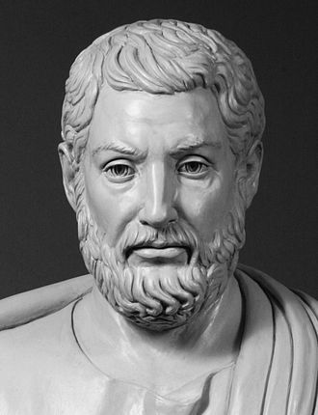
Cleisthenes, architect of Athenian democracy in 507 BCE

Slide 3
Cleisthenes’ Reforms (Principle of Isonomia)
Organisation of 139 demes into ten tribes and three groups (trittyes)
Substitution of demonymics Ifor patronymics
Sortition (radnom selection of magistrates rather than by family and heredity
Reorganisation of Council (Boule and expansion to 5000 to include 50 from each tribe
Reorganisation of law-courts (Dikasteria): jurors selected daily, up to 500 from each tribe.
Ostracism?
System of Ten Generals?

Slide 4
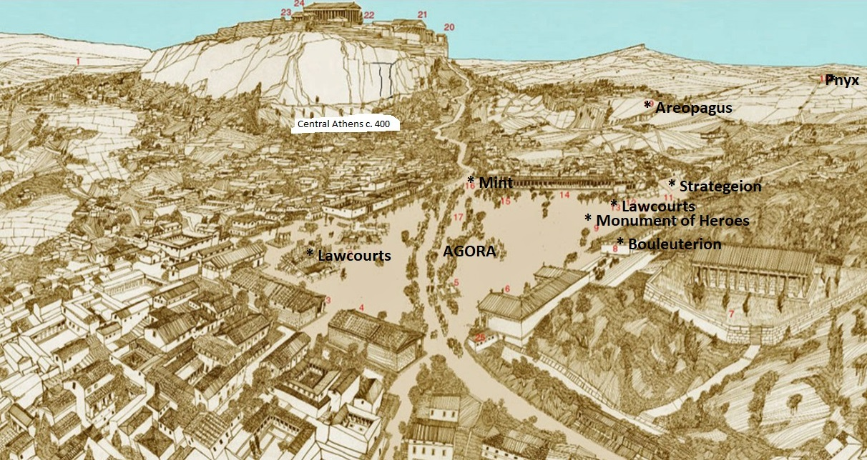

Slide 5
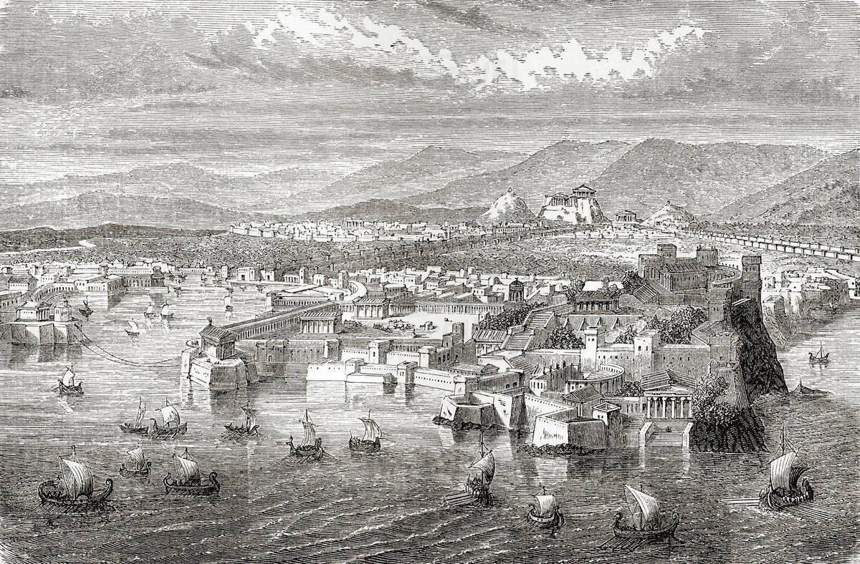
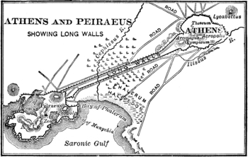

Slide 6
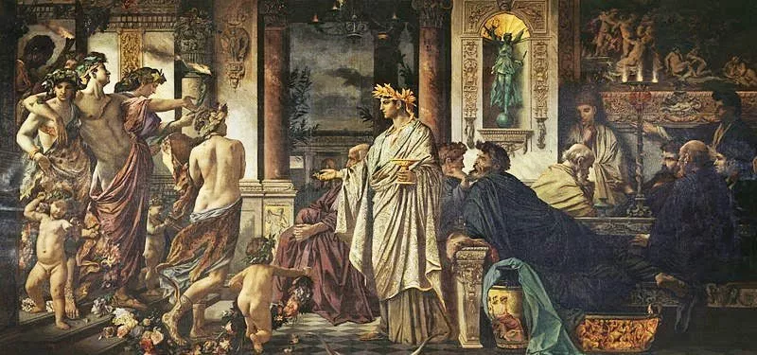

Slide 7
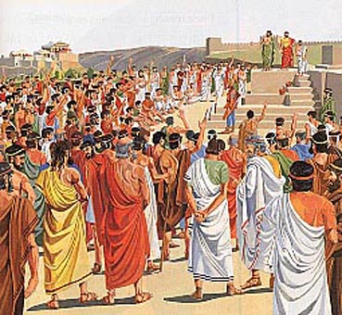

Slide 8
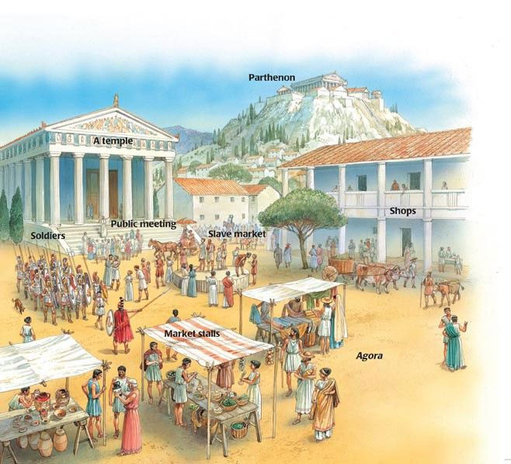

Slide 9
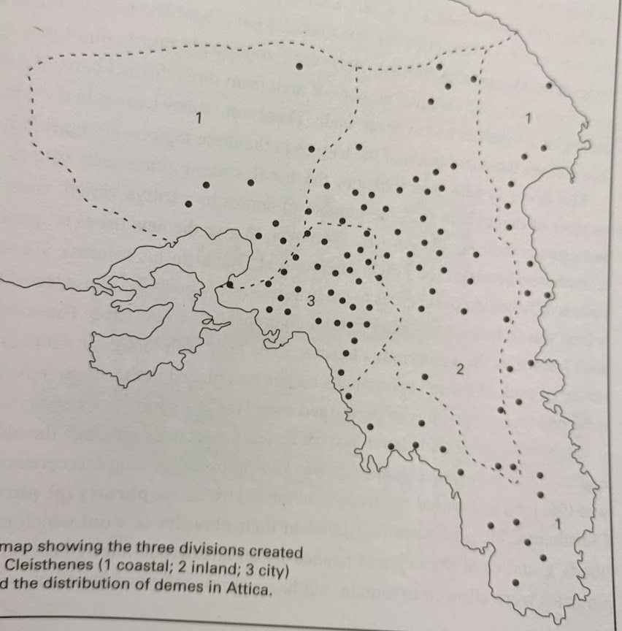
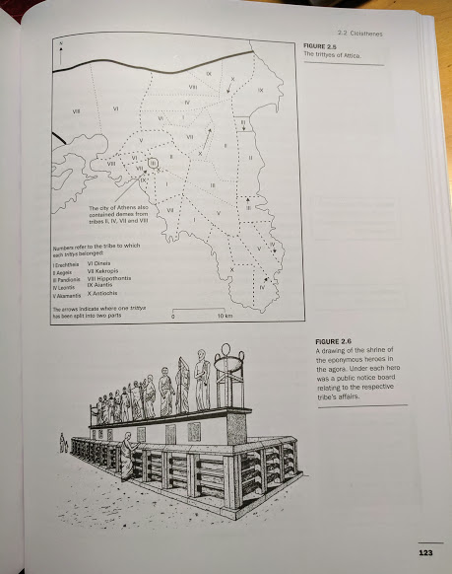
Demes, Tribes, Trittyes

