Slide 1
Homer, Iliad : Plot and ‘digressions’
Pavlos Avlamis (pavlos.avlamis@kcl.ac.uk)
Lecturer in Ancient Greek Language & Literature

Slide 2
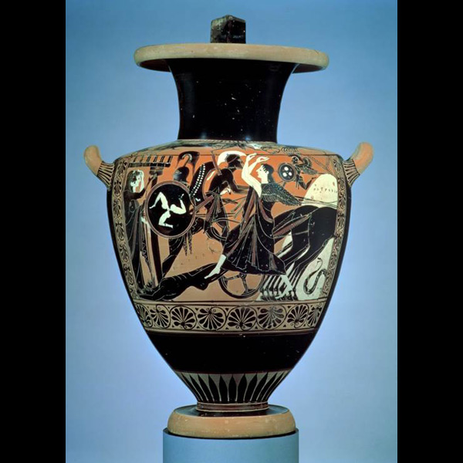
Focus: dramatic action in the Iliad and ‘digressive’ style
The Iliad is not a poem about the Trojan War, but rather about a specific event of the Trojan War: the dispute between Achilles and Agamemnon and the consequences of Achilles’ wrath.
Narrowness: of focus (the chain of events that problematize the view of warrior honour and compensation in the Iliadic world)
Narrowness: of dramatic time (14 days narrated at length out of a total of about 50 days of action)
Narrowness: of space – the plain between the Greek camp and the city of Troy (the gods look on too).

Slide 3
Focus: dramatic action in the Iliad and ‘digressive’ style
But this narrowness is constantly counterbalanced in the Iliad by ‘digressions’ that expand the plot and its focus, dramatic time, and dramatic space.
Digressions do not advance the plot in dramatic time but are nonetheless indispensable parts of the poetry of the Iliad.
At school level where we spend much time reading for plot, these digressions can seem boring or distracting or a good place to go on mental autopilot – but they are important.

Slide 4
Focus: dramatic action in the Iliad and ‘digressive’ style
OCR Specification:
Key topics: literary techniques and composition (among other topics) -
• structure and plot of the epic
• language of the epic including the use of speeches, formulae, similes and other narrative and descriptive techniques and their effects

Slide 5
Outline
Forms and types of digression that I will be focusing on:
Flashback
Foreshadowing
Similes
Speeches and stories of moral instruction (paradeigma [Gr.] / exemplum [Lat.])
Detailed, vivid descriptions (e.g. Shield of Achilles, bk 18)

Slide 6
Flashback
Earlier events in the war not part of the plot: e.g. the repeated references to the sacking of the city of Thebe earlier in the war, an even that is important for the background of Andromache, the wife of Hector (bk 6), but also in depicting a more honourable version of the warrior Achilles.
More implicitly: the opening books of the Iliad replay the earlier causes of war:
the catalogue of Greek and Trojan armies participating in the war in book 2 (otherwise out of place in this advanced point in the war),
the inspection of the main Achaean heroes through the eyes of Helen in book 3,
the decision to decide the war through a duel between Paris and Menelaus in book 4 and the oaths of truce between Trojans and Greeks which are then broken – all episodes that replay in a way the causes of the Trojan War: the abduction of Helen by Paris and his desecration of the bonds of hospitality.

Slide 7
Flashback
Poignant general flashbacks to a time before the war: e.g. bk 22.145-157:
[Achilles is chasing Hector around the walls of Troy] Past the place of watch, and the wind-waved wild fig tree they sped, ever away from under the wall along the wagon track, and came to the two fair-flowing fountains, where well up the two springs that feed eddying Scamander. The one flows with warm water, and round about it smoke goes up from it as from a blazing fire, while the other even in summer flows cold as hail or chill snow or ice that water forms. And there near the springs are broad washing tanks, fair and made of stone, where the wives and fair daughters of the Trojans were used to wash bright clothes formerly in the time of peace, before the sons of the Achaeans came.

Slide 8
Foreshadowing
Prophecies reach beyond the end of the Iliad to the sacking of the city: e.g. book 8 and 15 Zeus’ prophecies or Thetis’ prophecy about the death of Achilles already signalled in book 1 (revisited in 9 and 18).
They also raise the issue of what follows the war and are thus thematically important for the plot: return home and the father-figure (see esp. the choice of Achilles and Iliad 1, 9, and 24)

Slide 9
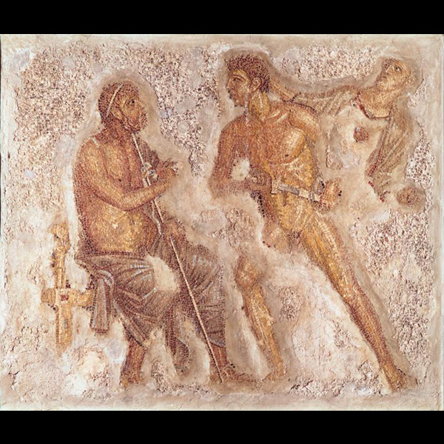
Rage of Achilles: book 1

Slide 10
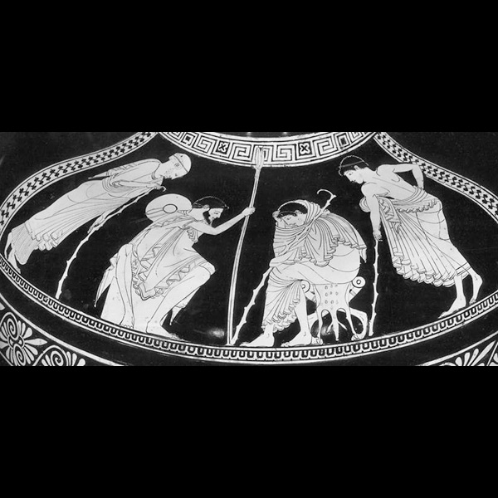
Failed embassy to Achilles: book 9

Slide 11
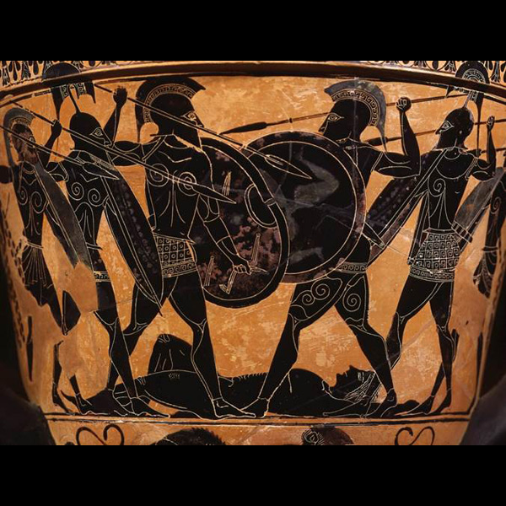
Death of Patroclus: book 16

Slide 12
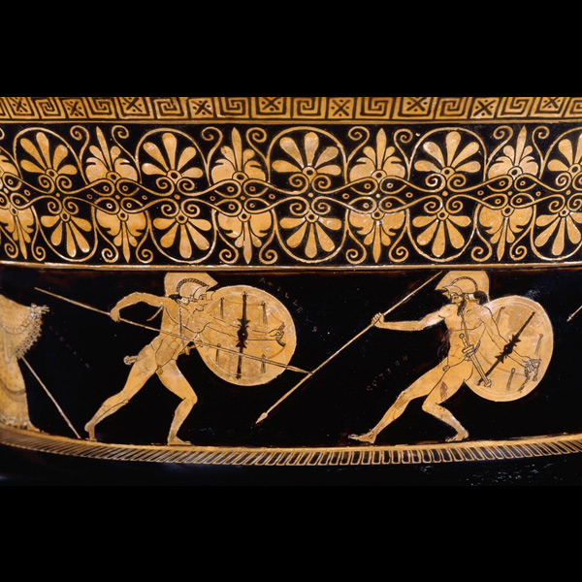
Achilles kills Hector: book 22

Slide 13
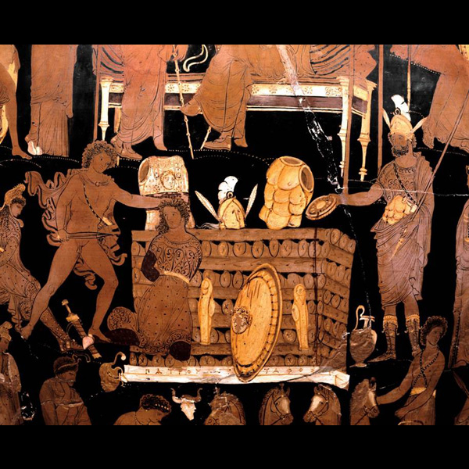
Achilles kills Trojan captives: book 23

Slide 14
Achilles drags Hector’s body: book 24

Slide 15
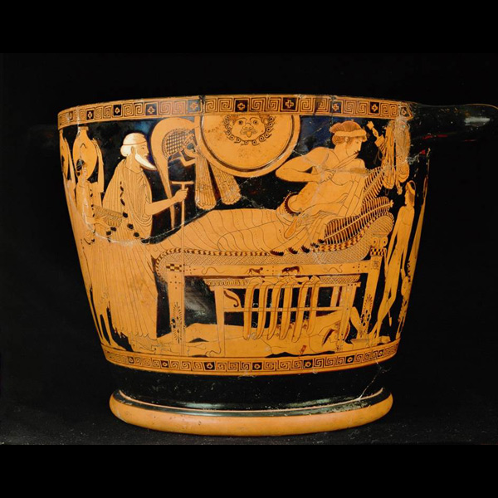
Achilles and Priam: book 24

Slide 16
Speeches and illustrative moral stories
Mythological stories or other stories of the past that are spoken by one character to another as an implicit form of instruction or exhortation.
Their implicit nature also invites the audience to think about the links between the moral story and the wider plot of the Iliad: see esp. Phoenix’s speech in book 9 and the story of Meleager, a mythical hero who withdraws from battle out of anger and does not accept compensation until it is too late

Slide 17
Similes
There are short similes in the poems (‘like a god’) but there are also much longer, sustained similes that are characteristic of Homeric epic. These similes move beyond the world of the Iliad.
Natural world (22.139-144:
As a falcon in the mountains, swiftest of winged things, swoops easily after a fluttering dove: she flees before him, and he close at hand darts again and again at her with shrill cries, and his heart commands him to seize her; so Achilles in his eagerness sped straight on, and Hector fled in terror beneath the wall of the Trojans, and plied his limbs swiftly.

Slide 18
Similes
There are short similes in the poems (‘like a god’) but there are also much longer, sustained similes that are characteristic of Homeric epic. These similes move beyond the world of the Iliad.
A human world that is taken out of the present of archaic Greeks, not the mythical world of the Iliad (24.479-484):
Priam entered in and, coming up to Achilles, clasped his knees in his hands, and kissed his hands, the terrible, man-slaying hands that had slain his many sons. And as when overpowering blindness of heart comes on a man, who in his own country slays another and escapes to a land of strangers, to the house of some man of substance, and amazement comes on those who look on him, so was Achilles struck with wonder at sight of godlike Priam, and struck with wonder were the others likewise, and they glanced at one another.

Slide 19
Descriptions (ekphrasis)
Ekphrasis: is a vivid description that brings before the eyes of the audience the object of the description
See the sustained description of the Shield of Achilles in book 18 (over 350 lines; cf. the shield of Agamemnon 11.32-37). Not simply an interlude, but offers rich thematic links to the rest of the plot.

Slide 20
Functions of digressions
Digressions do not allow generally for the passing of time but are not external to the rest of the plot; there are thematic links that are important.
They step outside the time and space of the plot (mythical stories, flashbacks, foreshadowing, similes)
Speeches also offer instruction to both internal audiences (characters) and external audiences
They contribute to characterisation of speaker (see e.g. speech of Nestor in book 1)

Slide 21
Suggestions for further reading
N. Austin (1966) ‘The function of digressions in the Iliad’, Greek Roman and Byzantine Studies 7: 295-312
M. Edwards (1990) Homer: Poet of the Iliad. Johns Hopkins University Press
R. Fowler (2004) Cambridge Companion to Homer. Cambridge UP
D. Cairns ed. (2001) Oxford Readings in Homer’s Iliad. Oxford: chapters by O. Taplin & M. Willcock

