Slide 1
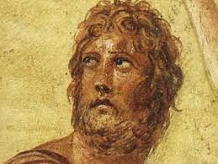
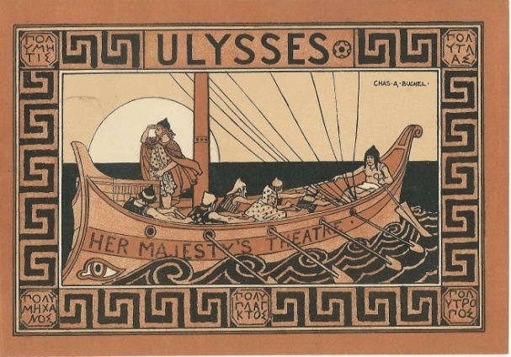


Odysseus: The PolYtropos HERO
Teaching the Odyssey at GCSE and A Level for Classical Civilisation

Slide 2
Epithets of Odysseus Alone
Much-praised polyainos
Very crafty polykerdes
Of grievous homecoming polykedes nostos
Of many stratagems polymechanos
Much-enduring/daring polytlas
Versatile, complex, polytropos

Slide 3
Other Epithets
Master mariner
Hero
Great-hearted
Wise
City-sacker
Kingly
Of many sorrows
Much prayed for

Slide 4
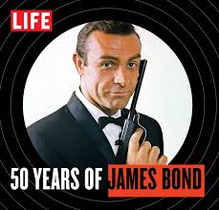
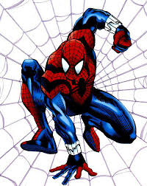
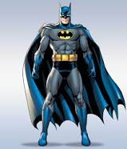
What Kind of Hero?

Slide 5
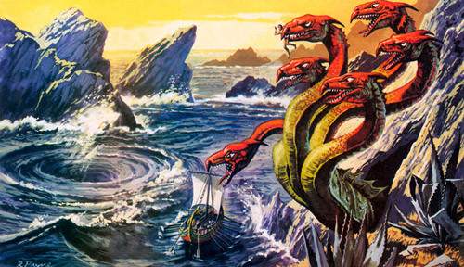
Navigator

Slide 6
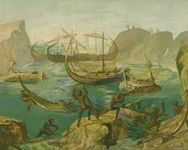
Barbarian-tamer

Slide 7
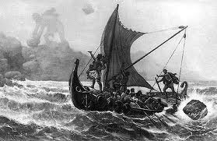
Lesson-Learner

Slide 8
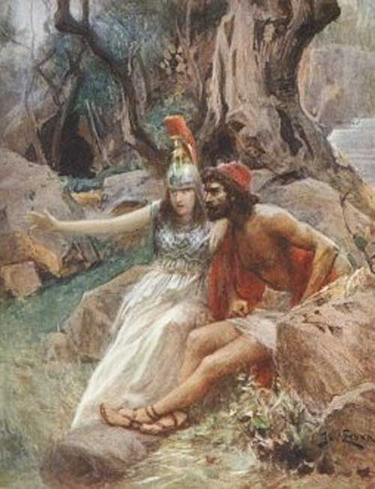
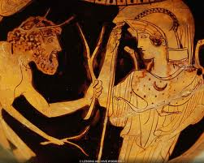
Favourite of the Cleverest Goddess

Slide 9
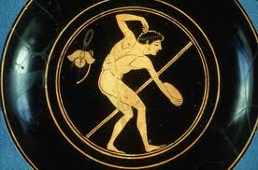
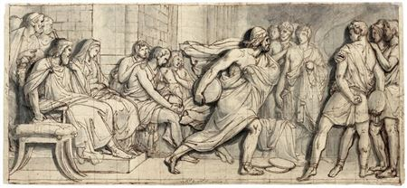
Athlete and discus-thrower

Slide 10
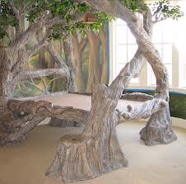
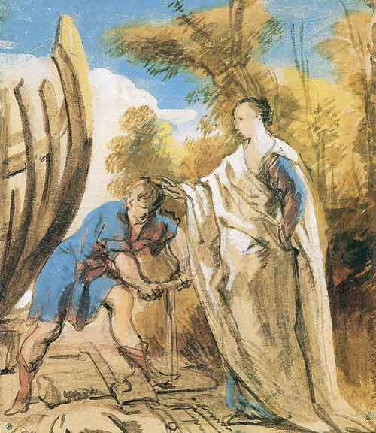
Carpenter

Slide 11
Hunter (on Circe’s Island)
As the stag came from the water I struck him on the spine with my bronze-spear, in the centre of his back, and it pierced right through, so he fell in the dust with a groan, and his spirit passed. Then I planted my foot on his carcass, drew the bronze spear from the wound, and laid it on the ground while I gathered willow shoots then wove a rope, six foot long, by splicing them together end to end. Next I tied the great creature’s feet together, and carried him down to the black ship on my back, using my spear to lean on, since he was too large to sling over my shoulder and steady with my hand.

Slide 12
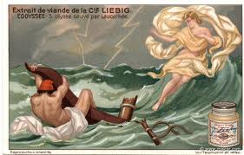
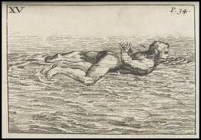
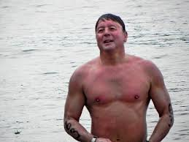
Swimmer

Slide 13
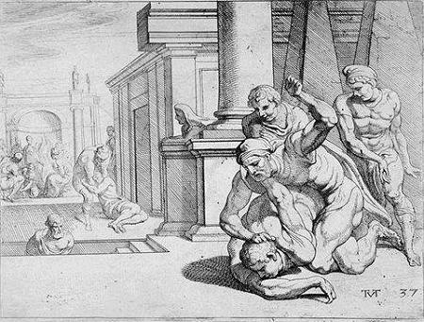
Boxer: Fight with Irus

Slide 14
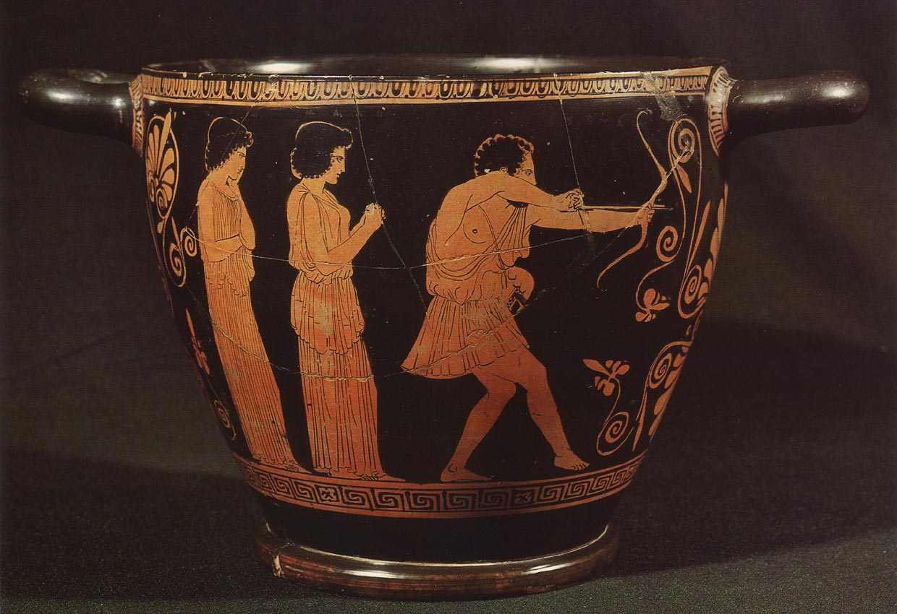
Archer

Slide 15
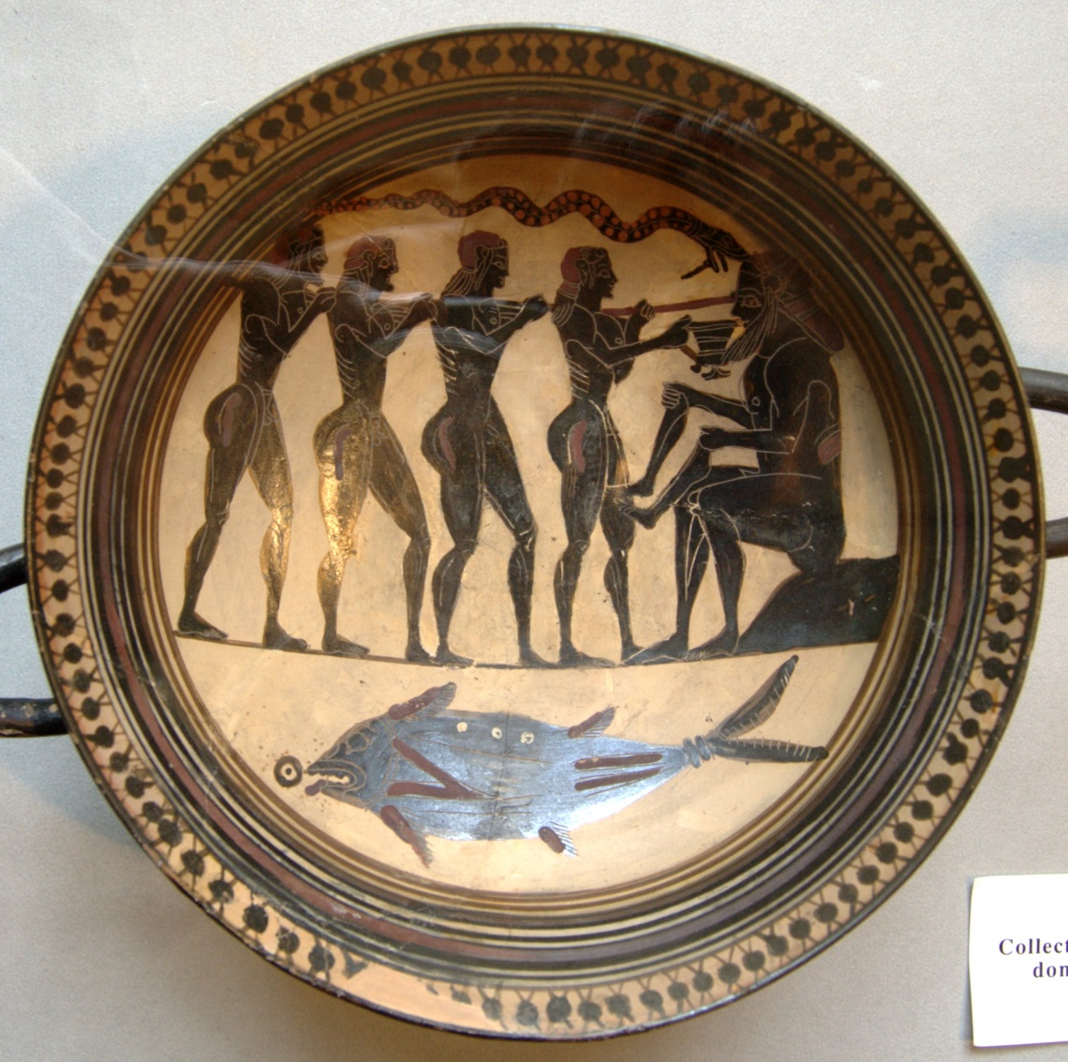
Trickster

Slide 16
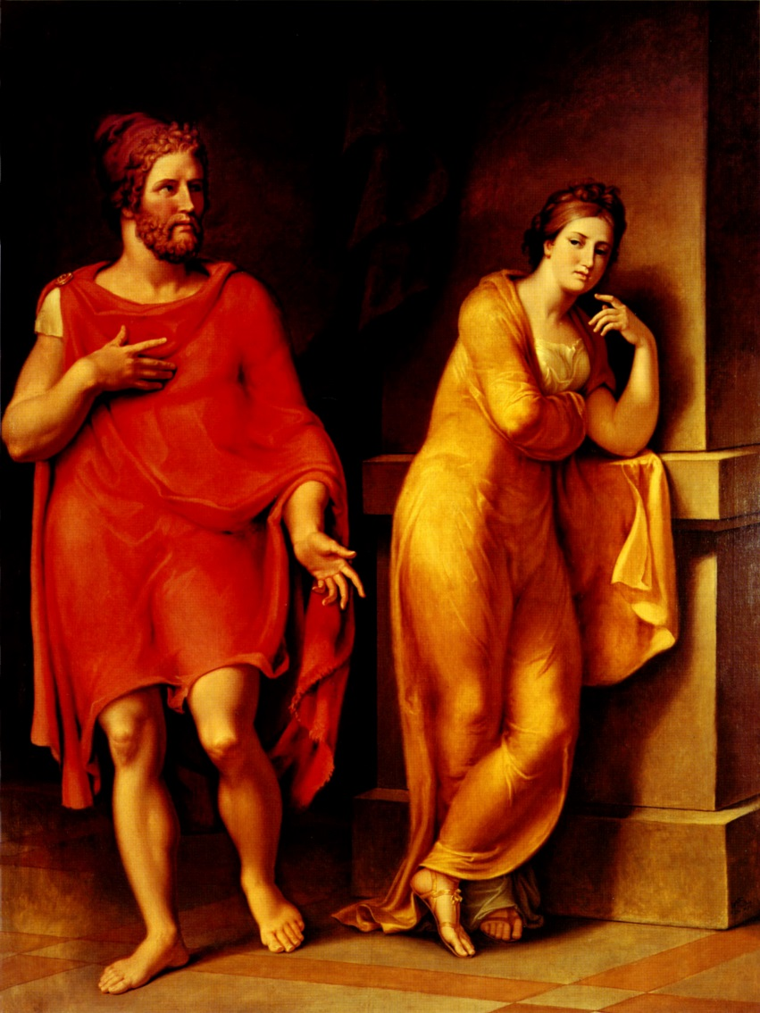
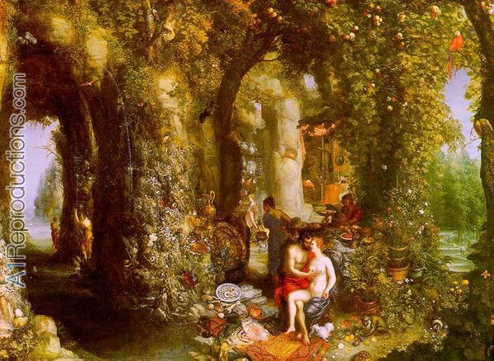
Desired by Calypso and Nausicaa

Slide 17
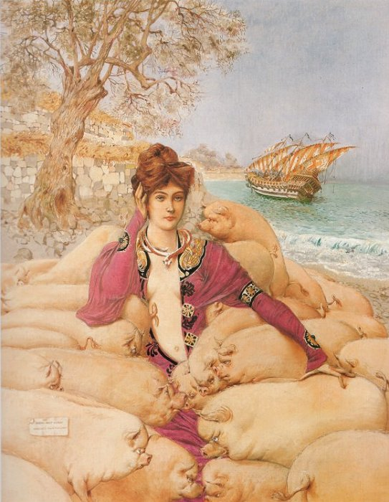
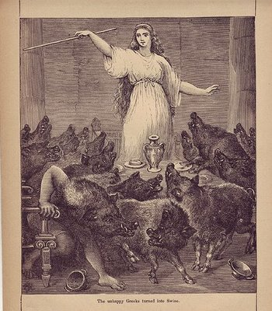
Witch-Tamer

Slide 18
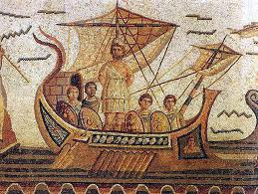
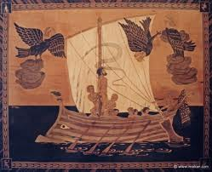
Investigative Scientist

Slide 19
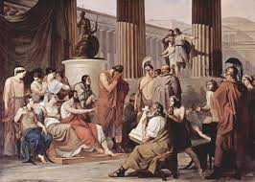
Storyteller and Autobiographer

Slide 20
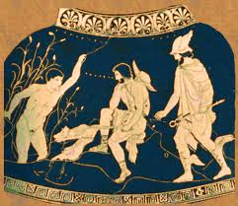
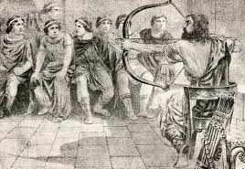
Visitor to the Land of the Dead

Slide 21
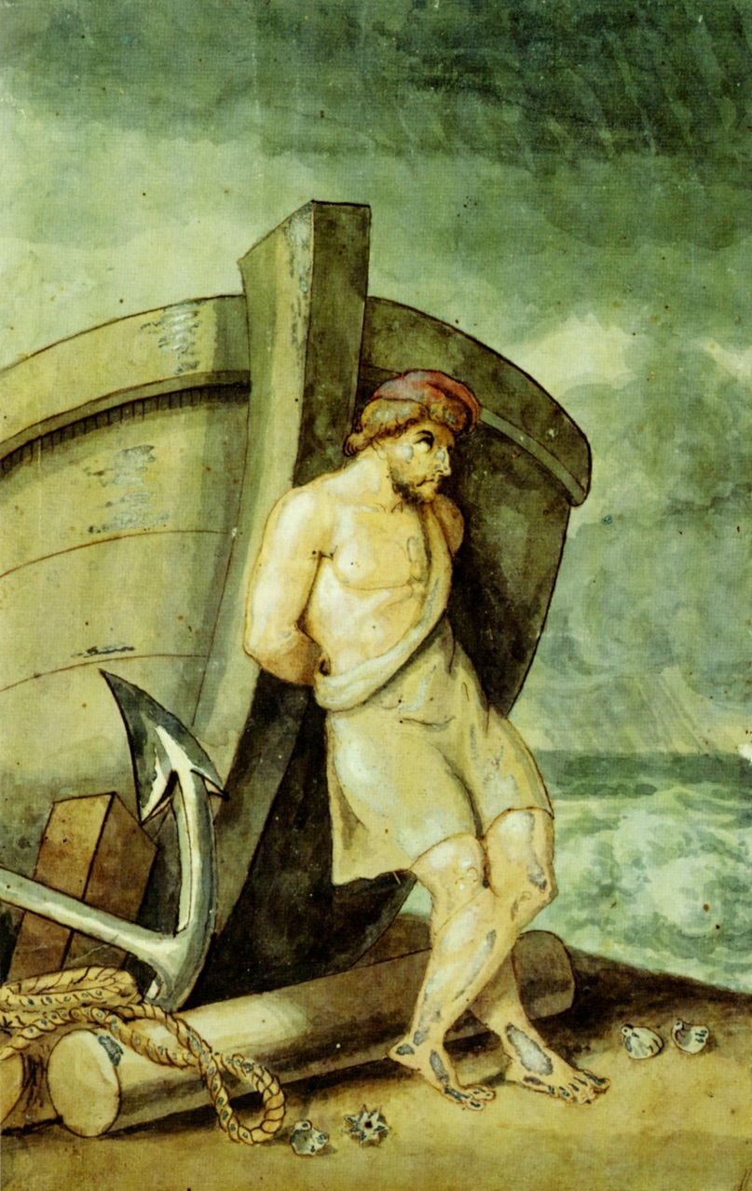
Philosopher

Slide 22
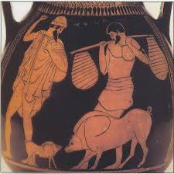
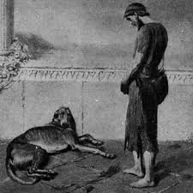
Employer and Pet-Owner

Slide 23
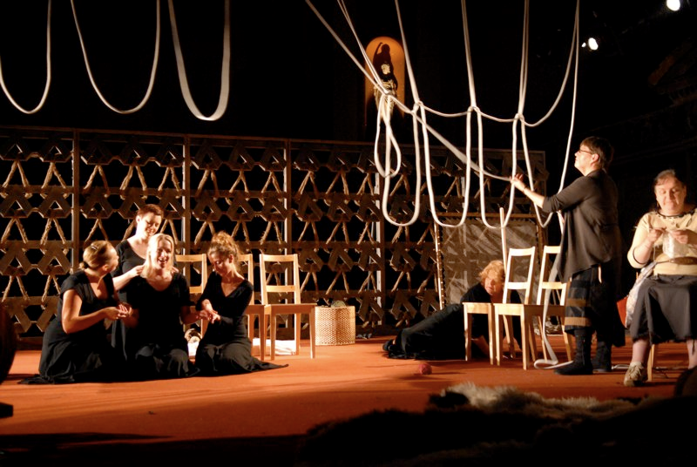
Not so great for the maids…

Slide 24
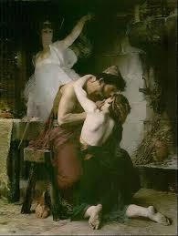
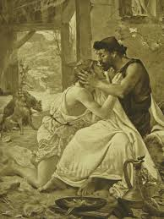
Father?

Slide 25
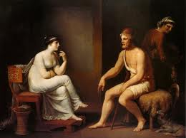
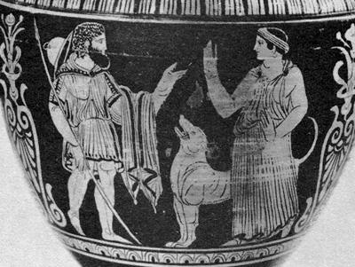
Husband?

Slide 26
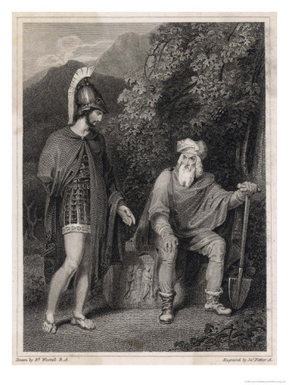
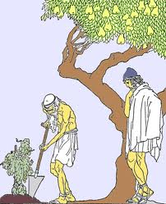
Son of an Orchard-Keeper

Slide 27
The Father of all Heroes; the Mother of all Stories
Quest Hero
Action Hero
Disaster Movie Hero
Revenge Hero
Travelogue “Road Movie” Hero
Episodic Hero with Superpowers
Romantic Hero
Proto-Sci-Fi-Hero
Initiation Hero (or is that Telemachus?)

Slide 28
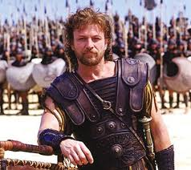
So who would you cast as Odysseus?

