Slide 1
GCSE Classical Civilisation
War & Warfare

Slide 2
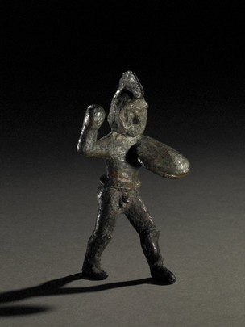
Bronze Warrior figure, Spartan, British Museum (1929,1016.6) Made in Laconia, 6th century BCE.

Slide 3
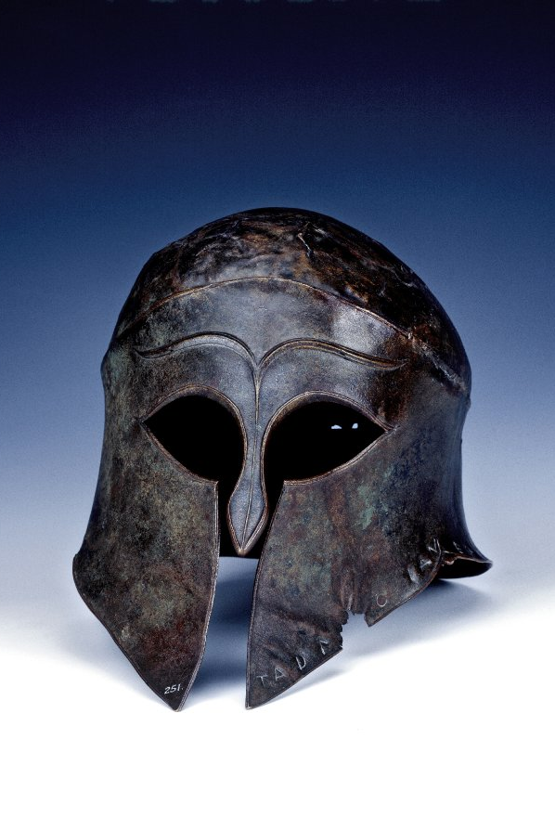
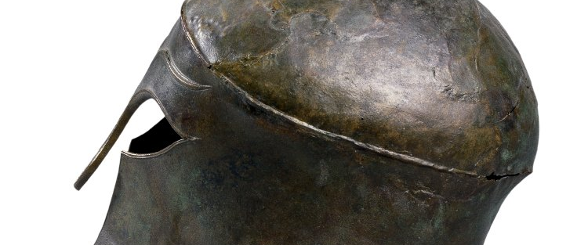
Helmet of Corinthian type, dedicated to Zeus at Olympia, c.460 BC, British Museum (1824,0407.32)

Slide 4
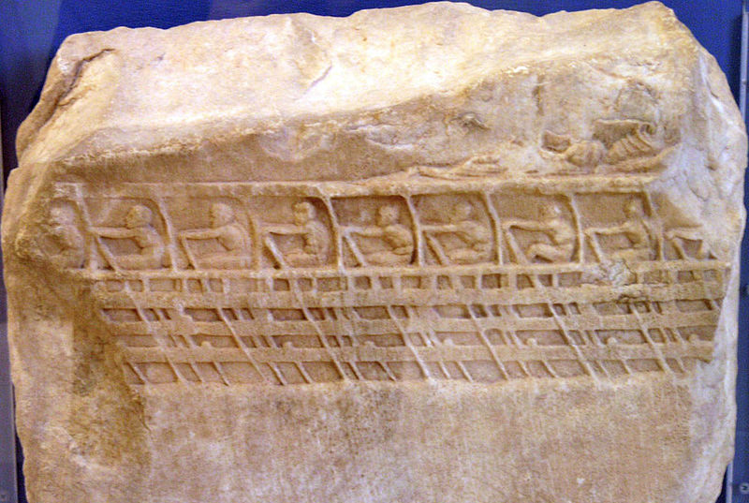
Votive relief with a depiction of a trireme (Lenormant). 4th cent. BC. The Athenian state ship Paralos under sail. Three rows of nude rowers bend to their oars and row. On the deck is reclining the ship;s commander. At the upper right is the hero Paralos, inventor on navigation.

Slide 5
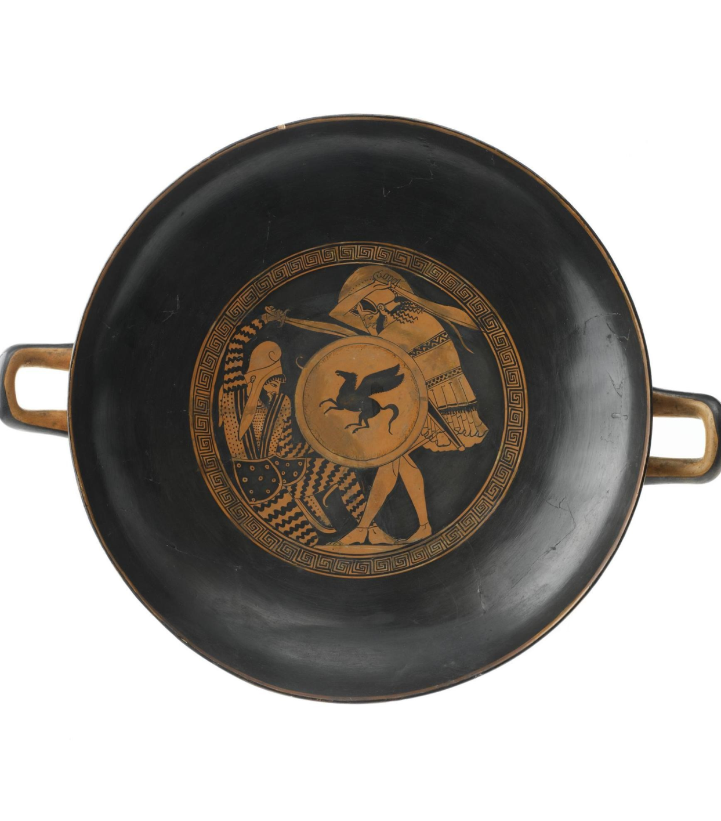
Red figure kylix of a Persian and a Greek fighting, The Triptolemos Painter

Slide 6
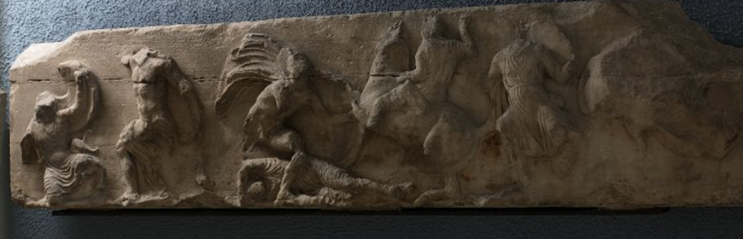
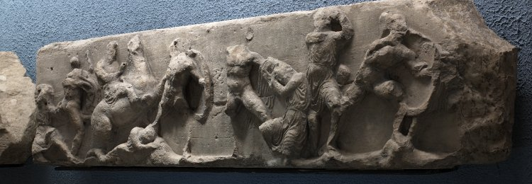
South frieze (the Greeks fighting the Persians), Temple of Athena Nike, Acropolis Athens now in the British Museum

Slide 7
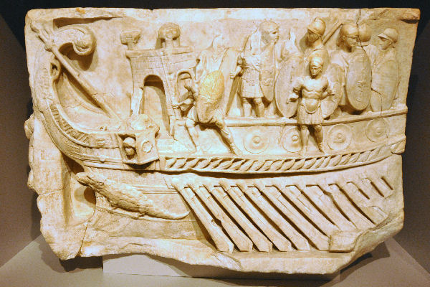
Relief commemorating the battle of Actium, Vatican Museum

Slide 8
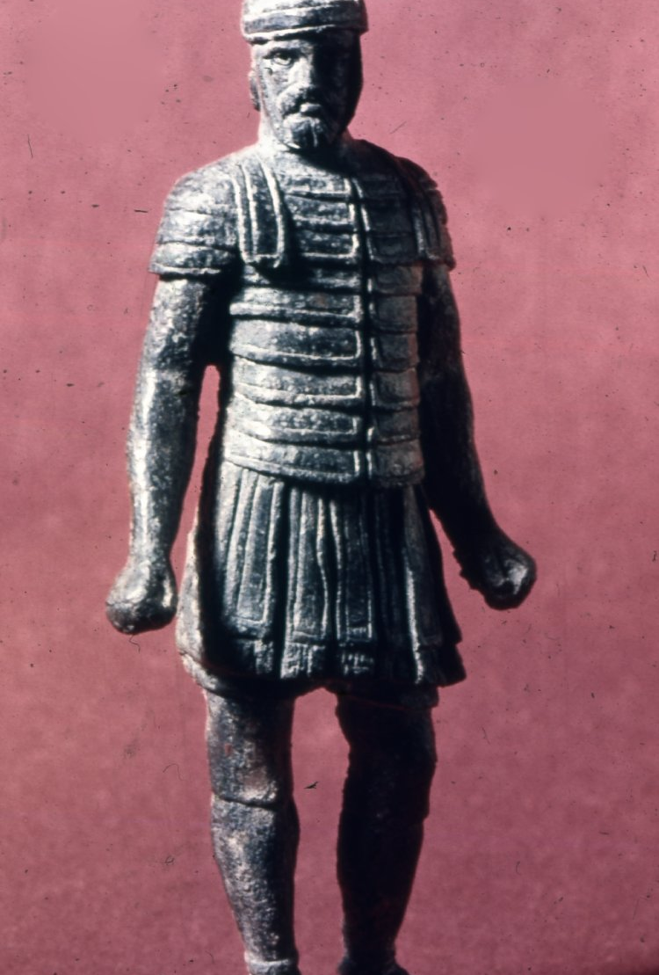
Bronze statuette of a legionary, British Museum (1867,0510.4)

Slide 9
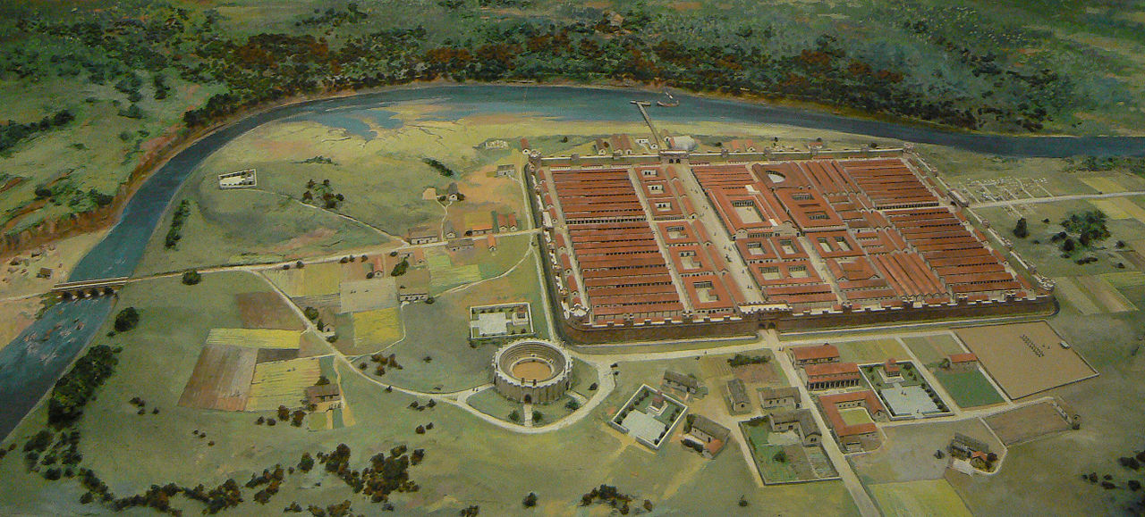
Roman fortress at Chester

Slide 10
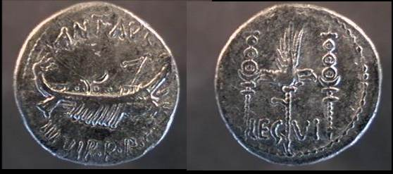
Mark Antony Legionary denarius, Obv: galley with banners, Rev: eagle between two standards, likely minted in Patrae 32 BC (example BMC 197, RSC 33, Sear 356)

Slide 11
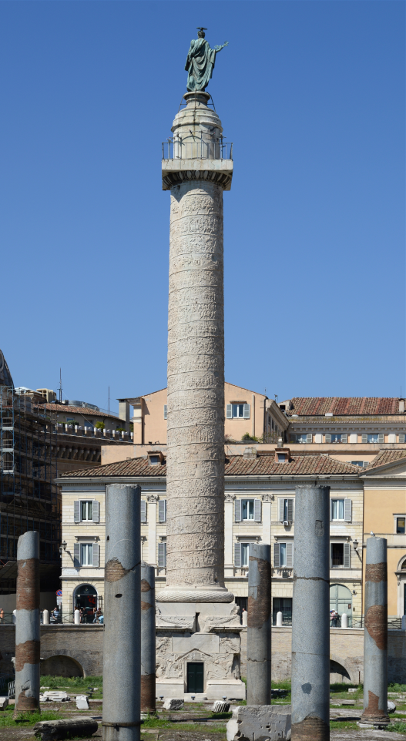
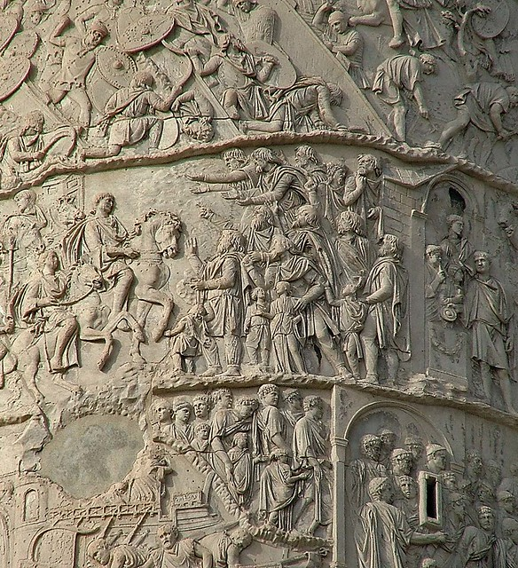
Trajan’s Column

Slide 12
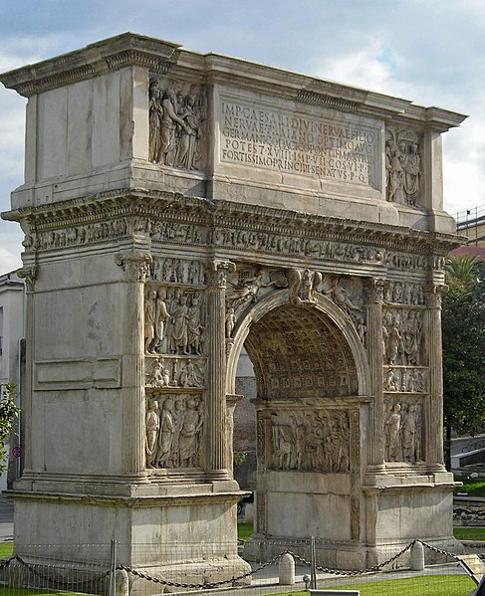
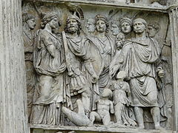
The Arch of Trajan, Benevento

Slide 13
Tyrtaeus 10 (7th century BCE)
For 'tis a fair thing for a good man to fall and die fighting in the van for his native land, whereas to leave his city and his rich fields and go a-begging is of all things the most miserable, wandering with mother dear and aged father, with little children and wedded wife. For hateful shall such an one be among all those to whom he shall come in bondage to Want and loathsome Penury, and doth shame his lineage and belie his noble beauty, followed by all evil and dishonour. Now if so little thought be taken of a wanderer, and so little honour, respect, or pity, let us fight with a will for this land, and die for our children and never spare our lives. Abide then, O young men, shoulder to shoulder and fight; begin not foul flight nor yet be afraid, but make the heart in your breasts both great and stout, and never shrink when you fight the foe.18 And the elder sort, whose knees are no longer nimble, fly not ye to leave them fallen to earth.19 For 'tis a foul thing, in sooth, for an elder to fall in the van and lie before the younger, his head white and his beard hoary, breathing forth his stout soul in the dust, with his privities20 all bloody in his hands, a sight so foul to see and fraught with such ill to the seer, and his flesh also all naked; yet to a young man all is seemly enough, so long as he have the noble bloom of lovely youth, aye a marvel he for men to behold, and desirable unto women, so long as ever he be alive, and fair in like manner when he be fallen in the vanguard. So let each man bite his lip with his teeth and abide firm-set astride upon the ground.

