Slide 1
#AskAnAcademic:
Homeric Epic
Dr David Fearn
University of Warwick
d.w.fearn@warwick.ac.uk

Slide 2
“Homer”: some key passages
Iliad 2.594-600:
The Muses encountering Thamyris the Thracian stopped him from singing
as he came from Oichalia and Oichalian Eurytos;
for he boasted that he would surpass even the Muses themselves,
daughters of aegis-bearing Zeus, if they were to sing against him.
These in anger against him maimed him, and took his wondrous voice
away from him, and made him a singer without memory.

Slide 3
Odyssey 8.62–5 on the Phaeacian bard Demodocus:
The herald came near, bringing with him the excellent singer
Whom the Muse had loved greatly, and gave him both good and evil.
She reft him of his eyes, but she gave him the sweet singing
art.

Slide 4
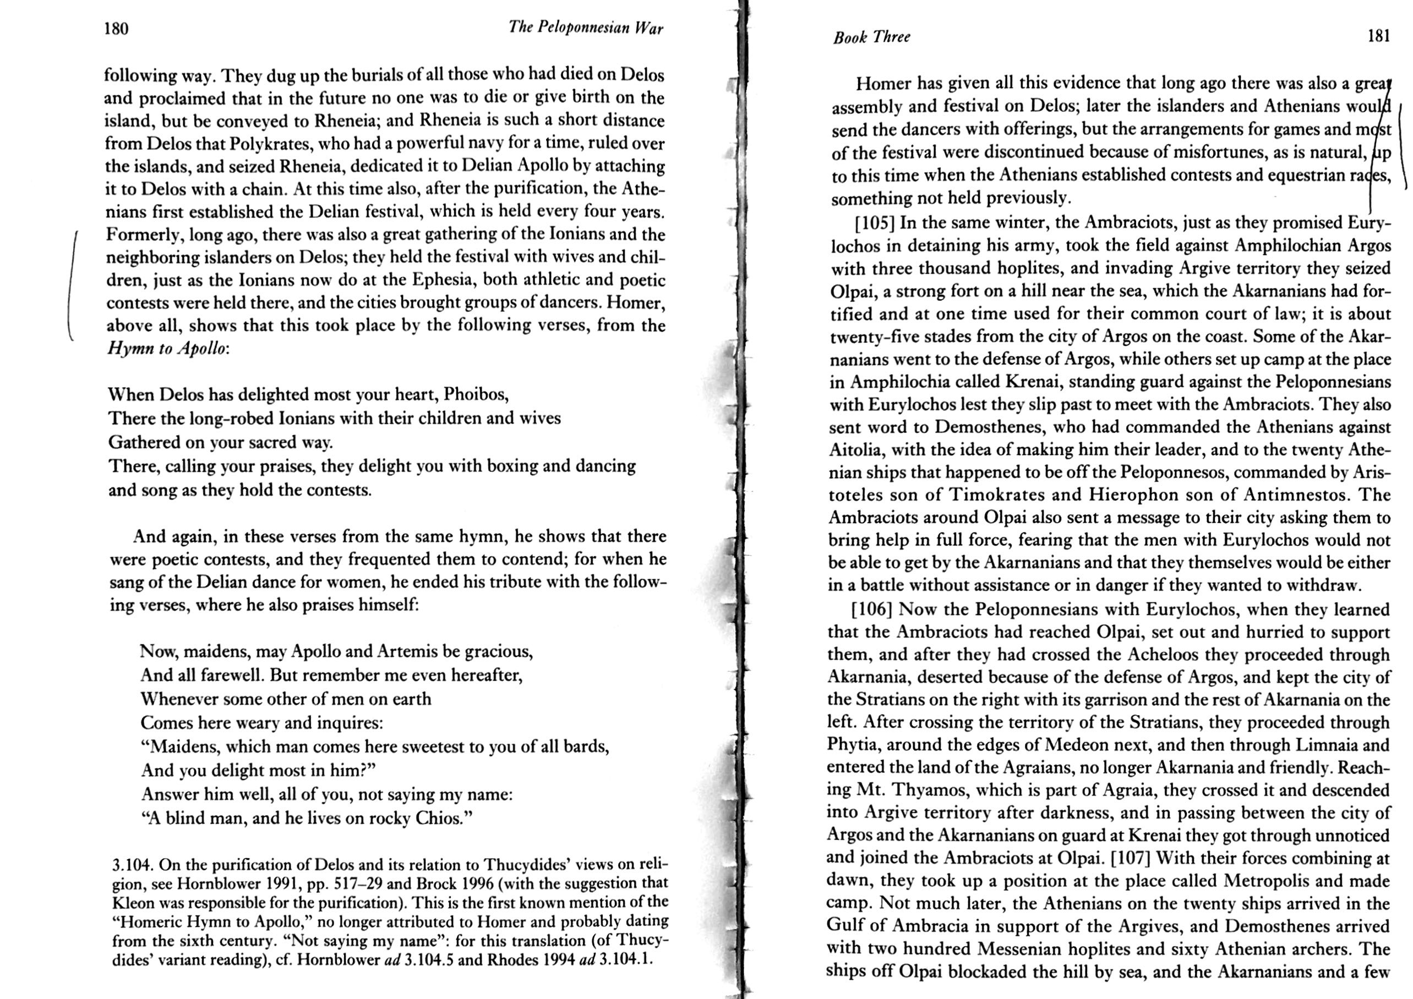
Thucydides 3.104, with end of the Delian section of the Homeric Hymn to Apollo (Trans. S. Lattimore)

Slide 5
The wry perspective from Lucian in the Roman Imperial Period (C2 AD)
Hardly two or three days had passed before I went up to Homer the poet when we were both at leisure, and questioned him about everything. “Above all,” said I, “where do you come from? This point in particular is being investigated even yet at home.” “I am not unaware,” said he, “that some think me a Chian, some a Smyrniote and many a Colophonian. As a matter of fact, I am a Babylonian, and among my fellow-countrymen my name was not Homer but Tigranes. Later on, when I was a hostage (homeros) among the Greeks, I changed my name.” I went on to enquire whether the bracketed lines had been written by him, and he asserted that they were all his own: consequently I held the grammarians Zenodotus and Aristarchus guilty of pedantry in the highest degree. Since he had answered satisfactorily on these points, I next asked him why he began with the wrath of Achilles; and he said that it just came into his head that way, without any study. Moreover, I wanted to know whether he wrote the Odyssey before the Iliad, as most people say: he said no. That he was not blind, as they say, I understood at once – I saw it, and so had no need to ask.
Lucian, A True Story 2.20

Slide 6
Herodotus 2.53 on Greek religion (trans. De Selincourt, Penguin):
But it was only – if I may so put it – the day before yesterday that the Greeks came to know the origin and form of the various gods, and whether or not all of them had always existed; for Homer and Hesiod are the poets who composed theogonies and described the gods for the Greeks, giving them all their appropriate titles, offices, and powers, and they lived, as I believe, not more than four hundred years ago. The poets who are said to have preceded them were, I think, in point of fact later. This is my personal opinion, but for the former part of my statement on these matters I have the authority of the priestesses of Dodona.

Slide 7
‘Man’
‘A man, Muse, tell me his story: a man of many ways, who was driven
to wander far, after he had sacked the sacred citadel of Troy.
Many men were they whose cities he saw, whose minds he learned;
many the pains he suffered at heart on the wide sea,
struggling for his own life and the homecoming of his companions.’
Odyssey 1.1-5

Slide 8
‘Come, tell us of your adventures’:
Alcinous recapitulates the proem
‘So come now tell me this and give me an accurate answer:
Where you were driven off your course, what countries peopled
by men you came to, the men themselves and their strong-founded
cities, and which were savage and violent and without justice,
and which were hospitable and with a godly mind for strangers.’
Odyssey 8.573-6

Slide 9
Odysseus describing the Cyclopes
‘ … the country of the lawless outrageous
Cyclopes who, putting all their trust in the immortal gods,
neither plow with their hands nor plant anything,
but all grows for them without seed planting, without cultivation…
These people have no institutions, no meetings for counsels;
rather they make their habitations in caverns hollowed
among the peaks of the high mountains, and each one is the law
for his own wives and children, and cares nothing about the others.’
Odyssey 9.106-15
‘Inside the cave there lodged a monster of a man (anêr pelôrios)… ;
… his mind was lawless, and in truth he was a monstrous wonder made
to behold, not like a man, an eater of bread, but more like a wooded
peak of the high mountains seen standing away from the others.’
Odyssey 9.186-92

Slide 10
Characterizing Killing
‘And like a lion reared in the hills, without leaving anything,
he ate them all, entrails, flesh and the marrowy bones alike.’
Odyssey 9.292-3
‘There Eurykleia found Odysseus among the slaughtered dead men,
spattered over with gore and battle filth, like a lion
who has been feeding on an ox of the fields, and goes off
covered with blood, all his chest and his flanks on either
side bloody, a terrible thing to look in the face; so
now Odysseus’ feet and the hands above them were spattered.
Odyssey 22.401-6

Slide 11
Suggestions for Further Reading
Recommended translations of the Iliad and Odyssey:
Richmond Lattimore (used here); Robert Fagles; Emily Wilson
• Introductions / Collections of Essays
L. Dougherty, Oxford Readings in the Odyssey (OUP 2009)
B. Graziosi, Homer: A Very Short Introduction (OUP 2019) – extremely useful, with lots of further references and bibliography.
R. Osborne, Greece in the Making: 1200-479 BC (Routledge 1996)
S. Schein (ed.) Reading the Odyssey: Selected Interpretive Essays (Princeton 1996)

