Slide 1
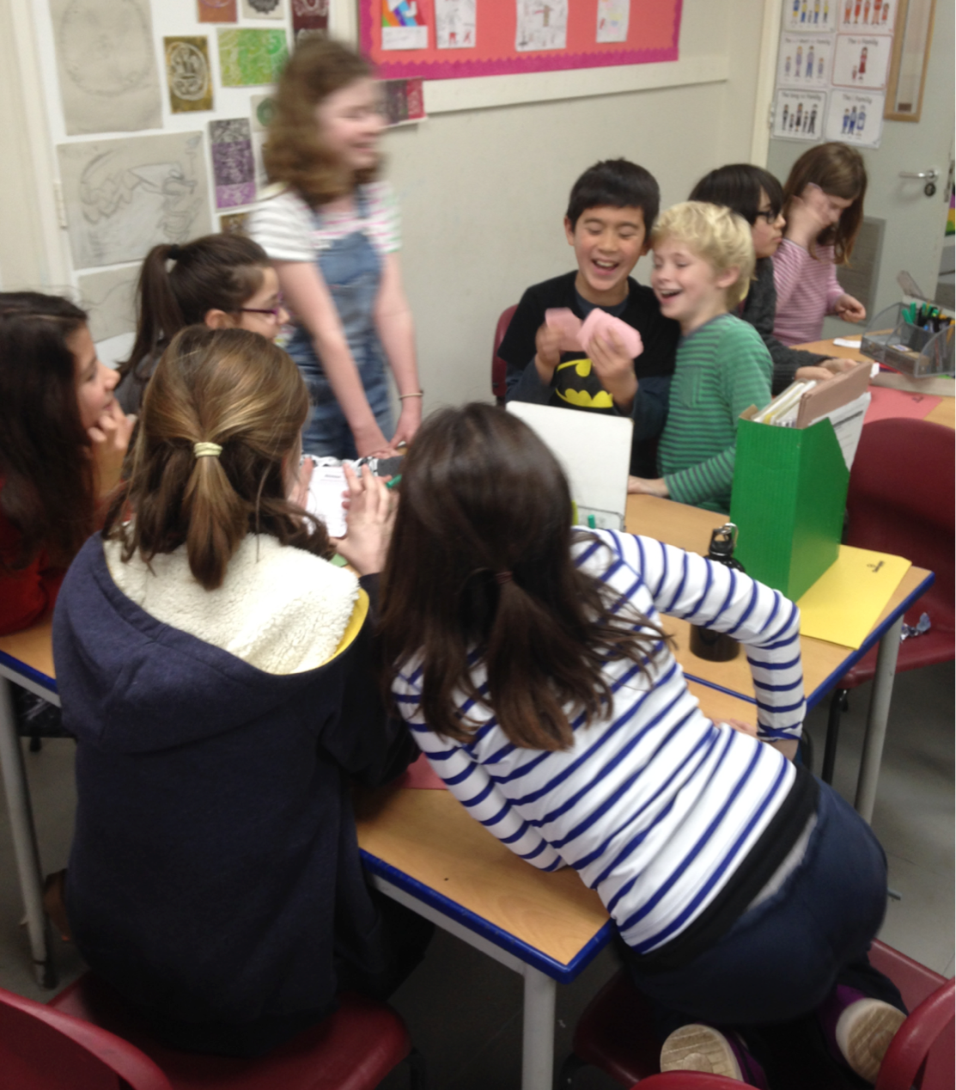
Classics at Primary

Slide 2

Classics for All
founded in 2010 by academics wanting to reverse the decline of Classics in the state sector
advocate for Classics in a challenging environment
organise & fund training
identify gaps in & commission resources
conduct research & spread best practice
hubs system & RG university partnerships
schools supported (as of end 2018) = 714

Slide 3
What is Classics?
Latin
Ancient Greek
Classical civilisation
Ancient History
as a subject in its own right, or split into subjects
embedded across the curriculum

Slide 4
primary Classics:
a few myths
Latin and Greek are ‘dead’ languages

Slide 5



primary Classicas:
a few myths
The languages are for higher ability pupils only
“Latin may be a good choice for those dyslexic pupils who anticipate difficulty around learning to speak a new language as the focus tends to be on reading. Latin pronunciation is consistent and the meaning of words can be deduced by breaking them into morphemes (smallest units of meaning) and analysing them. If they are encouraged to apply this skill to English, they may be able to improve their reading comprehension skills. Latin has a fairly small lexicon and many words may be familiar as a large proportion of technical, scientific and abstract words in English are derived from Latin.”

Slide 6

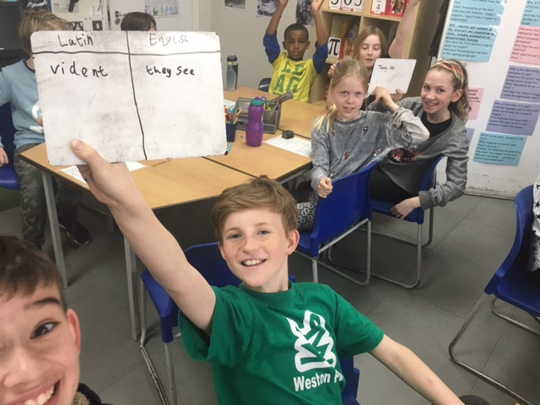


primary Classics:
a few myths
teaching is bound up in Victorian pedagogy

Slide 7
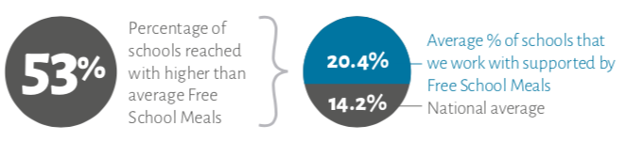
primary Classics:
a few myths
it’s the preserve of privately-educated elite

Slide 8
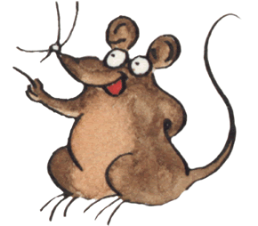

primary Classics:
resources
http://www.minimus-etc.co.uk/
popular & long-running book-based course
narrative in comic strip format based around lives of a household on Hadrian’s Wall
Latin language & Romano-British culture
training grants available up to £250
http://www.plp.org.uk/

Slide 9

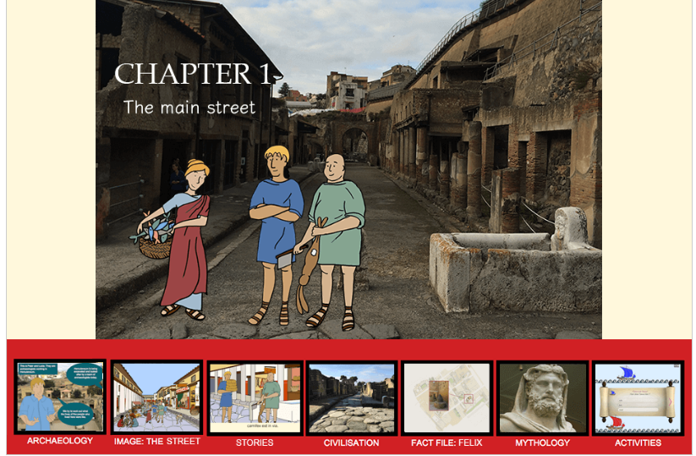
primary Classics:
resources
https://hands-up-education.org/primarylatin.html
6 online chapters exploring Latin language and archaeology of Herculaneum
interactive, online & free
training available

Slide 10
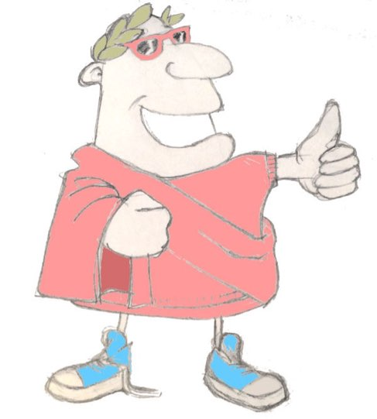
primary Classics:
resources
modular 33-session course encompassing foundation Latin language and Classical culture, emphasising connections between ancient and modern worlds, both in language and in culture.
Maximum Classics
https://maximumclassics.com
developed to support aims of KS2 national curriculum, especially English language and literacy
teachable by incumbent staff after minimal training (full grants available from CfA)

Slide 11
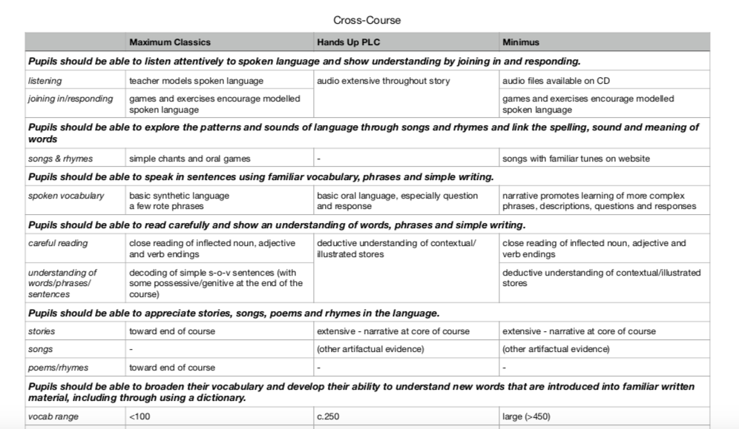
primary Classical languages:
resources for Latin

Slide 12

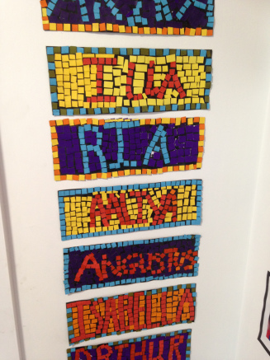

primary Classics: case study
St Mary’s CE Primary N8
One-term teaching of curricular Latin extended to one year due to success and popularity
The students love Latin and look forward to each lesson
Very successful with ‘unexpected’ students
EAL and SEN students fully engage… They participate enthusiastically in all activities

Slide 13

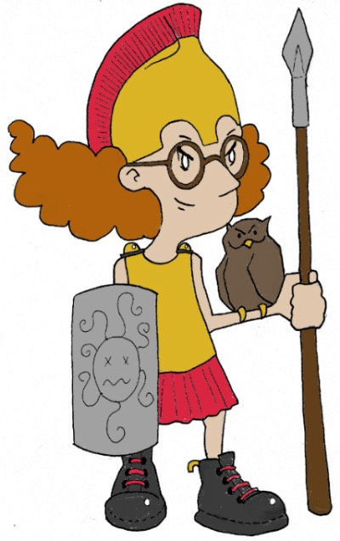
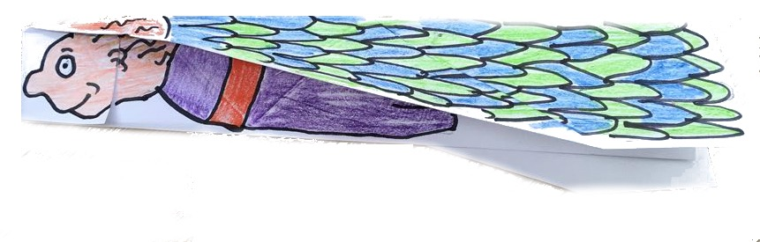
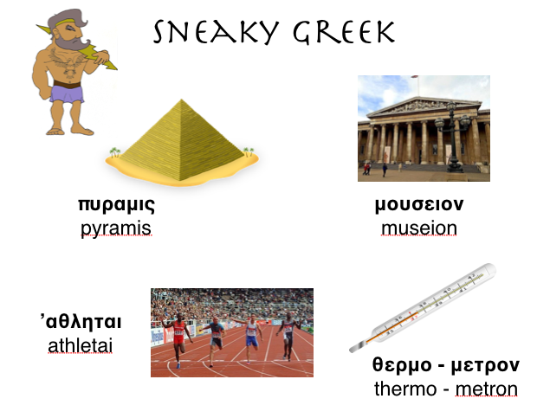
primary Classical languages
Greek
Mega Greek
https://maximumclassics.com
10 x 1 hour Ancient Greek language and culture sessions
online and free
includes word roots, mythology, cultural background
training grants available

Slide 14

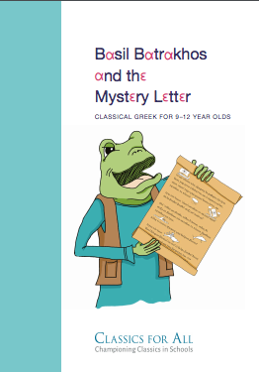

primary Classical languages
Greek
https://basilbatrakhos.com/
Ancient Greek for 9-12 year-olds
includes word roots, mythology, cultural background
book and training grants available

Slide 15







primary Classical languages
Greek
Mega Greek
Corpus Christi Primary
Leeds

Slide 16
Cross-curricular benefits of primary classics: English
grammar
vocabulary
root words
compounds
myths & stories
word classes
tenses
possessives
spelling
root words
passive
subjunctive
prefixes
subject/object
subordinate clauses
relative clauses
“The majority of findings support the claim that Latin helps with vocabulary, comprehension and reading development for English-speaking pupils... The specific impacts on special educational needs pupils and in socio-economically challenging areas are particularly noteworthy.”
Bracke, E & Bradshaw, C. 2017. “The impact of learning Latin on school pupils: a review of existing data”. The Language Learning Journal. 1-11.

Slide 17
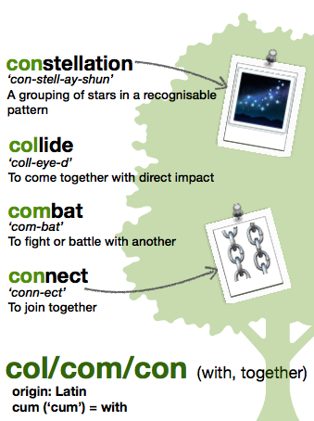
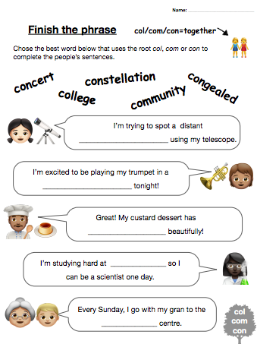
Cross-curricular benefits of primary classics: English
https://maximumclassics.com/ks2-3-word-roots/

Slide 18


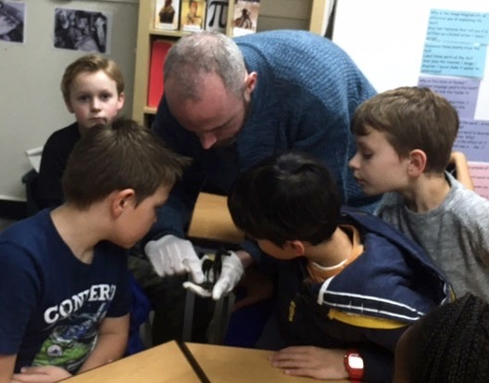

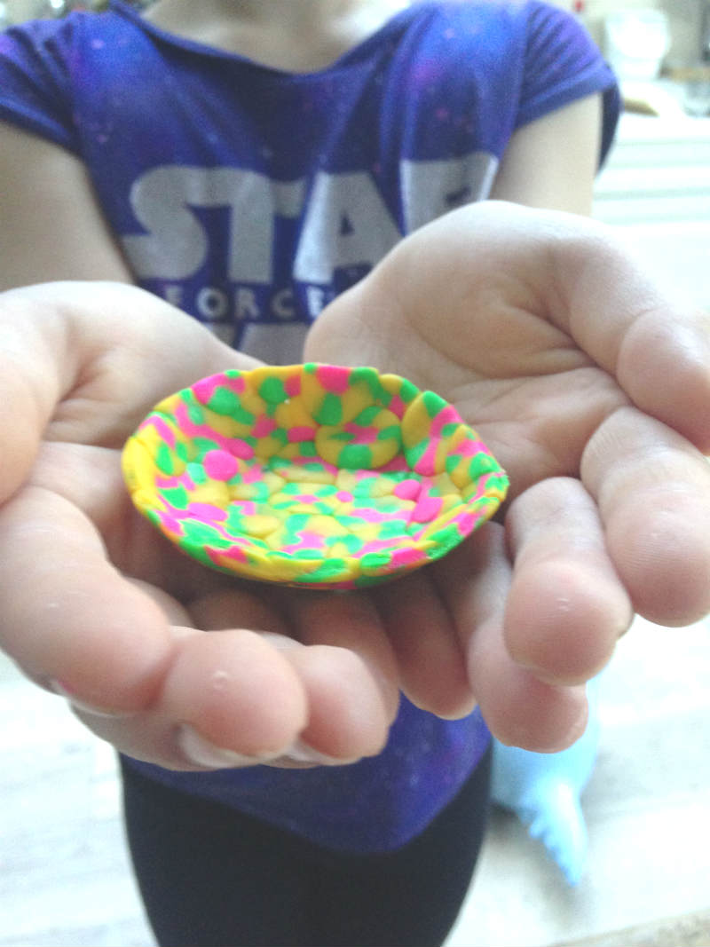


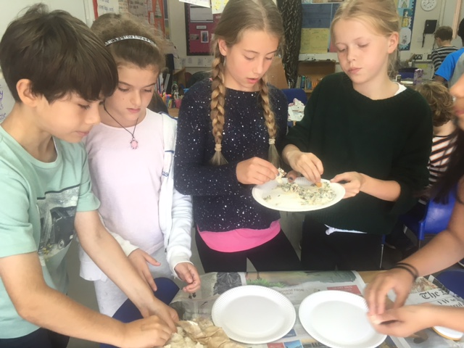

Cross-curricular benefits of primary classics
history
drama
PSHE
art & design
cookery
literature

Slide 19
Next steps
rolling grant applications with fast turnaround
free pre-grant consultations to work out best course/training/support package to suit school and its aims
grants cover training and ongoing support (in some cases resources and cover for training, too)
one short & simple form (school info & request)
charlie@classicsforall.org.uk and your local hub co-ordinator

