Slide 1
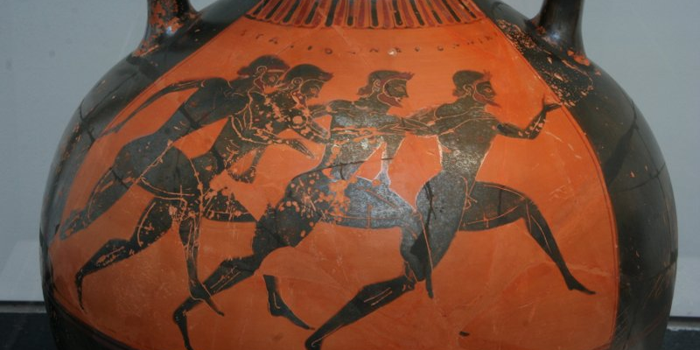
Postgrad Study in Classics/ Ancient History/ Archaeology
A Short Guide

Slide 2
Why study at PG level?
Try research and share closer links with academic community (share in established research projects)
A chance to study your favourite topic (Classics) in more depth and enhance your skills & broaden your perspective with something different/complementary (law? Conservation careers? Modern history?...)
Better employment prospects

Slide 3
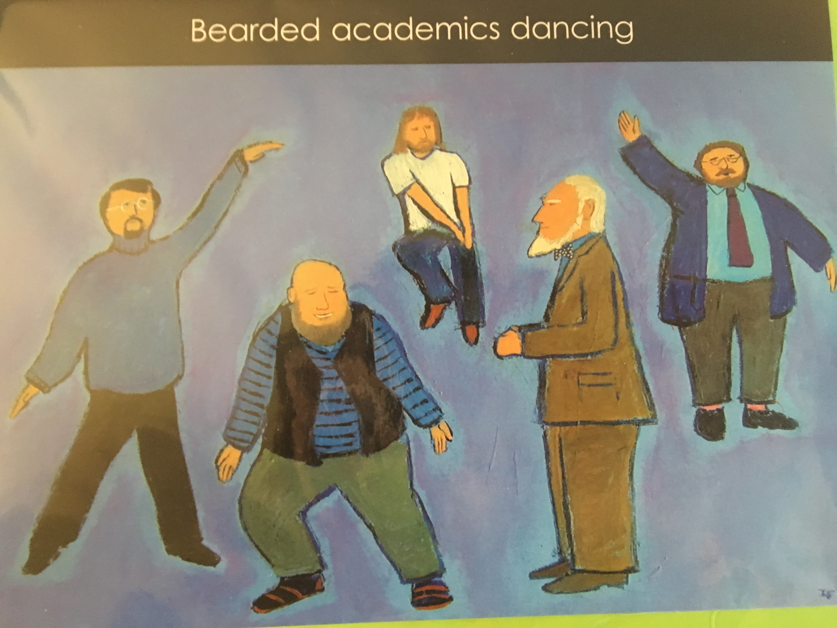
You don’t have to become like us by the way

Slide 4
On offer at Warwick
MA by Research
1 year full-time; 2 years part-time
Variant 1: 40,000-word dissertation
Variant 2: 25,000-word dissertation + two 5,000-word essays + ancient language training
Skills for job or further research: independent research; ability to produce lengthy analysis/ work with large amounts of data; subject-specific methodologies; oral presentations and relevant technology; language training;
Examined by external & internal; viva (rarely)

Slide 5
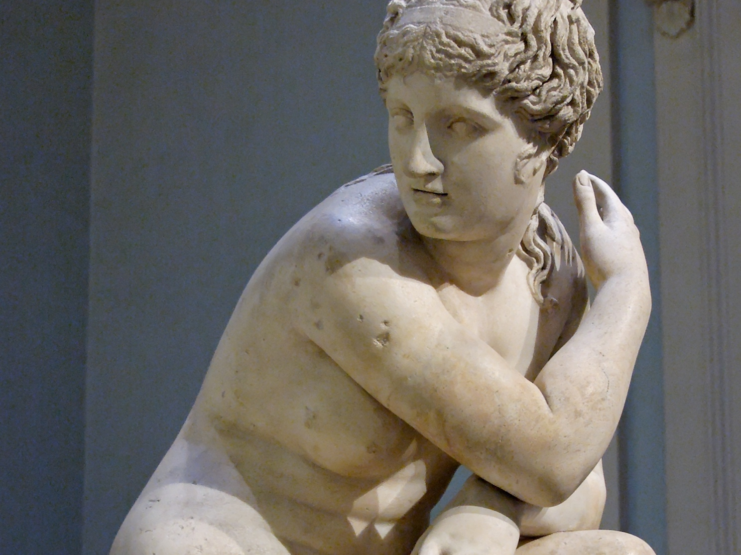
MA Dissertations in
Greek History & Archaeology
The development of nude female sculpture: an investigation into the changing form of the female nude in Classical and Hellenistic Greece
Arrian, the New Xenophon
Macrocosm and microcosm : exploring the role of Presocratic natural philosophy in classical Greek medicine
Ptolemaic Royal Women

Slide 6
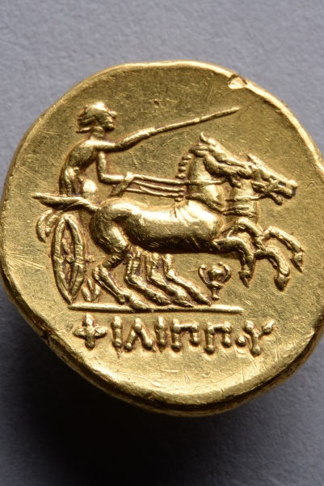
MA Dissertations in
Roman History & Archaeology
Legitimation of power: the iconography of the Golden Age myth on Roman imperial coinage of the third century AD.
Gauls, Goths and the Holy Roman Empire: the impact and significance of the sacks of Rome in 390 BC, AD 410 and 1527
Camus' Caligula: an intrinsically 'Roman' play?
Suetonius' Approach to Biography in the De Vita Caesarum
A denarius perpetuus?: the circulation of the "legionary denarii" of Marc Antony in Roman Italy and Britain 32-BC-AD 294

Slide 7
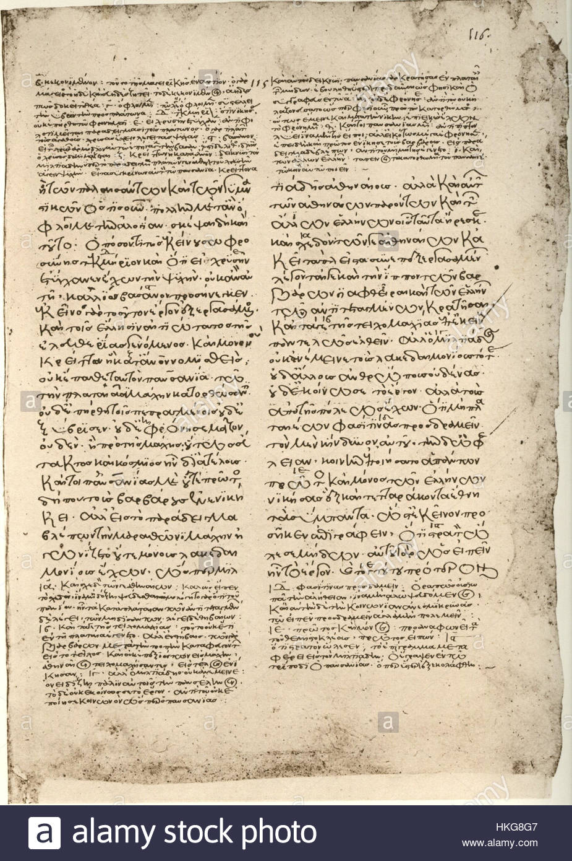
MA Dissertations in Literature
Themistius: a politician in disguise?
Portrayals of the mythological female in Ancient Greek literature and art
The nature, function and development of the chorus in the comedies of Aristophanes
Selections from the Appendix Virgiliana: a study of unity versus individuality
Early-Imperial Latin literature and Gothic fiction (1764-1900) : parallels and connections
In the guise of Tityrus : the pastoral tendency of Dante, Petrarch and Boccaccio

Slide 8
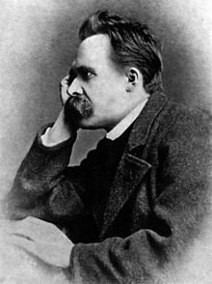
MA Dissertations in Reception Studies
Was James 'Athenian' Stuart a pioneer of the Greek revival?
Book 11 of Antoine Garissoles' Adolphid : an edition with an introduction, an English translation and explanatory notes
Interpretations of the ending of the Aeneid, from antiquity to the Renaissance
Hegel and Nietzsche's views on the Greeks

Slide 9
Taught MA
Taught MA in Ancient Visual and Material Culture: 1 year full-time; 2 years part-time
Taught MA in the Visual and Material Culture of Ancient Rome: 1 year full-time; 2 years part-time
Taught MA in the Visual and Material Culture of Ancient Greece: 1 year full-time; 2 years part-time
Core module (Approaching Ancient Visual and Material Culture); Language, ancient or modern; Numismatics; Epigraphy; Art; Dissertation
2-month course at British School at Rome/ British School at Athens
Assessed by essays, language exam/dossier, dissertation

Slide 10
Taught MA: dissertation topics
The identity of the satyr through the animal, the myth, and the human
The impact of Classical Antiquity on Nazi Germany
Museums in Britain’s Public Schools
Women in business in Southern Italy
Rome MA:
Foreign gods at Rome
Patron Gods in Rome of the Late Republic and Early Principate
Place of spectacles in late antique Rome

Slide 11
Taught MA in Ancient Literature & Thought
NEW! First intake in October 2019
Modules:
  Approaching Ancient Texts: Methodologies, Theories and Practice
  Roman Literature and Thought
  Greek Literature and Thought
  Dissertation
  Optional modules (Classical Epigraphy; Ancient Art; Feminist Literary Theory; Postcolonial Theory; Renaissance Culture and Society; Topics in Continental Philosophy …)

Slide 12
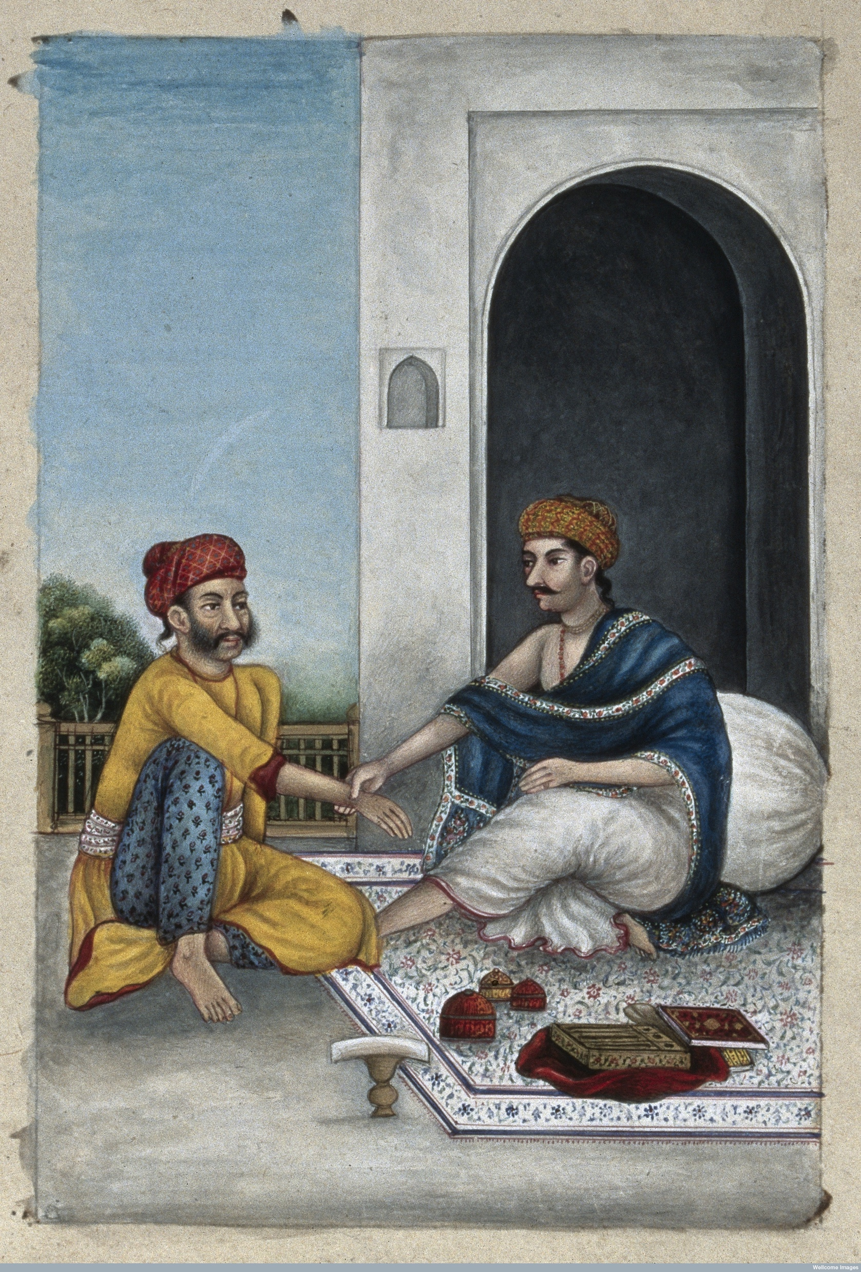
Applying
Entrance requirements
Deadlines for applications (£55 online fee)
Fees (2019/20):
  Taught MA = £9,010/ £4,505
  Research MA = £4,347/ £2,608 (subject to inflation rise)

Slide 13

Funding
Warwick Taught Master’s Scholarsips (10K) - deadline to apply is April 1, 2019
  in receipt of maintenance grant support OR special support grant from UK govt for ug course?
  in receipt of Disabled Students Allowance whilst studying, or receive Disability Living Allowance or Personal Independence Payment?
Departmental bursaries
PG loans: up to £10,280 for 2018/19 (to be updated)
Resident tutor jobs/ other jobs on campus
PhD: M4C; CADRE; Wolfson; Chancellor’s scholarships (EU and Overseas candidates); departmental funding

