Slide 1
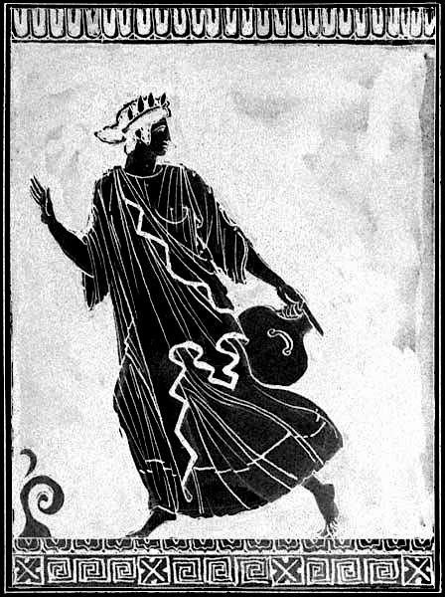
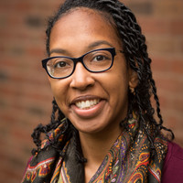



Classical Connections Seminar Series
The Metatheater of Blackness:
Danaids, Dunbar,
and Ellison
Dr Sarah
Derbew
(Harvard)
Thursday
25/10/ 2018
5pm-6pm
OC 1.06

