Slide 1
From Confucius to Constantine: Ancient Global History
Week 1:
Welcome!
What is Global History?
What is ancient Global History?

Slide 2

Rome in Every Direction – why we need global history
‘X or Y in the ancient world’ (e.g. Delphi: centre of the Ancient World 2014)

Slide 3
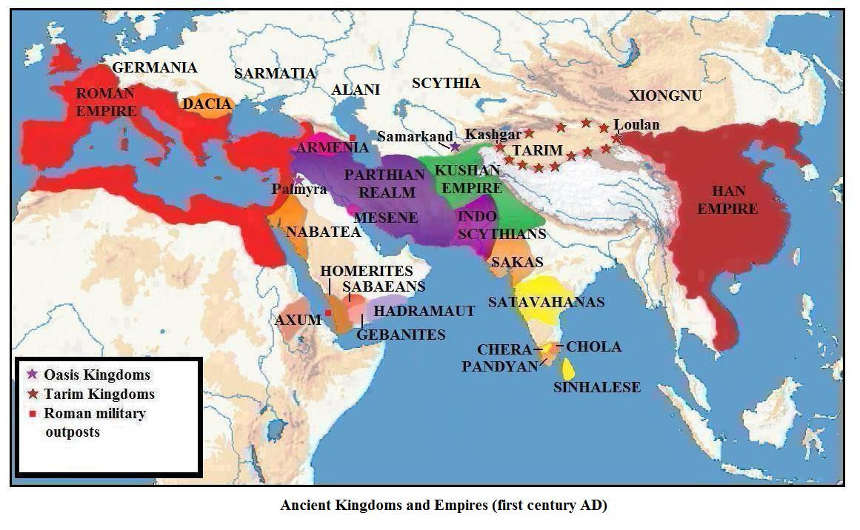

Slide 4
What is Global History? The history of Global history (and its opposite)
“this book [has been written] primarily to show that History as one whole is amenable to a more broad and comprehensive handling than is the history of special nations and periods”
H G Wells, The Outline of History 1920 [emerging out of WW1 – cf to concept of Axial Age generated after WWII by Karl Jaspers]
“It being the end and scope of all history to teach by example of times past such wisdom as may guide our desires and actions”
Sir Walter Raleigh History of the World 1614 (recommended by Oliver Cromwell to his on Richard ‘it’s a body of history, and will add much more to your understanding than fragments of story” But with the advent of the Nation State…
Texts about the ‘Oikoumene’ – the lived world (Strabo, Diodorus, Ptolemy) “the profit which history affords the reader lies in its embracing a vast number and variety of circumstances, yet most writers have recorded no more than isolated wars waged by a single nation or state” Diodorus Siculus 1.3.2
but then:
“Rome has organized the whole civilized world as if it were one family” Aelius Aristeides (cf also to China as Zhongguo ‘Middle Kingdom’)

Slide 5
What drives global history?
Desire to understand the size, shape and nature of the world
Desire to avoid conflict
Desire to prioritize connections between cultures
Desire for ‘border-crossing perspectives”
Desire to ‘de-center’ certain cultures (e.g. Rome at the centre of the Mediterranean - and indeed more widely the ‘West’ as the centre of culture and civilization cf to the Lazy History of Civilisation )
Desire to understand uniqueness and an opportunity to ‘defamiliarize the deceptively familiar’
Desire to contextualise modern global existence (cf to OECD PISA assessment and its criteria of ‘global competency’, or ‘global history is human history’)

Slide 6
How do you do global history?
“Those doing global history draw on the research done by other historians, making comparisons, noting larger patterns, proposing ways of understanding change that will clarify the nature and meaning of all human history”
P K Crossley What is Global History? 2008.3
“The key motivating question for global history is ‘just how unique, how distinctive, is our current condition of an intense interlinking of economies and polities??
Maxine Berg Writing the History of the Global: challenges for the 21st century 2013.1
“The key to global history is grasping the changing nature of connections and distinctive processes over time” P. Duara et al A Companion to Global Historical Thought 2014.1

Slide 7
When is Global History?
When can the world be considered ‘global’
From year dot? (cf to D. Christian 2005 Maps of Time)
From the emergence of homo sapiens?
From the time the world was first circumnavigated?
From 1571 – Manila established as a Spanish trading emporium connecting Eastern Eurasia with Americas?
From 19th century when global time zones were standardized?
From the era of global plane travel?
From the time of the creation of the world wide web?

Slide 8
Comparative Global History
“Only comparisons with other civilisations make it possible to distinguish common features from culturally specific or unique characteristics and developments, help us identify variables that were critical to particular historical outcomes, and allow us to assess the nature of any given ancient state or society within the wider context of premodern world history”
W. Scheidel Rome and China: Comparative Perspectives on Ancient World Empires 2009 p.5

Slide 9
Moses Finley The Use and Abuse of History 1986.119:
“ ideally we should create a third discipline – in addition to anthropology and sociology – the comparative study of literate, pre-industrial societies’
Suggested comparing Greece and Rome with medieval Islam, pre-revolutionary Russia, pre-colonial India and pre Maoist China.
Gore Vidal Creation 1981 – one character able to move around the ancient world between societies and meet with key figures (bending time a little)
Ancient War Video Games: Roman centurions v. Spartan hoplites

Slide 10
Connective Global History
Studying the Silk Road(s):
Named by Ferdinand von Richthofen (uncle of WW1 flying ace ‘the Red Barron’) in late 19th century
Described as ”the world’s central nervous system”
Active set of trade routes through until discovery in 1490s when Vasco da Gama navigated the southern tip of Africa, sailing onto India (same time as Columbus discovered America).
Not traversed by single merchants, but goods conveyed in relays of max 500 miles and traded.
Not just one road, but many routes – over land AND sea.

Slide 11
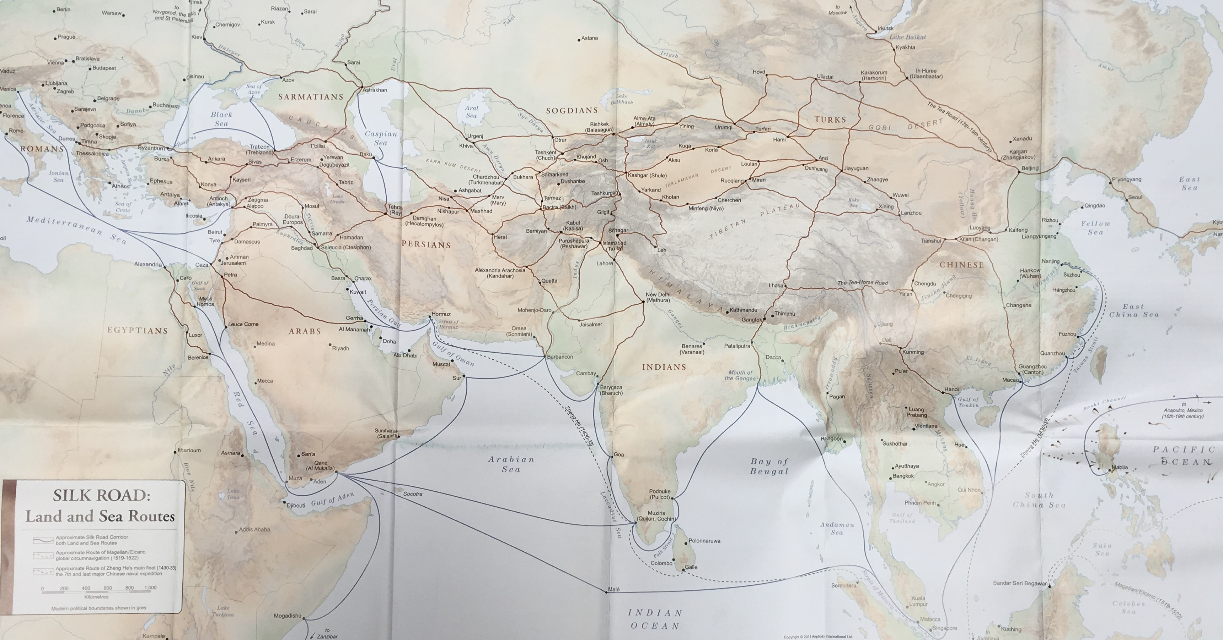

Slide 12
Global v. World History
Journal of Global History – 2006; Journal of World History 1990 cf Wiley Blackwell Companions to World History and to Global History.
World history defined as:
“comparing within and among societies, including comparing societies’ reactions to global processes”
“the story of connections within the human community”
“scholarship that explicitly compares experiences across the boundary lines of societies…. Deals with historical processes that have not respected borders, but rather have influenced affairs on everything from transregional to global scales: climate change, technology transfer, imperial expansion, cross-cultural trade, the spread of ideas, the expansion of religious faiths” J.Bentley
‘World History’ in USA: survey of what happened in the world.
‘World History’ in China: everything that happened outside China

Slide 13
The problems of doing Global History
One person cant know it all
One person cant even have the skills to study it all (e.g languages)
The need to work within teams and networks
Where does a global historian bring value to the study by specialists of individual cultures?
The inbuilt tendency towards the local (cf UNESCO French book 1949-2012) – and even when bigger, still bounded identities (1990s- EU called upon schools to teach about history of Europe in schools and the formation of the European identity)
The bounded nature of history as a discipline, university departments, bookshop shelves, research awards
“Globaloney”

Slide 14
Can you have ancient global history?
Depending on when you think you can have ‘global’ history…
4500 year ivory from an Asian elephant has been found in a workshop in Spain – trade, migration, inter-action between cultures a feature of humanity itself
A. Tonybee 1934-53: 10 volume study of rise and fall of civilisations
P. Braudel 1949 ‘The Mediterranean and the Mediterranean World’
Horden and Purcell 2000 The Corrupting Sea (Mediterranean focus again)
British Museum History of the World in 100 objects

Slide 15
This course and ancient global history
“The study of ancient civilisations…. Has much to gain and nothing to lose from broader perspectives” W. Scheidel Rome and China: Comparative Perspectives on Ancient World Empires 2009 p.10
Where have we come from: Europe de-prioritizing an 18th century love and admiration for China and (re)falling in love with ancient Greece in early 19th century
Where we are now: world in which we are increasingly global, but politics is increasingly insular (cf to Trump, Brexit)
Where we are going to: world in which China’s stated modern foreign policy is ‘one belt, one road’ 1 trillion dollars infrastructure investment to bind Beijing to the world.

Slide 16
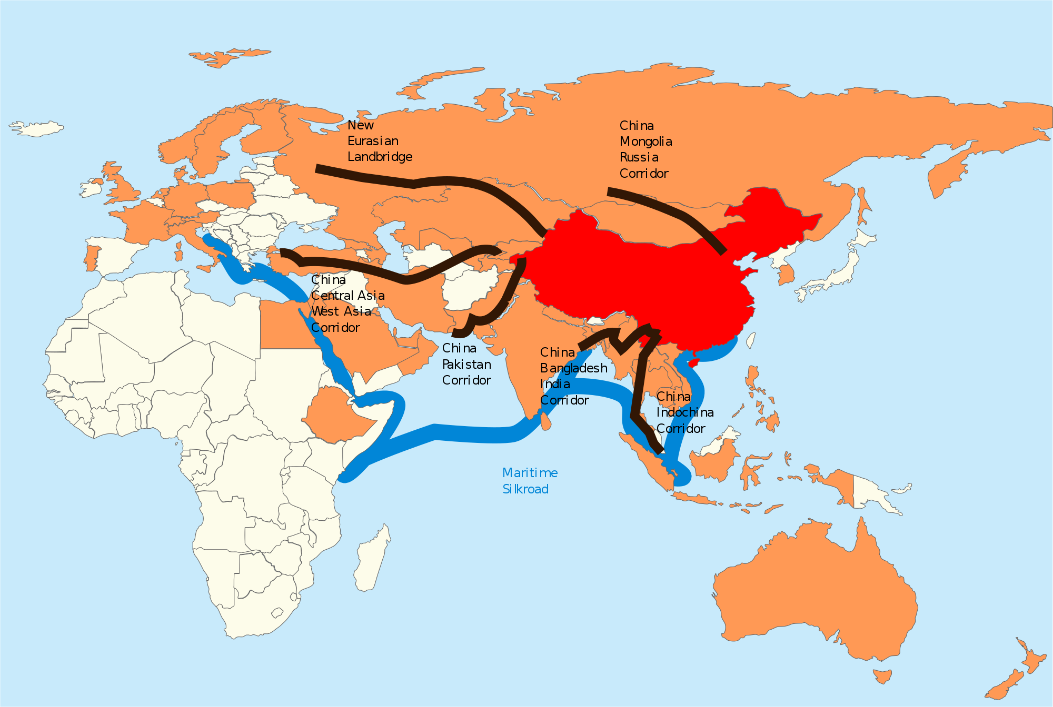

Slide 17
Reading:
B. Gills and W. Thompson (eds) Globalization and Global History 2008
D. Sachsenmairer Global Perspectives on Global History 2011
M Berg (ed) Writing the history of the Global 2013
D. Woolf (ed) A Global History of History 2011
B. Mazlish and R. Buultjens Conceptualising Global History 1993
L Hunt Writing History in the Global Era 2014
P. Duara et al (eds) A Companion to Global Historical Thought 2014
W. Scheidel (ed) State Power in Ancient China and Rome 2015
M. Pitts and M. Versluys (eds) Globalisation and the Roman world 2015
N. Sitwell 1986 Outside the Empire: The world the Romans knew

Slide 18
J. Bentley (ed) The Oxford Handbook of World History 2011
J. Tanner ‘Ancient Greece, Early China Sino-Hellenic Studies and Comparative Approaches to the Classical World: a Review Article’ in JHS 2009 (129)89-109.
G E R Lloyd The Ambition of Curiosity: Understanding the world in ancient Greece and China 2002
K. Curtis and J. Bentley (eds) Architects of World History: researching the Global Past 2014
D. Northrop A Companion to World History 2012
P. Stearns Globalisation in World History 2010
S. Moyn and A. Sartori (eds) Global Intellectual History 2013
P. Frankopan The Silk Roads 2015
M. Scott Ancient Worlds 2016
I. Morris Why the West Rules – for now 2010

