Slide 1
Ancient Global History
Term 2: Week 10

Slide 2
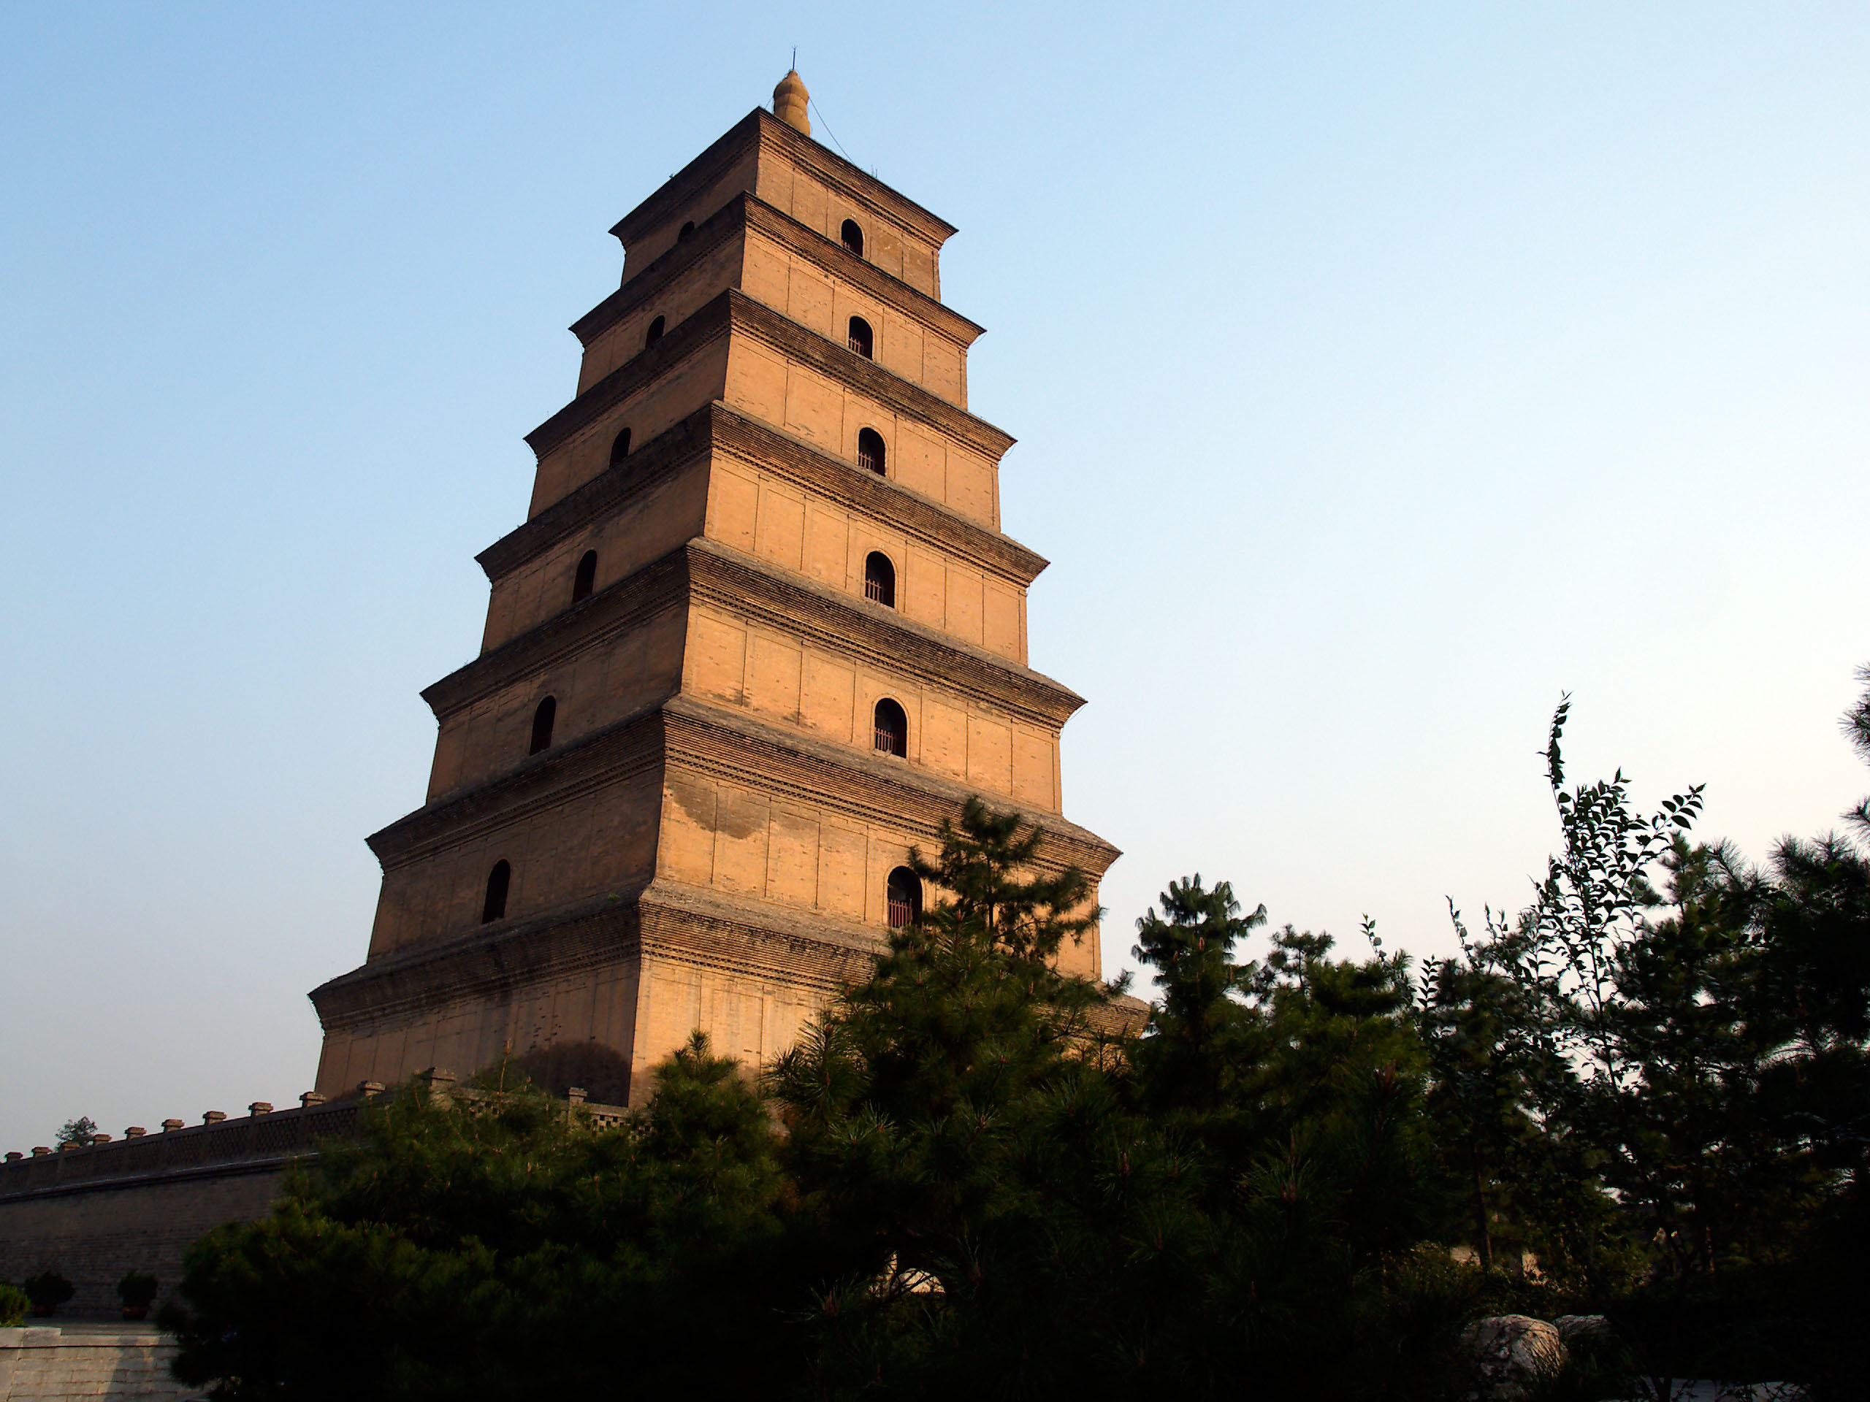
Buddhist Art / Architecture
For discussion:
The development of the Chinese pagoda from the design of the Buddhist stupa: Great Wild Goose Pagoda built in 7th century to commemorate return of a Chinese Buddhist monk from India (and house relics and manuscripts brought back by him). Many argue that Pagoda is fusion of Buddhist stupa (round) with Han-era watchtower

Slide 3
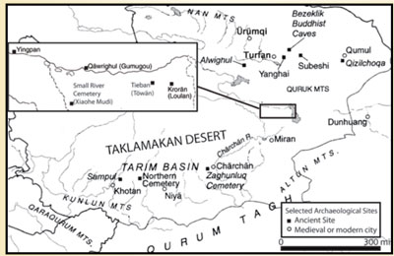
Dunhuang Caves (Mogao caves/Thousand Buddha Grottoes)
Architecture:
First cave built second half 4th c CE. Early caves are argued to have been more influenced in design by Buddhist architecture in India. E.g. Meditation Caves – square main chamber, with meditation cell opening on both sides (e.g. cave 285). Comparable to vihara style in India (e.g. Ajanta caves). Caves at Dunhuang (e.g cave 428) also copy the chaitya (prayer hall) style of Indian Buddhist architecture (e.g. Ajanta caves). But later caves (from 7th c CE) tend to follow Assembly Hall style (e.g. cave 429), a style not known in India.
Statues:
Carved in sandstone – fine sculpting not so easy - so often overlaid in clay stucco to allow for more details effects. Influenced by both Gandharan and Mathuran schools, as well as by later Gupta art (4th century CE).
Cf. S. Whitfield (ed.) The Caves of Dunhuang 2010

Slide 4
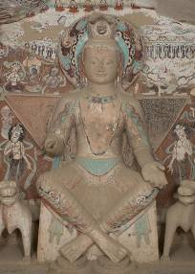
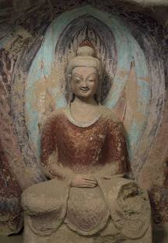
Cave 275: Early Buddha with central Asian influence
Cave 259: Northern Wei Statue (5th-6th c CE)

Slide 5
The Terracotta Army: an example of earlier influence?
See article by L. Nickel ‘The First Emperor and Sculpture in China’ Bulletin of the School of Oriental and African Studies 76.3 (2013) p.412-47.

Slide 6
Thinking towards the exam
Format:
Gobbets (text and images) – from texts and images we have discussed in class/seminars
Essays
Requirements:
Respond to 1 text gobbet and 1 image gobbet “Comment on points of interest/difficulty…”
Respond to 2 essay questions

Slide 7
Gobbets (we will do more of these next term)
(For) Soados son of Boliades, son of Soados, a [pious man and] friend of his
city, who has nobly a[nd generously] rendered assistance on many [important]
occasions to the mercha[nts and the] cara[va]ns and his fellow-citizens at
Vologesia[s]. He was a[l]ways unsparing of his [l]ife and fortune in matters of
im[p]or[t]ance to his city and for this was [honour]ed by decrees and popu[lar vot]es
and public statues and letters and by an edict (read by) Publicius Marc[ellus] [the]
most illu[strious] consul[ar] governor. In that he saved the caravan which had
[rece]ntly arrived from Vologesia[s] from the great danger that surrounded i[t], the
same caravan, [in recognition] of his [valo]ur, magnanimity [and piety] set up [four
stat]ues of him, one here in the sanctuary of Zeus (i.e. Baalshamin), one in the sacred
grove, one [i]n the sa[nctua]ry of Ares and the fourth in the sanctuary of Atargatis,
through the services of Agegos son of IaribPlOs and Thaimarsos son of Thaimarsos,
caravan leaders. In the year 443, the month Peritios (February, 132 CE/AD).
Palmyrene Honorific Inscription G14.

Slide 8
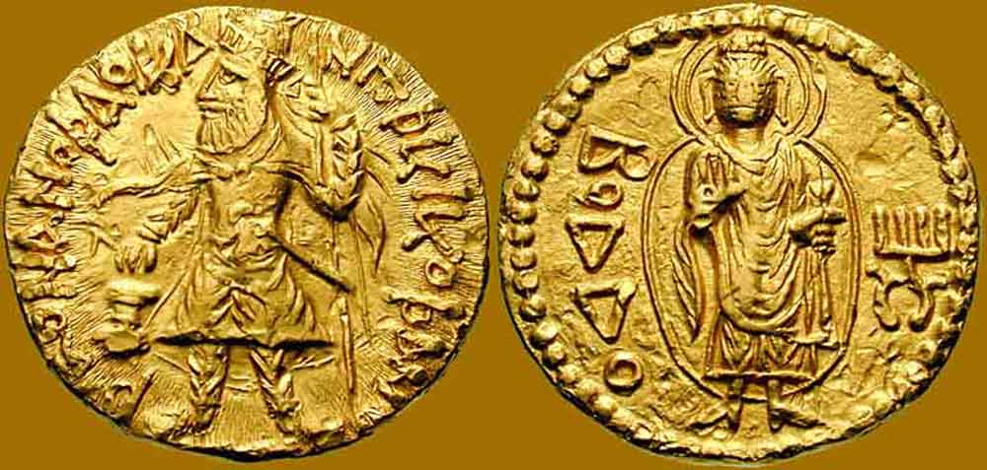

Slide 9
Essay Questions
Will focus on key topics/ themes/ ideas/ moments covered in lectures.
Will often be formatted as a statement or idea, which you are asked to discuss/ respond to with your own choice of case studies.
Best way to revise:
Work out key themes and issues of the course + key moments in the story of connections between cultures + key debates about how we study it.
Develop a series of case studies that interest you involving interaction between a number of different cultures from different times. Make sure you have good primary evidence to hand (from lectures/seminars) and think about what each of your case study could be used to exemplify.

Slide 10
‘The ports of ancient India were the most international places on the Silk Roads’ Discuss.
To what extent was ancient global connectivity the result of the work of individuals rather than states?

