Slide 1
Ancient Global History
Term 2: Week 2

Slide 2
What does Comparative history need to look like?
What’s its objective? Explaining difference or explaining the properties of each case?
How do you frame the comparison? Or ‘Why don’t they have that…’
How do you frame the outcome? ‘Better of worse… or just different?’
What kind of conclusions do you draw? ‘so what…’

Slide 3
The work of Prof Sir Geoffrey Lloyd
“The chief prize is a way out of parochialism”
E.g. G. Lloyd 1996 Adversaries and Authorities: Investigations into ancient Greek and Chinese science
See attached text (conclusions)
Central Argument: difference in context of learning between Greece and China: Greece as competitive where leaders debate, students follow more than 1 teacher v. China where usual practice is following of one master and learning from him.

Slide 4
H. Kim Ethnicity and Foreigners in Ancient Greece and China 2009
“to determine the historical, political and cultural factors that determined the Greek and also Chinese perception of foreigners” (p.2)
Key insights (see attached text)
Central argument: Greece, lacking material differences from its near ‘barbarian’ rivals, sought to distinguish between themselves as different peoples. China, confronted with such obvious different in style of civilization, did not need such a difference, and defined difference in terms of ritual and customs – which could be changed and with it the ‘foreign’ status of the group.

Slide 5
Module Feedback (Thank you!!)

Slide 6
K. Raaflaub (ed) The Adventures of the Human Intellect: Self, Society and the Divine in Ancient World Cultures 2016 (Wiley Blackwell)
Edited volume bringing together scholars writing on different topics (advantages/ disadvantages?)
Part of a wider Ancient World Comparative History series (see outline of other titles in this series – to what extent is this world history?)
The book has an introduction + series of essays but no conclusion – difficulties of bringing this kind of work together?
Introduction (see attached text) – in particular the key questions each scholar was asked to address (p.4)

Slide 7
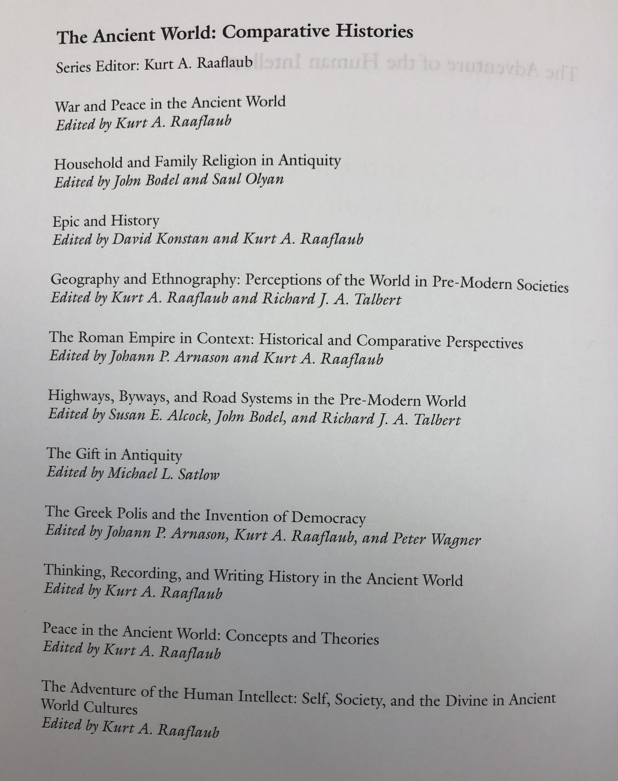

Slide 8
Comparing Kinship and Friendship
Y. Zhou Festivals, Feasts and Gender Relations in Ancient Greece and China 2010
Researches the social solidarity that was pursued within different institutions – festivals, symposia and gymnasia in Greece; ancestral sacrifice, family banquets and communal drinking parties in China (see p. 2-5)
Argues for a contrast between peer group and kinship centred relations.
The Greek tradition emphasizes extrafamilial homosocial bonds, the Chinese tradition revolves around patrilineal family and kinship.
In Results: also focuses on gender relations and equality, comparing mother-son bonds and female homosocial ties. pages 322-3
Analysis: pages 325-327

