Slide 1
Ancient Global History
Term 1, Week 3

Slide 2
Western and Central Asia
Western Asia:
Eastern Mediterranean / Asia Minor
Iranian Plateau
Realm of Achaemenid, Persian Empires, Conquest of Alexander the Great and Seleucids, Parthians, Sassanids
Up to borders of the river Indus
Central Asia
Covering Greco-Bactria, Pamir mountains, Hindu Kush
Realms of rapidly changing communities: Greco-Bactrians, Indo-Greeks, Kushans, as well as migrating nomadic tribes coming from East
Incredibly challenging geography

Slide 3
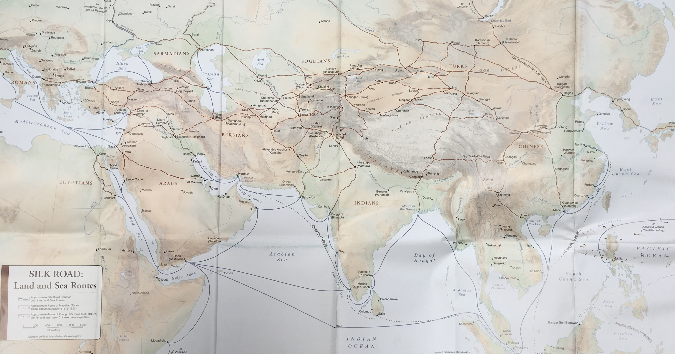

Slide 4
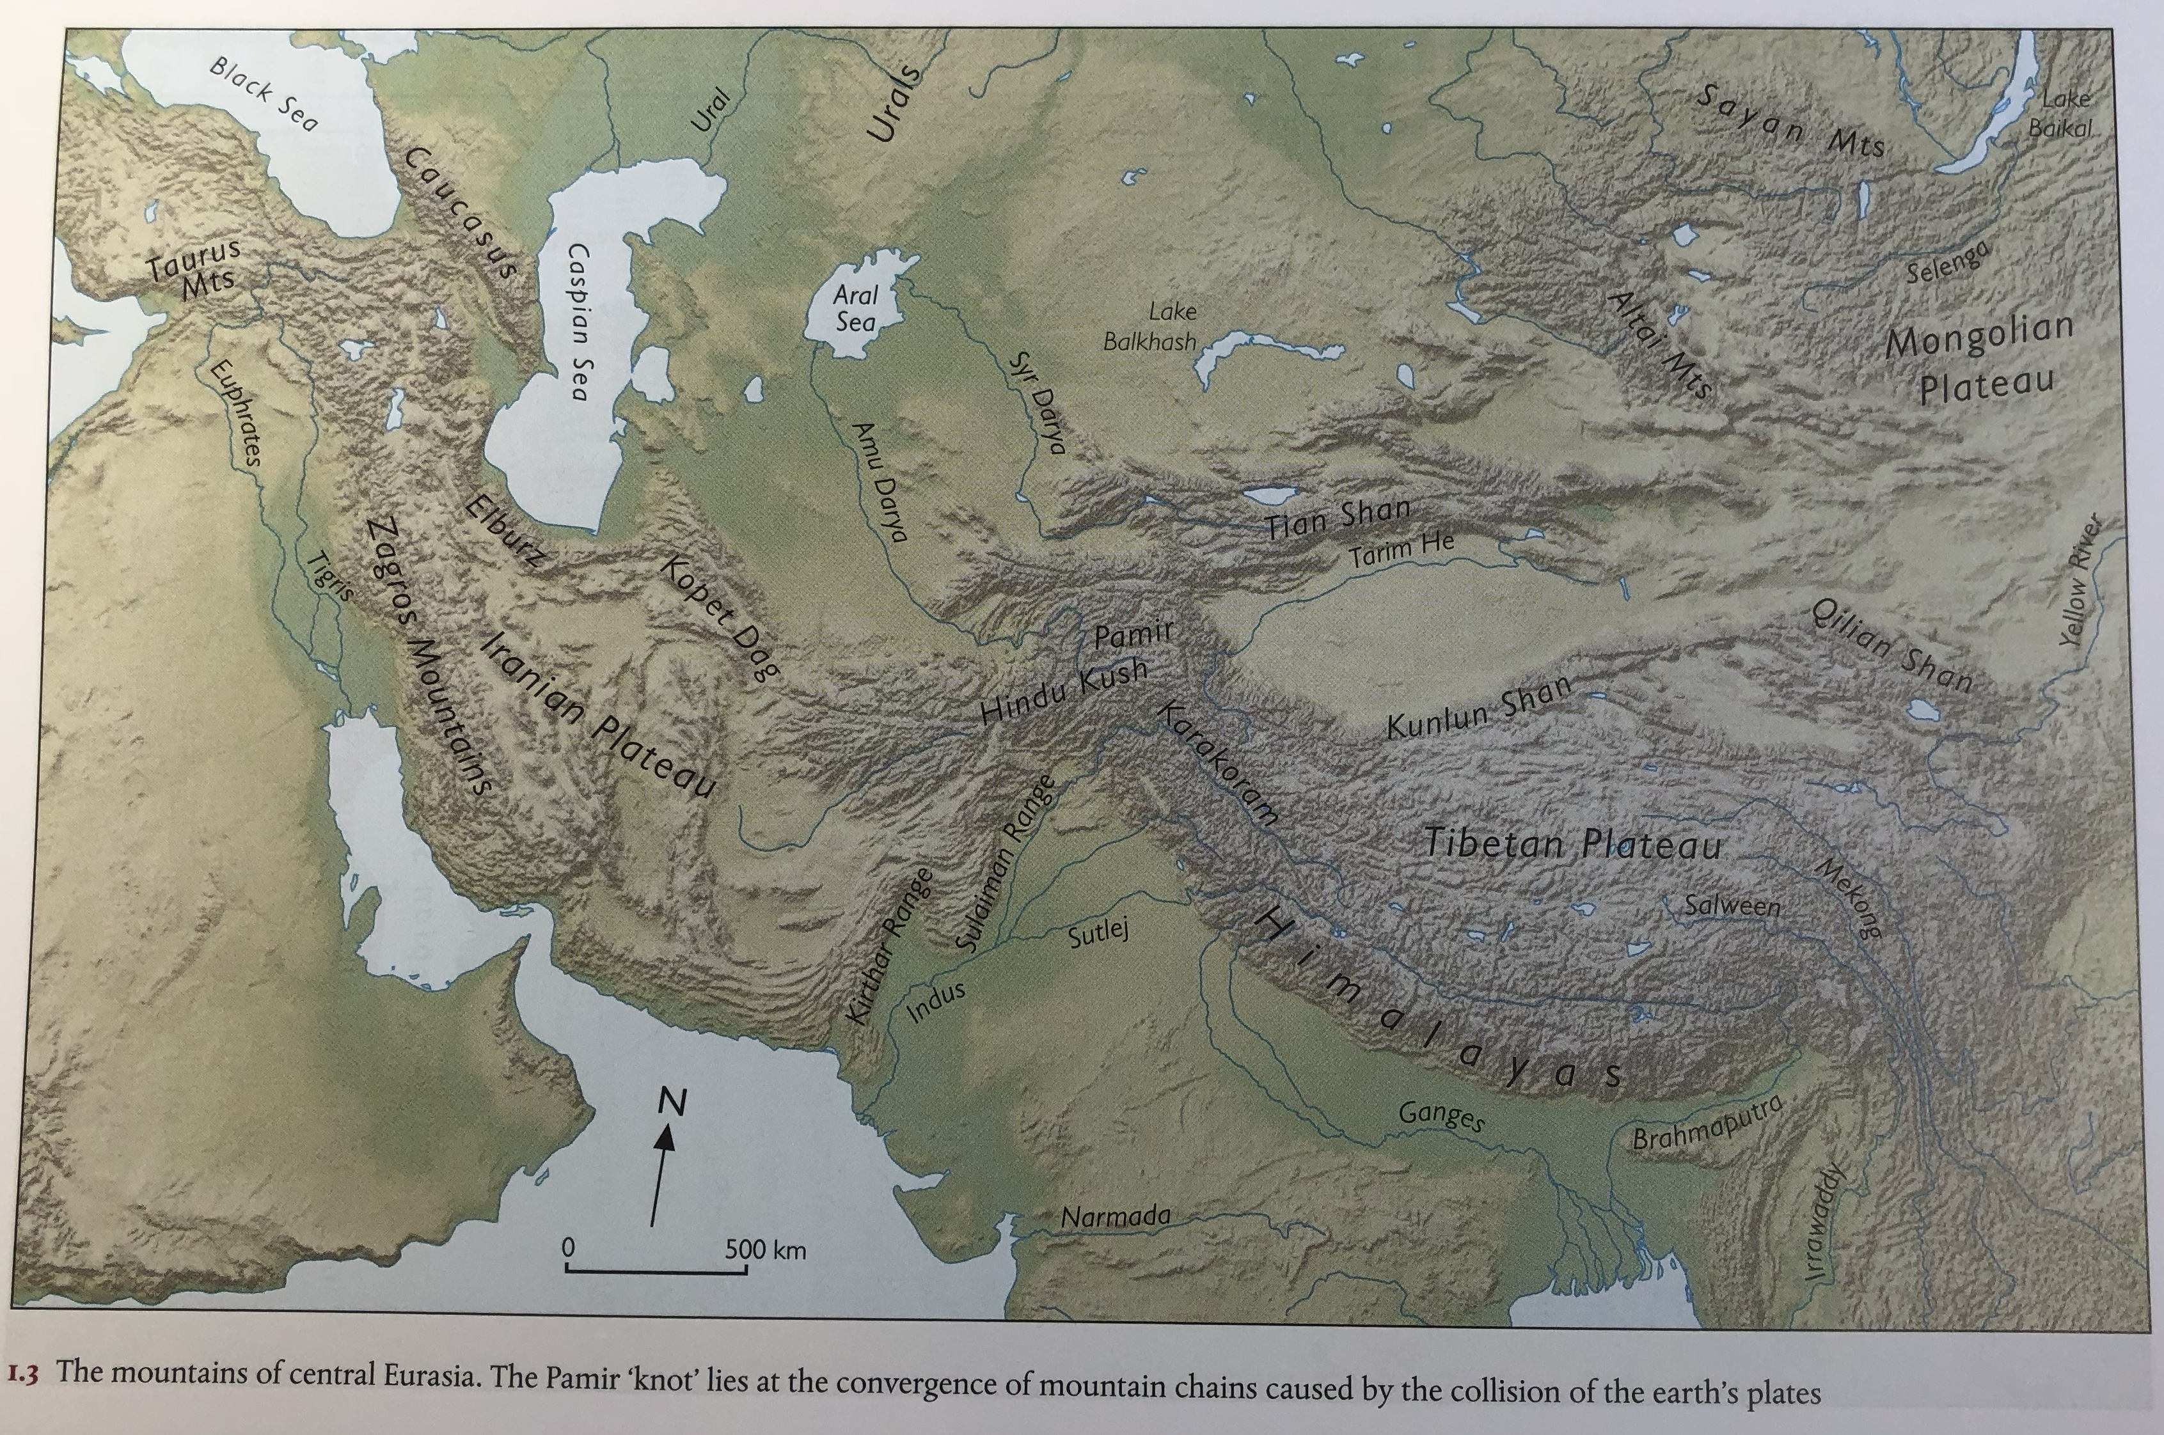

Slide 5
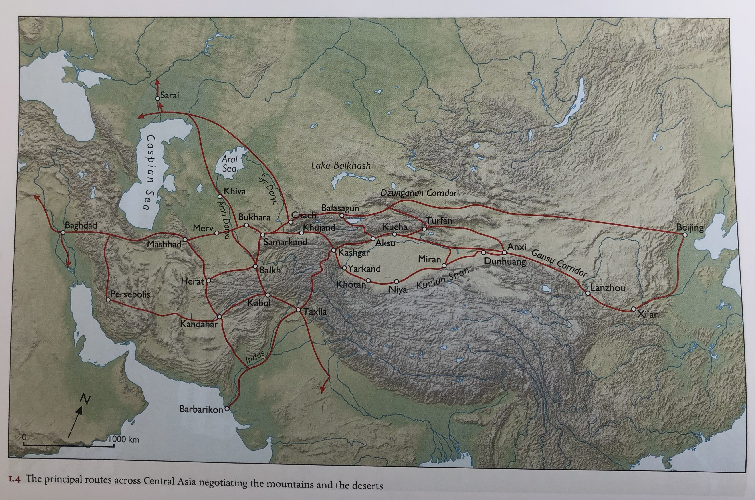
Geographical Features

Slide 6
Western Asia in the era before the Achaemenids
Pre-Achaemenids:
c.1400 BCE: a series of small kingdoms all in constant communication between their rulers (e.g. Amarna Letters) – maintaining diplomatic gift exchange, a delicate equilibrium of power and spheres of influence
Many of these kingdoms collapsed c. 1200 due to external threats, internal disturbance to social order
Re-consolidated c. 900 BC under the (Neo)Assyrian Empire. At its height by c. 640 BC. Single militaristic state that maintained itself by feeding off the energy and spoils of constant expansionist warfare (conquered states incorporated as provinces ruled through a centralized bureaucracy). Expansion driven by religious ideology (it was what god Ashur wanted + need for king to be seen as successful).
To the East on the Iranian Plateau, growth of Medes and Parsua (Persians). To the north growth + movement of nomadic tribes.
By 612 BC, the Medes, in alliance with Babylonians and Scythians, were strong enough to attack Assyria and to sack principal cities of Nineveh and Nimrud.
Babylonians assumed control of area of Mesopotamia and Levantine coast, while Medes extended their power into Anatolia.

Slide 7
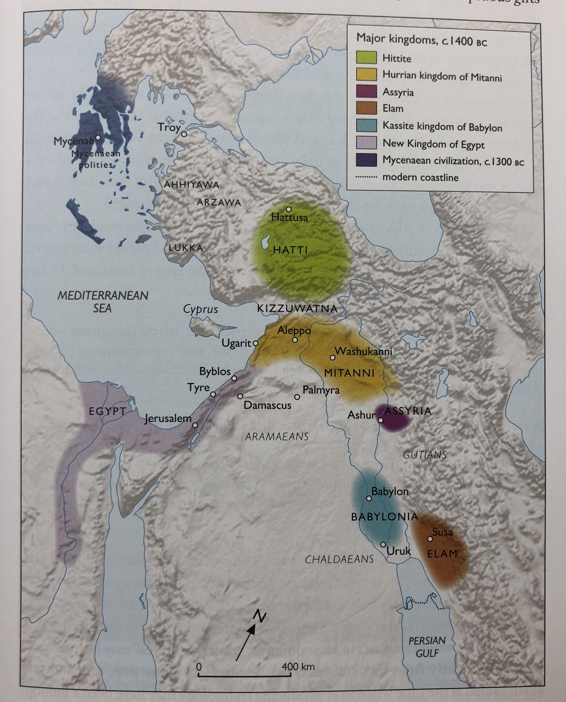

Slide 8
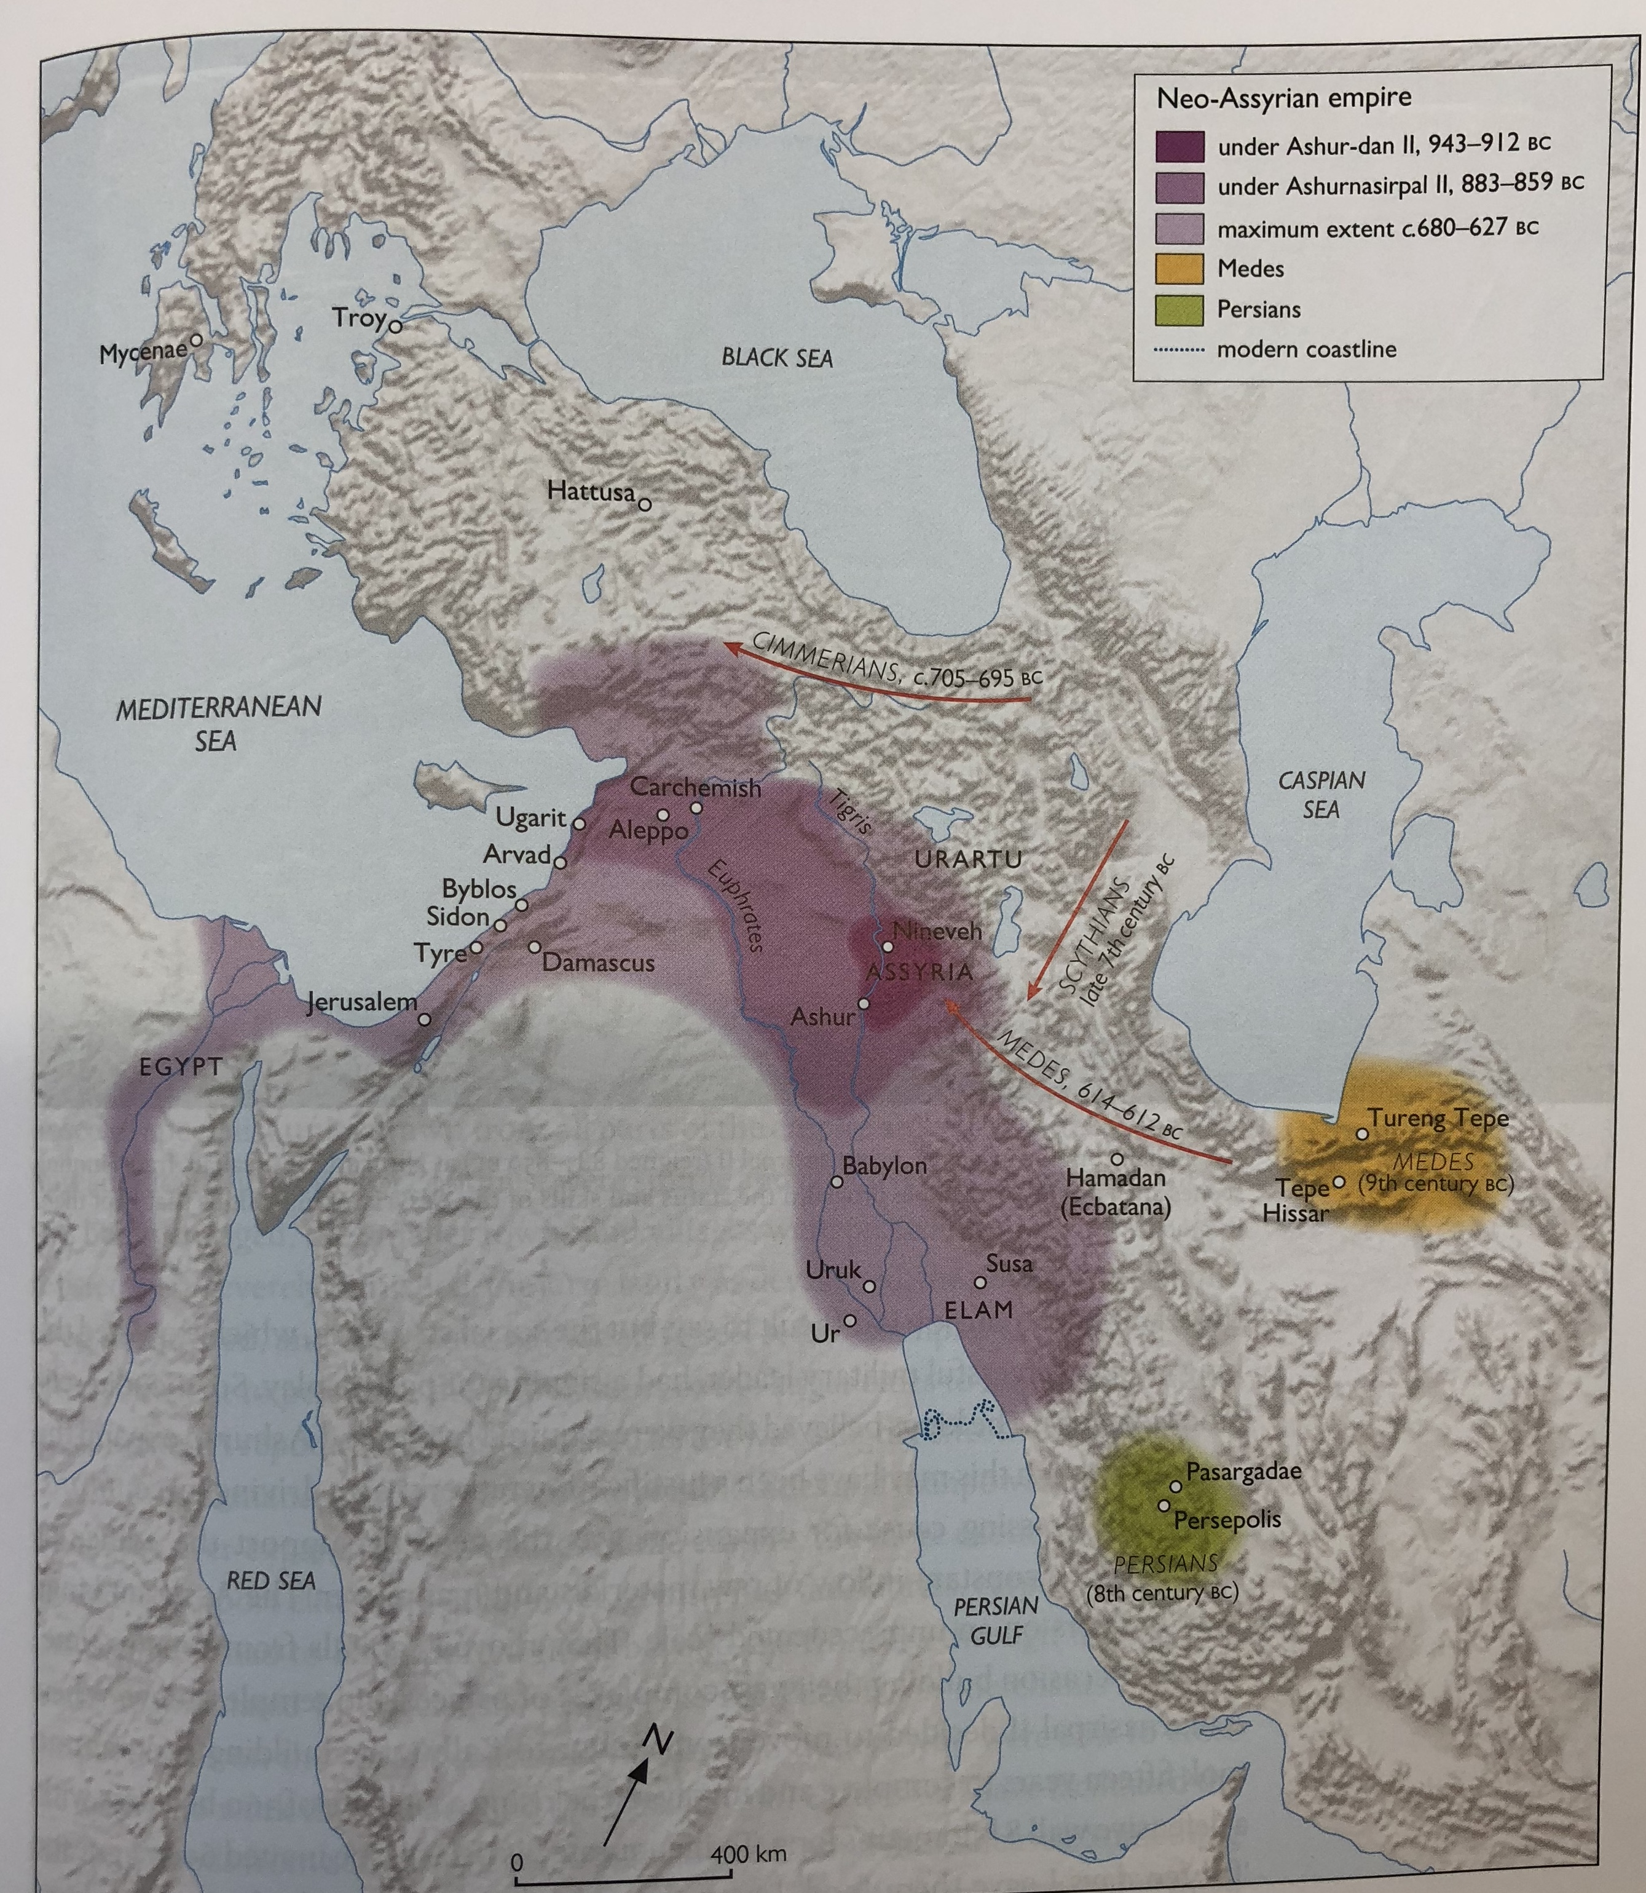

Slide 9
Achaemenid empire established in 6th century BCE by Cyrus the Great
550 BC Cyrus defeats Medes (taking capital of Ecbatana)
547 BCE Cyrus defeats King Croesus of Lydia, taking control of Western Anatolia
546-40 BCE Cyrus extends power over Iranian plateau in East.
539 BCE – Cyrus conquers Babylon (and he sends Jewish population back to Levant)
550-530 BCE – Cyrus attacking nomadic tribes in NE – adding regions of Margiana, Bactria, Sogdiana, Gandhara to Achaemenid empire.
Creation of a single empire from Aegean to Indus valley (with 1600 km border with nomadic tribes). See his tomb + Cyrus Cylinder (list of his achievements)
Son Cambyses (529-522) conquers Egypt
Darius I (521-486 BCE) adds Libya + tribute from Nubia. Famed attempt to take Greece at Battle of Marathon
“Here is the kingdom that I possess, from the Sakas who are beyond Sogdiana to the land of Kush (Nubia), from India to Sardis” (written on gold and silver tablets deposited in foundations of audience hall at Persepolis palace).
Empire bounded now by geographical limits: oceans, deserts and the steppe

Slide 10
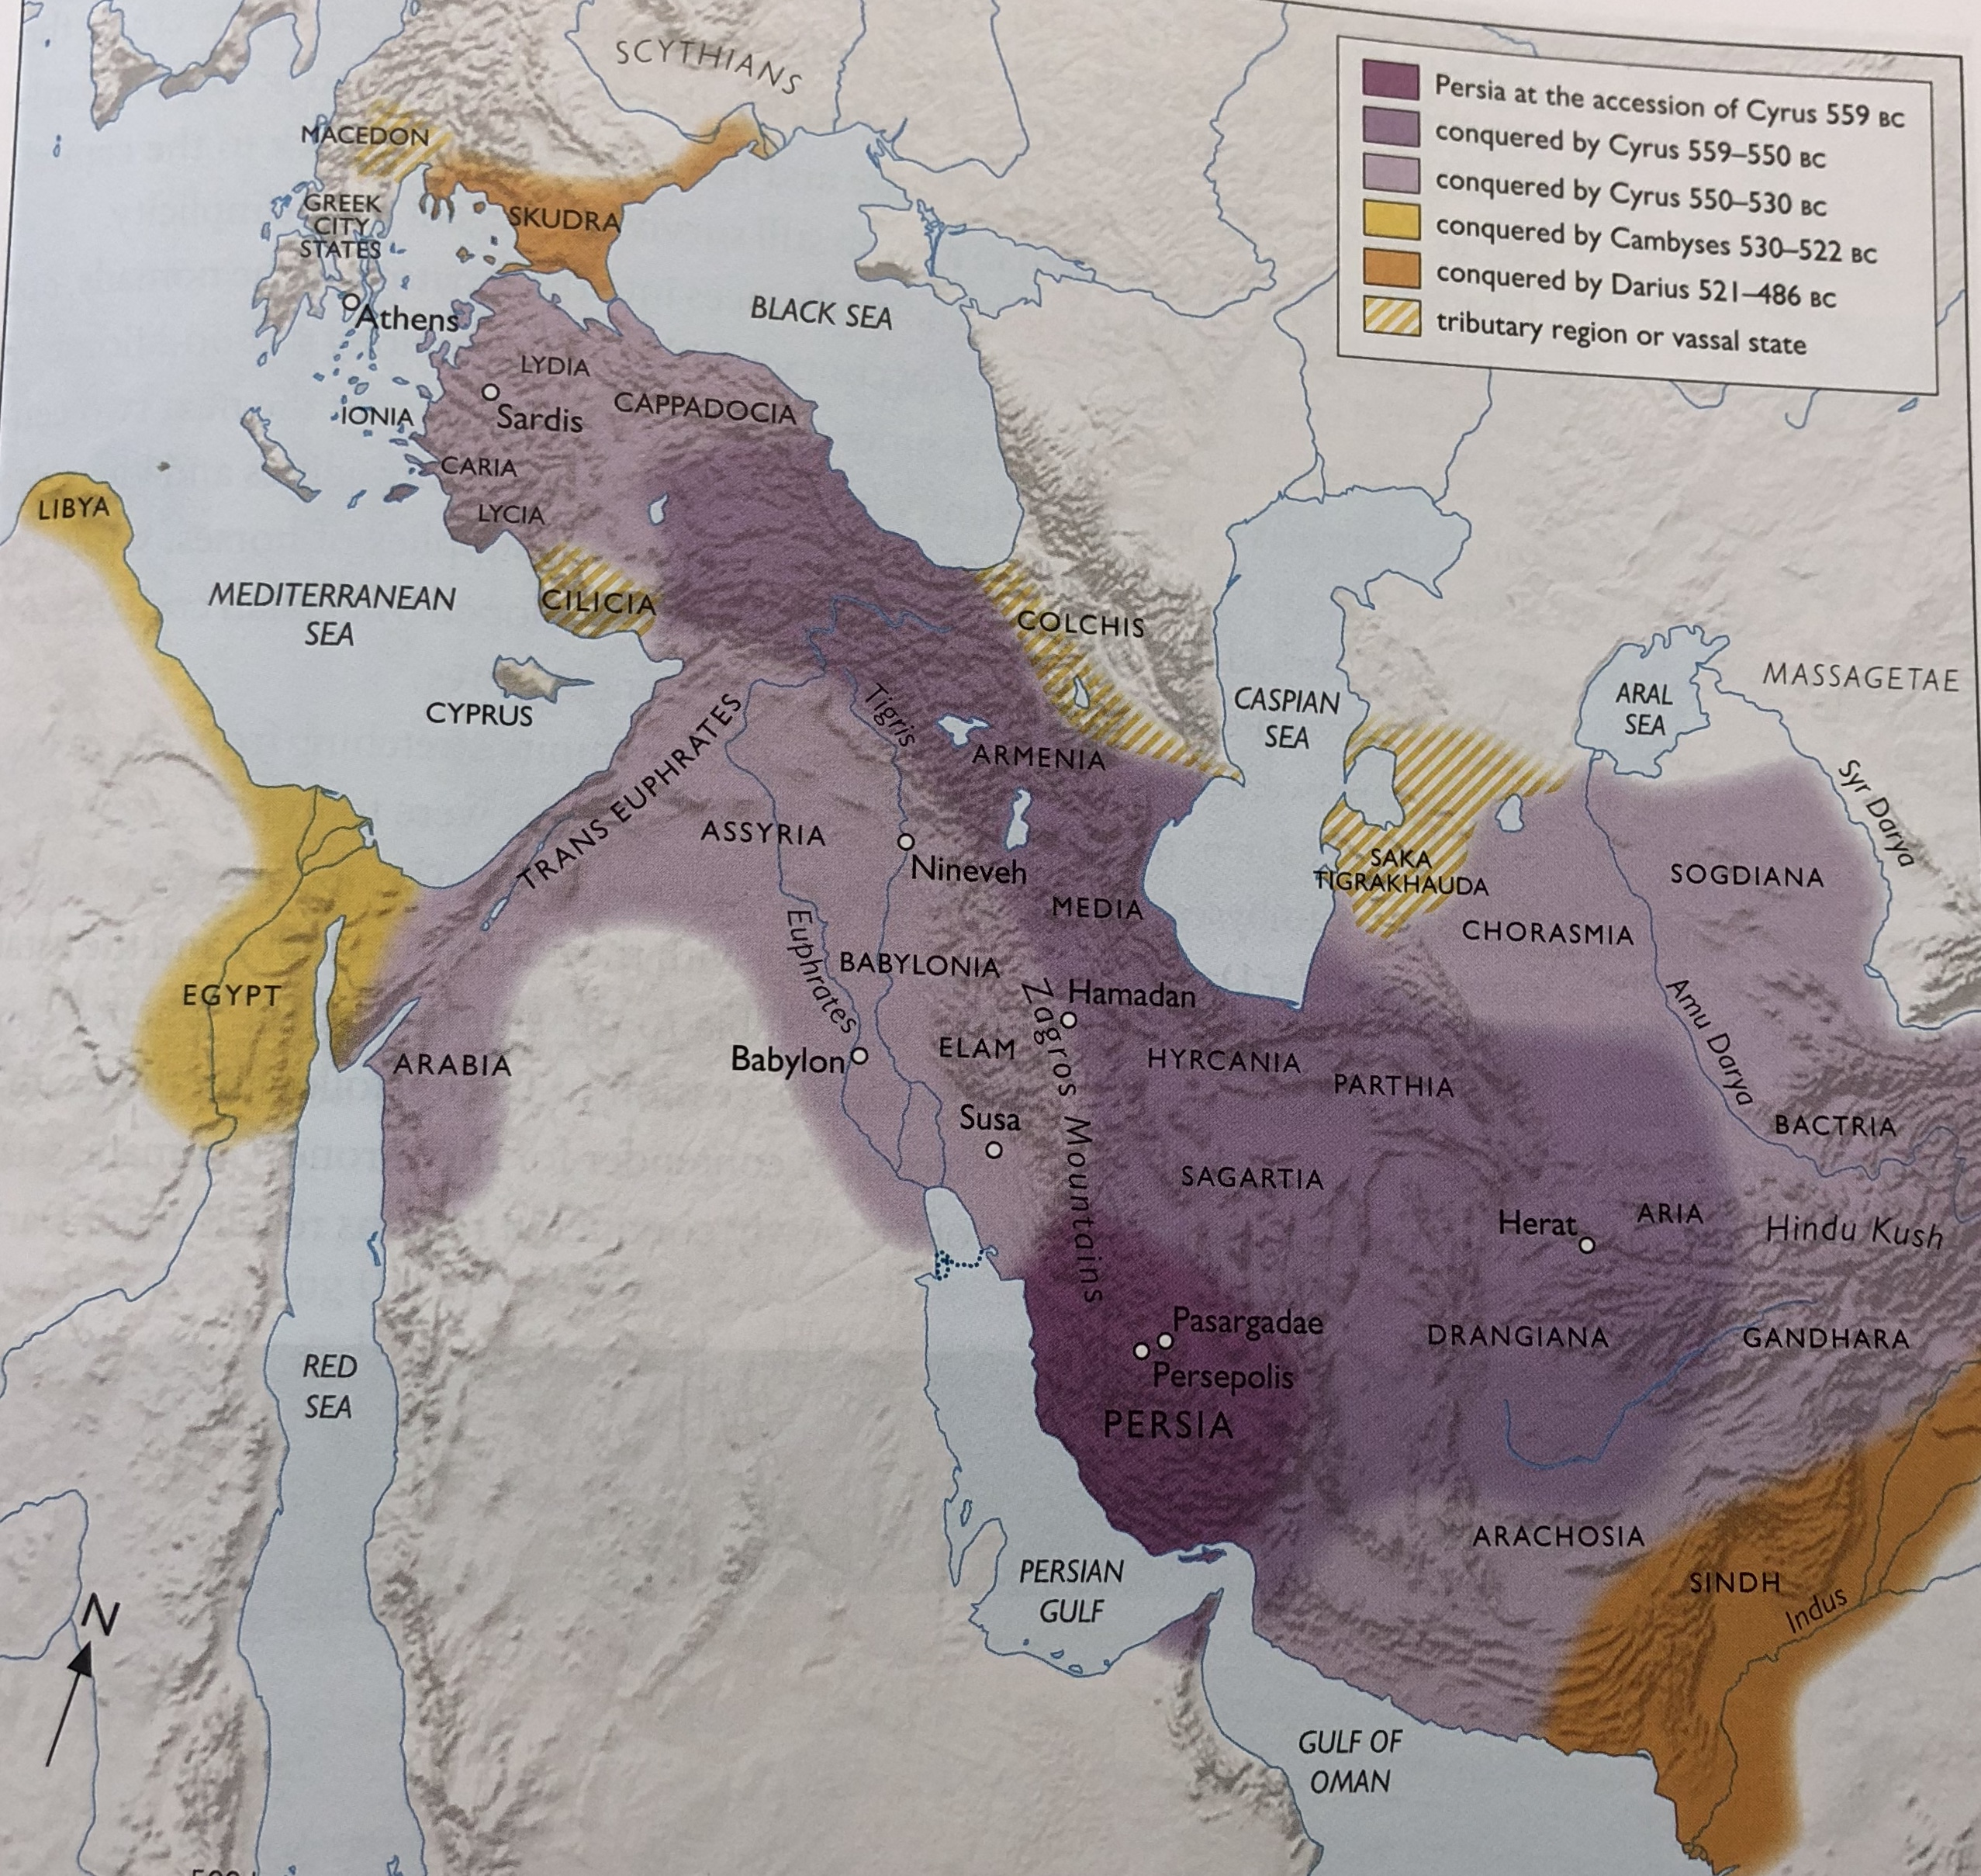

Slide 11
Nature of the challenge
A vast empire – bigger than any previously in history, spanning 5.5 million kms.
Unlike Assyrian, did not stamp its central authority at will (e.g. moving populations around) but encouraged decentralization and diversity
Local elites kept in power, local traditions, languages and gods respected.
Division of empire into 20+ provinces (satrapies) each with governor chosen by King from ranks of Persian nobility. Ruled province with held of indigenous upper class, tasked with maintaining peace + sending tribute to king. Had to be taken to Persepolis and presented as symbol of submission to King.
“the peoples who lived within days of walking, even months, as well as others who had never seen him (the King), and others who knew very well that they would never see him, and yet were willing to submit to him” Xenophon Cyropaedia 1.1.4-5.

Slide 12
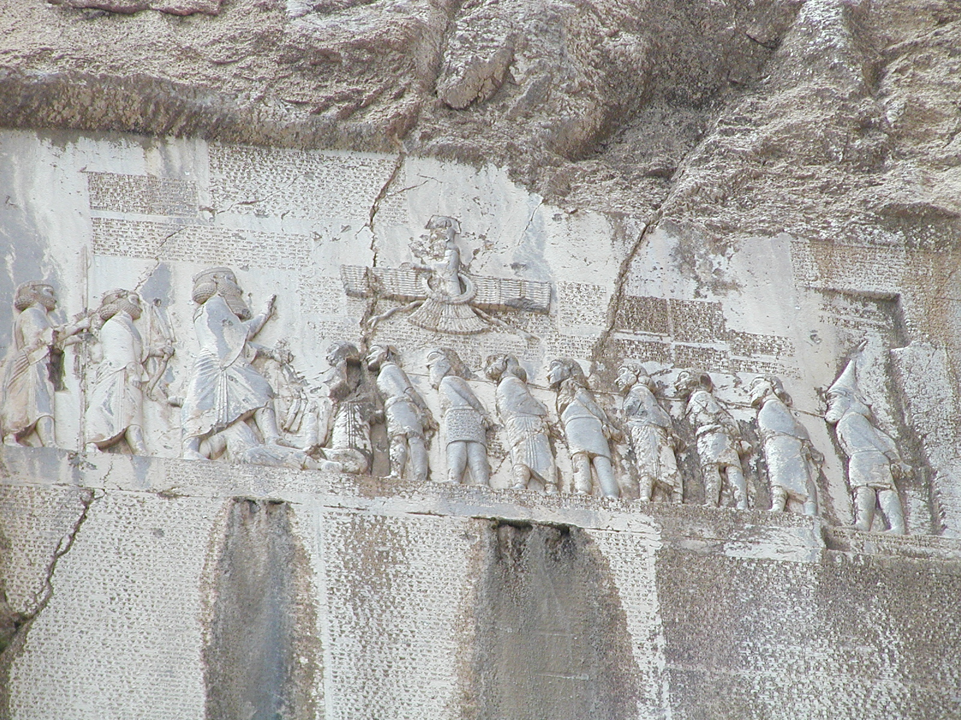
Behistun Inscription
15m x 25m wide inscription set 100 m up on a cliff face at Mt Behistun near Kermanshah on a major road connecting Babylon and Ecbatana.
Inscribed by Darius the Great at record of the achievements of his family. Written in Old Persian, Elamite and Babylonian.
Accompanied by enormous relief of Darius holding bow of authority, with his foot over pretender to the throne.

Slide 13
1.1] I (am) Darius, the great king, the king of kings, the king in Persia, the king of countries, the son of Hystaspes, the grandson of Arsames, the Achaemenide.
[1.2] Says Darius the king: My father (is) Hystaspes, the father of Hystaspes (is) Arsames, the father of Arsames (is) Ariaramnes, the father of Ariaramnes (is Teispes), the father of Teispes (is) Achaemenes.
[1.3] Says Darius the king: Therefore we are called the Achaemenides; from long ago we have extended; from long ago our family have been kings.
[1.4] Says Darius the king: 8 of my family (there were) who were formerly kings; I am the ninth (9); long aforetime we were (lit. are) kings.
[1.5] Says Darius the king: By the grace of Auramazda I am king; Auramazda gave me the kingdom.
[1.6] Says Darius the king: These are the countries which came to me; by the grace of Auramazda I became king of them; Persia, Susiana, Babylonia, Assyria, Arabia, Egypt, the (lands) which are on the sea, Sparda, Ionia, [Media], Armenia, Cappadocia, Parthia, Drangiana, Aria, Chorasmia, Bactria, Sogdiana, Ga(n)dara, Scythia, Sattagydia, Arachosia, Maka; in all (there are) 23 countries.
[1.7] Says Darius the king: These (are) the countries which came to me; by the grace of Auramazda they became subject to me; they bore tribute to me; what was commanded to them by me this was done night and (lit. or) day.
[1.8] Says Darius the king: Within these countries what man was watchful, him who should be well esteemed I esteemed; who was an enemy, him who should be well punished I punished; by the grace of Auramazda these countries respected my laws; as it was commanded by me to them, so it was done.
[1.9] Says Darius the king: Auramazda gave me this kingdom; Auramazda bore me aid until I obtained this kingdom; by the grace of Auramazda I hold this kingdom.
[1.10] Says Darius the king: This (is) what (was) done by me after that I became king; Cambyses by name, the son of Cyrus (was) of our family; he was king here; of this Cambyses there was a brother Bardiya (i. e. Smerdis) by name possessing a common mother and the same father with Cambyses; afterwards Cambyses slew that Bardiya; when Cambyses slew Bardiya, it was not known to the people that Bardiya was slain; afterwards Cambyses went to Egypt; when Cambyses went to Egypt, after that the people became hostile; after that there was Deceit to a great extent in the provinces, both in Persia and in Media and in the other provinces.

Slide 14
Communicating across such distance
Construction of a system of Royal Roads with posting stations at regular intervals.
Most famous ran from Sardis to Susa (2500 km – covered in 90 days)
“There is nothing in the world that travels faster than these Persians couriers… men and horses are stationed along the road, equal in number to the number of days which the journey takes – a man and a horse for each day. Nothing stops the couriers from covering their allotted stage in the quickest possible time – neither snow, rain, heat nor darkness” Herodotus 8.98.
Use of the roads required permission of satraps (also to use the relay stations and warehouses along the routes) – see Sealed Authorisation Tablets (halmi). Stocking of the warehouses a concern of central and local government.
The royal court was ‘nomadic’ in that it too used the roads to move between its capitals through the year (summer and winter residences)
But also using sea routes: Persians construct a man-made canal linking Nile to the Red Sea

Slide 15
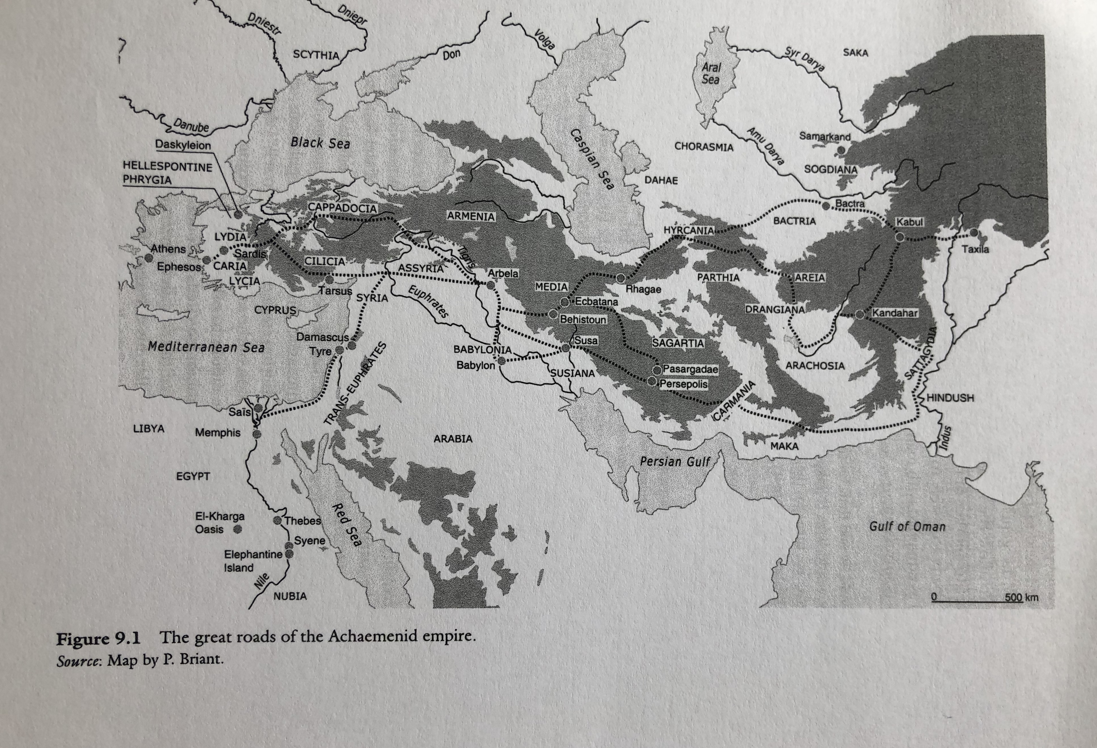
Royal Road Network

Slide 16
The coming (and going) of Alexander the Great
Alexander as the last ‘King of Persia’ – ironically the royal road network used by Alexander to move quickly across the Empire.
Sweeping conquest of Achaemenid empire 334-323 BCE, assumption of royal title (and burial of his dead predecessor, Darius), continuation of Persian style of respecting local customs and traditions, use of local governors and satrapies.
Death led to the breaking up of that empire into monarchies created by his generals.
Seleucid Empire: Seleucos receiving Babylon and surrounding area in 320s, subsequently set out to enlarge his empire in West and East:
“Always lying in wait for the neighboring nations, strong in arms and persuasive in council, he [Seleucus] acquired Mesopotamia, Armenia, 'Seleucid' Cappadocia, Persis, Parthia, Bactria, Arabia, Tapouria, Sogdia, Arachosia, Hyrcania, and other adjacent peoples that had been subdued by Alexander, as far as the river Indus, so that the boundaries of his empire were the most extensive in Asia after that of Alexander. The whole region from Phrygia to the Indus was subject to Seleucus” Appian The Syrian Wars 55.
But as a result, he had the greatest difficulty in maintaining its integrity stretched over the greatest distance (1.5 million square miles – population 20-30 million)

Slide 17
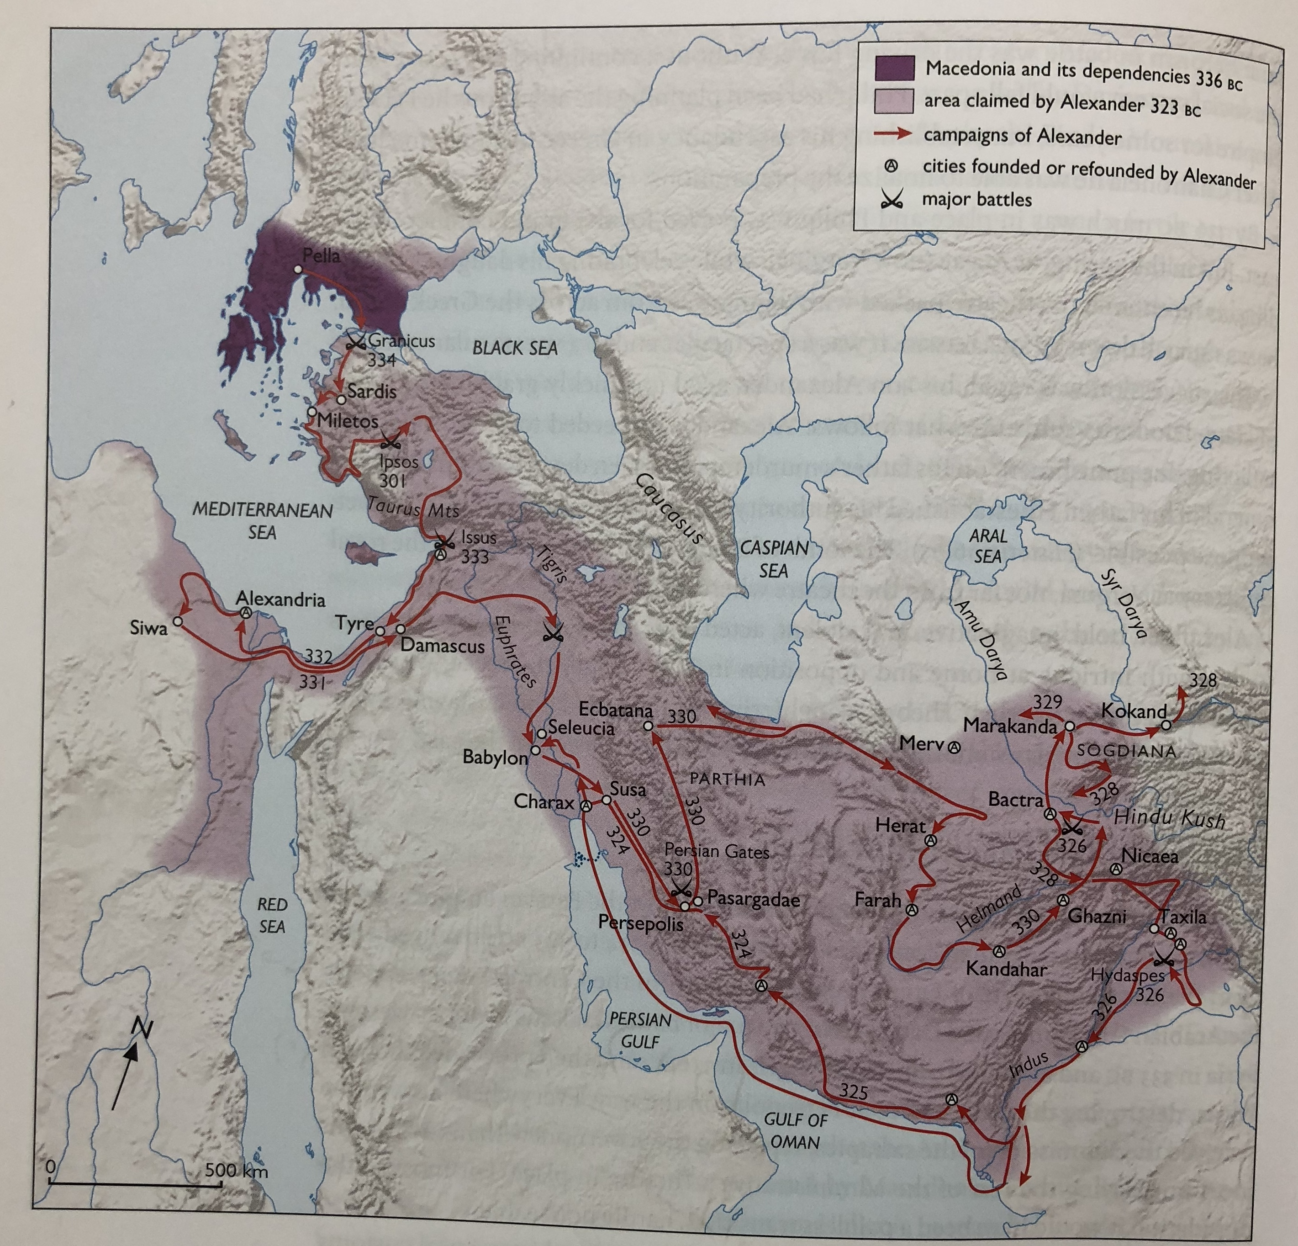

Slide 18
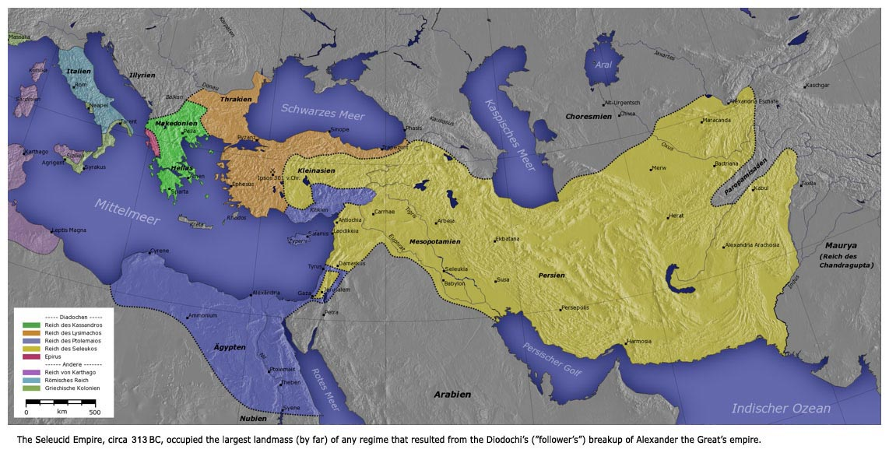

Slide 19
Seleucid difficulties in maintaining their realm
Between 308 and 305 Seleucus took control in Bactria and in 293 he embarked on a more intrusive phase of royal control through extensive Greek colonization.
In 303 BCE Seleucus agreed to cede Gedrosia, Paropamisadae and all territory beyond Indus to King Chandragupta (and sent Ambassadors – Megasthenes)
Successors Antiochus I and Antiochus II faced with push back by Ptolemies, and also nomadic invasions from north.
Led to, after 250 BCE, the declaration of independence by Bactria, Parthia and Cappadocia.
Successors Seleucus II not able to re-capture, but faced with even more pushback from Egypt, another round of break-away states (eg. Attalids) as well as civil wars + rivals for throne.
Antiochus III from 223 to 187 BC: initial failures against Egypt, from 215-205 BC absented himself from the Mediterranean and campaigned to re-assert authority over Bactria + make new agreements with India King. Came back to Mediterranean in 205 calling himself ‘Antiochus the Great’ in imitation of Alexander.
Polybius 11.34.15-6: All in all he secured his kingdom, stunning all his subjects with his audacity and tenacity. Through this campaign, he proved himself wealthy of the kingship, not only to the inhabitants of Asia, but to those also living in Europe.”

Slide 20
Greco-Bactria (relationships East and West)
The region of Bactria to mid 3rd century BCE:
Ctesias of Cnidos – writing a history of Persia in 23 books – spoke of attempts to conquer Bactria by King Ninus of Assyria – difficult because of its inaccessibility and being full of warlike men, Cf Diodorus 2.5.5-7. Cf Herodotus 1.153.4
Cyrus the Great wanted to conquer the Bactrians – Cyrus secures Bactria by defeating the nomadic Massagetae (Hdt 1.201-216)
Bactria under Darius, Xerxes and Artaxerxes (522-424 BC). Bactria had an important role to play in Empire even perhaps link to family of Darius himself. Persians culture well implanted – use of Aramaic.
Alexander established command over Bactria + founded 8-10 cities there. But area in turmoil by time of death + after with many rival plots + attempts to break away.
Reconquered by Seleucus I – based his son here (Father and Son rule from West and East).
Establishment of new settlements including Ai-Khanoum
Establishment of fixed silver coinage based on Attic standard
Bactria becomes a land of 1000 cities (cf Strabo 15.1.13)

Slide 21
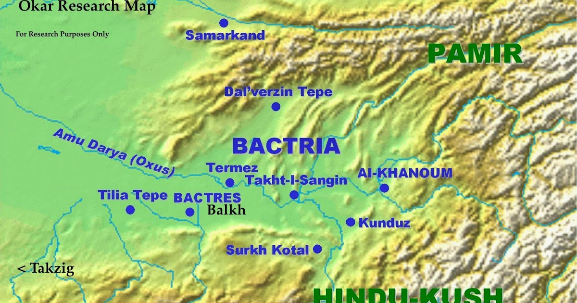
Bactria

Slide 22
Ai Khanoum
Ai Khanoum sits at the junction of the Amu Darya (Oxus) and Kokcha rivers in Eastern Bactria.
Remains of a heroon, a gymnasium, a theatre for 6000 people, two temples, private dwellings, administrative area, and a palace complex, as well as inscriptions, coins, and abundant ceramic evidence. The site, with a natural acropolis, c. 60 m high, was secured by strong fortification walls.
In heroon – Clearchus inscription was found from 275 BC – transcript of old wisdom attributed to Seven Wise Men of Greece (taken from Delphi). The second text is the copy of one of the series of these so-called Delphix maxims. More than 5000 km from Delphi

Slide 23
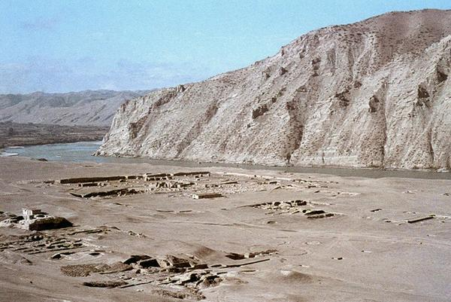
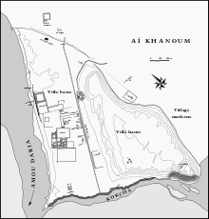
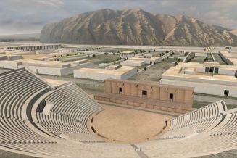
Ai Khanoum

Slide 24
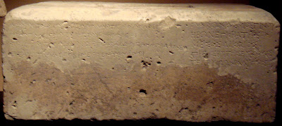
“These wise sayings of older men, far-famed, are dedicated in holy Pytho; from where Clearhus assiduously copied these things and set them up in the temenos of Cineas to shine out far and wide.”
"As children, learn good manners as young men, learn to control the passions in middle age, be just in old age, give good advice then die, without regret."

Slide 25
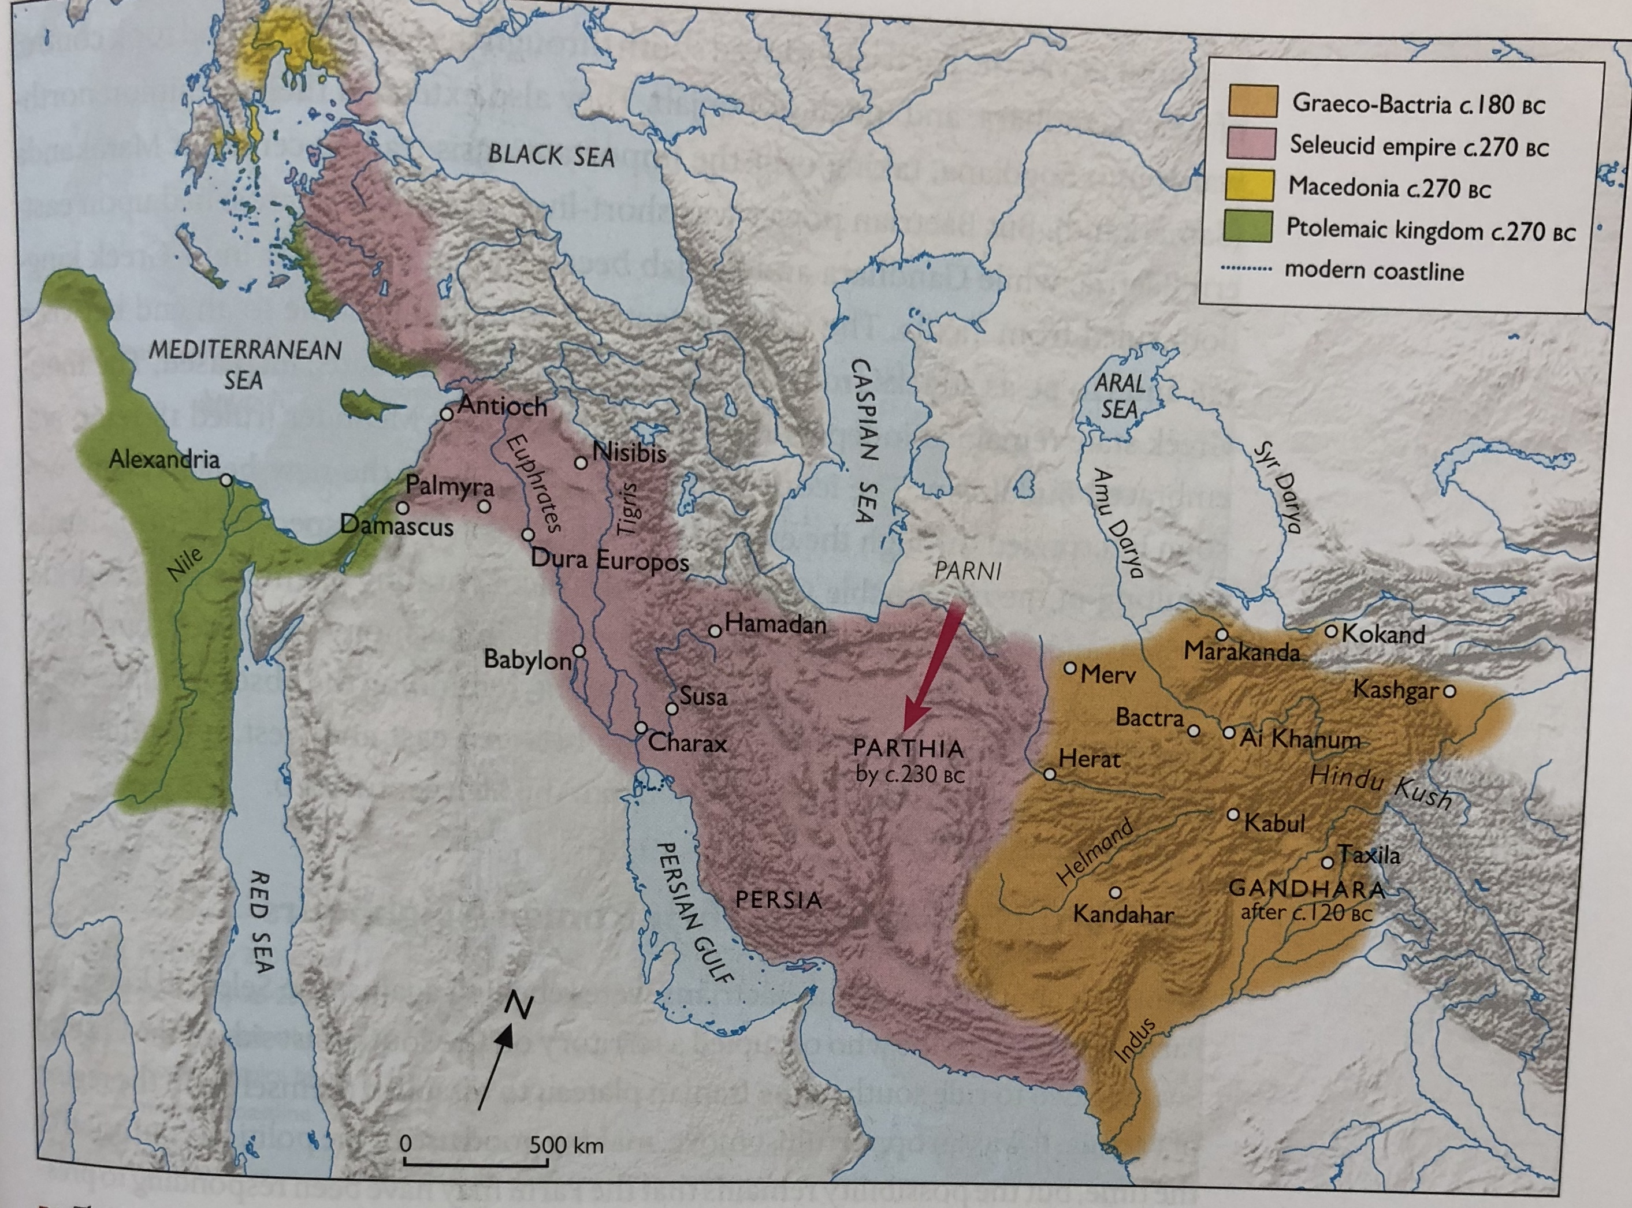

Slide 26
Greco-Bactria as independent power
In 245 BC, Diodotus the satrap of Bactria proclaimed himself independent
Key reasons: Personal ambition; Greek resentment of Macedonian political dominance; impatience with increasing demands for resources to fight wars in West; need to defend their own boundaries against nomad threat.
Over next 130 years, Greco-Bactria would thrive as independent kingdom, encompassing Sogdiana, Margiana and Aria.
Antiochus III returns to Bactria 215-202, and eventually conquers Euthydemus (who had usurped power from sons of Diodotus). Euthydemus claims Antiochus II needs him to keep safe his eastern borders (Polybius 10.49.15)
Euthydemus (and son Demetrius) expanded rule of Greco-Bactria northwards into Ferghana and Tarim Basin, but also southwards in 190s, over Hindu Kush, to take over areas, which had been given by Seleucids to Mauryan India.
“The Greeks who caused Bactria to revolt grew so powerful on account of the fertility of the country that they became masters, not only of Ariana, but also of India, as Apollodorus of Artemita says, and more tribes were subdued by them than by Alexander” Strabo 11.10.1.
Successor King was Eucratides. To commemorate his achievements – Eucratides had struck a twenty stater gold coin – the largest and most valuable gold coin ever to be struck in the Hellenistic world.

Slide 27
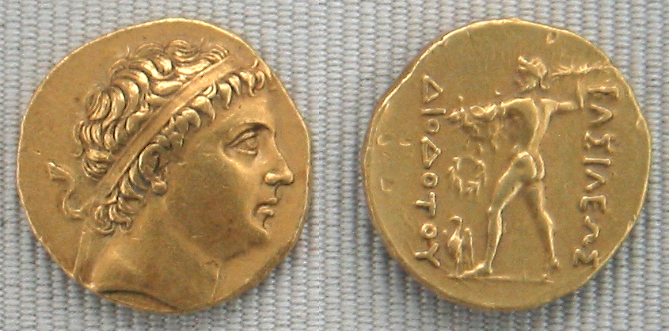
Diodotus as ‘King’

Slide 28
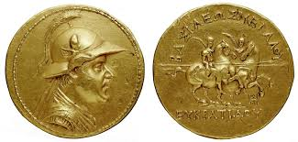
Eucratides coin

Slide 29
The Parthian take-over of the Seleucid world
Parthia led by by Andragoras (245-239/8) – independent of Seleucids at same time as Bactria.
In 239 BC – Arsaces invaded Parthia and killed Andragoras – Strabo 11.9.3. (Arsaces from Parni (another territory of formerly nomadic origin – thought to have been responsible for destroying Merv (Strabo 11.8.2).
Justin (41.4.9) says Arsaces concluded a peace treaty with Diodotus II to stop problem of expanding Bactria.
Antiochus III (215-205 BCE) heads to Arius river – through Parthian heartland. The Parthian king Arsaces II was humbled but allowed to maintain local authority after reducing his realm to a specific area.
Mithridates I of Parthia (171-138 BCE) seizes Media and Mesopotamia from Seleucids, and despite Seleucid fight backs, Parthia continues to expand through into the 1st century BCE.

Slide 30
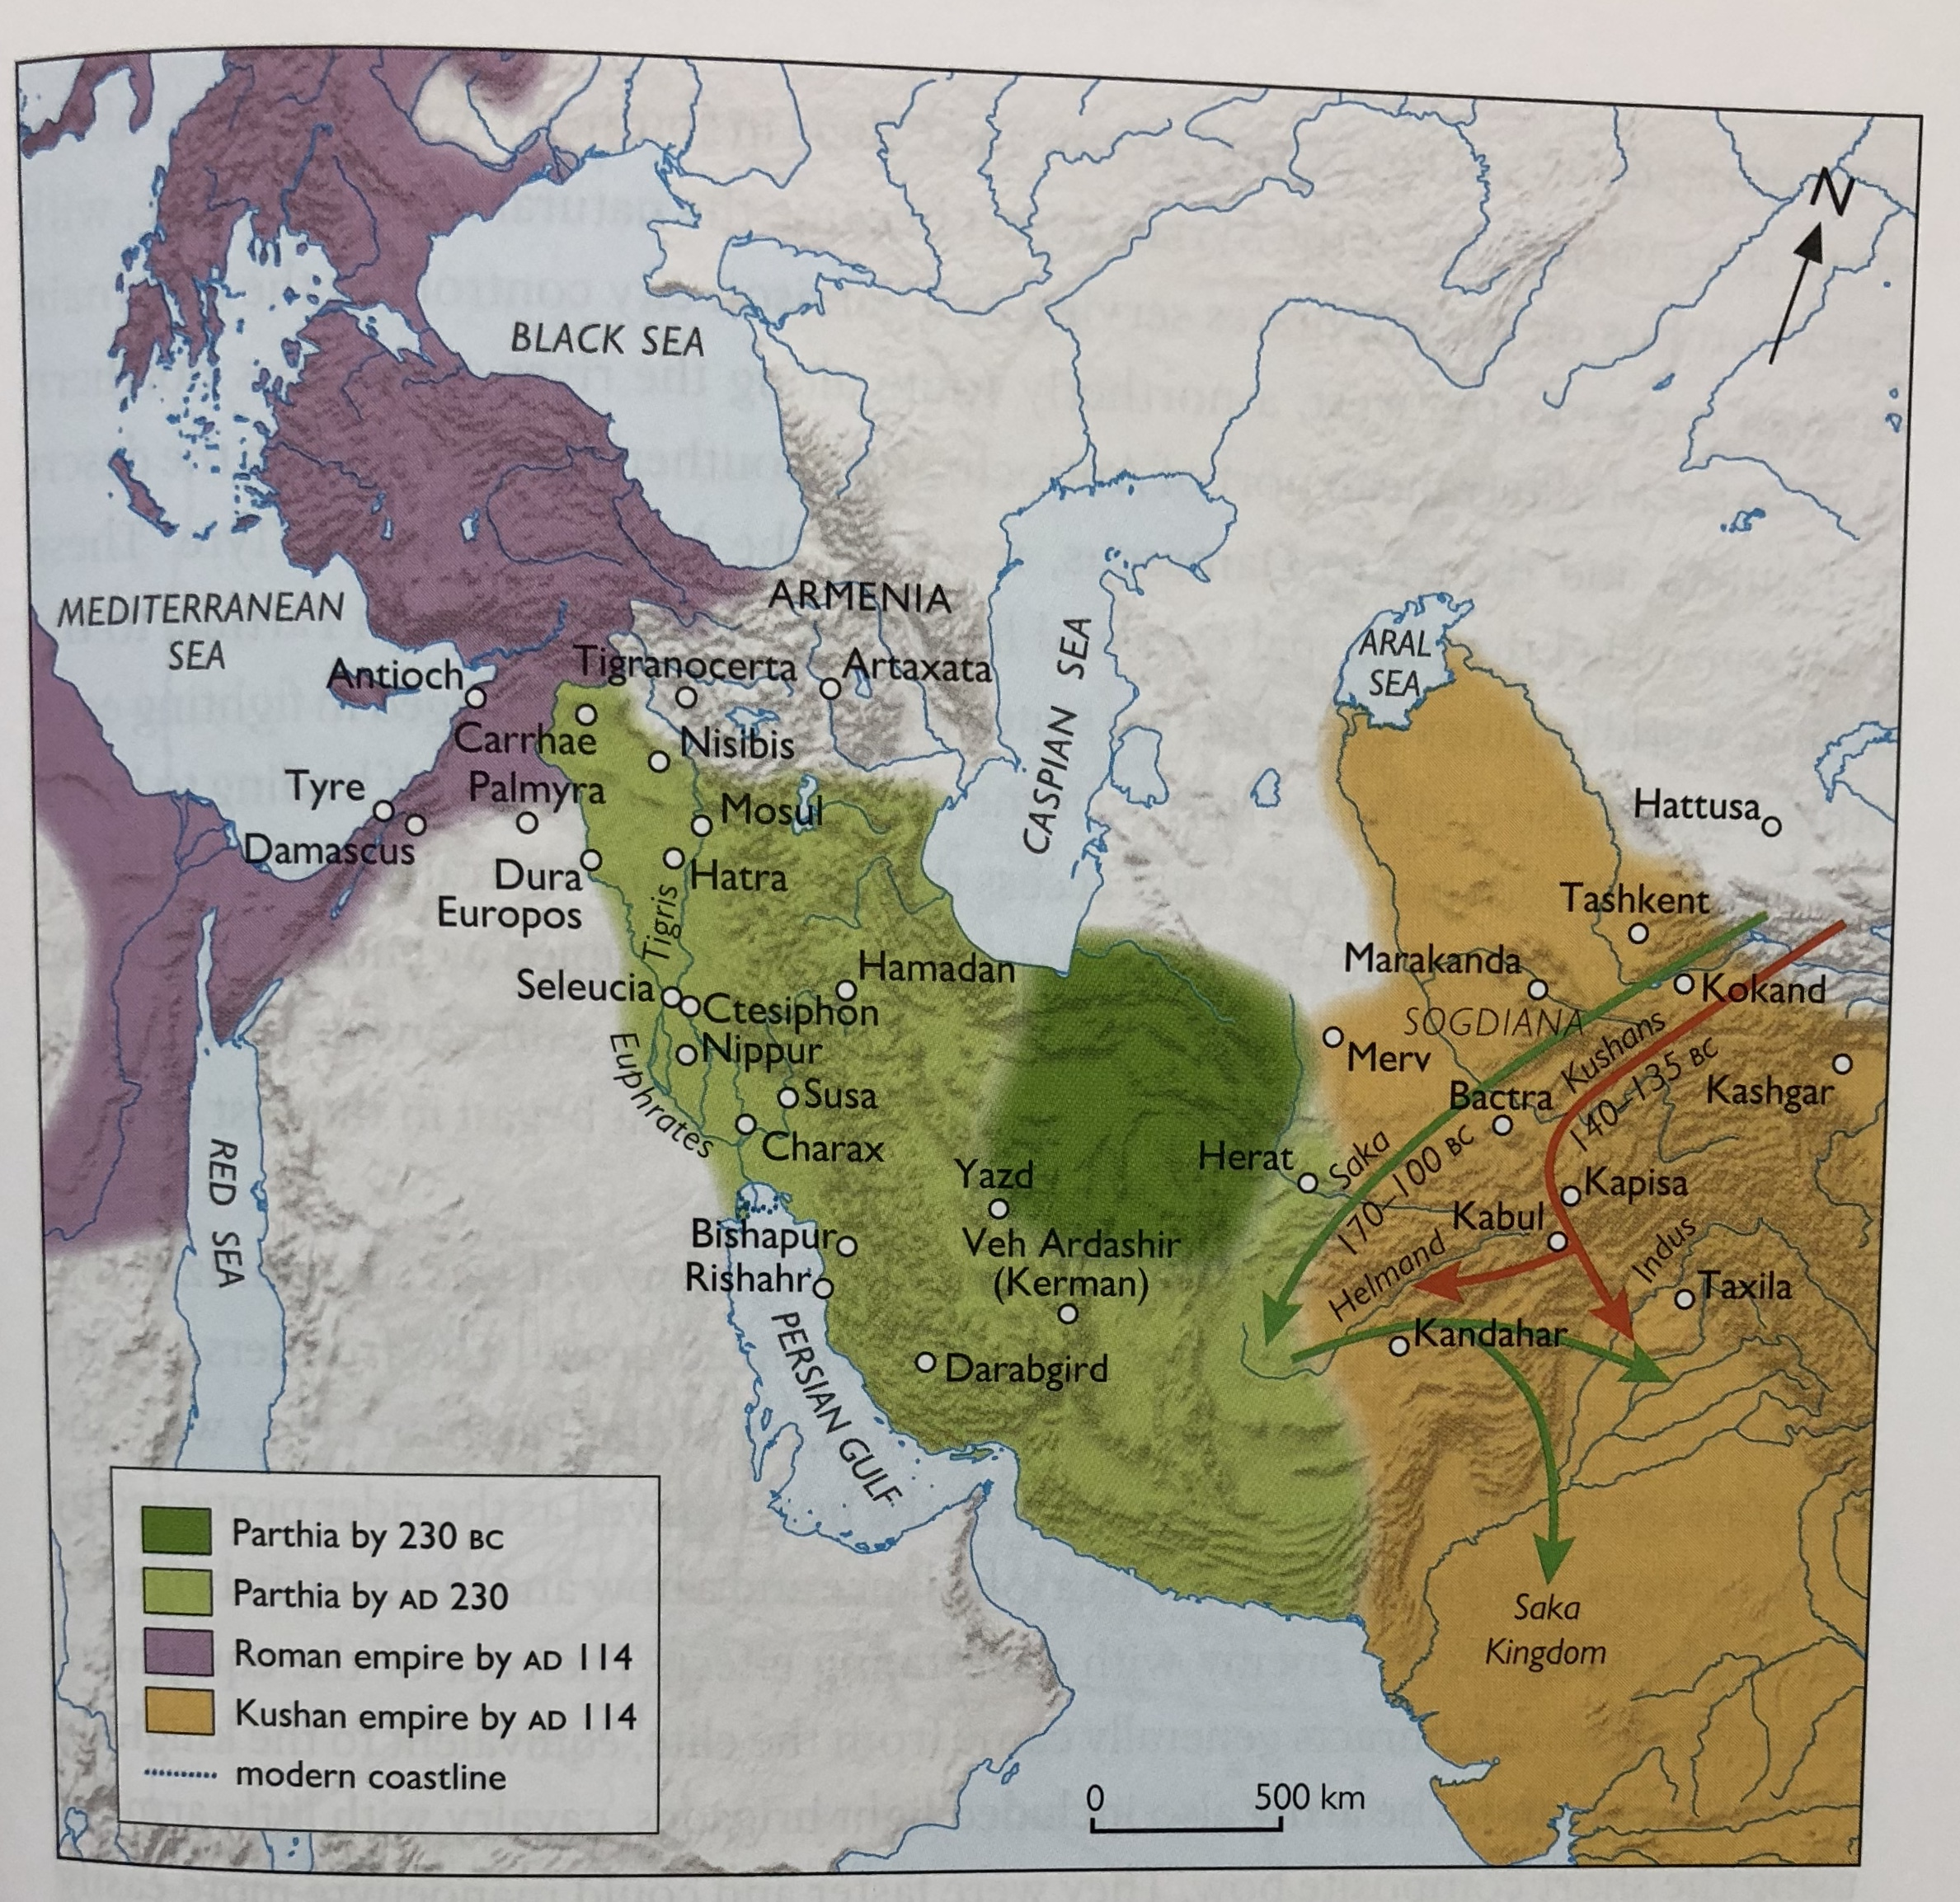

Slide 31
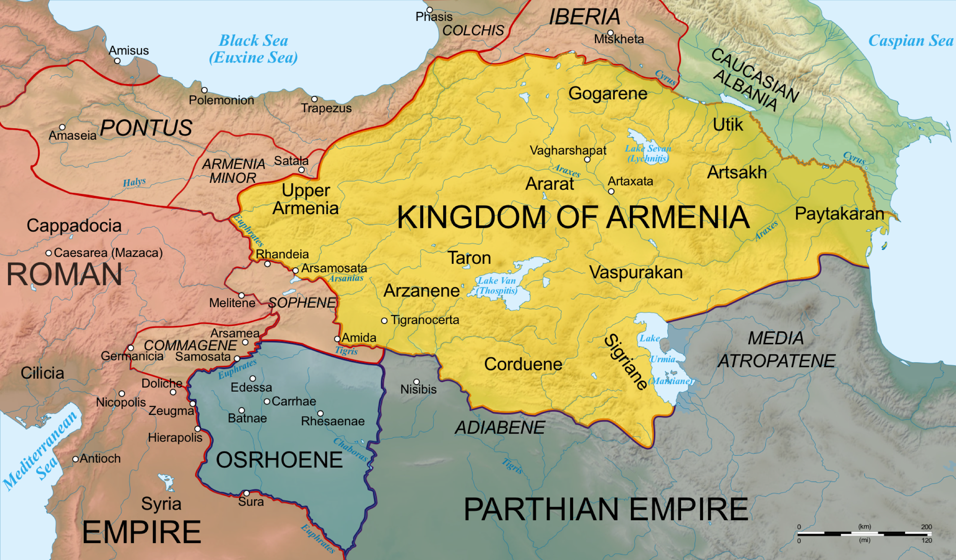
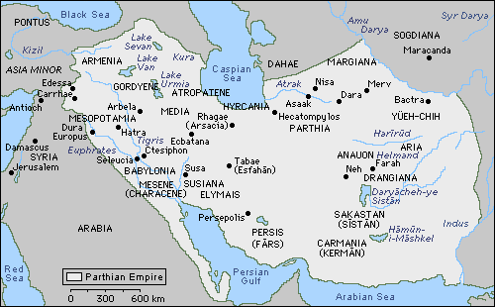

Slide 32
Nature of Parthian realm
Empire ran from India to the Euphrates (smaller than preceding Seleucid and Achaemenid empires) from 1st century BCE– 3rd century CE.
It was composed of a mix of pre-existing satrapies (directly controlled by royal officers) and a series of autonomous kingdoms ruled by local dynasties.
Parthian ‘empire’ as a network of political and cultural micro-communities. Home to regular, on-going and serious political and military civil crises in which overall power was hotly disputed.
Yet managed to survive because of its innate flexibility:
Parthian monarchy had no strong centralized power, no strong imperial apparatus
No official orthodox religion
Following conquest, most political structures encountered were maintained, mixed in with some local dynasts who owed their power to Parthian king’s support (client kings) – oath of loyalty to king but still semi-autonomous.
Parthian king spent most of his time focused on growing/ re-freshing bonds of allegiance with local rulers, rather than trying to control what happened in individual territories.
Only occasionally attempted direct occupation. Also from end 1st century CE, would replace local monarch with a member of Arsacid ruling family to help ensure greater loyalty. E.g. territory of Characene.
Spectrum of solutions utilized to maintain bond between local ruler and Parthian King – flexibility as key (often confused with weakness ‘political clowns of the millennium’

Slide 33
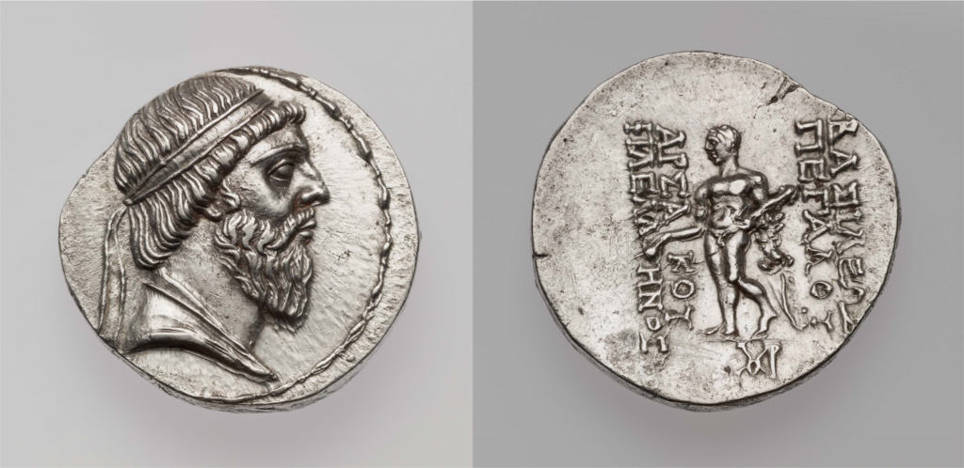
Coin of the Arsacid king Mithradates I, c. 141–138 BCE. On the obverse is a diademed bust of Mithradates; the reverse features Hercules, and describes the king as a “Lover of Greeks.

Slide 34
A bilingual inscription in Greek and Parthian carved onto the right and left thighs, respectively, of a bronze Heracles statue. The text records the victory of the Arsacid king Vologaeses IV over the kingdom of Characene (in Parthian, Meshan) and dates to 151 CE.
Translation of the Greek text
1 In the year 2 according to the Greeks 3 462 [=151 CE], the King 4 of Kings Arsaces 5 Vologaeses, 6 son of Mithradates 7 the king, campaigned 8 in Mesene 9 against Mithradates the king, 10 son of Pacorus, the 11 previous king. And 12 having driven Mithradates 13 the king from Mesene, 14 he became master of 15 all Mesene; and this 16 bronze statue of Heracles 17 the god, which was brought 18 by him from Mesene, 19 he dedicated in the shrine 20 of the god Apollo who 21 sits near the bronze 22 gate.
Translation of the Parthian text
1 [In the year] 2 [398] A[rsa]ces 3 Vologaeses, King of Kings, 4 son of King Mithradates, fought 5 in Mesene against King Mithradates, 6 son of Pacorus, King of Kings. King Mithradates 7 he [sc. Vologaeses] drove out from there. All 8 Mesene he took. This statue 9 of Verethragna the god which from 10 Mesene he removed, having had it inscribed, in 11 the temple of Tir he set up as an offering.

Slide 35
Nomads arriving into Greco-Bactria and Parthia
Arrival of migrating nomadic tribes (Yuezhi and Wusun) from east into central Asia had severe repercussions for both Greco-Bactria and Parthians.
Settlement of Ai Khanoum invaded and destroyed by Yuezhi.
Yuezhi settle in area of Greco-Bactria
Around 145 BC the Greeks of Bactria decided to retire from central Asia to the empire they had conquered in Western India. They evacuated Bactria and left it to nomadic Yuezhi tribes.
Movement of Yuezhi also then displayed many of the Scythians (Sakas) living in northern central Asia who subsequently invaded and had to be incorporated into the Parthian realm. Sakas would then later invade into Greek realms in India.

Slide 36
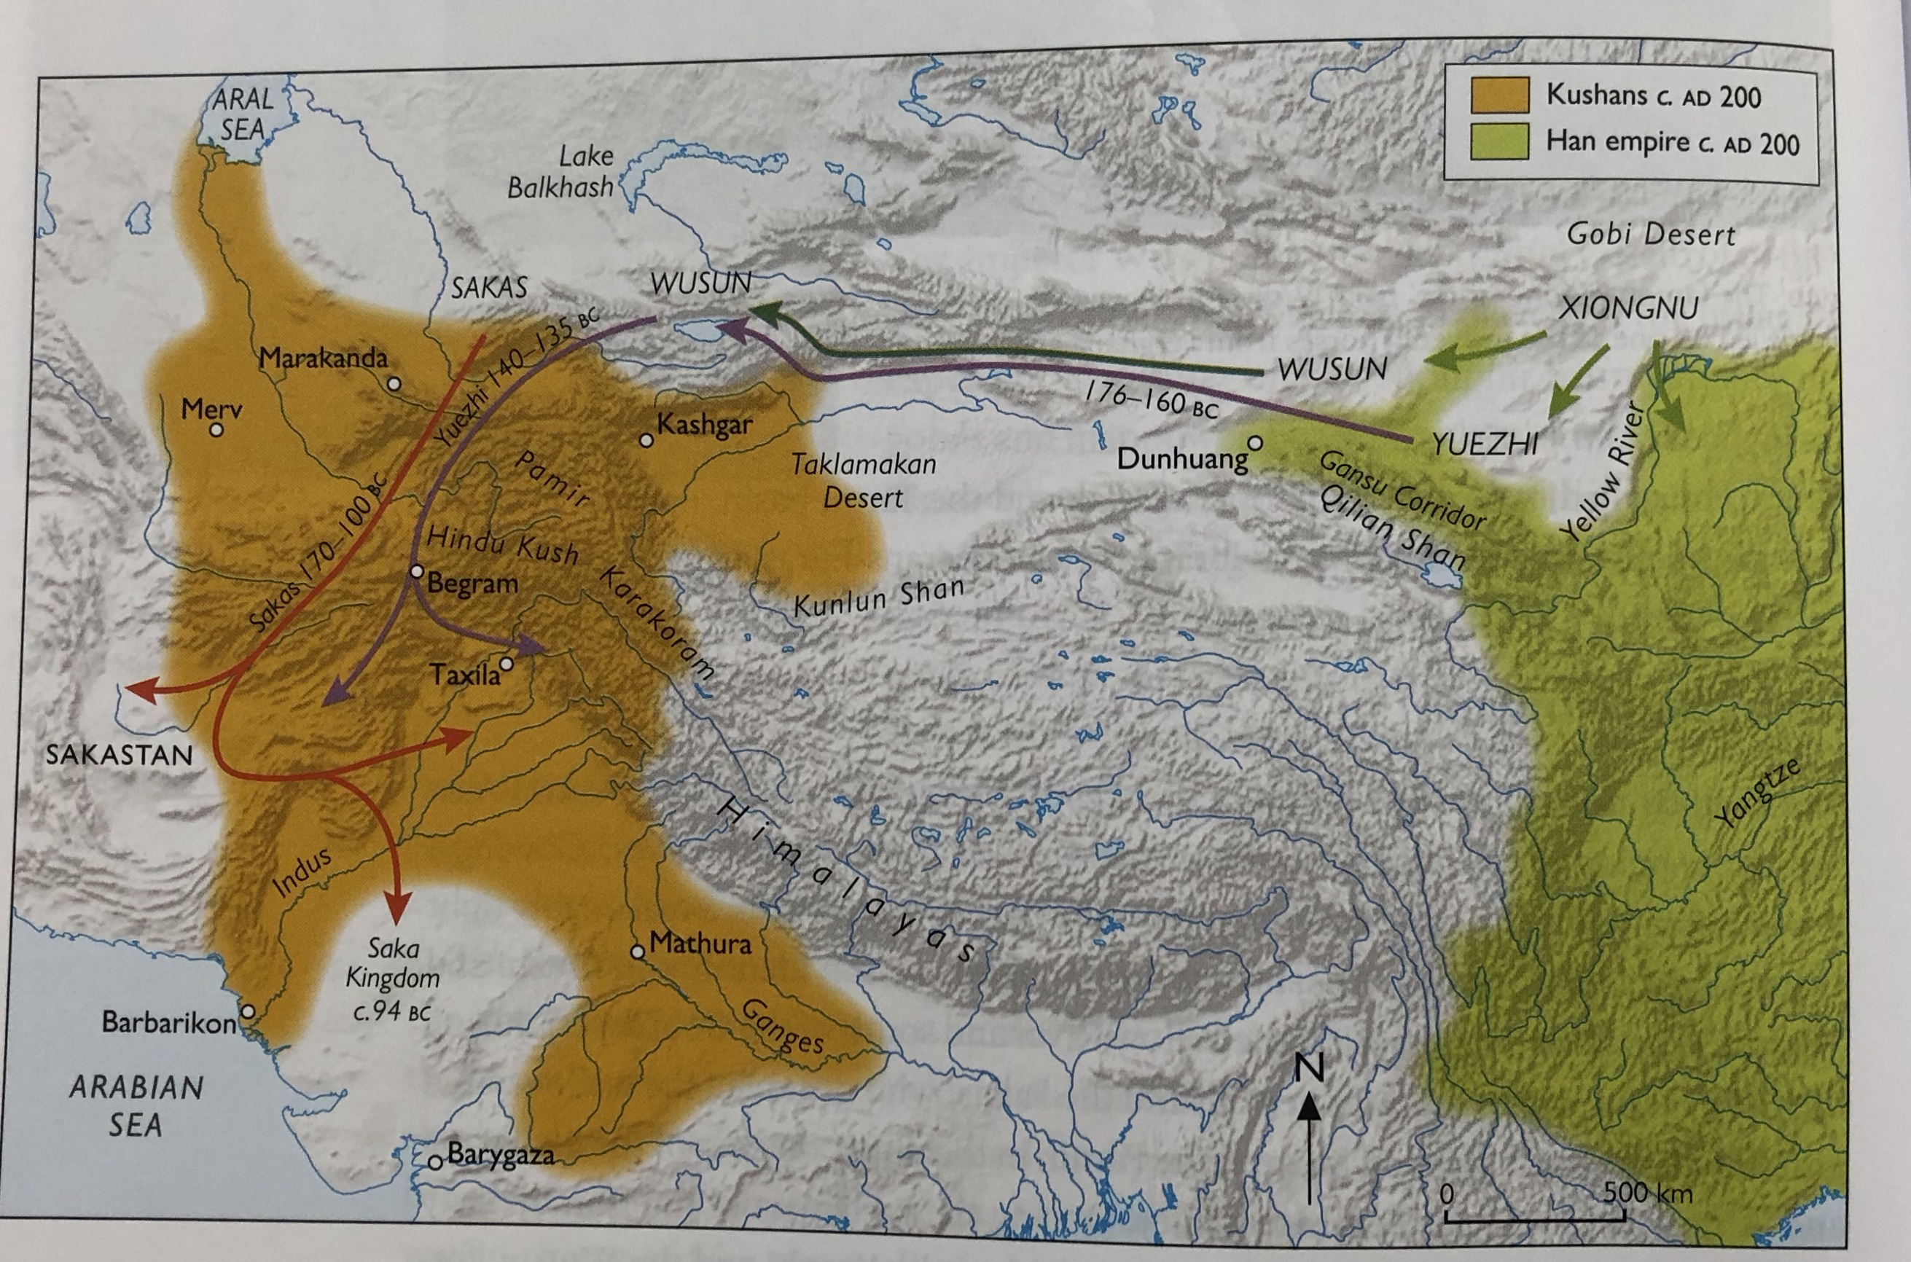

Slide 37
The Kushan Empire
The name Kushan derives from the Chinese term Guishang, used in historical writings to describe one branch of the Yuezhi.
Early Kushan rulers united the disparate tribes in the first century B.C. Gradually wresting control of the area from the Scytho-Parthians, the Yuezhi moved south into the northwest Indian region traditionally known as Gandhara (now parts of Pakistan and Afghanistan) and established a capital near Kabul. They had learned to use a form of the Greek alphabet, and Kujula’s son was the first Indian ruler to strike gold coins in imitation of Greek and Roman coins.
The rule of Kanishka, the third Kushan emperor who flourished from the late first to the early/mid-second century A.D., was administered from two capitals: Purushapura (now Peshawar) near the Khyber Pass, and Mathura in northern India.
Under Kanishka’s rule, at the height of the dynasty, Kushan controlled a large territory ranging from the Aral Sea through areas that include present-day Uzbekistan, Afghanistan, and Pakistan into northern India as far east as Benares and as far south as Sanchi.
Incredible wealth as benefits their place at the centre of Silk Roads exchange. Varied mix of cultures

Slide 38
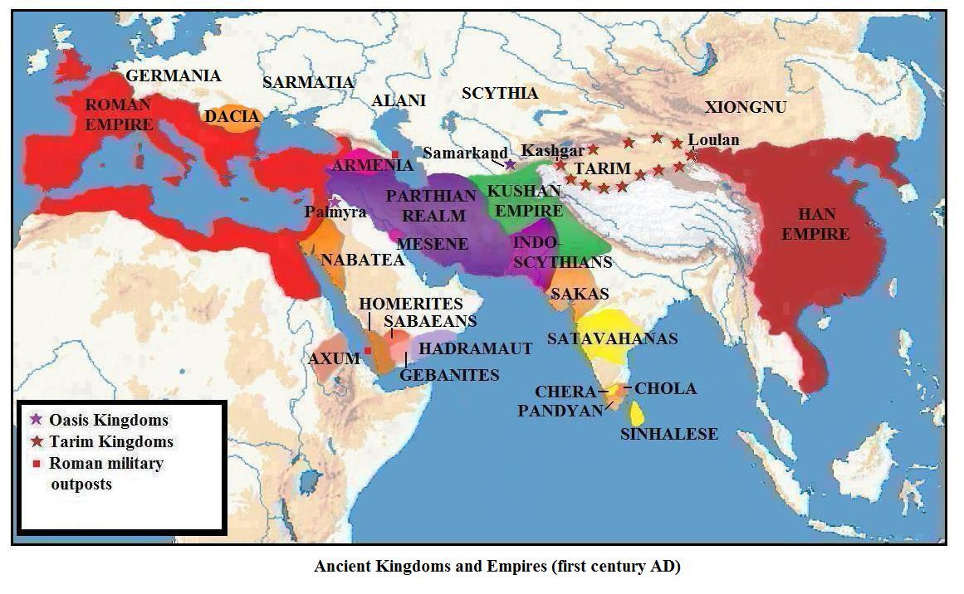
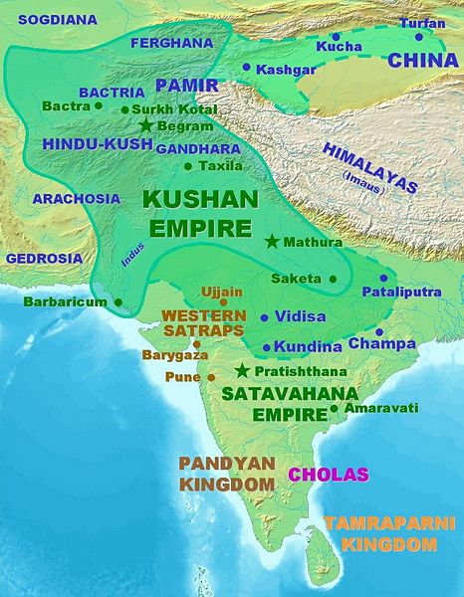

Slide 39
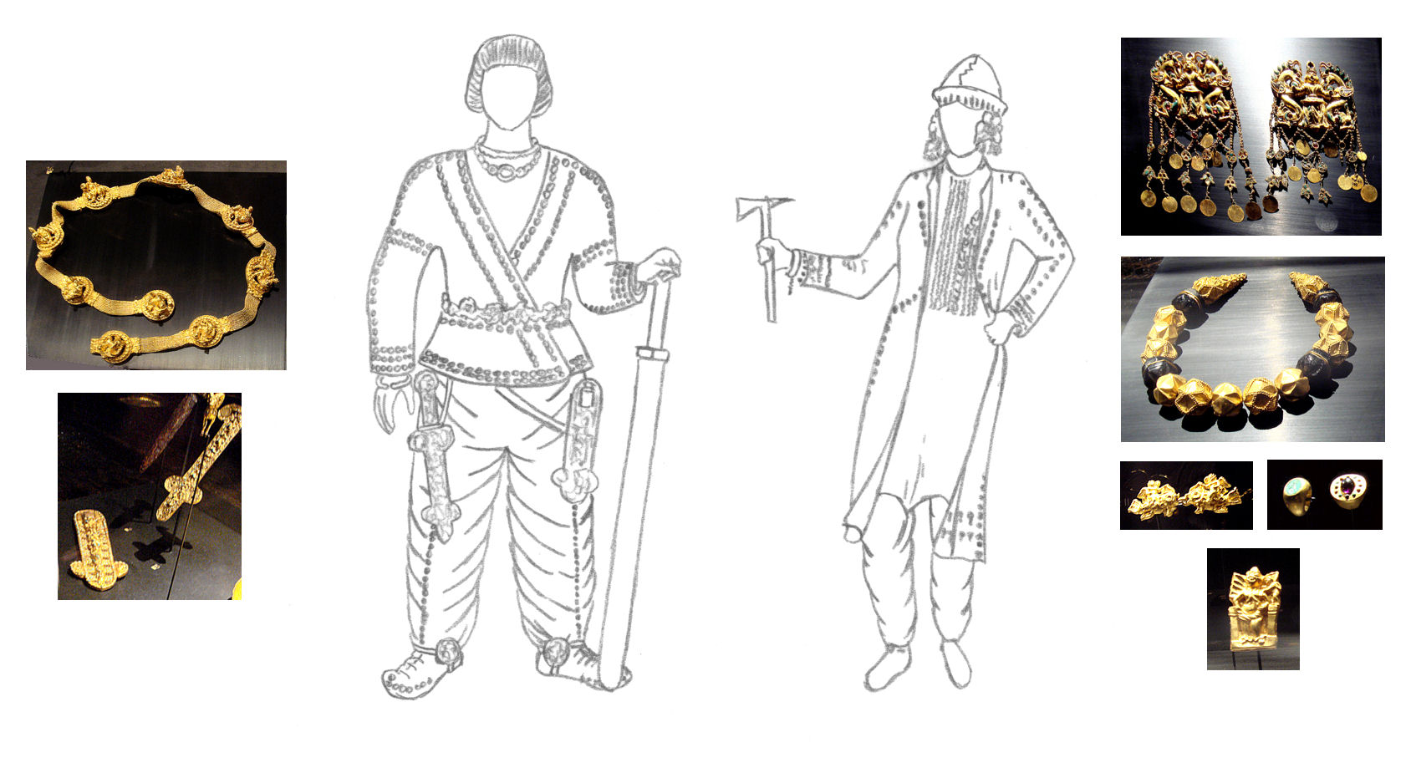
Wealth and Cultural Diversity of this region
The Tillya Tepe Burials:
A collection of about 22,000 ornaments, coins and other kinds of artifacts, made of gold, silver, ivory, that were found in six burial mounds (five women and one man) with extremely rich jewellery, dated to around the 1st century BCE (and up to maximum 1st century CE – so period of Greco-Bactrian/Parthian/Saka/Nomad/Kushan transition). Also examples of Chinese and Indian bronze mirrors.
Hidden by last communist government of Afghanistan in 1989 in a vault deep under central bank in Kabul and keys distributed to 5 people (names unknown). Only reopened after 2003.

Slide 40
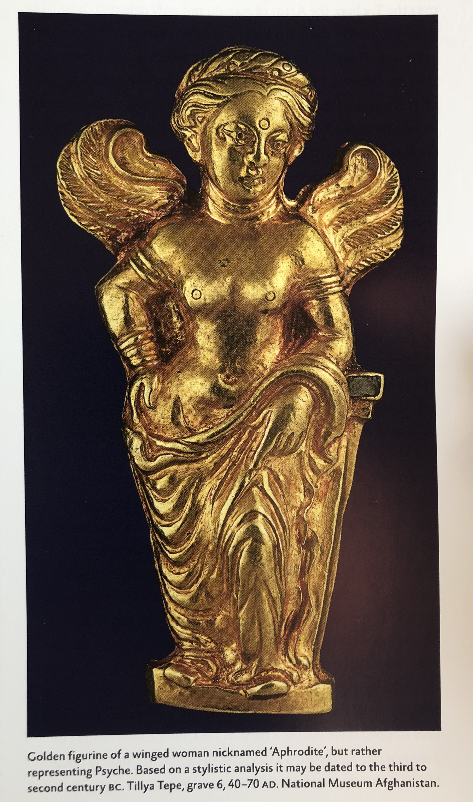
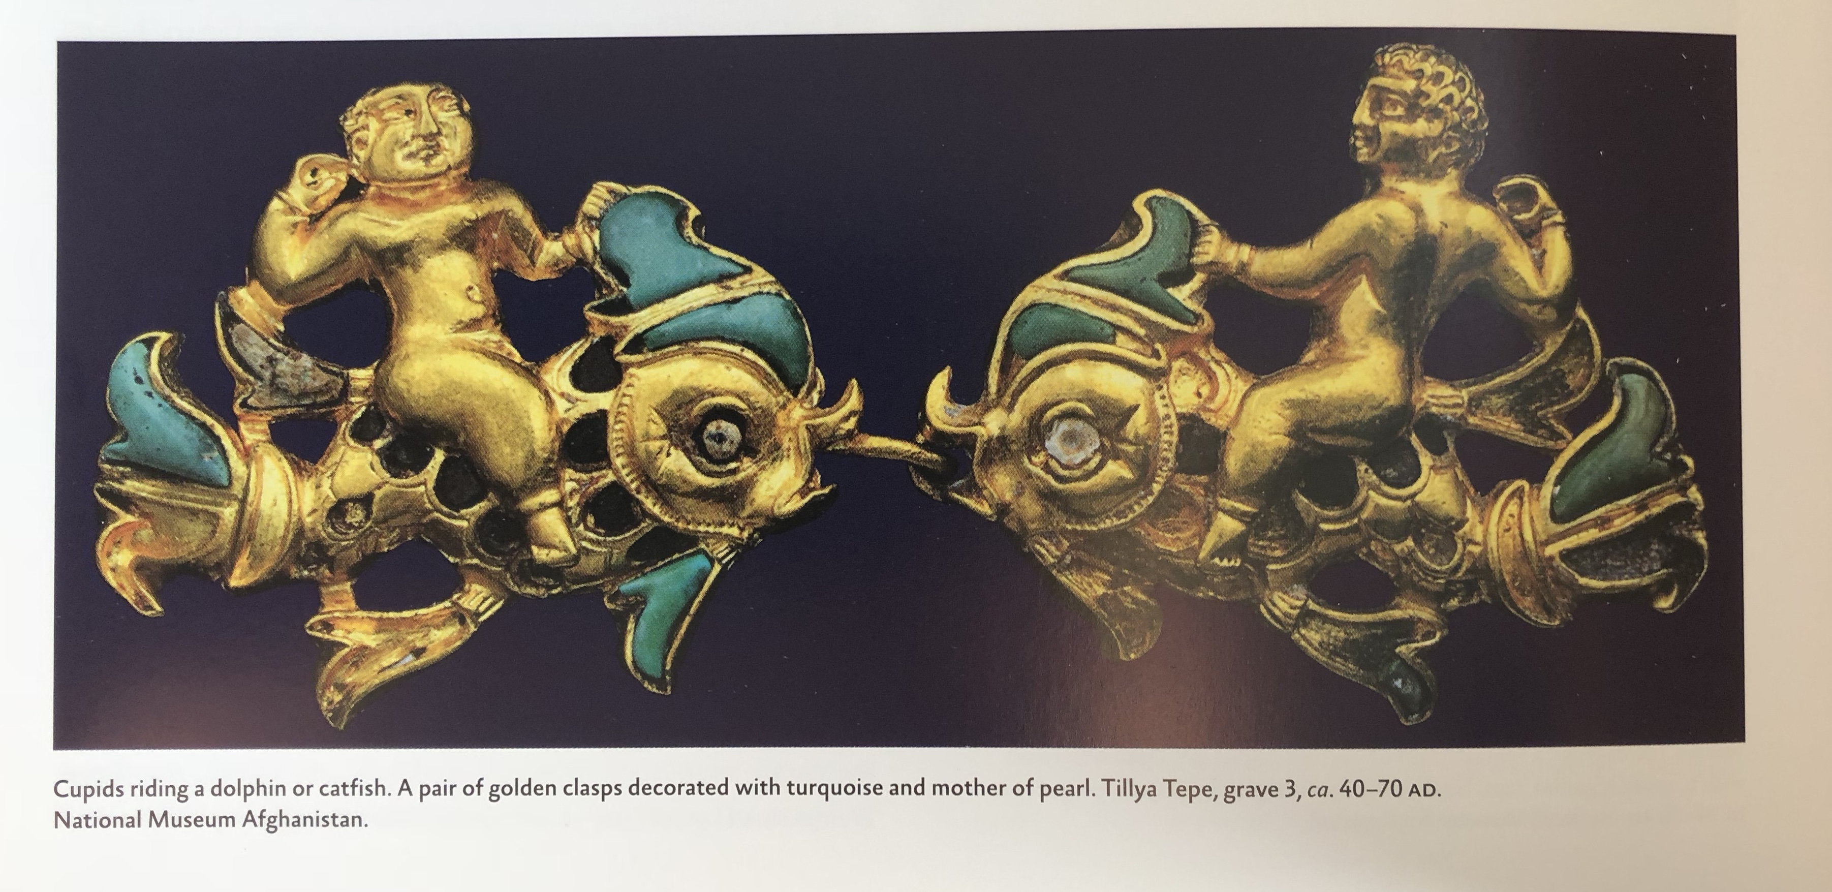

Slide 41
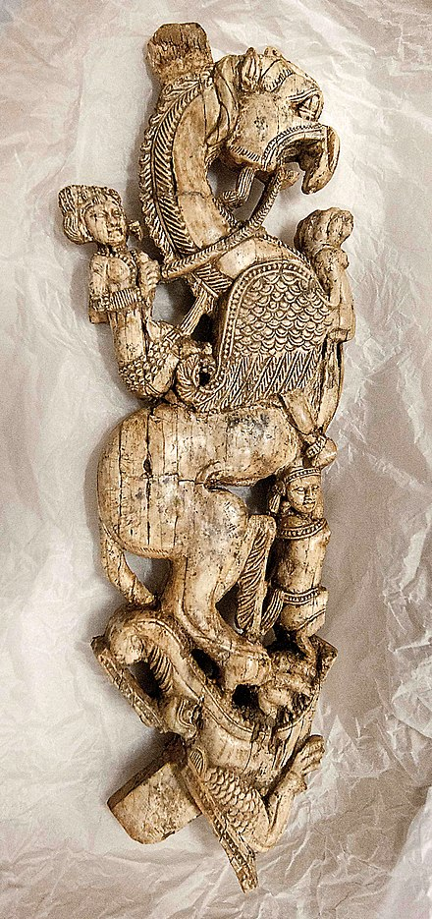
Wealth and Cultural Diversity of Kushans
Begram Hoard (from ancient city of Kapisa – summer capital of Kushan empire). Discovered late 1930s:
Large number of bronze, alabaster, glass and ivory objects, Chinese lacquer bowls, coins, remains of furniture.
Ivories offer example of intricate carving showing subjects of lions, elephants, birds, flowers, female nudes, musicians, dancers, personal ornaments, and architectural backdrops. Dated to 1st-2nd c CE.

Slide 42
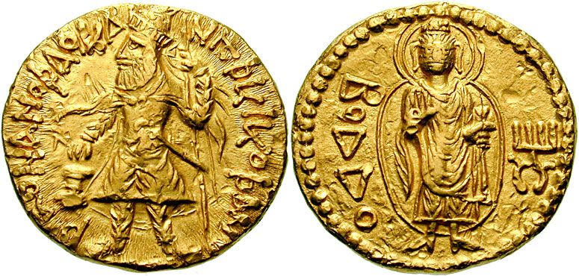
Kushan Coins
The coin designs usually broadly follow the styles of the preceding Greco-Bactrians rulers in using Hellenistic styles of images with a deity on one side and the king on the other
The Kushan religious pantheon is extremely varied, as revealed by their coins and their seals, on which more than 30 different gods appear, belonging to the Hellenistic, the Iranian, and to a lesser extent the Indian world.
Coin of Kanishka I (127-150 CE) with depiction of Buddha on reverse (with ‘Boddo’ in Greek script)

Slide 44
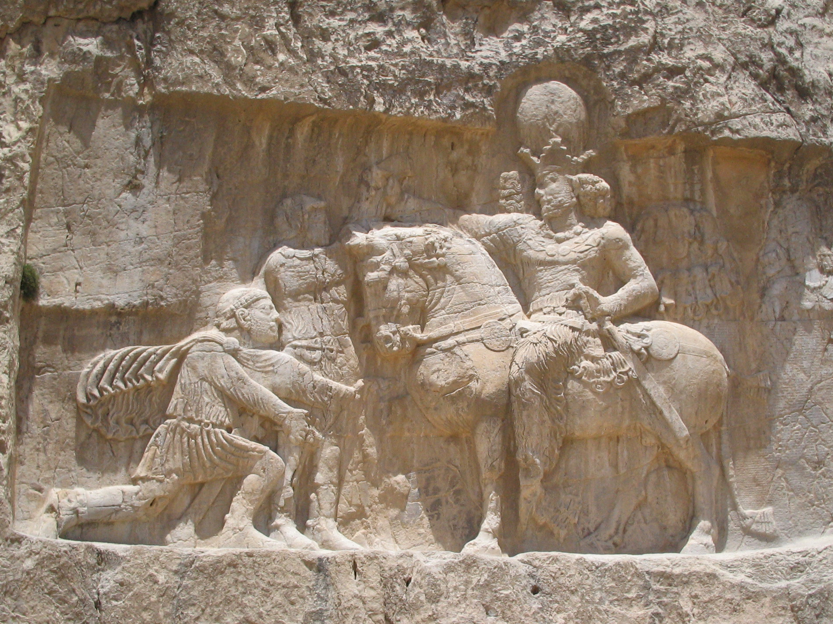
The Parthians and Kushans give way to the Sassanids
Sassanids rule from 224 to 641 CE
Ardashir I defeated and killed Parthian rule in battle and proceeded to annex the now defunct Parthian empire.Crowned in Ctesiphon in 224 as ‘King of Kings’
His son, Shapur I expanded the empire to take over the Kushan empire, as well as successfully annex territory from Roman empire (and even take Roman Emperor Valerian prisoner).
Over next century, war with Romans ensured western border constantly moving, and nomadic invasions also continued to plague Eastern border.
Rock-face relief at Naqsh-e Rustam of Shapur I (on horseback) capturing Roman emperor Valerian (standing) and Philip the Arab (kneeling) suing for peace, following Sassanid victory at Edessa

Slide 45
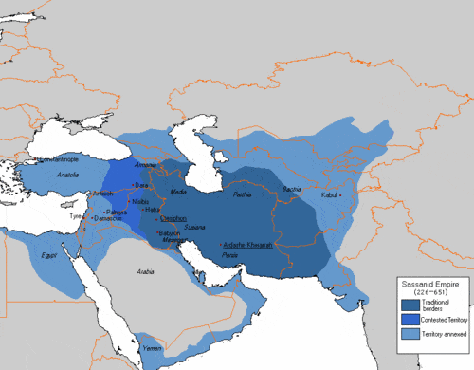

Slide 46
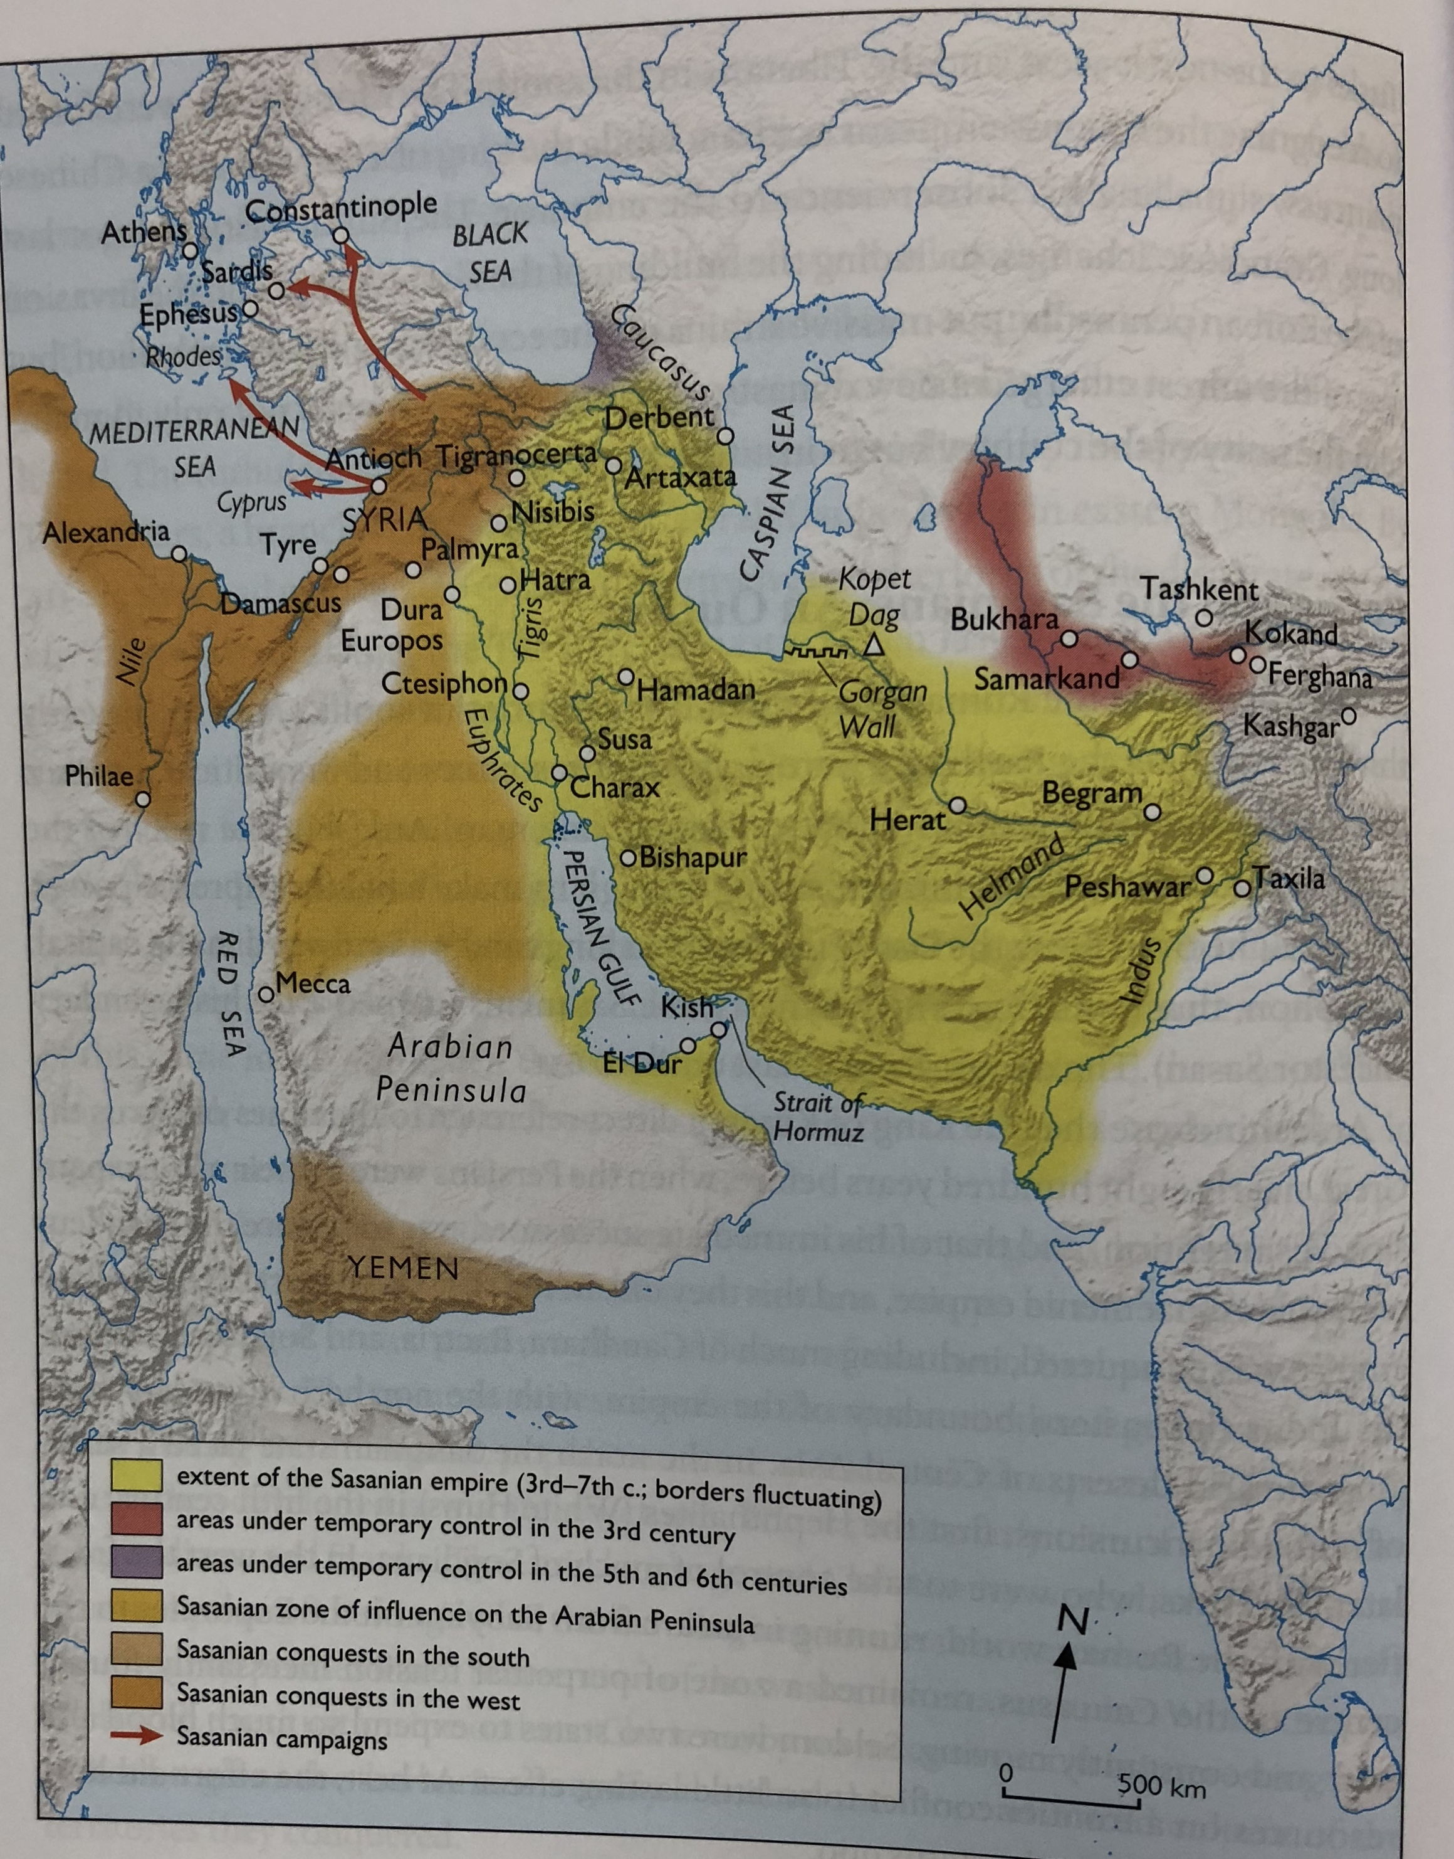

Slide 48
Bibliography
B. Cunliffe By Steppe, Desert and Ocean: The Birth of Eurasia 2015
P. Edwell Between Rome and Persia 2008
C. Baumer The History of Central Asia (Volumes 1 and 2) 2012
R. McLaughlin The Roman Empire and the Silk Routes: the ancient world economy and the empires of Parthia, Central Asia and Han China 2016
C. Benjamin Empires of Ancient Eurasia The First Silk Roads Era 100 BCE-250 CE 2018
N. Di Cosmo and M. Maas (eds) Empires and Exchanges in Eurasian Late Antiquity: Rome, China, Iran and the Steppe c. 250-750 2018
J. Grainger Rome, Parthia and India: The Violent Emergence of a New World Order 150-140 BCE 2013
J. Boardman The Greeks in Asia 2015

