Slide 1
Vedic Religion
Becky ROLFE, TUNRAYO OLAOSHUN, SOPHIA AKHTAR, ZOE BAKER

Slide 2
Periodisation
Prevedic religions (pre-history and Indus Valley Civilisation; until c. 1500 BCE)
Vedic period (c. 1500–500 BCE)
"Second Urbanisation" (c. 500–200 BCE)
Classical Hinduism (c. 200 BCE-1100 CE)
Pre-classical Hinduism (c. 200 BCE-300 CE)
"Golden Age" (Gupta Empire) (c. 320–650 CE)
Late-Classical Hinduism – Puranic Hinduism (c. 650–1100 CE)
Islam and sects of Hinduism (c. 1200–1700 CE)
Modern Hinduism (from c. 1800).
James Mill (1773-1836)
The History of British India
→ Hindu, Muslim, British
A Michaels (2004) Hinduism. Past and present (Princeton, NJ: Princeton University Press)
→ Complex, more elaborate

Slide 3
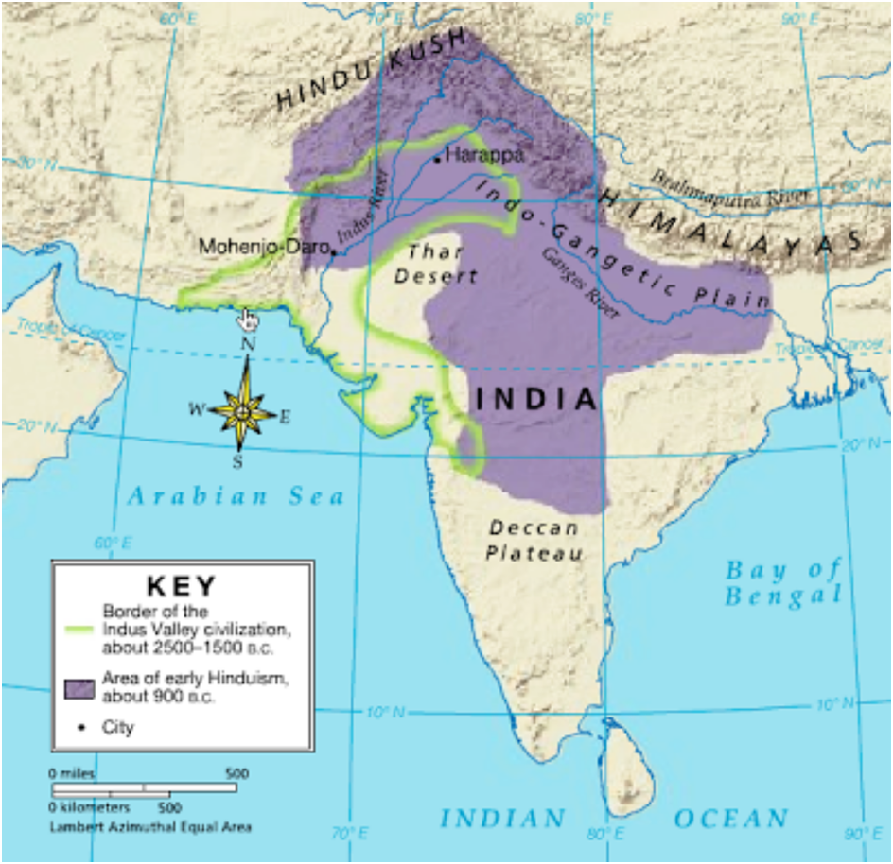
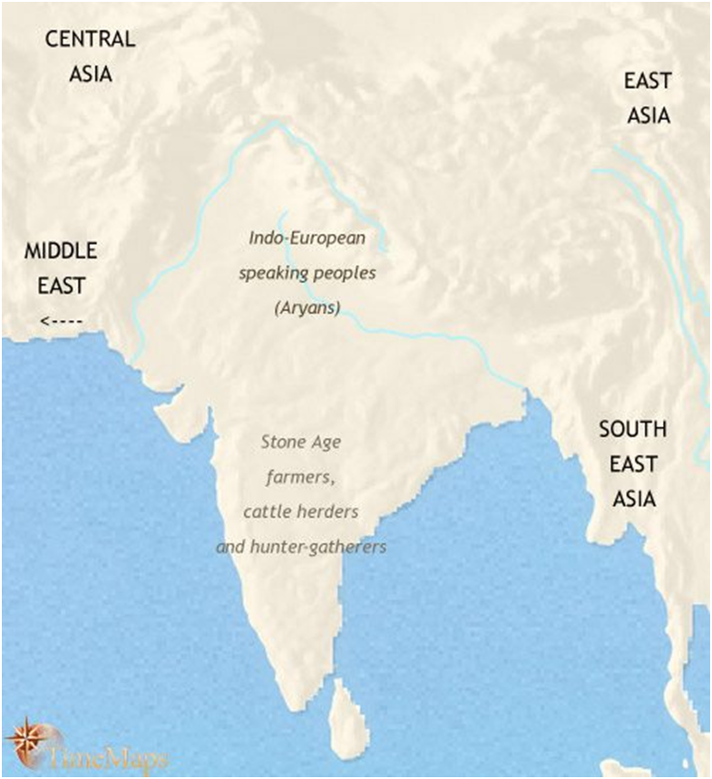

Slide 4
Languages and Texts: S. W. Jamison and M. Witzel (1992) “Vedic Hinduism”
Branch of the Indo-European language family
“earliest period of Indian history for which we have direct textual evidence” – p2
Dating still remains problematic
Almost all evidence is textual
Transmission → priestly schools (or śåkhås)
Oral
Knowledge of religion is entirely verbal

Slide 5
The Vedic Pantheon
“It is probably not an accident that ancient India does not have a “pantheon” in the sense of ancient Greece, for example” (Jamison, 2016).
Most of the information we have about the Vedic gods comes from the Rigvada, which contains hymns to the various deities.
Many of the gods are personifications, and often relate to rituals, for example the ritual fire (Agni) or ritual food (Soma).

Slide 6
The Vedic Pantheon
Agni- god of deified Fire, especially ritual Fire.
Indra- a powerful warrior god.
Soma- the deified soma drink, as well as the plant from which it is derived.
The Ādityas or "Sons of Aditi”- a group of divinities with some core gods: Varua, a king-figure; Mitra, Varua's constant partner; Aryaman, often accompanies them, a more shadowy figure than Mitra and Varu a, though frequently joined with them, as well as Bhaga who is fairly vague but seems to have brought good luck.
The Aśvins- divine twins.
Pū an- a "pastoral" god, nonetheless protects and makes thrive many aspects of daily life.
Usas- personification of ‘Dawn' and the most prominent goddess.
Other deified personifications include: Sūrya ‘Sun', Dyaus 'Heaven, Sky’, Pthivī 'Earth', who was a mother goddess, the Āpas 'Waters', who were a group of goddesses, Våyu or Våta 'Wind'; and Parjanya ‘Thunder’.
There is a division between the Devas and the Asuras, which Kuiper (1975) says is “the central problem of Vedic religion.”

Slide 7
The Rig Veda – an introduction…
The oldest Vedic text in possession.
A collection of 1000+ hymns. Use in rituals.
1200 BCE?
Does not contain any raw political and economic records (e.g. chronicles, nor any lists of kings or priests) (Raaflaub, K.A. ‘Vedic India: Thinking and Doing,’ The Adventures of the Human Intellect, 2016, p. 186)
Proof of “beginnings of speculative thought in India” (Brown, W.N. ‘Theories of Creation in the Rig Veda’ 1965, p. 23)

Slide 8
Some thoughts and themes
The supremacy and role of Heaven / the sky god.
The celestial riddle mill (1: 164.2, 13), and general celestial directions in the text – the wheel as a symbol of the cyclical nature of the seasons and the wandering nature of the seven celestial bodies. (Merker, B. 1988. ‘Rig Veda Riddles in Nomad Perspective’ p. 39)
Projects questions, making the reader think, rather than be provided with the answers for the origins of the world’s forces. → “The texts posits human thought as the creative force in the world, and also centres mental speculation, the creation of alternative cosmic models, as one of the chief enterprises of thought.” (Raaflaub 2016 188)

Slide 9
Vedic Ritual
Ritual is intrinsic to the practice of vedic religion
The vedic word for ritual is Yaj
Person who carries out the ritual is the yajamāna
The Rig Veda that gives us information on ritual is the Yajurveda
Soma or agni rituals

Slide 10
Soma ritual: the Somayajña
The Rigveda (8.48.3) says:
We have drunk soma and become immortal; we have attained the light, the Gods discovered.
Now what may foeman's malice do to harm us? What, O Immortal, mortal man's deception?
(Ralph T.H. Griffith translation)

Slide 11
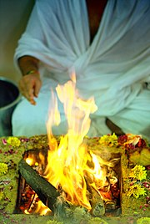
The set up
The yajamāna is generally a king
The holy place is a vedi
An Agni ritual

