Slide 1
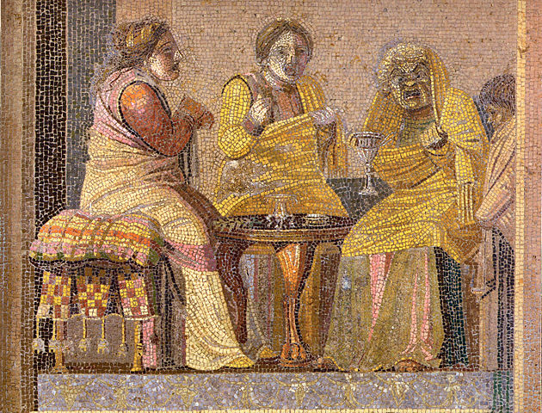
Witches, rage and garlic breath: Horace Epodes 3
The Vulnerable Body in Roman Literature and Thought:
Taster lecture

Slide 2
Set texts
In translation
Ovid, Amores 1.1, 1.2, 1.3, 1.5, 2.7, 2.8, 3.7
Horace Epodes
Phaedrus Fables
Horace Satires Book 1
Persius Satires
Seneca Letters 1-12, 24, 30, 47.
Seneca Thyestes
Statius Achilleid
In Latin for Q800 / Classics & English students:
Ovid Amores 2.7, 3.7
Horace Epodes ﻿8 and 12
Horace Satires 1.4.1-85
Phaedrus, Fabulae 2.5, 3.Prol., App.10
Statius Achilleid 1.126-877
Seneca Letters 12, 24
Seneca Thyestes 690-1112

Slide 3

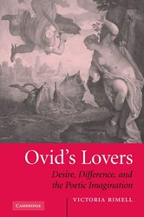
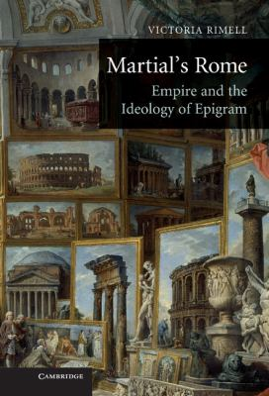


The fragility of ‘Rome’

Slide 4
Thinking the ancient through the modern
Imposter syndrome
Sexual violence
Disability studies
‘The snowflake’
Vulnerable adolescence
The challenge of ageing
Performing masculinity
Positive vulnerability?
Marginal groups

Slide 5
Biography: Quintus Horatius Flaccus (65-8BC)
Son of a freedman, but born free (Sat.1.6.8).
Despite being educated in Rome (Sat.1.6.76-80), and in Athens (Epist.2.2.45), Horace says he turned to verse because of poverty (Epist.2.2.51-2).
In 44BCE, Horace joined the Republican cause (under M.Brutus), and in 42, fought on the losing side in the battle at Philippi.
Horace’s first work, the Epodes, was composed c.42-30BC, during Rome’s bloody transition from Republic to autocracy. 7 and 16 express horror at the renewal of civil war.
Success was secured early on with the patronage of the wealthy Maecenas, who at some point gifted him an estate in the Sabine hills (Sat.2.6.1-5, Epist.1.14.2-3). The Epodes are dedicated to Maecenas. Horace was also friends with Virgil and Varus, and was invited to become Augustus’ personal secretary (he declined).
Horace was an equestrian in status, and could have risen to senatorial rank.

Slide 6
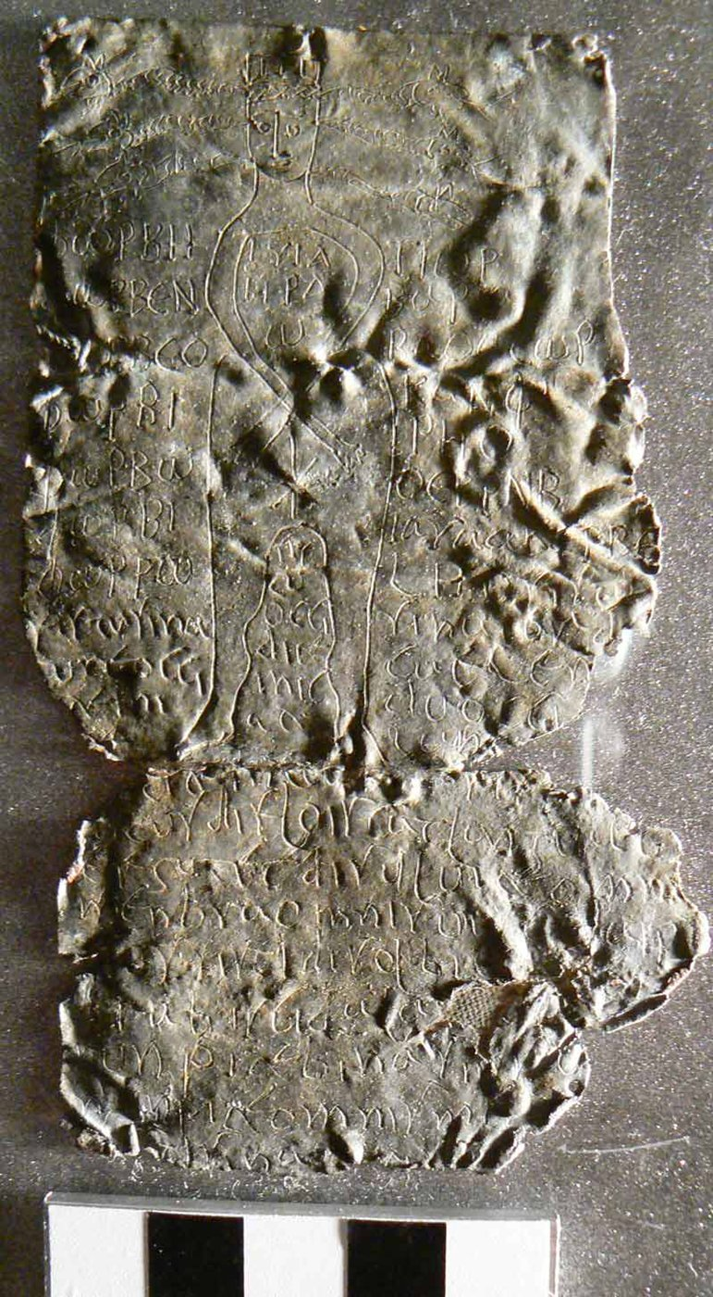
Epode = epodos, -i (m), Greek epōidos / epōide
‘sung over/after’, or song as spell, charm,
incantation

Slide 7

Quintus Horatius Flaccus, son of a libertus
Epode 15.11-15: ‘if there is any manliness in “Floppy” ’
Flaccus = flabby, feeble, flaccid

Slide 8
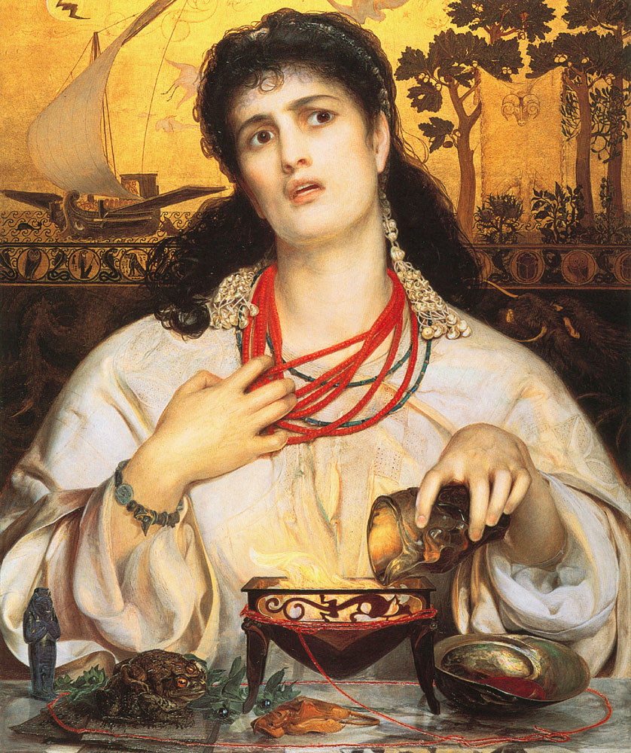
Epode 3: garlicky powerplay

Slide 9
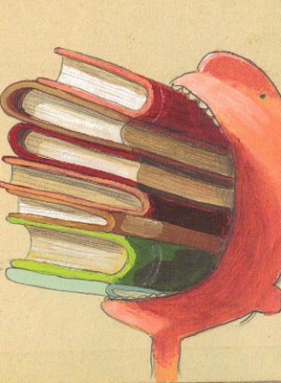
Poetry as food/flavours
sal = salt, wit
satura = satire (lit: overflowing dish, mixed platter)
asper = pungent
acer = acrid or bitter

