Slide 1
Vulnerable Body 4
Discordia and powerlessness: Horace’s penetrating Epodes (I)

Slide 2
Flaccus, son of a libertus
Epode 15.11-15
O Neaera, you’re destined to grieve long for my virtues! For if Flaccus is some sort of man (nam si quid in Flacco viri est). He’ll not allow you to spend every night with another - angered he’ll seek a truer mate. Nor will his lasting injury be assuaged by your sweet charms, Once true sorrow has entered him (si certus intrarit dolor).

Slide 3
Satire 1.6.65-77
‘And yet, if the flaws that mar my otherwise sound nature are small and few in number, even as you might find fault with moles spotted over an otherwise attractive person; if no one will justly accuse me of greed or meanness or lewdness; if, to venture on self-praise, my life is free from stain and guilt and I am loved by my friends – I owe all this to my father, who, though poor with a tiny farm, would not send me to the school of Flavius, which great boys used to go to, the sons of great centurions, with slate and satchel slung over the left arm. No, he boldly took off his boy to Rome, to be taught those studies that any knight or senator would have his own offspring taught.’

Slide 4
Epistles 1.20: the slave-like book
You grieve at private viewings, praise public life,
Though I didn’t rear you so. Off, where you itch to go!
Once out, there’s no recall. ‘Ah, what have I done?
What did I hope?’ you’ll say, when someone hurts you,
When you’re rolled up small, your sated lover weary.
But unless the augur, hating your errors, has lost all sense,
You’ll be dear to Rome till your youth deserts you:
Then when you’ve been well-thumbed by vulgar hands,
And start to grow soiled, you’ll be silent food for worms….
….
This fate, too awaits you, that stammering age will come upon
You as you teach boys their ABC in the city’s suburbs…

Slide 5
…(19-28)
When a warmer sun attracts a few more listeners,
You’ll tell them I was a freedman’s son, that, of slender
Means, I spread wings that were too large for my nest,
And though my birth lessens them, you’ll add to my merits:
Say, in war and peace, I found favour with our leaders,
Was slight of frame, grey too early, fond of the sun,
Quick-tempered, yet one who was easy to placate.
If anyone happens to ask about my age,
Tell him I completed my forty-fourth December,
When Lollius. as consul, was joined by Lepidus.

Slide 6
The Epodes: bitter influences
Epistles 1.19.23-5:
I was the first to introduce Parian iambics to Latium, adopting the rhythms and the spirit of Archilochus, but not his subject-matter and the words that hounded Lycambes. (23–5).
Compare Odes 1.16.22-6:
Restrain your spirit! Me too in youth’s sweet day eager passion tempted, and drove in madness to impetuous verse! Now I would change those bitter lines for sweet…

Slide 7
Epode 6.11-16
Take care, take care: I lower my fierce horns eagerly
Against the doers of evil,
Like false Lycambes’ slighted son-in-law, or
Bupalus’ bitter enemy.
Do you think if a venomous tooth attacks me
I’ll cry, un-avenged, like a child?

Slide 8
The hard-soft iambic voice
As befits ‘not soft men’ (non molles viros, Epod.1.10)
Epod.6.15-16: ‘Or if any one with venomous tooth should attack me, shall I forgo revenge and whimper like a child (puer)?’ Watson 2003 ad loc.: ‘puer suffices on its own to convey the notion of helplessness in the face of aggression.’
Epod.8: an old woman he is sleeping with asks him why he has become impotent (vires quid enervet meas)
Epod.11.4: burning with lust for ‘soft boys and girls’ (mollibus pueris aut puellis)
12.15-16: your ‘soft performance’ (mollis opus)
14.1: Why your ‘soft indolence’? (mollis inertia)
16.37-8: Let the soft and hopeless lie down on doomed couches! (mollis et expes / inominata perprimat cubilia!)
In 17 he is under a woman’s power once more…(Canidia)

Slide 9
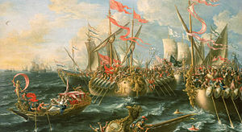
Epode 1: hearts and minds
‘Battle of Actium’ Lorenzo A. Castro, 1672

Slide 10
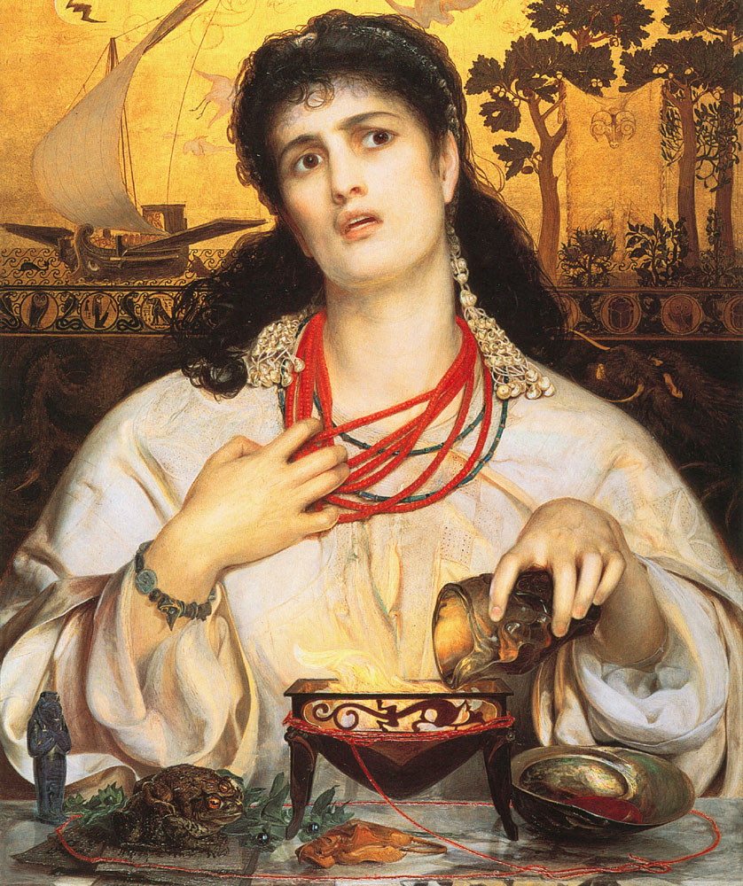
Epode 3: garlicky powerplay

