Slide 1
Vulnerable Body 5
Discordia and powerlessness: Horace’s penetrating Epodes (II)

Slide 2
The Epodes: Themes so far
Horace not an objective, distanced commentator on current events, but a compromised, traumatised participant.
The poet veers between male self-mastery/effeminate subjection.
Abuse poetry seems to both respond to that ‘victim status’ and perpetuate it, while of course trying to make victims of others
Horace makes the genre/form of iambic poetry inseparable from his own precarity as son of a freedman who was on the losing side in the civil wars.
BODILY vulnerability is an ongoing theme: bodily weakness translates into and comes to stand for all kinds of other vulnerabilities.

Slide 3
Canidia: witches and hags
Etymologies/connected words: canities (white or grey hair, old age), canere (to sing), caninus (dog-like, snarling, biting), canis (dog).
Epodes 5, 17; Satires 1.8 (plus Epodes 3, 6, 8, 12, Sat.2.1, 2.8). Notice Canidia’s role at the end of the both the Epodes and the Satires.
Compare the biting, vengeful iambic poet at Epodes 6 (atro dente, 6.15; dens ater, 8.3)

Slide 4
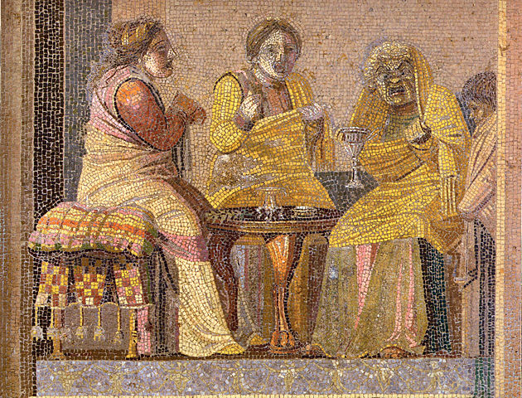
Villa del Cicerone, Pompeii

Slide 5
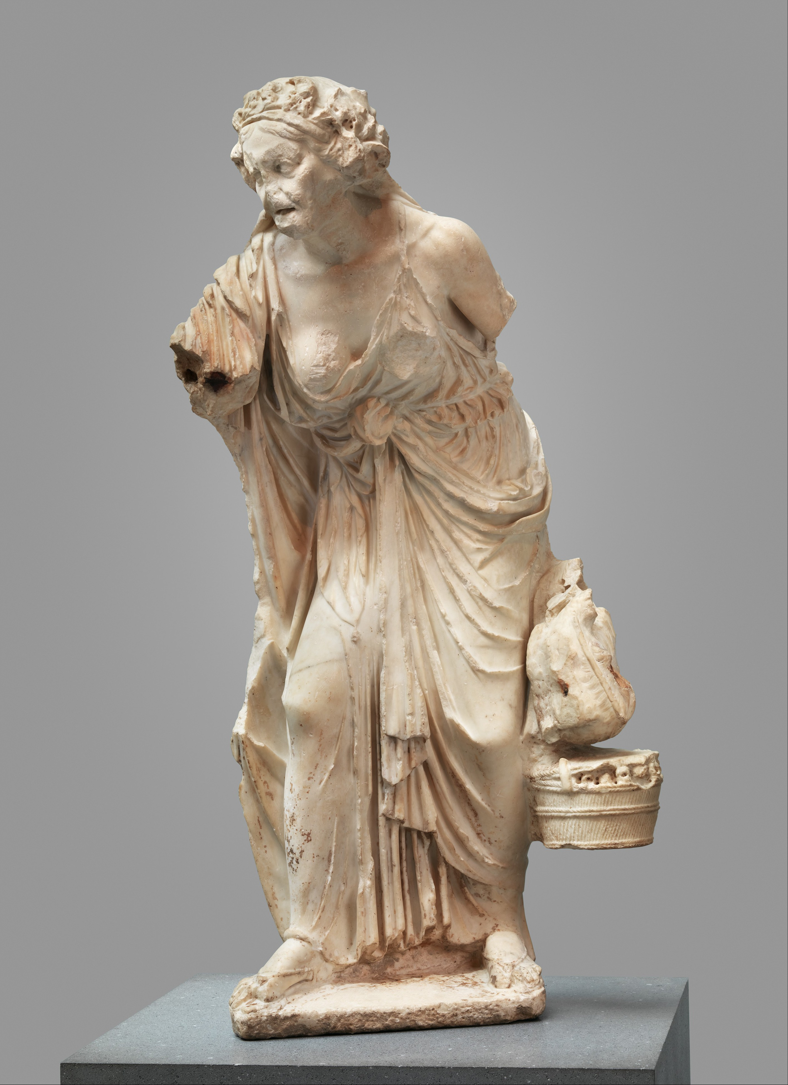

Slide 6
Epode 8
How do lines 2-14 of Epode 8 shape and constitute the old woman’s body?
In the battle for rhetorical/oral supremacy, who wins?

Slide 7
Epode 12
Compare and contrast Epode 12 with Epode 8.
Watson p386: ‘It is evident that the primary function of such beast-analogies, when applied to sexually active women, is not, as Richlin has claimed, to dehumanize their subject, but rather to intimate that female lust is animal-like in character: that is to say, dangerous, intemperate and insensate…’ Do you agree?
What is the effect of the poet-lover being compared to an animal (lamb, deer) in the final lines of Epode 12?

