Slide 1
Vulnerable Body 6
Satire’s bodies:
Horace’s ‘pedestrian muse’

Slide 2
Satire: satura – satur – satis.
satura quidem tota nostra est
‘satire, indeed, is all ours’
Quintilian 10.1.49

Slide 3
Sermo (‘conversation’)
Sat.1.4.40ff:
First I will take my own name from the list of such as I would allow to be poets. For you would not call it enough to round off a verse, nor would you count anyone a poet who writes, as I do, lines more akin to prose (sermoni propriora).’

Slide 4
Epist.2.1.250-57
‘As for me, I should not prefer my “chats” (sermones) that crawl along the ground (repentis per humum) to the story of great exploits (res gestas), the tale of distant lands and rivers, of forts on mountain tops, of barbaric realms, of the ending of wars under your auspices throughout the world, of bars that close on Janus, guardian of peace, and of that Rome who under your sway has become a terror to the Parthians – if only I had power equal to my longing.’

Slide 5
Satire in Latin, thus far
ENNIUS (239-169BCE)
PACUVIUS (220-130BCE)
VARRO (i.e. Marcus Terentius, 116-27BCE)
VARRO OF ATAX (82-35BCE)
LUCILIUS: active btw 130-103BC

Slide 6
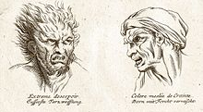
Grotesque bodies: moral as physical flaws

Slide 7
Harsh medicine
Sat.1.10.3-4 (Lucilius rubbed down the city molto sale – with much [abrasive, salt-scrub] wit)
Ennius Saturae 6-7V:
‘Greetings, poet Ennius, you who offer to mortals draughts of verse burning deep in the marrow’.

Slide 8
Writing the (satirist’s) body
Sat.1.6.64: vita ac pectore puro (with a pure life and heart)
Sat.1.5.7-8: ‘Here, thanks to the water, which was disgusting, I declare war against my stomach, and wait impatiently while my companions dine.’
Sat.1.5.29-30: ‘Here I put black ointment on eyes, being lippus (sore or watery-eyed, suffering from conjunctivitis). Meanwhile Maecenas arrives and Fonteius Capito, a man without flaw, so that Antony has no closer friend.’

Slide 9
Sat.1.6.66-70: ‘And yet, if the flaws that mar my otherwise sound nature are small and few in number, even as you might find fault with moles spotted over a good-looking person ….I owe this to my father.

Slide 10
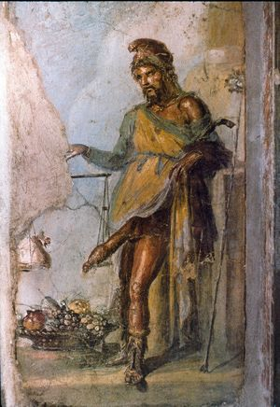
Satire 1.8: Priapus (House of the Vetii, Pompeii)

