Slide 1
Vulnerable Body 8
Phaedrus and the underdog

Slide 2
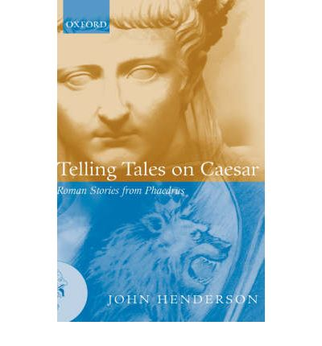
A poet on the margins

Slide 3
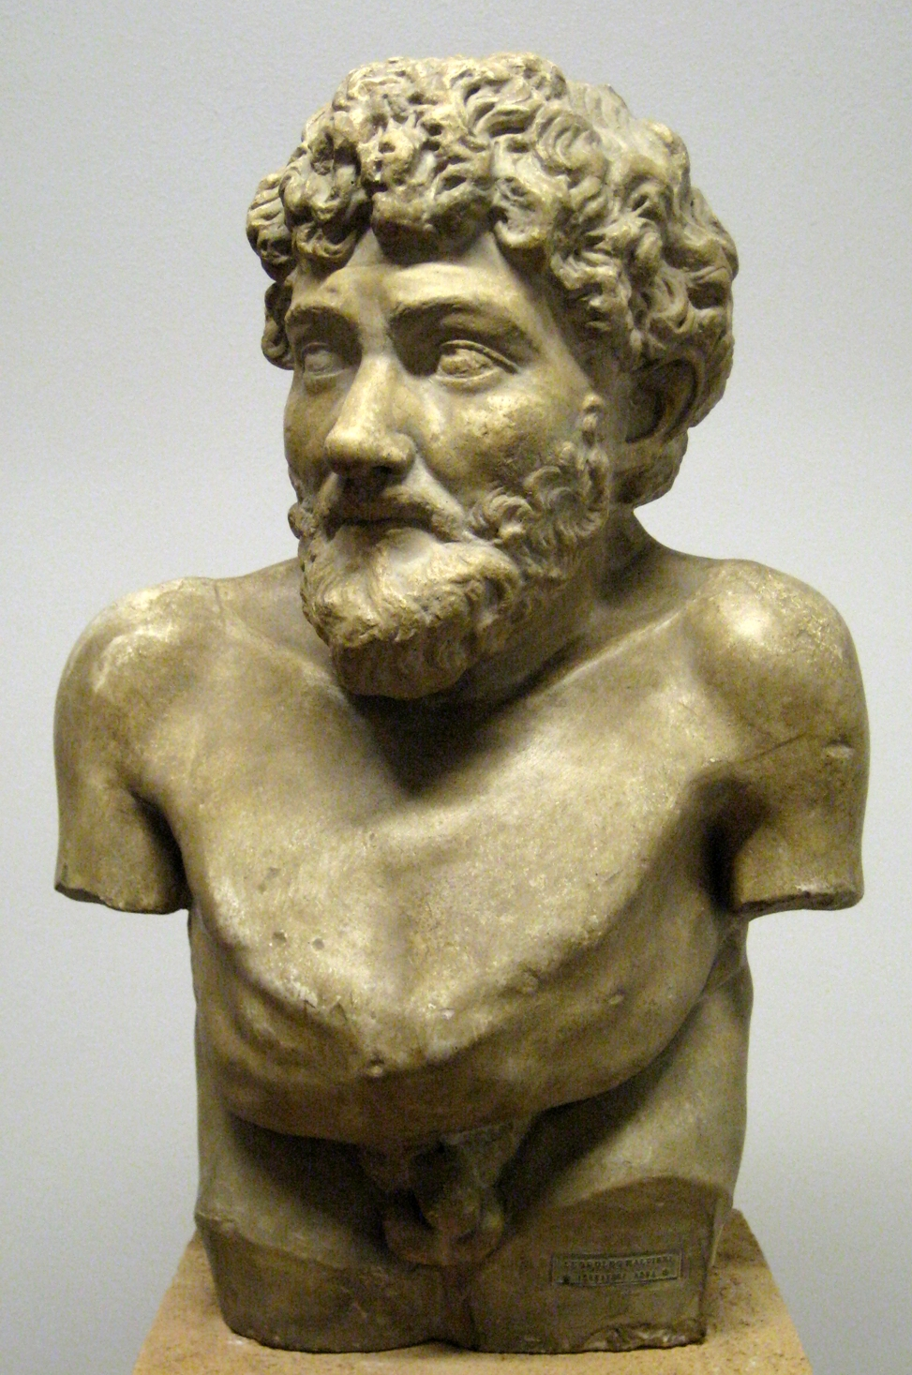
Aesop’s vulnerable body

Slide 4
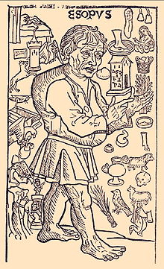

Slide 5
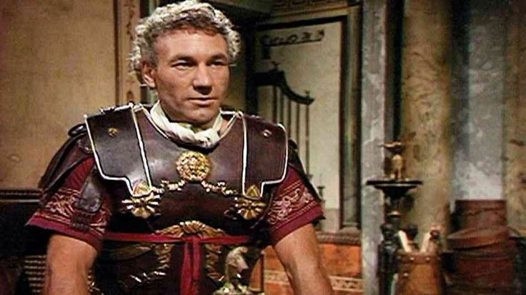
A victim of Sejanus?

Slide 6
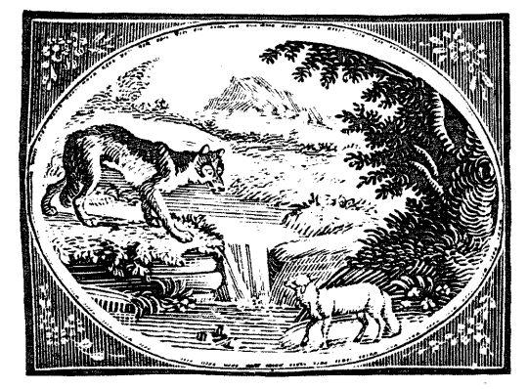
The wolf and the lamb, 1.1

Slide 7
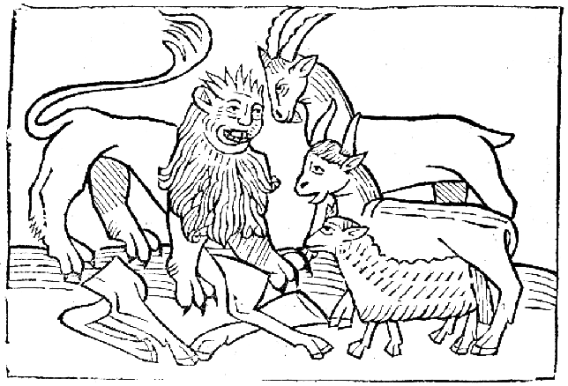
The cow, the goat, the sheep and the lion (1.5)

Slide 8
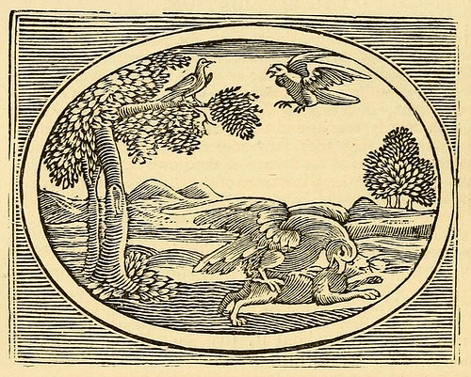
The sparrow and the hare (1.9)

Slide 9
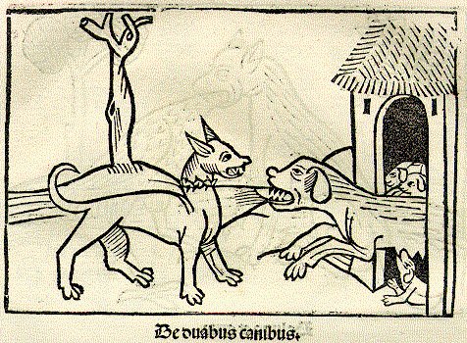
The dog and her puppies (1.19)

Slide 10
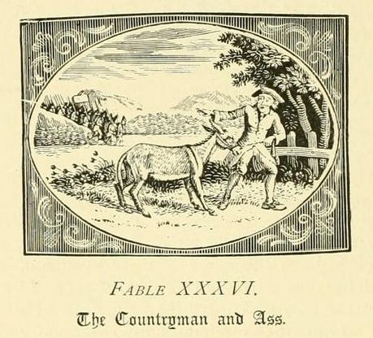
The ass and the shepherd (1.15)

Slide 11
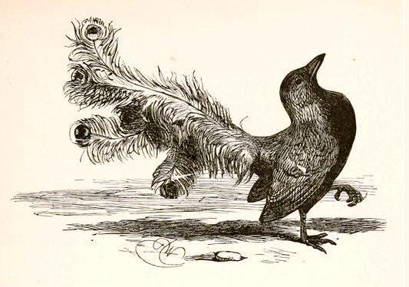
The jackdaw and the peacock (1.3)

Slide 12
The poet’s body
‘Slavery is to freedom as incontinence is to self-control and emotions are to bodily appetite; the slave is to the master as body is to mind, as woman is to man, as child to father.
W.Fitzgerald,
Slavery in the Roman Imagination

Slide 13
‘Bifocal hermeneutics’
As a freedman, Phaedrus can write ‘from below’
Yet as a man of letters, a poet of learning and sophistication, he can also speak from the opposite perspective, ‘from above’.

Slide 14
Key questions…
Is this really light reading, or is its lightness a veil for risky, subversive political commentary and performance?
To what extent are the fables performances of power? Can there be any real transfer of power to those who are genuinely vulnerable or socially marginalized?
What is the role of humour in all this? And how much power is the reader granted to ‘enable’ the voice of the slave, the freedman, or the person in the gutter, to rise up and sound out, authentically and authoritatively?

Slide 15
Do we get a brave new insight into imperial Roman culture through Phaedrus, or are these fables just tweaked versions of the same old stories?
Is being a slave, or slave-like, just a literary trope, shorthand for all things ‘Aesopic’?
And what would be the point of (an aristocratic?) Phaedrus experimenting in the poetry of the low, the ugly, the vulnerable and the powerless?

Slide 16
Can you think of a historical or contemporary example of an author or well-known figure who has either sought advantage from a pose of inferiority or vulnerability, or has been successful in turning actual social/bodily/economic vulnerability into a strength?

