Slide 1
The Vulnerable Body
Satire’s Bodies: Horace (II)

Slide 2
‘This satire itself requires the immoral body as the fons et origo of its own speech’
Gunderson ‘The libidinal rhetoric of satire’ in Freudenburg (ed.) The Cambridge Companion to Roman Satire, p227

Slide 3
Horace’s ‘split personality’
Decorous, pure, tight-lipped
yet also
dirty, unruly,
blemished,
myopic

Slide 4

The Veteran (sat.1.1.4-7)

Slide 5
Q: How does a notion of universal, undeniable vulnerability help Horace vaunt his status as a poet?

Slide 6
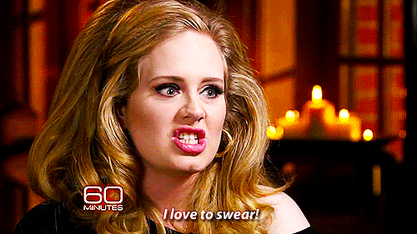
The filthy mouth (os impurum): can the son of a libertus get away with it better?

Slide 7
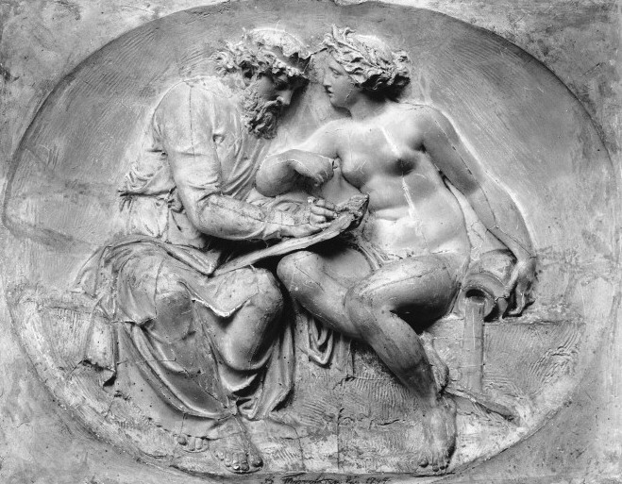
I’ll give her any name I choose. Pretentious, moi?

Slide 8
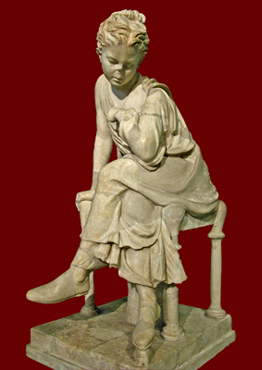
The vulnerable slave-girl, again

Slide 9
Satire 1.4, vv.105ff
How does Horace write a new genealogy for Roman verse satire here?

Slide 10
Satire 1.4
What counts is not social pedigree but rather ‘an aristocracy of virtue in which bodily correctness and the management of physical appetites go hand in hand with moral and intellectual training’
Thomas Habinek, ‘Satire as aristocratic play’ in Freudenburg ed.

