Slide 1
Vulnerable Body
Beyond tragic vulnerability: Seneca Thyestes (II)

Slide 2
Me (and) my body
‘It’s my body.’
‘My body belongs to me.’
‘I don’t like my body.’
‘Women should be allowed to decide what to do with their own bodies.’
‘I think my body is trying to tell me something.’
‘I’m in the wrong body.’

Slide 3
Atreus and Thyestes: a zero-sum game?
Absolute, invincible power - the most shameful vulnerability
Yet the problem of desire, and of uncertain paternity remains unresolved.
As long as women are living human beings, there is always a limit to patriarchal control of reproduction and of female desire.
Thyestes dramatises a series of displaced punishments culminating in non-revelation.

Slide 4
WOMAN
Terrible avenger
The origin of life
Creative genius
Passive earth
Shame

Slide 5

Eructat

Slide 6
'Going beyond the private excesses regularly attributed to Roman voluptuaries -at banquets characterised by the overflow of wine and bodily fluids- Antony's body erupts in public. We catch a glimpse here of the self-presentation expected of Rome's political leaders, who should feel ashamed even to belch in front of others. Antony is criticised both for his lack of self-control and for his promiscuous mingling with low persons in the pursuit of sensual gratification.'
C. Edwards (The Politics of Immorality in Ancient Rome, Cambridge, 1993, 192):

Slide 7
Pliny Panegyricus 49.6, 8:
‘As for the length of your banquets, polite manners prolong what frugality cut short. You do not arrive already gorged with a solitary feast before midday, to sit menacingly over your guests, watching and marking all they do, nor when they are fasting and hungry do you belch (eructans) from a full stomach and present or rather throw at them the food you disdain to touch, and after a pretence at enduring this insulting mockery of a banquet take yourself back to secret gluttony and private excesses…The emperor has rid his tables of the accessories of oriental superstition and the indecent antics of impudent fools; in their place is warm hospitality, love of culture, and civilized wit.’

Slide 8
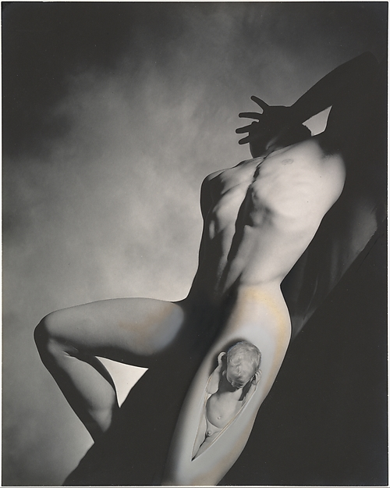
George Platt Lynes 1939 (The second birth of Dionysus), at The Met

Slide 9


