Slide 1
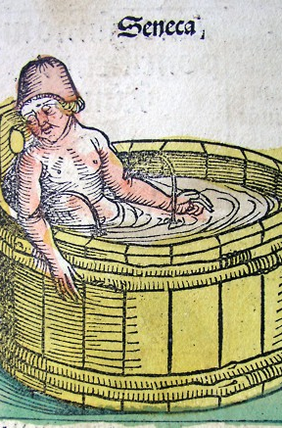
Learning how to die in Seneca’s Letters (II)
Vulnerable Body, term 2, week 8

Slide 2
Recap
Striving towards wisdom in Seneca’s Letters involves daily reckoning with the body, in its mortality and vulnerability.
As he puts it at Ep.92.1, the body is cherished out of regard for the soul (corpus in honorem animi coli).
Trying not to be enslaved to bodily pleasures, occasionally hating the body but having to deal with it, is not the same as being indifferent to the body.

Slide 3

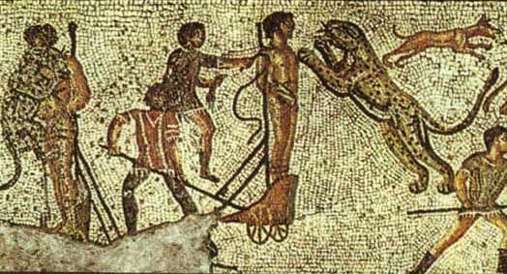
‘It is natural to be terrified by torture’ (Ep.14.6) *see handout 2

Slide 4
The master-slave conundrum (handout 1)
‘Yet slave-owning is by no means unproblematic even (or especially?) for the man who is truly free. ..In his treatise on the tranquillity of the mind, Seneca argues at length that to preserve mental equilibrium one should avoid attachment to earthly possessions. These include, of course, slaves…
Seneca confesses he cannot function without slaves: self-reliance is an impossible ideal.’
C.Edwards in Bartsch-Wray Seneca and the Self, pp155-6.

Slide 5
*Key idea*
There is an ongoing (energising) tension in Senecan thought between the drive towards male self-sufficiency and invulnerability, and the need to confront the reality of our physical and emotional vulnerability.

Slide 6

The Letters, time and embodiment
The exchange of informal, ‘daily’ letters with a close friend allows Seneca to focus on time, on being in time, and therefore on bodily and emotional experience.
In the early letters especially, he is interested in how we might build the resilience to deal with change over time, as embodied subjects.
*Look at handout 3

Slide 7

Engaging with scholarship on the Senecan self
Bartsch (‘Senecan metaphor and Stoic Self-instruction’ in Bartsch-Wray vol.):
Key point: now that bodily invulnerability is no longer sustainable in old age/under conditions of extreme political precarity, we must replace that ideal with the ideal of psychic impenetrability.
Compare Edwards’ article in same volume
e.g.p156, ‘For Seneca we can no more function without slaves than the mind can without the body’

Slide 8

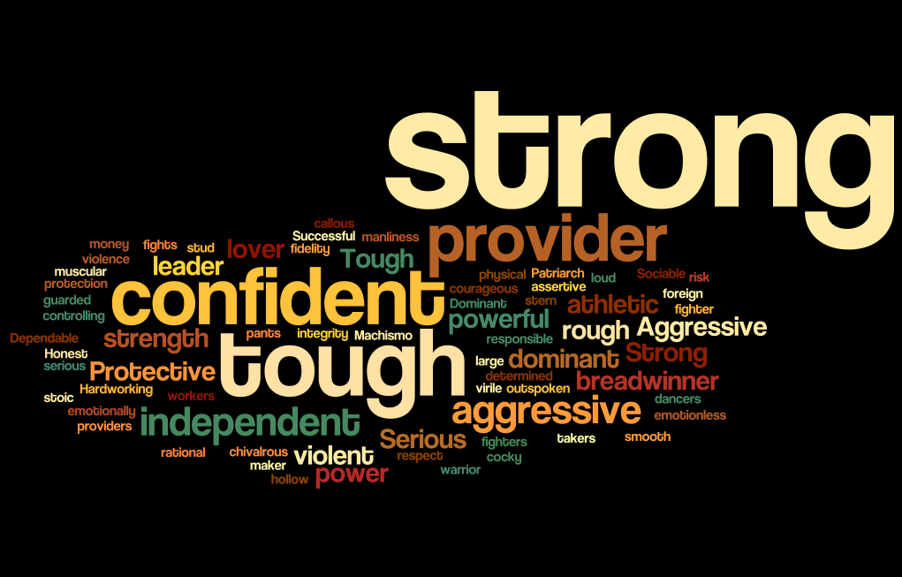
Do we come to Senecan Stoicism with our own preconceptions about a) Stoicism and b) masculinity?

Slide 9
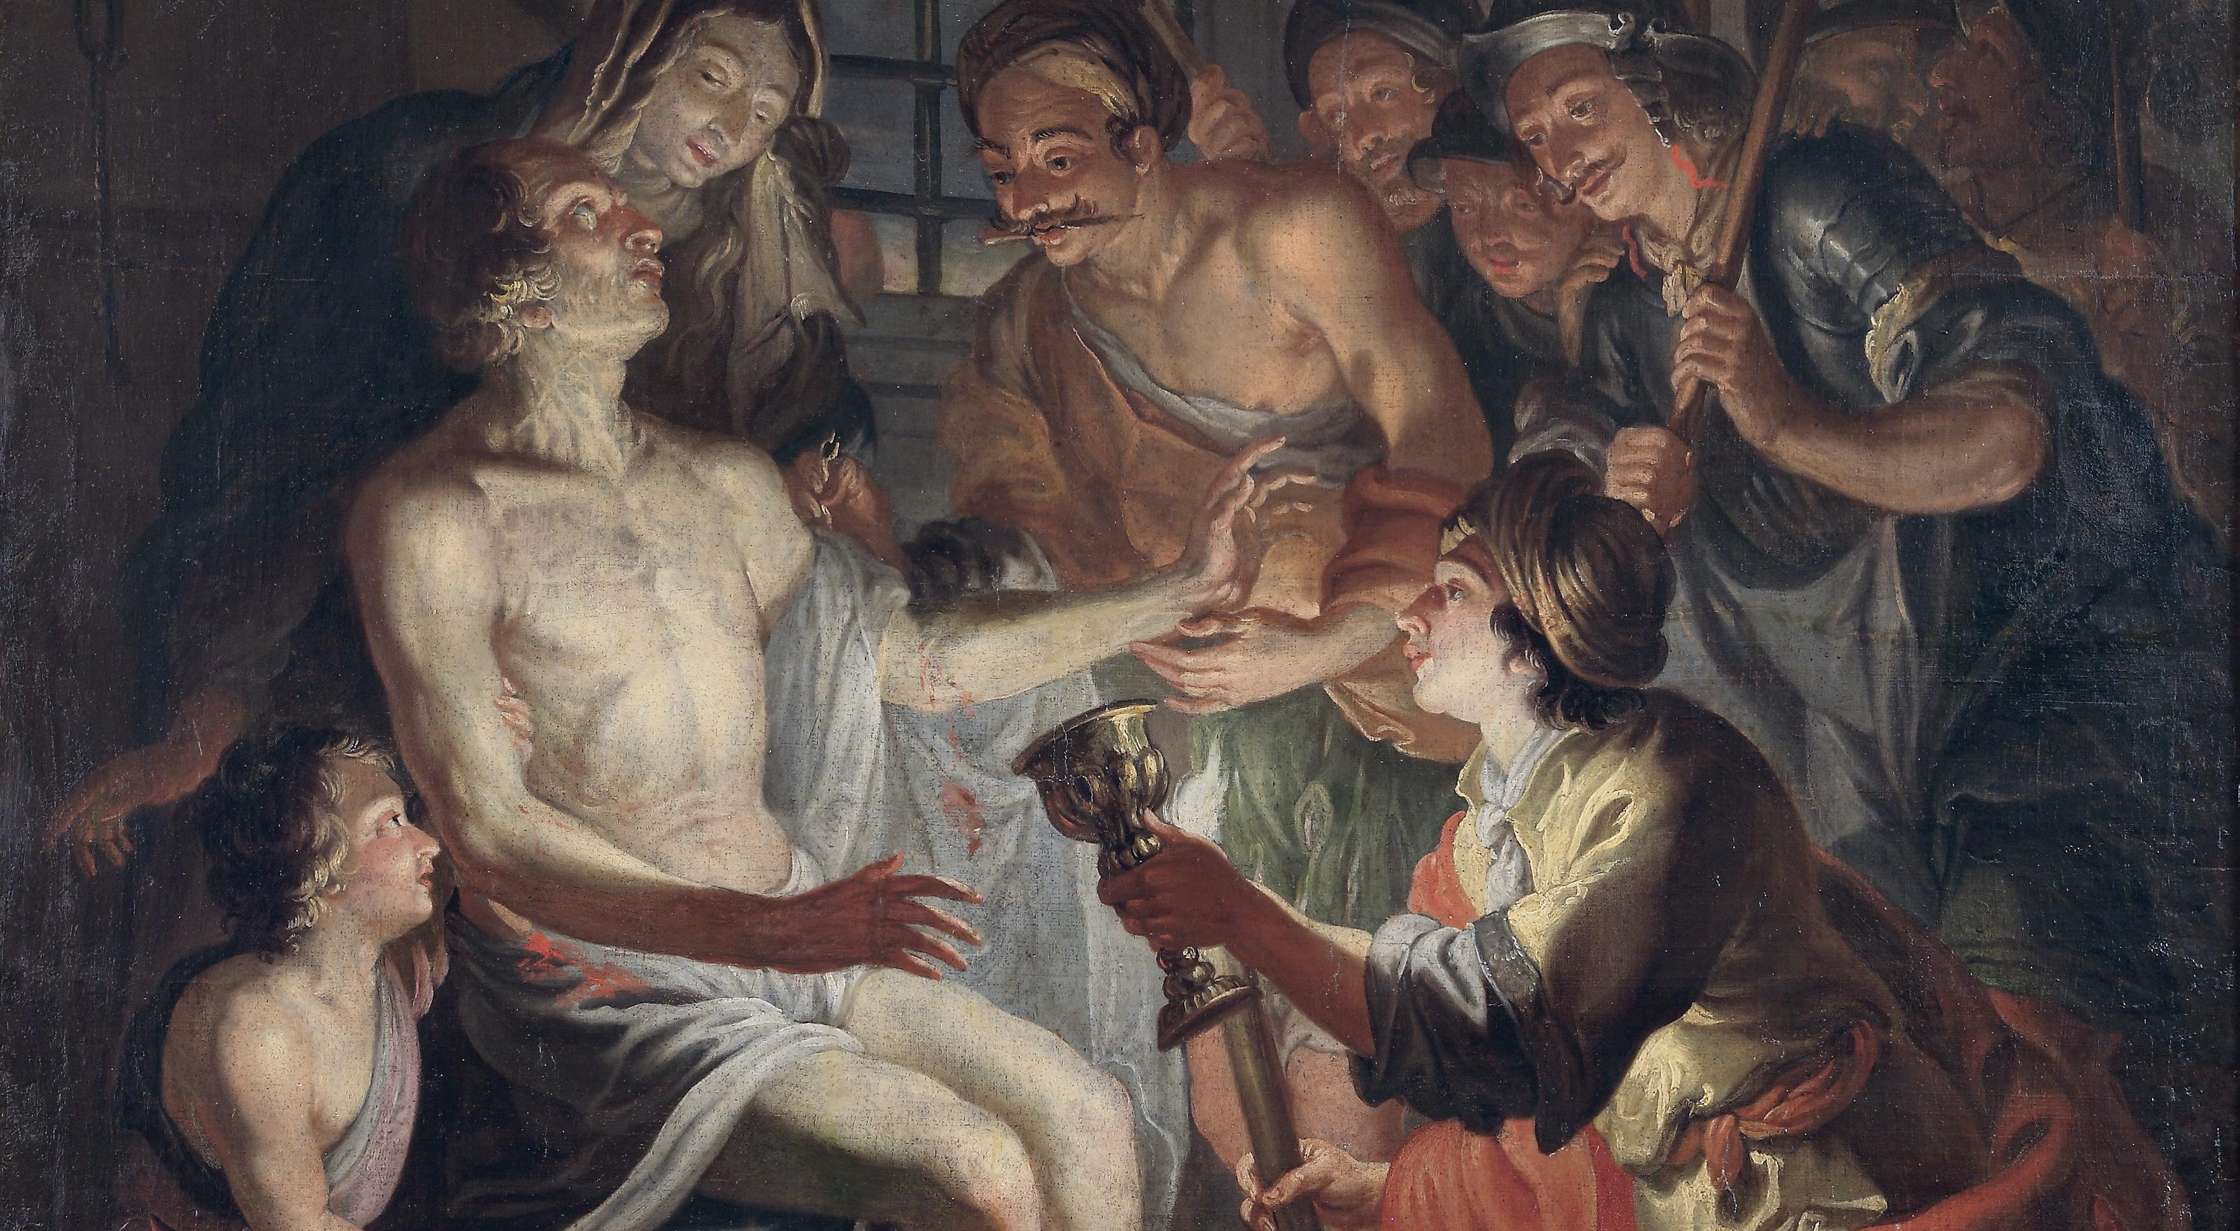
Matthias Stomer Der Tod Senecas (1615?)

Slide 10
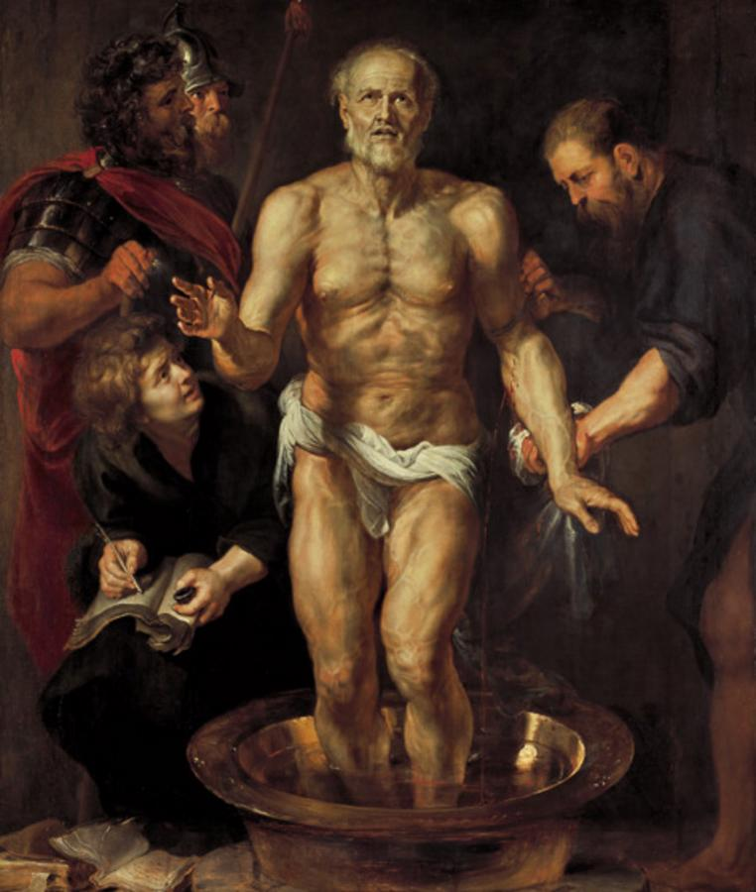
Rubens 1612-13

Slide 11
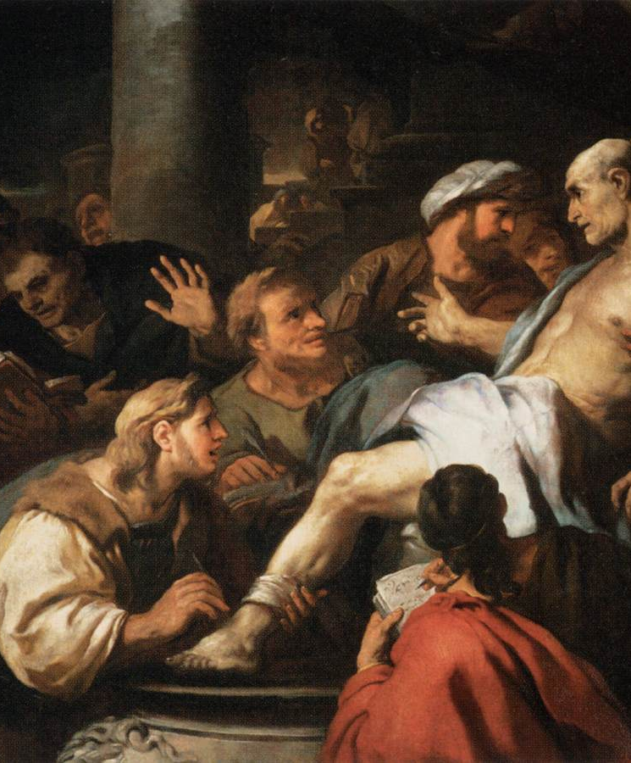
Luca Giordano 1684-5

Slide 12
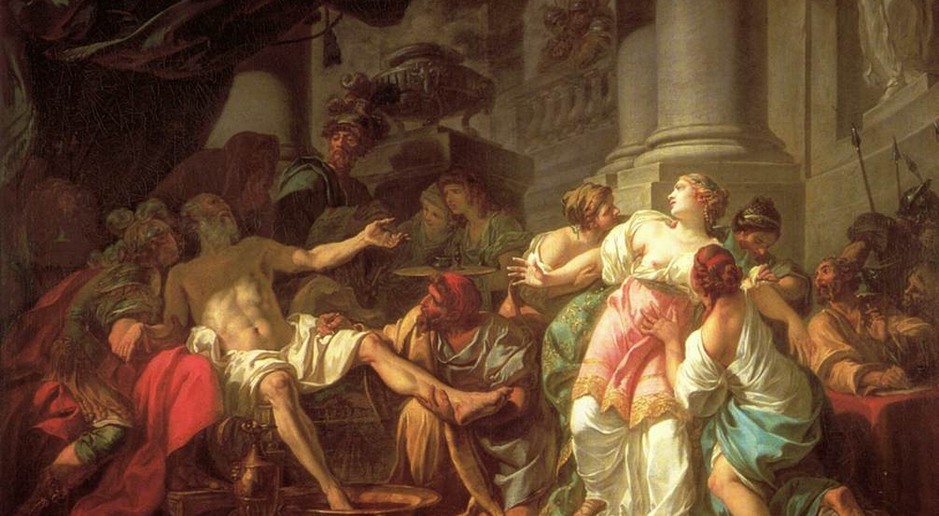
Jacques-Louis David 1773

Slide 13
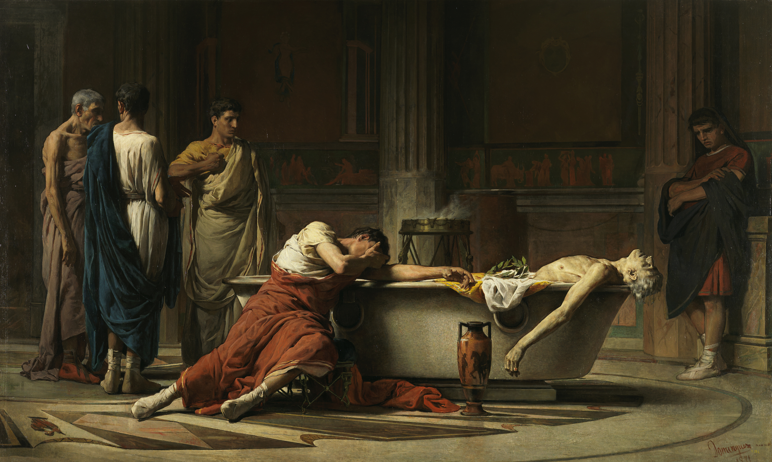
Manuel Domínguez Sánchez 1871

