Slide 1
Vulnerable Body
Achilles’ heel: Statius’ Achilleid

Slide 2
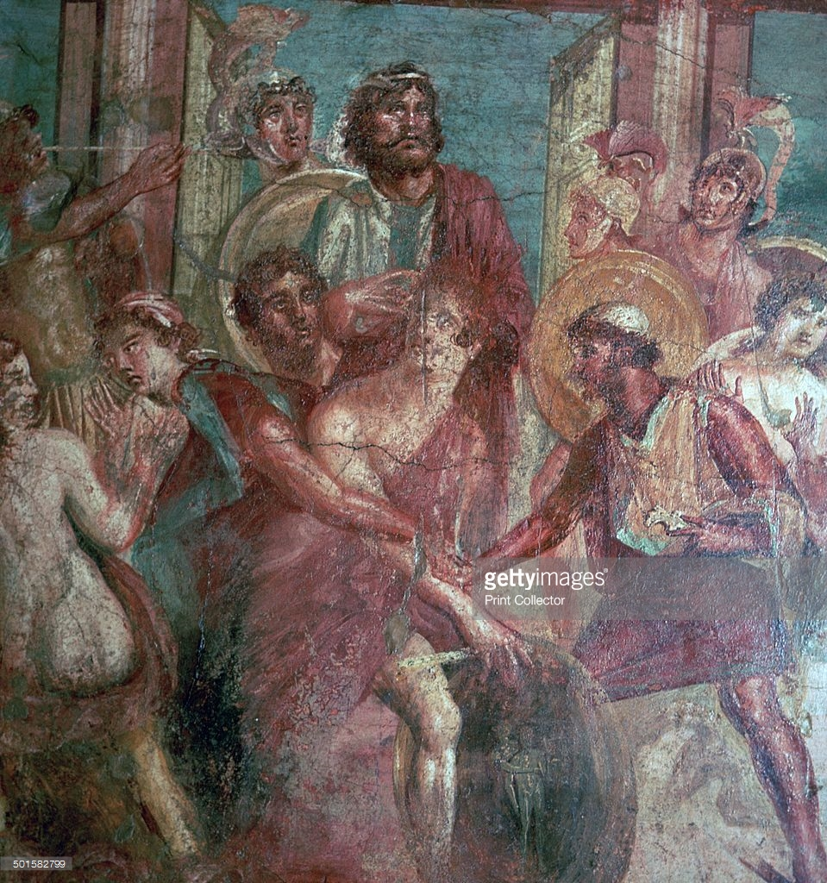
Outing Achilles (House of the Dioscuri, Pompeii)

Slide 3
Thetis’ ‘persuasion’ (Ach.1.247-82)
If dressing as/becoming a girl was good enough for:
Hercules
Bacchus
Jupiter
Caenis

Slide 4
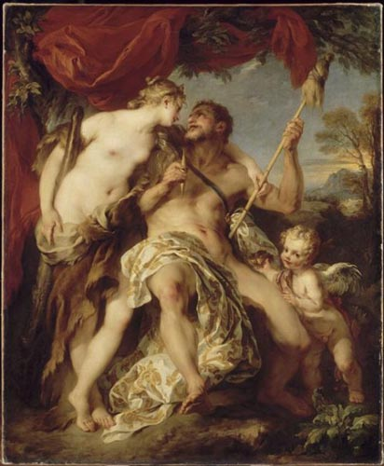
Hercules and Omphale

Slide 5
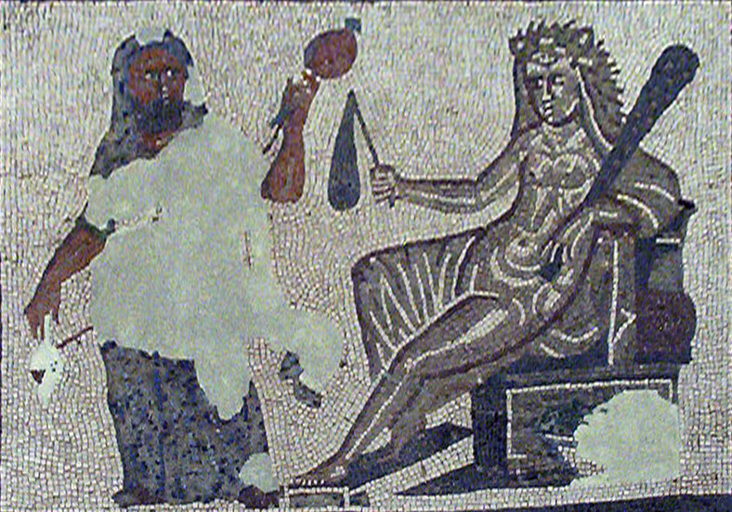

Slide 6
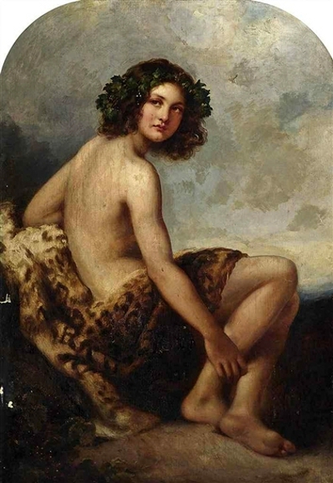
The young Bacchus

Slide 7
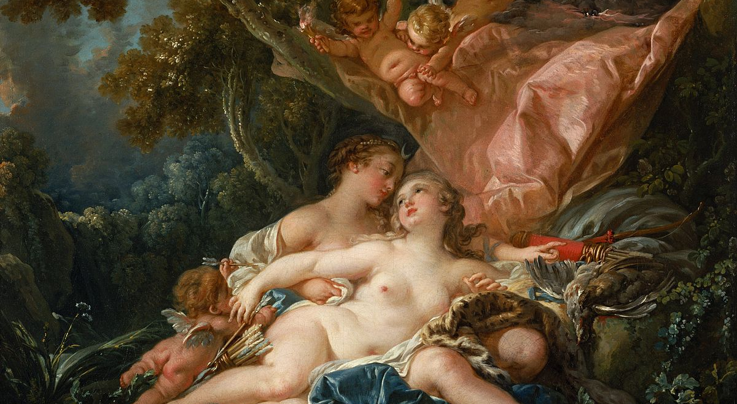
Jupiter dressed as Diana

