Slide 1
Vulnerable Body
Achilles’ heel:
fighting vulnerability in Statius’ Achilleid (the mother’s story)

Slide 2
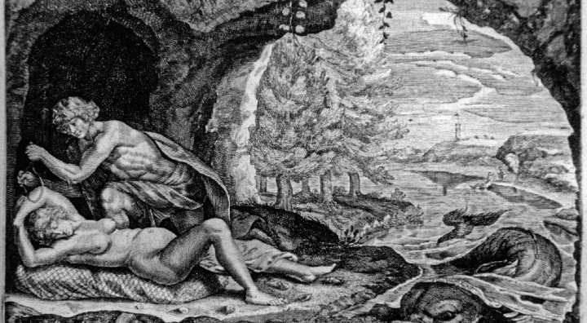
Peleus and Thetis (1677 engraving)

Slide 3
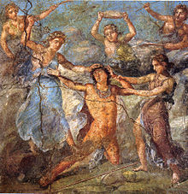
‘innocent’ Bacchic wands? (House of the Vetii, Pompeii)

Slide 4
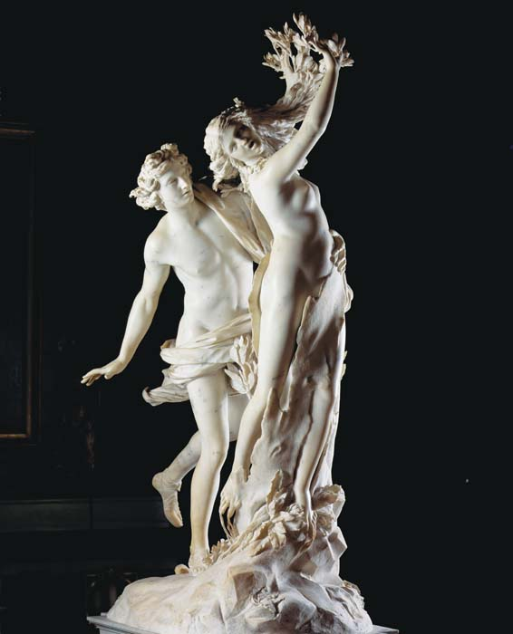
Apollo and Daphne, primus amor (Bernini)

Slide 5
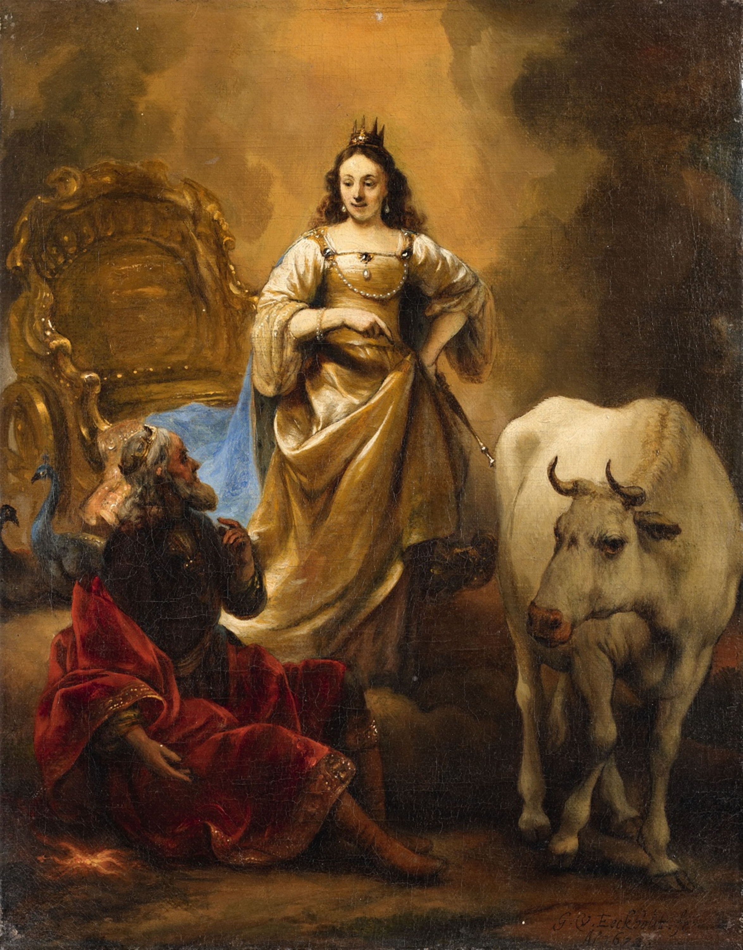
Jupiter and Io, Ov.Met.1.610ff. (Dutch 15th century, G.van den Eeckhart)

Slide 6
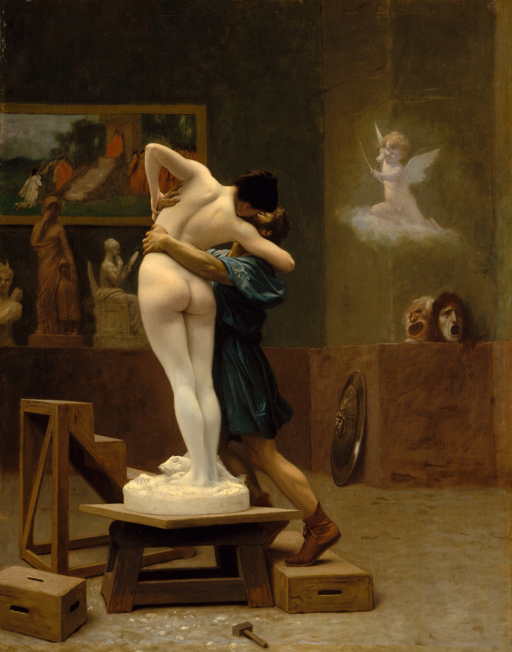
Thetis as Pygmalion? (J.-L.Gerome, Pygmalion and Galatea, 1890)

Slide 7
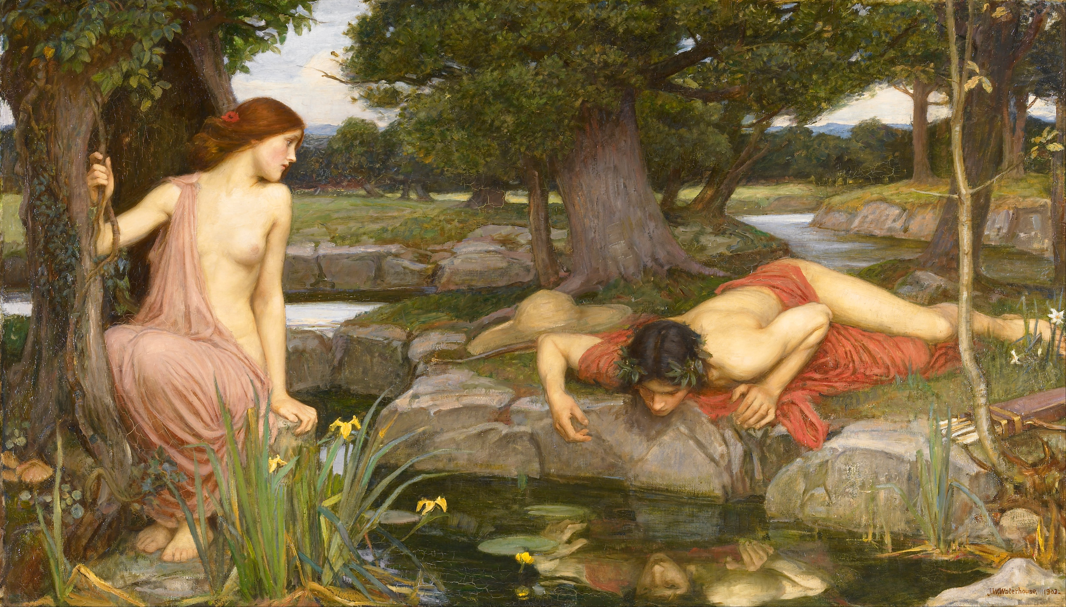
Or as Ovid’s Echo? (John William Waterhouse 1903)

Slide 8
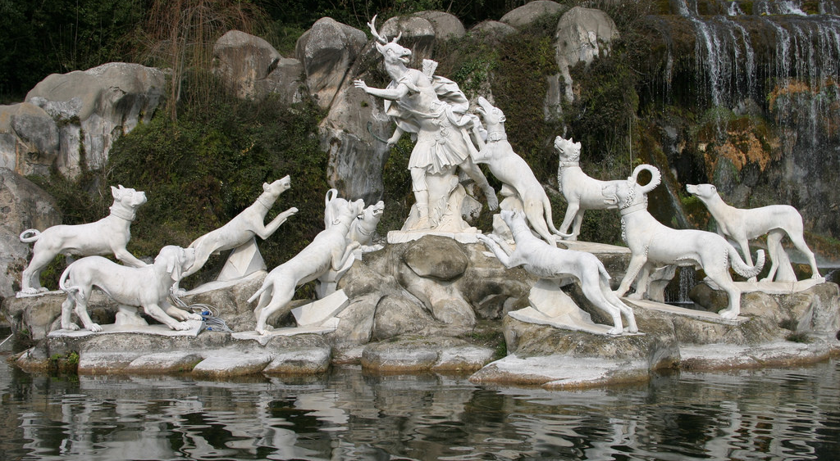
Achilles as Ovid’s Actaeon?

Slide 9
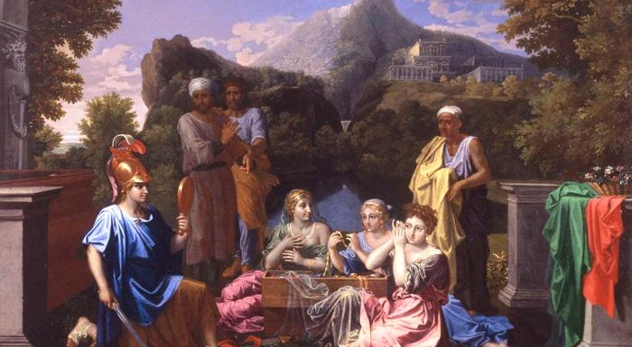
Achilles in the mirror (N.Poussin, 1656)

