Slide 1
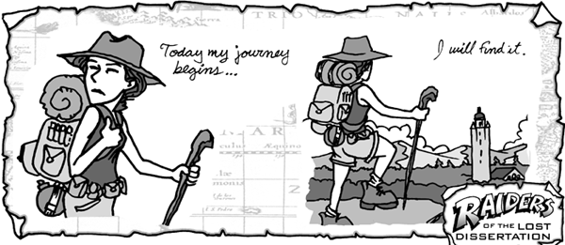
Dissertation Preliminary Briefing
April 2017

Slide 2

What do you want to know?

Slide 3


WHY?
The joy of research…
Independence
A taste of pg study
Transferrable skills (analysis; problem solving; structure; extended writing; presentation; time management; presentation; discussion; empathy)
Sense of satisfaction: it’s all yours!

Slide 4

WHAT YOU NEED TO DO NOW
Broad topic area
Personal Tutor/ a.n.other
Library briefing
By end of this term

Slide 5
TOPICS
Assessing the social and political importance of Octavia Minor
The monetization of the Roman countryside in the imperial period
Jewellery through Antiquity and its importance
To what extent did archaic and classical Greeks have an interest in their own ancient history?
The influence of classical literature on Victorian and 20th century novels
A comparative study of the Delian league and NATO
Reception of Greek mythology in graphic novels
The application of international relations theory to major controversies in ancient history
Magic and witchcraft in the ancient world
To what extent is Alfred Hitchcock inspired by the methods of suspense and drama in Greek tragedy?

Slide 6

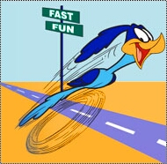
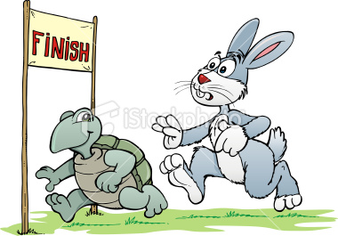
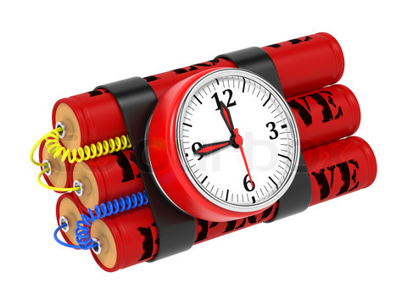
WHAT YOU NEED TO DO OVER SUMMER VACATION
Background reading
What approaches / material?
Research question
Different approaches to writing the dissertation:

Slide 7
Schedule next year
http://www2.warwick.ac.uk/fac/arts/classics/students/modules/dissertation/
250-word plan of study and title [Week 2]
Plan including chapter headings [Week 4]
Sample chapter [Week 11]
Presentations [Weeks 2/3]
Title [Week 3]
Dissertation [Week 10]
Submit via Tabula and as hard copy

Slide 8

ANY QUESTIONS?

