Slide 1
The Roman Economy
Term 2
Wednesday
Introduction
where’s it from?

Slide 2
Outcomes
How Material traces of the past and how they can be used to study the ancient economy
The range of Artefacts and Ecofacts
The potential and pitfalls of using different types of evidence
Getting to grips with archaeological evidence

Slide 3
“We are too often the victims of the great curse of archaeology, the indestructibility of pots “
-Finley, M 1959 Technology in the ancient world. Economic History Review, 2nd series, XII, 120-5.

Slide 4
Material Traces of an economy
Production
Exchange
Distribution
Consumption

Slide 5
Term 2 Syllabus
Week 1
Intro - Provenance
Week 2 Quantifying and locating the economy
A- How old and how much; B - Agricultural evidence
Week 3
A - Extraction and manufacture; B - amphora seminar
Week 4
A – Settlement and consumption; B – Fine wares
Week 5
A - Coarse wares; B – Ceramic Building Materials
Week 6
Reading week
Week 7
A – Marble; B –Was the Roman army a total institution??
Week 8
A - Guest Lecture ; B - Transport and Military supply
Week 9
A Ras el Bassit (Syria); B - Nepi (Italy)
Week 10
A - Pepper Spices and silks B – The materiality of the Roman economy

Slide 6
What is Material culture?
Finds
Artefacts:
Ceramic; Worked Bone; Metals; Glass; Stone
Ecofacts:
Animal Bone; Fish bone; Seeds; Pollen;

Slide 7
Development of the study of finds
Art Historical
Typological
Contextual:
Ethnography;
Technology;
Scientific methods;
Quantification

Slide 8
Where is it from?
Stamps and other markings
Typology
The material itself
Further Scientific analysis

Slide 9
Stamps
Where made,
When was it made
who made it,
what was it for

Slide 10
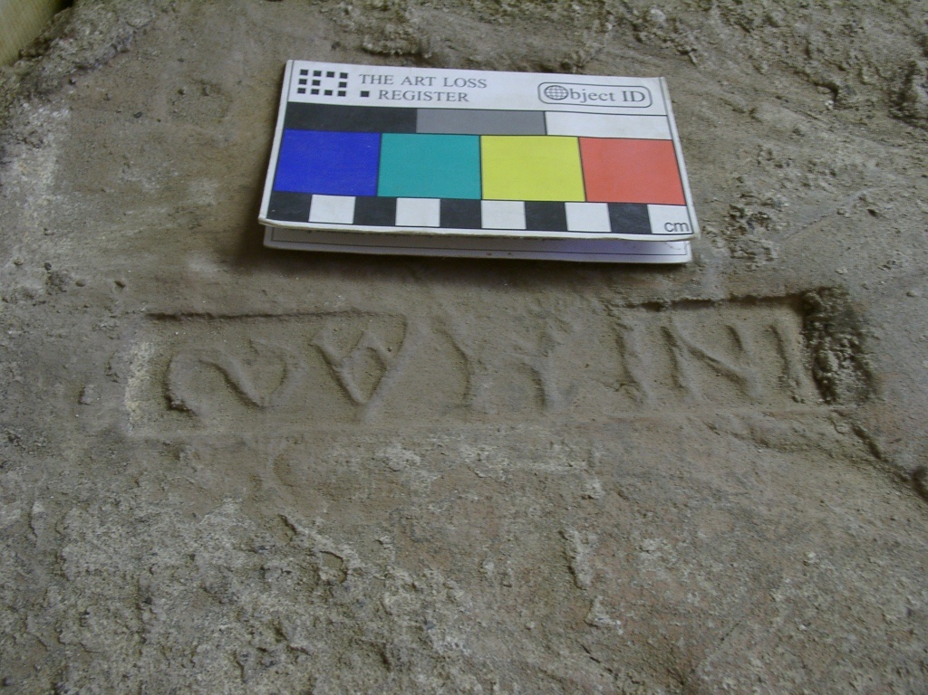
Indiction Stamp

Slide 11
Stamp 14 - I NIMAS (Lauffray, J. 1944; no 2471a and b, Bardhill 2004, 302) stamps dated AD 413-5 from the Theodosian church of St Sophia, Constantinople and on a stamp dated AD 430/1 from the palace of Antiochus. Two different dies were observed to have been used for this stamp, reads ιν(δικτιϖνοζ) ιΜα( ) S.
Stamp 15 INIBAΓA (no 8972a, Bardhill, 2004, 204.) A stamp dated AD 429-33 AD from the palace of Antiochus reads ιν(δικτιϖνοζ) ιβα ( ) Γρα( ).

Slide 12
Other markings
Signatures
Tallies
Graffiti
Dipinto

Slide 13
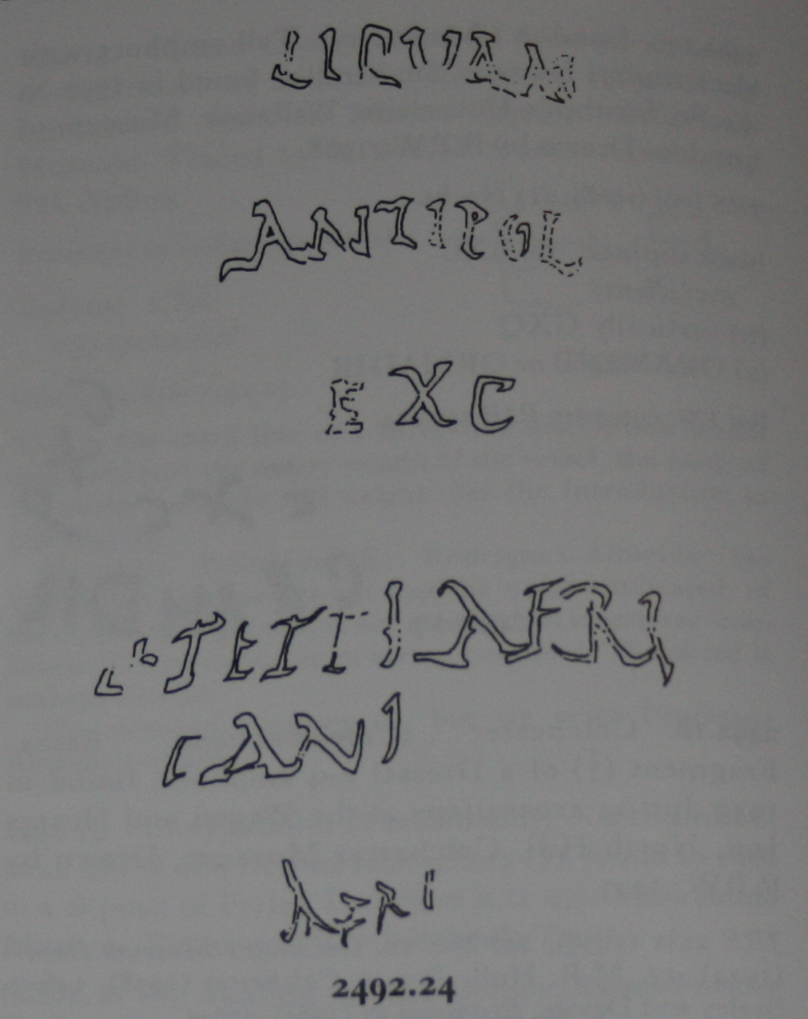
Lucius Tettius Africanus’s finest fish sauce from Antipolis; (product) of Africanus

Slide 14
Typology
Forms related to function but are also related to regional traditions

Slide 15
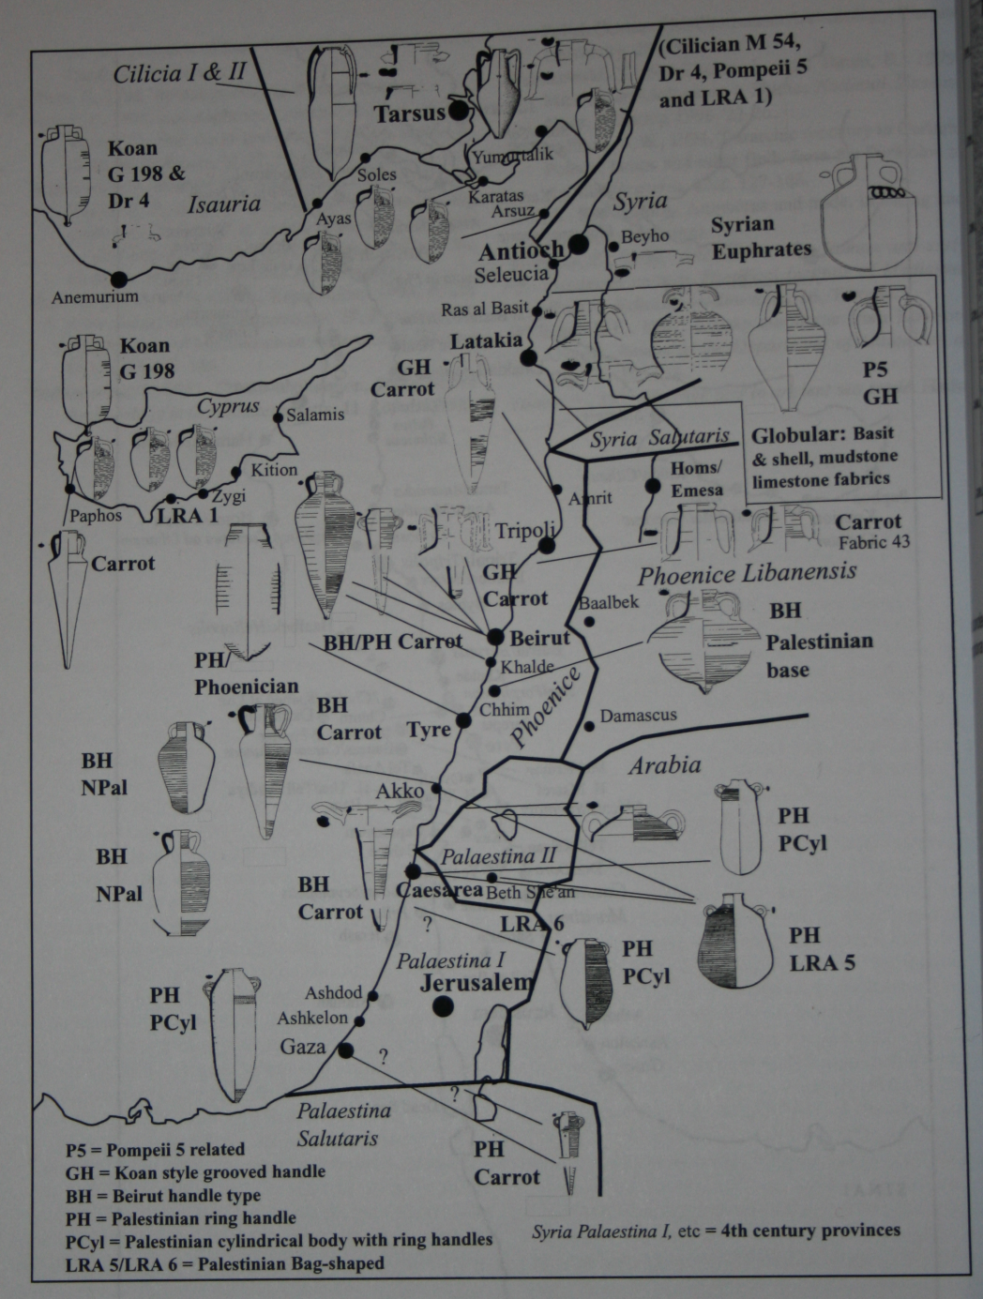
Amphora

Slide 16
The material Itself a. Fabrics
Term used to describe the pottery. Will comprise the clay itself and temper which may be added for technological or aesthetic reasons. A number of these are distinctive to the eye or under simple magnification
Observe: Hardness, colour, fracture and feel.
Inclusions: identity, amount, sorting, shape, size

Slide 17
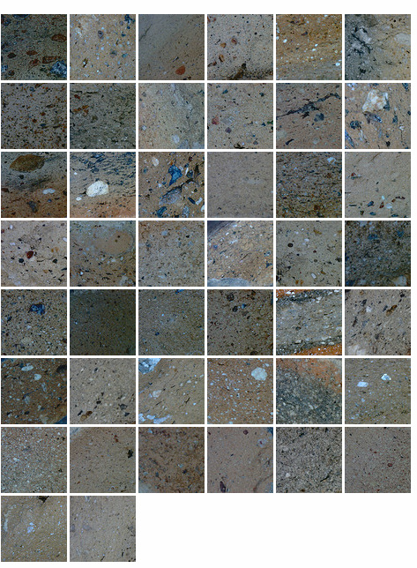
Amphora found At Bassit

Slide 18
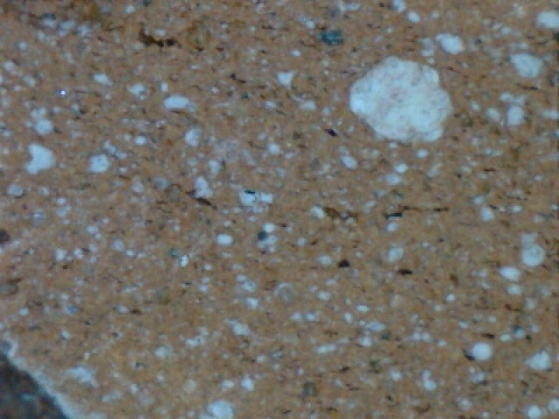
African

Slide 19
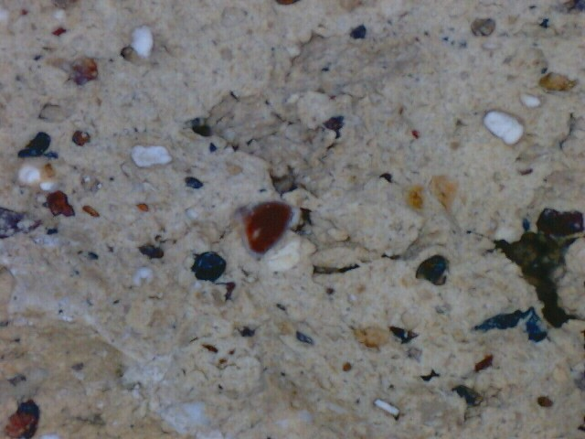
Cilician

Slide 20
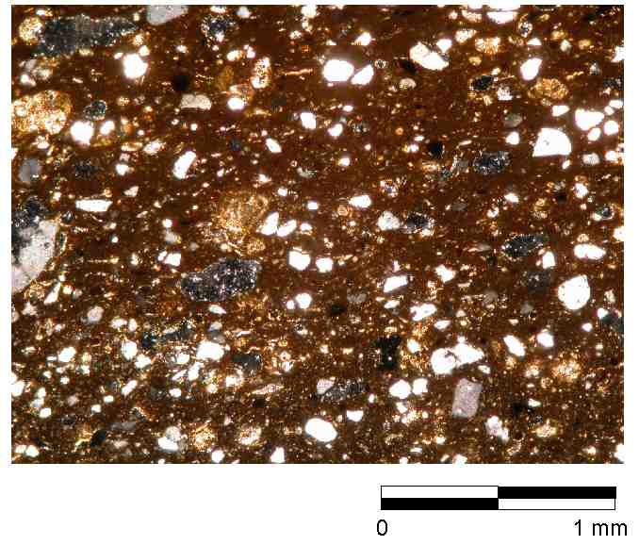
N African Thin section

Slide 21
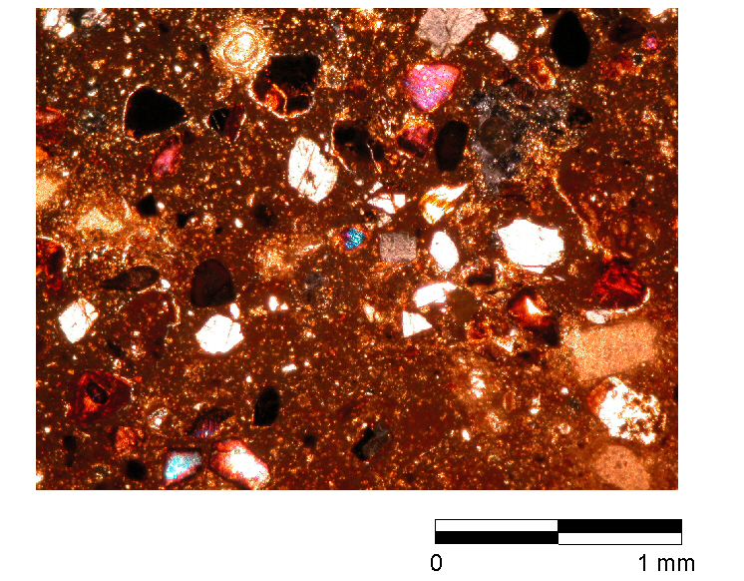
Cilician thin section

Slide 22
Chemical analysis
Qualitative – what elements make up the sample?.
Quantitative – how much of each elemnt is present

Slide 23
Chemical Analysis

Slide 24
Problems with chemical analysis
Post depositional Leaching
Temper
Cross lab standards
Contamination
Analysis
Publication
Integration

Slide 25
Other materials
Metal ore and smelts. coins
Glass, raw glass
Teeth – St isotope ratios
Stone – O isotope levels sourcing white marbles varibility within quarries greater than between quarries

Slide 26
ICPMS case study (Horningsea)
Fabric | No | Fe2O3 | MgO | TiO2 | MnO | Ba | Co | Cr | Cu | Li | Ni | Sc | V | Y | Zn | Zr* | La | Ce | Nd | Sm | Eu | Dy | Yb | Pb
D00 | 57 | 0.3659 | 0.07 | 0 | 0 | 32 | 0.9 | 5.3 | 1.6 | 6.9 | 4 | 0.9 | 5.3 | 1.5 | 4 | 3.1 | 2.7 | 5.5 | 2.8 | 0.4 | 0.1 | 0.2 | 0.1 | 1.4
D00 | 58 | 0.5741 | 0.1 | 0.1 | 0.02 | 61 | 1.4 | 8.4 | 3.5 | 6.3 | 4.6 | 1.2 | 6.9 | 3 | 9.5 | 3.7 | 4.2 | 7.9 | 4.4 | 0.4 | 0.2 | 0.5 | 0.2 | 0.2
M21 | 59 | 0.4935 | 0.08 | 0 | 0.01 | 41 | 1.1 | 7 | 1.5 | 6.8 | 4.5 | 1 | 6.8 | 1.7 | 5 | 2.7 | 3.1 | 5.2 | 3.2 | 0.4 | 0.1 | 0.3 | 0.1 | 1.5
O04 | 29 | 0.5359 | 0.08 | 0 | 0.01 | 17 | 1.2 | 5.8 | 1.6 | 12 | 5.9 | 1.1 | 11 | 1.4 | 5.1 | 3.1 | 2.4 | 4.9 | 2.5 | 0.4 | 0.1 | 0.2 | 0.2 | 1.8
O04 | 30 | 0.354 | 0.08 | 0 | 0.01 | 23 | 1.1 | 4.8 | 2.2 | 8.1 | 6.5 | 1 | 6.8 | 1.4 | 6.7 | 3.5 | 2.5 | 5 | 2.6 | 0.4 | 0.1 | 0.3 | 0.2 | 1.4
O04 | 32 | 0.3675 | 0.08 | 0 | 0.01 | 21 | 1.1 | 4.9 | 1.8 | 10 | 4.8 | 0.9 | 6.8 | 1.6 | 5.2 | 3.6 | 2.8 | 5.4 | 2.8 | 0.4 | 0.1 | 0.3 | 0.2 | 1.8
O04 | 33 | 0.4174 | 0.08 | 0 | 0.01 | 27 | 1.3 | 7.3 | 2.1 | 5.4 | 4.4 | 1 | 6.8 | 1.5 | 5.5 | 3.2 | 2.7 | 5.5 | 2.8 | 0.4 | 0.1 | 0.3 | 0.2 | 1.5
O04 | 34 | 0.3567 | 0.08 | 0 | 0 | 25 | 1 | 5.1 | 2.1 | 6.1 | 3.7 | 0.9 | 6.3 | 1.4 | 6.6 | 3 | 2.5 | 5.1 | 2.5 | 0.3 | 0.1 | 0.2 | 0.1 | 1.4

Slide 27
Normalise to Aluminium
Factor analysis – try to reduce number of factors

Slide 28
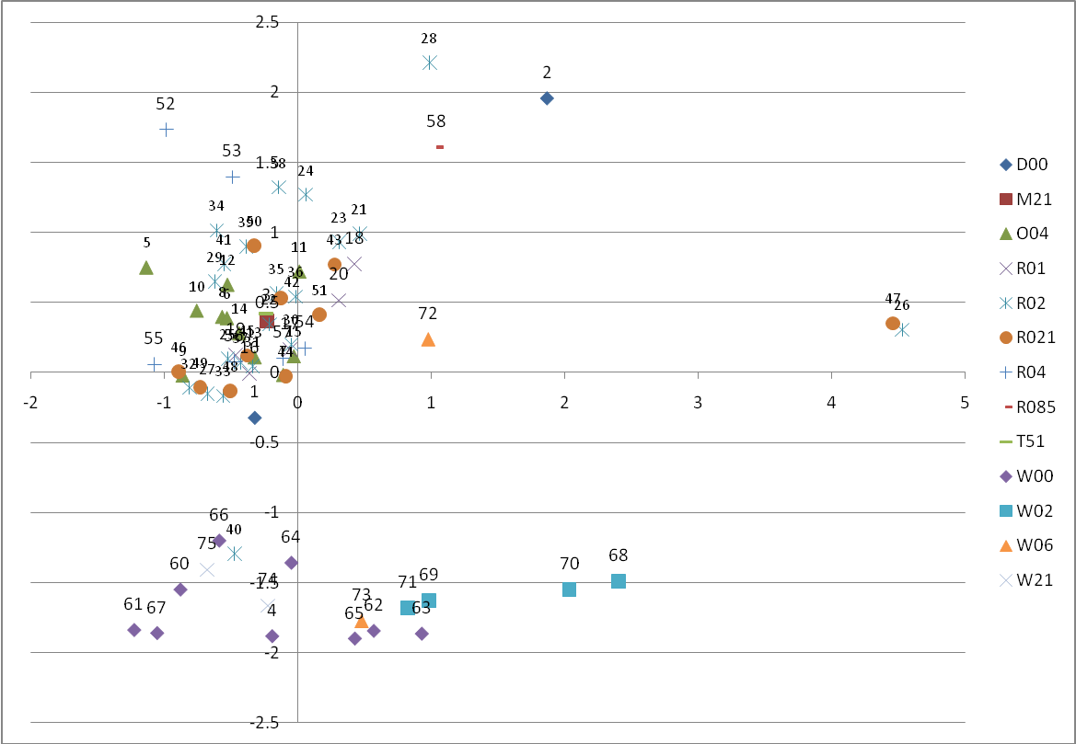
First Iteration

Slide 29
To Sum up
The study of the material traces of the past can inform us about the ancient economy.
Different materials have different histories of research and potential. These can be integrated but should know the potential pitfalls.
A number of techniques exist to study provenacing whose effectiveness varies depending on material and technique.

