Slide 1
Term 2
Week 2
A. When and how much

Slide 2
Methods of Recovery
Field Survey
Excavations
Chance finds

Slide 3
Field survey
Sites:
Hut – a single building
Farm – tile pot walls plaster
Villa – colonaded court yard, baths
Large villas, Towns, burials, kilns, presses, temples

Slide 4
Pros and Cons
Rapidly cover a wide area
Shows levels and types of exploitation
Material is unstratified – dating relies on the recovery of objects of known date ( usually pottery)
Only coarse date ranges can be elucidated
Recovery effected by site use in past and contemporary usage – crops, weather, access
Latest occupation may obscure earlier settlement

Slide 5
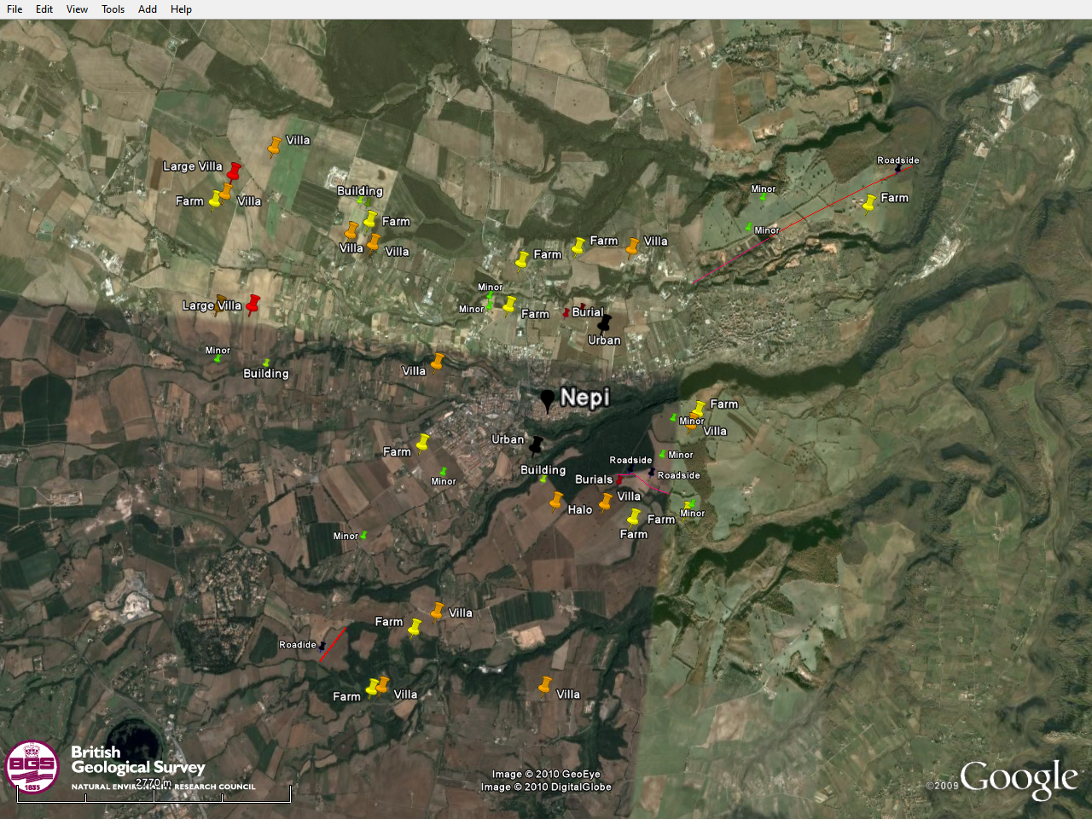
Nepi, Italy Survey

Slide 6
Nepi Date Distribution

Slide 7
Homs Village 358

Slide 8
Excavation
Identification, recording and removal of deposits in reverse order of formation (Contexts).
Finds are kept from contexts.
Site interpretation made of grouping contexts into larger units phases are groups of contexts from contemportily related activity defined by the stratigraphy.

Slide 9
Stratigraphy

Slide 10
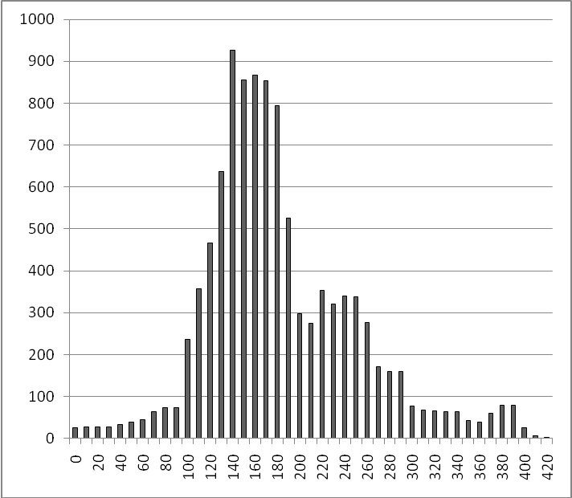
Nantwich Date Distribution

Slide 11
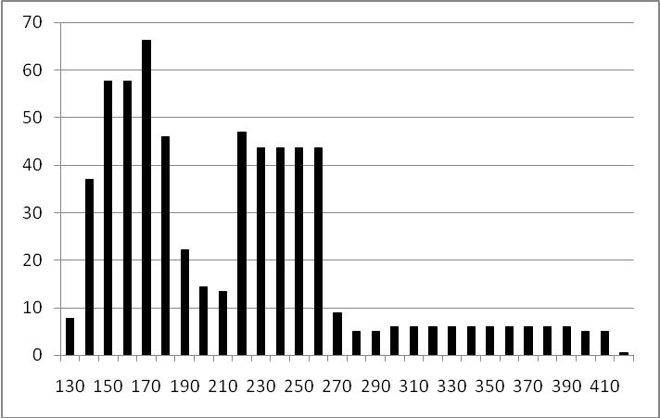
Mortaria Only

Slide 12
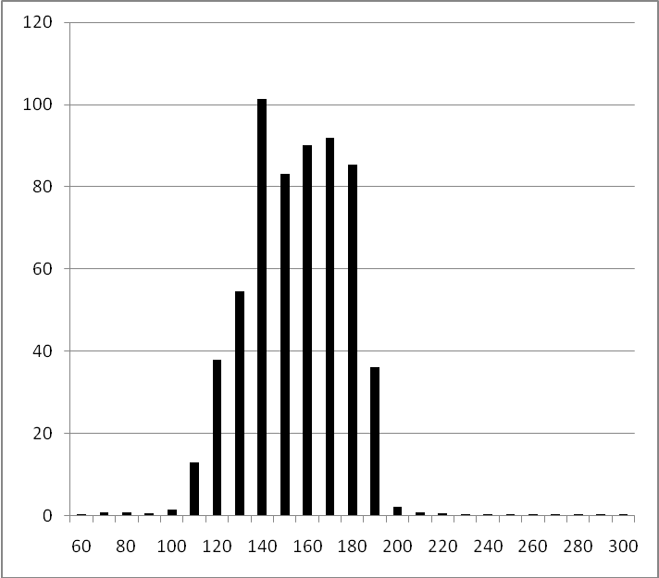
Samian

Slide 13
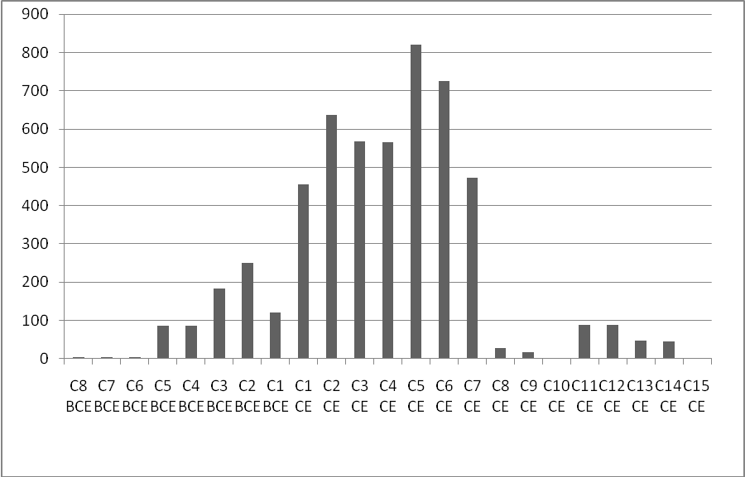
Ras al Bassit

Slide 14
Quarry Farm, Ingleby Barwick, Stockton-on-Tees

Slide 15
The finds themselves.
Some finds can have their date of manufacture etc deducted by stamps ( the example par excellence is coins, but some pottery stamps can give useful dating data, as can decorated pots and the forms.
Typologies have been constructed showing the development of forms and with some forms having known dates chronological

Slide 16
Residuality
  Material which is older than its context
    Heirlooms
    Reuse
Intrusive Material
  Material which is more recent than its context
    Bioturbation
    Poor control

Slide 17
Using different dating evidence
BEY006 (2181) Primary fill of Robber Trench. |  |  |  | 325 | 350 | 375 | 400 | 425 | 450 | 475 | 500 | 525 | 550 | 575 | 600
Evidence Type | From | To
Pot | 350 | 400
Coin | 501 | 525
Lamp | 350 | 400
Glass | 401 | 600
CBM | 410 | 425
 | 350 | 600
TPQ |  | 500
Midoint | 475 | 500

Slide 18
NorthWest Coin profiles
Period | british mean | Dates | Nant | Mwi | Mw2 | Mw3 | Nantwich | King St | Middlewich MD | Midlewich All
1 | 6.47 | To AD41 | 0 | 0 | 11 | 11 | -6.47 | -6.47 | 106.9321 | 86.75034
2 | 11.73 | 41-54 | 0 | 0 | 0 | 0 | -11.73 | -11.73 | -11.73 | -11.73
3 | 5.9 | 54-69 | 0 | 1 | 2 | 3 | -5.9 | 41.71905 | 14.71856 | 19.52373
4 | 30.85 | 69-96 | 0 | 7 | 12 | 19 | -30.85 | 302.4833 | 92.86134 | 130.1669
5 | 19.9 | 96-117 | 5 | 3 | 25 | 28 | 172.4077 | 122.9571 | 237.832 | 217.3881
6 | 15.79 | 117-38 | 1 | 2 | 10 | 12 | 22.67154 | 79.4481 | 87.30278 | 85.90492
7 | 18.67 | 138-161 | 8 | 0 | 7 | 7 | 289.0223 | -18.67 | 53.49495 | 40.65203
8 | 11.52 | 161-180 | 7 | 1 | 10 | 11 | 257.7108 | 36.09905 | 91.57278 | 81.70034
9 | 4.66 | 180-192 | 2 | 0 | 3 | 3 | 72.26308 | -4.66 | 26.26784 | 20.76373
10 | 15.18 | 193-222 | 0 | 0 | 4 | 4 | -15.18 | -15.18 | 26.05711 | 18.71831
11 | 7.29 | 222-238 | 0 | 0 | 3 | 3 | -7.29 | -7.29 | 23.63784 | 18.13373
12 | 8.08 | 238-260 | 0 | 0 | 5 | 5 | -8.08 | -8.08 | 43.46639 | 34.29288
13 | 144.3 | 260-275 | 1 | 4 | 3 | 7 | -105.838 | 46.17619 | -113.372 | -84.978
14 | 121.24 | 275-294/5/6 | 0 | 0 | 0 | 0 | -121.24 | -121.24 | -121.24 | -121.24
15 | 17.49 | 294-317 | 2 | 2 | 0 | 2 | 59.43308 | 77.7481 | -17.49 | -0.54085
16 | 44.13 | 317-330 | 0 | 0 | 0 | 0 | -44.13 | -44.13 | -44.13 | -44.13
17 | 245.54 | 330-348 | 0 | 1 | 2 | 3 | -245.54 | -197.921 | -224.921 | -220.116
18 | 98.22 | 348-364 | 0 | 0 | 0 | 0 | -98.22 | -98.22 | -98.22 | -98.22
19 | 118 | 364-378 | 0 | 0 | 0 | 0 | -118 | -118 | -118 | -118
20 | 4.8 | 378-388 | 0 | 0 | 0 | 0 | -4.8 | -4.8 | -4.8 | -4.8
21 | 50.25 | 388-408 | 0 | 0 | 0 | 0 | -50.25 | -50.25 | -50.25 | -50.25
 |  | N | 26 | 21 | 97 | 118

Slide 19
Nantwich and Middlewich coin profiles

Slide 20
Scientific Dating
C14
Dendrochronology
Theroluminesence
Thermo-remnant magnetism
Rehydroxylation Dating

Slide 21
Quantification
Finley, M. 1985 The Ancient Economy London: The Hogarth Press, p33
.’Wheeler tells the cautionary tale of the discovery on the Swedish island of Gotland of 39 sherds of terra sigillata pottery scattered over an area of some 400 square metres, which turned out in the end all to be broken bits of the same bowl.’

Slide 22
Quantification
Counts
Weights
Minimum Numbers
Animals (Mind), Pottery (MnR) Tile (MT)
Detailed analysis: need counts of objects, data is sparse
Be aware of RHB measures

Slide 23
Problems with Count and weight
Small common objects can swamp figures.
What are we counting?
Objects come in different sizes and different weights
Objects break differently
Parts ( long bones) may be differentially reused.

Slide 24
Minimum numbers
Min No of individuals
E.g. no of legs/ 4 of no of front left leg;
MV No of vessels, no of rims handles and bases - identifying vessels, vessel parts forms without handles
MnR: Numbers of rims
MT : Minimum no of tiles/ Bricks

Slide 25
Estimated Vessels, pseudo Counts
Rim Equivalent (RE)– percentage of rim remaining
Base Equivalent (BE) – percentage of base remaining
EVE – Estimated Vessel equivalent – (RE+BE)/2
PIE – Pottery Information equivalent . A Pseudo-count transformation of EVE data
Tile Equivalent data

Slide 26
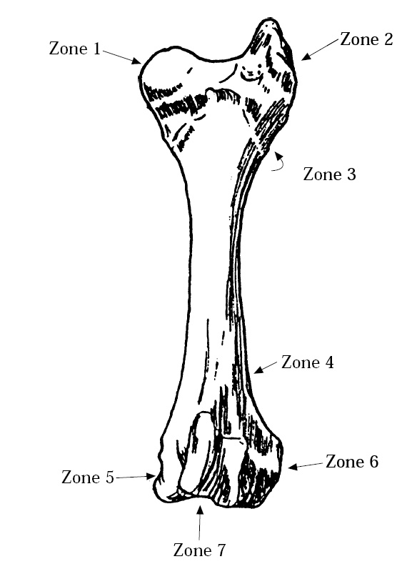
Bone Zones

Slide 27
Able to integrate Pottery data (other vessels), CBM Data, with animal bone data. Other objects can be counted as individuals
So meaningful multivariate stats can be carried out on datasets

Slide 28
To Sum Up
Data collection:
  Field survey: wide area, no independent dating
  Excavation: specific site, independent dating
  Dating:
  Intrinsic to find
  Built up by associations from different projets over time.

Slide 29
Quantification
A range of methods have been developed to counter the bias inherent in archaeological recovery.
We are usually looking at samples of incomplete objects, so methods that allow indicators of object counts are preferred as a means of meaningful high level multivariate statistical analyisis.

