Slide 1
The Roman Economy
Week 2 – Lecture 2
Agricultural Production

Slide 2
The Evidence
Animal Bones and Plant Remains
Ephemeral
Survive in specific conditions:
  Desiccated
  Anaerobic
  Burnt or mineralised

Slide 3
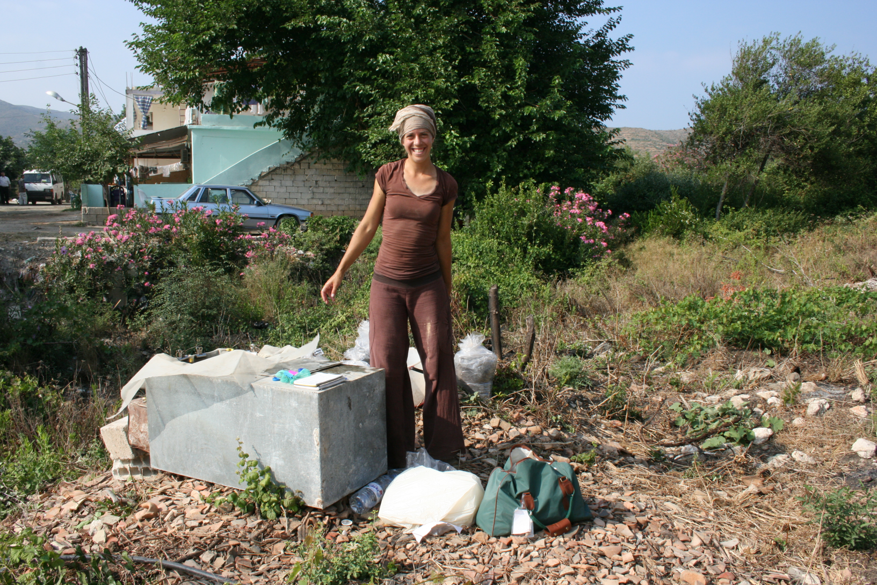
Wet Sieving

Slide 4
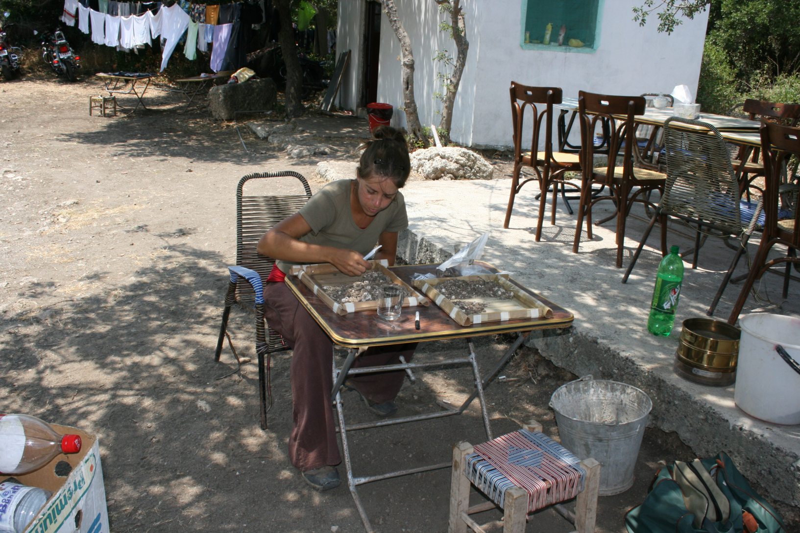
Sorting Flots

Slide 5
Human Bones
Evidence of diet and health can be recorded in human bones.
Rich diet
  Diffuse idiopathic skeletal hyperostosis (DISH) – obesity and diabetes
  Gout
  Caries (but may be indicative of poor dental hygiene)

Slide 6
Poor Diet
Enamel Hypoplasia – pits and scores in tooth enamel
Vitamin deficiency
  Vitamin D – rickets
  Vitamin C – Scurvy – periodontal disease.
Iron deficiency – probably anaemia – Criba Orbitalia

Slide 7
Mean Skeleton height from sites in Roman Britain

Slide 8
Incidence of caries, enamel hypoplasia and Ceibia Orbitalia in Roman -British populations

Slide 9
Modes of Production
Household production
Household Industry
Individual workshop
Nucleated Workshop
The Manufactory
The Factory - c.f. flour mills at Barbegal, Southern France
Estate Production
Military and official production

Slide 10
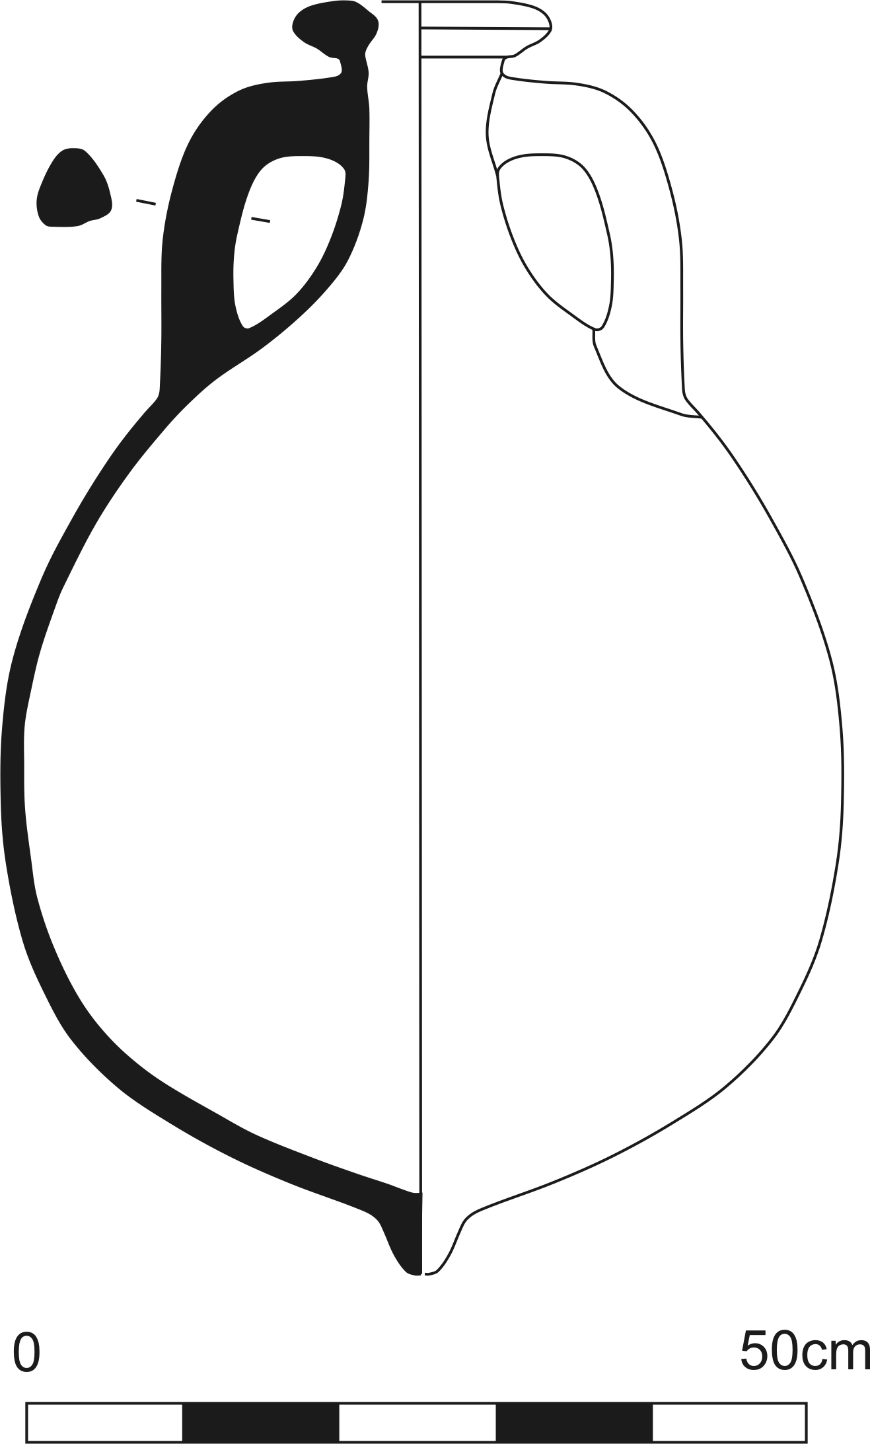
Olive oil
Olea Europea Sativa

Slide 11
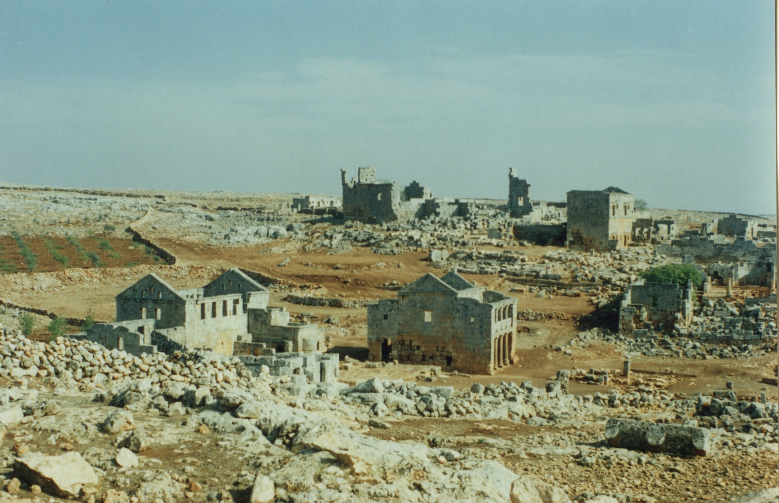
Segilla, Syria

Slide 12
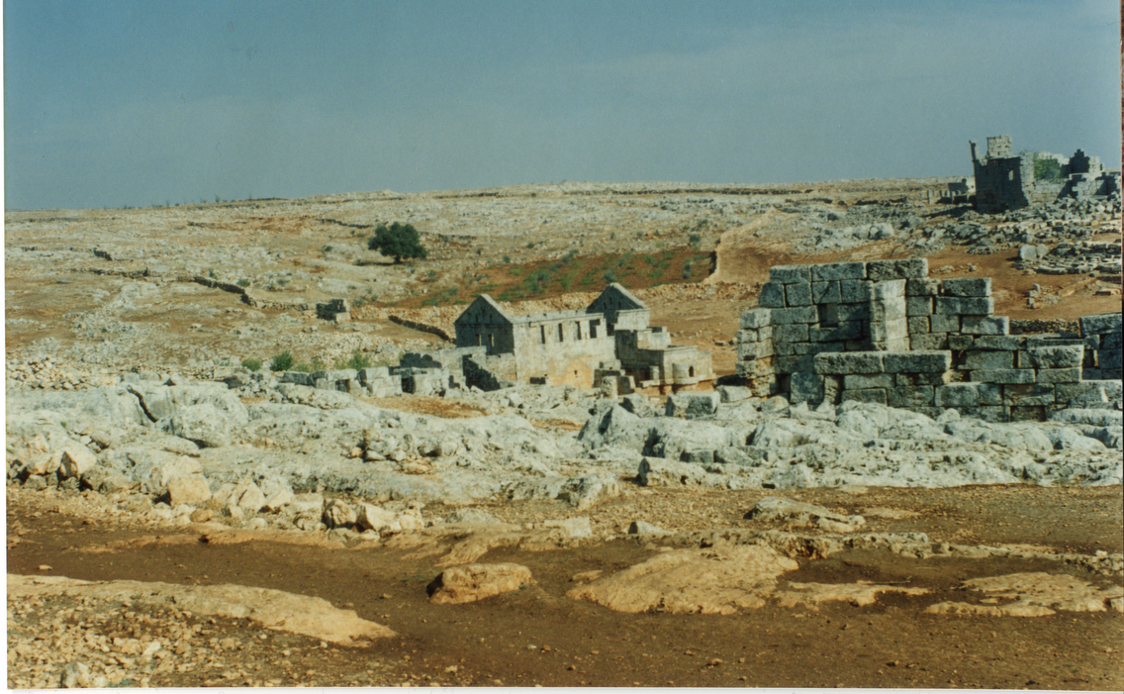

Slide 13
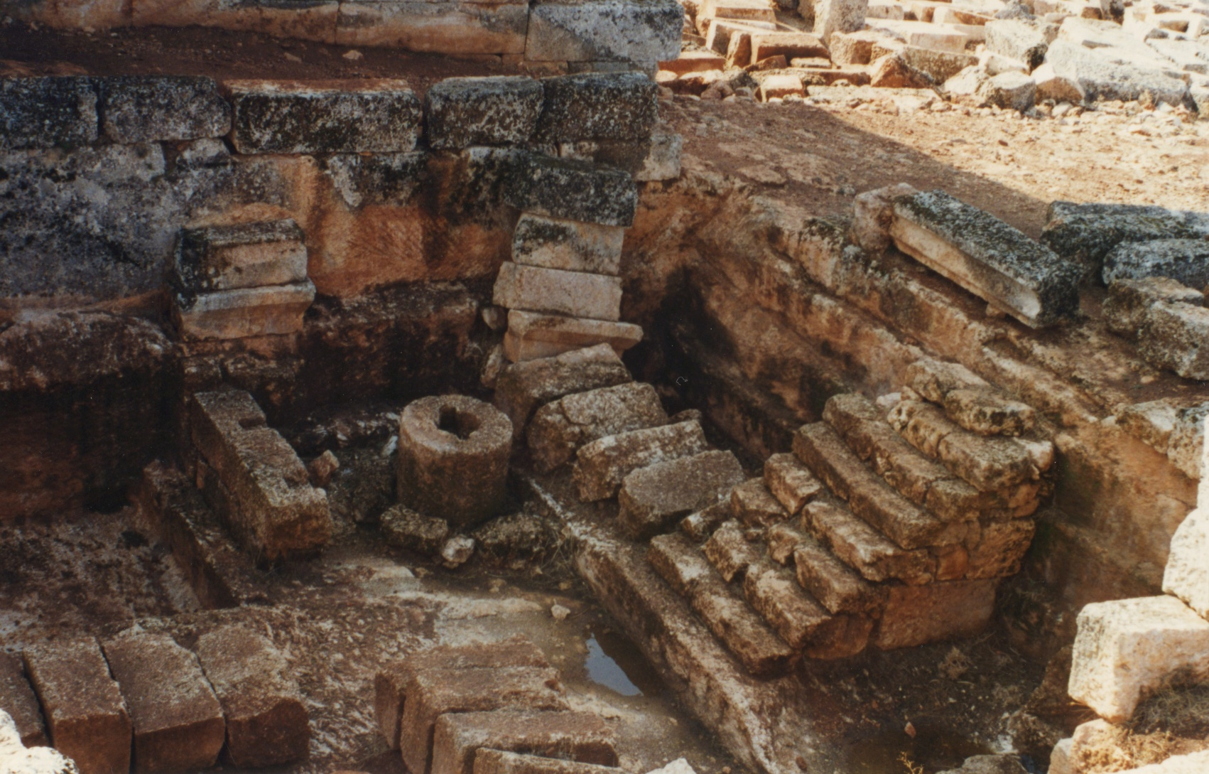

Slide 14
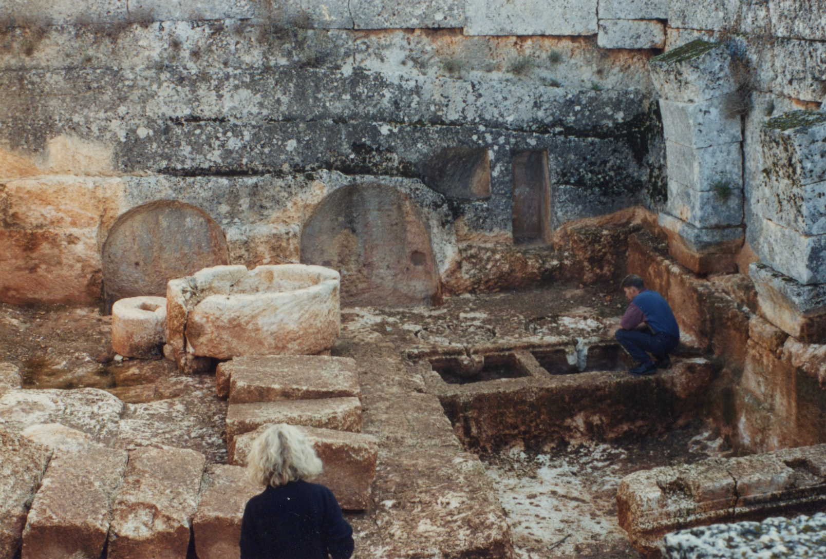

Slide 16
Olive summary
Spain, Tunisia Tripolitania (Libya) North Syria
Other locations but not so intensive
Food c. 20L a year; lasts a year before going rancid
Also used on body, perfumes, medicines, soap, light
Monte Testaccio – 40-50 million discarded amph, 80% dressel 20 amphora, 2000 billion l.

Slide 17
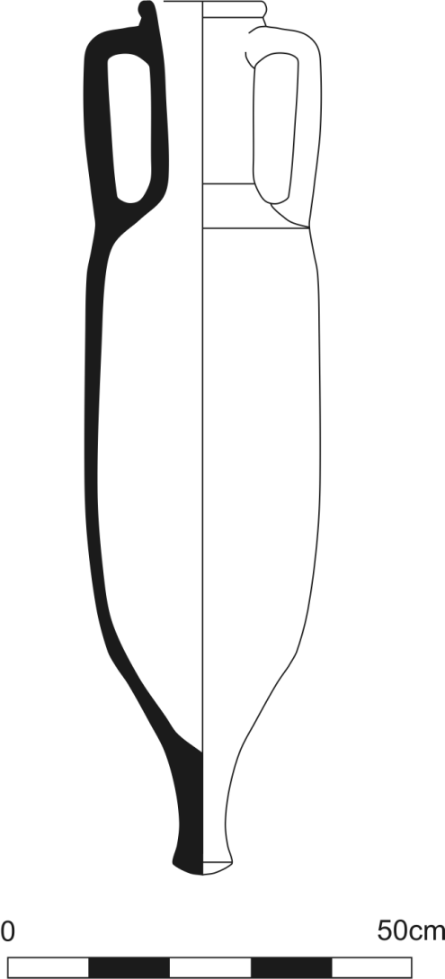
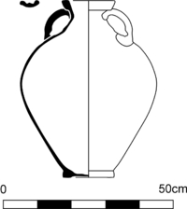
Wine

Slide 18
Wine production in Britain
Wooden presses
Tacitus claims olives and vines don’t flourish in Britain
Probus in 3rd century granted permission to Gauls, Spaniads and Britons to cultivate vinyards and make wine
No evidence of specialised tools
Vine pollen does not travel far

Slide 19
Wollaston, Nene Valley
Large scale prodution
Trenches and irrigation channels with plants supported by wooden structures
Pastinatio trenches Columella, De Re Rustica, 4.25.424-427

Slide 20
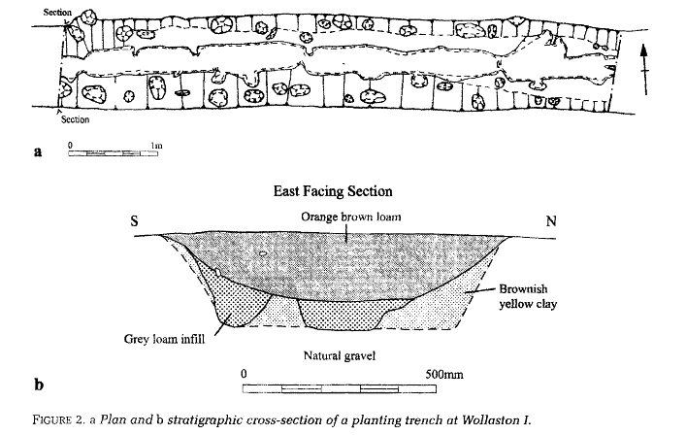
Pastinatio Trenches

Slide 21
Grain
Emmer, Spelt, (Glume wheat – parching/ pounding)
Bread Wheat
Emmer better for porridge and cakes

Slide 22
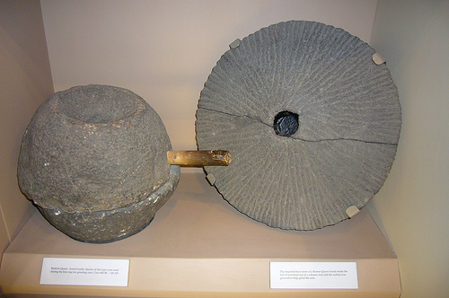
Milling

Slide 23
Meat
Pig (Urban elites)
Cattle (Military)
Sheep ( Native)

Slide 24
Meat distribution

Slide 25
Secondary products
Leather
Milk
Butter
Cheese
Animal bone – ‘the plastic of the roman world’

Slide 26

Cheese production

Slide 27
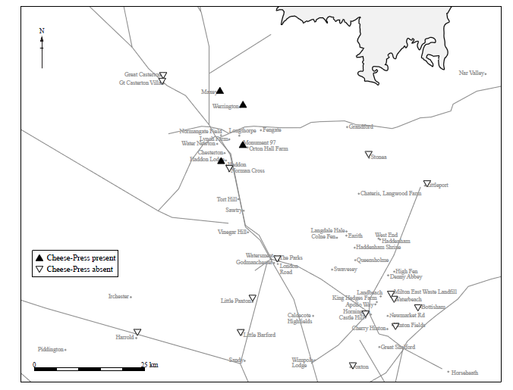
Cheese presses in Cambridgeshire

Slide 28
Other sources
Foraging
Game
Shell fish
Fish

Slide 29
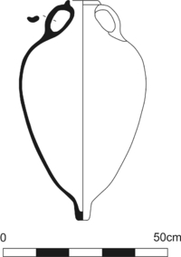
Fish Sauce

Slide 30
Production
Salt fish guts fermented in the sun for 2-3 months then sealed in jar .
Liqumem is the clear liquid at the top.
Garum is thicker
Allec is the sludge at the bottom

Slide 31
Main production:
Straits of Gibraltar, Africa, The Crimea, Brittany, Italy
Food: E.G. Apicius - Melcas : Cheese sweetened with honey served with pepper and liquamem.
Seems to peak C1/C2 – related to olive boom?

Slide 32
Salt
Seas shore or inland – where plenty of rock salt (E.g. Nantwich, Middlewich )
Brine is left to evaporate (inland tends to be supersaturated)
Brine then heated
Briquetage – Very coarse, porous pottery absorbs water allowing salt to evaporate.

Slide 33
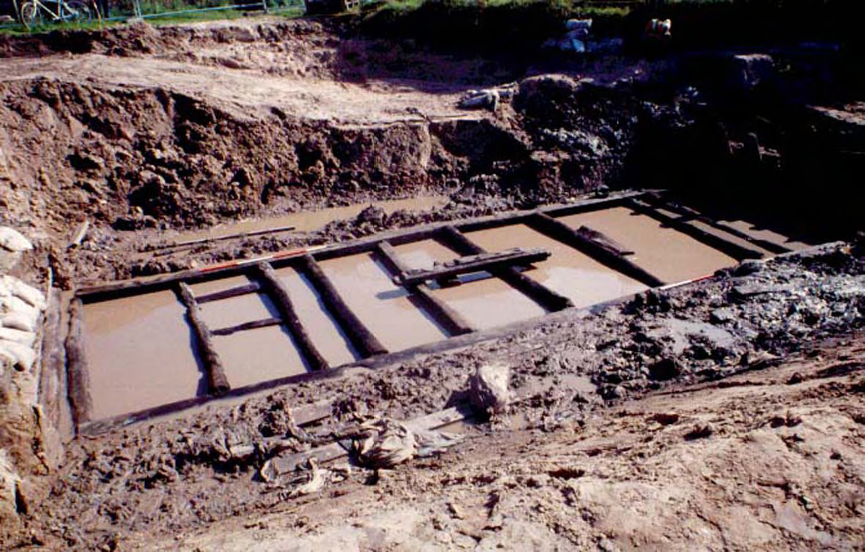
Nantwich Salt tanks

Slide 34
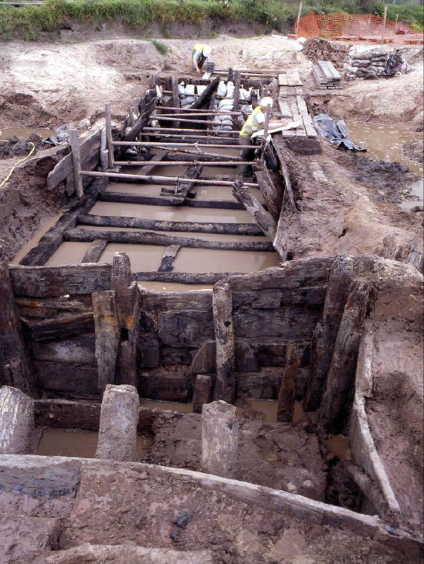
Nantwich Brine tanks

Slide 35
To Conclude
Evidence can be ephemeral – need secondary indicators
Patterns can be discerned
The Roman world was not homogenous in terms of tastes or wants.

