Slide 1
The Roman Economy
Week 3 lecture 1 Production (non agricultural)

Slide 2
Ceramics
Clay (Kaolinite) Primary and Secondary
Dig Clay – Usually not Topsoil
Clean (Beating, Sieving, wet and knead) Or
Levigation (Clean then decant – allowing larger particles to drop to bottom)
Weathering/ Souring
More than one clay may be used
Tempering (thermal shock resistance)
Forming: Hand made, Wheel made, Moulding, Slip Cast
Kilns: Bonfire, Up draught, Down Draught
Fuel

Slide 3
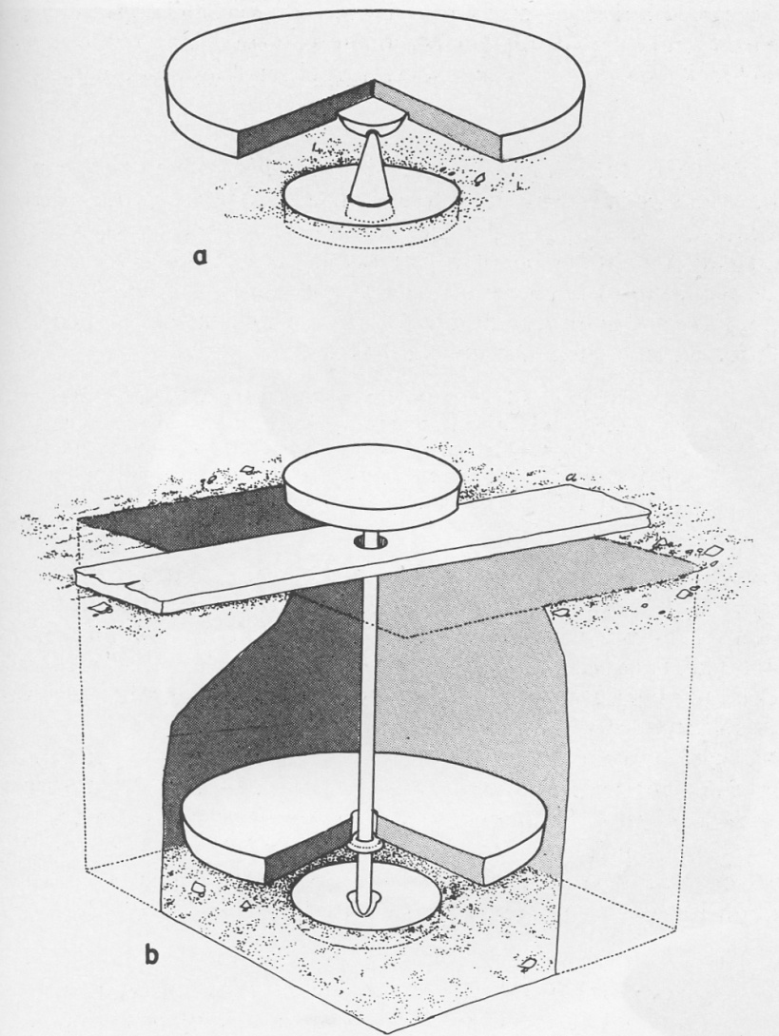
Forming (Wheel made)

Slide 4
Forming
Hand made
Slow wheel
Wheel
Mould
Slip casting

Slide 5
Other Techniques
Burnishing - non-stick, less porous
Incision - knife, combing, rouletting
Stamps - Parisian
Applied - face pots, rustication
Barbotine & 'Celtic art'
Rough cast
Glazing
Slips
Mica Dusting

Slide 6
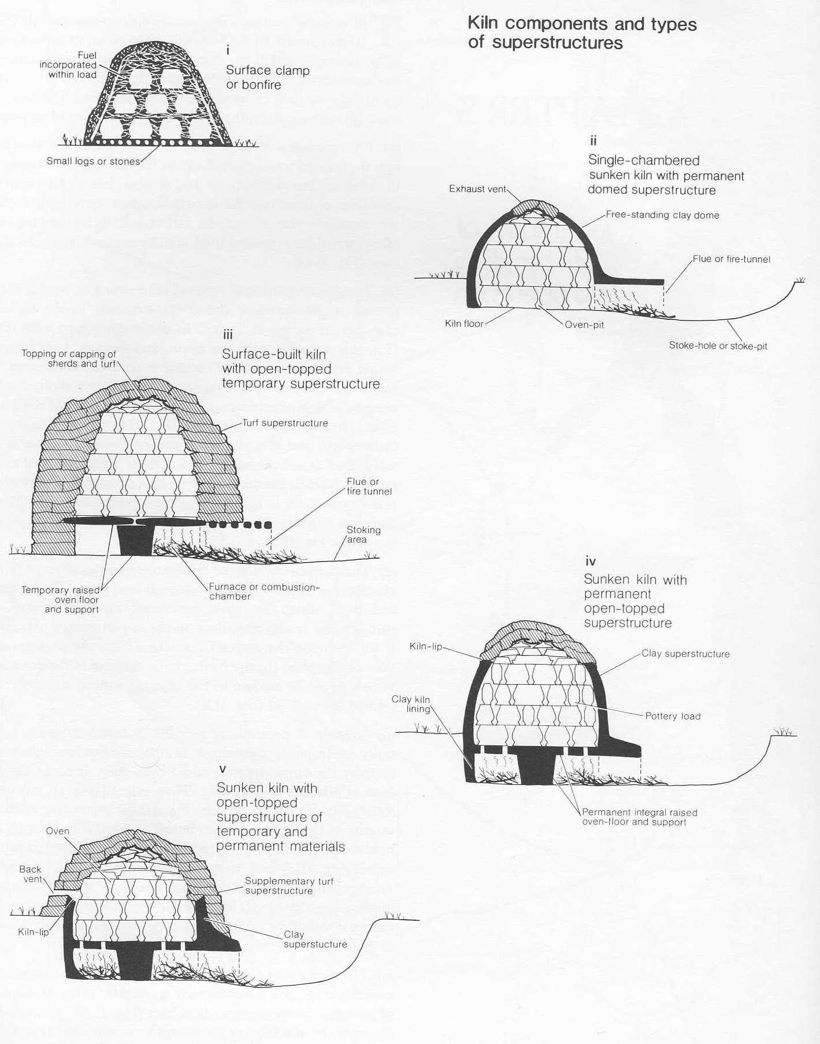
Kilns

Slide 7
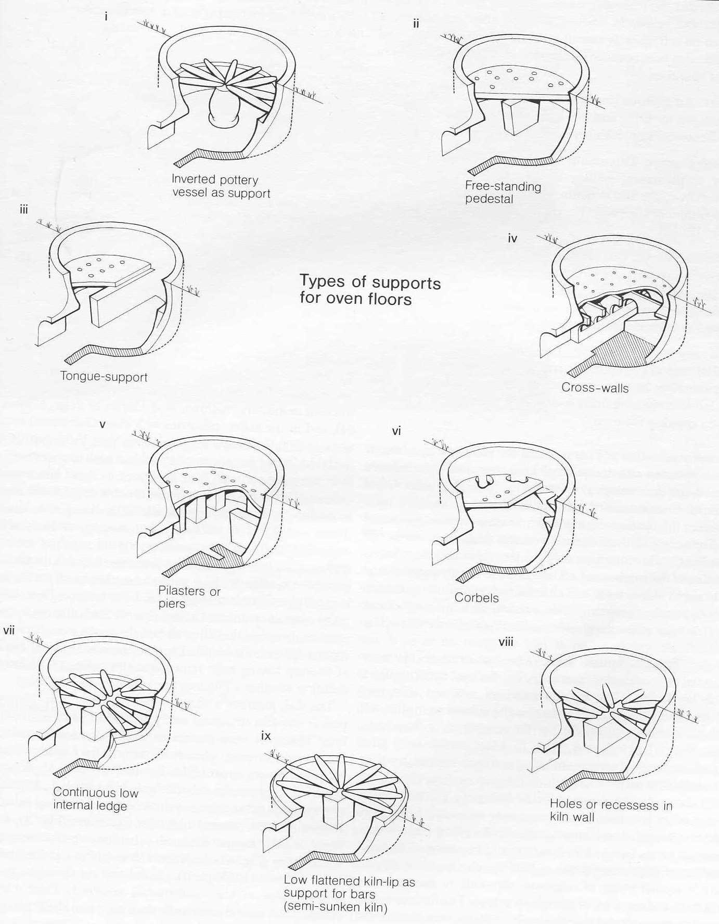

Slide 8
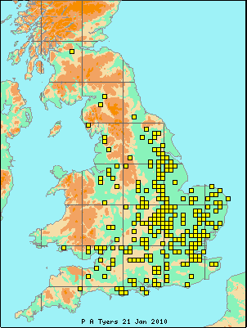
Pottery Kilns of Roman Britain

Slide 9
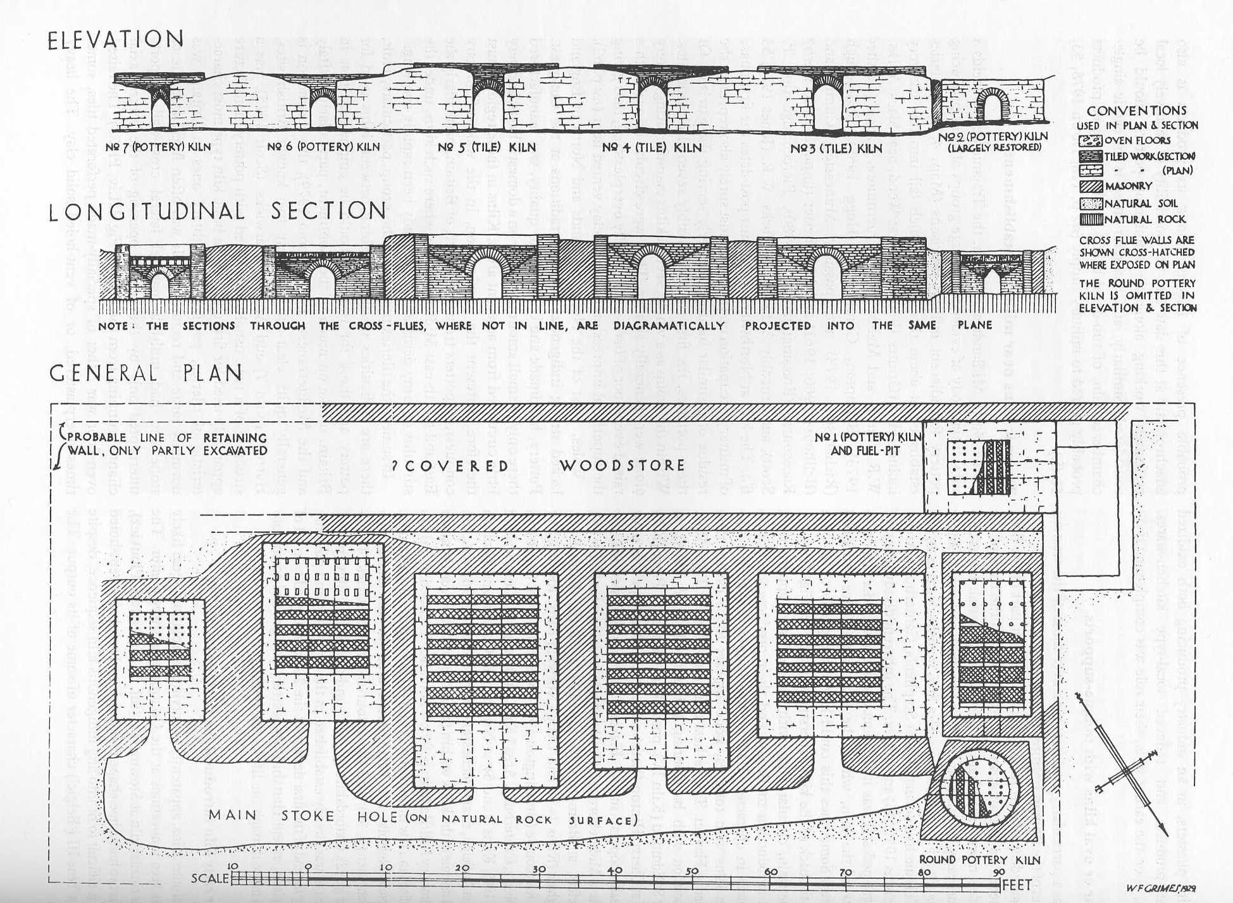

Slide 10
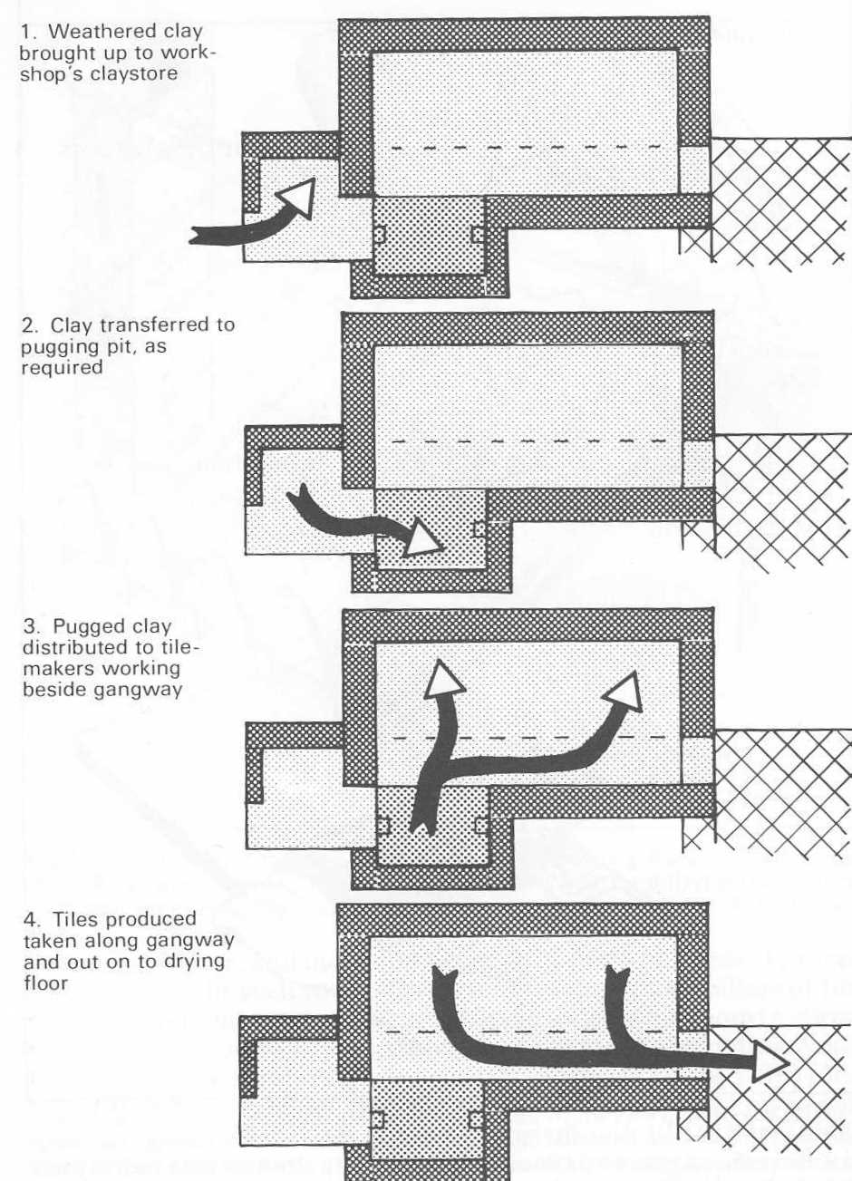

Slide 11
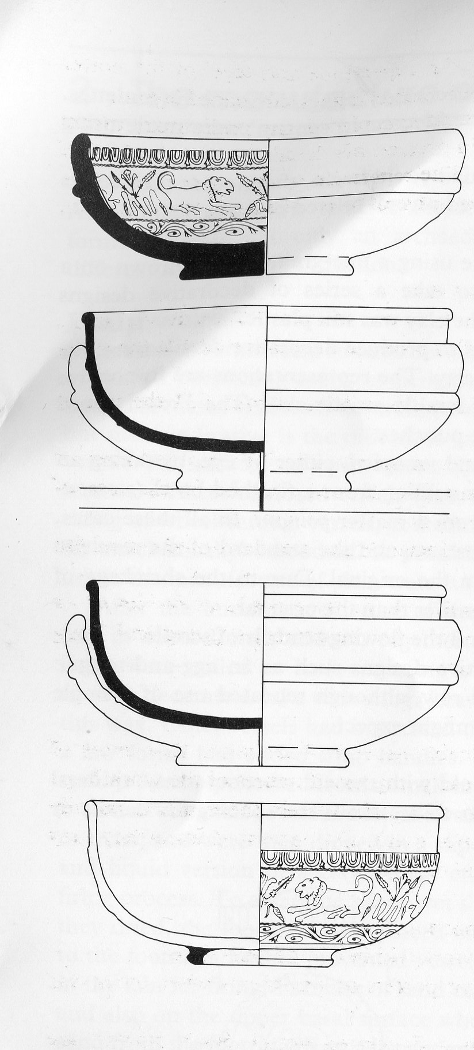
Samian Mould

Slide 12
Glass
Three components: Former, Flux , Stabiliser
Former -Sand (Silica)
Flux – reduces melting temperature -Soda (Natron)- Wadi Natrun, Egypt; Saline plants
Stabiliser – calcium less soluble in water, possibly included with former or flux rather than a separate ingredient.

Slide 13
Glass Vessel manufacture
Cast – in use until mid-late C1
Blown – started in Syria/ Palestime Mid C1 BC
Mould Blown – Common up until C2, sporadic after C4
Free Blown

Slide 14
Copper and its alloys
Ores: native, Oxidised, Sulphides
Sulphides need roasting
Smelting under reducing conditions – no Oxygen
Smithing and Casting
Alloying

Slide 15
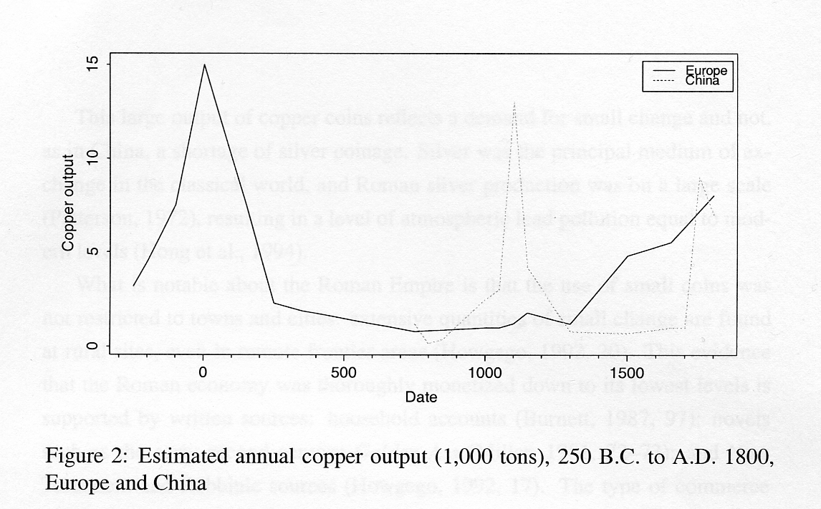
Copper output

Slide 16
Iron
Very widespread distribution of ores:
Carbonates, Hydrated oxides, Limonites, Hematites, Magnetite, Ferroginous Gossans, Manganese ores Bog Iron.
Solid state bloomery process – most impurities liquify in smelting
Smithing remove remaining slags by reheating and hammering
‘Inefficient’ – many old slags reused in C17.

Slide 17
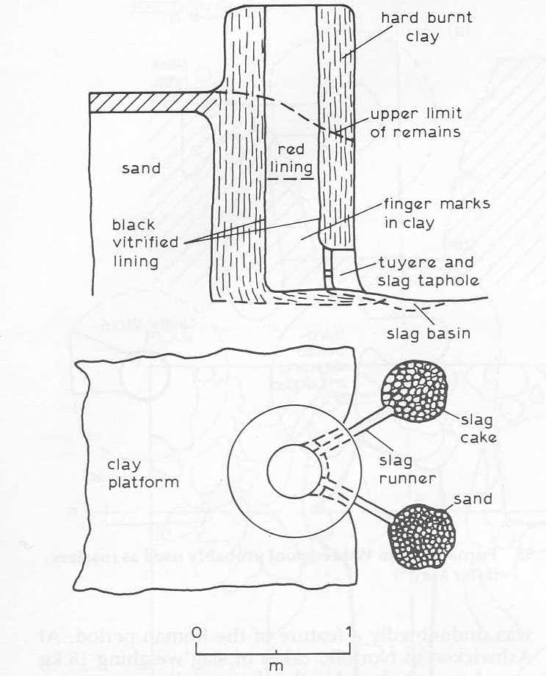
Shaft Furnace

Slide 18
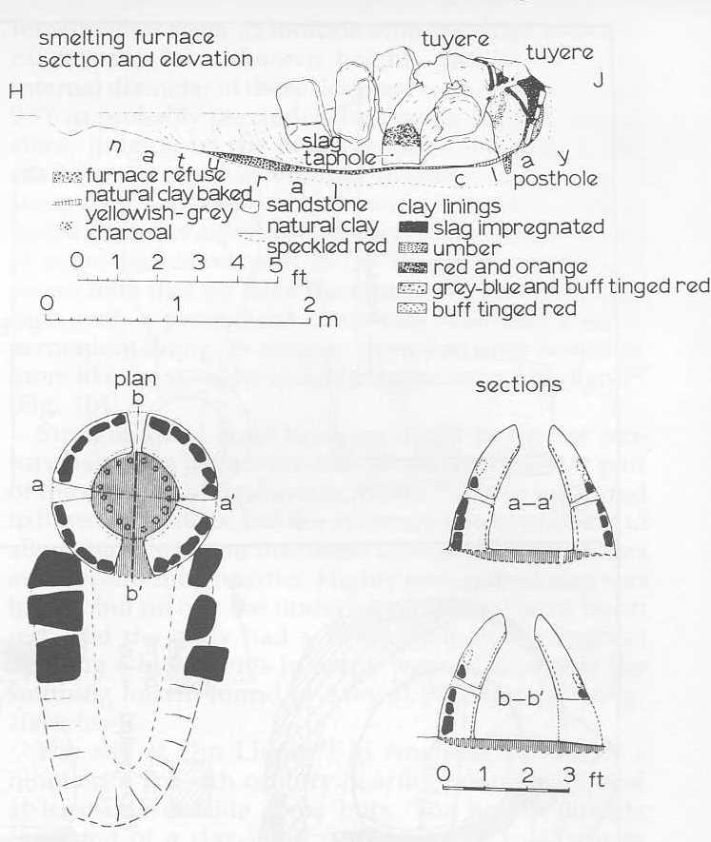
Developed Bowl

Slide 19
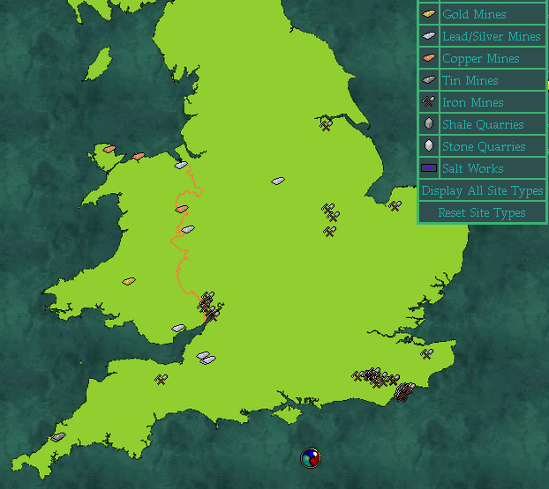
Metal Mining in Britannia

Slide 20
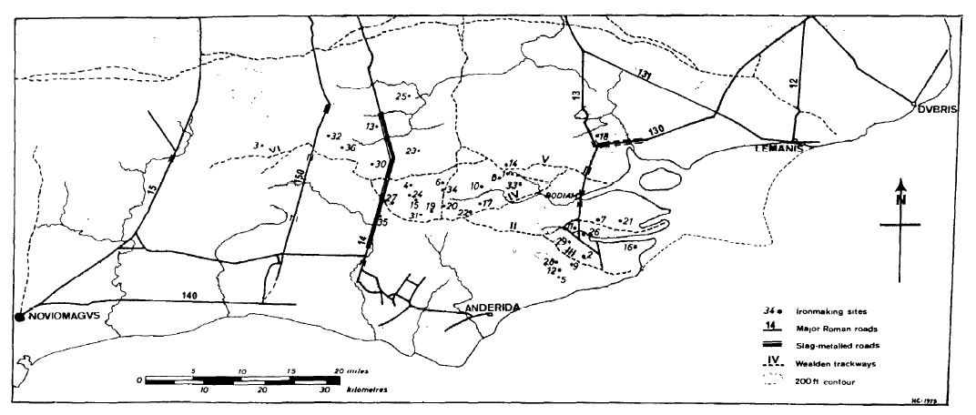
Roman Iron Production in The Weald

Slide 21
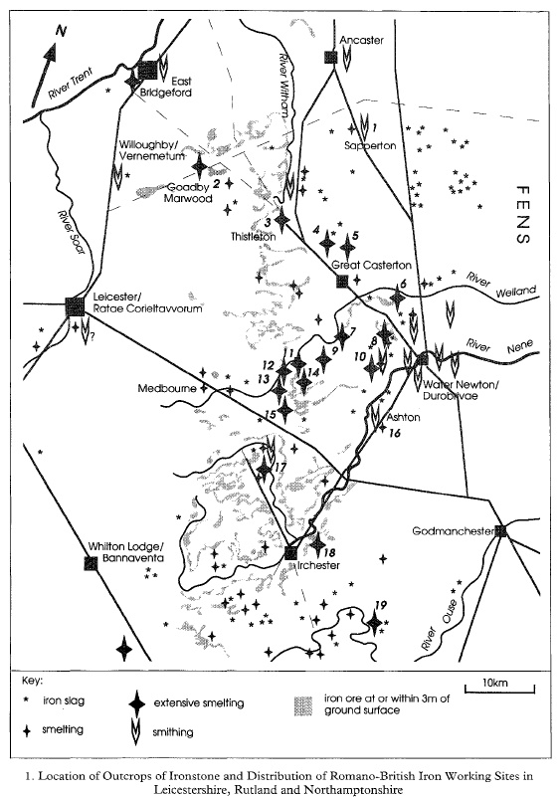
Iron working in Leicestershire, Rutland, Nottinghamshire

Slide 22
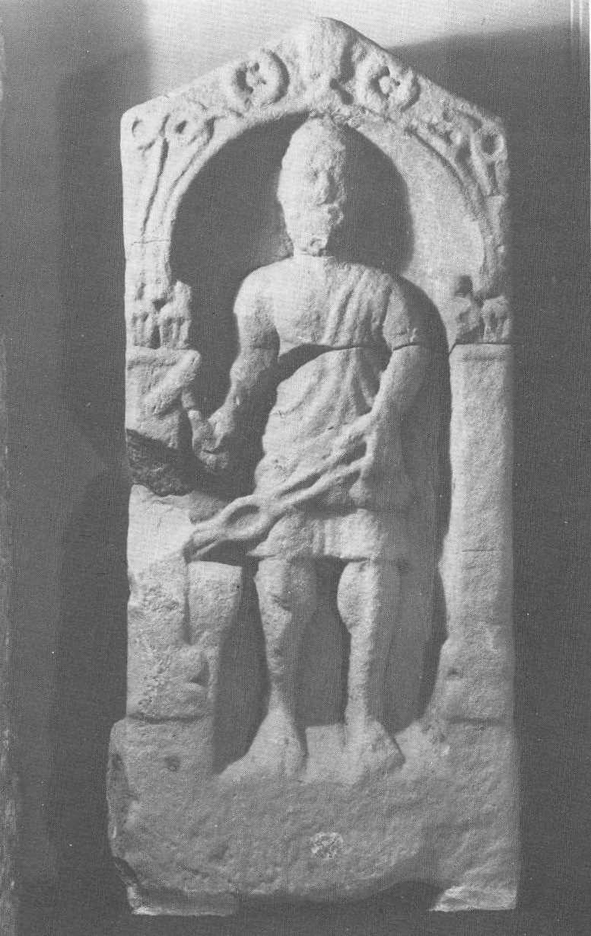
Smithing

Slide 23
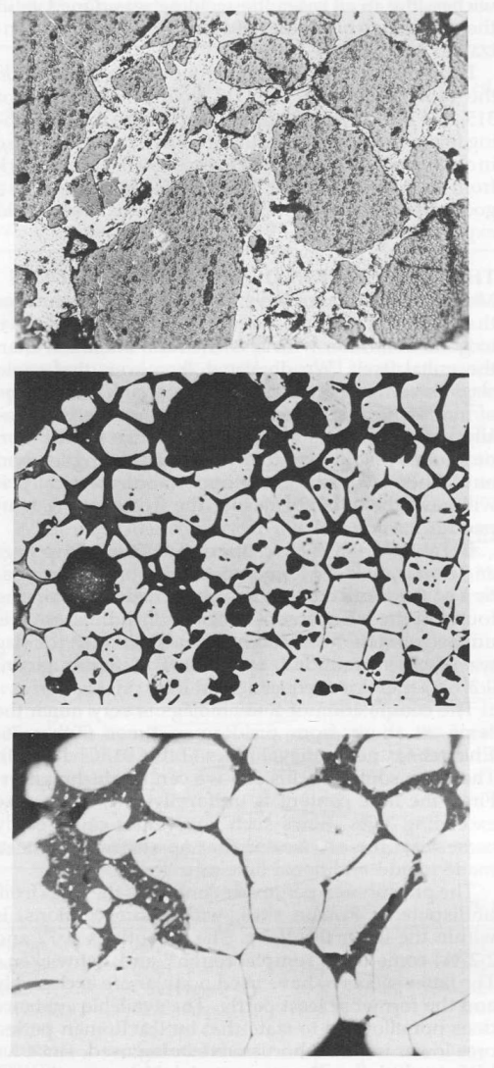
Hammer scale

Slide 24
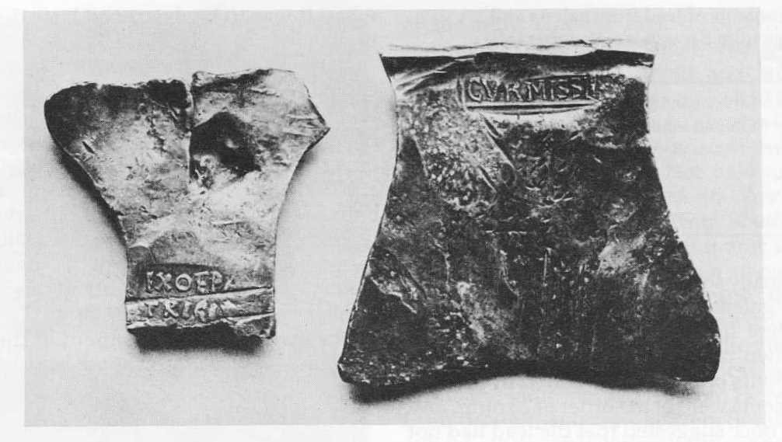
Silver and lead

Slide 25
Textiles
Preparation of fibre
Spinning,
Weaving
Dying (Fuller)
Leather

Slide 26
Other materials
Mortar and Plaster
Mosaics
Wood
Worked Bone

Slide 27
Summary
The empire allowed the rapid transfusion of technologies.
Different technologies traditions and scales were acting simultaneously
The output of some industries e.g. Samian, Iron, copper far outstripped anything until the later middle ages

