Slide 1
Roman Economy Week 4
Consumption and location

Slide 2
Where did Economic Activity Take Place?
What traces does it leave in the archaeological record
Shack
Farm
Villa
Town House
Shop
The forum

Slide 3
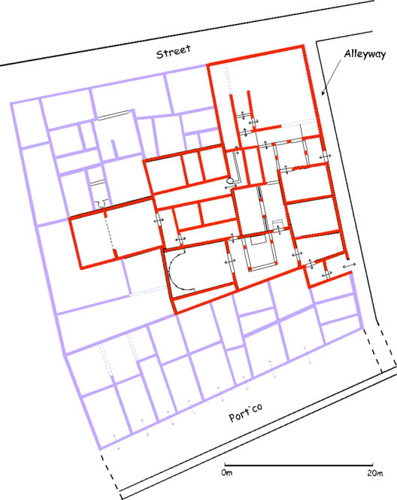
The Home

Slide 4
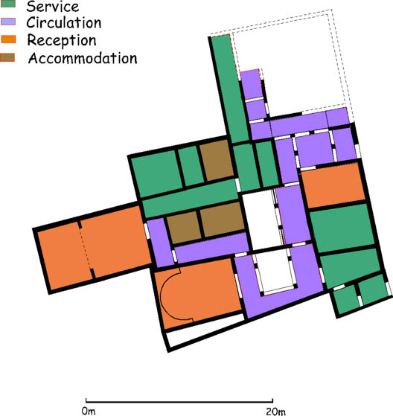

Slide 5
Site Types
Base level Rural – ladder and brickwork settlements
farms
Villa
‘Small Towns’
Vicus
Oppidum, Urbs, Municipium
Towns
Colonia
Civitas (Polis)
Military
Temple

Slide 6
Taphonomy
Briefly where and how material deposited can reflect site type ( More layers in Villas and Urban sites) effect the nature of the evidence for different sites

Slide 7
Small Finds: A blanket term often used to describe an excavated object which needs more detailed initial recording , description in publication, and possibly a more controlled environment for storage than pottery or animal bone. Crummy 1983.
Bulk finds: Pottery, Brick and Tile, Animal bone, Architectural Stone.

Slide 8
Animal Bone
Military sites- Cattle predominate
Urban Sites – Pigs dominate
Rural site – Sheep / Goat

Slide 9
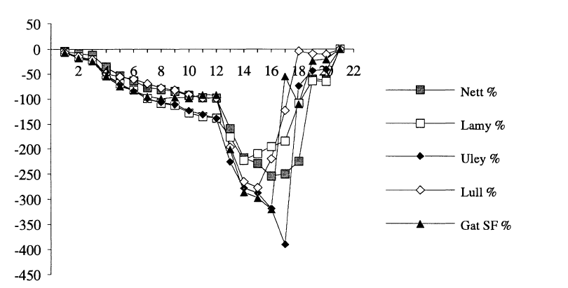
Coins (Temples)

Slide 10
Small Finds
Functional groups:
Personal Ornamentation
Toilet, Surgical or pharmaceutical instruments
Manufacture or working of textiles
Household utensils and furniture
Recreational purposes
Weighing and measuring
Used for or associated with written communication
Transport
Buildings and services
Tools
Fasteners and Fittings
Agriculture, horticulture and animal husbandry
Military equipment
Religious beliefs and practices
Objects and waste from metal working
Objects and waste with antler, horn, bone, tooth working
Manufacture of pottery or pipe clay objects
Unknown function
Others have included: (Heating and lighting; Coins, Vessels)

Slide 11
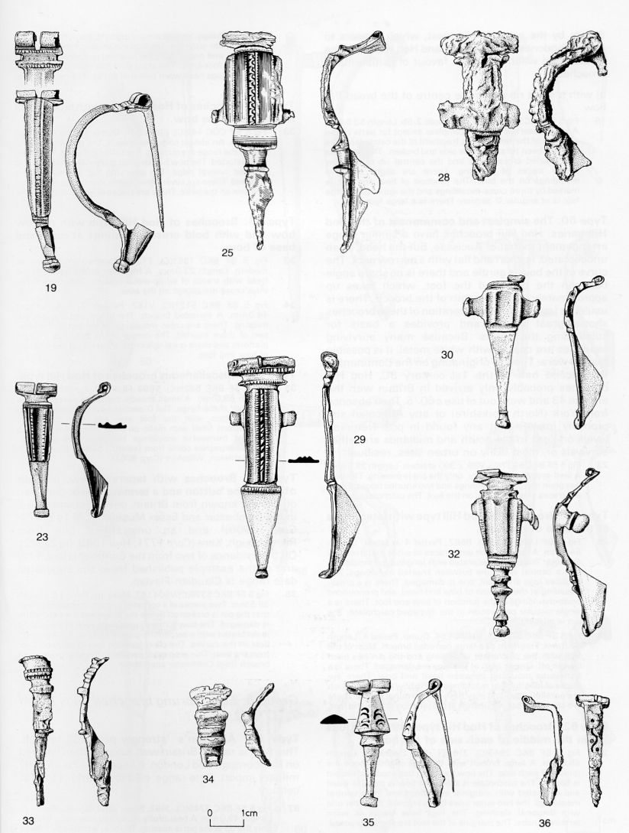
Personal Ornamentation

Slide 12
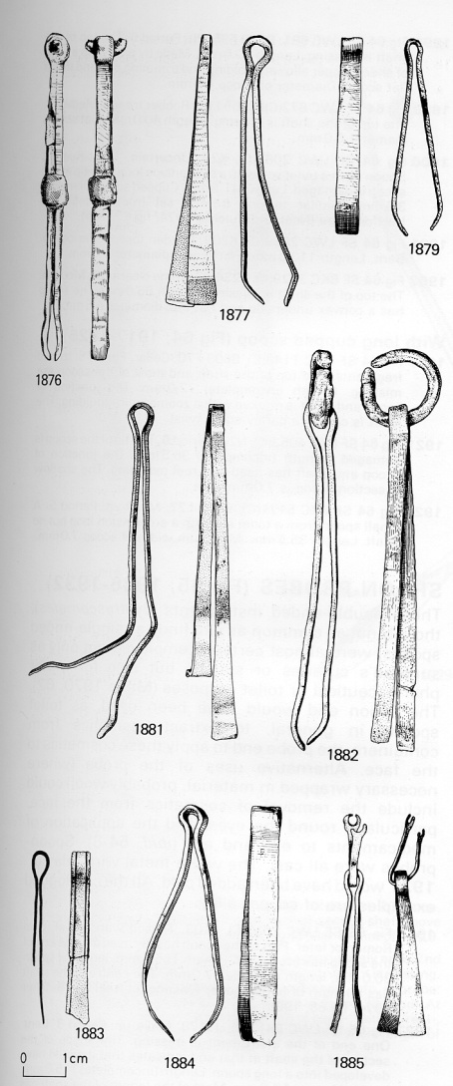
Toilet, Surgical or pharmaceutical instruments

Slide 13
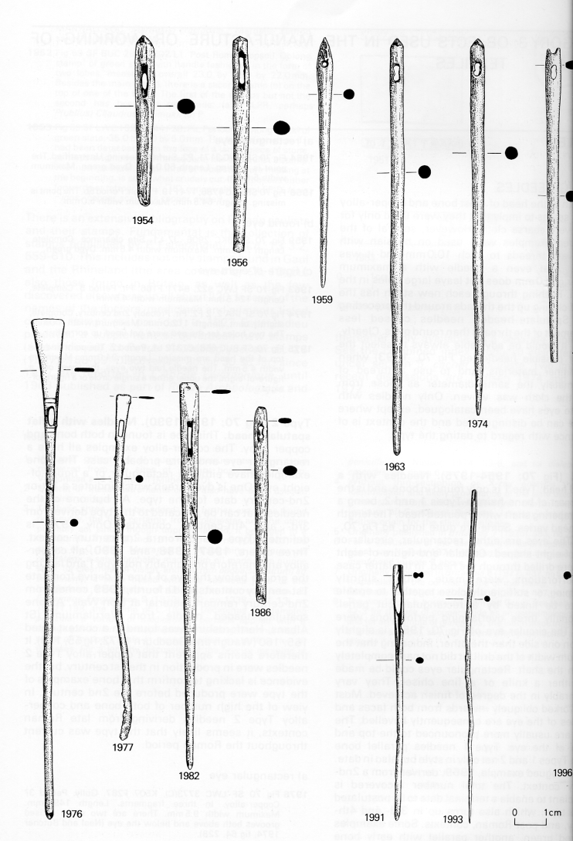
Manufacture or working of textiles

Slide 14
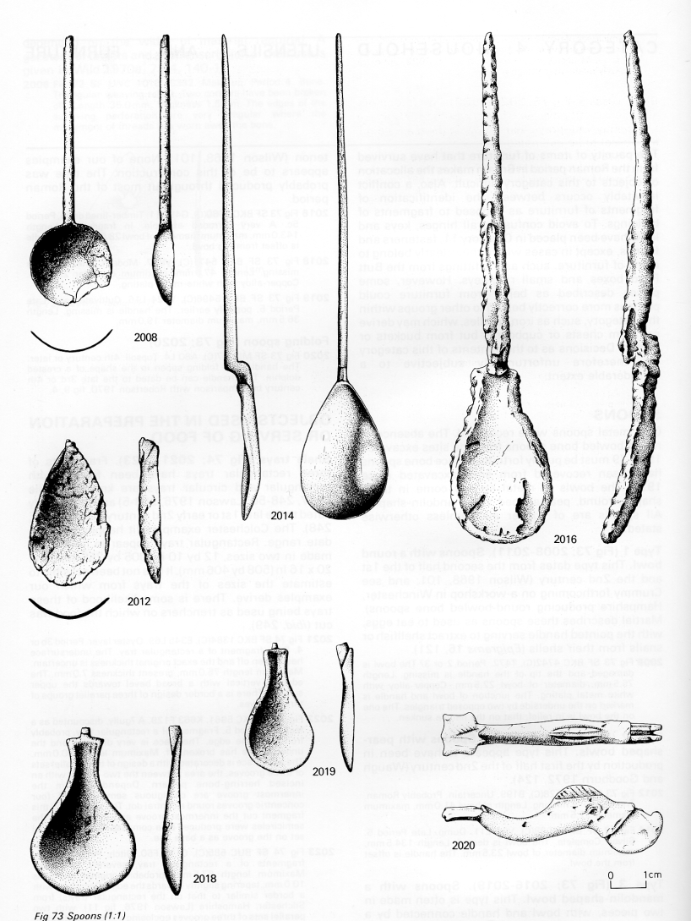
Household utensils and furniture

Slide 15
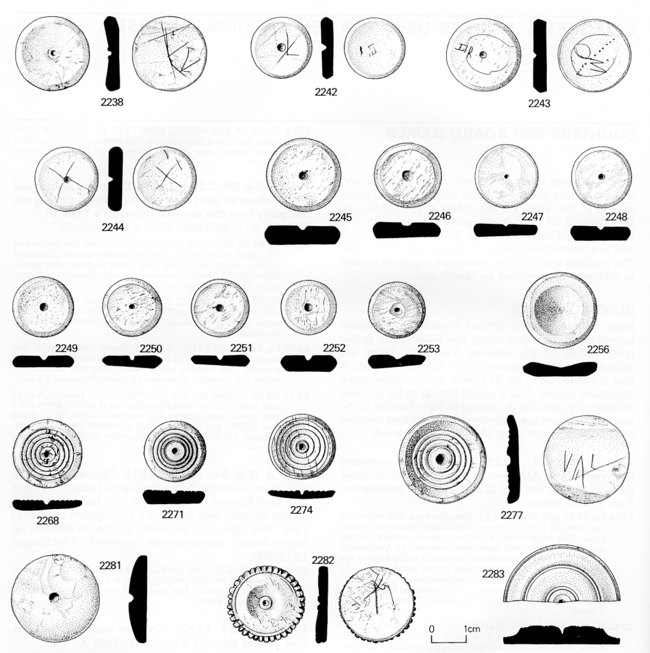
Recreational purposes

Slide 16
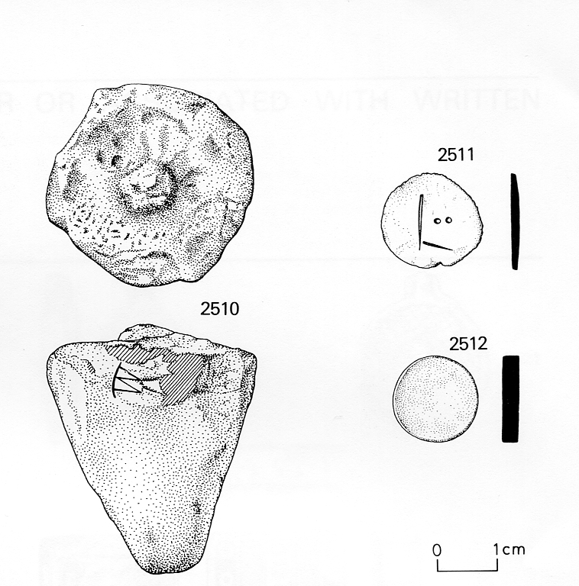
Weighing and measuring

Slide 17
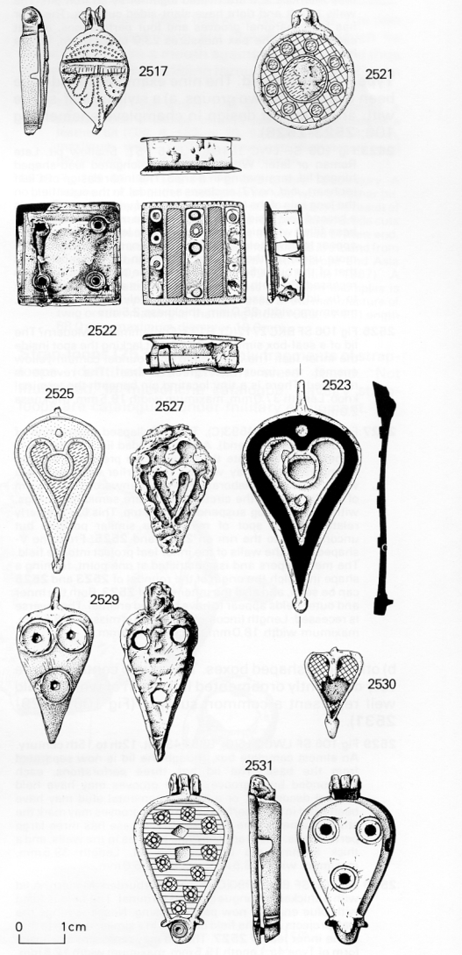
Used for or associated with written communication

Slide 18
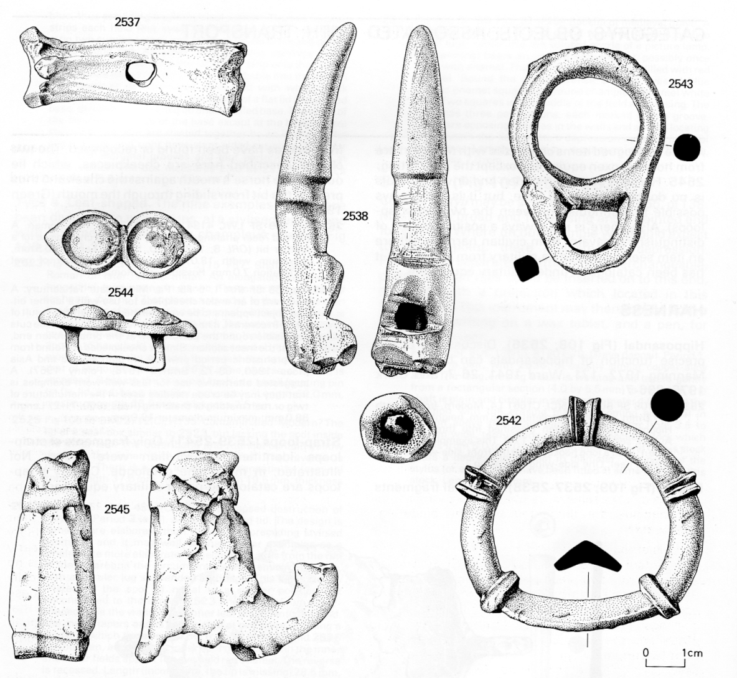
Transport

Slide 19
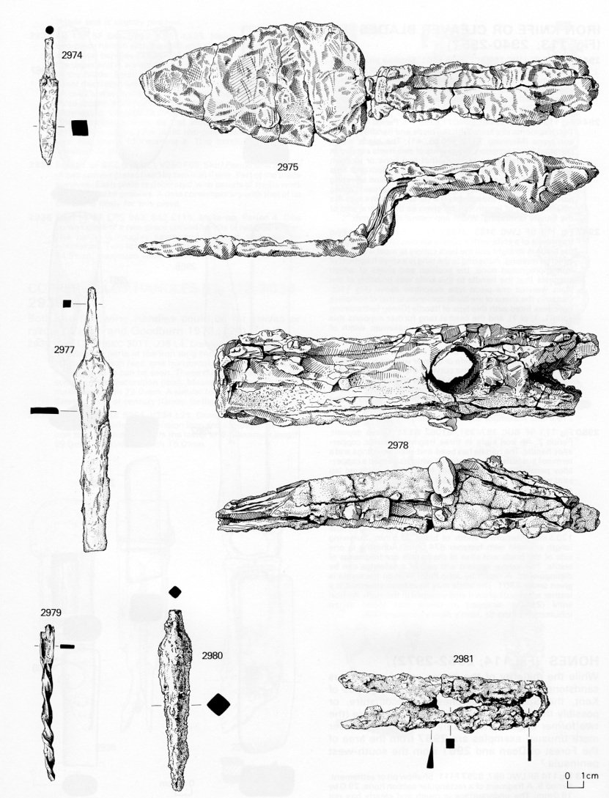
Tools

Slide 20
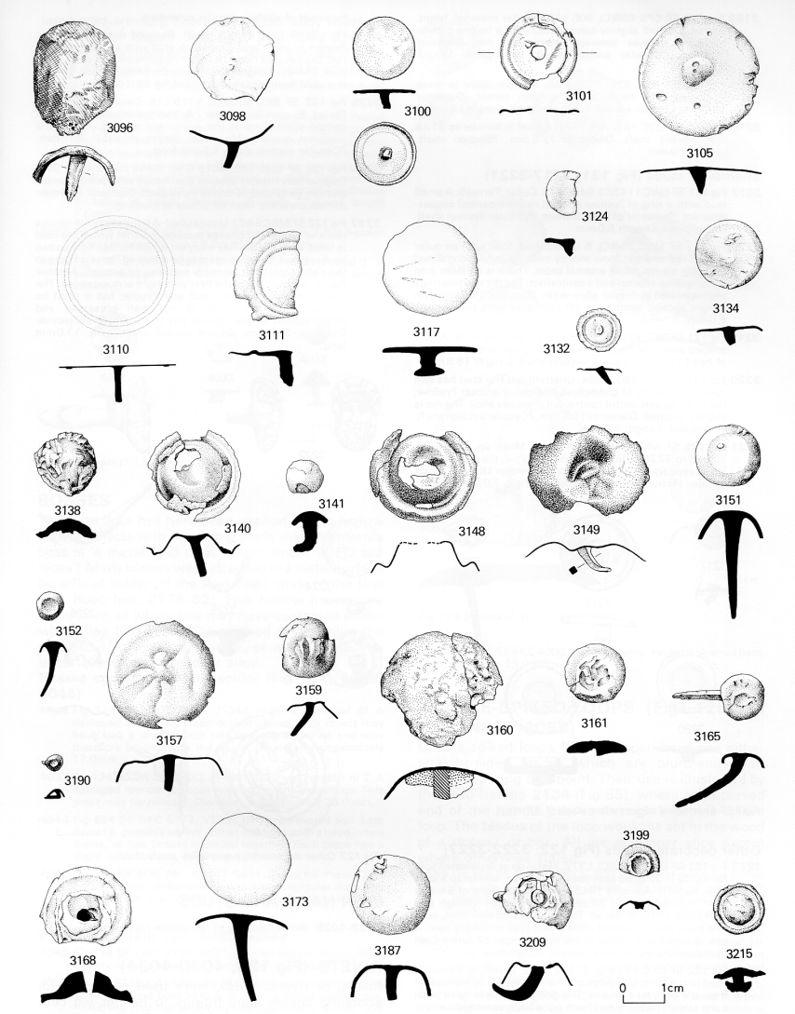
Fasteners and Fittings

Slide 21
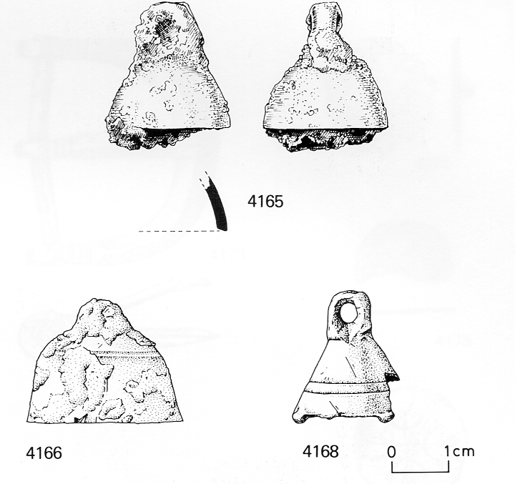
Agriculture, horticulture and animal husbandry

Slide 22
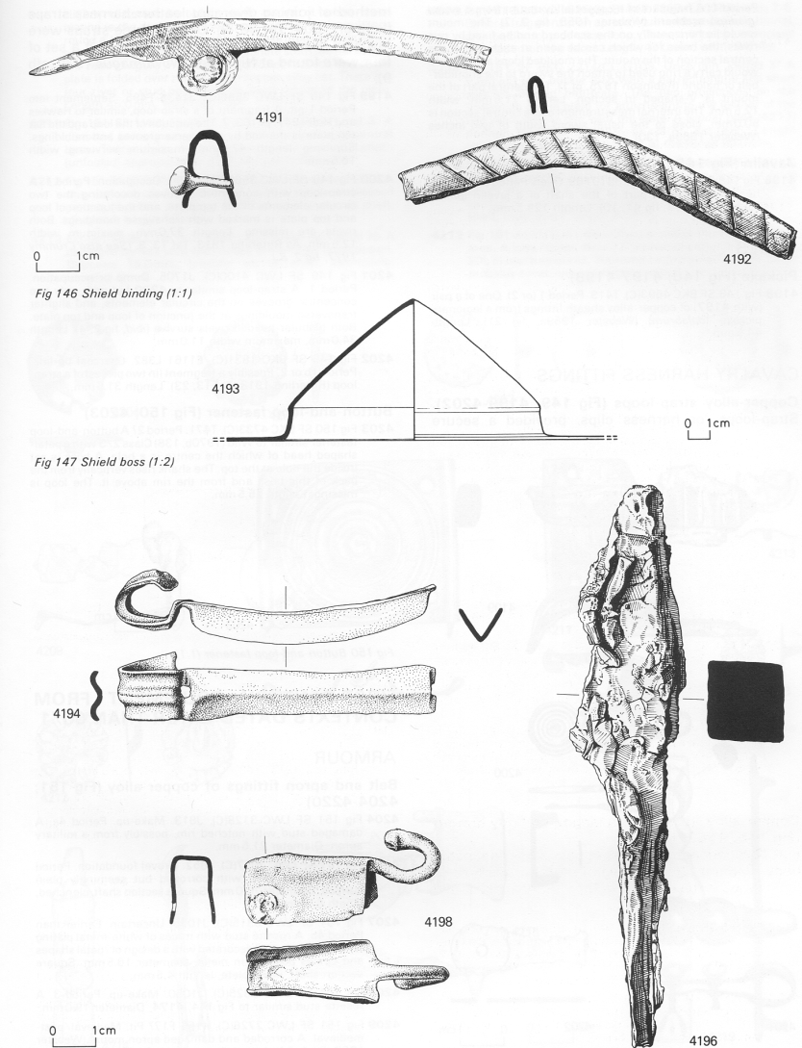
Military equipment

Slide 23
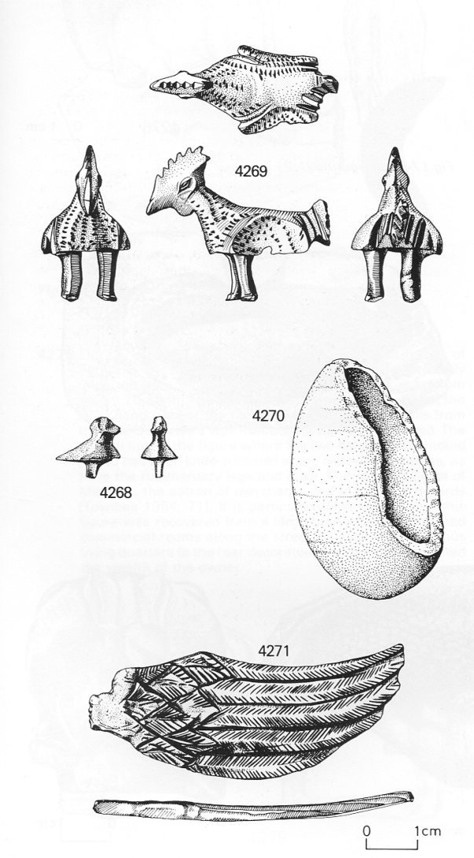
Religious beliefs and practices

Slide 24
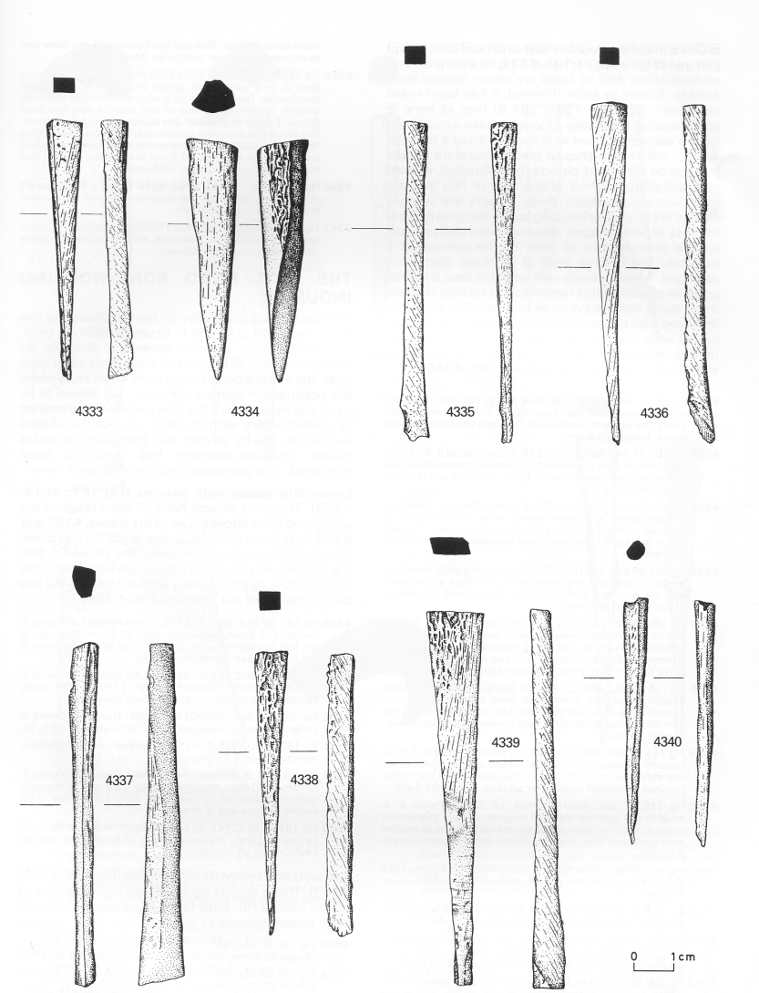
Objects and waste with antler, horn, bone, tooth working

Slide 25
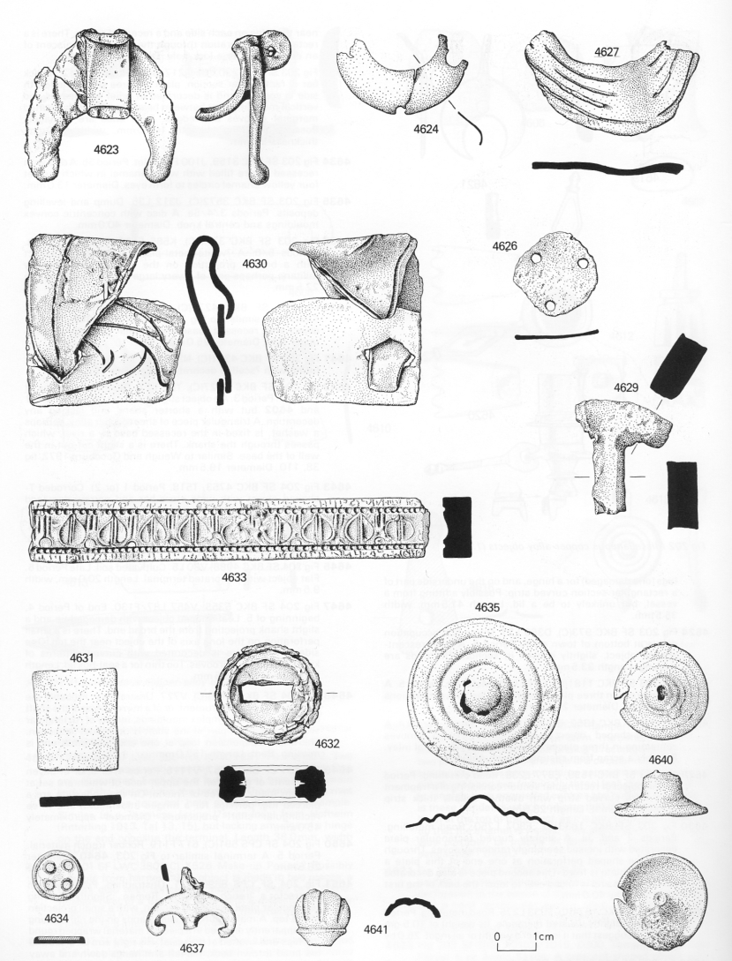
Unknown function

Slide 26
Examples of Function by site type

Slide 27
Ras el Bassit by Area and Phase

Slide 28
Pottery Functional Groups
A –Amphora
F – Flagon Ju – Jug CJ – Constricted Neck Jar
J – Jar
WMJ – Wide Mouth Jar SJ – Storage Jar (Other Jars)
Bk- Beaker Cu – Cup Tk-Tankard
M – Mortaria
B- Bowl D – Dish (Table wares)
L - Lid
O – Other
Casserole
Cooking pot
Basin
Pithoi/ Dolia

Slide 29
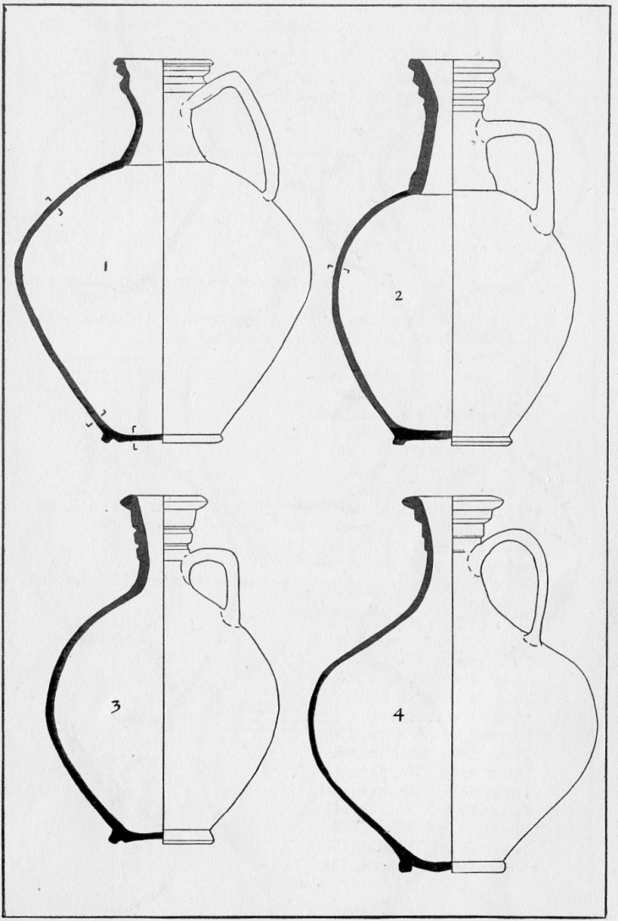
Flagons/ Jugs

Slide 30
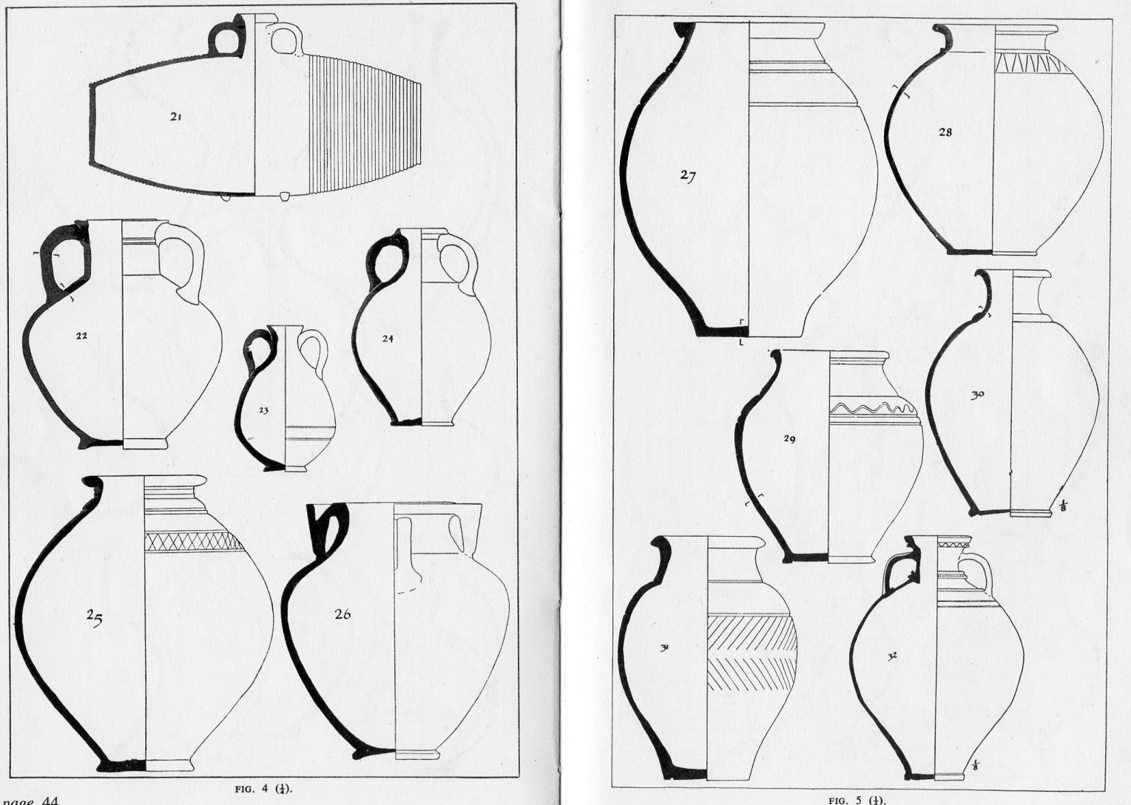
Constricted necked jars

Slide 31
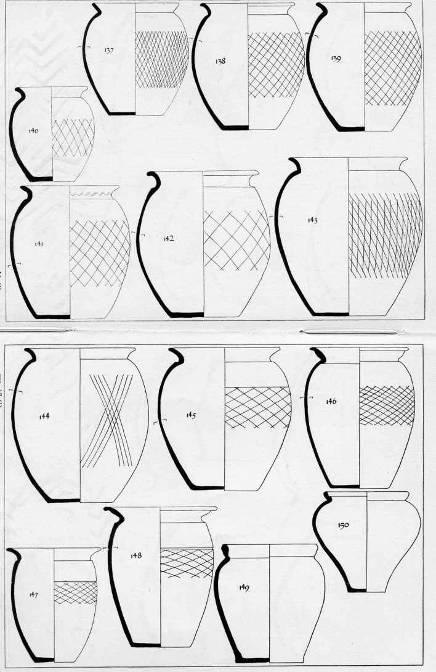
Jars

Slide 32

Wide Mouth Jar

Slide 33

Storage Jar

Slide 34
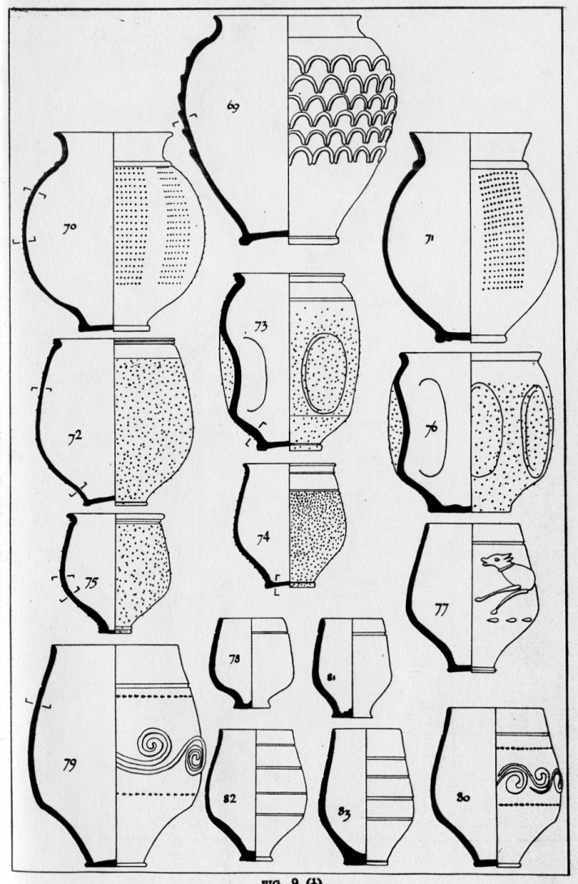
Beaker

Slide 35
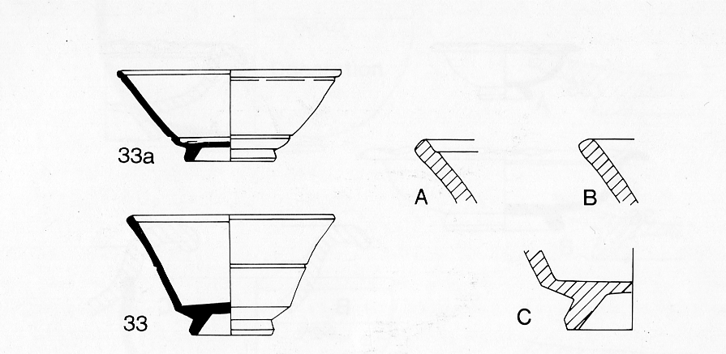
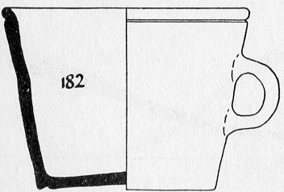
Tankards/ Cups

Slide 36
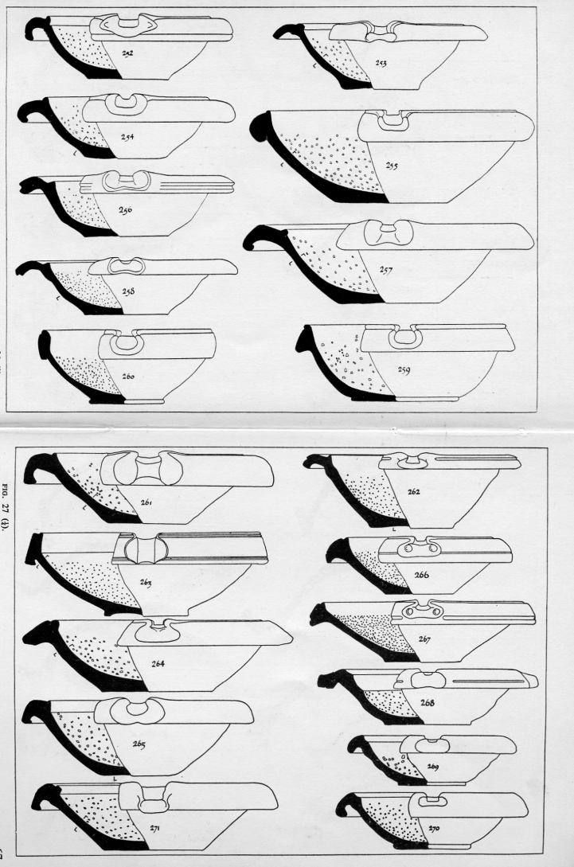
Mortaria

Slide 37
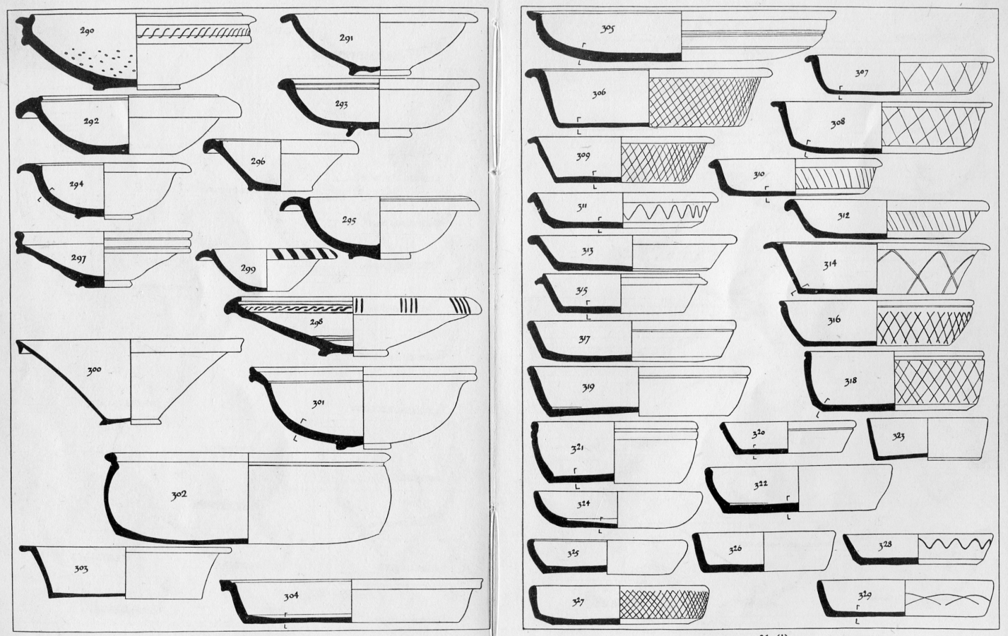
Bowls and Dishes (Table Ware)

Slide 38
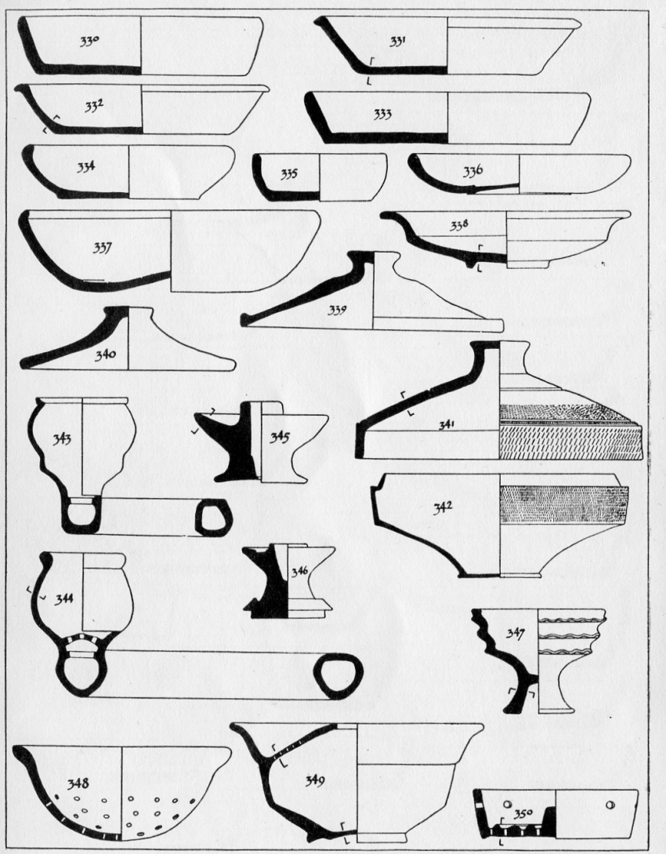
Lids/ Other

Slide 39
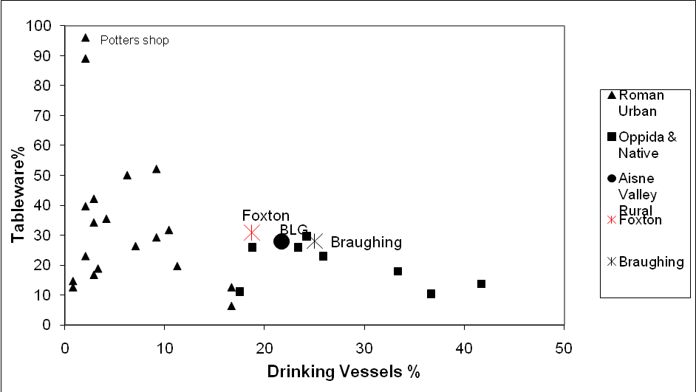
Tableware V Drinking Vessels

Slide 40
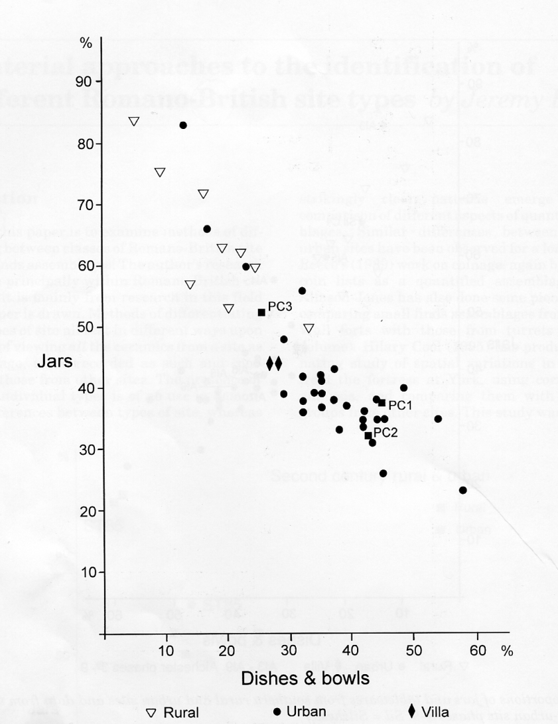
Jars V Tableware

Slide 41
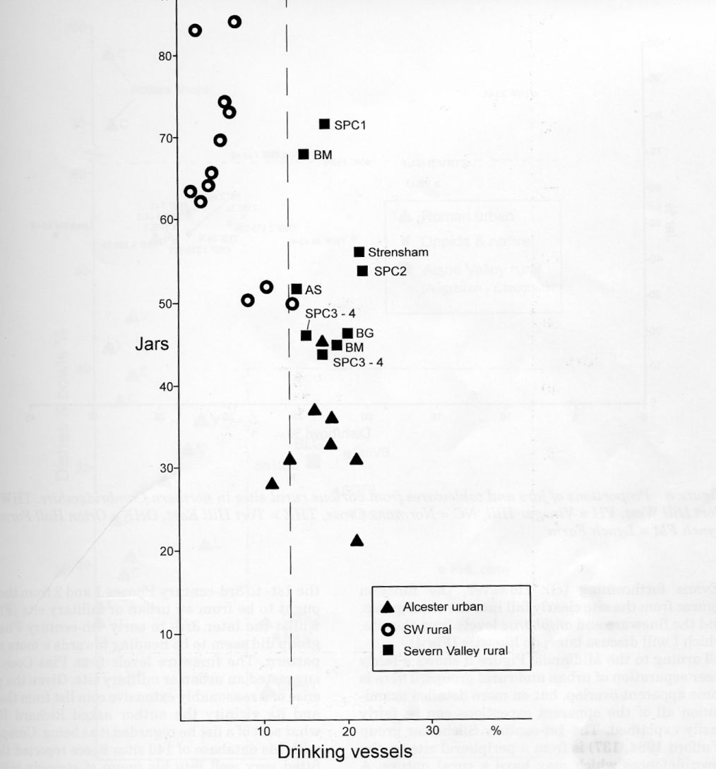
Jar V Drinking Vessel

Slide 42
Sites in Cambridgeshire

Slide 43
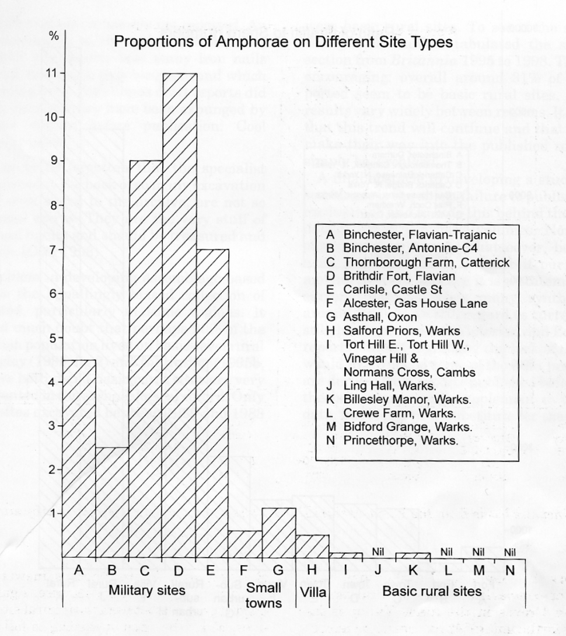
Amphorae

Slide 44
Ware Types
A - amphora
B – Black Burnished
C – Shelly
E - Grog Gallo Belgic
F – Fine(Colour coat)
G – Gritty Normally hand made
M - Mortaria
O – Oxidised
Q – White Slip
R – Reduced
S – Samian
W – White ware
Z - Medieval
N – Dolia; L T Bricks and Tiles

Slide 45
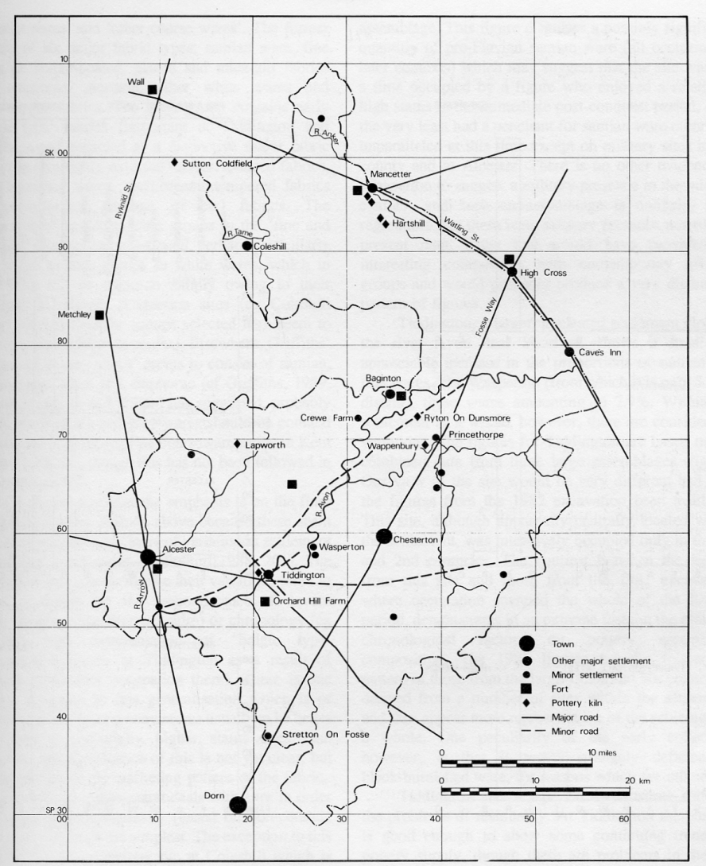

Slide 46
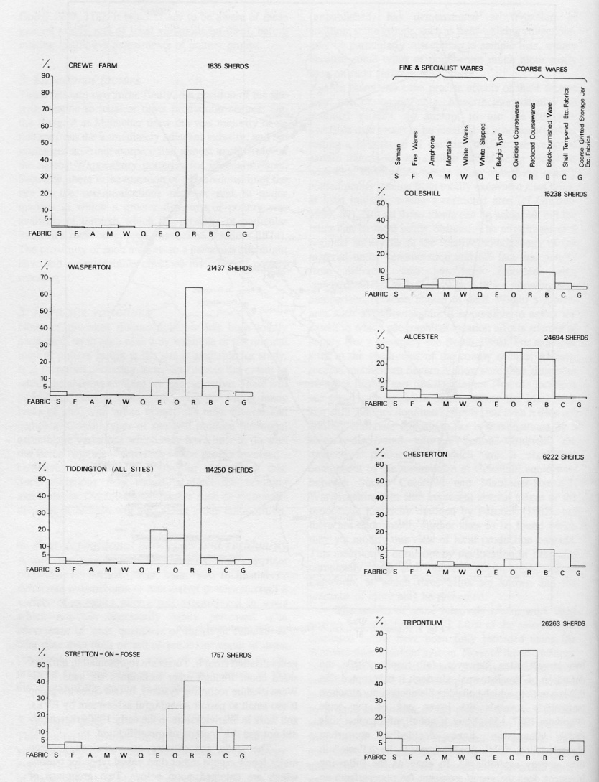

Slide 47
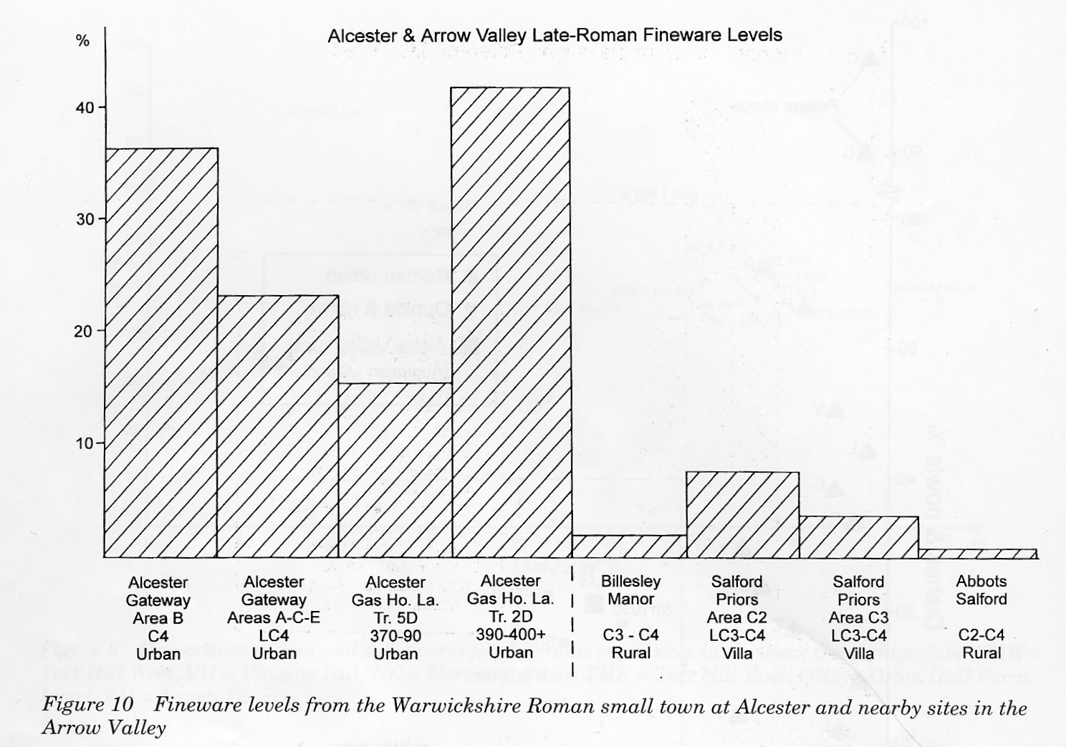
Fineware levels

Slide 48
Samian
the proportion of samian present within Roman pottery groups strongly reflects the character of the site from which the groups derive (e.g. Willis 1998a, Table 1 and 2);
there exists a marked correlation between site type/status and the proportion of decorated samian ware present, as opposed to plain ware (Willis 1998a, Table 3).

Slide 49
Samian
the proportion of samian present within Roman pottery groups strongly reflects the character of the site from which the groups derive;
there exists a marked correlation between site type/status and the proportion of decorated samian ware present, as opposed to plain ware .

Slide 50
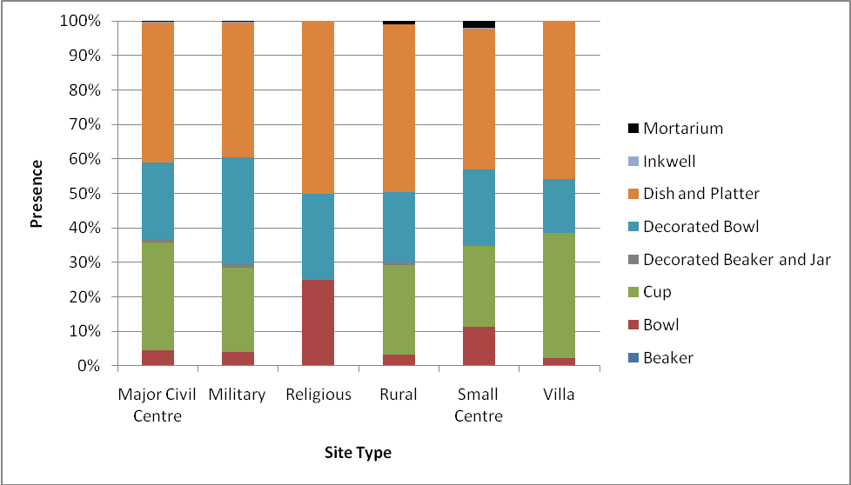
Willis’ functional analysis (for larger categories) for different sites

Slide 51
Willis’s functional analysis for different site types
)

