Slide 1
Pots and Pans
Week 4 Lecture 2
Sigillata and Other Fine wares

Slide 2
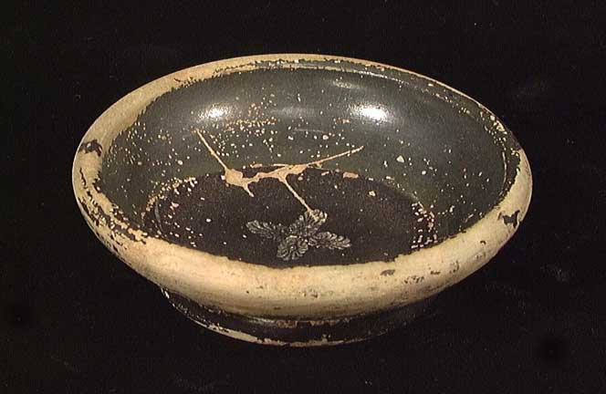
Hellenistic Black Gloss Tradition

Slide 3
Sigillata Red Gloss wares
C1 BC move from ‘Hellenistic’ Black gloss to Red Gloss
Eastern Sigillata a – c.150BC – LC2/ EC3AD ( AD10 – 200 influenced by Italian forms)
Arratine c. 40 BC – C. AD 50
Eastern Sigillata AD 1 -150
Southern Gaulish AD 40 -110
African Red Slip LC1 - C7/8
Central Gaulish AD C2
Eastern Gaulish AD MC2 – C3

Slide 4
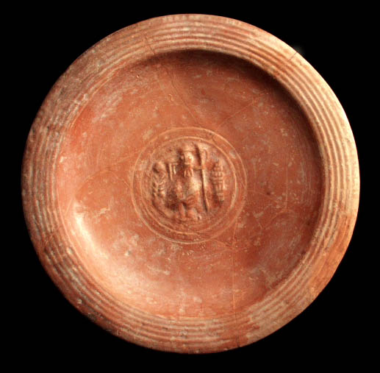
ESA

Slide 5
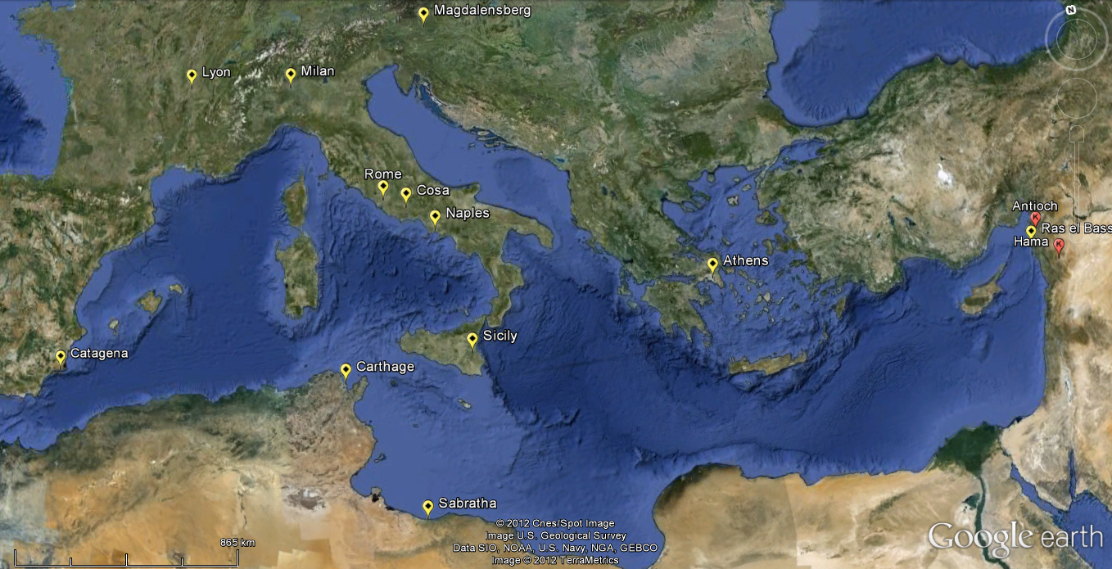
ESA Distribution

Slide 6
ESA Chronology
Starts somewhere before 150 BC
Early Transitional Black gloss phase
Wide spread distribution after 50 BC
Decline starts end Augustan Period (AD 20), replaced with Arratine/ Italian TS
Possible revival Mid –late C1 AD (evidence from Pompeii)
Short lives as ESB2 (Adriatic source) soon replaces.
Does not last beyond Antonine period (C2) in core zone.

Slide 7
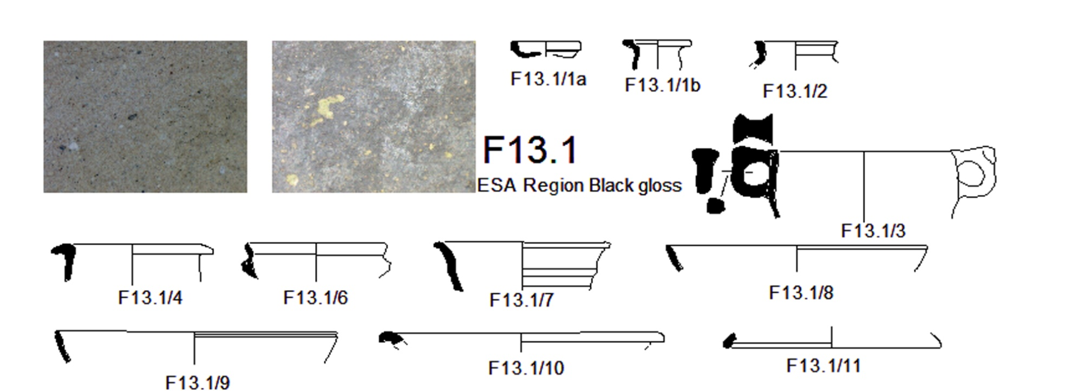
ESA Region Black Gloss

Slide 8
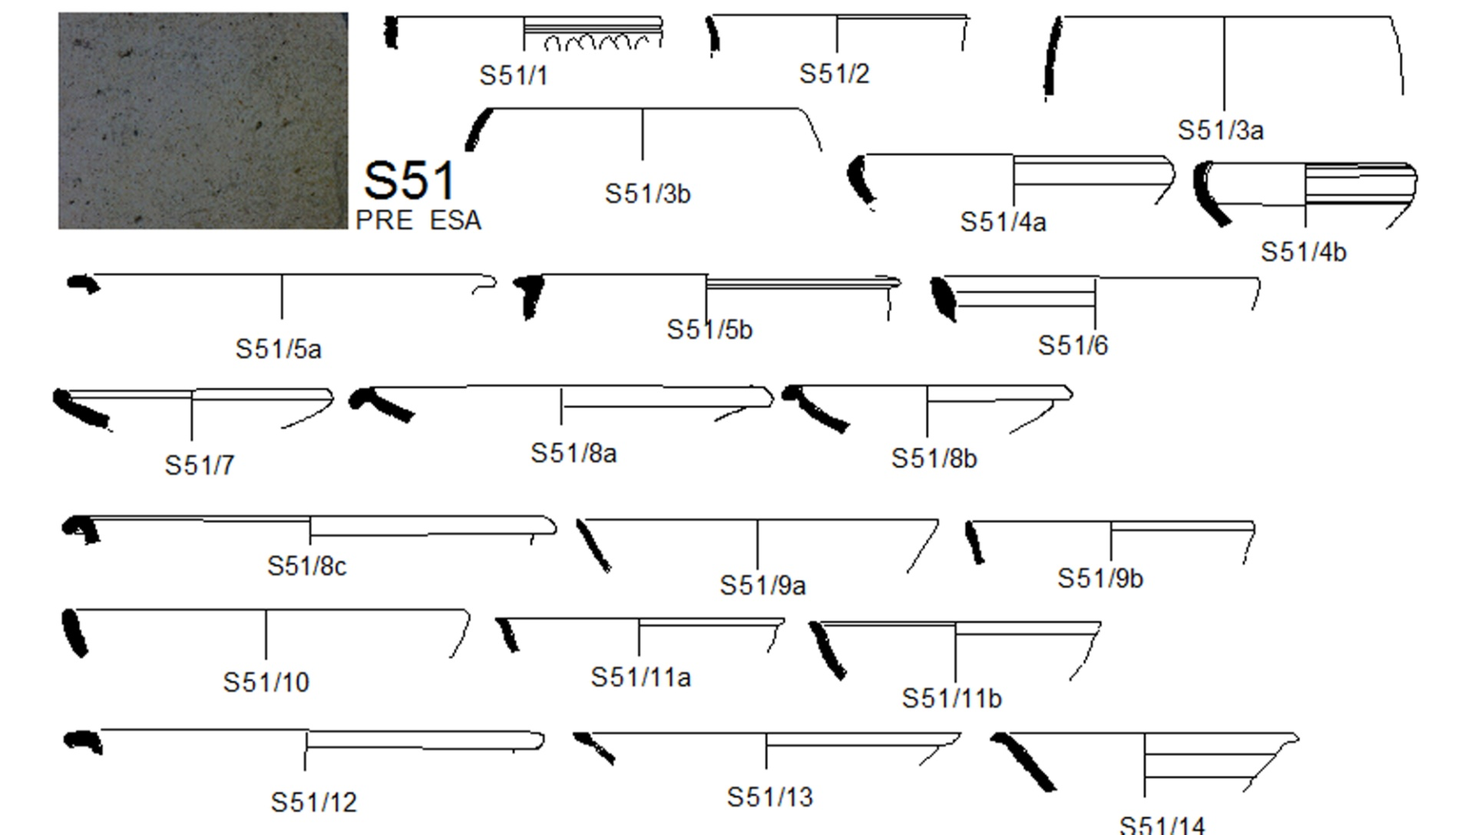

Slide 9
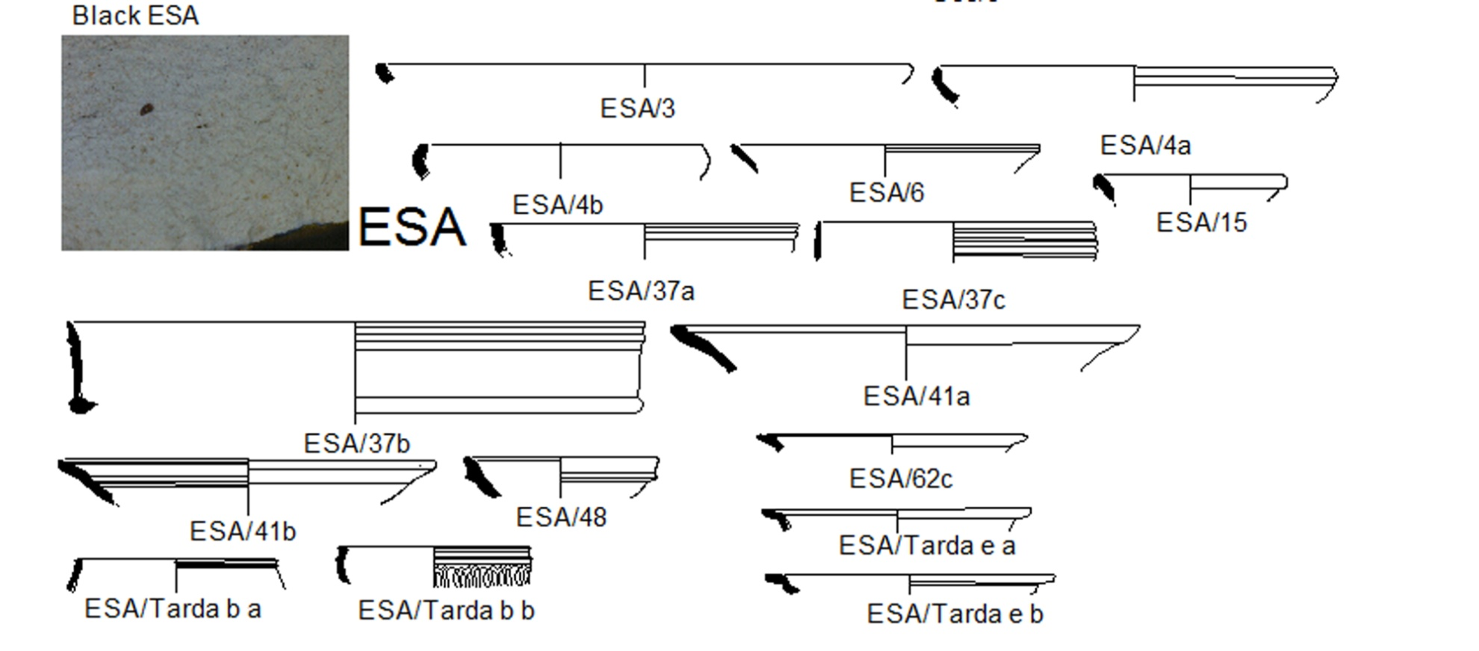

Slide 10
Italian Terra Sigillata
Now known to come from several sources :
Arezzo, Pisa, Tiber valley, Pozzuoli most important.
Red gloss introduced AD 40 -30.
Diverse range of forms until AD 40 – 50 when stagnation sets in
Dates in the west come from short lived military sites

Slide 11
Distribution
Quickly exported to Gaul, Spain, Rhineland
By 15 – 10 BC found in the Aegean
Then Syria, Palestine Eygpt
By 10/20 AD at Arikamedu, India
Forms varies in wesst and eastern export markets e.g. Cup form Haltern 8 dominates in west, but rare in East.
Loose market in mid 1st century due to rise of Aegean production

Slide 12
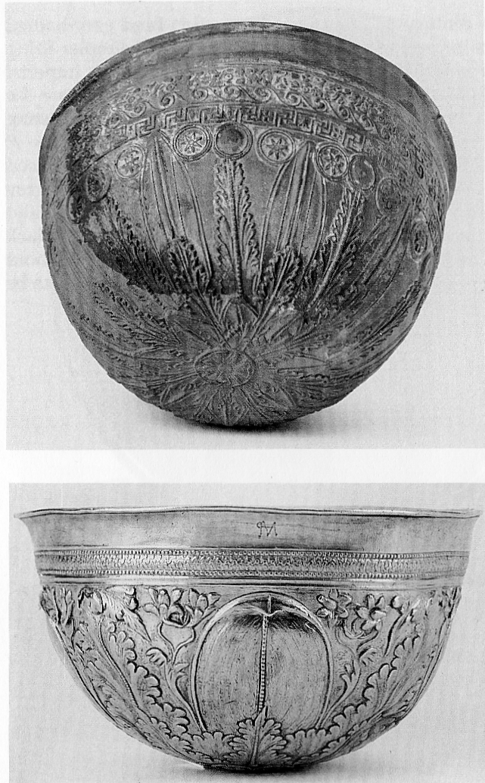
Megarian Bowl

Slide 13
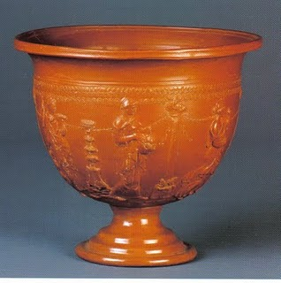
Arratine

Slide 14
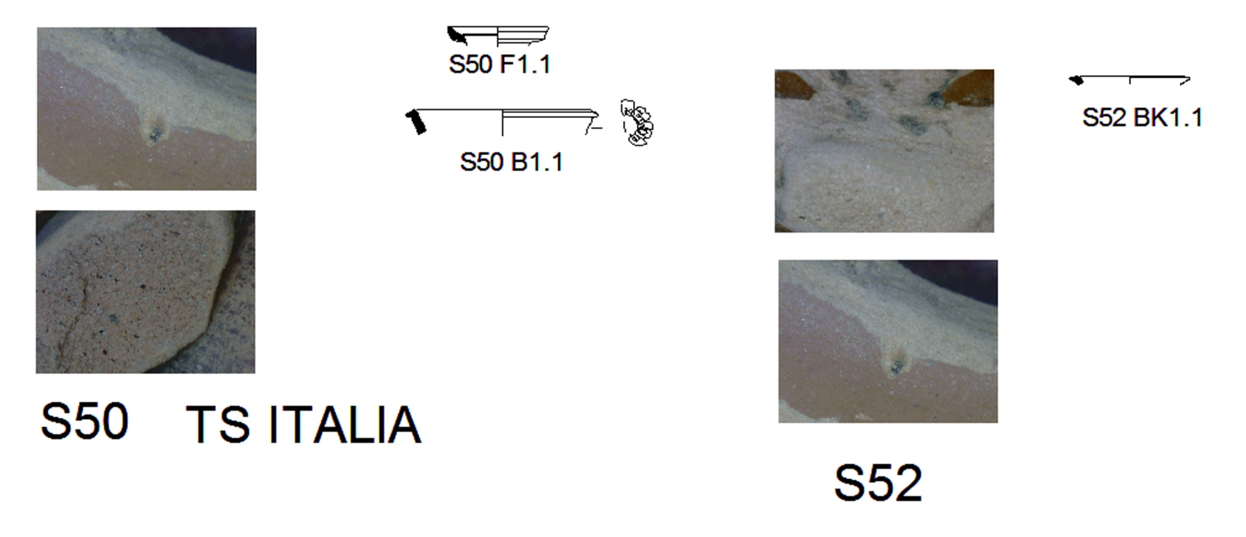
Italian TS

Slide 15
Decorated vessels a substitute for more expensive metal (silver) vessels

Slide 16
Many Stamped Forms
Slaves and Proprietors, including Greek names
Some 90 firms noted, occasionally working together.
Foim sie of 1 up to c. 60 slaves, most with 10 or less, but a fair number with 10-30.
i.e. An industry of workshops/ nucleated workshops but with some manufactories.

Slide 17
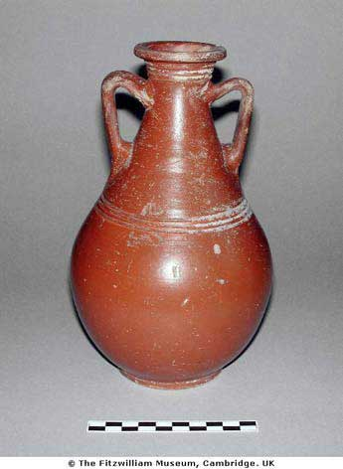
ESB

Slide 18
Source: Asia Minor ( Tralles)
Mainly in Aegean
1AD – c.AD 150
Founded by C. Sentius, who has stamps at Arrezzo (Arratine) and Lyons (SG Samian)

Slide 19
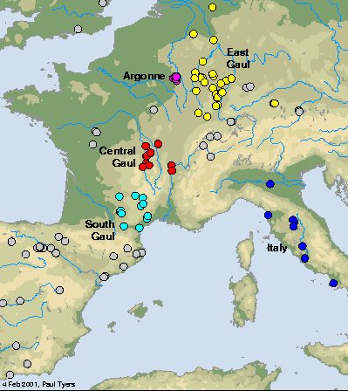
Gaulish Terra Sigillata Kilns

Slide 20
Samian / Gaulish TS
Very well studied, with a good understanding fabrics, of development of forms over time ( e.g. Shift from Plates/ Platters to Dishes then Bowls.
A good body of work on identified potters and workshops
Dating can be refined to around +/- 25 years.

Slide 21
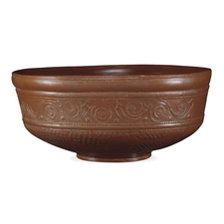
Southern Gaulish

Slide 22
Southern Gaul
La Grafesenque – Arratine imitations start at AD1/10. Reasonable imitation starts AD20
Ateius moves to Lyon
AD 35/40 forms develop – simplifications of Arretine types
Also made at Montans and Banassac
Peaks perhaps AD 80-100, lower quality
Finishes AD 110 – Reasons not clear

Slide 23
Stamp Information shows different framework
Slaves only mentioned once as ancillary workforce
Cemetery data suggests little differentiation social stratification
evidence for kiln sharing
Extensive pottery making complex
Dockets give details of individual firings: 25,000-30,000 vessels from 10 ‘firms’
Marketed through towns ( potters shops)

Slide 24
Central Gaulish
Les Matres de Veyres Starts AD 100 collapses AD120 potters move to Lezoux and East Gaul
Lezoux starts in C1, better slip from AD 70 (rare in britain)
AD120 new technology (LMDV migrants?)
AD120-200 main centre
Ends in AD 196-7 with sack of Lyon by Severan
Some local production in C3
Some moulds shared with SG

Slide 25
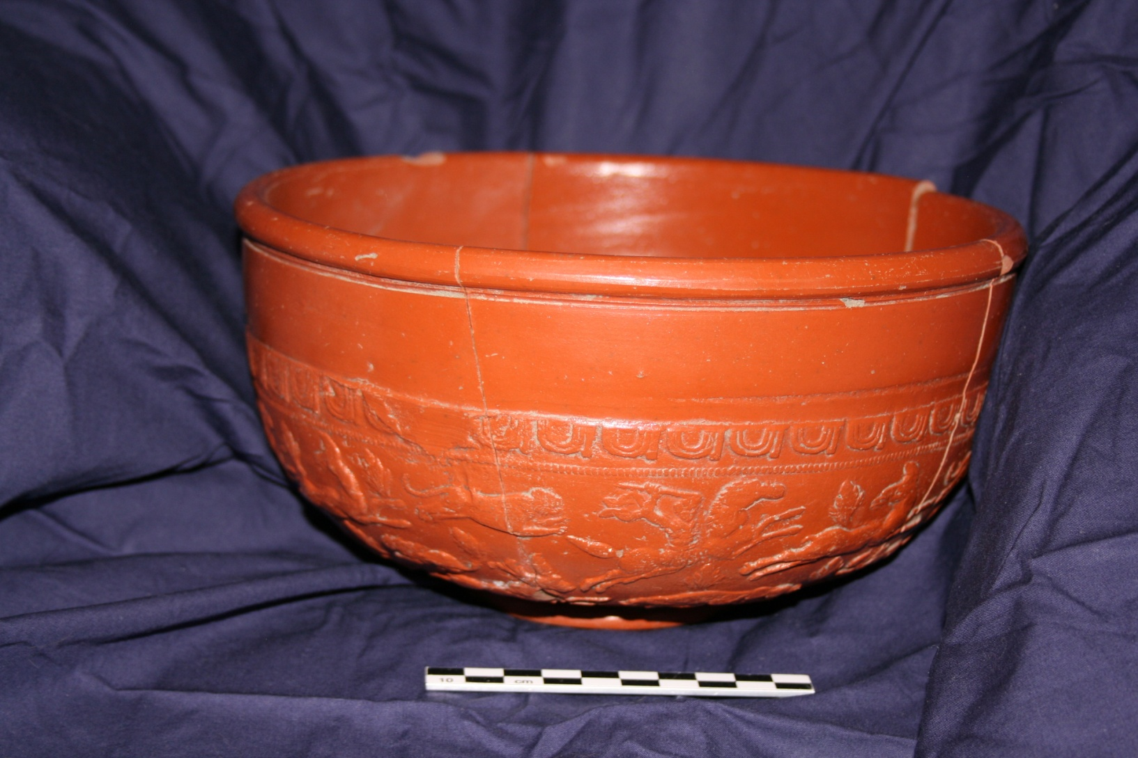
Central Gaulish

Slide 26
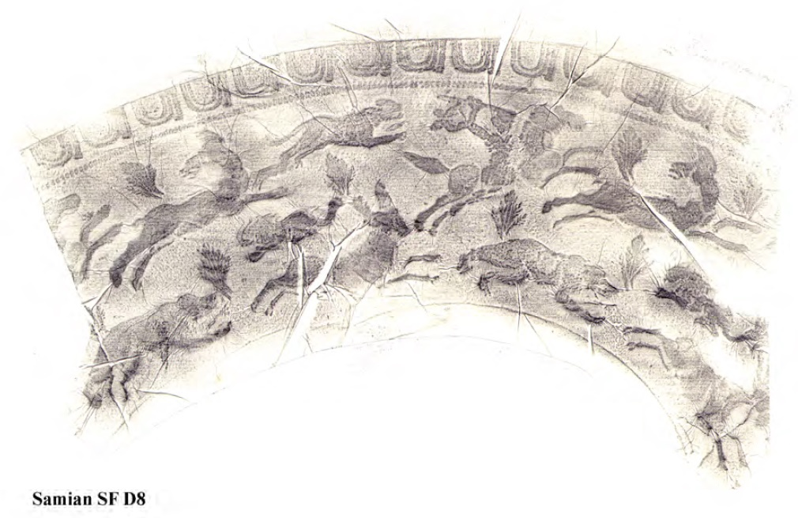
Detail of Decoration

Slide 27
Dragendorf 37 Decoration
D8. Form 37, Central Gaulish. Complete bowl,
showing freestyle hunting scene in the style of Cinnamus
ii, with his ovolo (Rogers B233) and bush space filler
(Rogers N15). Types are the horseman (O.245),
panther (O.1507), hind (O.1822I), stag (O.1720),small lion (O.1421) and bear (closest to O.1633L). A
stamped bowl from Lezoux (Rogers 1999, pl. 32, 45)
shows the same ovolo, bush, horseman, stag and
hind. c.AD 150-180. [1207] (1225)

Slide 28
Eastern Gaul
Trier, Rheinzabern, Argonne.
Minor centres in AD50
Sinzig, Trier Had/Ant; Rheinzabern Early Ant – not found on Antonine wall
Rh and Trier main C3 supply to Britain – reaches Chester ( 6%) but more common on East coast (15%)

Slide 29
Proto industrial Model(Dark, K. 2000)
1 Money based exchange system, with efficient enough communications) to give access to regional, or larger markets.
2 Regions containing clusters of rural craft based production aimed at serving regional markets
3 products marketed though urban centres
4 use of traditional technologies already employed in region, not new ones
5 Co-ordination to produce standardised products

Slide 30
Staffordshire
1710-19 – 67 Potters, home workshops, transport by pack horse 50km. Canals in 1766, Manufactory 1756 – 1500 pieces at once, workforce still in 10s.

Slide 31
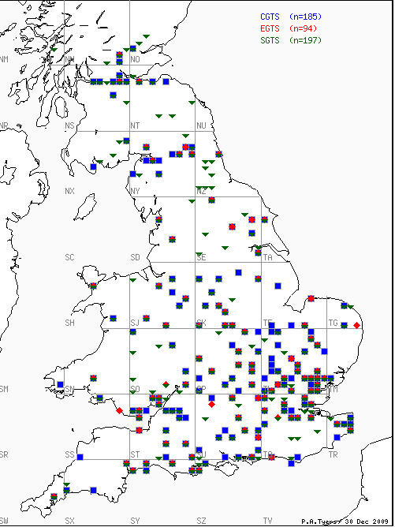
Distribution of Sigillata in Britain

Slide 32
Other Sigillatas
Spanish
Cypriot
Replaced by red slip

Slide 33
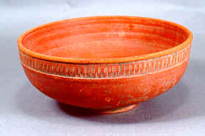
African Red Slip

Slide 34
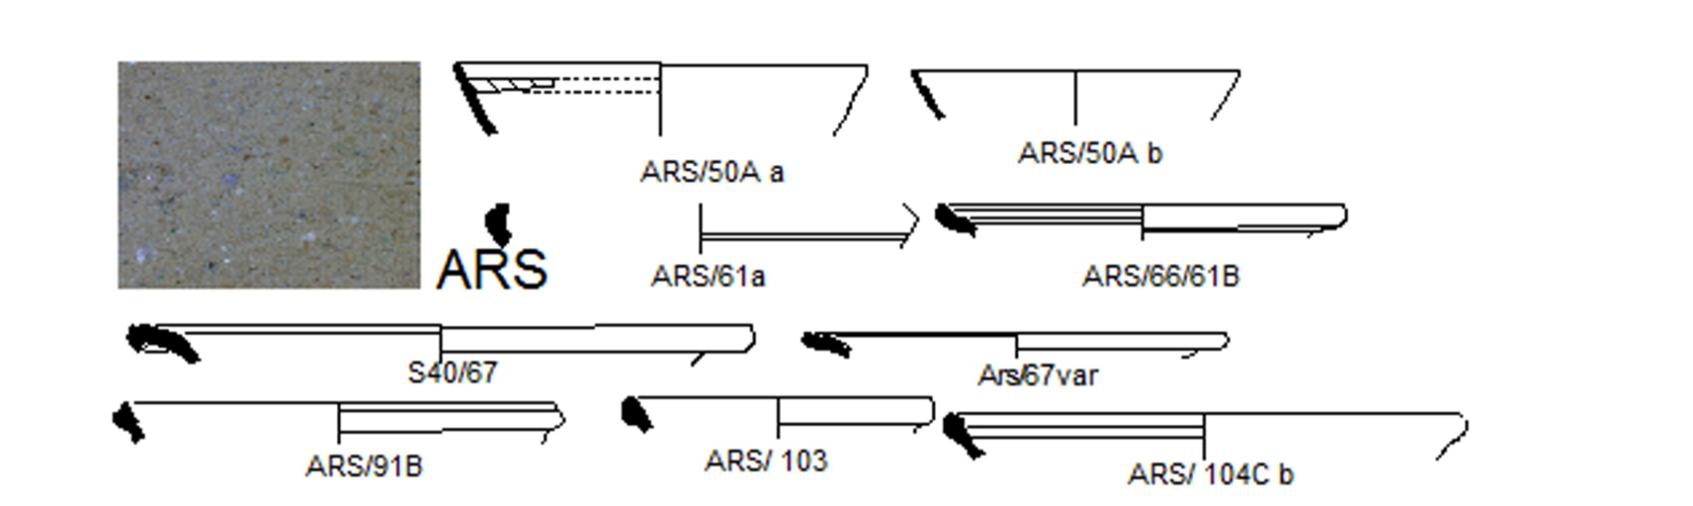
African Red Slip

Slide 35
ARS
A Roman tradition fineware that goes on, originating from Hellenistc casseroles.
Fineware starts AD60-80, North Tunisia,
Starts later in Central (AD200) and Southern Tunisia
Starts to dominate C2-EC3 in West Med
C3 – massive penetration of Eastern market replacing ESA .
Ec4 vandal occupation – some new form
C5 – declines in west (end of Annona)

Slide 36
Greece – dominant LC3 – EC5, then Phocaen red slip takes over.
Mid C5 – levant sees rise in Cypriot red slip
AD 533 reconquest – production limited to N Tunisia
End in C6 – EC7

Slide 37
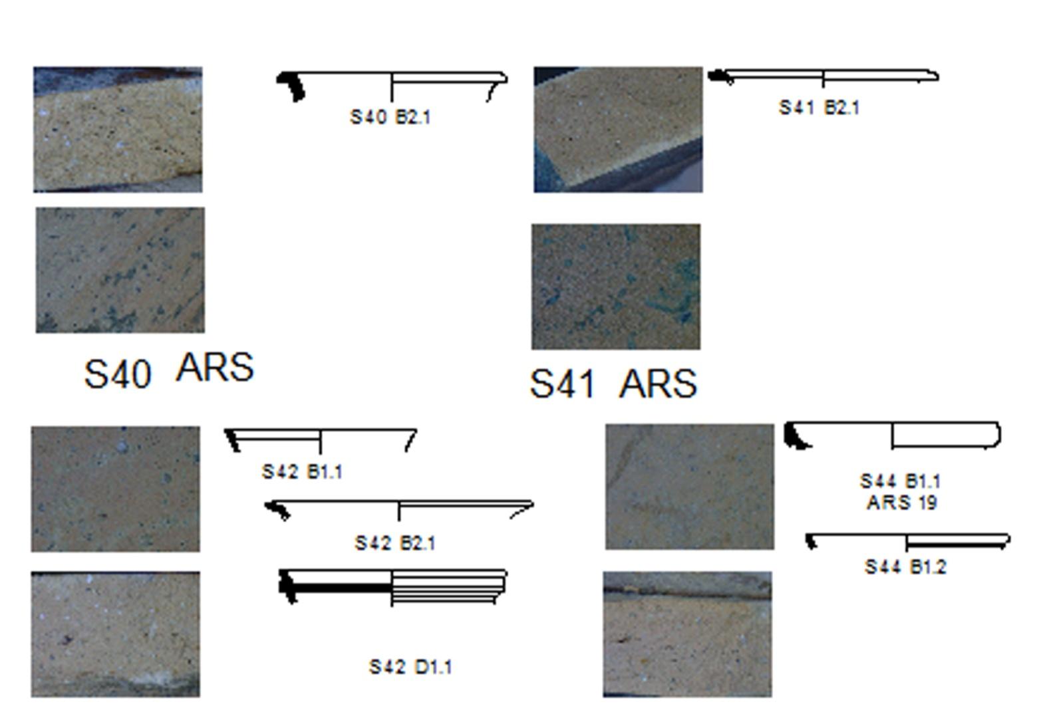

Slide 38
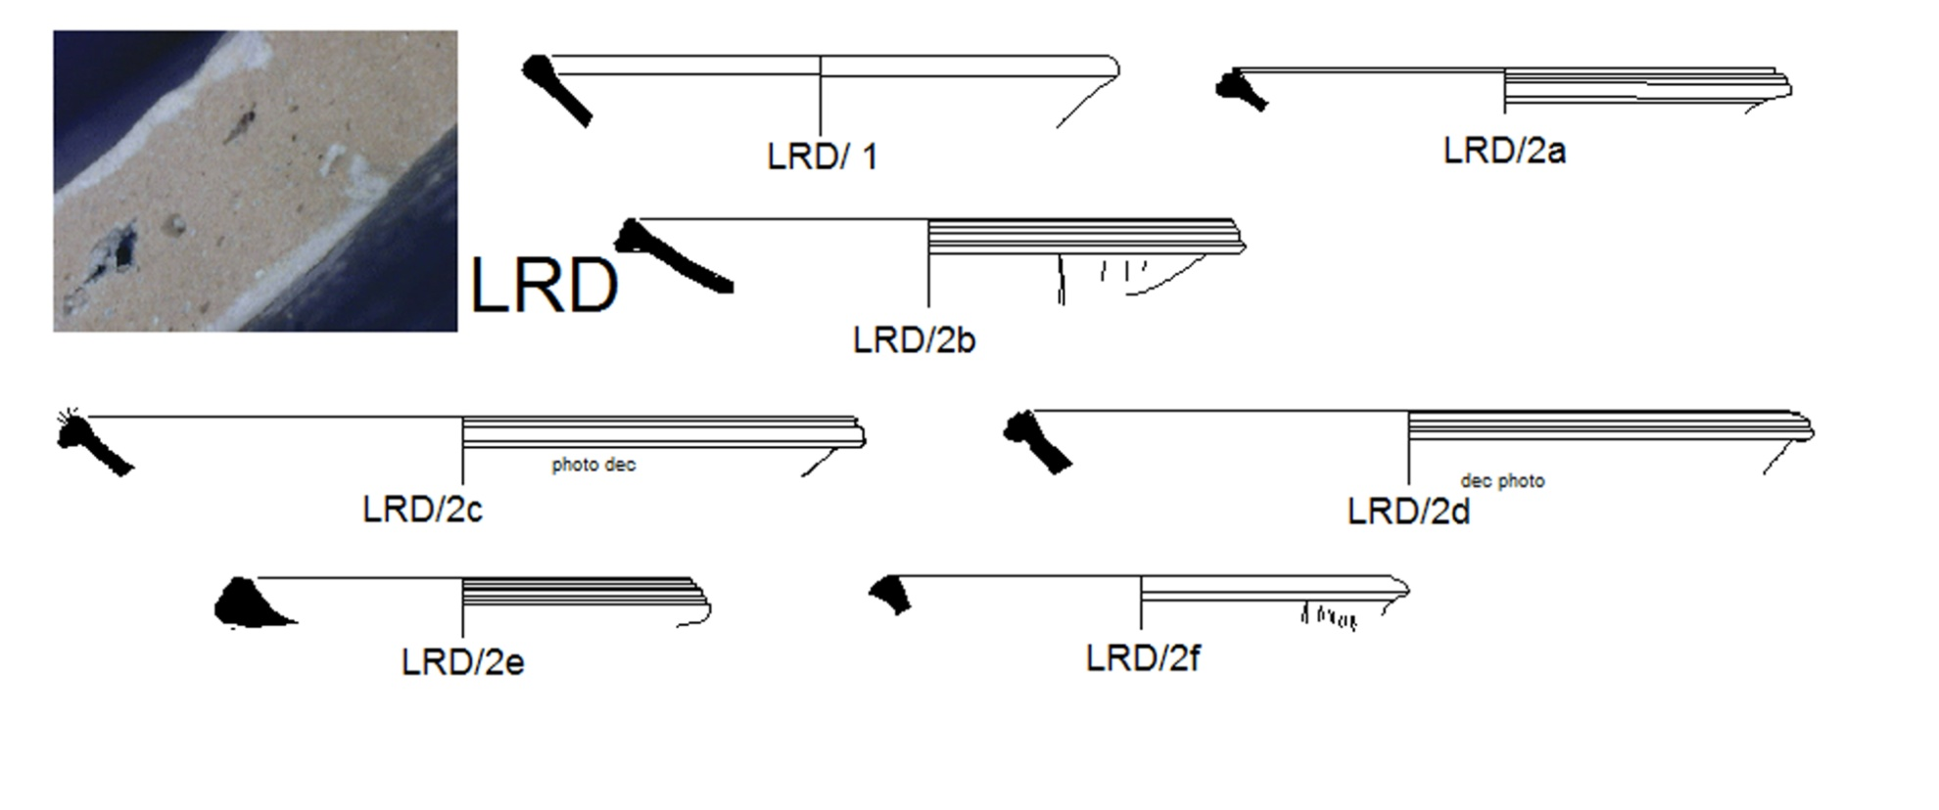
Cypriot Red Slip

Slide 39
Southern Aegean, Turkey, Syria
Starts end C4
Decline C6 down to reconquest of North Africa
Replced by Eygptian red slip in e C7

Slide 40
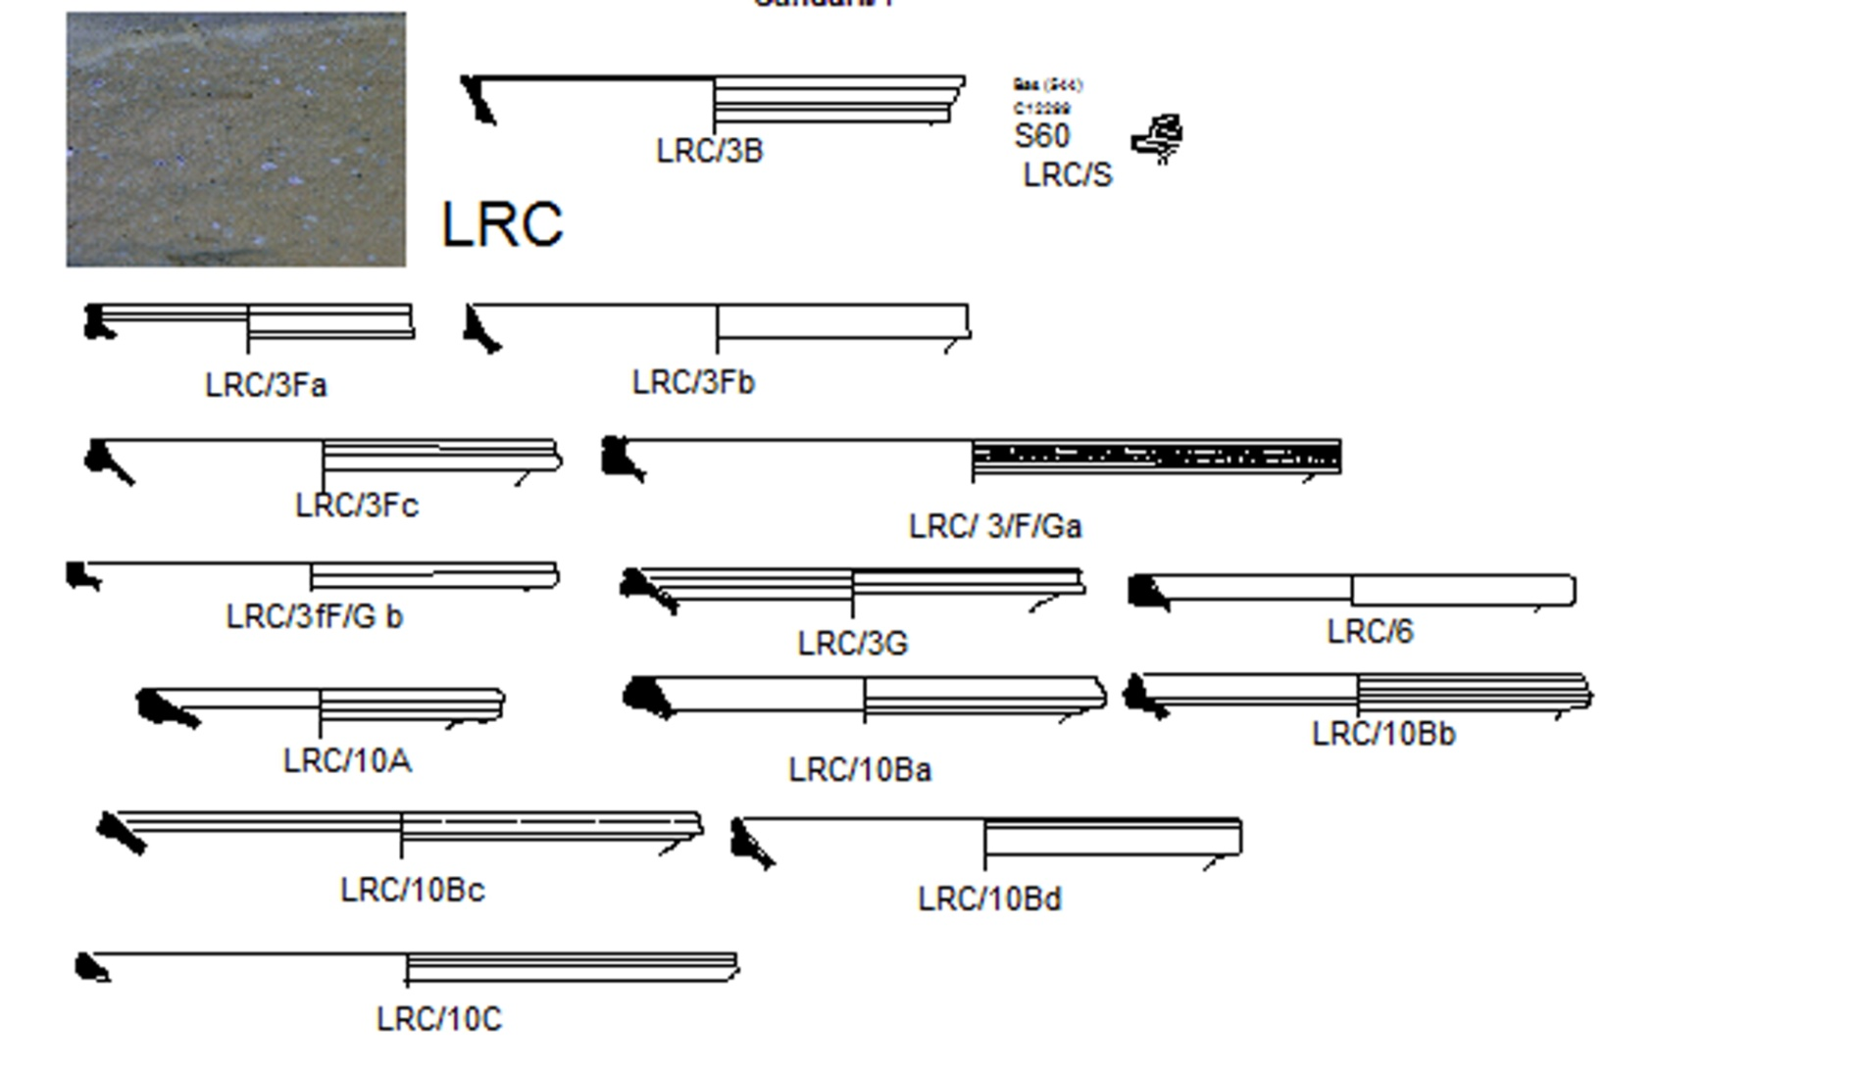
Phocean red slip

Slide 41
LRC - Phocean
LC4 start Rapid take over of Turkey and Greece in C5. found in Britain LC5
Western supply AD 450-550,
Highlights shipping routes to West, especially Marseilles.
Its rise coincides with the Vandal conquest

Slide 42
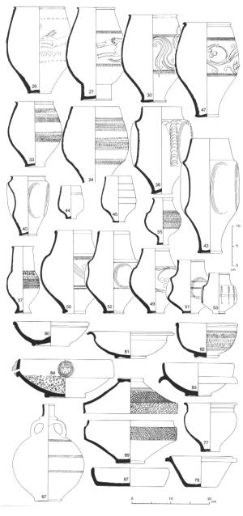
Later Finewares In Britain Nene Valley Colour coat

Slide 43
Lower Nene Valley Colour Coats
Starts AD 160
Originates alongside a greyware tradition
Comes in a variety of colours: red, Browns, Dark Browns.
Later Roman Diversification to include coarseware forms (does not happen to other CC wares)

Slide 44
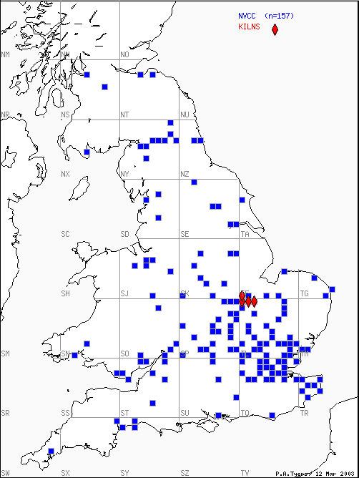

Slide 45
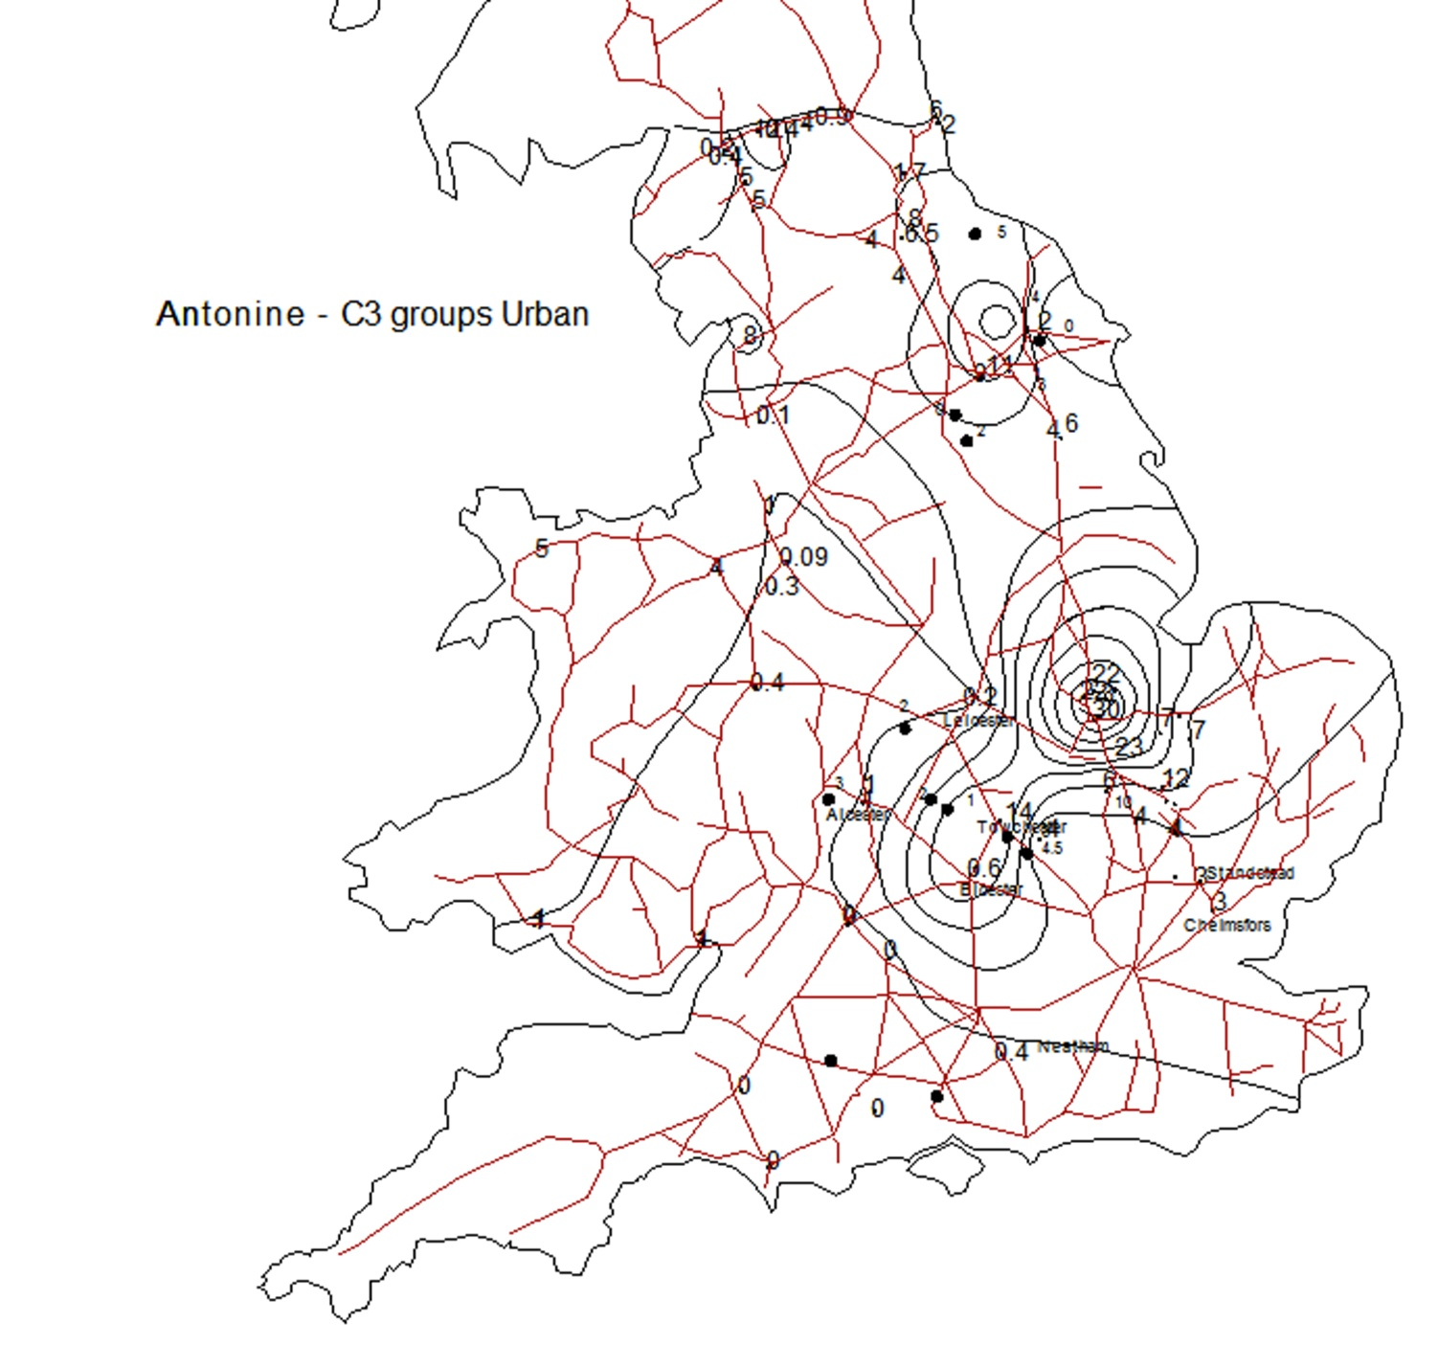

Slide 46
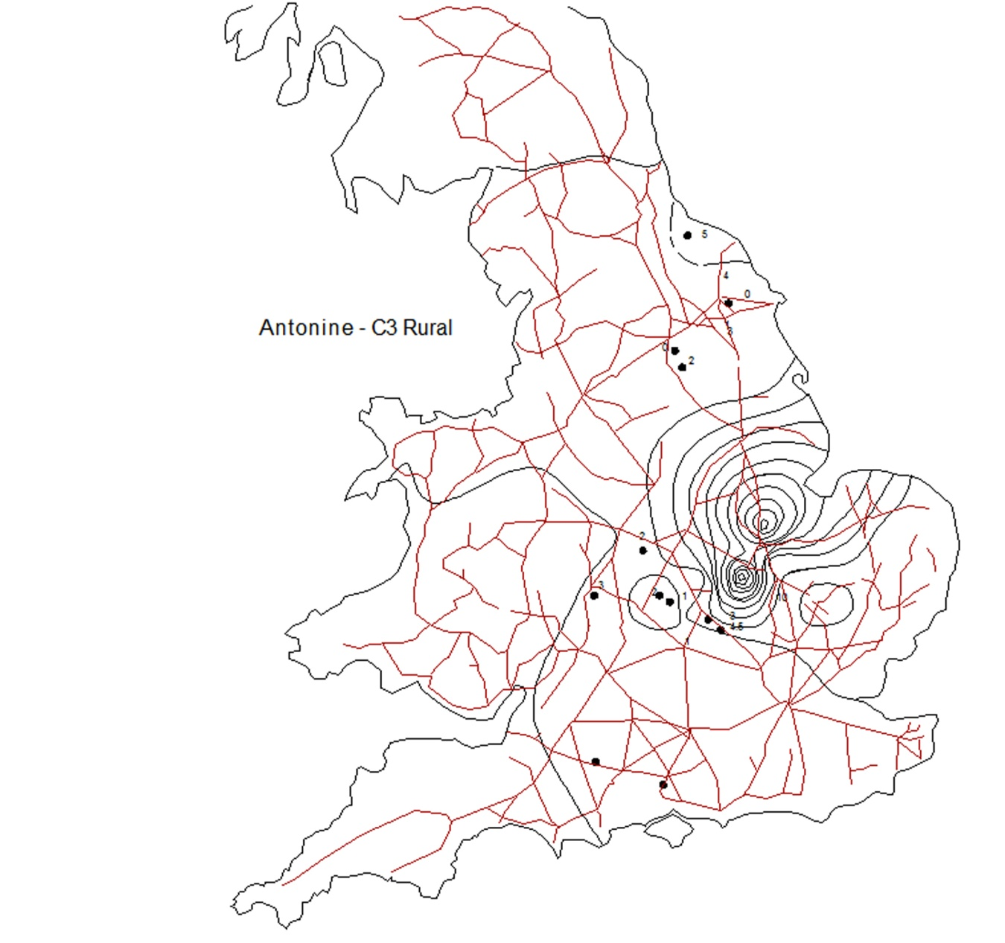

Slide 47
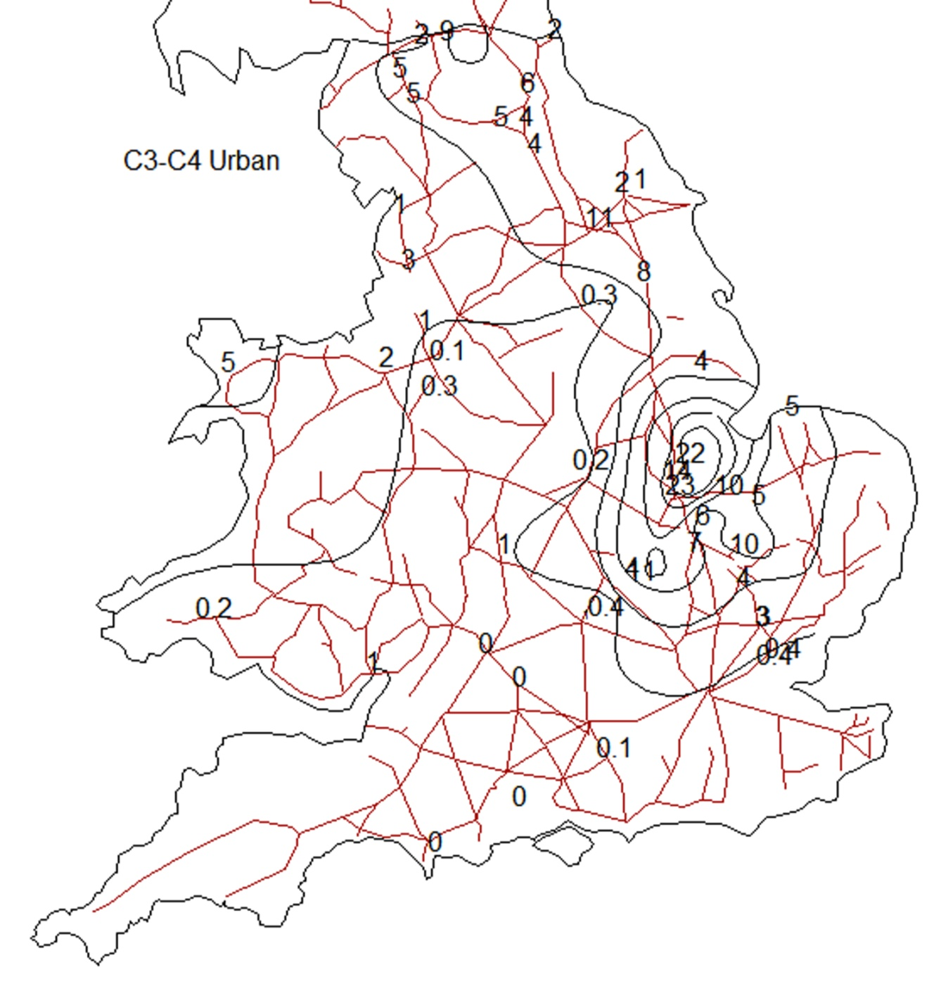

Slide 48
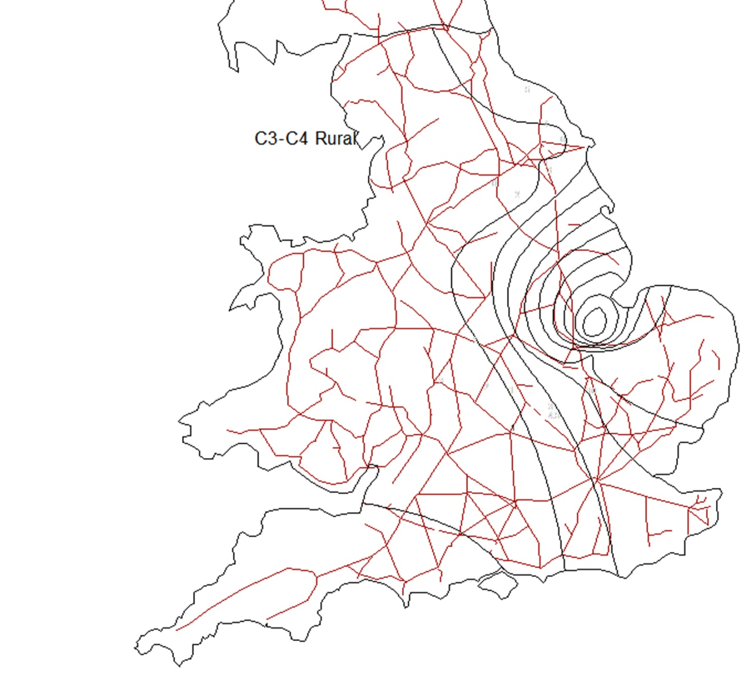

Slide 49
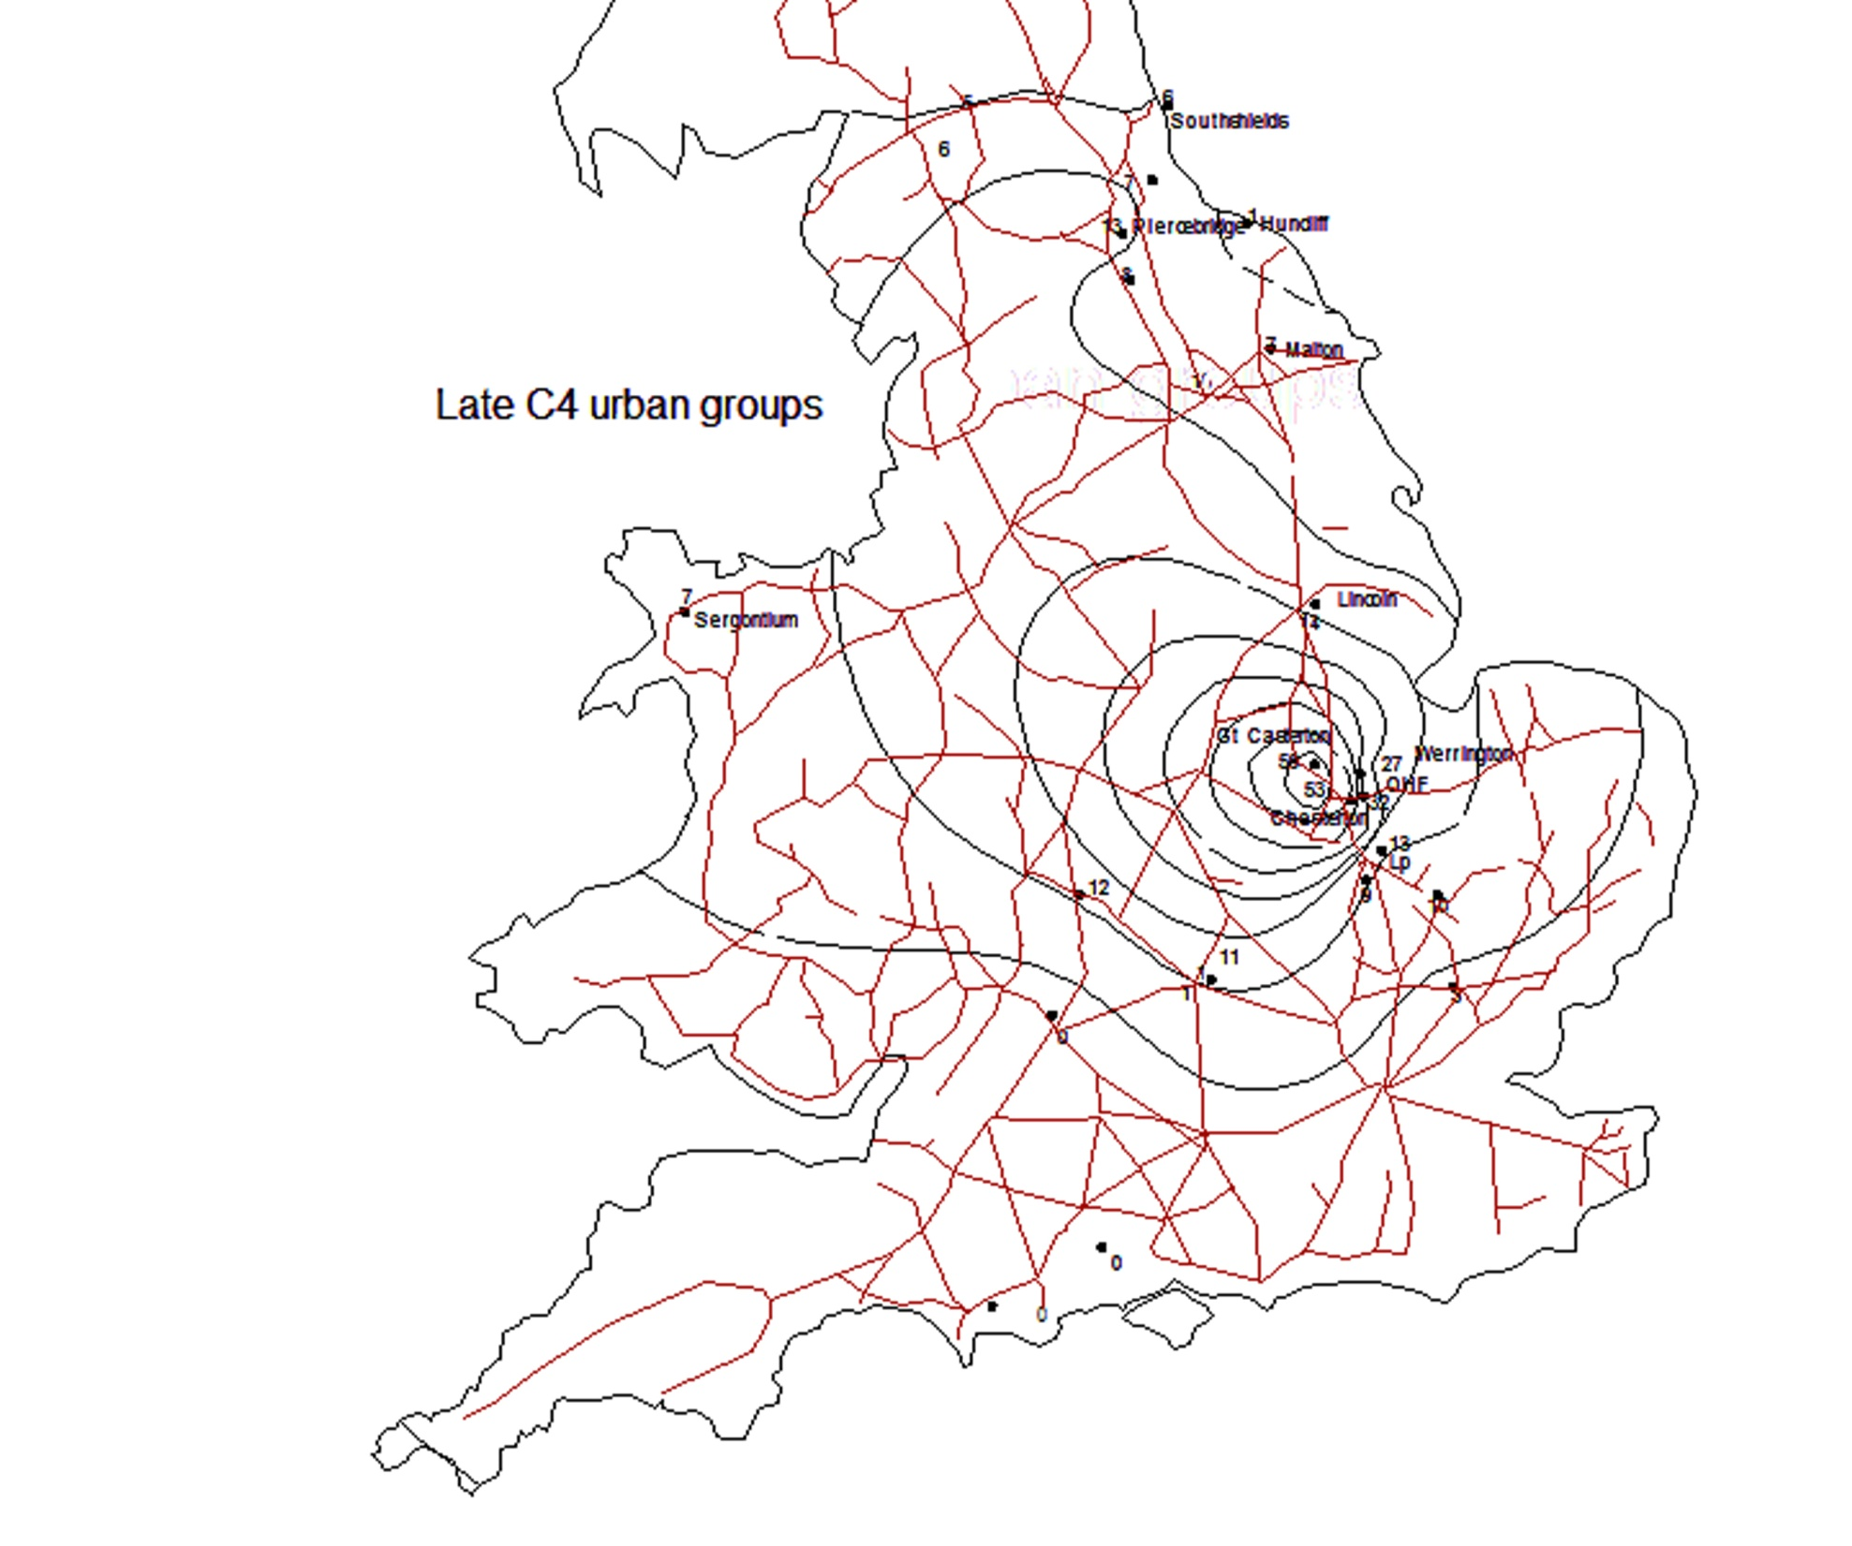

Slide 50
Conclusion
Fineware pottery has a long history of study
Precise details of chronology and distribution help map changes and connections in the Roman Economy
The changes in the range of forms are indicative of wider social changes.

