Slide 1
The Roman Economy
II.7.a
The economics of Ceramic Building Materials

Slide 2
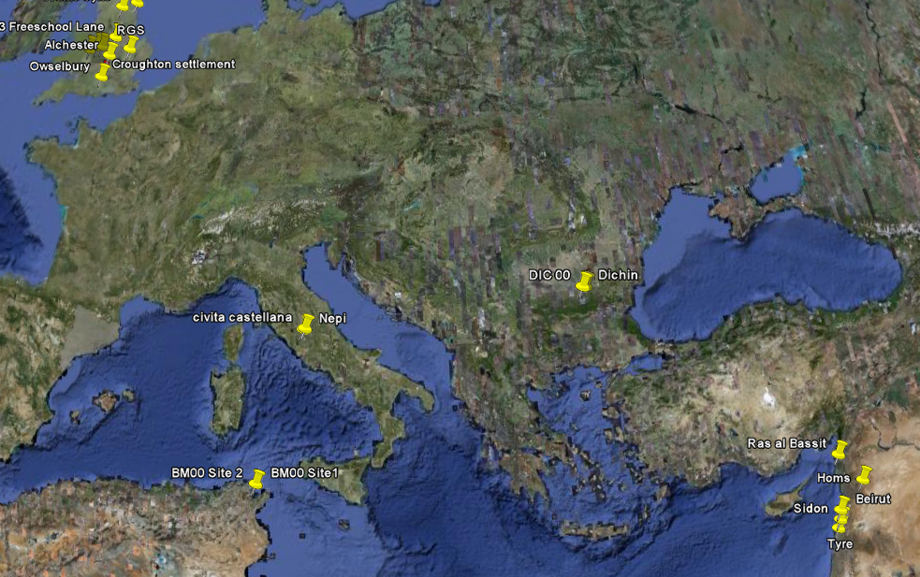

Slide 3
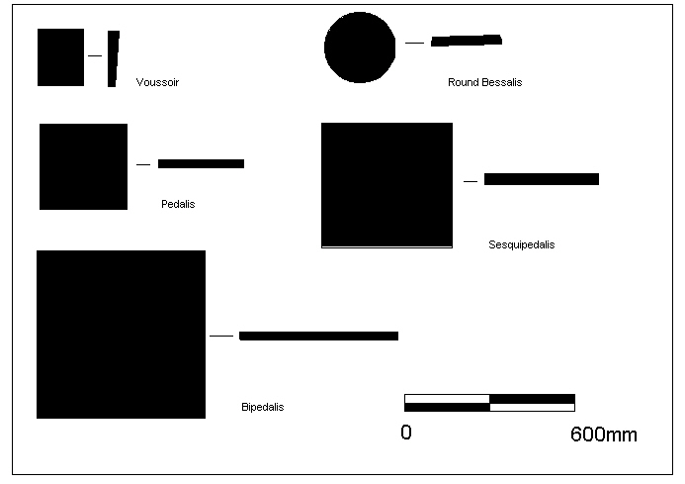
What is CBM

Slide 4
Roof tile styles

Slide 5
Dating

Slide 6
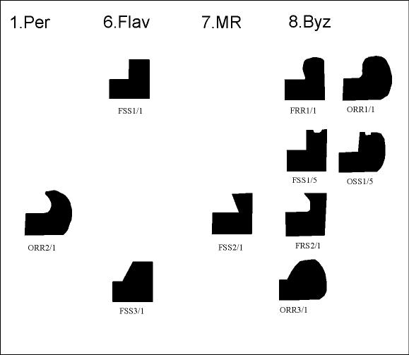
Dating

Slide 7
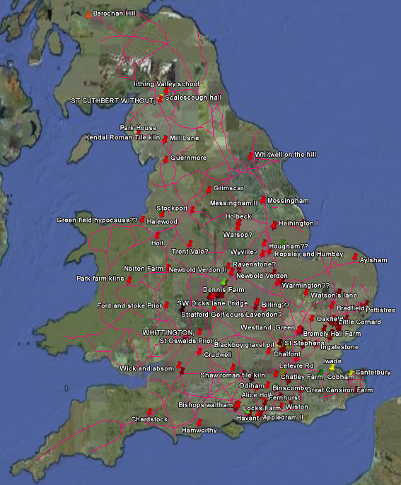
British Tile Kilns

Slide 8
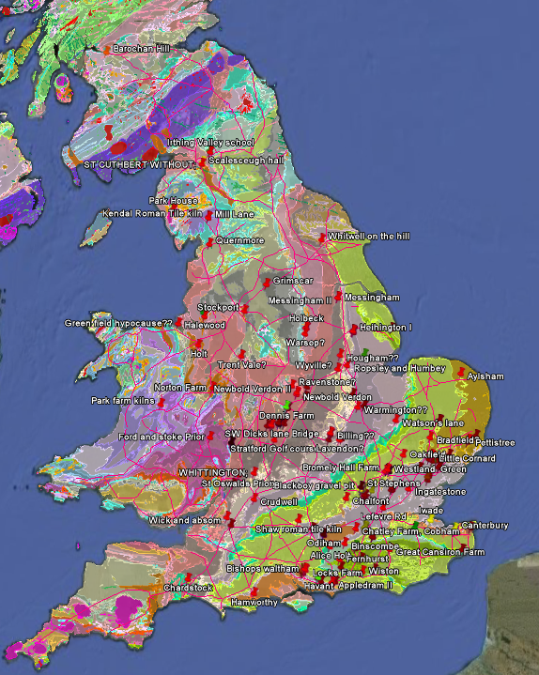

Slide 9
Modes of production
Military (Holt)
Municipal (Gloucester)
Estate (Piddington)
Manufactury/ Nucleated workshops – specialist ceramics ( Harrold, Towcester, Horningsea)
Mixed Production
Itinerant Tile makers MC2

Slide 10
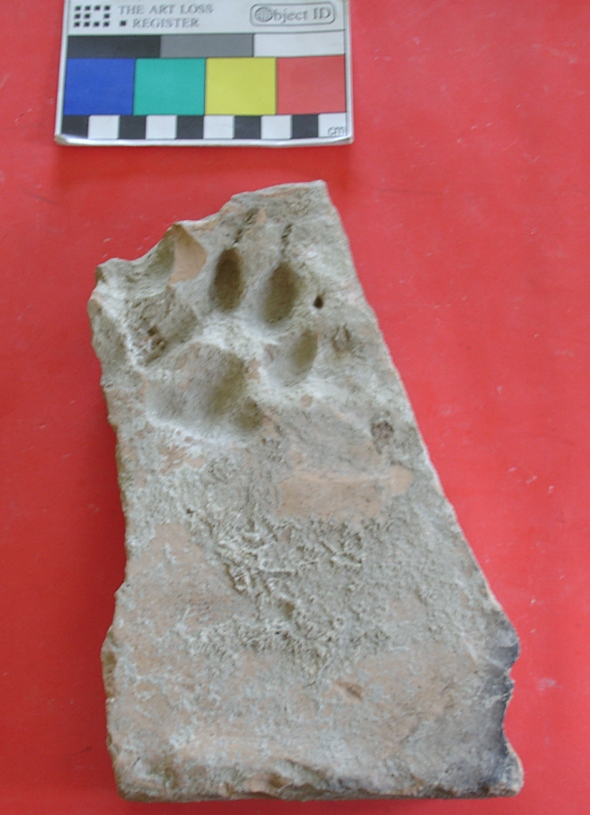
Dog Print, Bulgaria

Slide 11
Proportion of Tiles with Animal Prints

Slide 12
Other Markings

Slide 13
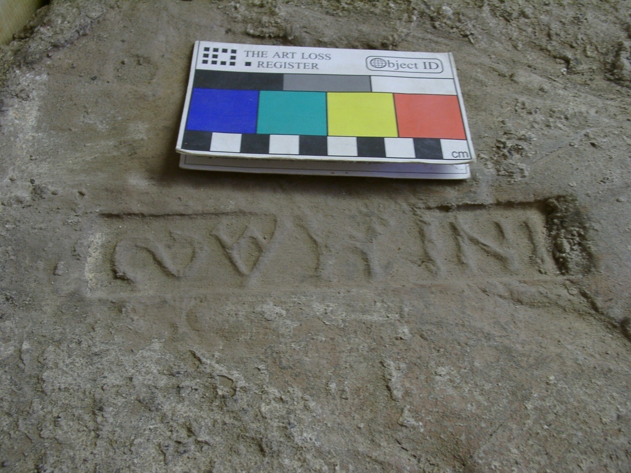
Indiction Stamp

Slide 14
Stamp 14 - I NIMAS (Lauffray, J. 1944; no 2471a and b, Bardhill 2004, 302) stamps dated AD 413-5 from the Theodosian church of St Sophia, Constantinople and on a stamp dated AD 430/1 from the palace of Antiochus. Two different dies were observed to have been used for this stamp, reads ιν(δικτιϖνοζ) ιΜα( ) S.
Stamp 15 INIBAΓA (no 8972a, Bardhill, 2004, 204.) A stamp dated AD 429-33 AD from the palace of Antiochus reads ιν(δικτιϖνοζ) ιβα ( ) Γρα( ).

Slide 15
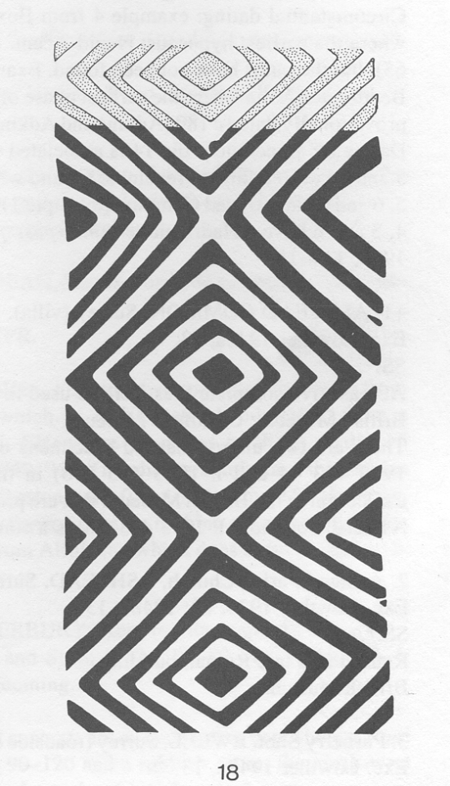
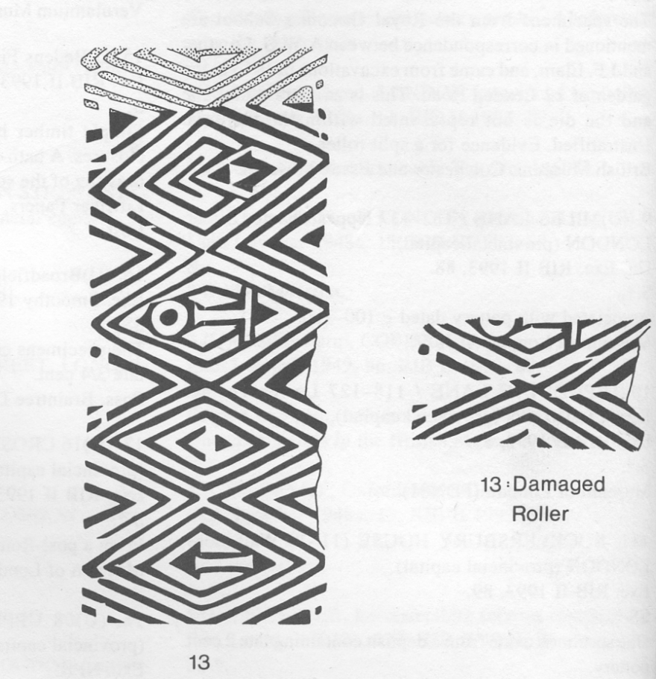
Roller relief patterns on Flue Tile

Slide 16
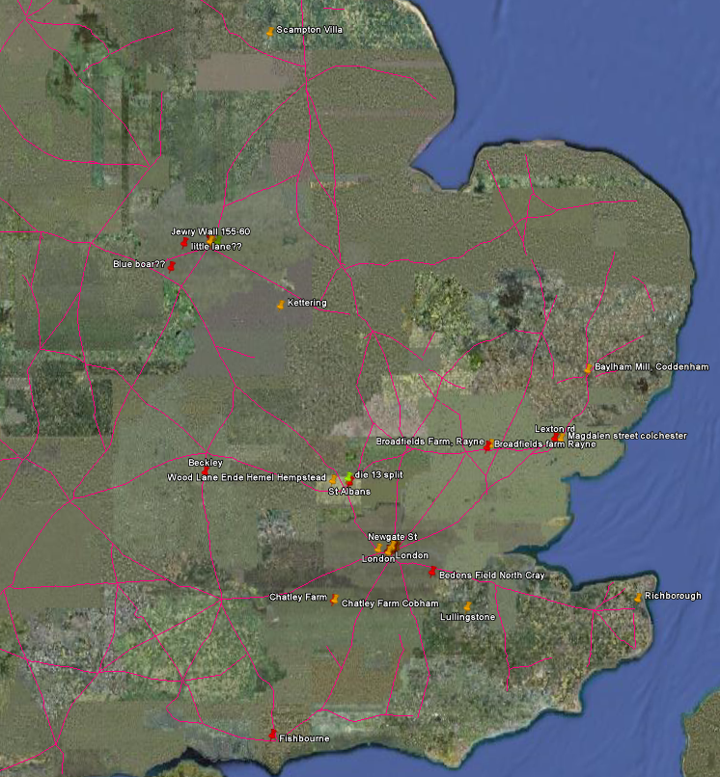
Roller stamp

Slide 17
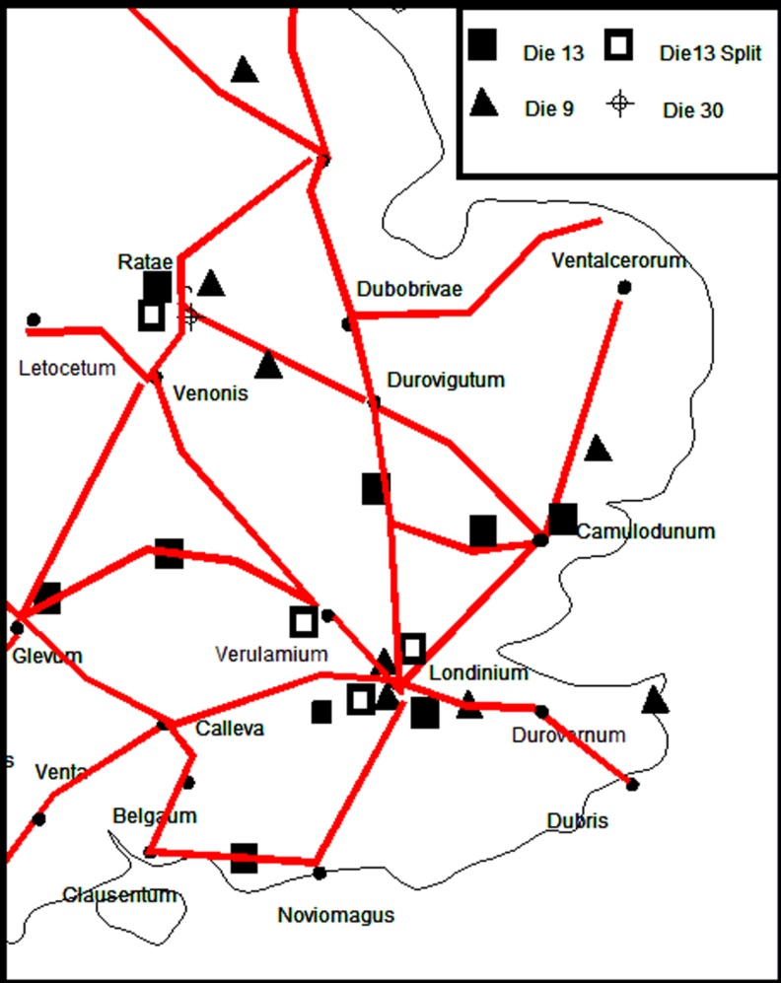
Tracing Tile makers

Slide 18
Exchange

Slide 19
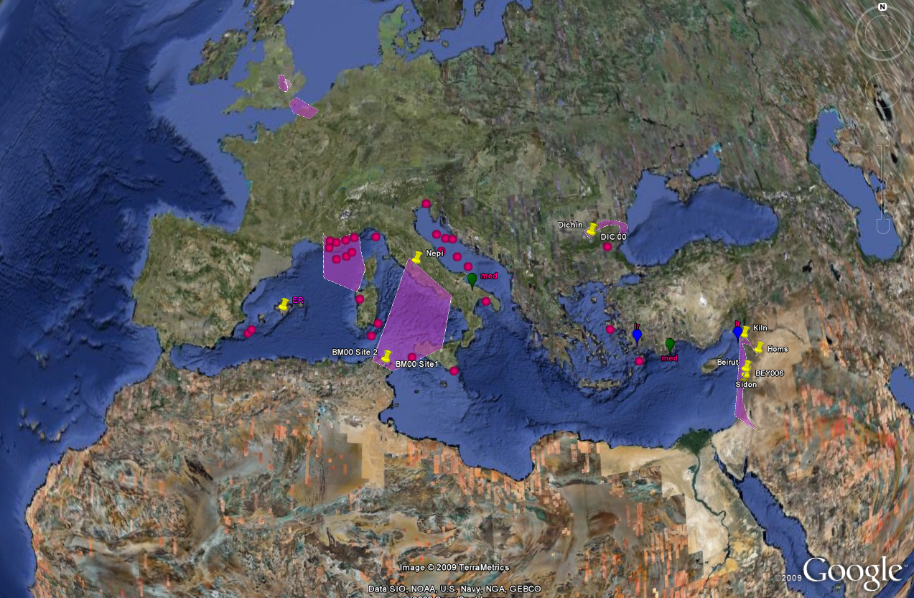
Shipwrecks and Distribution

Slide 20
Tile wrecks by Period

Slide 21
Tile wreck proportions by Period

Slide 22
Fabric Supply

Slide 23
T91 Pink grog Temperd Tile

Slide 24
Pink Grog tiles

Slide 25
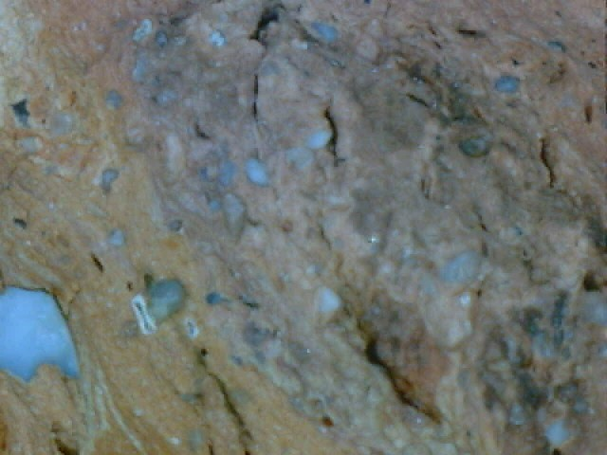
T51

Slide 27
Associations with specialised Ceramic production
Cilicia - Assocaited with amphorae, Coffins
Horningsea, Cambs - Large storage jars
Pink Grog Tempered ware, Towcester – Storage Jars
Harrold, Bedfirdshire – specialist CBM, storage jars
Crambeck, Yorks

Slide 28
Variables: Amount of tile in a cargo For a cargo of a single private roof, 600 tegulae and 600 imbrices, with a total displacement of 6.6 tonnes, would have has a cubic capacity of c. 76 m³ and a value of about 7200 denarii. No of new tiled builings in city +hinterland Amount of replacement
Period | Ships min | Ships max | Annual ships min | Annual ships max | Tile trade | Trade Min | Trade Max
Seleucid | 380 | 6333 | 8 | 133 | 6% | 133 | 2222
Roman | 460 | 7667 | 9 | 153 | 7% | 131 | 2190
Byzantine | 600 | 10000 | 12 | 200 | 16% | 75 | 1250

Slide 29
Hellenistic Beirut

Slide 30
Roman Bieriut

Slide 31
Byzantine Beirut

Slide 32
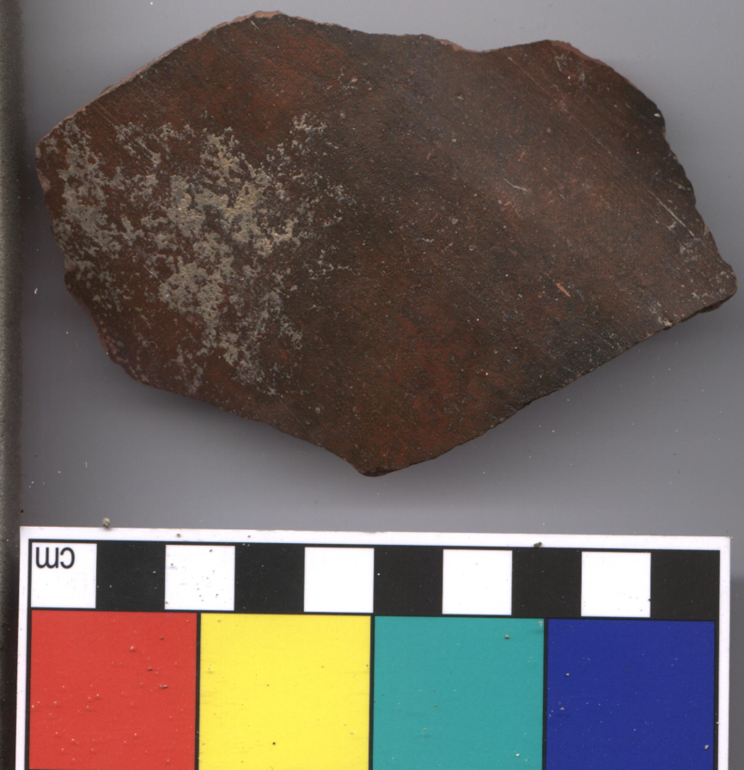
Painted Tile and red slip tile

Slide 33
Croughton Landscape

