Slide 1
The Ancient Economy
II.8a Building and the economy

Slide 2
Buildings: an act of Public Conspicuous consumption for the elite both in the gifting of public buildings but the places where you lived
A balance between the wants and needs of client – Architect and Builder. Within social setting.
Way of shaping the location and manner of economic transactions

Slide 3
Locations of economic transactions
The Forum/ Agora
The Macellum
Shops Taverna Bakery
The Baths
The private House

Slide 4
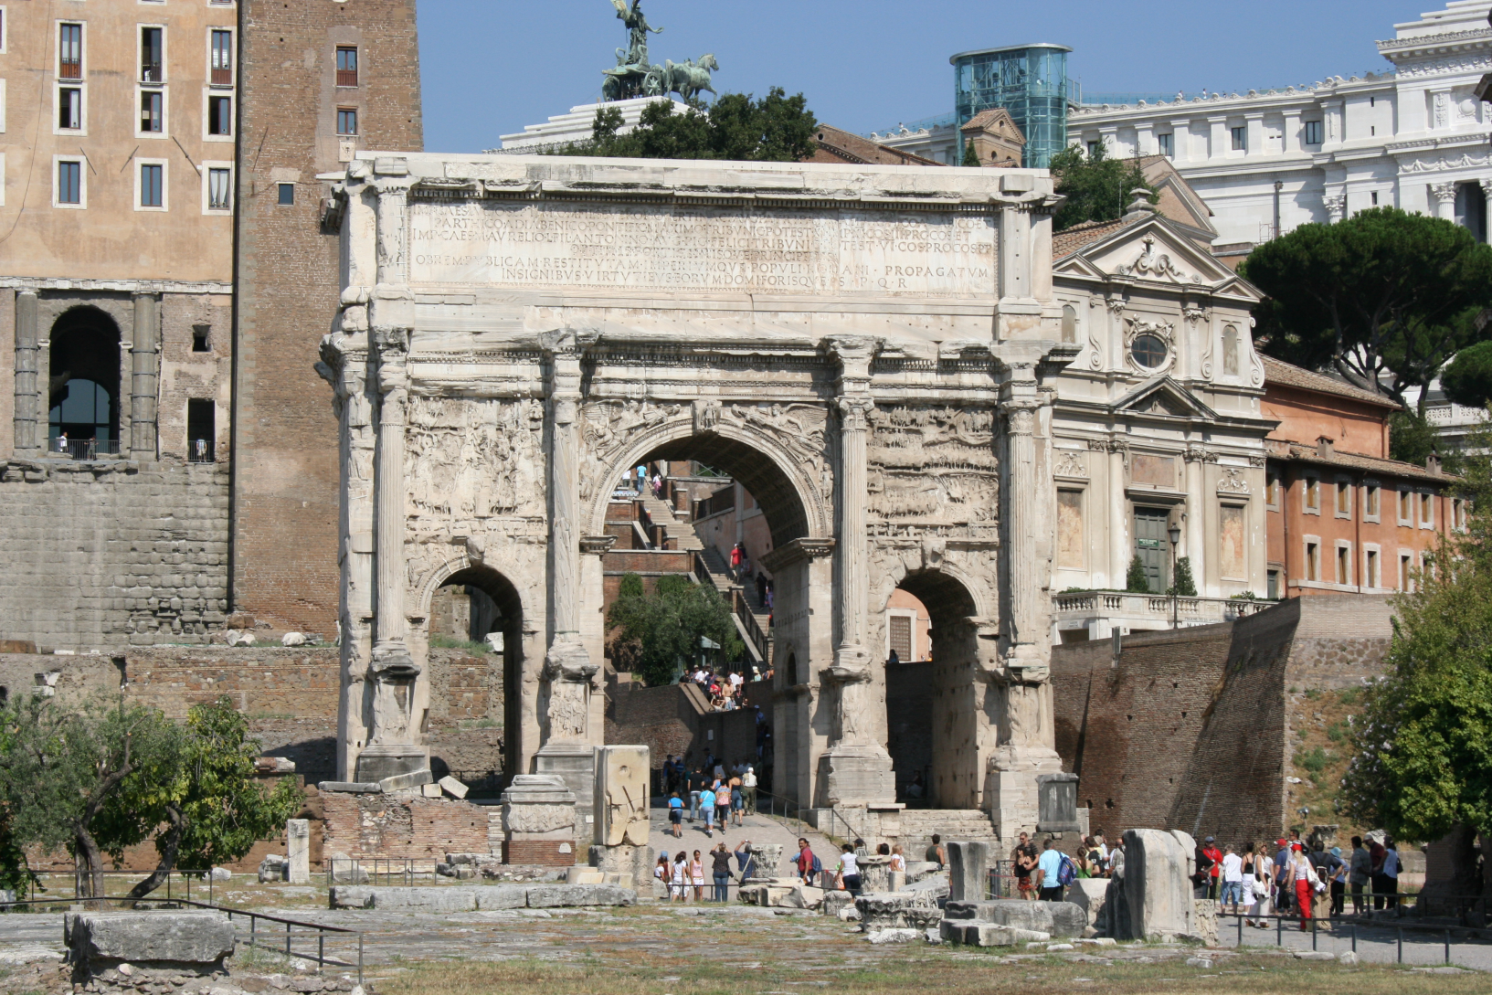
Forum at Rome

Slide 5
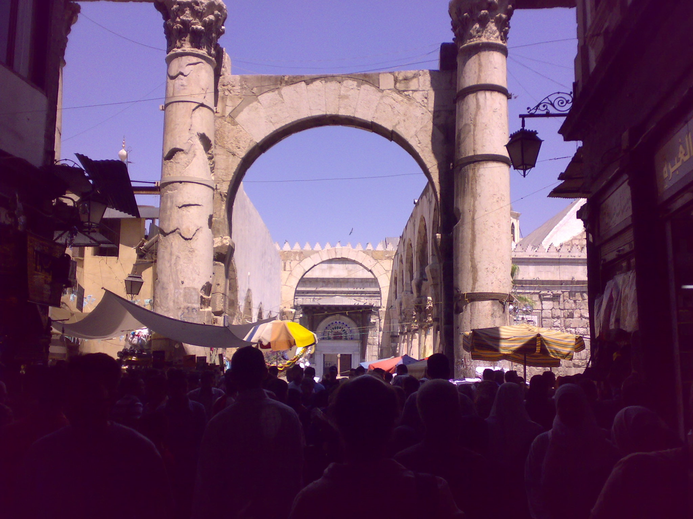
Damascus

Slide 6
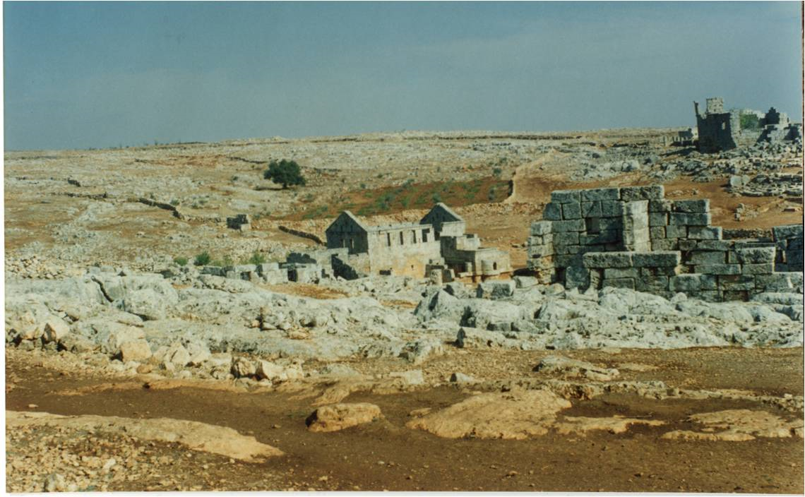
Small Towns

Slide 7
Urban Form
Lynch, 1960 ‘The Image of the City’
Paths: the channels through which the observer customarily, occasionally or potentially moves.
Edges: linear elements not used or considered paths by the observer.
Districts: sections of the city perceived as having a two dimensional extent, which have a common identifying character and that the observer can enter.
Nodes: the strategic points around a city that the observer can enter and are the foci to and from which they are travelling.
Landmarks: The point references that the observer does not enter.

Slide 8
Hillier and Hanson 1984 The Social Logic of Space. Cambridge: CUP
proposed that elements should exist hierarchically. how paths could penetrate districts.
These paths or streets could be distinguished hierarchically by width, accessibility and directionality. thoroughfare could be distinguished as wide and straight with open access to all traffic,
Streets narrower and winding with homes opening up to them directly and restrictions on the types of traffic.
the degree to which it was possible to move directly through a district

Slide 9
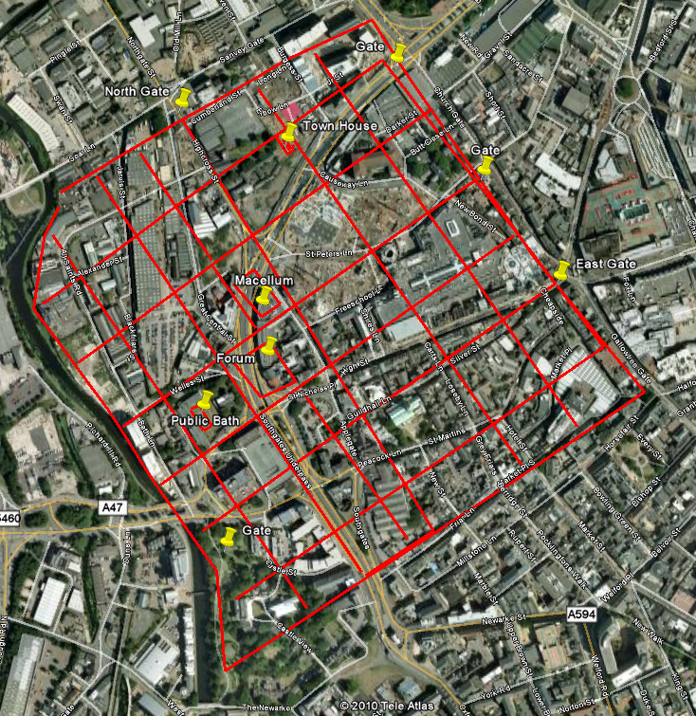
Leicester

Slide 10
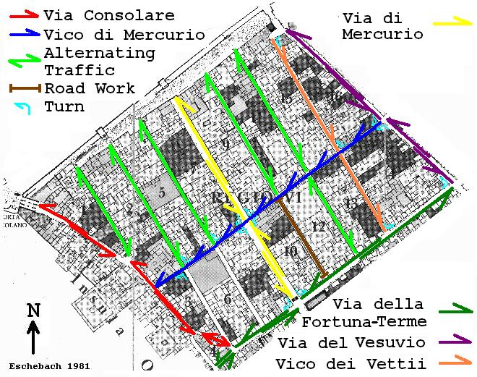

Slide 11
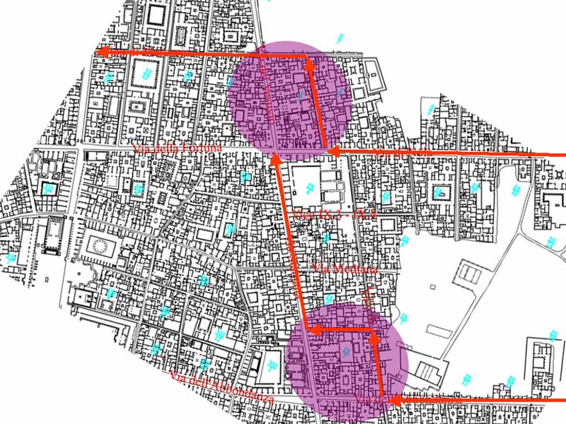
Traffic flow in Pompeii

Slide 12
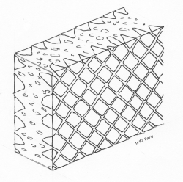
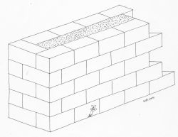
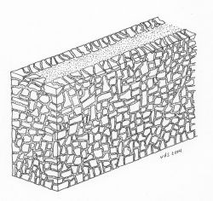
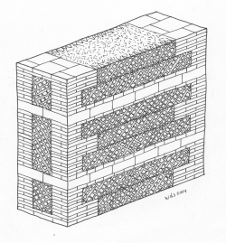
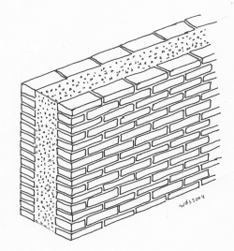
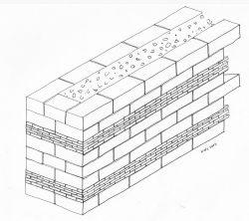
Opus Quadratum
Opus Incertum
Opus quasi reticulatum
Opus vittatum
Opus mixtum
Opus latericium

Slide 13
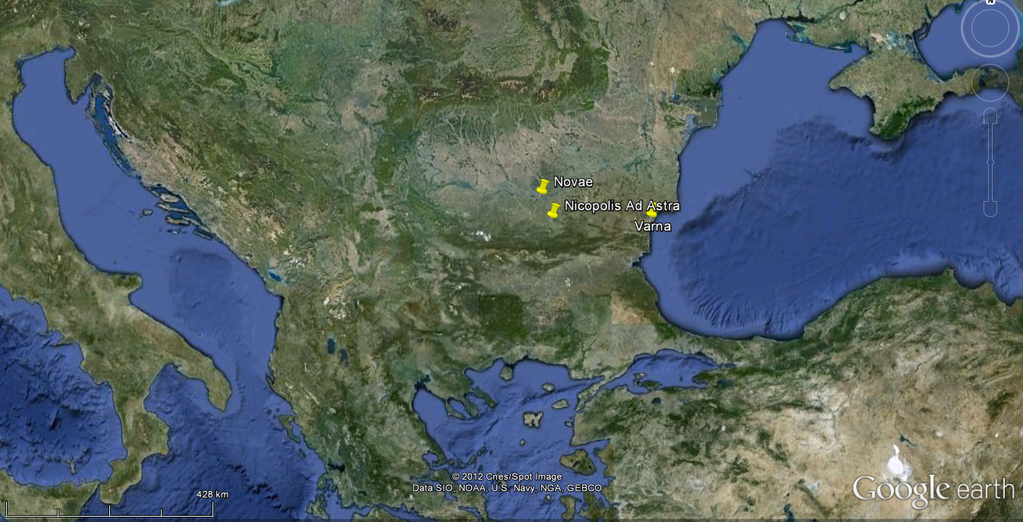
Bulgaria

Slide 14
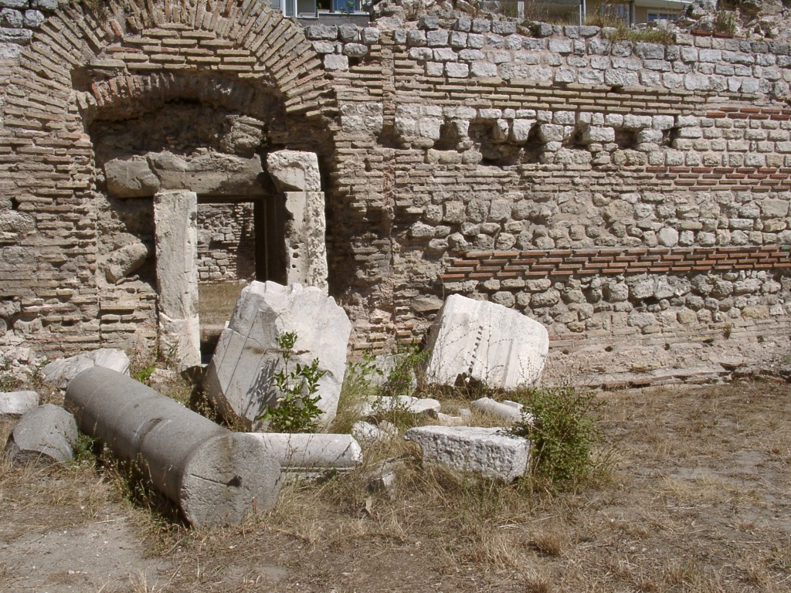
Varna, Bath House

Slide 15
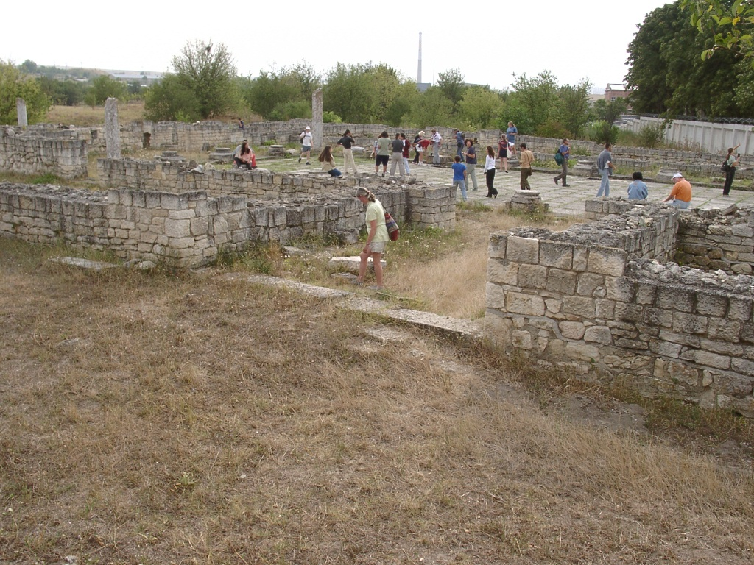
Novae, Bulgaria

Slide 16
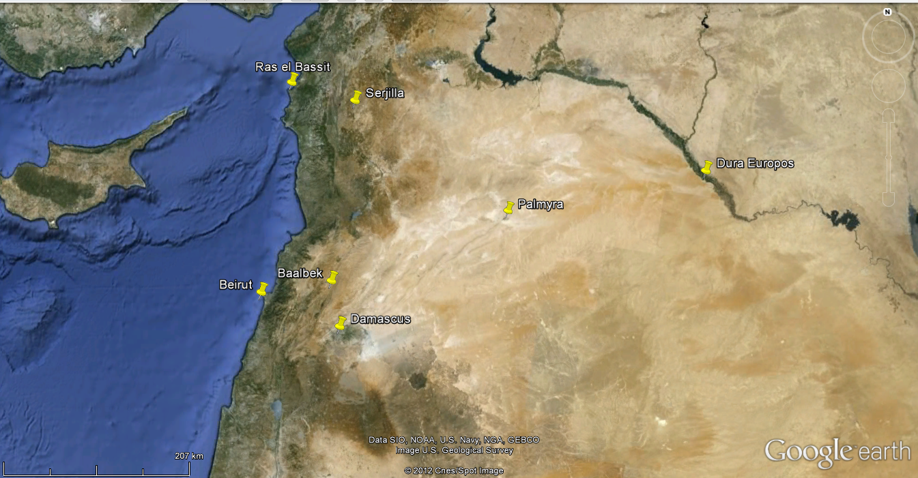

Slide 17
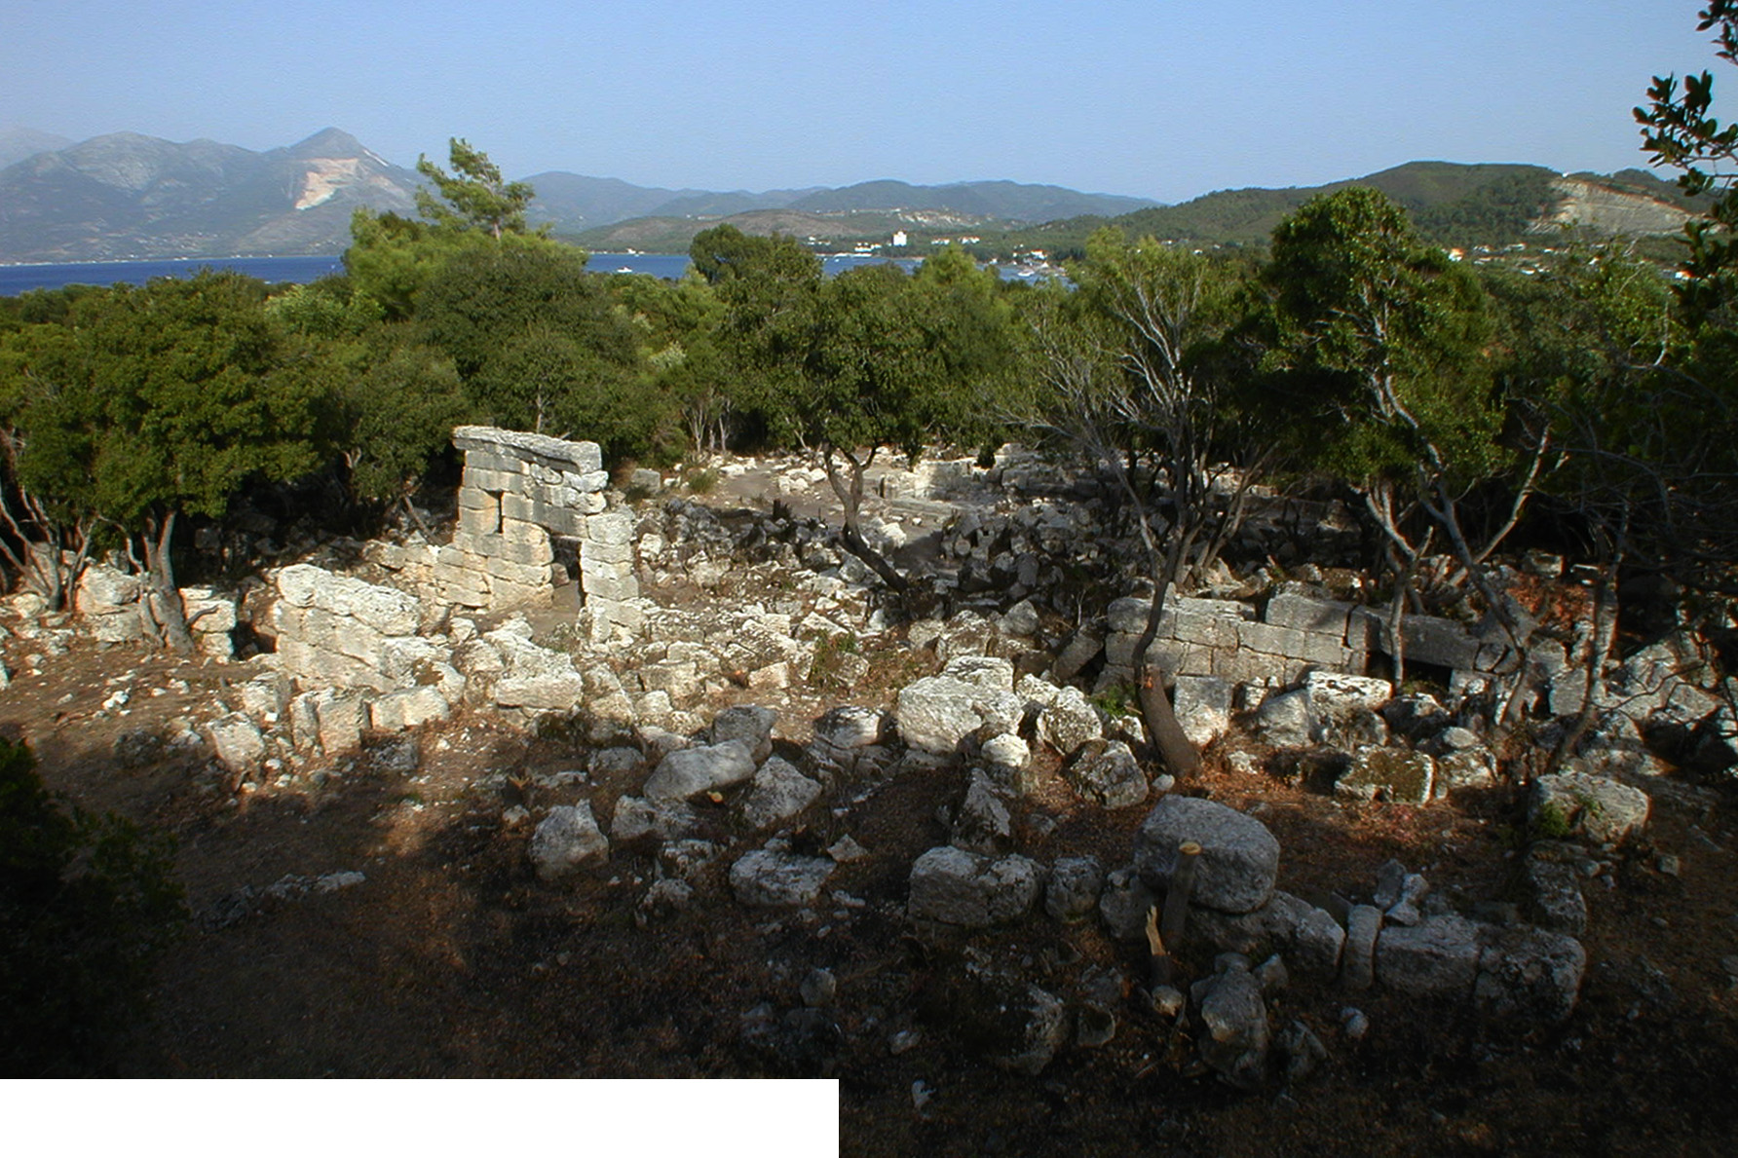
Ras el Bassit

Slide 18
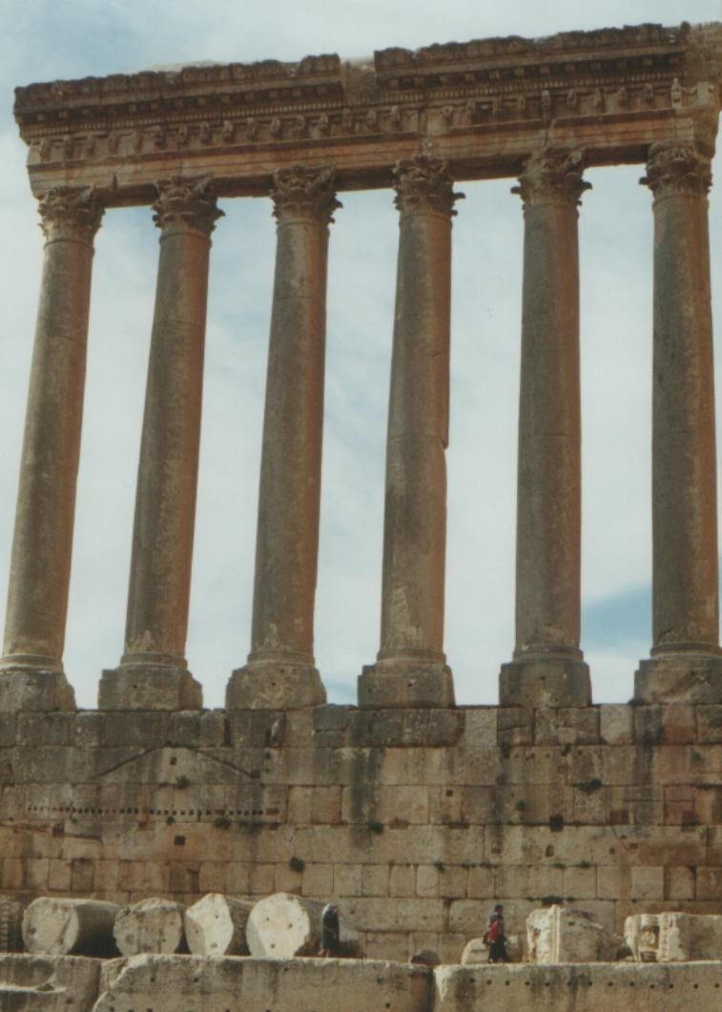
Baalbek Temple of Jupiter 1

Slide 19
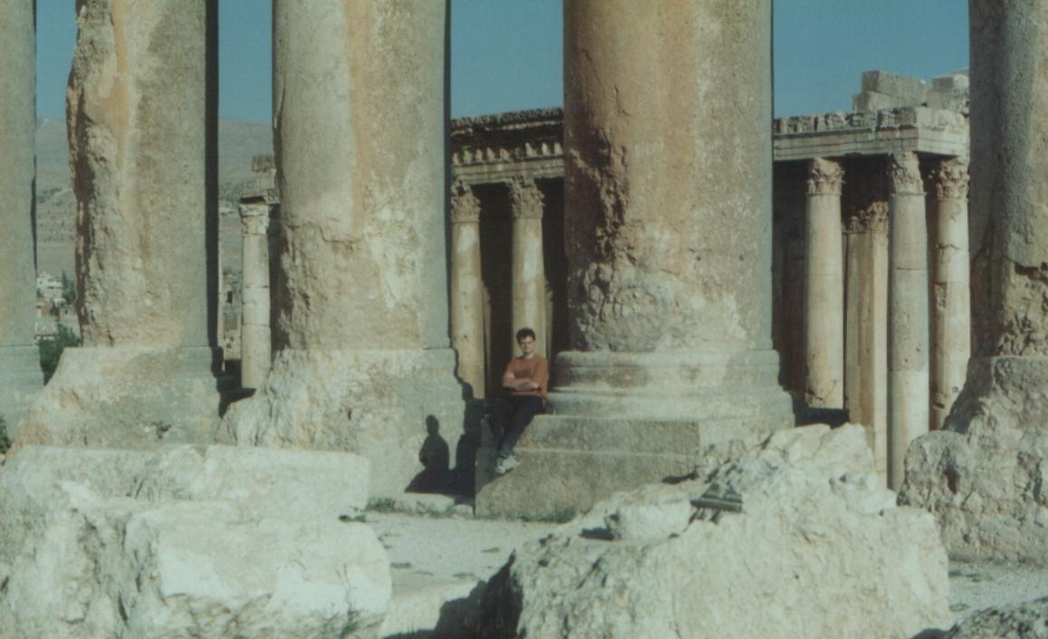
Baalbek Temple of Jupiter 2

Slide 20
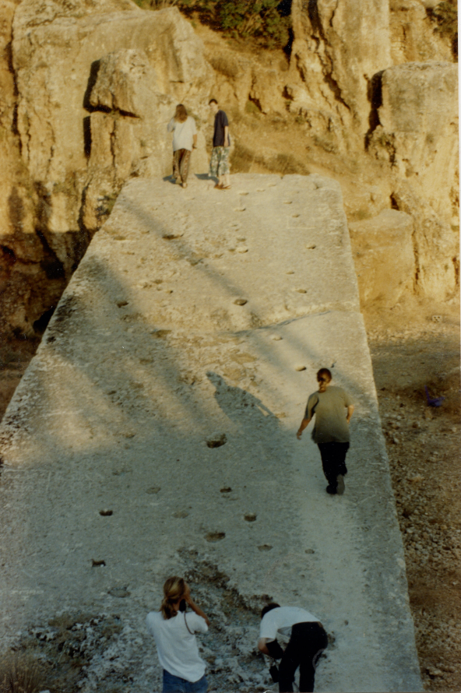
The Stone of the Pregnant Woman

Slide 21
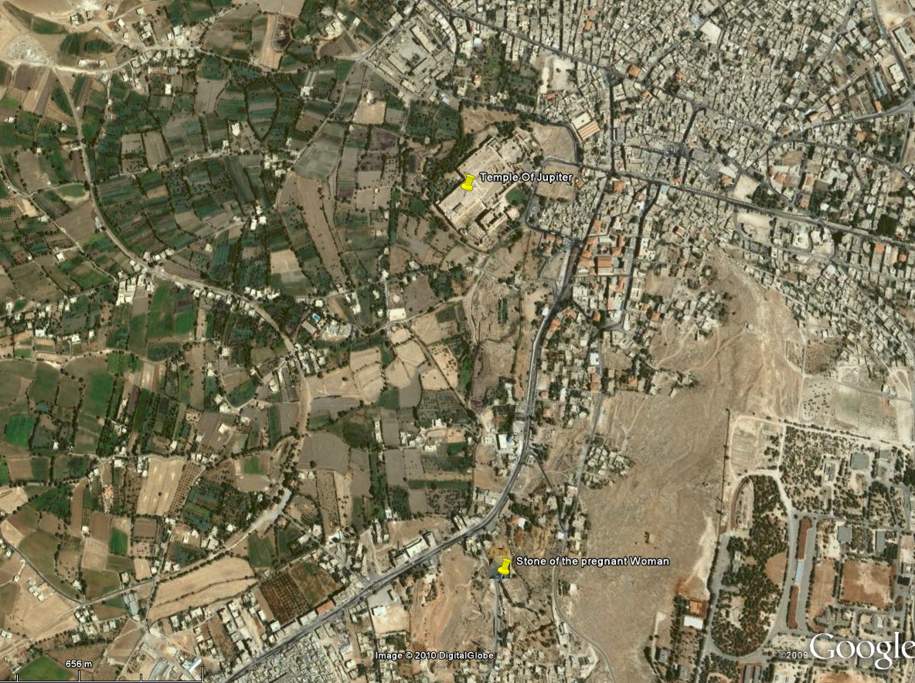
Baalbek Quarries

Slide 22
Decorative stones
White marbles – hard to provenance
Grain size
Coloured marbles
Other stones

Slide 23
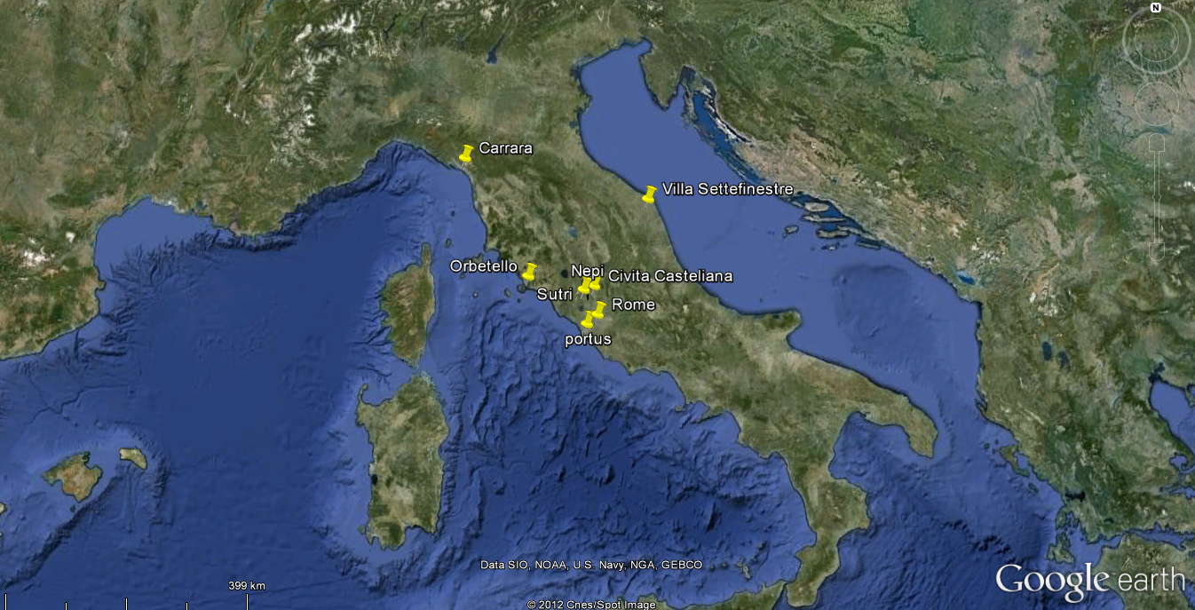

Slide 24
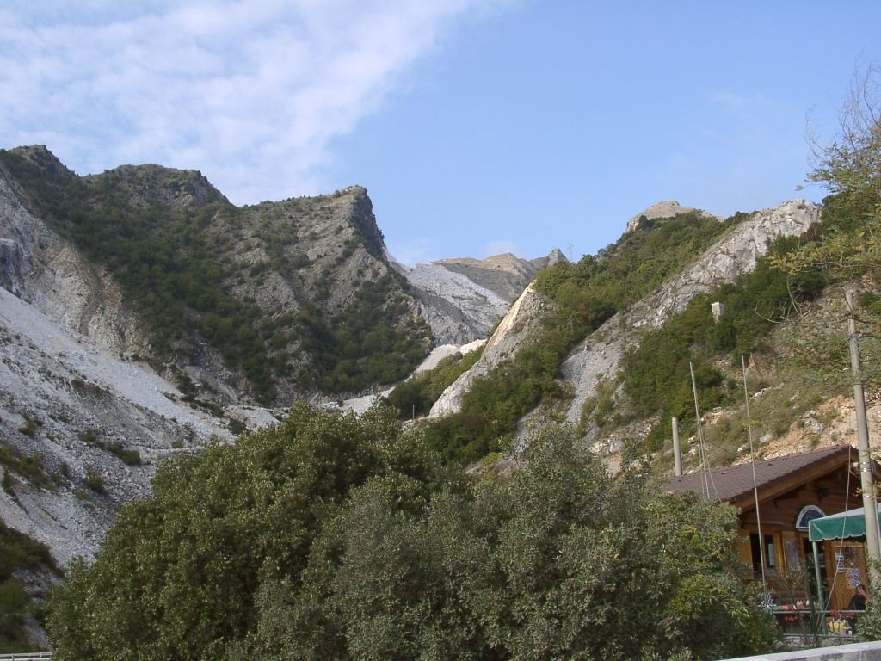
Carrara

Slide 25
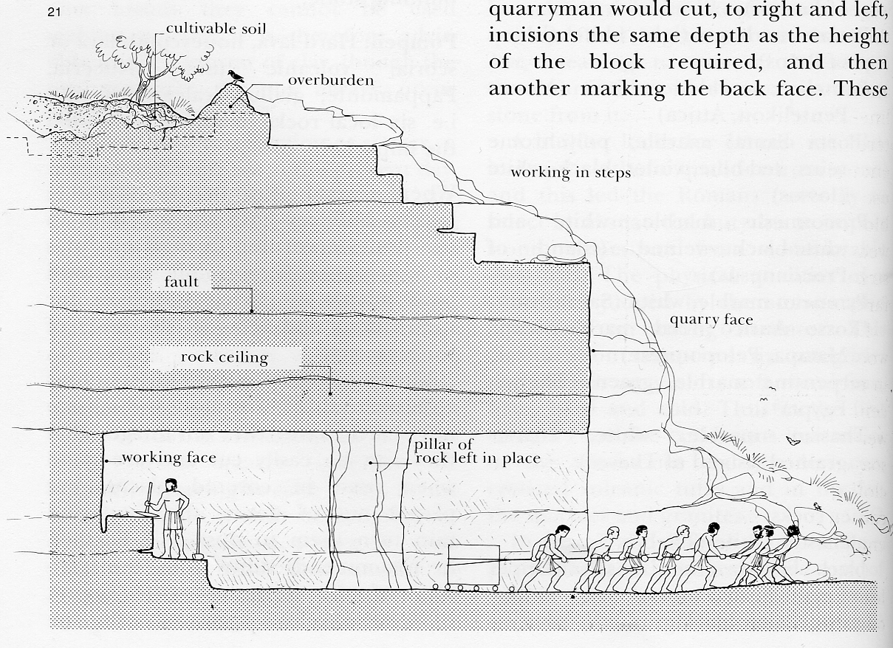
Extraction of stone

Slide 26
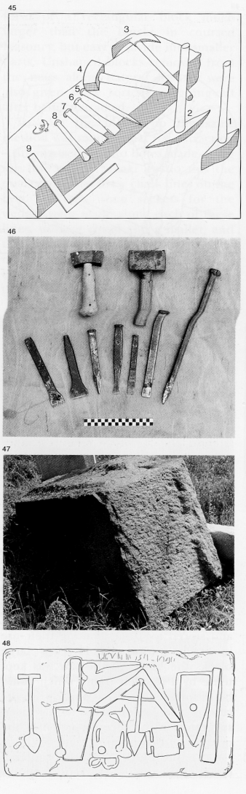
Tools of the Mason

Slide 27
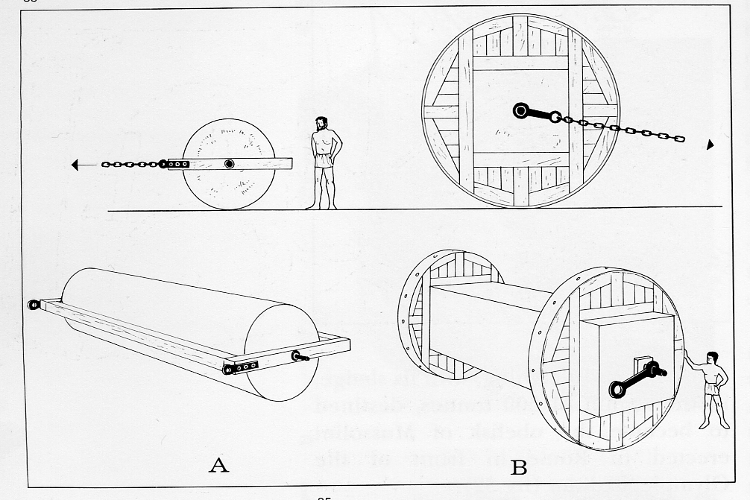
Transportation of Stone

Slide 28
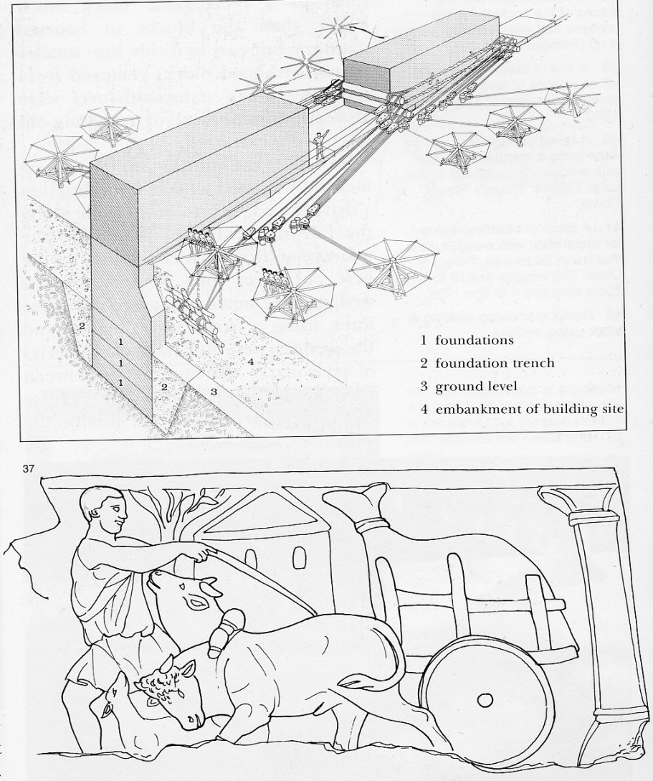
Transport 2

Slide 29
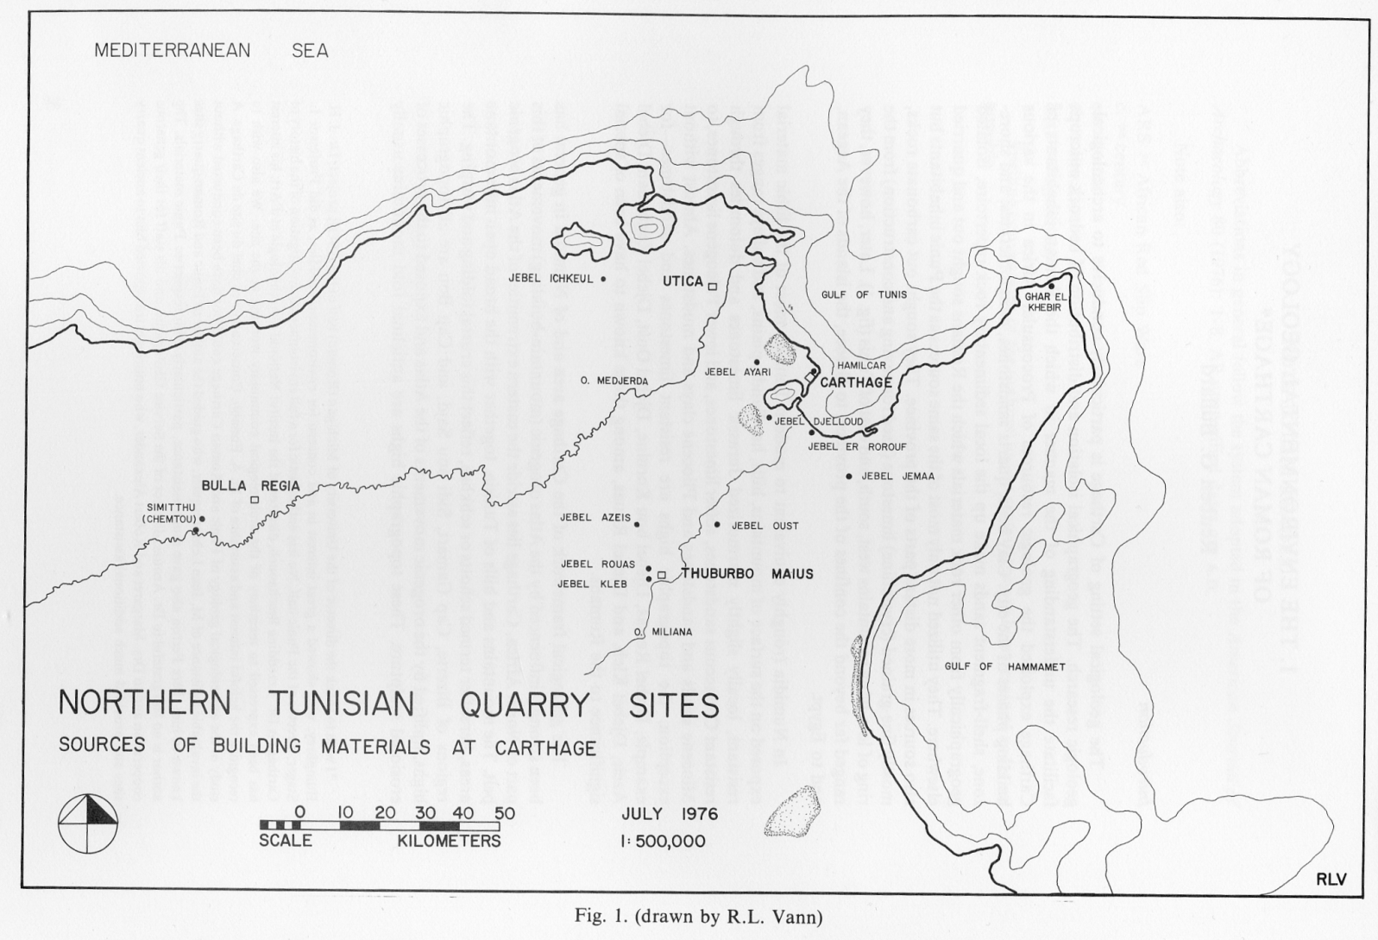
Local Stones for Carthage

Slide 30
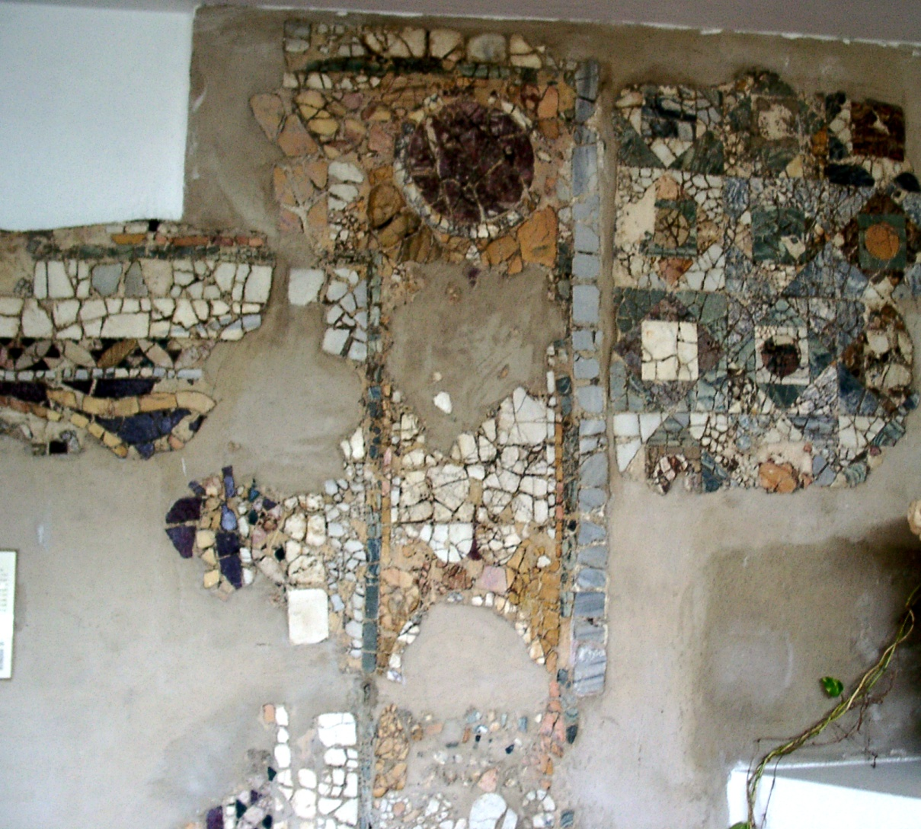
Opus Sectile Pavement, Carthage

Slide 31
Imported Stones
Chemtou, Tunisia
Chios,
Cipollino, Euboa
Filfila, Algeria
Lesbian, Lesbos
Parian, Paros
Pentelic, Attica
Porta a santa, Iassos
Proconneseus,
Pyrenean, Saint-Beat
Rosso Antici, Cape Matapa, Pelopopennese
Serpentine, Thebes
Thasian, Thasos
Alabaster, Thebes
Black/ Green Basalt, Upper Egypt?
Grey/ black granite, Aswan
Pink Granite Aswan
Red porphyry, Egypt,
Green Porphyry, Cape Matapa, Pelopopennese

Slide 32
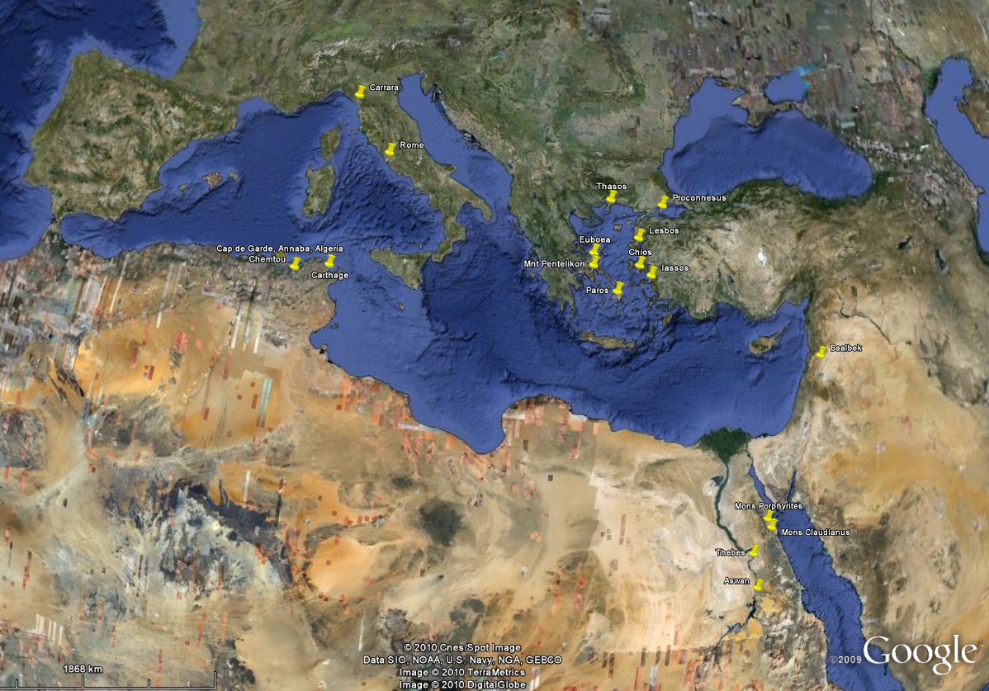
Important Quarries of the Roman World

Slide 33
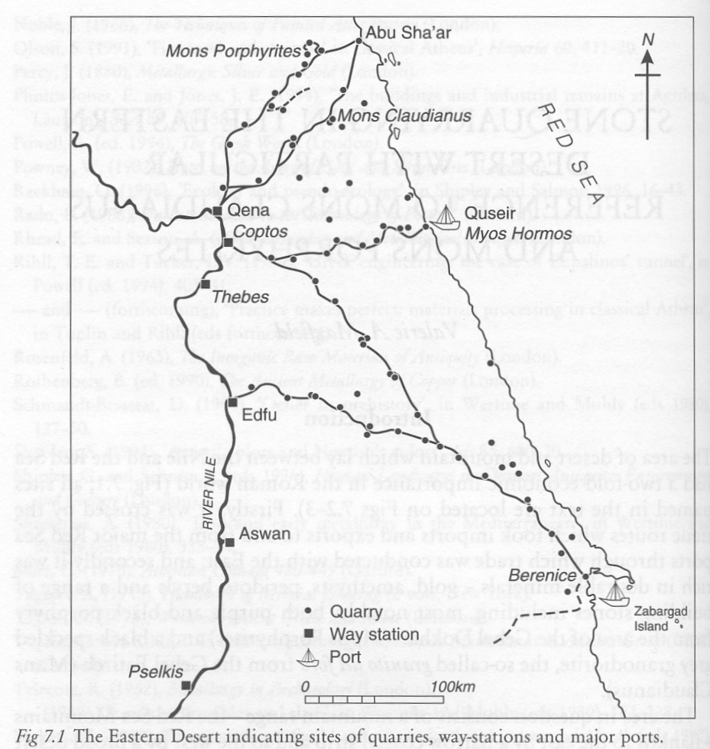
The organisation of the Eastern Desert

Slide 34
Lime and Mortar
Ancient technology ( evidence from Catulhyek 6th Millennium BC). Described by Cato and Vitruvius.
Burning limestone at 1000C – quick lime – hydrated (slaking), blocks dissolve – expend heat – forms a putty.
Mixed with aggregates/ clay to form mortar:
Rich >1% clay) lean (2-8% clay) Hydraulic (20% clay)

Slide 35
Stone roof tiles
Diamond shape
Triangle
Inverse Triangle
Rectangle
Usually identified by nail hole.

Slide 36
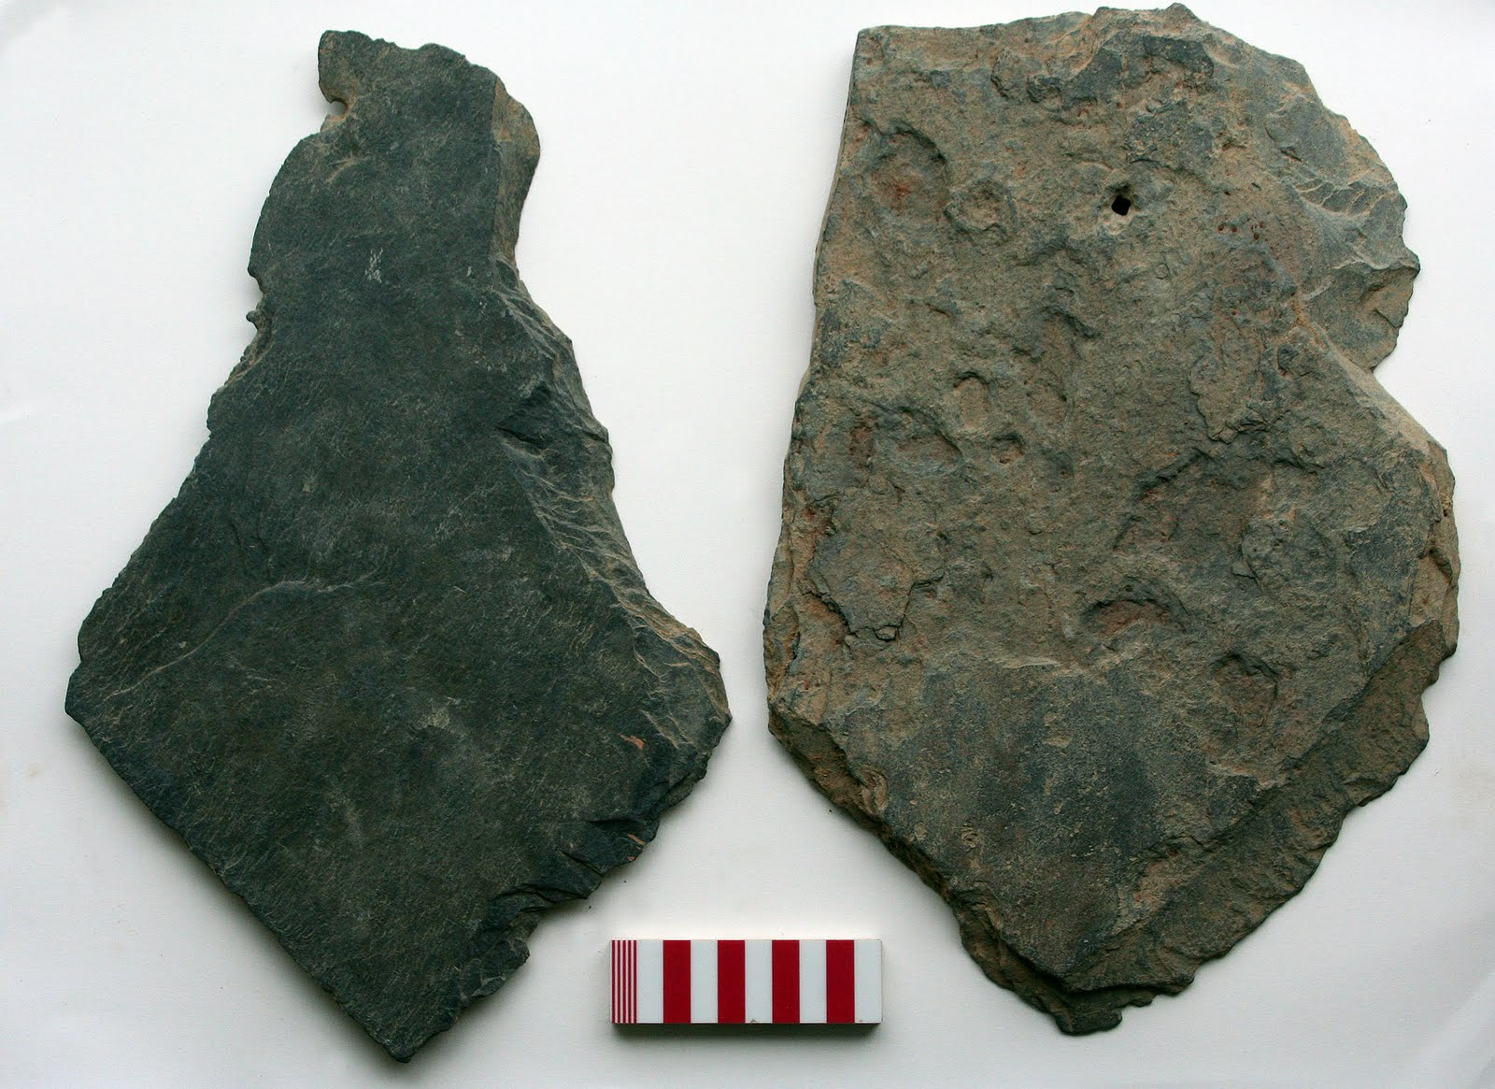

Slide 37
Ceramic and slate roof tile

Slide 38
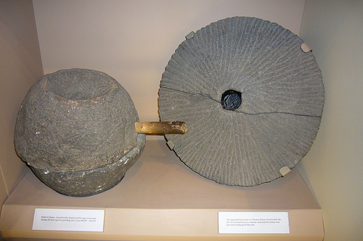
Milling

Slide 39
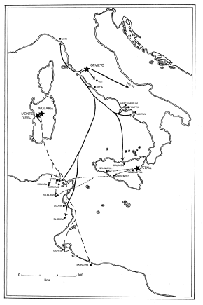

Slide 40
Important Mill Stone Sources
Leucitophytre from the Orieveto region
Red Brown persilicic lava from Sardinia
Basalts (probably Etna)
Carthage and elsewhere in N Africa
Trachy-andesite from Volvic
Donkey Mill in London
Mayen/ Eifel Hills
May be over identified

Slide 41
