Slide 1
The Roman Economy
Week 8 - Transport

Slide 2
Transport
Land Transport
Roads
Vehicles
Inland Water ways
Harbours
Sea Travel

Slide 3
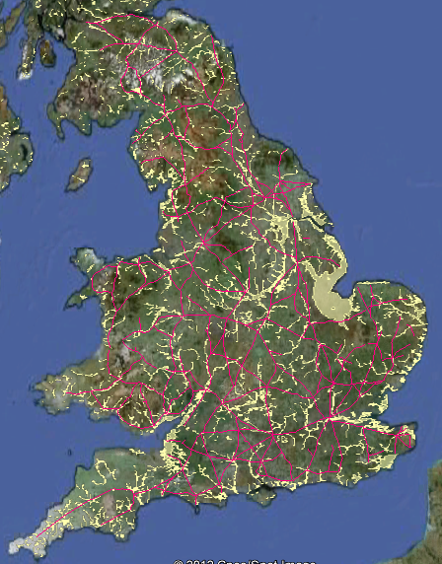
Roads Roman Roads of Britain

Slide 4
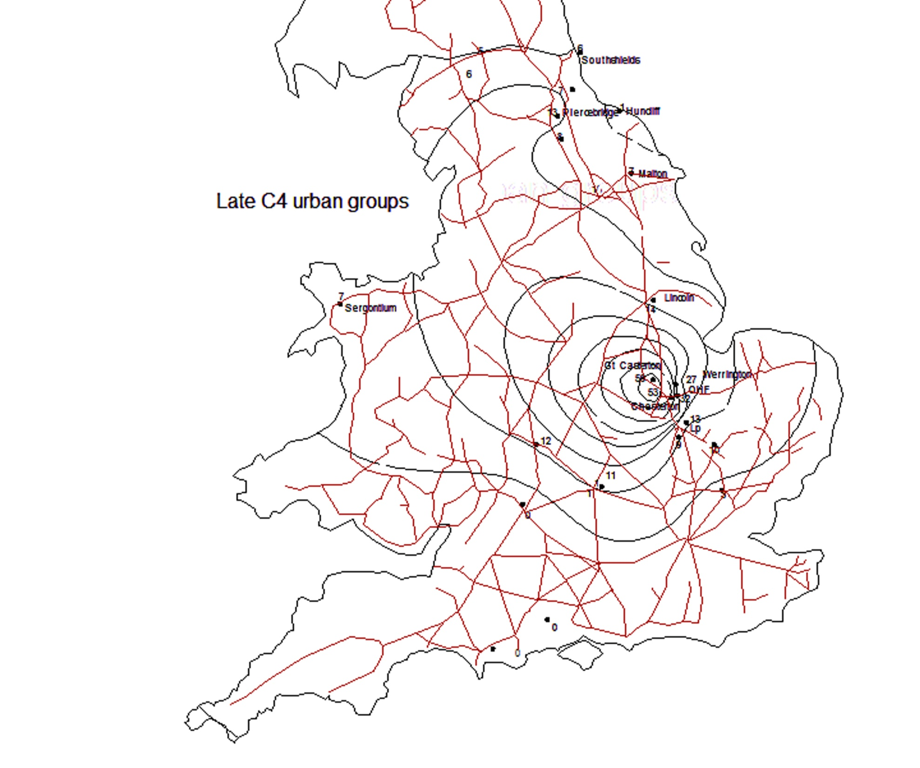
Later Roman distribution of Nene Valle wares

Slide 5
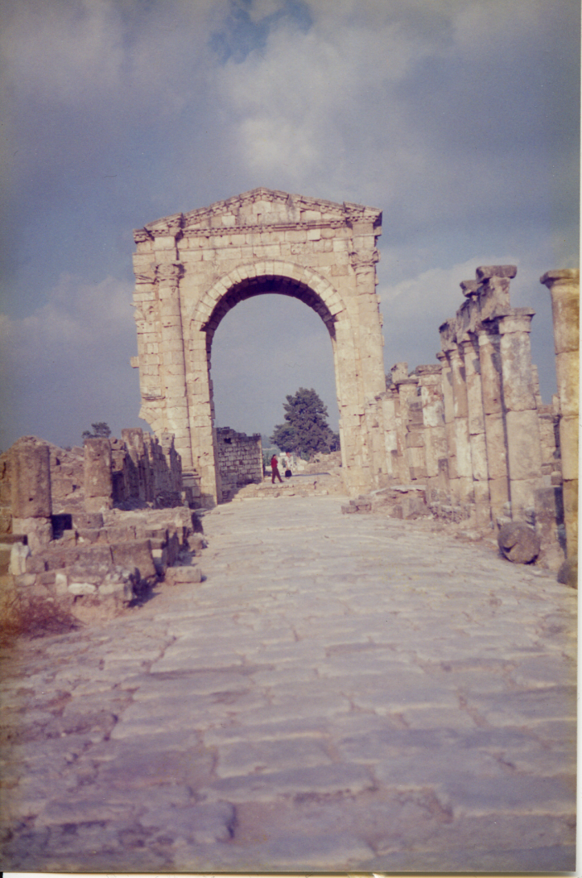
Apamea

Slide 6
Land Transport
Roads
Etruscan roads cut into bedrock
Follow tracks
Explosion of wheeled vehicles
Gravel surfaces
Paved surfaces

Slide 7
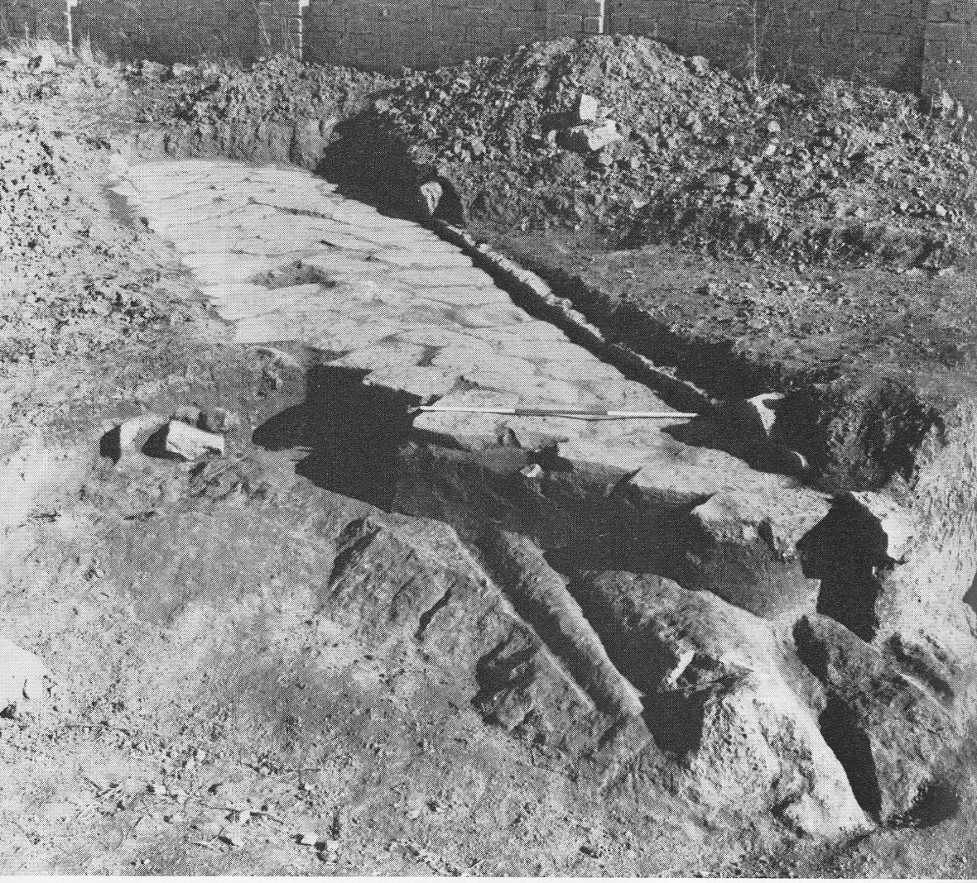
Early Roads

Slide 8
Early Roads in Italy
Earliest forms of transport – by foot and pack animals. Can penetrate (slowly) most regions. Paths would develop along natural ridge lines and transhumance lines. Limits to speed and amounts. Very Seasonal.
Development of Etruscan road building in 7th century BC in parallel with a huge increase in 2 and 4 wheeled vehicles (Mainly evidenced by carvings).
Roads follow valley bottoms, ridge ways etc. Generally cutting down to bed rock (Volcanic Tufa) with V shape cuts and gullies for drainage. Massive scale in places for drainage and cuttings into vertical cliffs – winding up as seen today.
Room for two carts in width
Dating difficult – usually relies on relationship to other features, usually tombs. Inscriptions very rare.

Slide 9
Early Roads
Waterways passed by fords, drainage from valley ( also improves agricultural potential) one span bridges of timber.
Wheels cut into bed rock, and roads deteriorate especially in winter with build up of soil, frost damage etc ( seen today in minor roads in Italy).

Slide 10
Later Developments
Climatic/ Environmental change in the second half of the 2nd millennium. Rivers change courses and a build up of alleviation. Valley bottoms left and ridge ways still followed.
Increase in network and rural sites

Slide 11
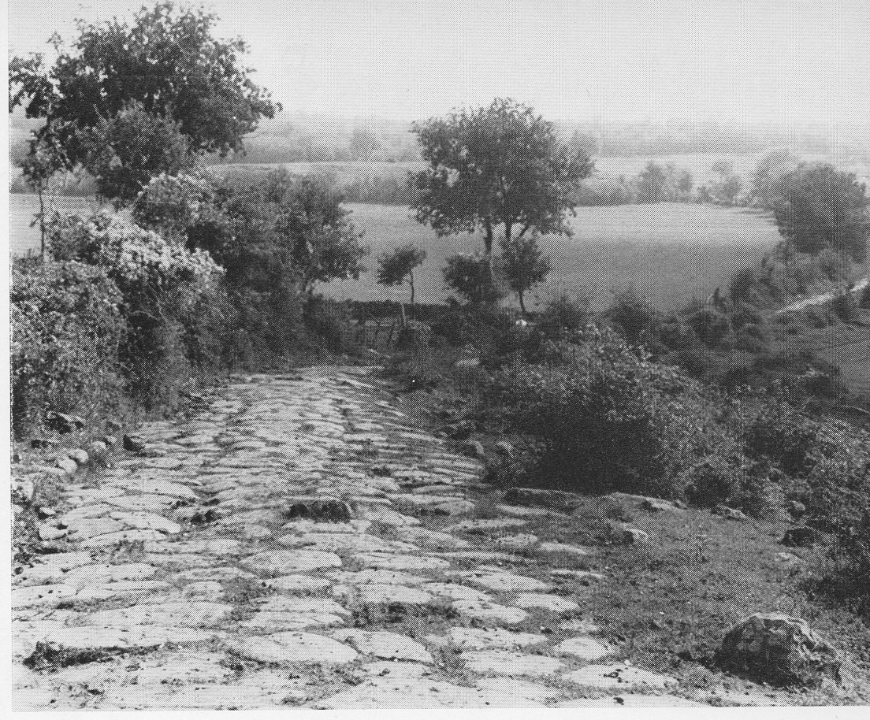
Via Amerina, S of Nepi

Slide 12
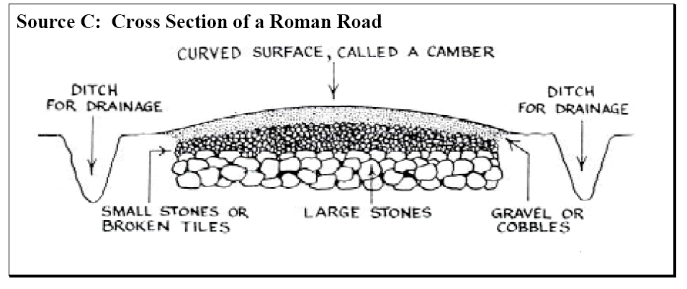

Slide 13
Roman Roads
Using paving (Slece) on secondary roads.
More sophisticated bridges
Chevalier classification:
1. Public and Military roads
2. Local roads
3. Minor Roads

Slide 14
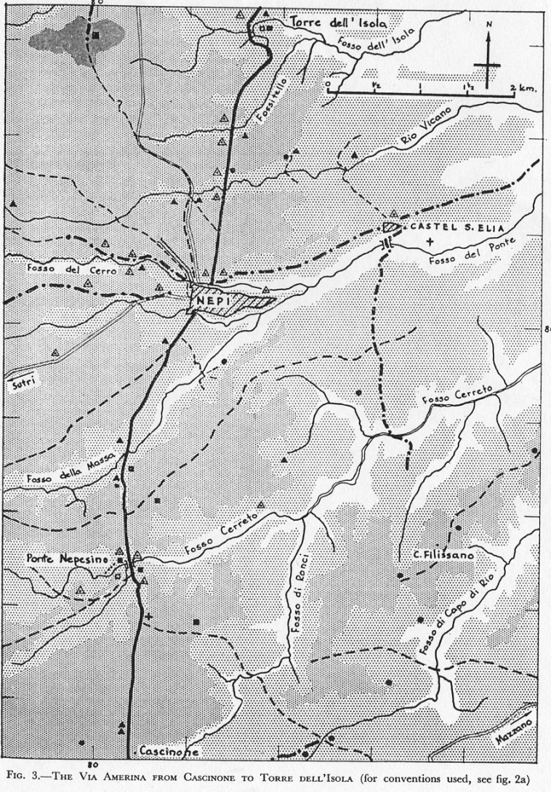
Roads around Nepi

Slide 15
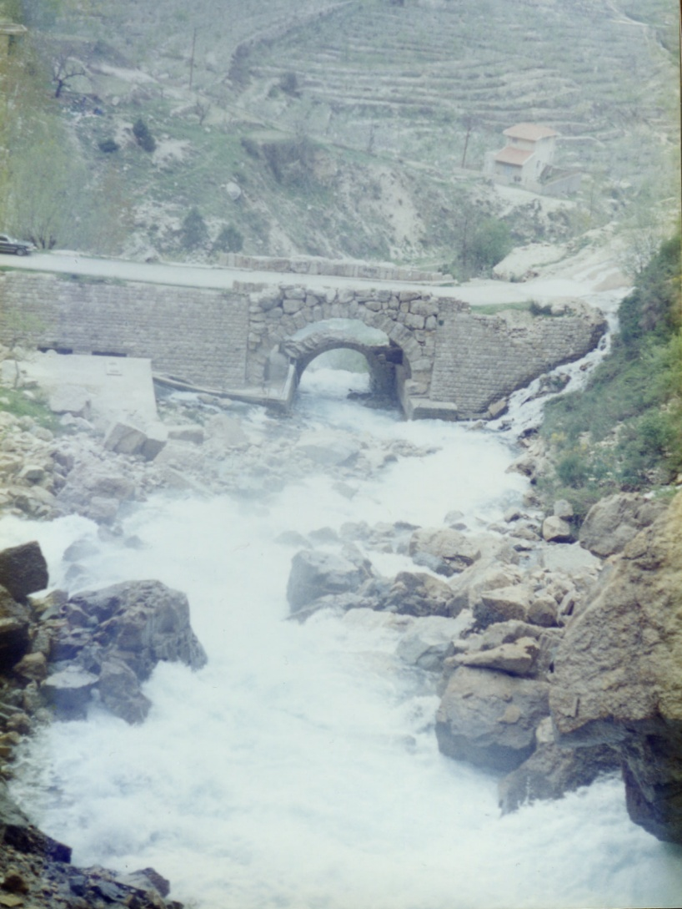
3 Bridges, Lebanon

Slide 16
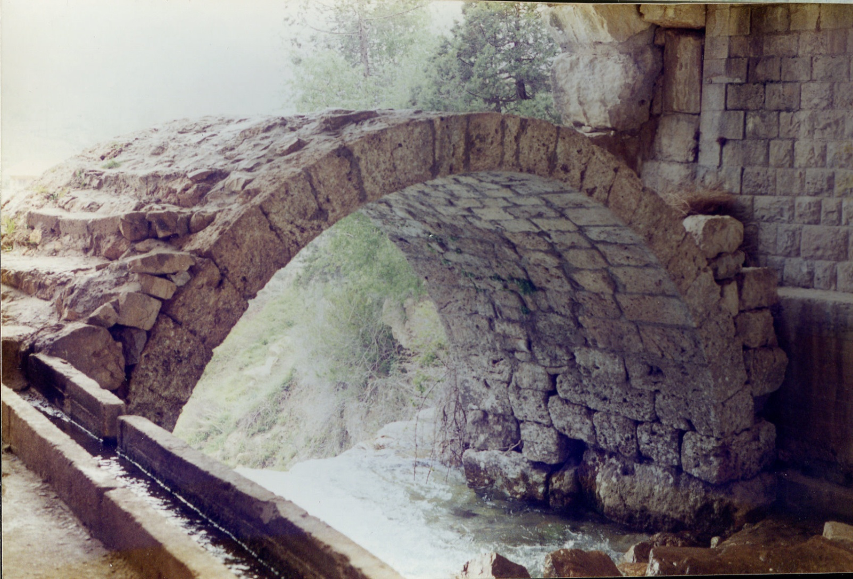

Slide 17
Cost of Transport Cato, De Agricultura/ On farming (L C2 BC)
Note on Buying Crushing Mills
A crushing mill bought in Suessa country cost HS 400 and 50 lb. oil; HS 60 assembly; ox transport, 6 days’ work, 6 men with the ox herds, HS 72; axle with accessories, HS 72; grand total HS 729, counting HS 25 for the oil.
Bought at Pompeii, complete with accessories, HS 384; transport, HS 280; best assembled and adjusted on site, for which allow HS 60: grand total HS 724.
If getting new millstones for an old mill, 1 foot 3 fingers thick at the centre, 3 feet high, axle slot foot square. When you get them home they have to be fitted to the mill. They are sold at the walls of Rufrium at HS 180; fitting, HS 30. Same price at Pompeii.

Slide 18
Cost of Transport
Cato’s figures used by Yeo to calculate transport costs of food – influenced Finley and Jones.
However – commodities cost varies around Italy ( local geology, previous transportation etc.) and Appling information about a very unusual occurrence to general transportation.
Figures used to calculate travel times – but miscalculated distance from Brundisium to Rome, so used figures for Oxen for all travel (and not known if example used roads)

Slide 19
Speed of transport
Oxen – 2 miles and hour
Mule 4 miles an hour
36 miles a day not unusual – Court allows 20 miles a day travel time.

Slide 20
Diocletian’s Edict
1200 pounds by wagon 20 denarii per roman mile.
E.g. 1 modius of wheat (22 lb) 0.4 d per modius per mile.
Compare Sea voyage Alexandria to Rome (1250 miles) 16 denarii per modius.
However: comparing bulk transport with cost of hiring a vehicle
A self sufficient villa would have staff and equipment to carry out transportation.
Does not include transport costs to and from Docks, Handling charges etc.
Ratio of costs sea: river 1: 5; river :road c. 1:5
Remember rivers can be seen as up stream and down stream
Sea travel not possible in winter (October to April)
These networks are not alternatives but an integrated system.

Slide 21
Agriculture and land transport
Columella and Varro both reference Cato, who would have been writing when the advantages of road transport network becoming obvious.
Cato considered climate and soil first but then road water and neighbourhood (Viam, Aquam, Vicinum)

Slide 22
Cato, On Farming
It must have good weather; it must not be liable to storms. It must thrive from its own excellence and from its good location: if possible, it should be at the root of a mountain, south-facing, in a healthy position. There must be plenty of labour and a good water supply. There must be a sizeable town nearby, or the sea, or a river used for traffic, or a good and well-known road.

Slide 23
Cato
Travel to property in relative comfort ( visit it more)
Supply and export of goods and services
Good to be self sufficient but sometimes need outside goods and services

Slide 24
Varro De Re Rustica 1.16.1-7
And so it is profitable near a city to have gardens on a large scale; for instance, of violets and roses and many other products for which there is a demand in the city; while it would not be profitable to raise the same products on a distant farm where there is no market to which its products can be carried. Again, if there are towns or villages in the neighbourhood, or even well-furnished lands and farmsteads of rich owners, from which you can purchase at a reasonable price what you need for the farm, and to which you can sell your surplus, such as props, or poles, or reeds, the farm will be more profitable than if they must be fetched from a distance; sometimes, in fact, more so than if you can supply them yourself by raising them on your own place. For this reason farmers in such circumstances prefer to have in their neighbourhood men whose services they can call upon under a yearly contract — physicians,⁵⁵ fullers, and other artisans — rather than to have such men of their own on the farm; for sometimes the death of one artisan wipes out the profit of a farm. This department of p223a great estate rich owners are wont to entrust to their own people; for if towns or villages are too far away from the estate, they supply themselves with smiths and other necessary artisans to keep on the place, so that their farm hands may not leave their work and lounge around holiday-making on working days, rather than make the farm more profitable by attending to their duties.

Slide 25
Villa location and Road Building
Common for private roads to be built to connect to a main road

Slide 26
Cicero. (106 B.C.–43 B.C.). Letters. The Harvard Classics. 1909–14. XIV. To His Brother Quintus (In Britain) Arpinum and Rome, 28 September
I examined the road, which appeared to me to be so good as to seem almost like a highroad, except a hundred and fifty paces—for I measured it myself form the little bridge at the temple of Furina, in the direction of Satricum. There they had put down dust, not gravel (this shall be changed), and that part of the road is a very steep incline. But I understood that it could not be taken in any other direction, particularly as you did not wish it to go through the property of Locusta or Varro.

Slide 27
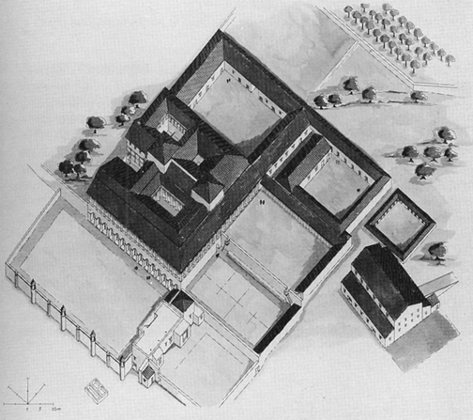
Villa Settefinestre

Slide 28
Villa Location
Settefinestre:
On a hill dominated valley of Oro, diverticulum to Via Aurelia 1.7km 4-5kn to Cosa and harbour and other urban centres
Economic cost negligible as workers and equipment already on the staff
Via Aurelia also part of connections to the wider economy

Slide 29
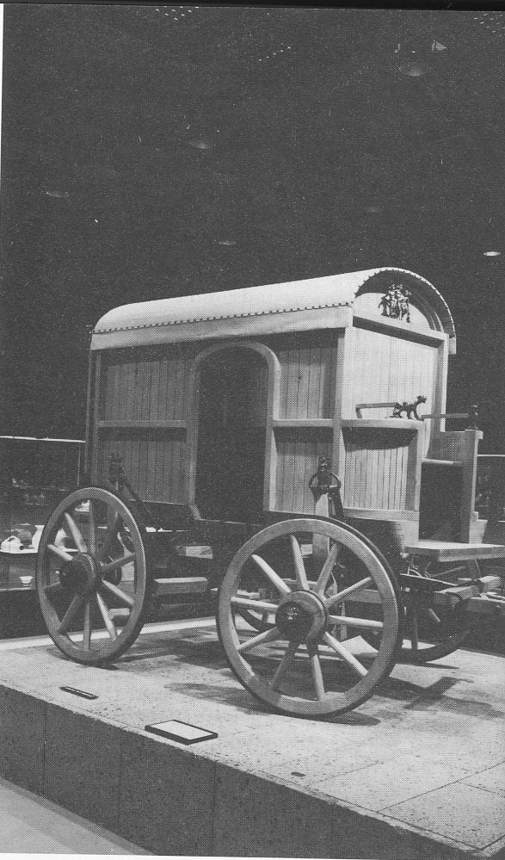
Roman Vehicles

Slide 30
Vehicles
Vehicles and technologies
2 and 4 wheeled vehicles 3500 BC – spokes 2500BC
Evidence: carvings – slow carts to light carts for horses prestigious and rhetoric of sculpture.
Bulgarian burials suggest suspension and pivoted axels
Contrary to earlier suggestions – usable horse collars existed – shafts and traces also in evidence
Don’t need to much sophistication – horses prestige for light carrying – oxen for heavy loads
Mules and beasts of burden also used a good deal
maps existed to plan for long journeys
Antonine Itinerary

Slide 31
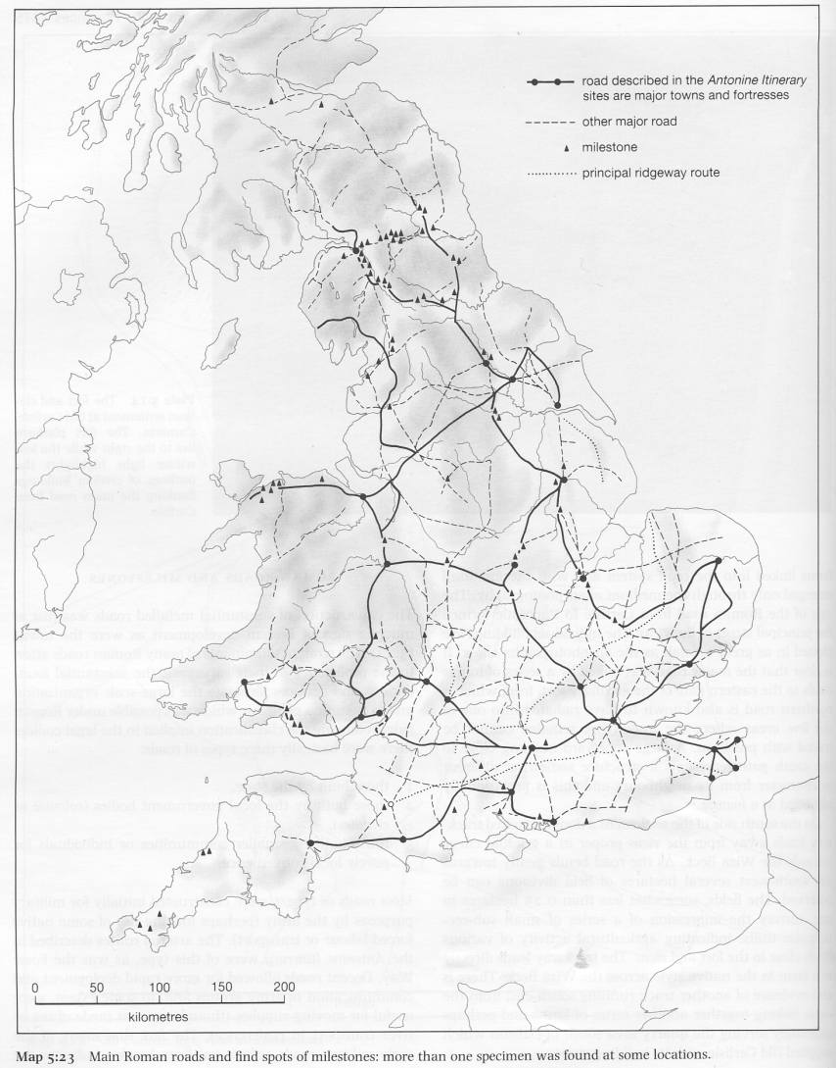
Detail of Roads and Mile stones in Roman Britain

Slide 32
Phenomenology of Roads
Compare roads North and south of Nepi
Not just a functional difference – but a way of Romanising the landscape.
Landscapes of Imperialism
But also landscapes of revolt (Boudiccan revolt)

Slide 33
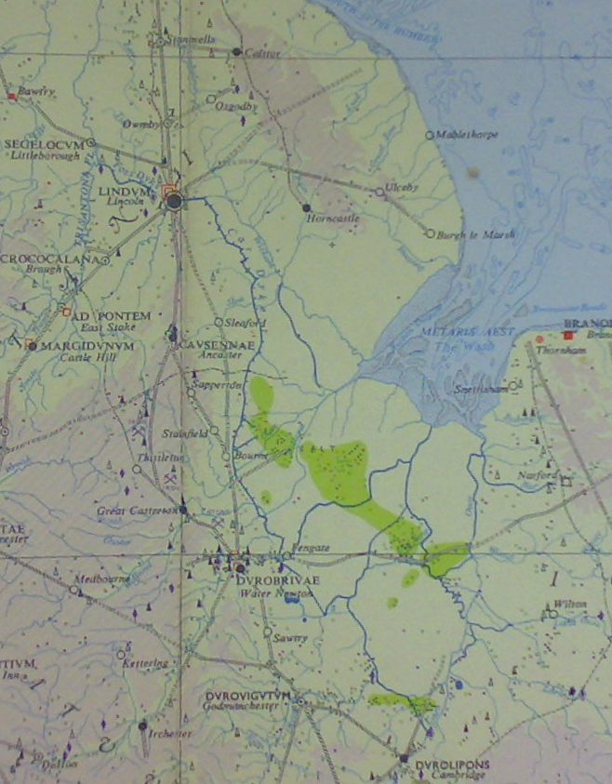
Inland waterways

Slide 34
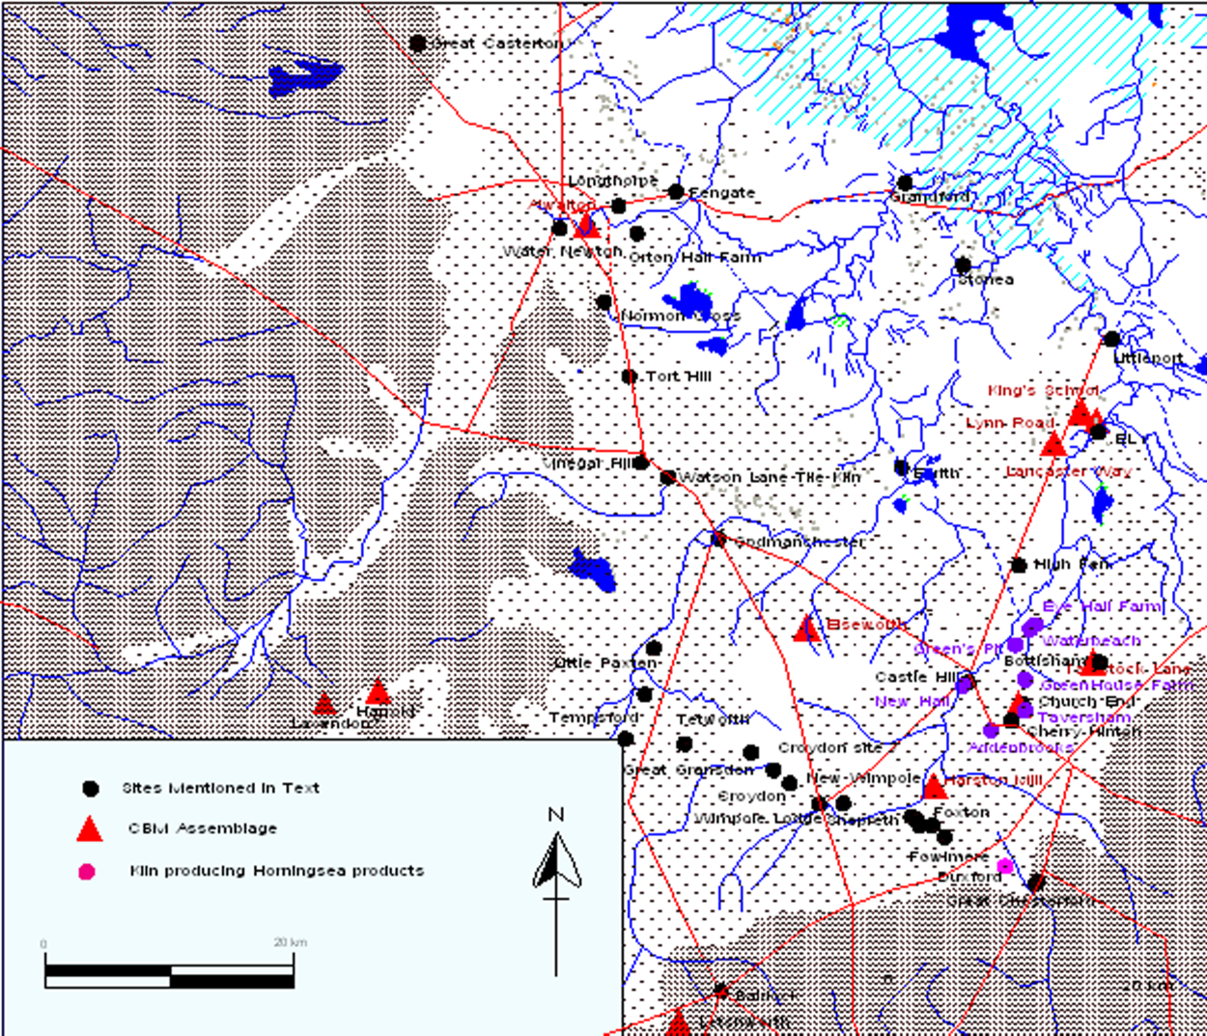
Cambridgeshire Car Dyke

Slide 35
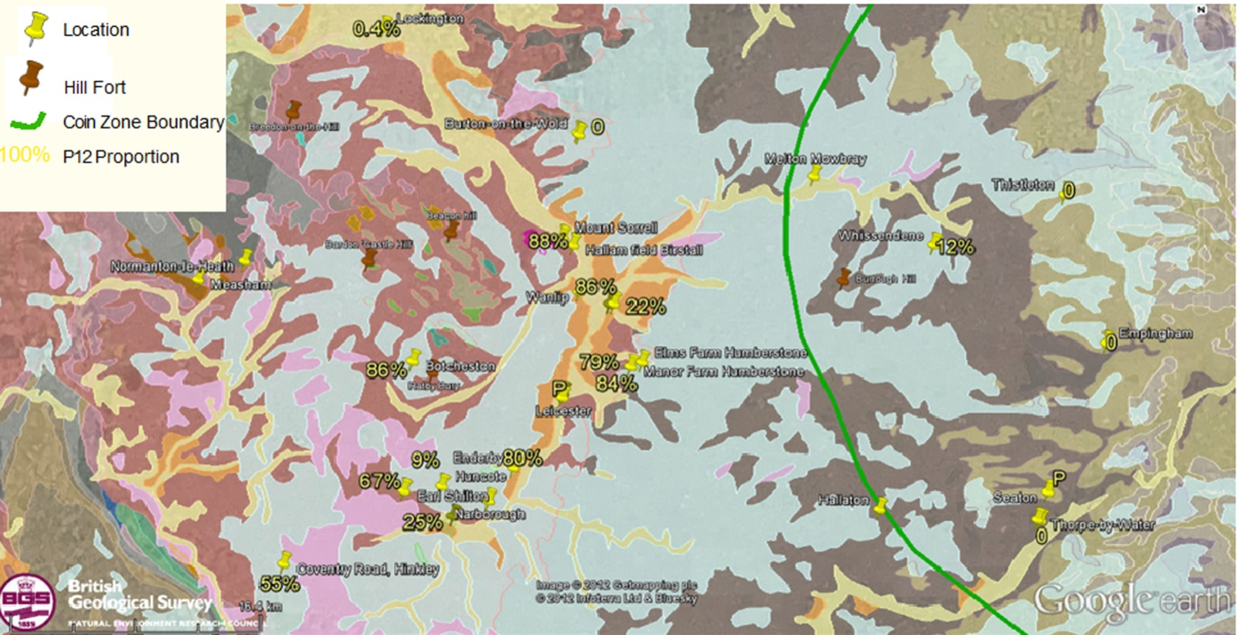
Gold Mica tempered pottery

Slide 36
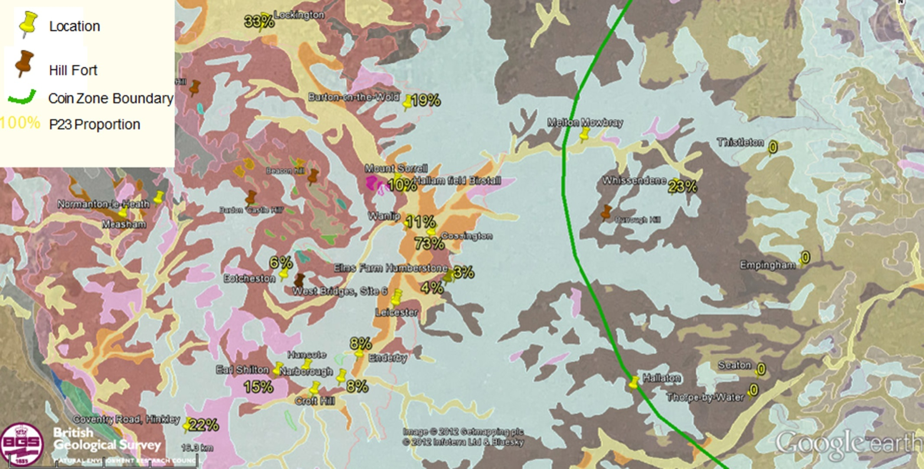
Quartz tempered pottery

Slide 37
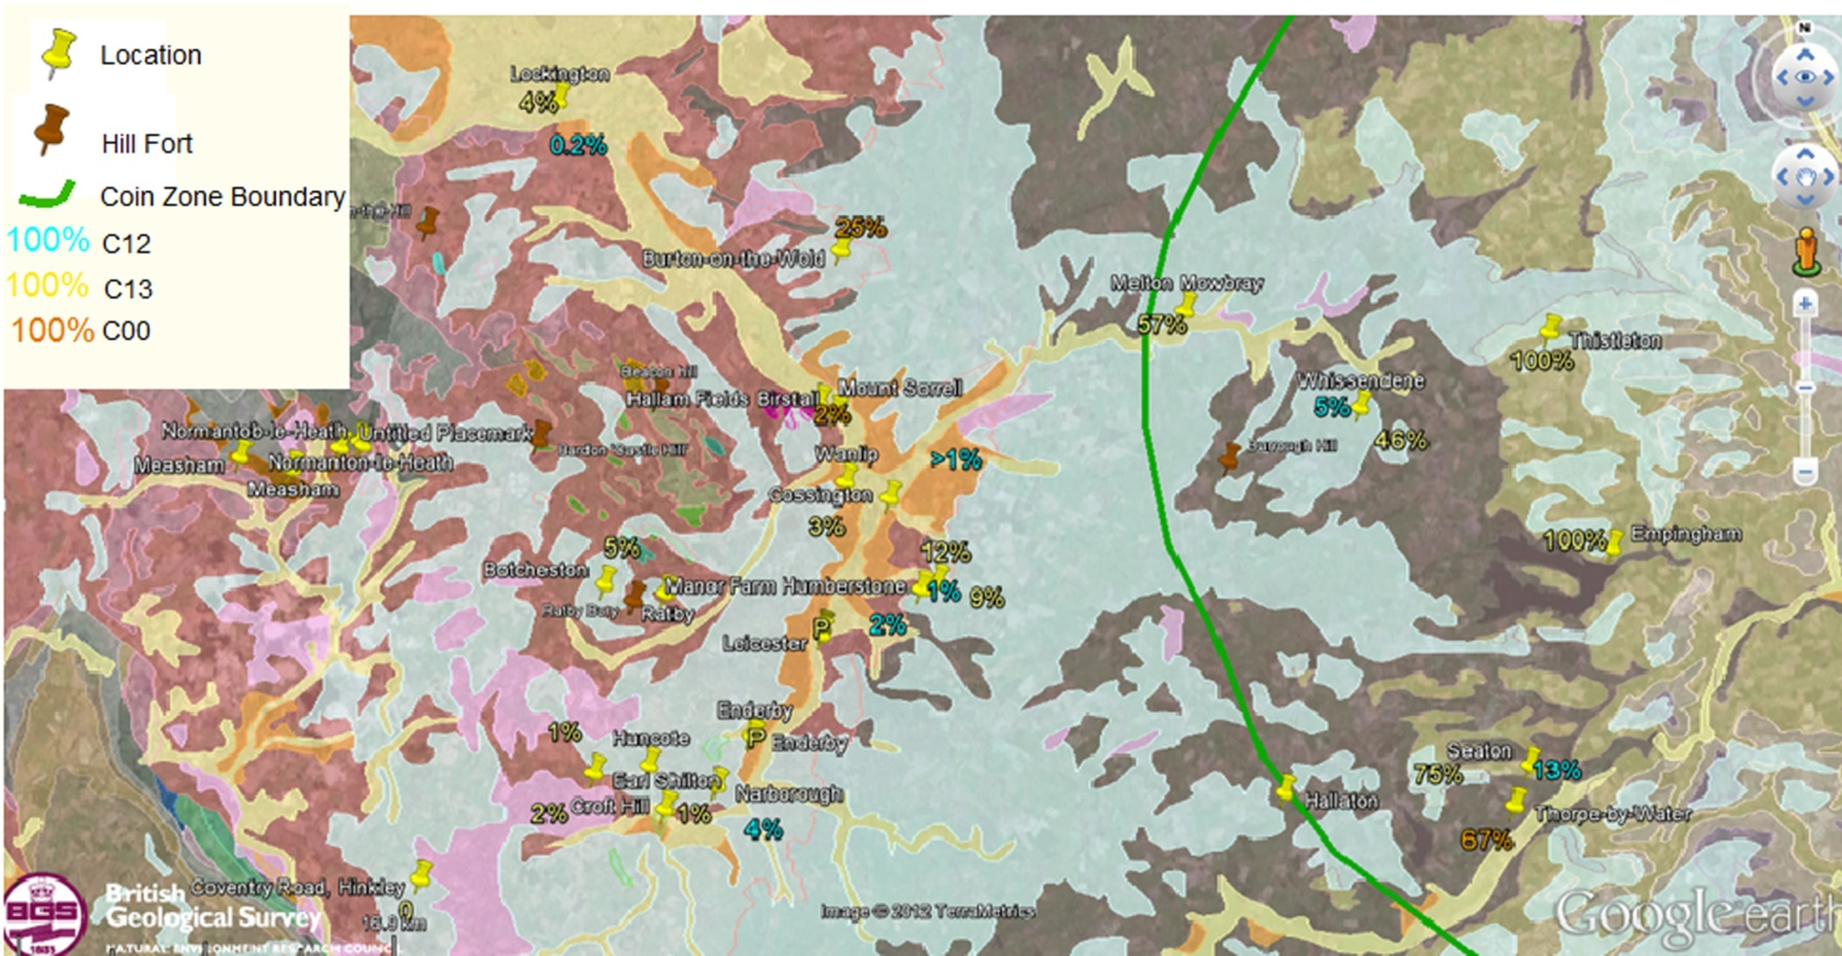
Shell tempered pottery

Slide 38
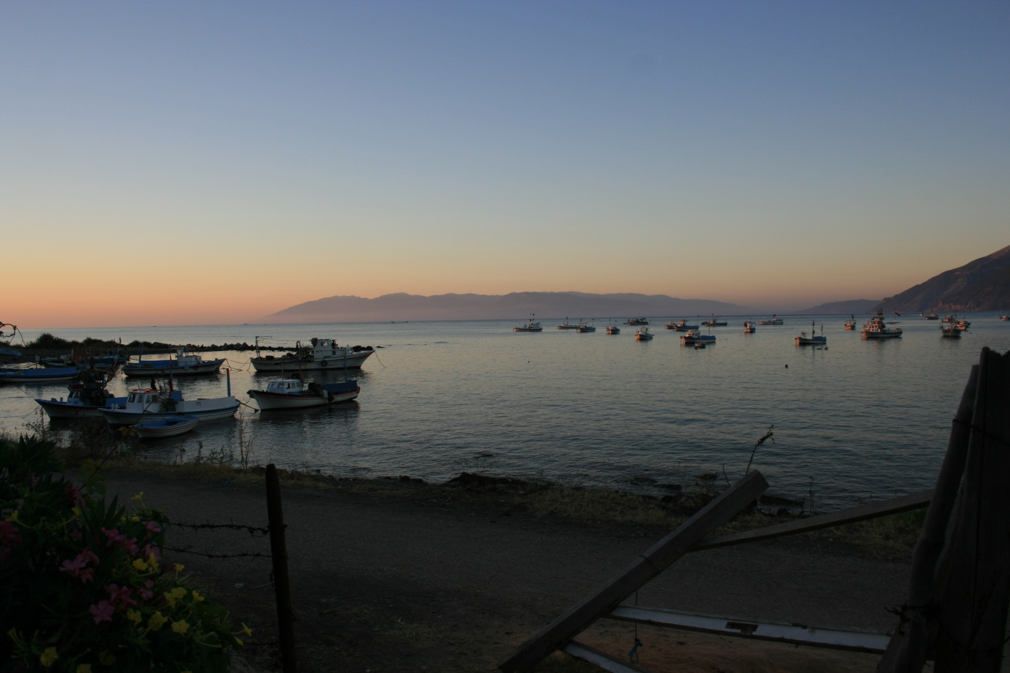
Bay of Bassit

Slide 39
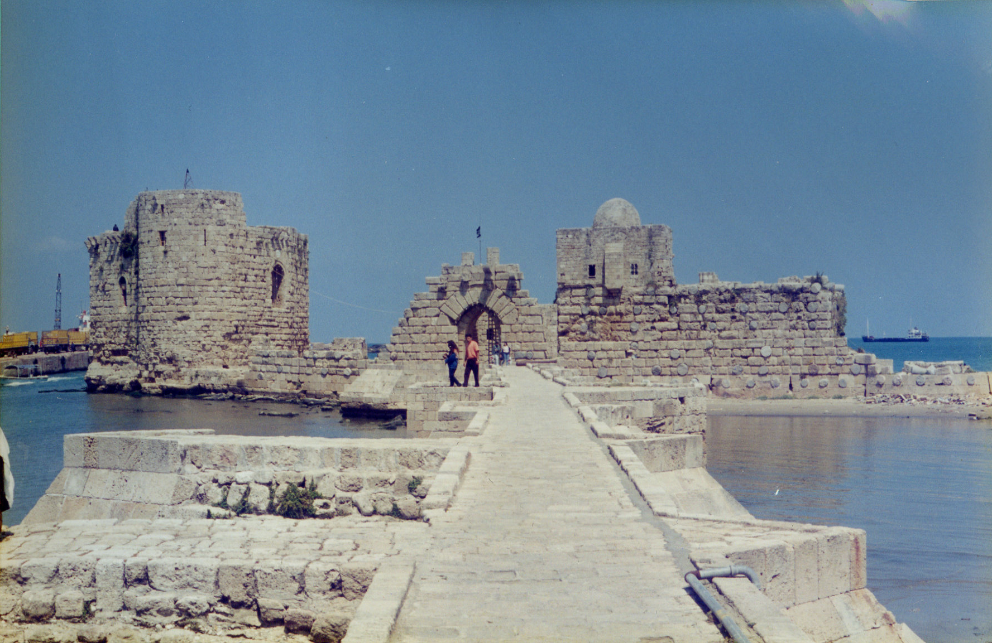
Sidon

Slide 40
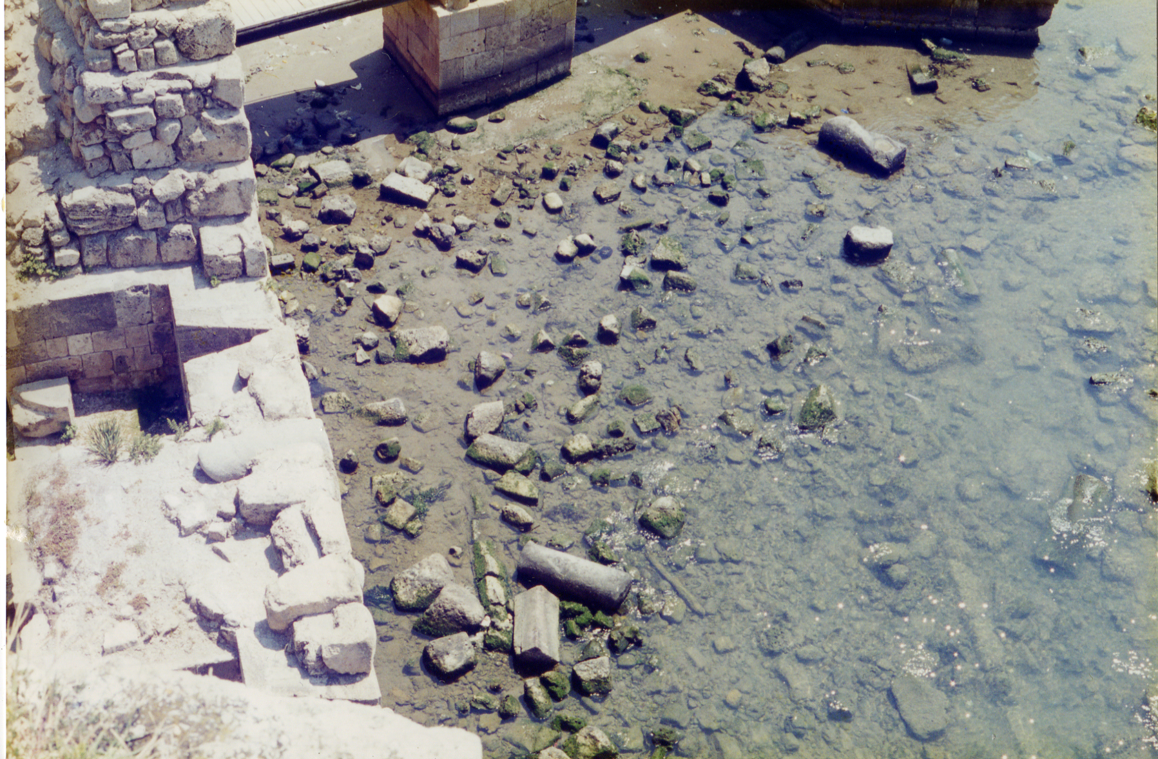
Sidon

Slide 41
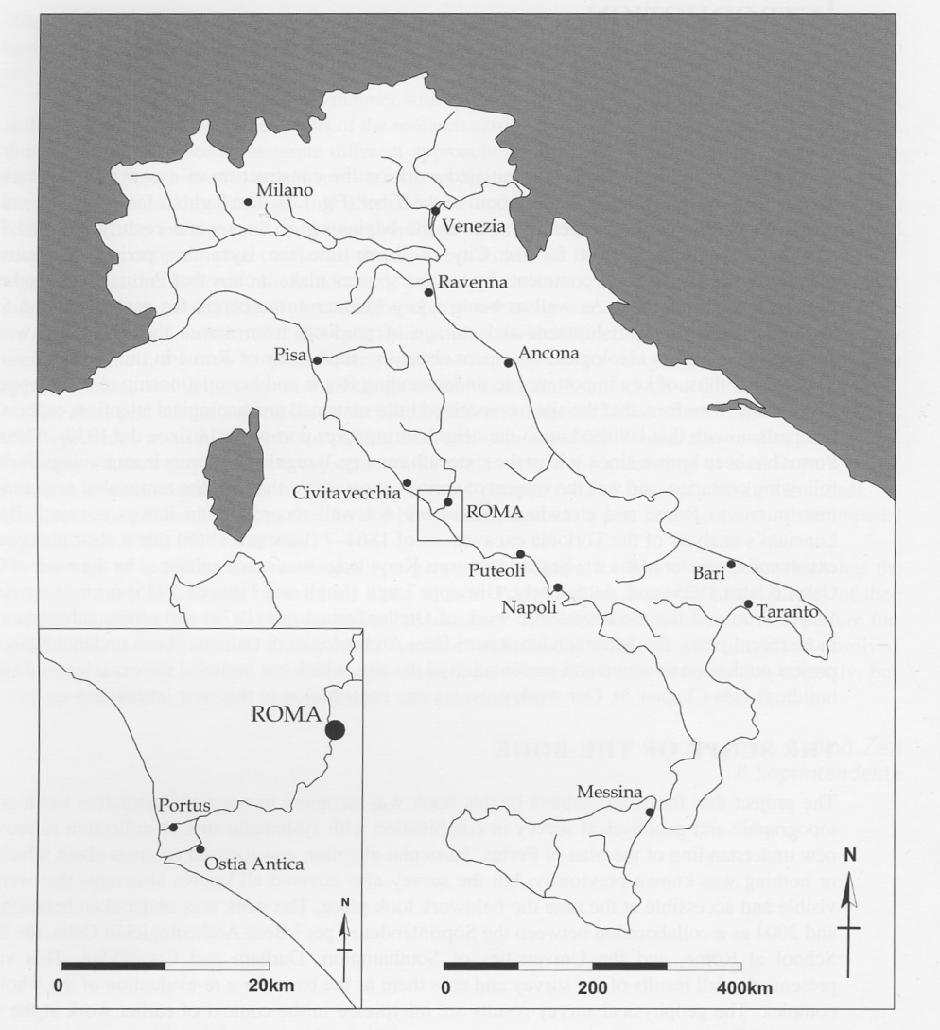
Portus

Slide 42
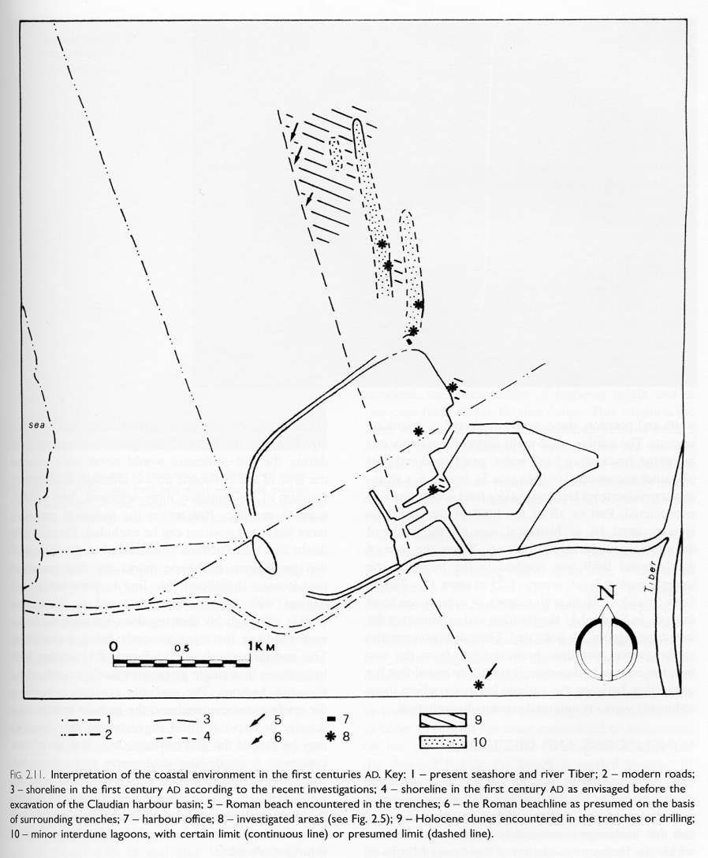
1st Century Portus

Slide 43
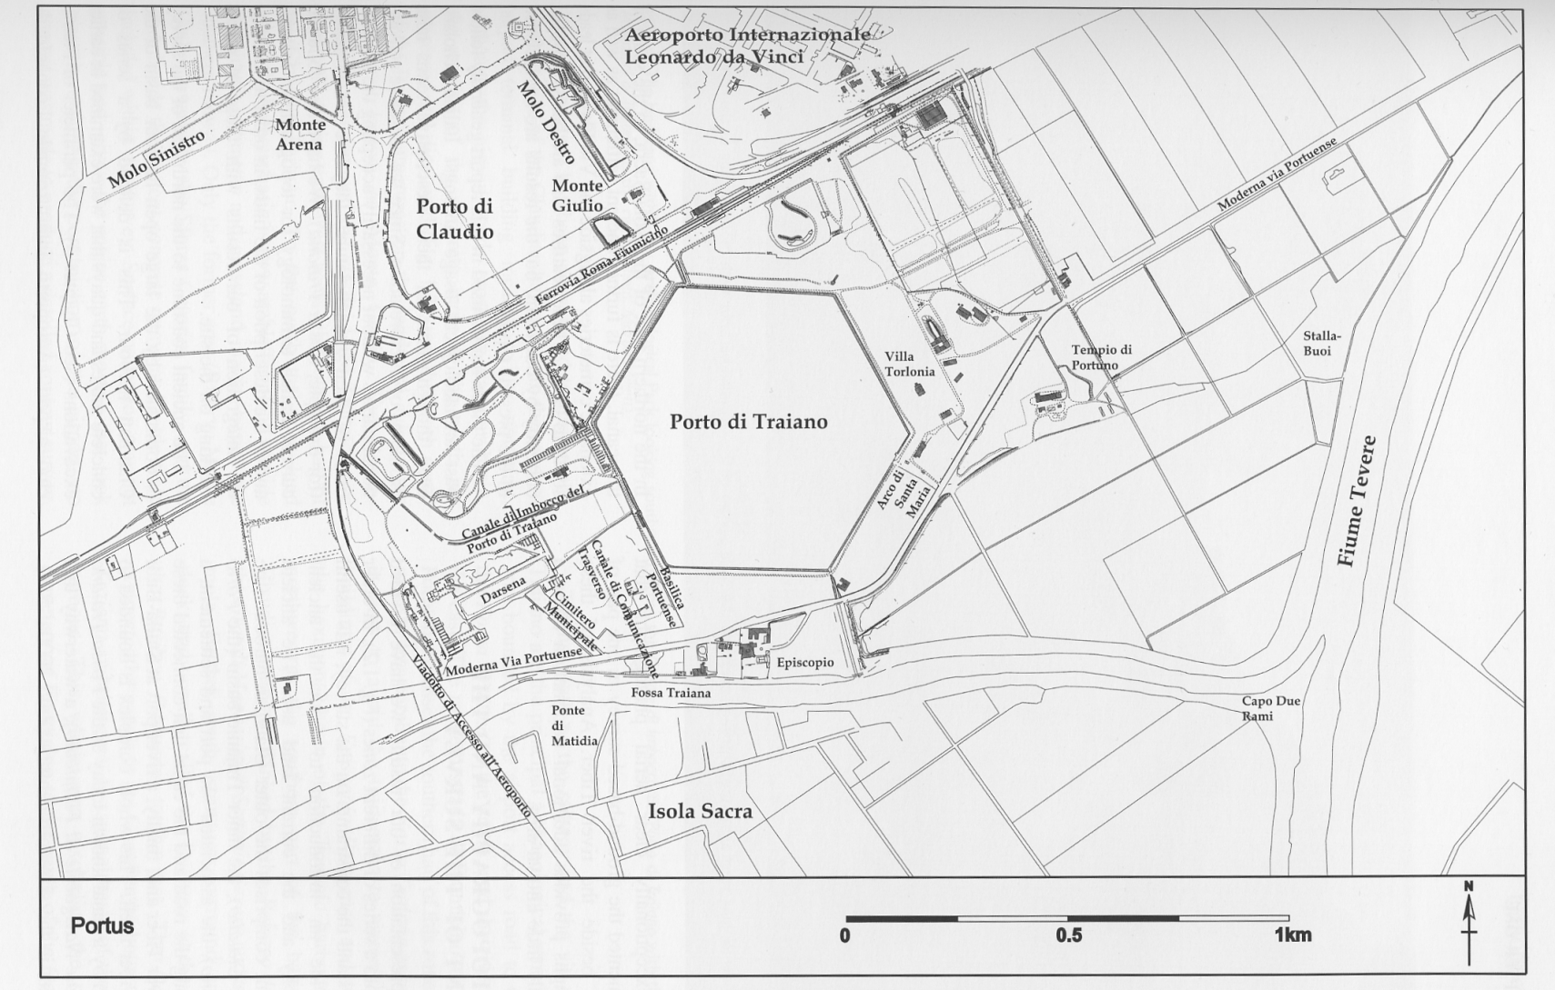
Portus

Slide 44
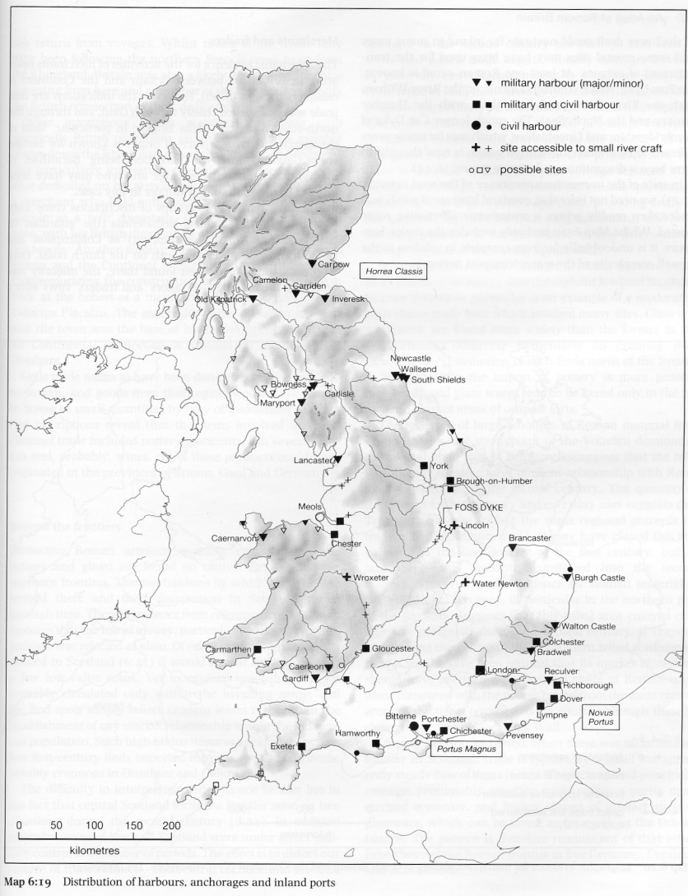
Britain

Slide 45
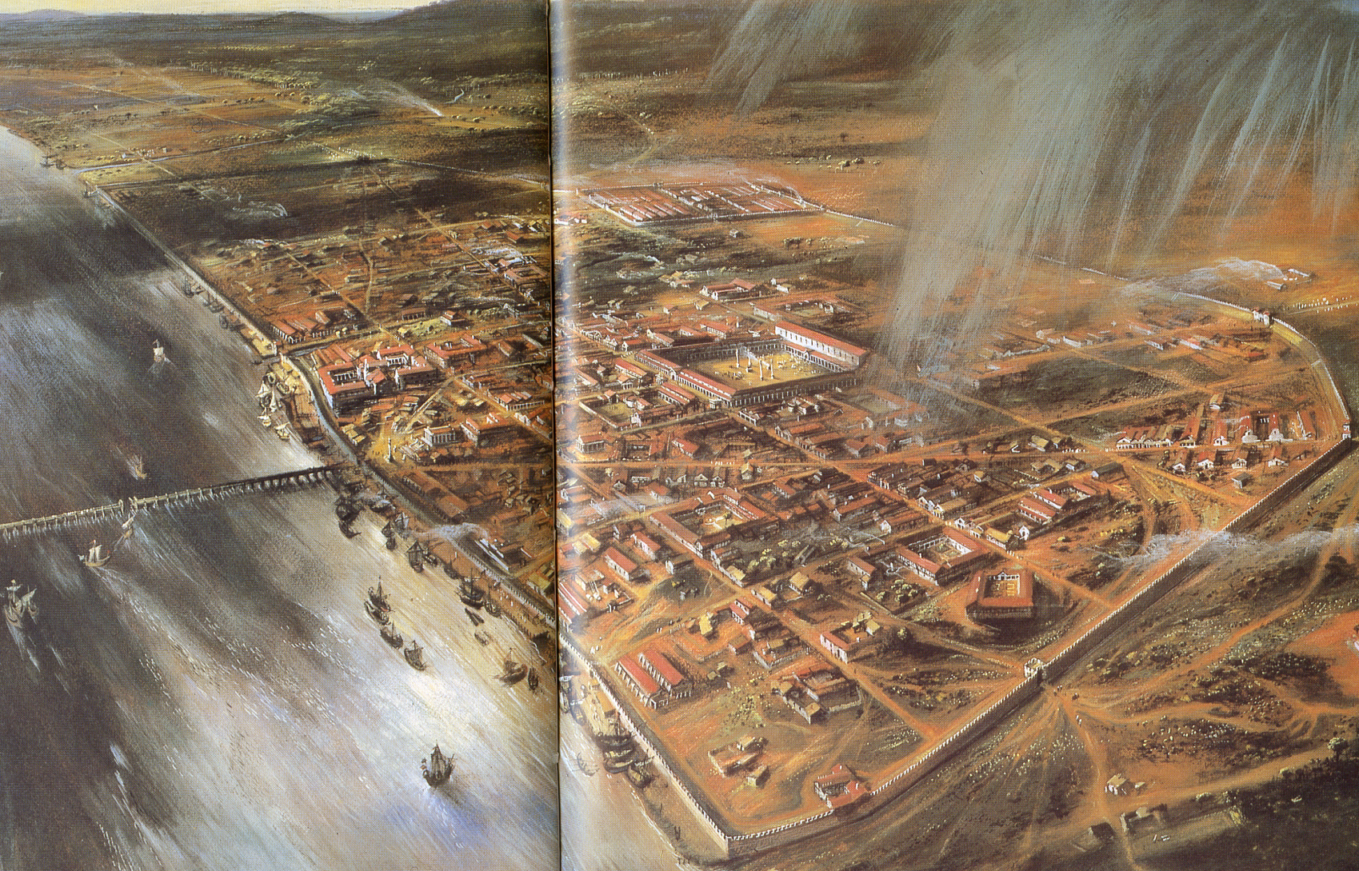
London

Slide 46
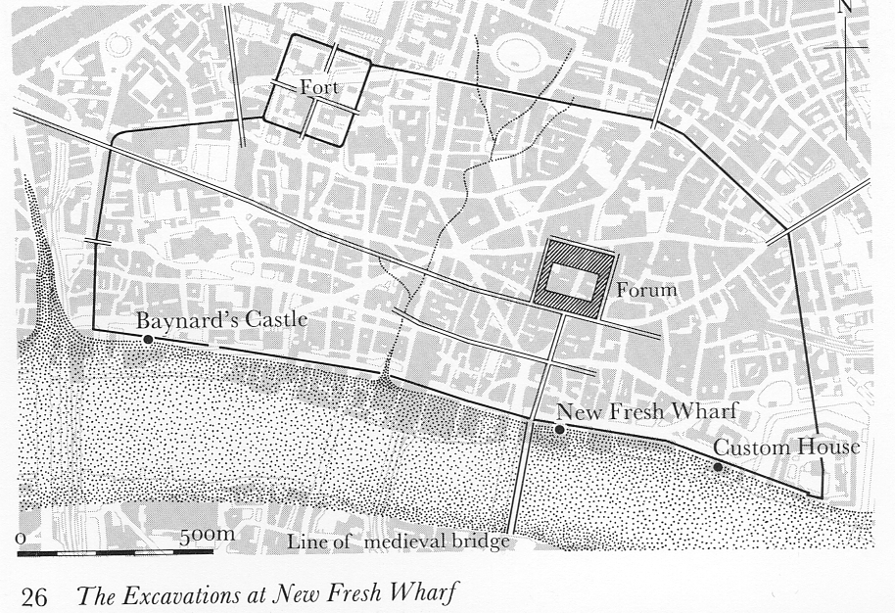

Slide 47
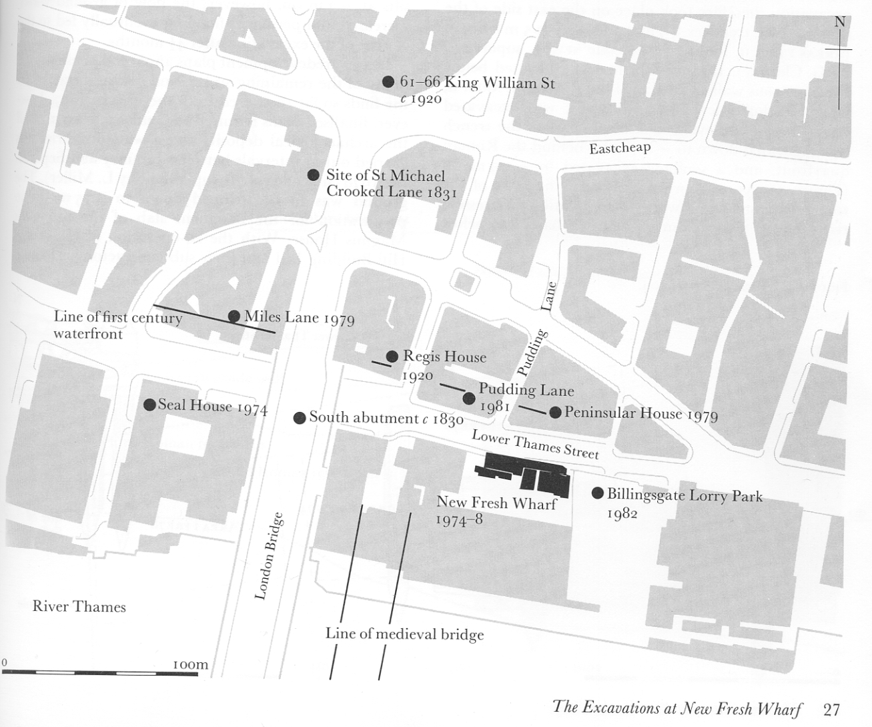
New fresh Wharf

Slide 48
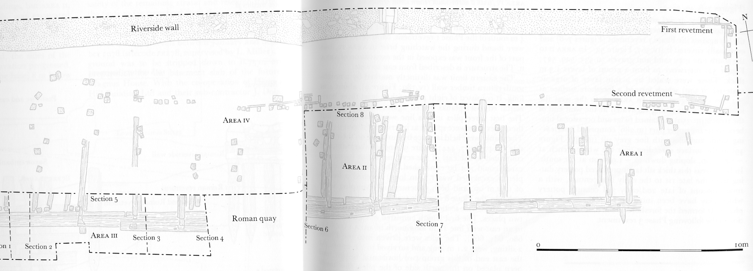

Slide 49
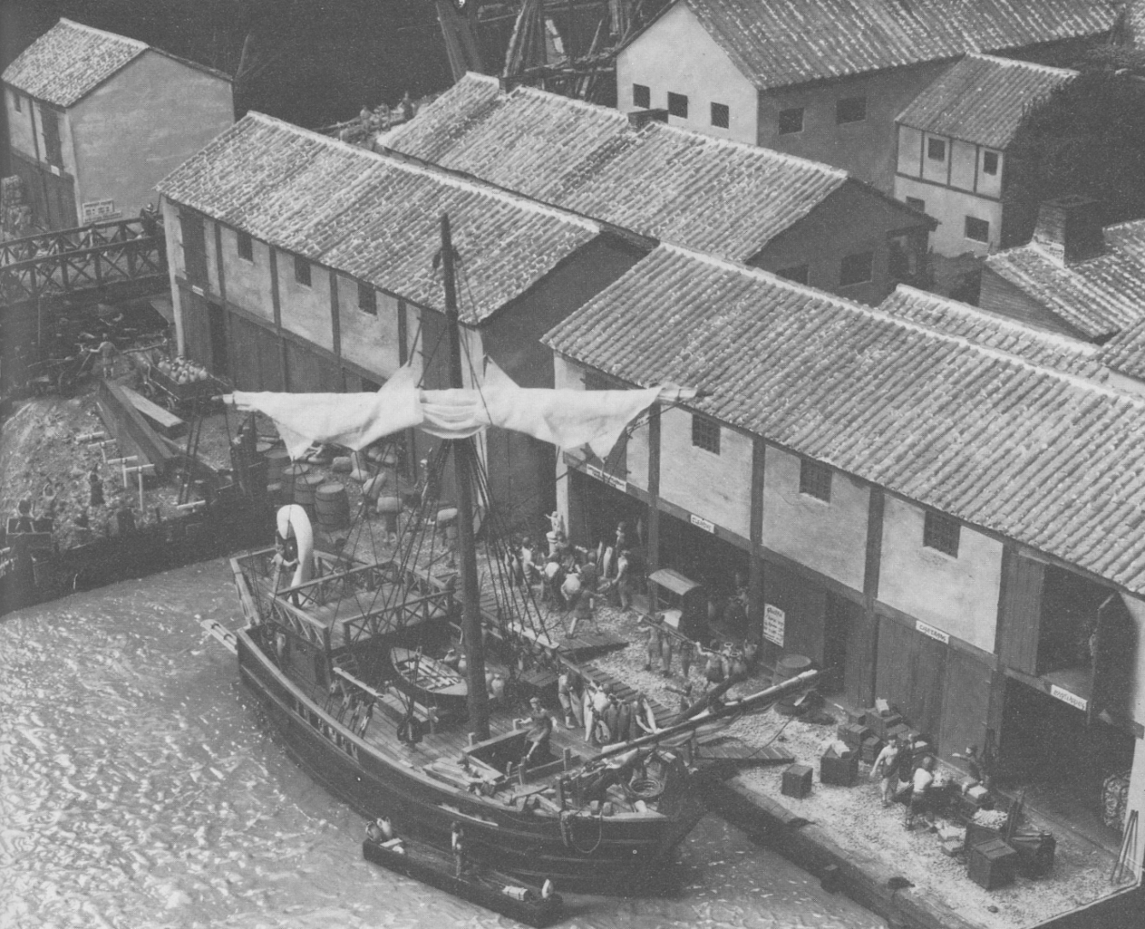
Billingsgate

Slide 50
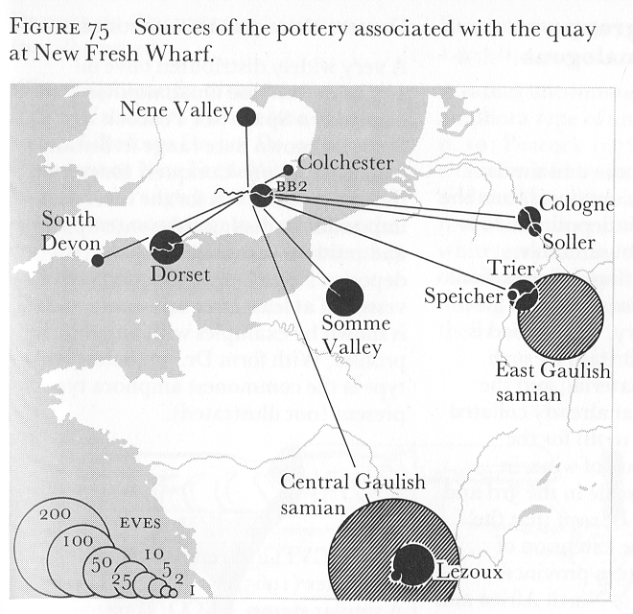
Pottery Sources

Slide 51
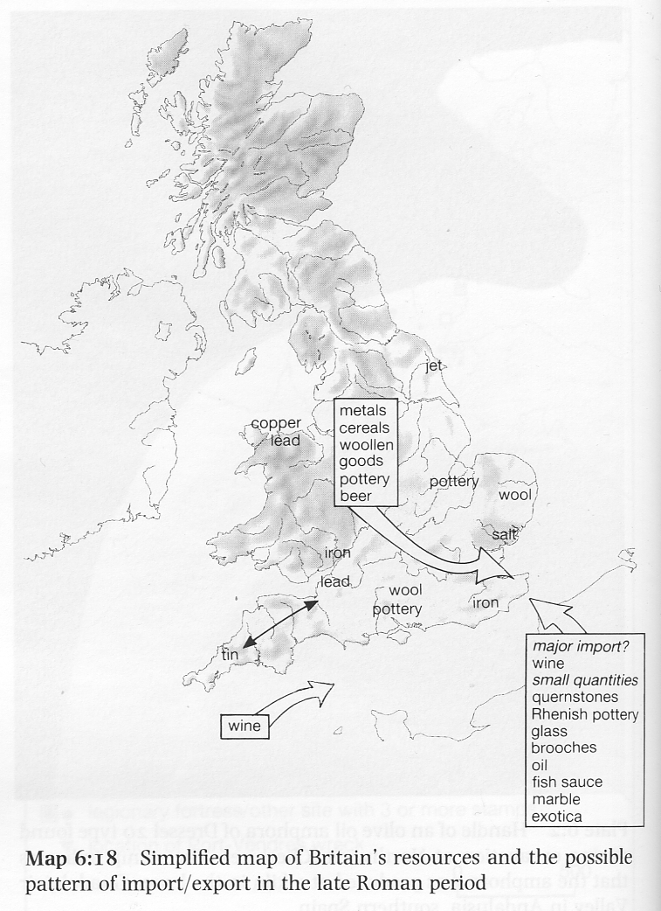
Imports and Exports

Slide 52
Ship construction
Older types:
Rafts; Skin boats; Log boats;
Planked boats
Shell first: Clinker (N European); edge to edge (Carvel) – Greco – Roman
Skeleton: needs a much larger managed ship yard – In use Byzantine but unclear when started
Some ships show elements of both.

Slide 53
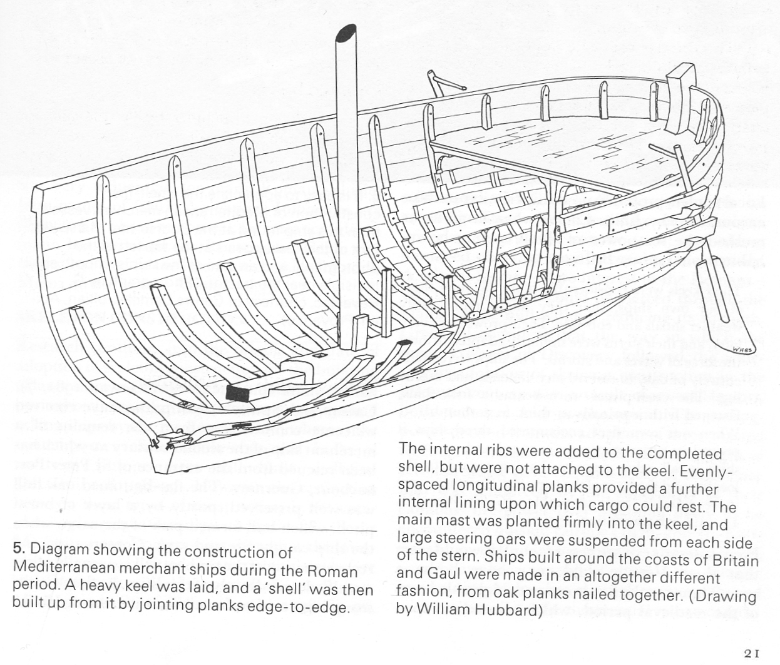
Shell first

Slide 54
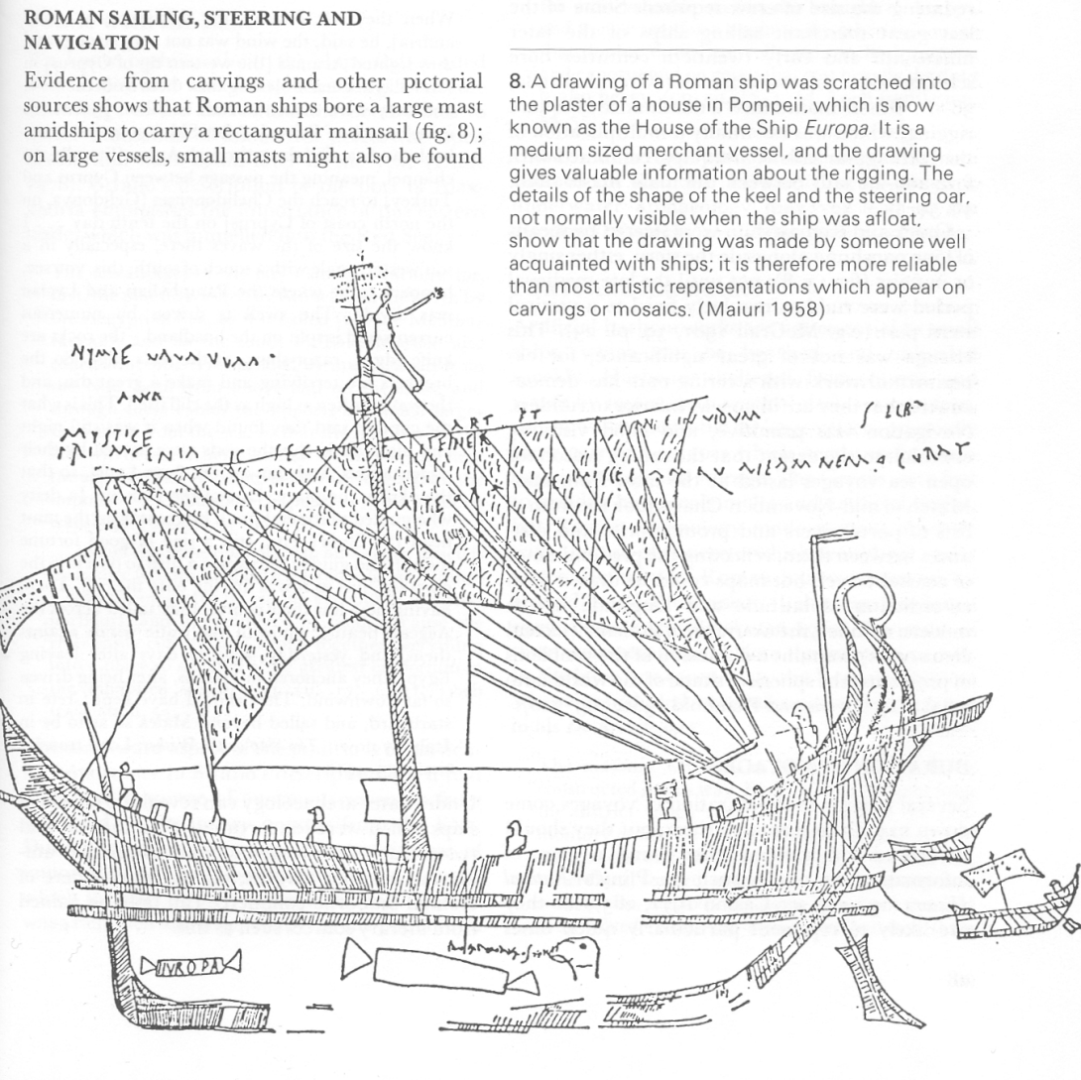
Ship Steering

Slide 55
Ship Sizes
Long ships (military) not so popular as few rivals to Roman sea power
Round ships (Merchants) Large Rectangular mainsail and extra sails on masts for very large ships
Larger ships for grain supply (Lucian: Isis) c 300 – 500 tons
Other ships. Average 15 – 37m, 100-150 tons
Not rivalled until C15 and C19 (Steam ships)

Slide 56
Lucian - The ship or the Wishes 435-7
I say, though, what a size that ship was! 180 feet long, the man said, and something over a quarter of that in width; and from deck to keel, the maximum depth, through the hold, 44 feet. And then the height of the mast, with its huge yard; and what a forestay it takes to hold it! And the lofty stern with its gradual curve, and its gilded beak, balanced at the other end by the long rising sweep of the prow, and the figures of her name-goddess, Isis, on either side. As to the other ornamental details, the paintings and the scarlet topsail, I was more struck by the anchors, and the capstans and windlasses, and the 6stern cabins. The crew was like a small army. And they were saying she carried as much corn as would feed every soul in Attica for a year. And all depends for its safety on one little old atomy of a man, who controls that great rudder with a mere broomstick of a tiller! He was pointed out to me; Heron was his name, I think; a woolly-pated fellow, half-bald.

Slide 57
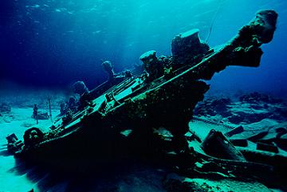
Ship Wrecks

Slide 58
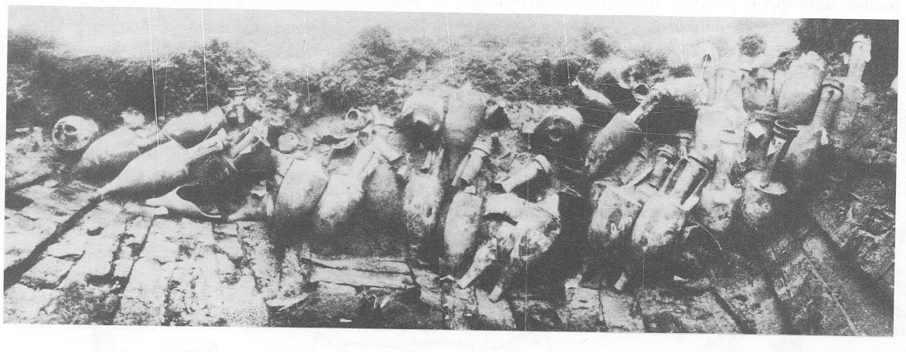
Madrague De Giens

Slide 59
Madrague De Giens
South coast of France, 20Km s of Toulon, c.60-50BC.
1635 fine vessels , coarse wares, Amphorae stowed in three layers (Dr 1b) stacked closely together , points of upper bodies fitted between necks below. Padded with pine branches. Stamped Publius Vevius Papus – from Terracina, S Italy.
Possible some salvage in Roma times.
Could carry 5800 - 7800 amphorae, (@50 Kg)
290 – 390 tons cargo (3 or 4 layers)

Slide 60
Les Roches d'Aurelle
994 | 43.3 | 6.59 | Roman | Les Roches d'Aurelle | Amphorae, pottery and tile | From Frejus 250 tegulae and imbrices, chimney tile unused. 60 empty? Wine amphorae (Laubenheimer G5 and G2); 1000 pieces coarse pottery; Roman coaster.

Slide 61
Le Secanion
1059 | 43.3 | 7.6 | Roman | Le Secanion | Tile | Several hundred tegulae and imbrices. Tegulae stacked in three rows. Imbrices laid flat head to head

Slide 62
Cabrera a
123 | 39.9 | 2.56 | Early Roman | Cabrera a | Amphorae and Tile | Tiles overlay amphorae (African 2, containing articulated mackerel; Almagro 50 [PW22] and 51c [Keay 23] fish sauce.

Slide 63
Kerme Gulf
543 | 36.6 | 27.4 | Late Roman | Kerme Gulf | Tile | 5 000 tiles with amphorae and coarse pottery

Slide 64
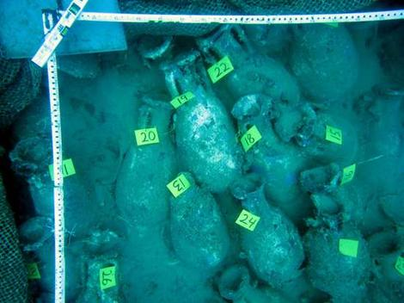
Alcante

