Slide 1
Roman Economy
Week 9 Lecture 1
Indo Roman Trade

Slide 2
Look at the Red Sea Ports
Look at trading links to East Africa and Arabia
Look at the evidence of contacts with India
What good were exchanges, and what other items travelled alongside them?
Who controlled the trade?
Who conducted the trade?
Where did traders live?
What routes travelled?
What is the duration and extent of this trade?

Slide 3
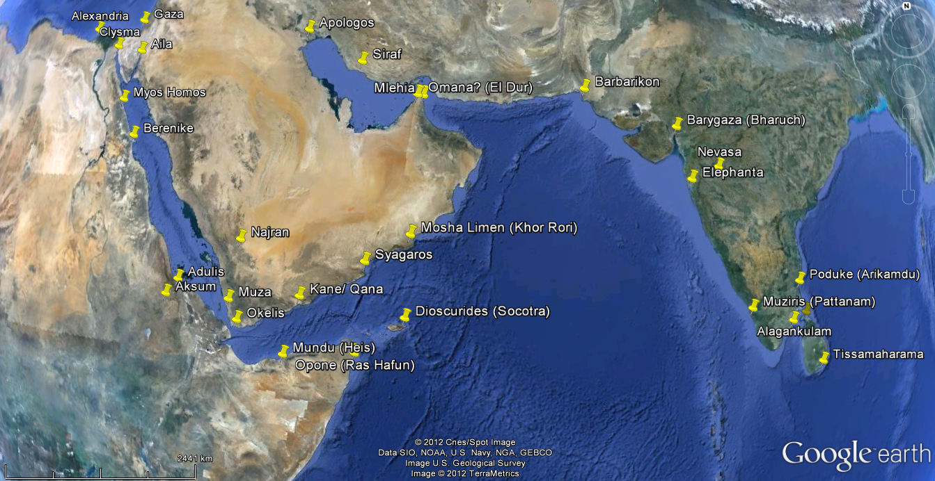

Slide 4
Arikamedu – excavation by Sir Mortimer Wheeler 1945
116 Amphora sherds
38 sherds of Terra Sigillata
Orthodox view:
Trade was Roman controlled, Arikamedu colonised by Roman Traders AD C1-C2.

Slide 5
Popularised by Wheeler, whose framework informed by British Empire, and legacy in training Indian archaeologists.
Model of Transit and terminal trade:
Transit – entrepots between West and East, finds rare
Terminals Centres where local products in demand for exchange with Western goods.

Slide 6
Traditional view
Trade peaks between Augustus and Marcus Aurelius
Then much reduced and carried out by Non Roman middlemen

Slide 7
Greek and Latin sources
Ptolemy (geography), C2
Periplus Marius Erythraei, MC1
Pliny The Elder, AD23-79
Strabo, Armenian, c. 64BC-AD23
Cosmas Indicopleustes (Indian Traveller), AD 549-59
Alexandrian Tariff codified as Justinian Digest AD 533
a list of spices with a 25% import duty, lists white and long pepper, but not black pepper

Slide 8
Indian Texts
Tamil Sangam poems 300 BC to AD 300
Ciliappatikaram, C5
Refers to ‘Yavamas’ – foreingers
Applied to Greeks C1BC- CAC1
The Roman Traders
Mentions settlements in 2nd century, Guards and craftsmen, but ambiguous relationship
Then Arabic traders

Slide 9
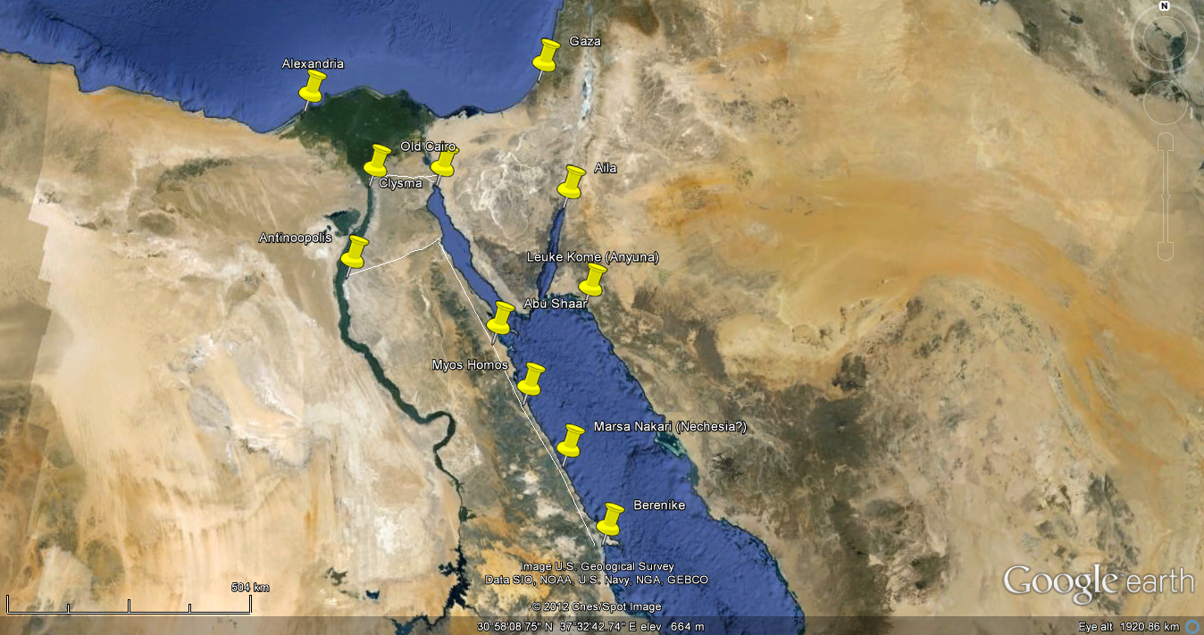
Red Sea Ports

Slide 10
The red sea
6 ports to Alexandria via desert stations and Nile
Ptolemy 6 Ports:
Clysma, Myos Hormos, Philoteras, Leukos Limen, Nechesia, Berenike.
Periplus: Myos Hormos, Berenike
Strabo – MH the more important

Slide 11
Myos Hormos
Terminus of a road.
Two phases (Chicago excavation):
Late Augustan – Mid 3rd
Horreum, shops, jetty made from amphorae
C2 stone harbour
Mudbrick, coral, ashlar with plaster rendering, no apparent street grid
Abandonment
Mamluk Occupation
Residual Ptolemaic occupation (submerged)

Slide 12
Berenike
Important part of Ptolomeic elephant trade
MC3 BC – AD C6,
Settlement shifts to east and south over time due to silting
Terminus of Via Hadriana, perhaps military rather than trade?

Slide 13
Shenshef
23 km SSW of Berinike
No early Roman material – 5th century AD foundation
Presence of Indian goods demonstrates continuation of Indian Trade in the late Roman period

Slide 14
Aila
An important port from 3rd Century
Important part of overland frankincense route before this (Saudi, Leuke Kome)
Not a port in Strabo, but Eusibeus (C4) mentions it
Survives into C7, after Berenike abandoned.
Architecture mainly mudbrick, with ashlar monumental building – poss early Church.

Slide 15
Eastern Red sea
Aromatics trade
Land-based after red sea to Nabatean Kingdom
Remains important even after development of Egyptian trade
Trade with India and East Africa

Slide 16
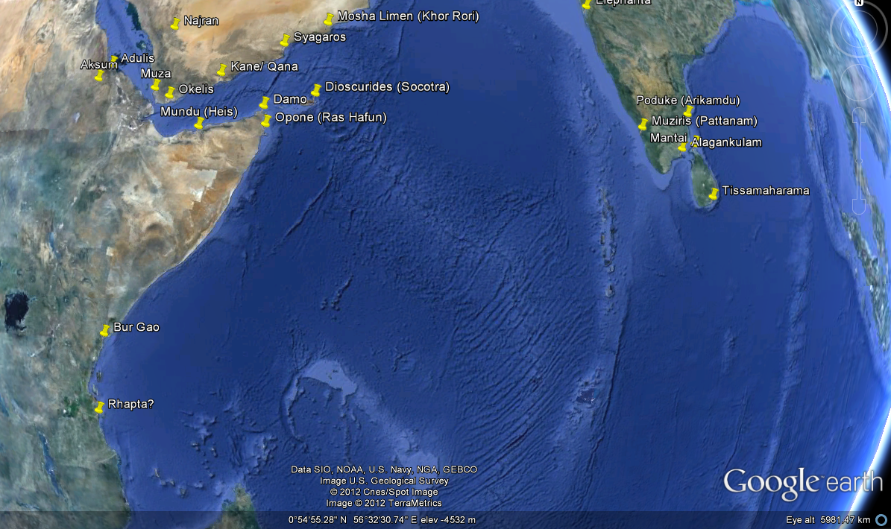
East Africa

Slide 17
Adulis important for export of Ivory and tortoise shell
Flourishes in C3-C7 as Aksumite kingdom a major international force
Indian connections strongest C2-C5
C5 external evidence changes – rise of Sassanian power dominating Gulf.

Slide 18
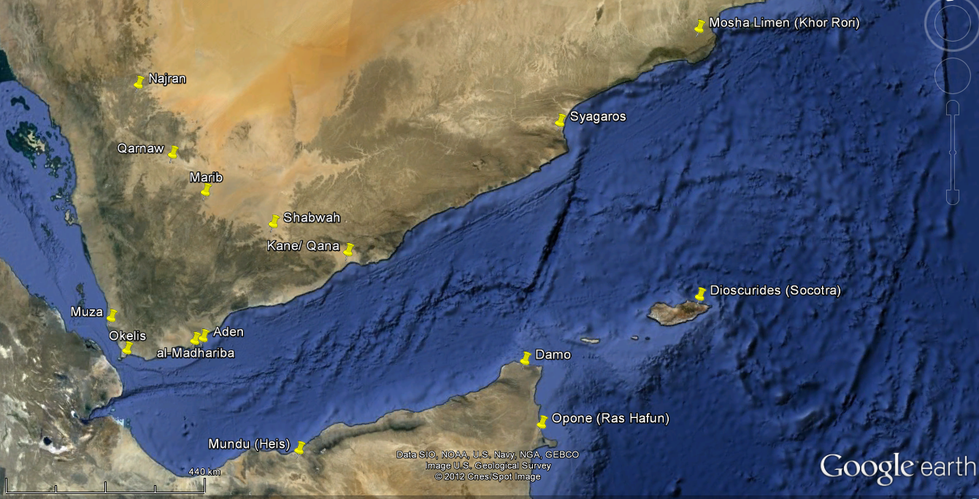
Arabia Felix

Slide 19
Closer links to East Africa than Roman world
Supply land routes to South Arabia

Slide 20
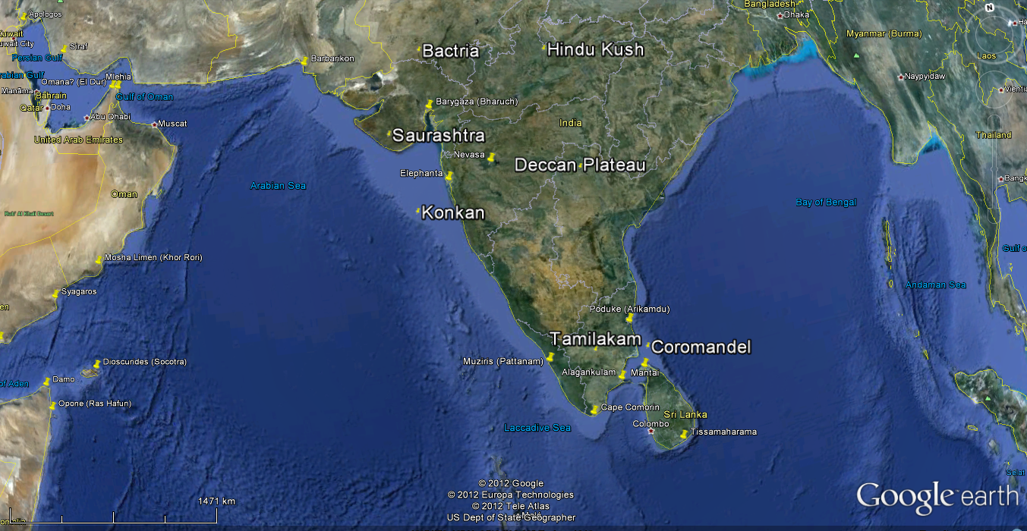
India

Slide 21
A number of regions with differing amounts of connectivity.
N India –
established urban tradition before Alexander the Great (327-5BC)
Large centres
Coins
Craft specialisation
Peak connection with Roman world coincides with ‘Early Historic Period’

Slide 22
Taxila
Capital of Gandhara during Kushana period ( C2BC – AD 230)
Merging of Classical and Buddhist traditions
Any fine art works though Roman now thought to be indian but influenced by classical works.

Slide 23
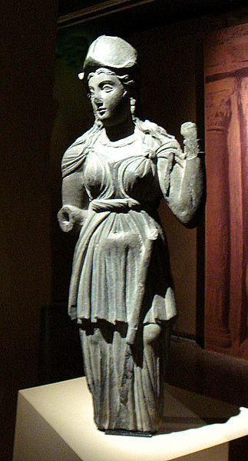
Gandharan Athena

Slide 24
Barbarikon
Most Northerly site mentioned in Greco-Roman sources. Not archaeologically investigated
Mouth of Indus, modern Pakistan
Port served royal capital of Minnagar (Unlocated)

Slide 25
Barygaza (Bharuch)
Mentioned 29 times in Periplus
Treacherous approach – located at safe anchorage point –c. 30km from coast
Three routes: Bactria, Ganges valley, lower Krishna Valley
Also manufacturing centre
Some survey work, but poorly published and a lot of medieval and modern occupation.

Slide 26
Limrike/ Malabar
SW Indian Coast
A number of ports mentioned
Muziris – Principle port mentioned, Pliny recommends Bakare – possibly the result of inter tribal enmity.
Location of Muziris problematical because of shift of Periyar river.
Possibly modern Pattanam

Slide 27
Arikamadu
Wheeler thought Augustan to AD 200
Megalithic antecedents, pottery includes Arratine and ESA and ESB AD 10-50
Amphorae: Koan (Gk) 540-50%
Knidian stamps – C1 BC – 50 BC/AD
LRA1 – C5+
Coins rare

Slide 28
Sites have pre-existing occupation
Some Roman settlers, and some intermingling

Slide 29
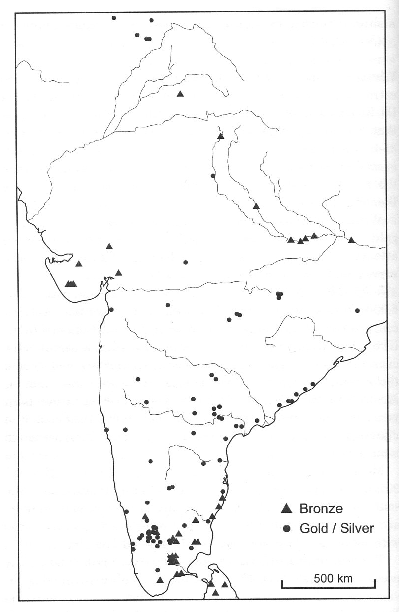
Roman Coins in India

Slide 30
Coins
Pliny refers to 50 million sesterces per year
Circa 120 find spots, but meaning problematical
70% silver coins and 90% gold coins from Hoards in the South. Largest hoard over 1500 pieces.

Slide 31
Hoard Types
1. Early Julio Claudian
(Mostly Augustus – Tiberius) most Denarii, limited issues, fairly good condition
2. Later J-C
(Mostly Tiberius and Claudius) normally Aurei, fewer coins but wider range of types, more widespread

Slide 32
3. Post J-C
Often with earlier coins, consists of aurei, C2 aurei in excellent condition.
C3 apparent hiatus
4. C4-5+
Gold solidi, mostly fourth to fifth but occasional 6th and early 7th century examples

Slide 33
Dating may be problematical, as coins are prior to some currency reforms – not in imperial circulation
Some suggestions that mainly C2 as recognised as good value, and will mask early trade

Slide 34
Concentrations at
Coimbatore (a source of gems) mainly J-C in date
Krishna River, Andhra Pradesh, Mostly C2

Slide 35
Roman Coins in India

Slide 36
Coins?
Bronze coinage may have circulated
Coin based culture existed, but varies by region.
In South silver punch marked coins found with Roman ones, suggesting some use as currency
Perhaps mainly bullion but with some local use as currency.
Less coin hoards in north reflection of more moneterised economy?

Slide 37
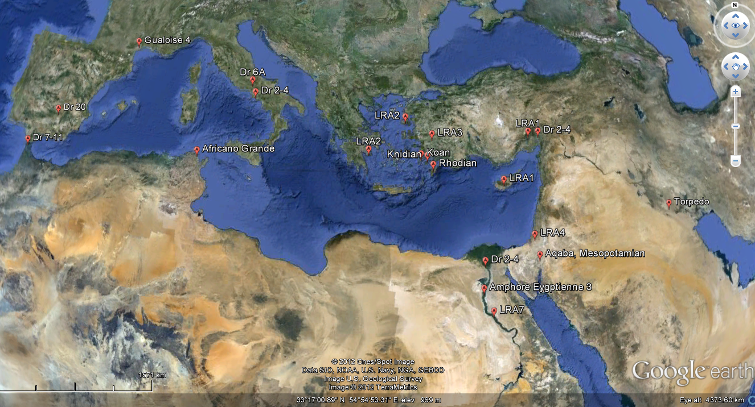
Amphorae

Slide 38
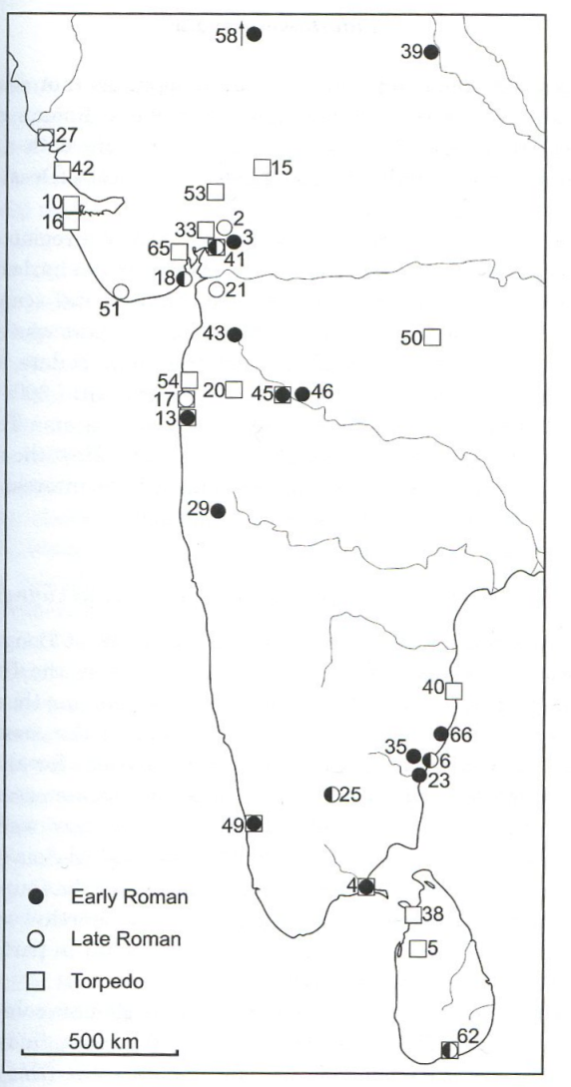
Amphorae in India and Sri Lanka

Slide 39
Product | Source | ER | ER | LR/ Other | LR/ Other
 |  | Myos Hormos | Berenike | Berenike & Shenshef | Aila
Food
Rice | India: Bartgaza, Limrike | Y | Y | Y
Black Pepper | India (SW) Limrike | Y | Y | Y
Cocunut | India | Y | Y | Y
Emblic | India/ Sri Lanka |  | Y
Mung Bean | India/ Sri Lanka |  | Y
Abrus | East Africa? |  | Y | Y
Abysinnian pea | Etheopia |  | Y | Y
Baobab | East Africa |  | Y | Y
Tamarind | East Africa |  | Y
Wod and Ivory
Teak | India, Barygaza | Y | Y | Y
Rhodesian teak | Africa |  | Y | Y
bamboo | India |  |  | Y
Sandalwood | India/ Mediterrenian |  | Y
Ivory | Africa/ India/ Arabia | Y | Y | Y

Slide 40
 |  | Myos Hormos | Berenike | Berenike & Shenshef | Aila
Textiles and Basketry
Cotton | India Barbarikon, Barygaza, Limrike, Ganges | y | y | y
Cotton, resist Dye | India | y islamic? |  | y
Cotton, Sail Clot | India |  | y
Basketry, Matting | India (North)
Epigraphy and Coins |  | y
Graffitio | Prakrit-Brahmi | y | y
Graffitio | Tamil-Brahmi | y
Graffitio | South Arabian |  |  |  | y modern cxt
Graffitio | Ethiopic |  |  | Y
Graffitii/ Inscriptions | Palmyrene | Y | Y
coin | India (West) |  |  | Y
Coins | Aksum |  |  | Y | Y

Slide 41
Product | Suggested Source | ER | ER | LR/ Other | LR/ Other
 |  | Myos Hormos | Berenike | Berenike & Shenshef | Aila
Gems
Agate, Onyx, Sardonyx, | India (West), Barygaza | Y | Y
Carneleian and sard | India (West/ South>) Eygpt | Y | Y
Almandine garnet | Inida (South) Limrike | Y | Y
Rock crystal | Inida (South) Limrike | Y | Y
Amethyst | Inida (South) Limrike | Y | Y
Aquamarine | Inida (South) Limrike | Y | Y
Emerald | Inida (South) Limrike | Y | Y
Sapphire | Inida (South) Limrike | Y | Y
Lapis Lazuli | Afganistan (NE) Barbarikon | Y
Rocks
Basalt | Hadrarnawt | Y |  | Y SURFACE
Basalt | Aden | Y
Calcite jars | Arabia | Y |  | Y
Startite jars | Yemen |  |  |  | Y
Obsidian | Eritea Howakii Bay | Y | Y | Y

Slide 42
Product | Suggested Source | ER | ER | LR/ Other | LR/ Other
 |  | Myos Hormos | Berenike | Berenike & Shenshef | Aila
Beads and Ornaments
Mosaic bead | Java |  |  | Y SURFACE
Indo-Pacific glass beads | South India/ Sri Lanka |  | Y | Y
Pearls | Gulf/ India (Gulf of mannar) Limrike, Gange, Omana |  | Y
Ostich egg bead | East Africa |  |  | Y
Job's tear bead | India 9East/ NE) |  | Y | Y
Glass Cameo | Sasanian |  |  | Y SURFACE
Pottery
Glazed ware | Mesopotemia | Y | ? | Y
RW | India (NE) | Y | Y | Y Residual?
CRSW | India (Inc SW) | Y | Y | Y Residual?
Paddle Impressed wares | Indiia (East?) | Y | Y | Y Residual?
Coarse wares | India | Y | Y | Y Residual?
Organic Black wares | India (NW) | Y | Y | Y Residual? | y Residual
Organic Storage Jars | Hadramawt | Y | Y | Y Residual? | y
Whole moth cooking pot | South Arabia (Aden) | Y | Y
Red dandy ware | Adulis region | Y | Y | Y Residual?
Coarse wares | Aksum region | Y | ? | Y | y

Slide 43
LC1-MC3 Roman activity at red sea ports for economically motivated trade in the Indian Ocean,
A lack of infrastructure implies a lack of imperial control.
Direct exchange with India is indicated as well as the use of way point
Luxury goods more common in north.
Use is made of local existing exchange networks
Coins and amphora follow coast and river networks
Some Indians live in Eygpt,

Slide 44
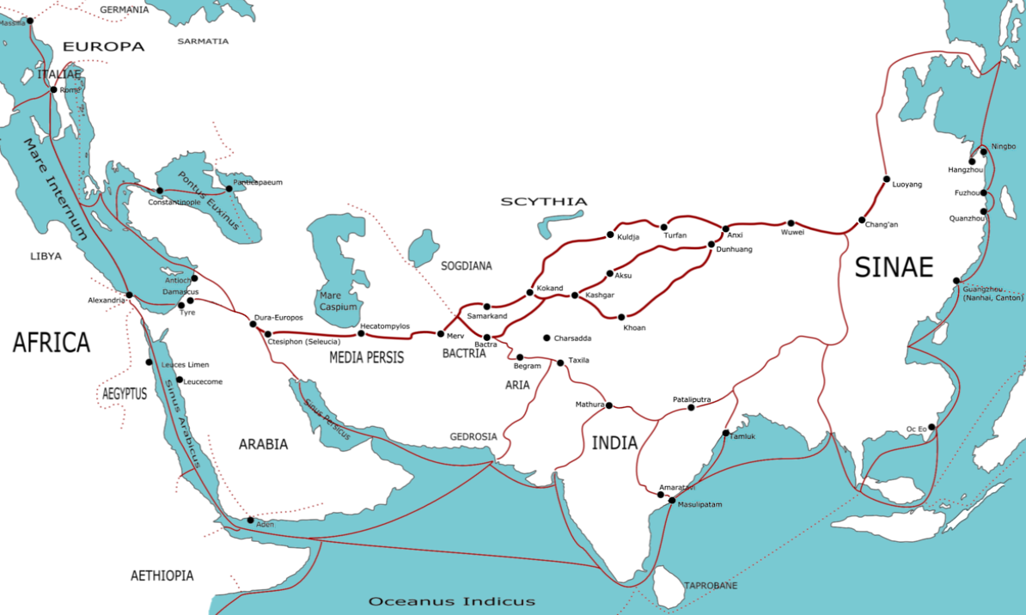
The Silk Road

Slide 45
The land route
Silks, spices gums, jewels and precious stones in return for amber, ivory, rhino horn (Embassy of Marcus Auralius)
Through Bactria and Parthia or across the Indian Ocean, up the red sea to Antioch, Damascus Palmyra, Petra.
Later attempts to avoid Parthia by going through Caucasus and across Caspian sea.
From Asia Minor to North Syria had to cross the Taurus and Amanus:
Cilician Gates to cross the Taurus
Cilician coast, the Pyramus to the Pylae Amani (Bogtche pass) then Zeugman on the Euphrates, or the plains of Chalybon.
Coast road to Myriandos, mountains at Pylae Syriae, then the plain
Selucia, then the Orontes valley to reach Antioch.
Zeugma – renowned for its crossing of the Euphrates.
Follow back down to Selucia and Ctesiphon, or via Palmyra to Circesium and to Parthia

Slide 46
Isidore of Charax
A geogerapher of 1st century BC/AD
Partian Stations/ Mansiones Parthicae
An itinary of trade route from Antioch to India
Zuegma to Bactrai on the silk route
Maes Titianus – had agents explore the route

Slide 47
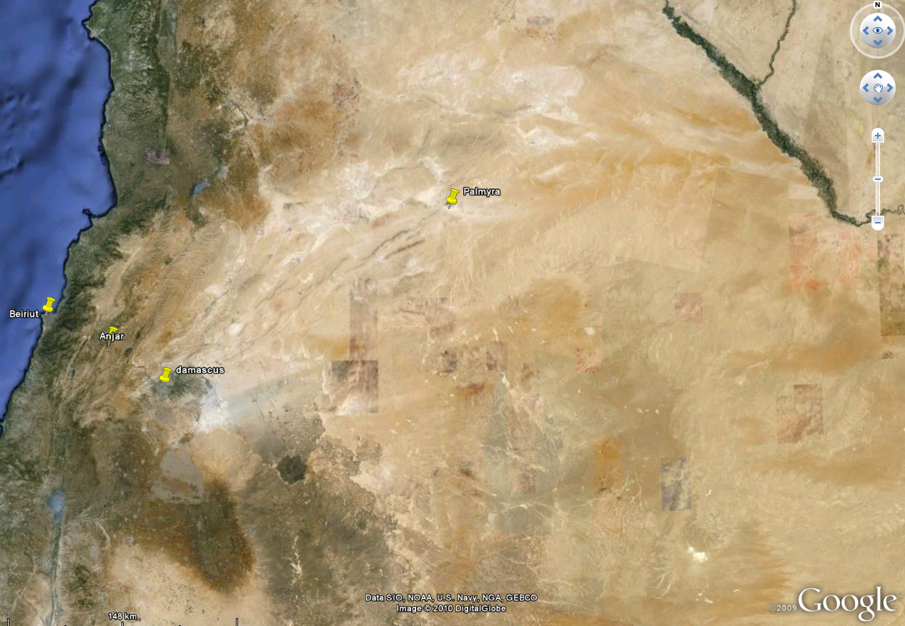
The silk road in the Roman East

Slide 48
Palmyra
Centred on the Spring of Efqa
Territory ranges from Kheurbet el Bilas 75km Qasr el Hair 65 km
Seleucid trading station, some building C2 BC
Temple of Bel AD 17 dedicated AD32
Colonia 211/212 free of land and poll tax
C3 perhaps 150 – 200 000
A council/ senate, assembly of people
C. 240 – birth of Zenobia
269-273 – Revolt

Slide 49
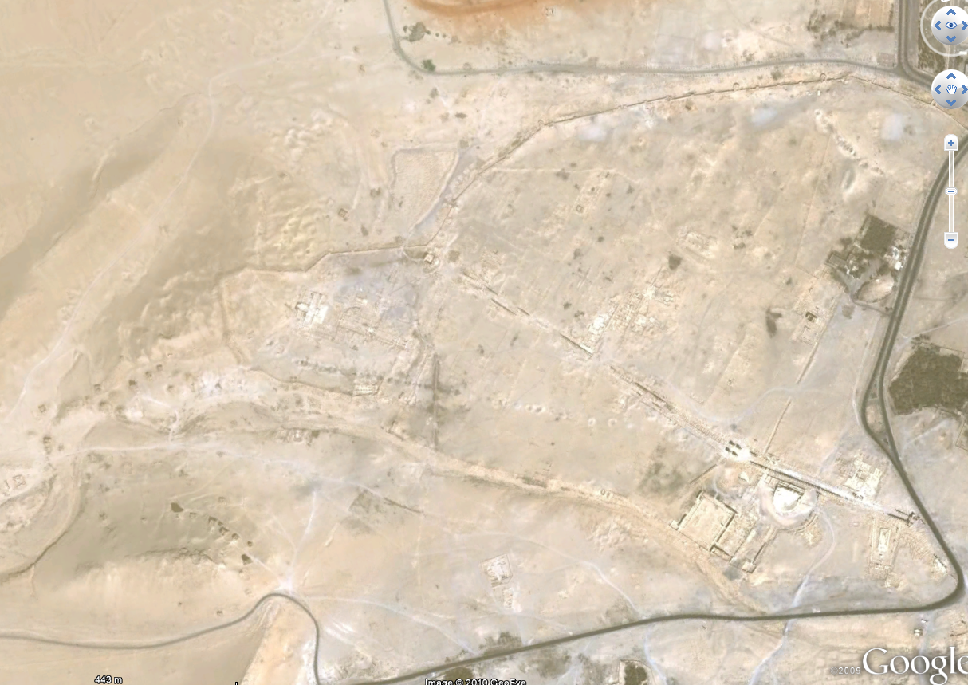
Palmyra

Slide 50
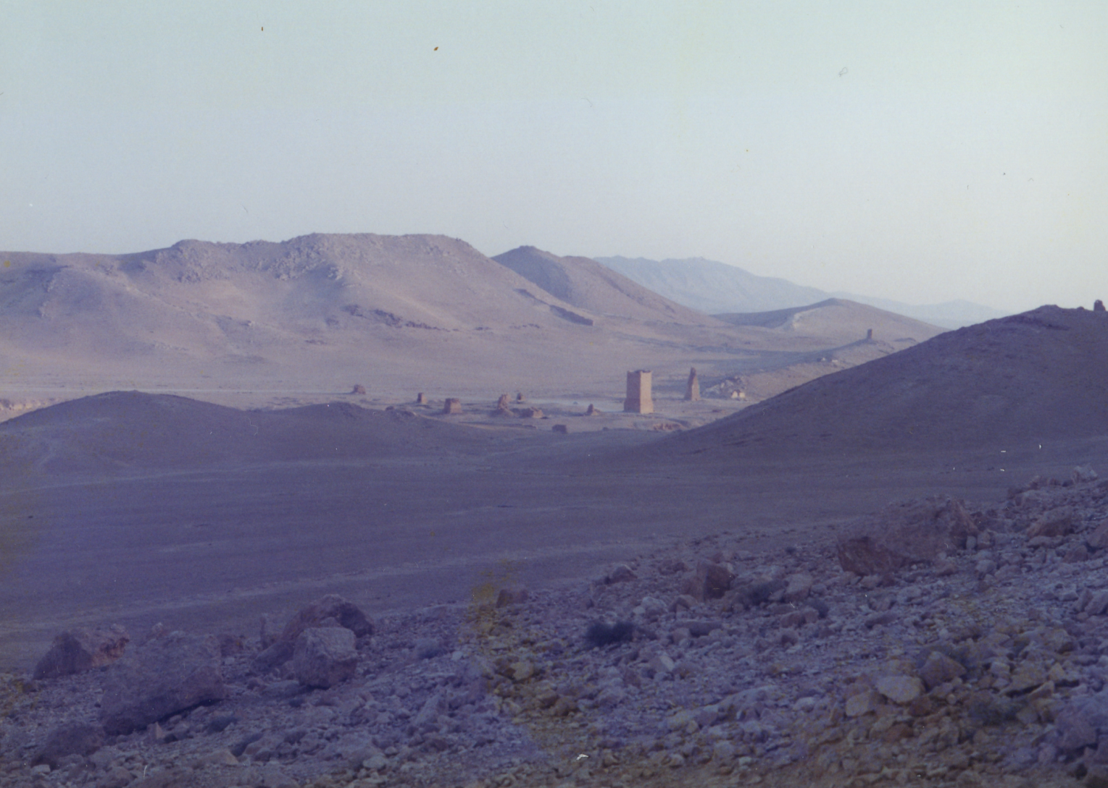
Approach to Palmyra

Slide 51
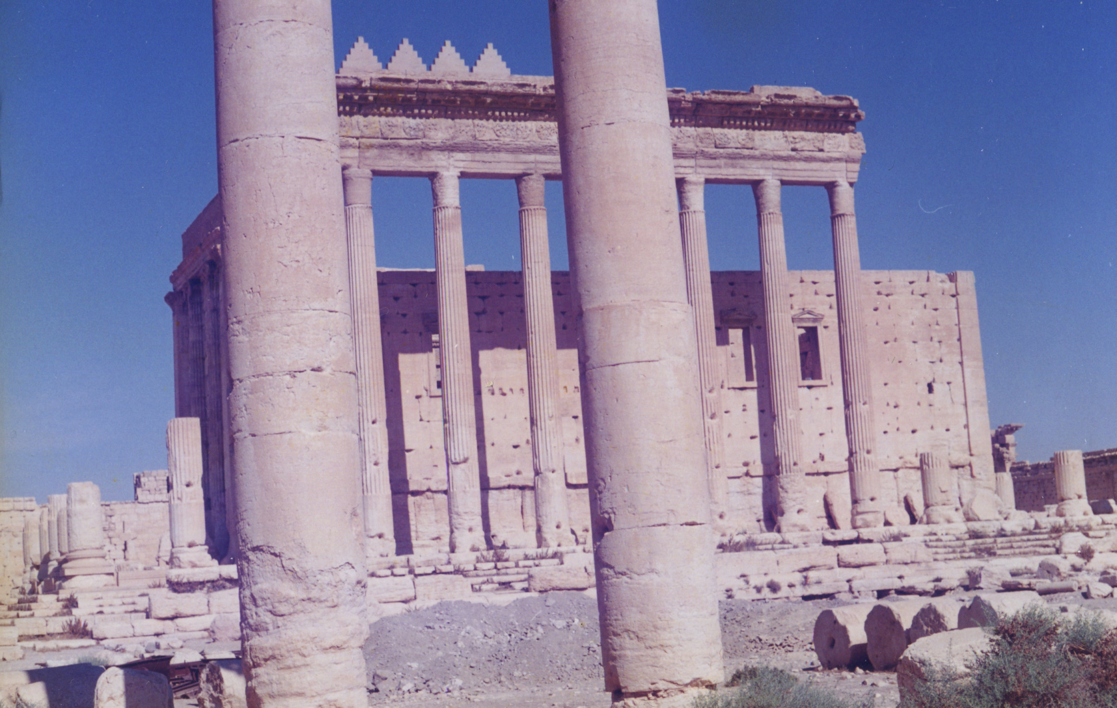
Temple of Bel

Slide 52
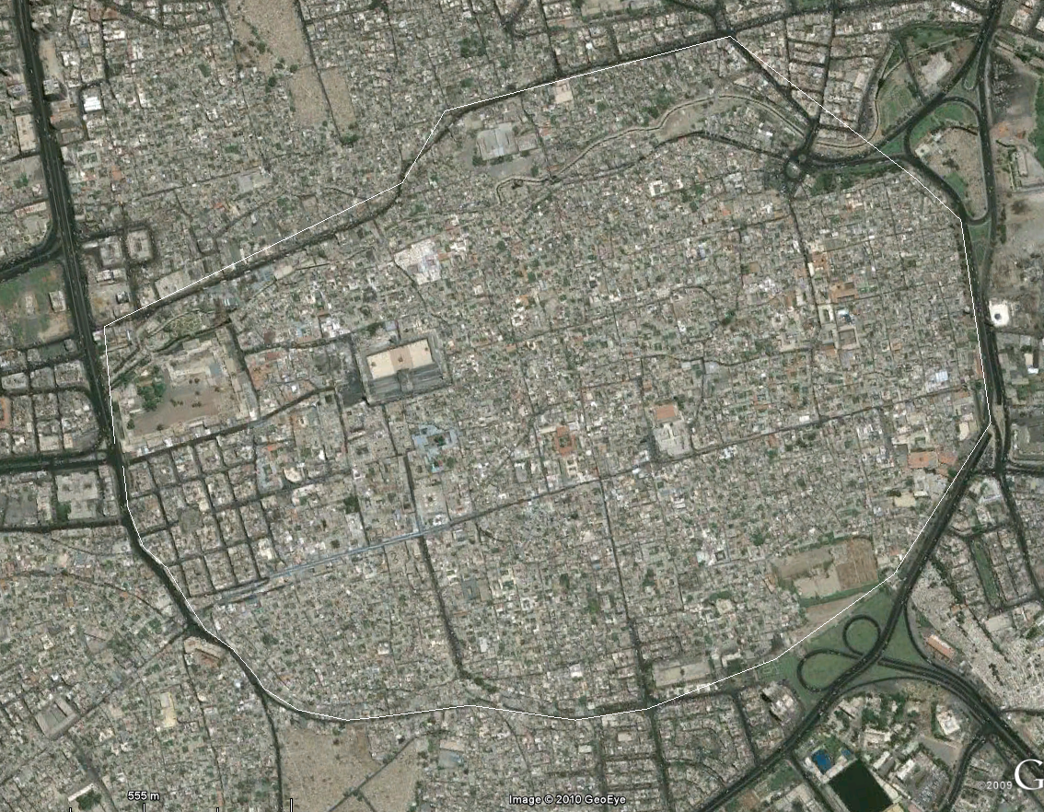
Damas

Slide 53
Damascus
7th millennium BC – Founded
323 BC – Alexander the Great
Seleucid capital at Antioch leads to decline
64 BC annexation by Pompey
AD37 decreed to Nabataea
AD 106 Returns to Roman rule
C2 AD –Metropolis
AD 222 – Colonia (Severus)
A trading city linking Arabia, Petra, Palmyra.

Slide 54
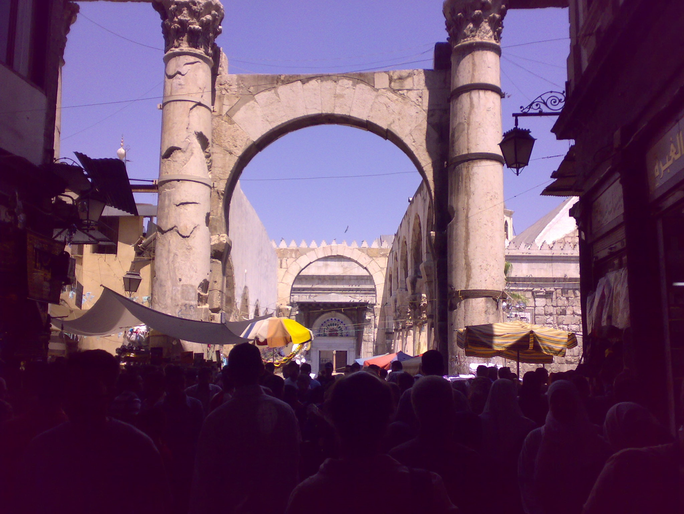
Damascus

Slide 55
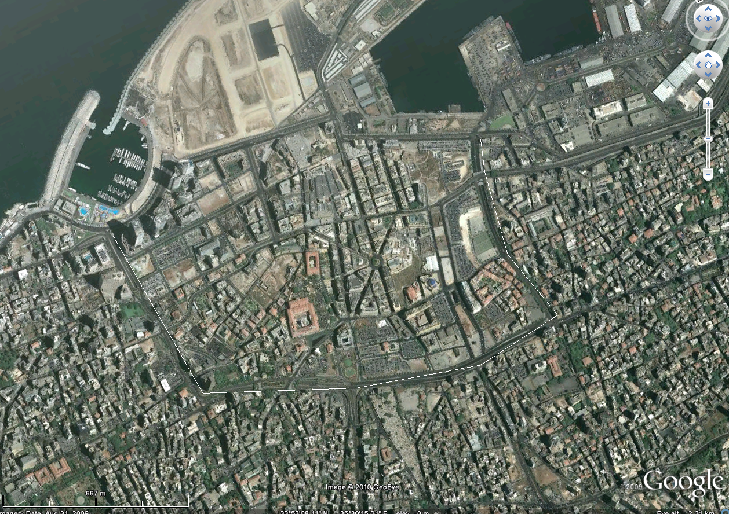
Beirut

Slide 56
Berytus
Procopius (Anecdota 25)
Adversely effected by Justinian policy of establishing monopolies: merchants, sailors, workmen, traders in the agora.
Importing silk (thread) from east and re exporting at a profit having worked it into clothes.
Serikarios – silk workers
Metaxopratai – raw silk merchants
Vestioprati – merchants in silk garments
Katartioi – raw silk dressers
Orthoniopratai – linen merchants
There are silk weaving factories - genica publica olosirica (mistranslated as public brothels draped in silk)
C6 Tyre

Slide 57
Producers of purple Sellers dyers and fishers
Concentrated in Tyre, but also occurred in Berytus
12 kinds of purples 10 000 denarii for red wool to 150 000 for purple silk
Status – sellers highest – fishers lowest.

Slide 58
Looked at the links between the Roman wold and India.
Seen the nature of the ports in the red sea and their connections to East Africa Arabia and India.
Examined the nature of Indian ports and regional differences
Looked at the Coin and amphorae evidence
Looked at the trade connections in the wider context of other connections to the East

Slide 59
Fin

