Slide 1
The Roman Economy
Week 9b – Case study 1:
Nepi Field Survey

Slide 2
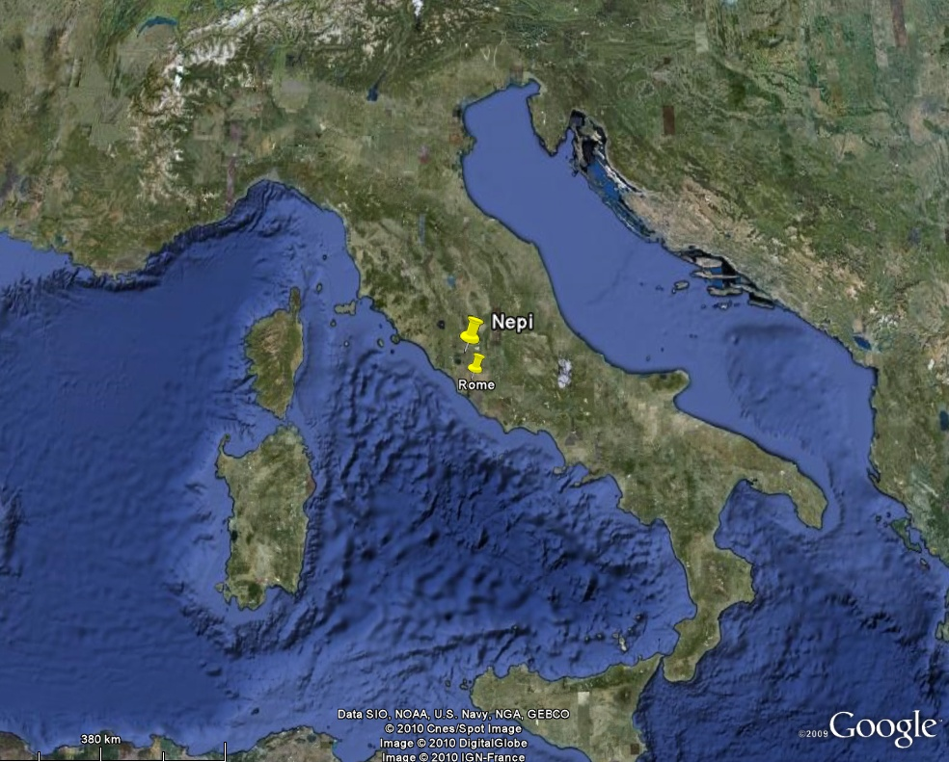
Site Location

Slide 3
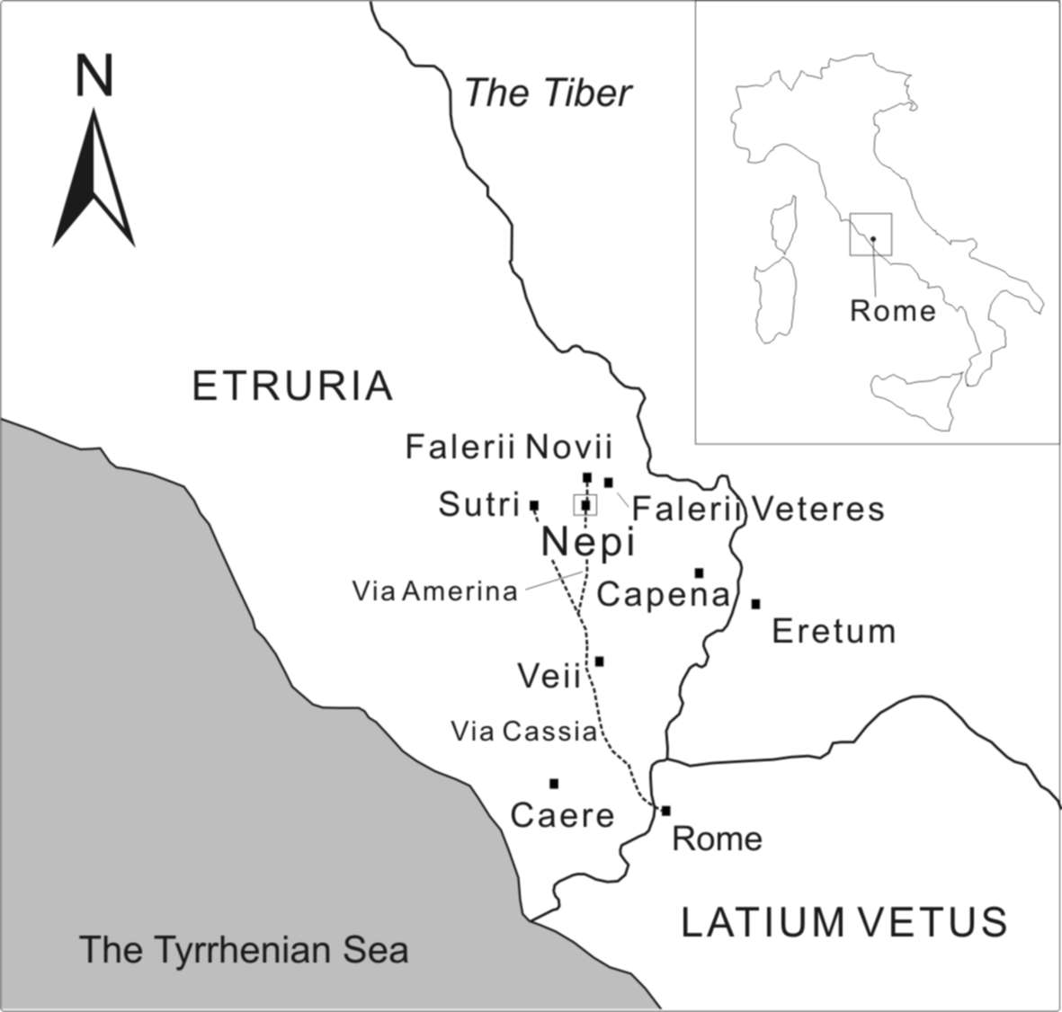

Slide 4
South Etruria Survey
Started after WW2
Recorded many new sites revealed by the application of modern agricultural methods
Mapped the changing landscape from the Neolithic until the present day

Slide 5
BA – Thin scatter of settlements
Etruscans – sites widely dispersed linked by tracks and roads
C3 BC – Rome – Road construction, decline of towns, exploitation of marginal land.
Peaks in AD C1/2
Continuous decline into the fifth century

Slide 6
Nepi Survey
Carried out in 1999 and 2000
Investigating Etruscan/Faliscan patterns in detail, especially the relationship between villages/ towns (landscape of the living) and cemeteries (Landscape of the dead).
Benefiting from development of ideas and techniques related to Landscape archaeology, especially GIS (Geographical Information Systems)
Roman pottery coded in 2008

Slide 7
Methodology
Explored the fields within the predicted territory of the urban centre
Using Thiessen polygons
Sample to be walked based on transects along cardinal and intercardinal direction.
Visibility limited by ownership, vegetation cover and the agricultural cycle.

Slide 8
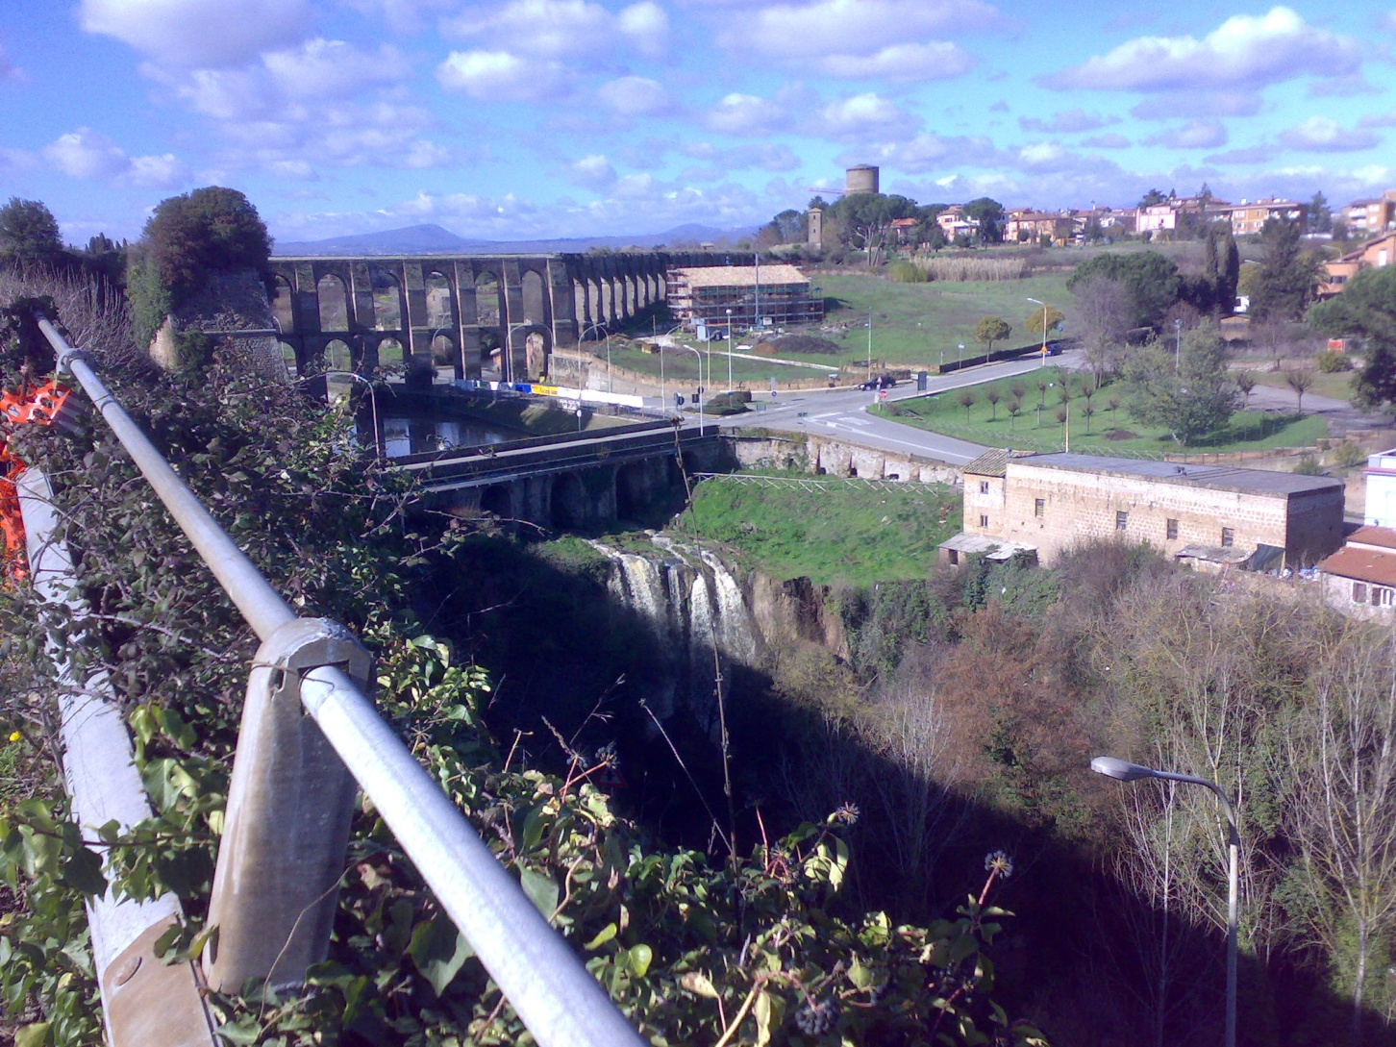
North from Nepi

Slide 9
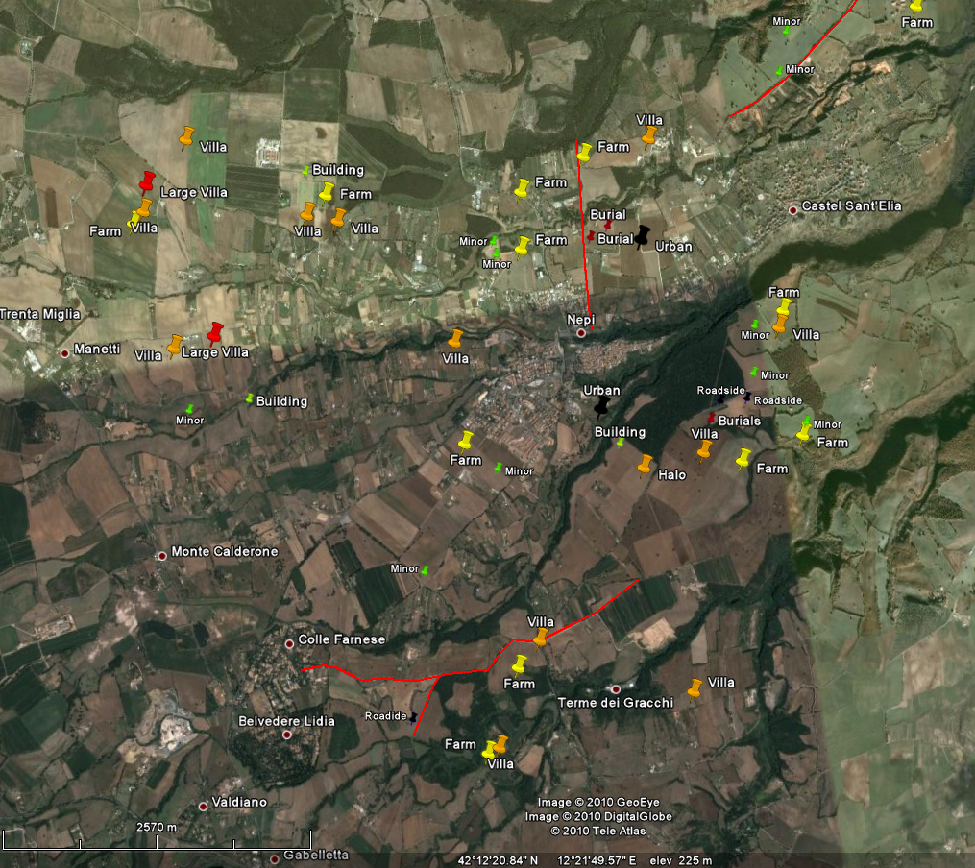
Landscape

Slide 10
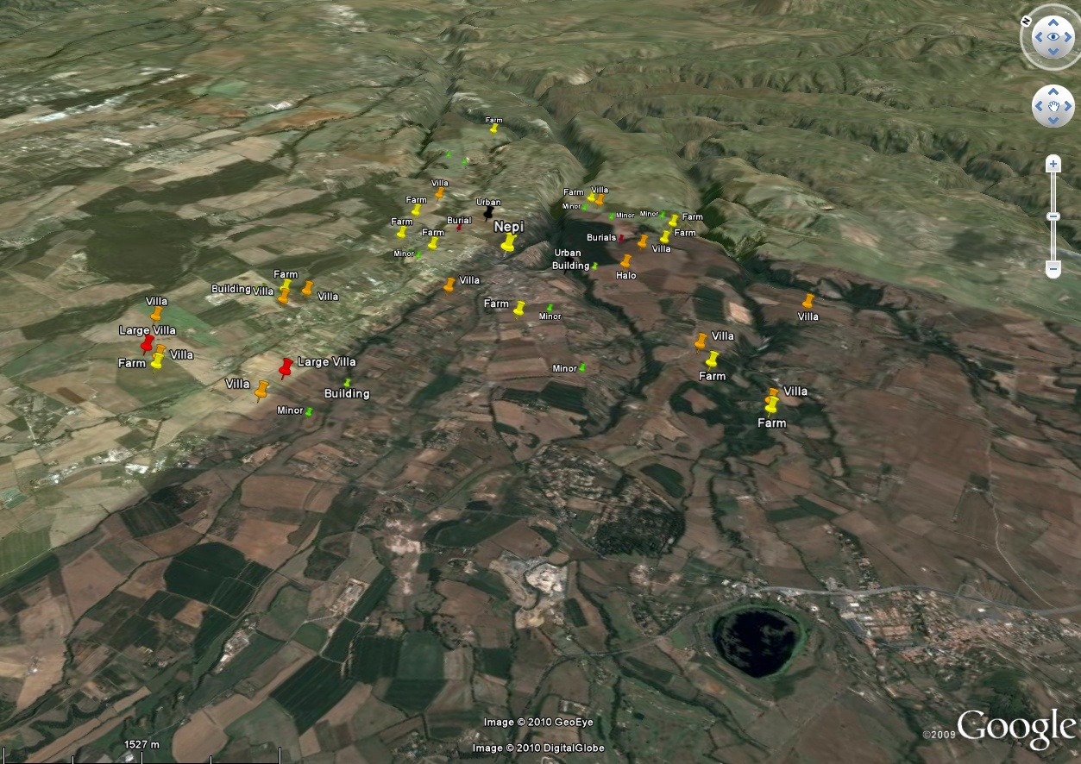
Survey Area in relief

Slide 11
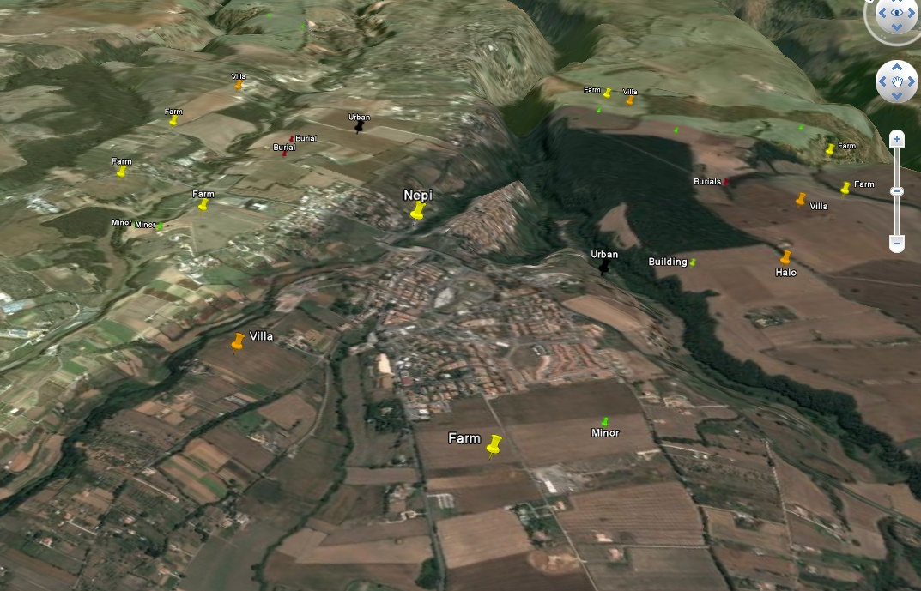
Close up

Slide 12
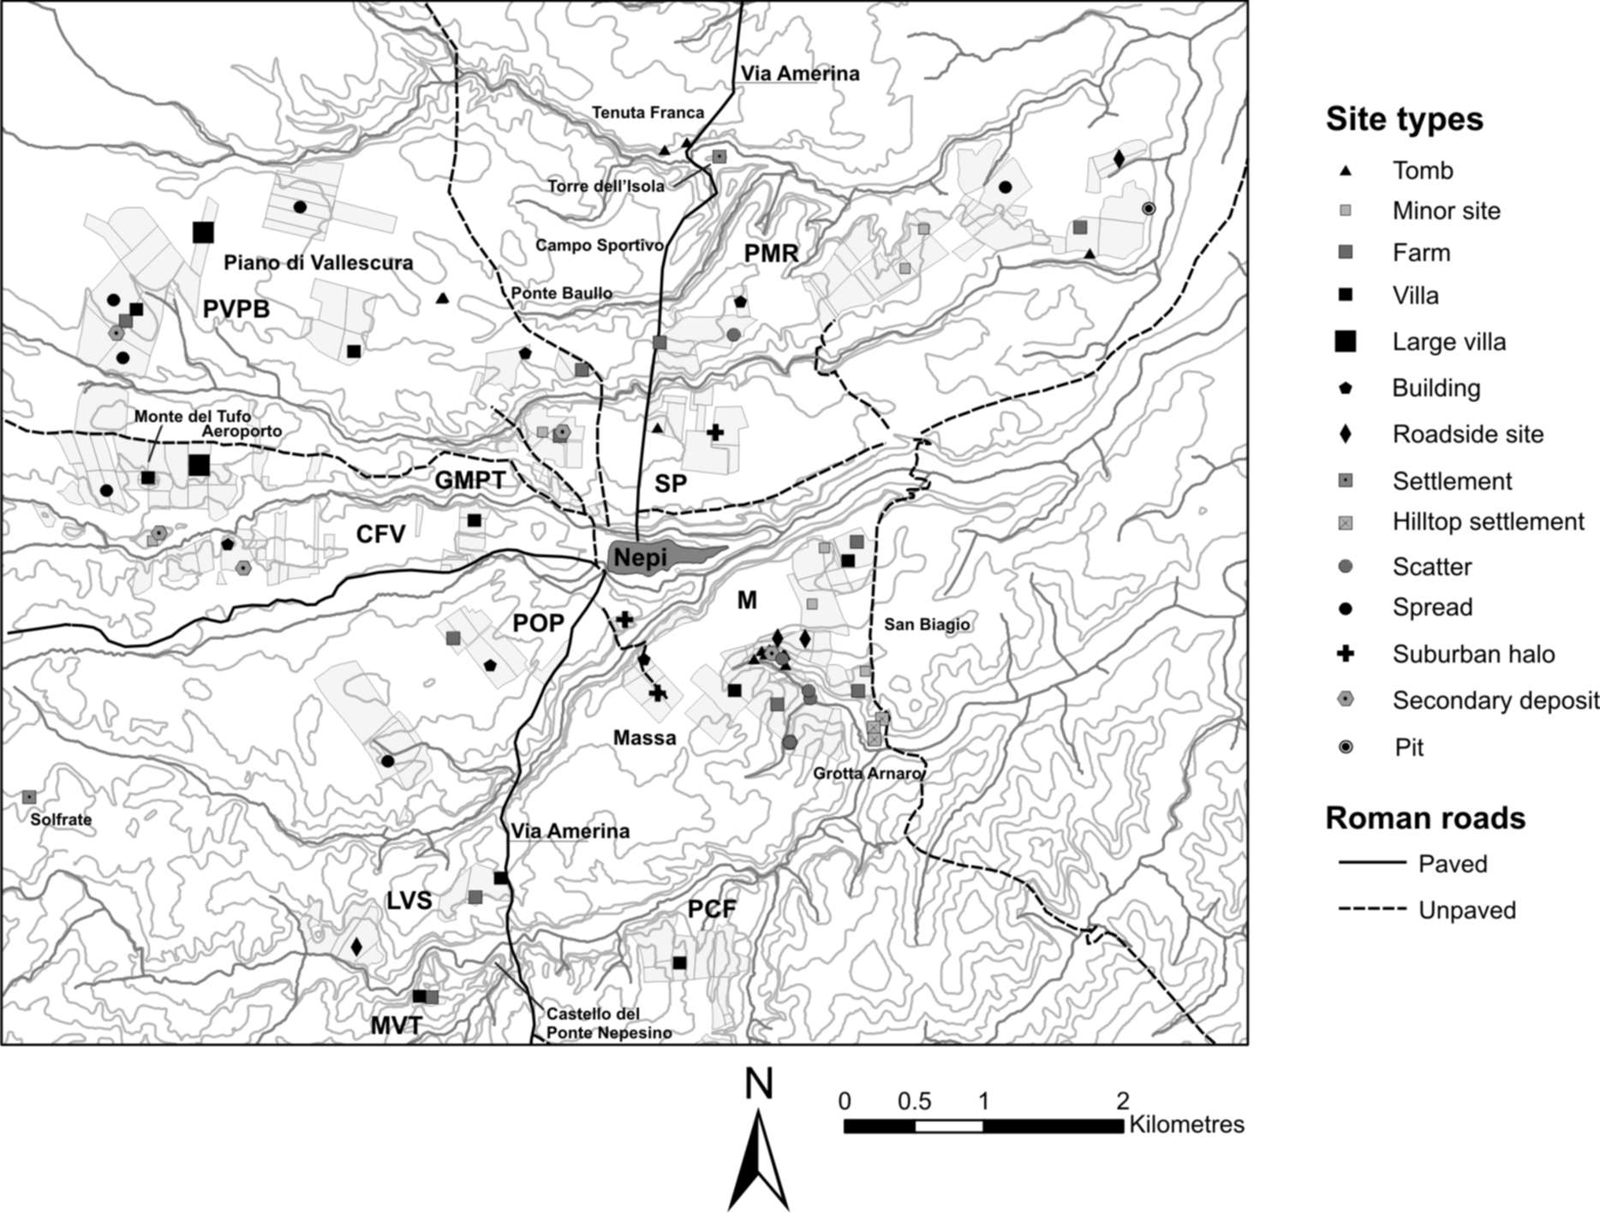

Slide 13
Date Range

Slide 14
Date Range for sites

Slide 15
Large Villas

Slide 16
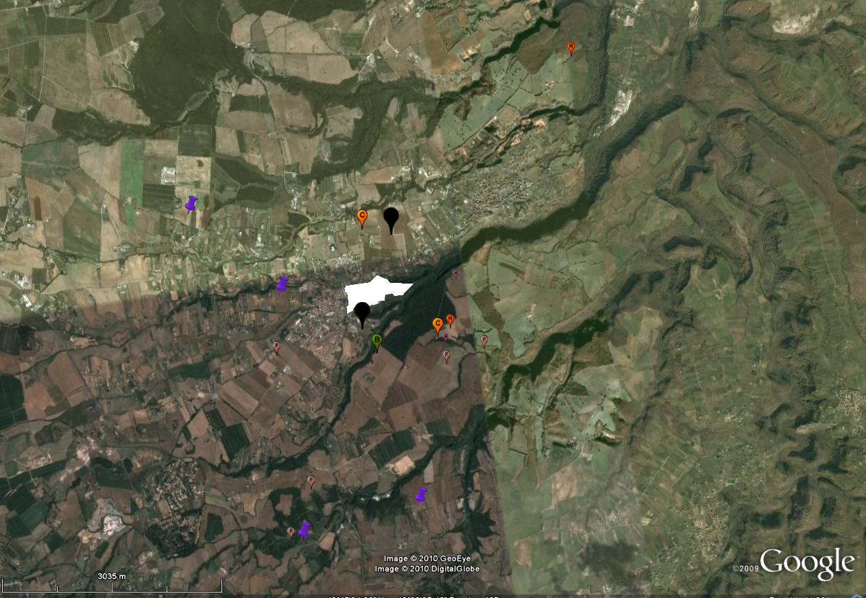
Second Century BC

Slide 17
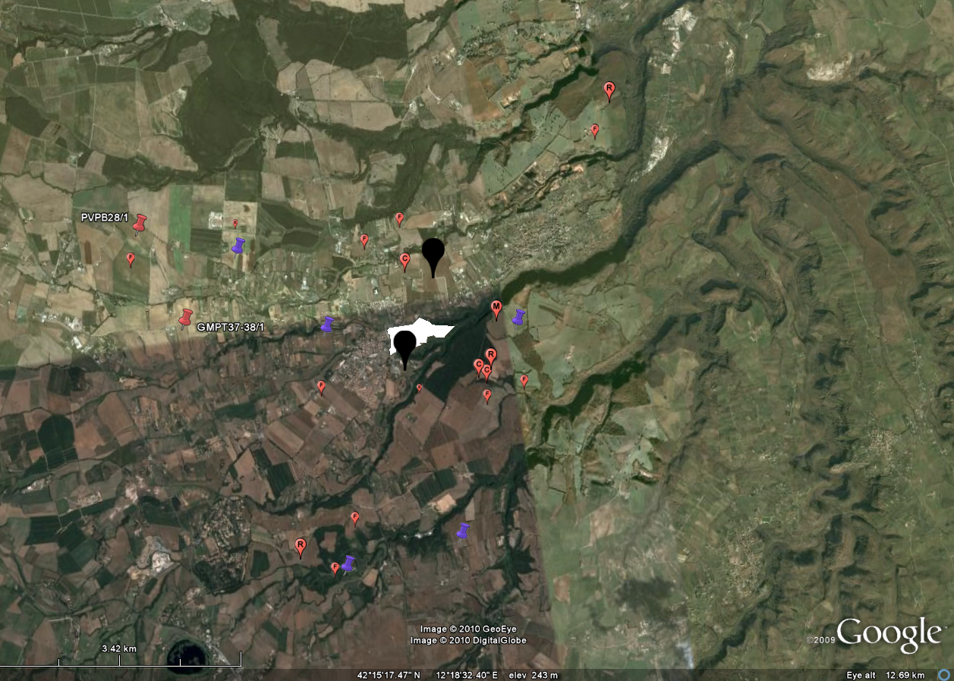
C1 BC to AD C1

Slide 18
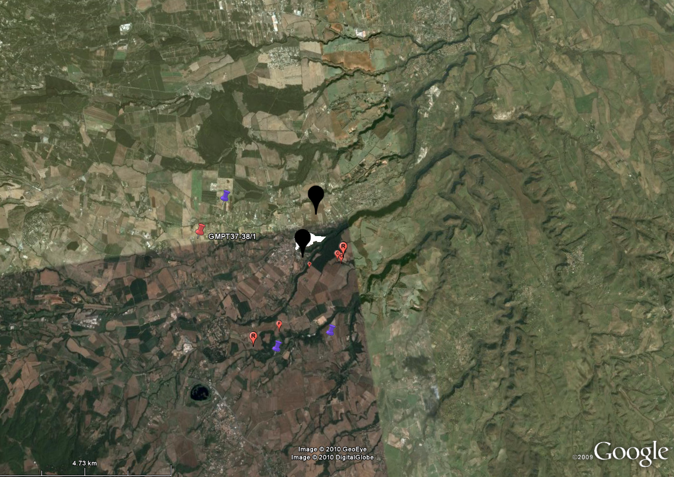
2nd Century

Slide 19
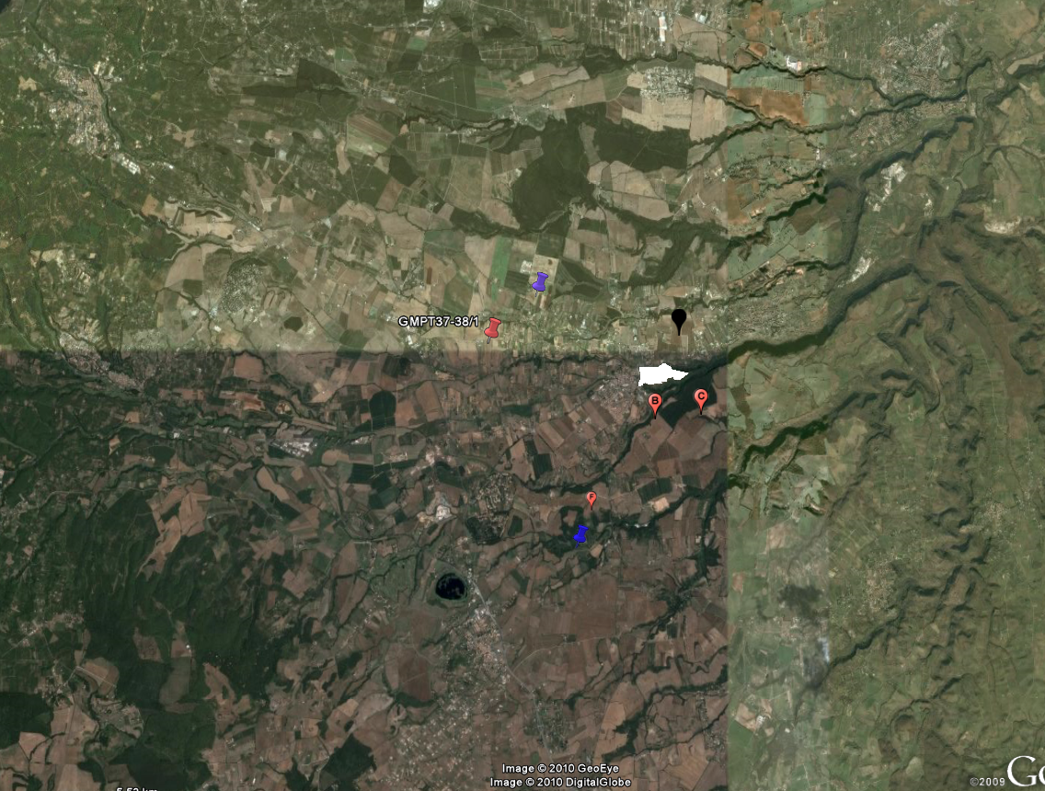
3rd – 4th Century

Slide 20
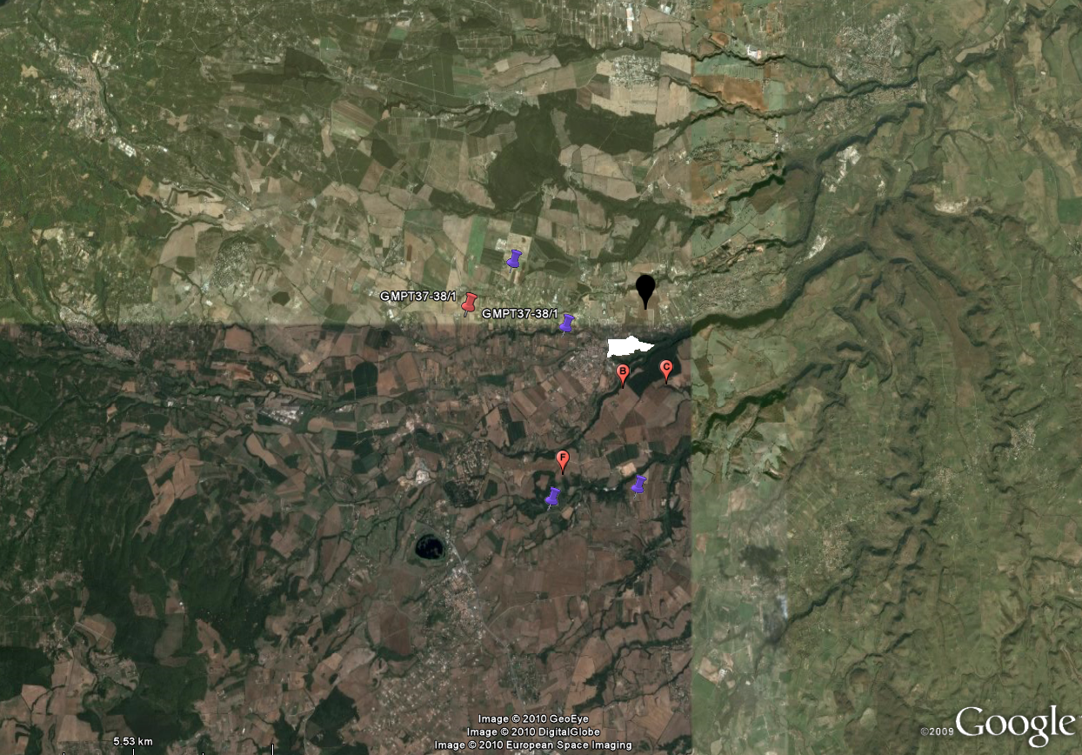
5th Century

Slide 21
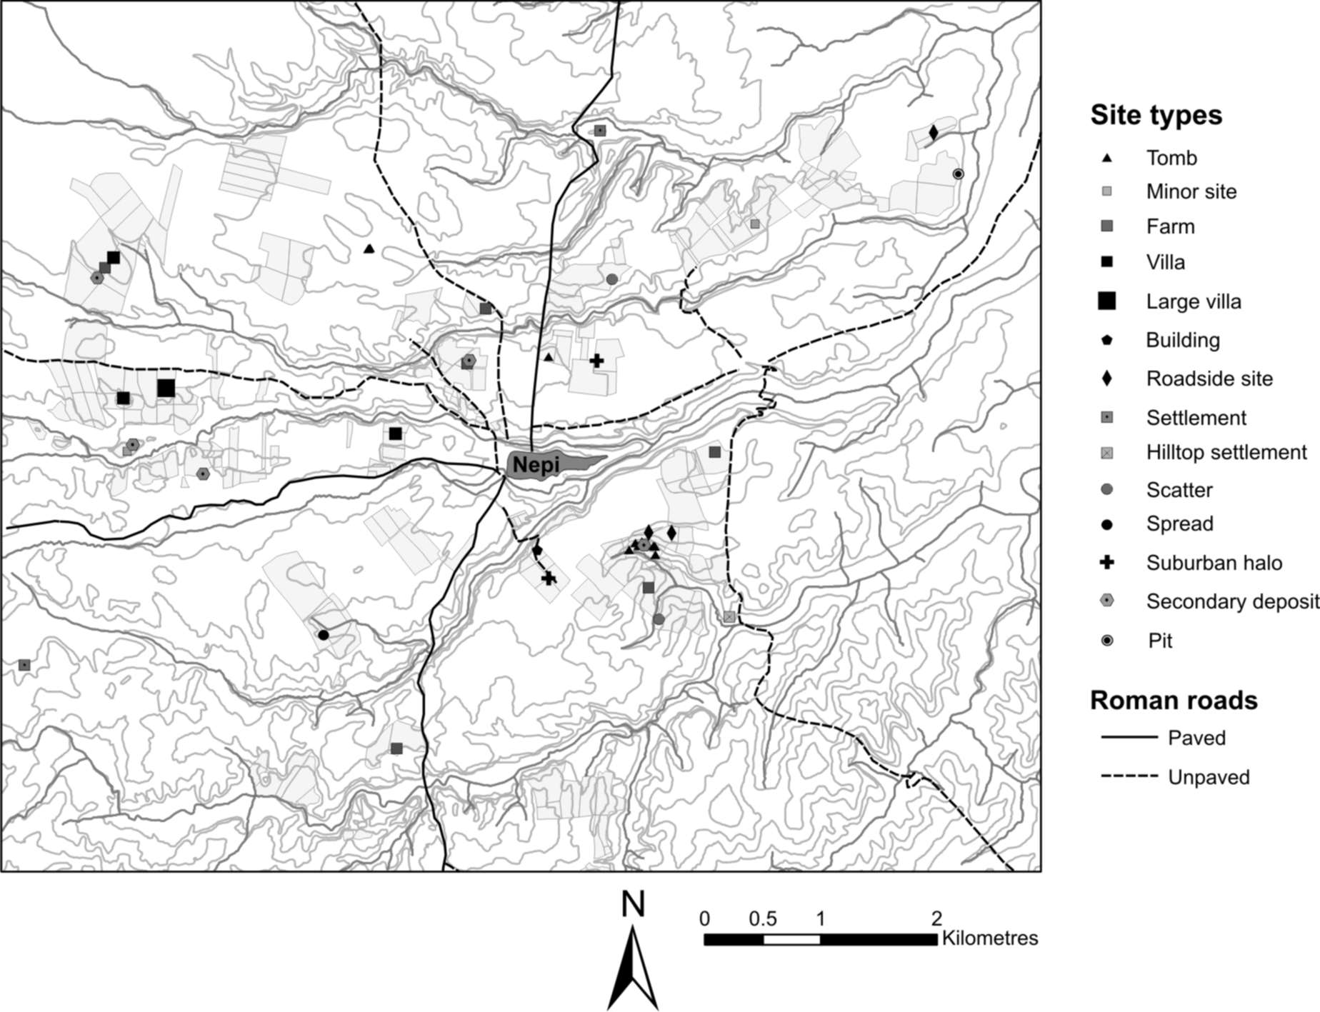
C2/C3 BC

Slide 22
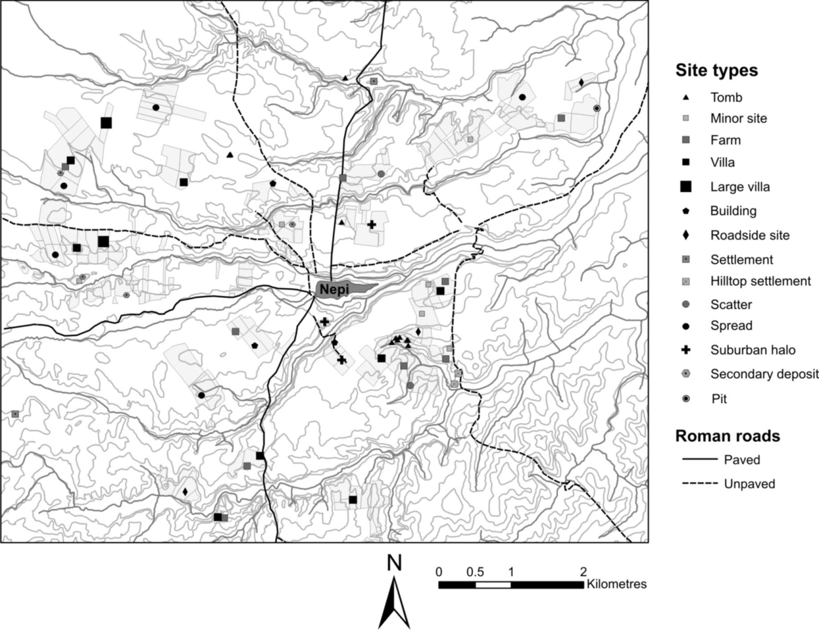
C1 BC – AD C1

Slide 23
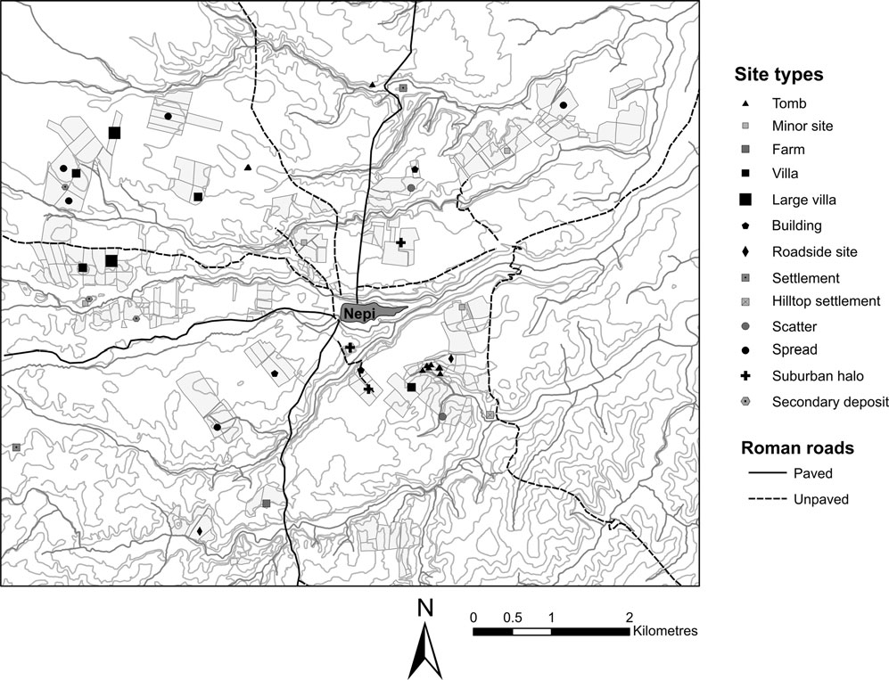
C2-C3

Slide 24
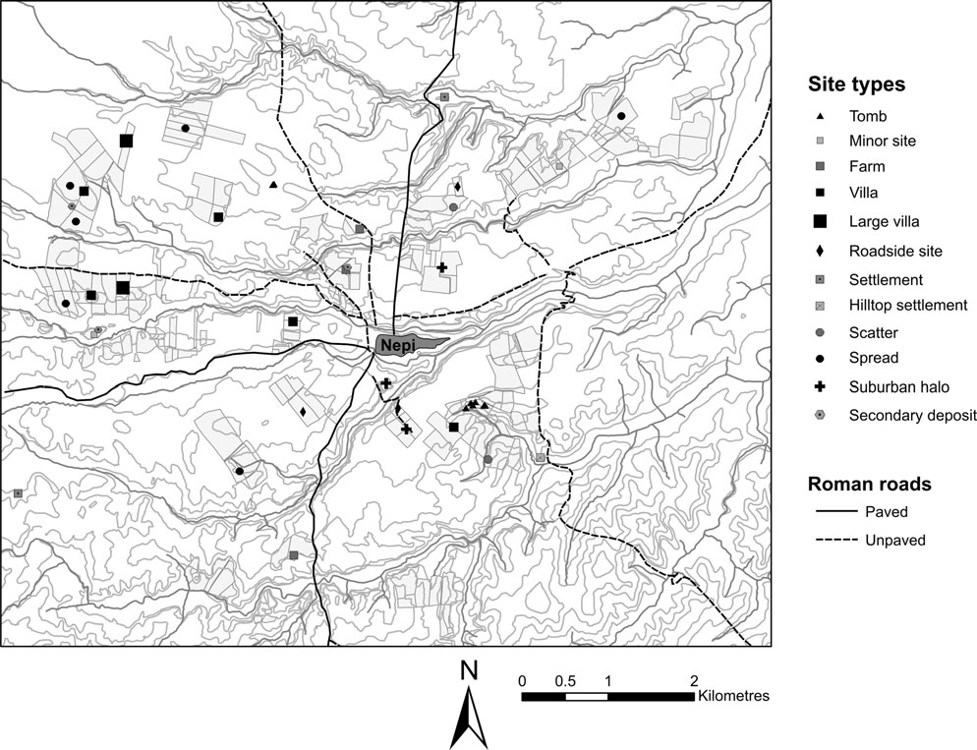
C4-C5

Slide 25
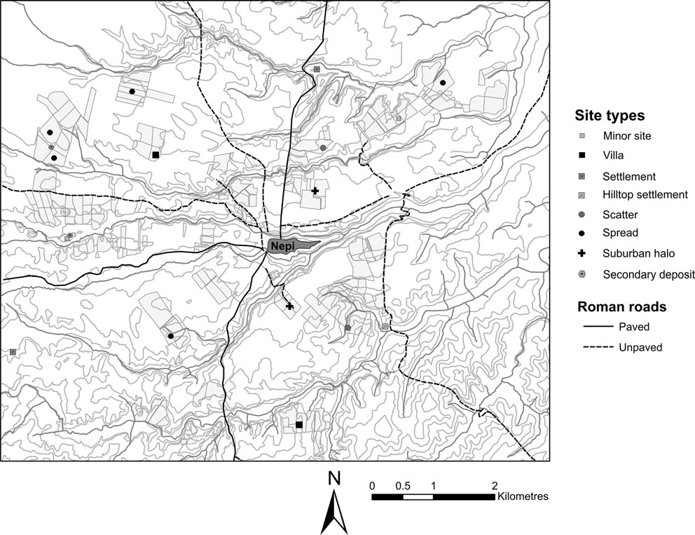
C6-C7

Slide 26
Dating summary
We see the patterns expected from previous work, with farms disappearing into the Villa economy (c.f. Slave mode of production)
This peaks in AD C1st, sharp decline in mid 2nd – depopulation of country side? Rise of large villa estates?? Increased urbanisation
Some recovery in later 3rd, but over by the 5th (retreat to the hills)

Slide 27
Ware groups

Slide 28
Ware by site

Slide 29
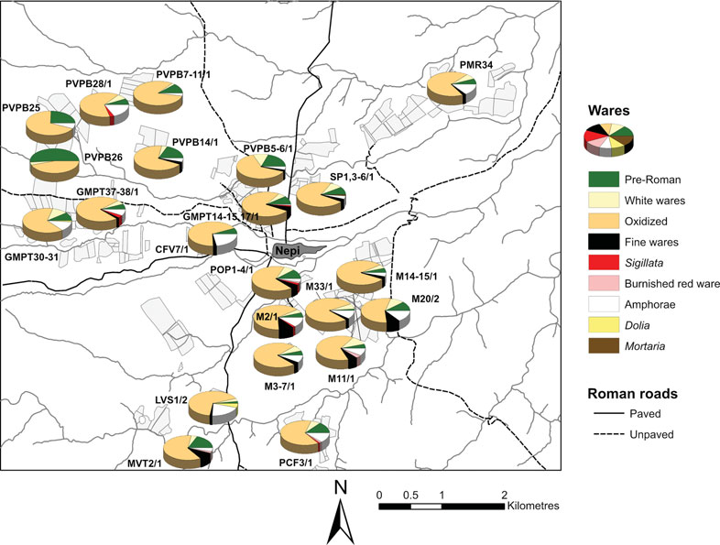

Slide 30
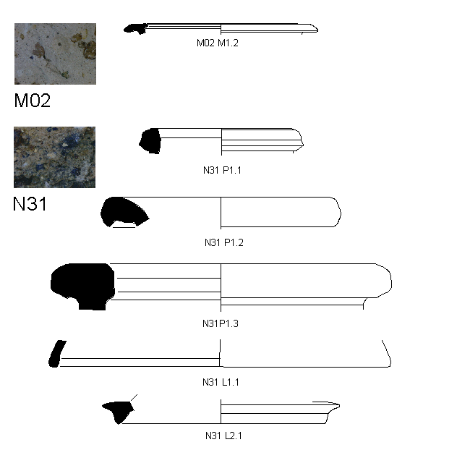
Mortaria and Dolia

Slide 31
There is a clear relationship between ware consumption (deposition) and site function.
Of Interest – Mortaria only found in urban context in C1 BC – in North Europe are found at levels of c. 3-5% even in base level rural sites.
Dolia only found at farms.

Slide 32
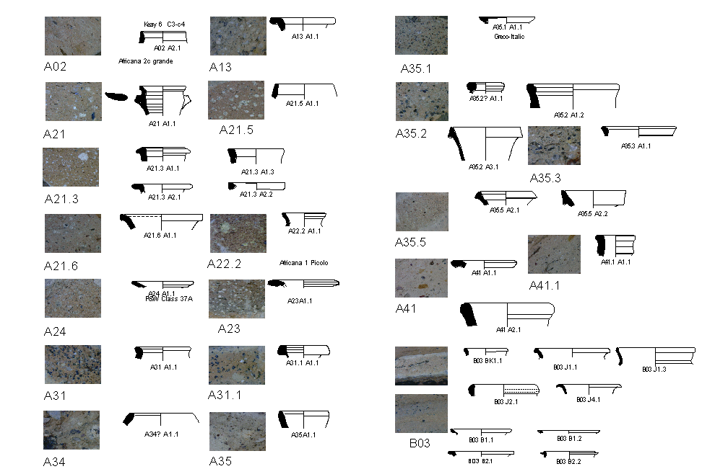
Amphora

Slide 33
Amphora
Origin | No% | Wt% | MNR% | RE%
Italian | 9% | 14% | 11% | 9%
N/A | 0% | 0% | 0% | 0%
North Africa | 54% | 43% | 34% | 35%
North Africa ?? | 5% | 9% | 8% | 7%
North Africa? | 9% | 8% | 18% | 19%
Other | 8% | 8% | 3% | 1%
Sicily? | 2% | 4% | 3% | 4%
Spanish | 13% | 14% | 24% | 26%
 | N | 806 | 26105 | 38

Slide 34
Import Provenance by Period

Slide 35
Imported commodities Date Distribution

Slide 36
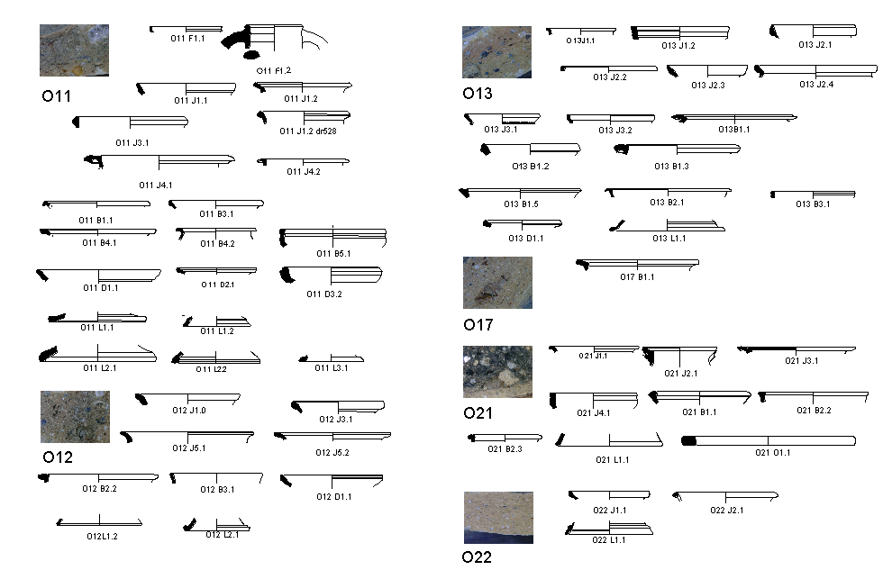
Class O

Slide 37
Date Range

Slide 38
Proportional Date Range

Slide 39
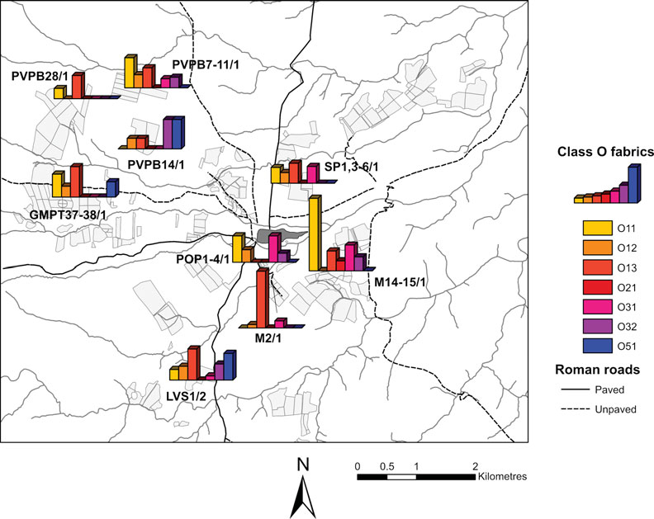

Slide 40
Function by Time

Slide 41
Function by site type

Slide 42
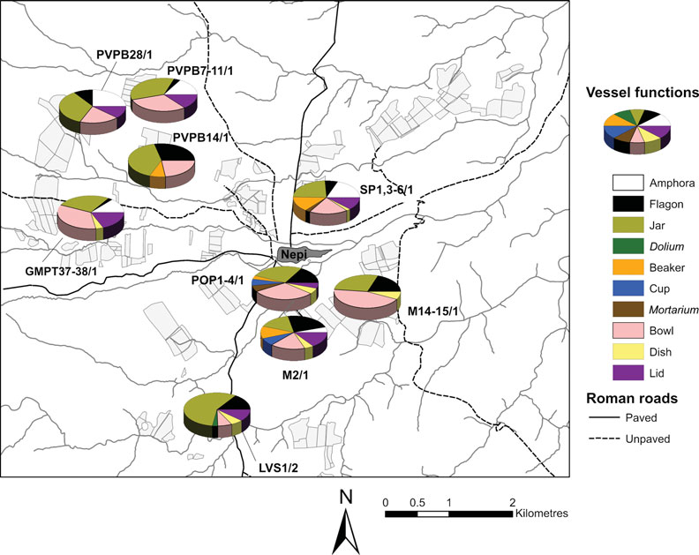

Slide 43
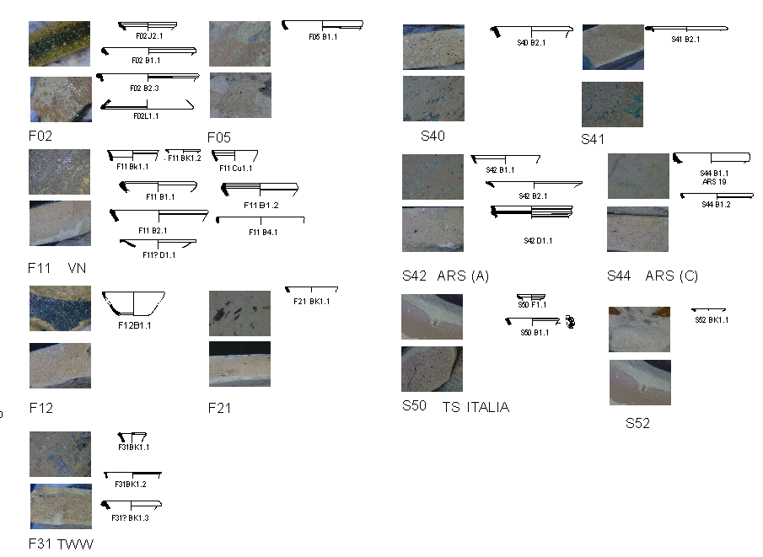
Fine ware and Sigillata

Slide 44
Fine ware and Sigillata by Site

Slide 45
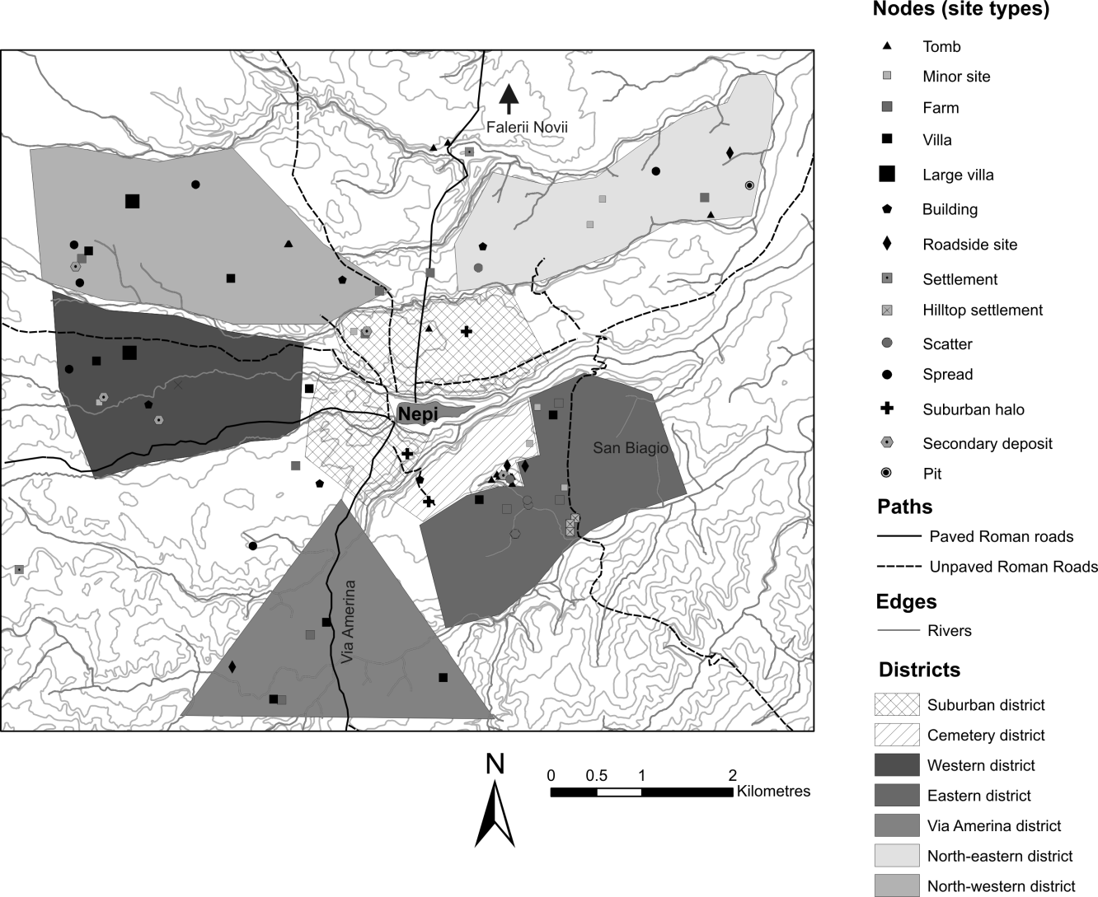
Landscape Characterisation

Slide 46
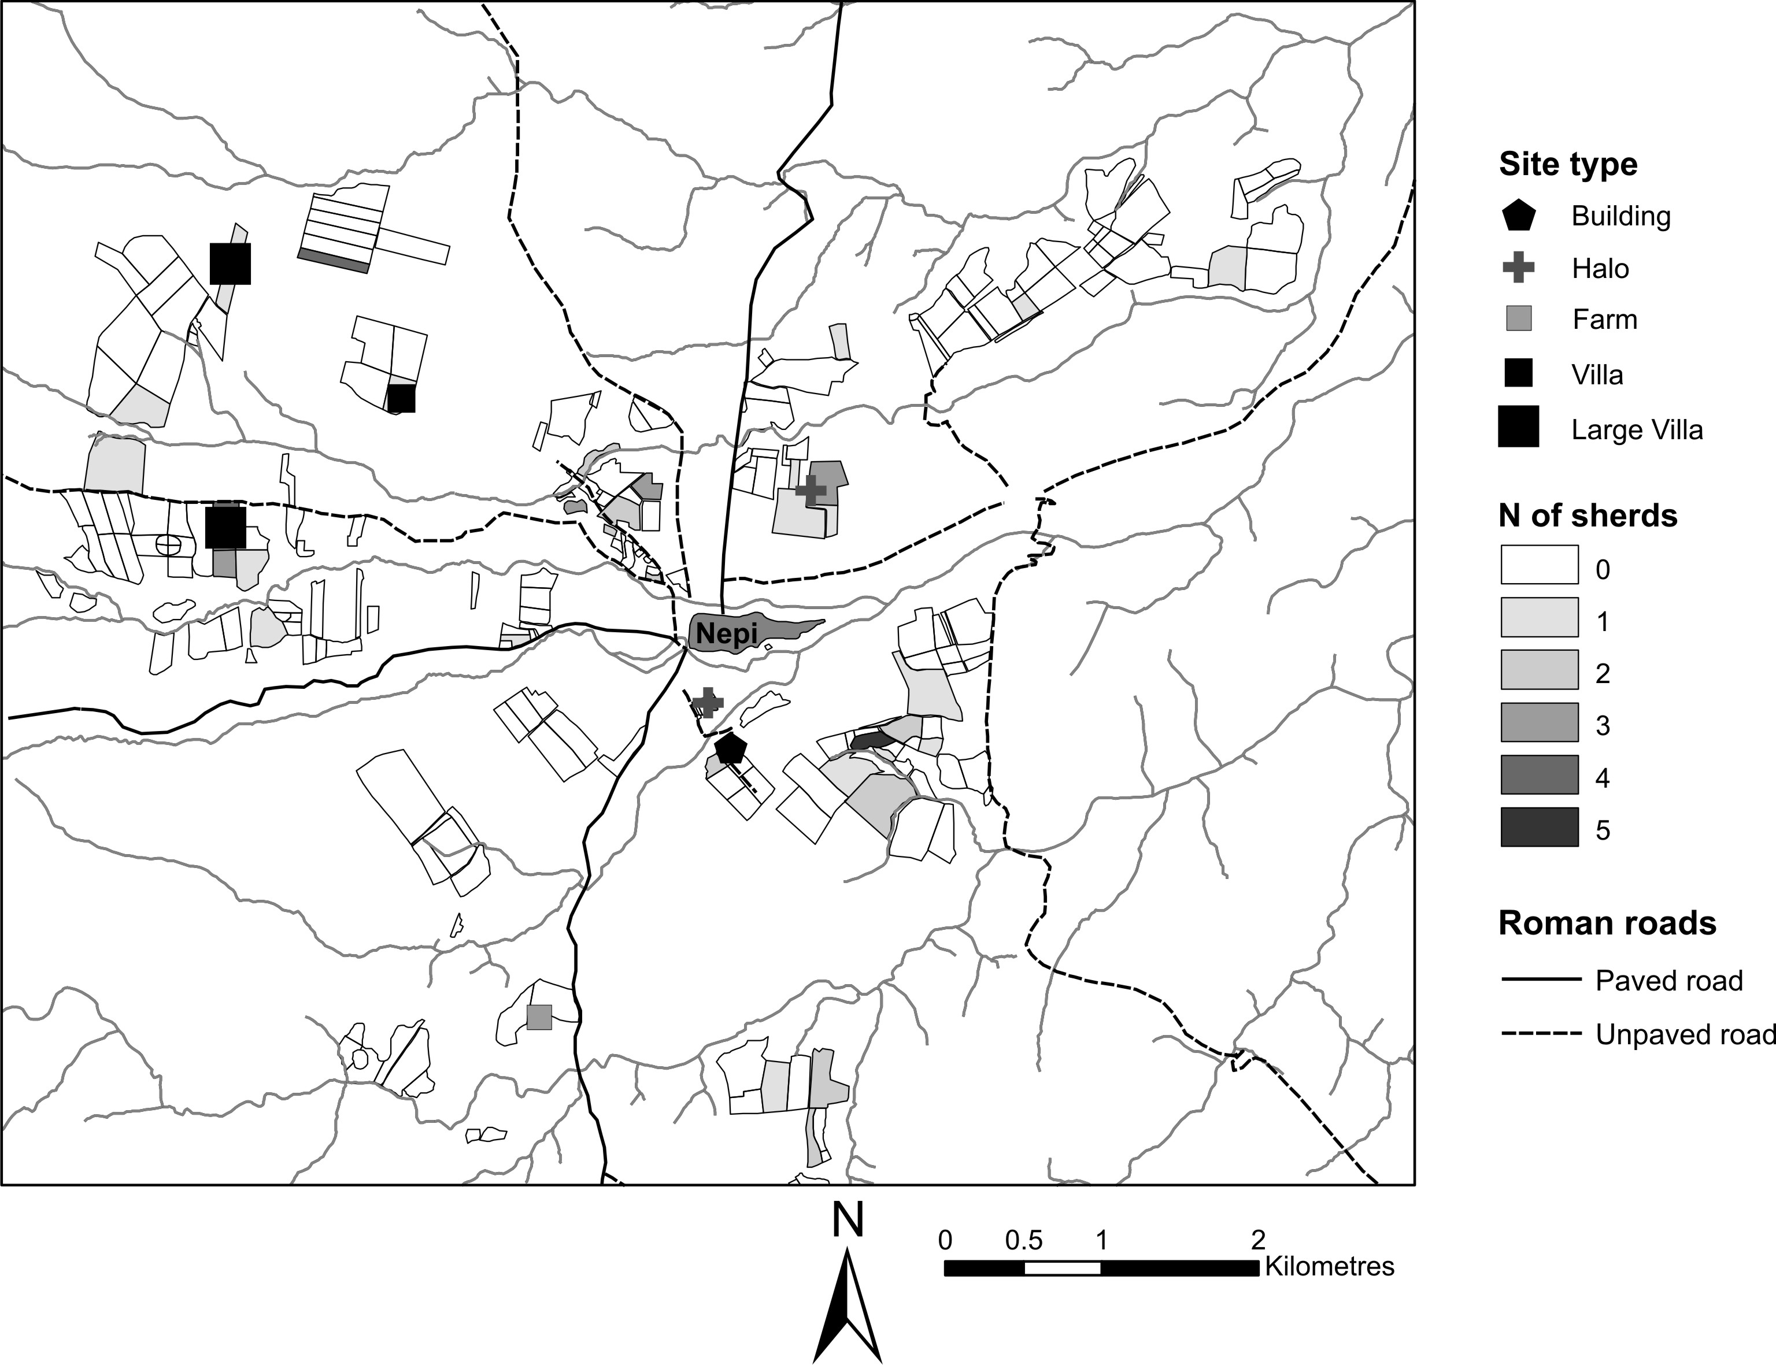
ARS

Slide 47
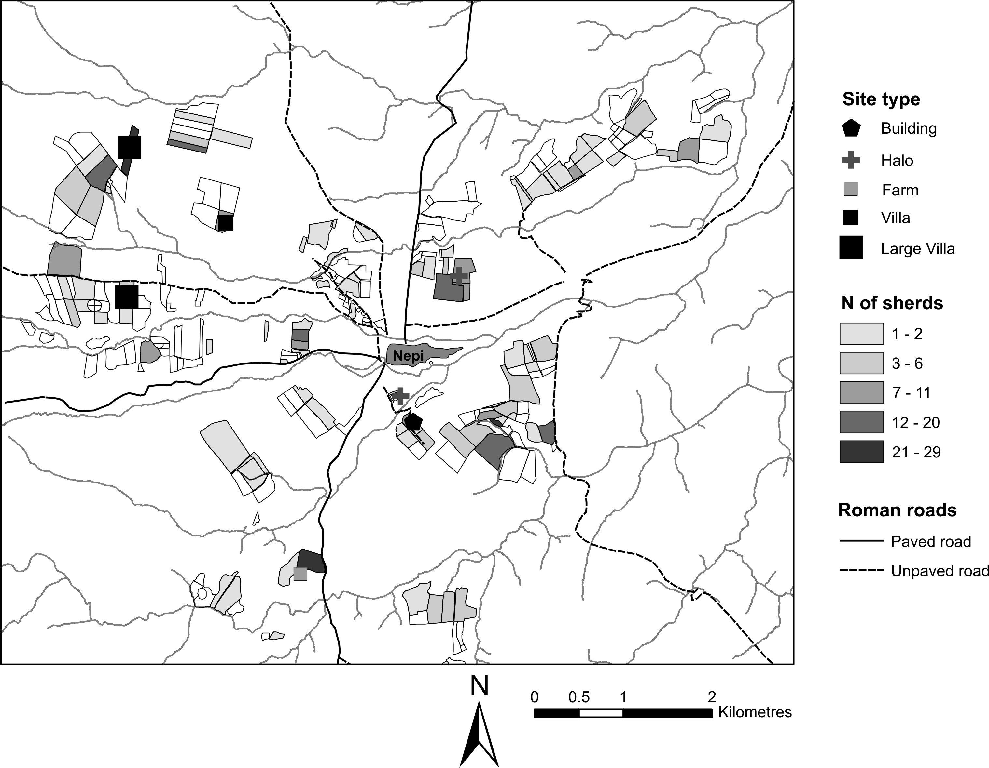
N African Amphorae

Slide 48
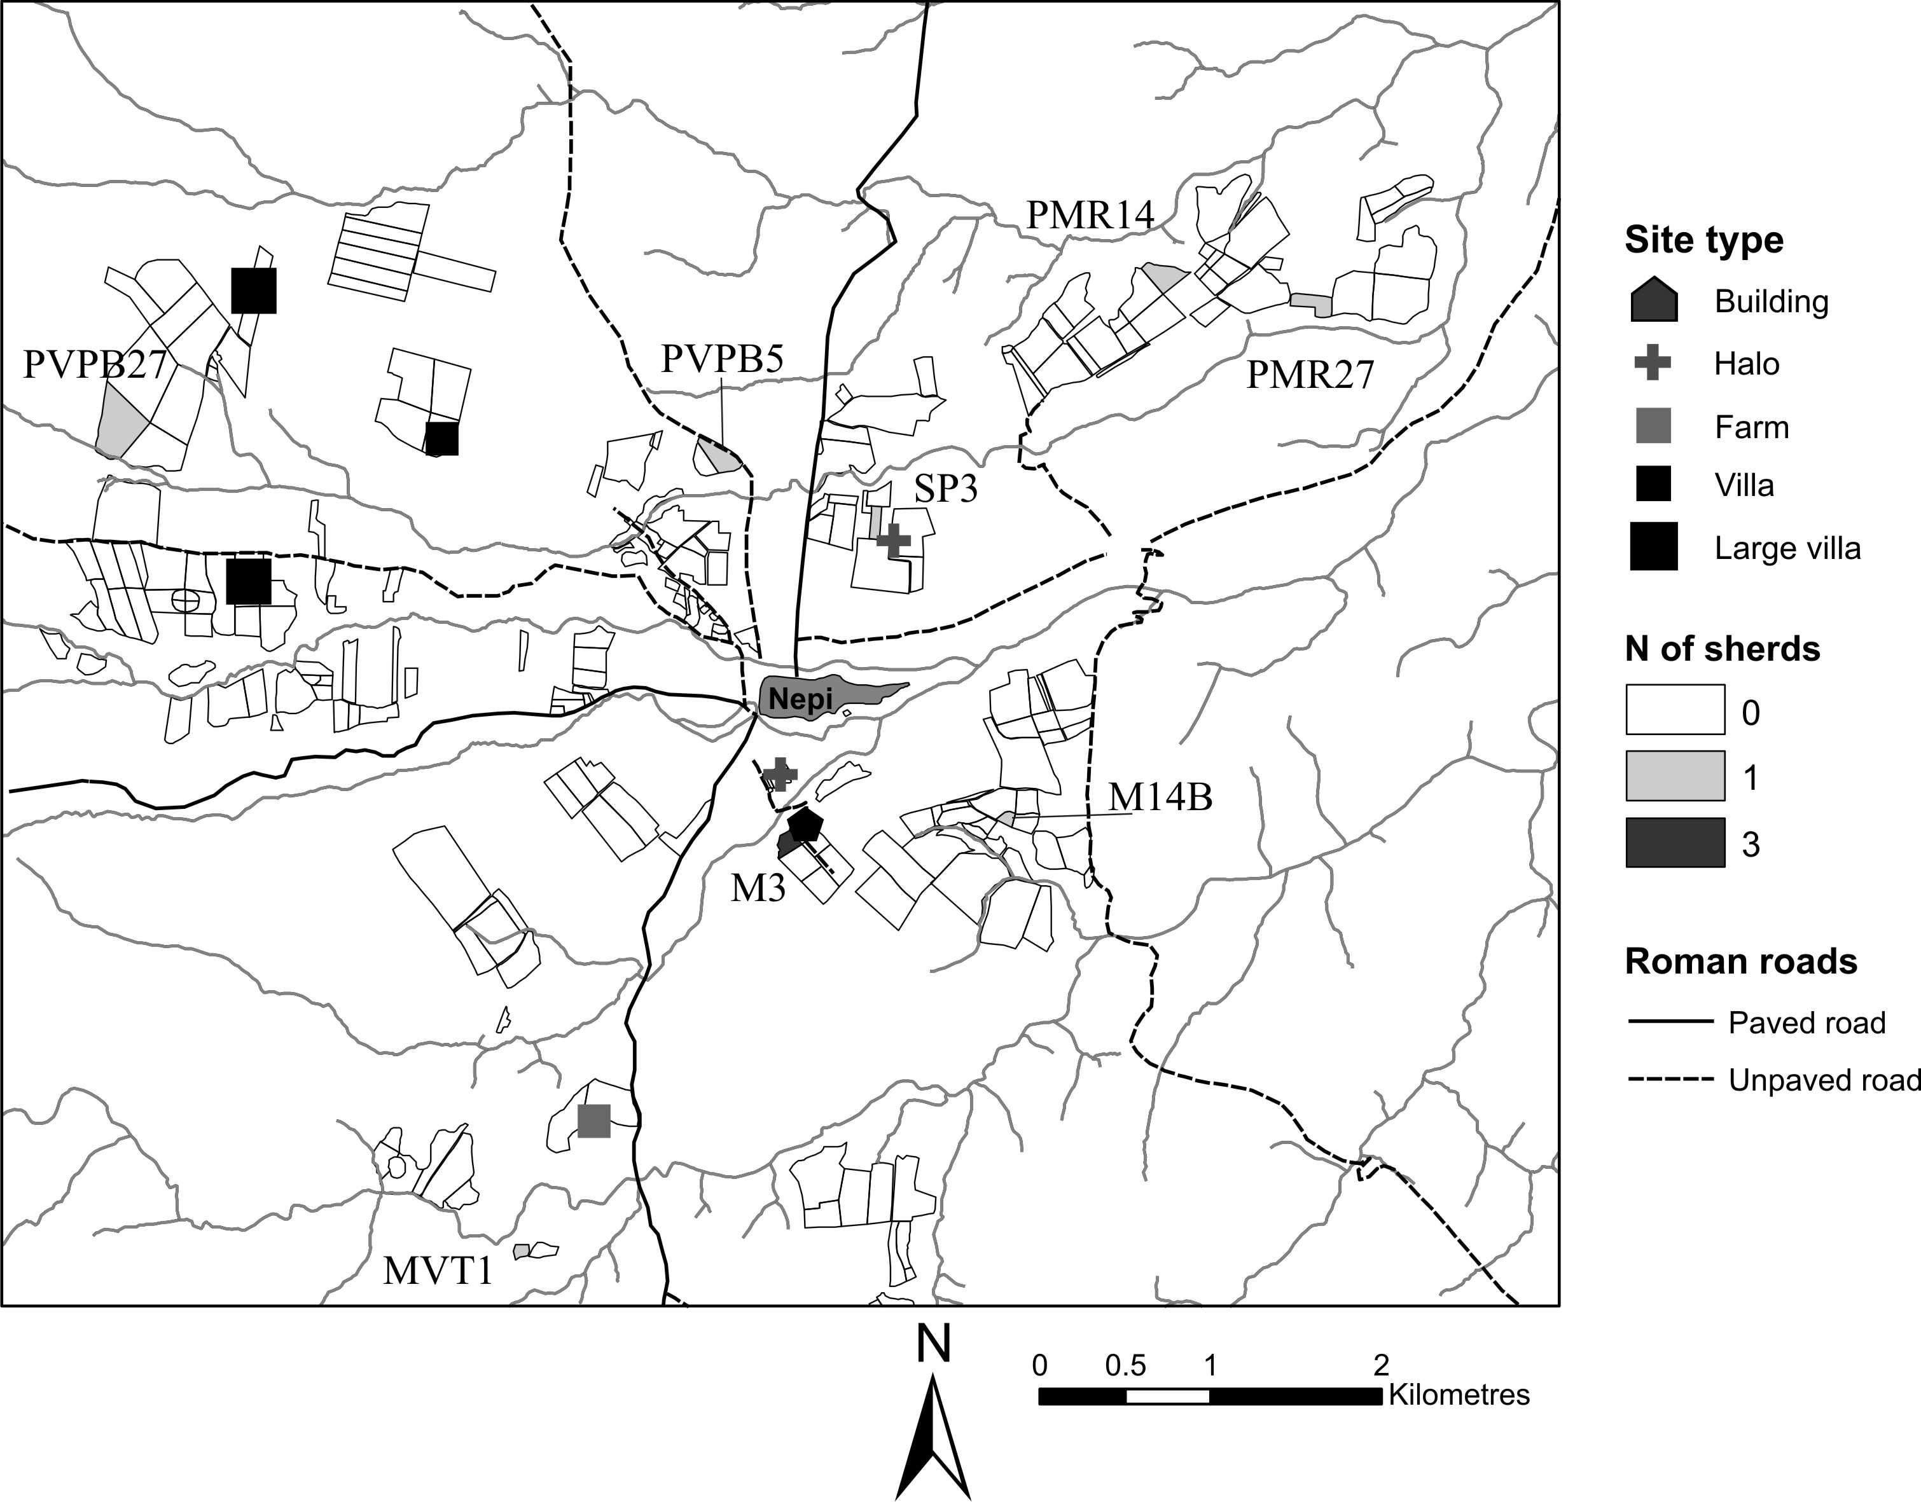
N African CW

Slide 49
Roof colour

Slide 50
Conclusions
Survey reveals a lot about the economic landscape.
The region of Nepi developed into a villa economy, and benefited from the wider trading networks of the empire.
Different settlements and different economic functions which can be left in the material remains.
There is rapid decline from the later second century AD, but some form of recovery in the third, but this ceases after the 5th, due to political instability

