Slide 1
Agriculture at the margins

Slide 2
Tripolitania

Slide 3
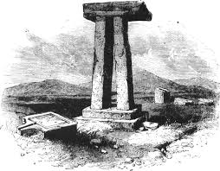
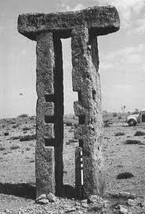
Megaliths or olive presses?

Slide 4
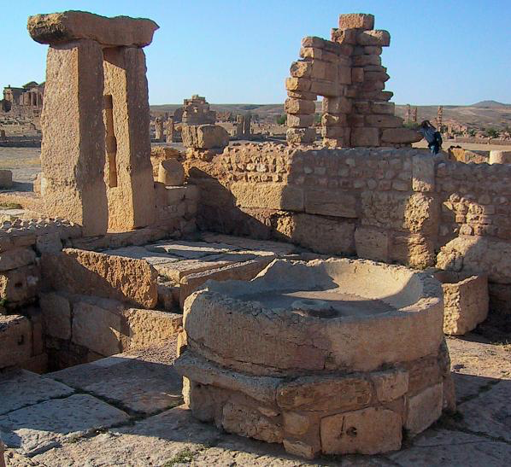
Press in Sbeïtla, Tunisia

Slide 5
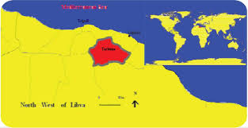
The Gebel, Tarhuna plateau

Slide 6
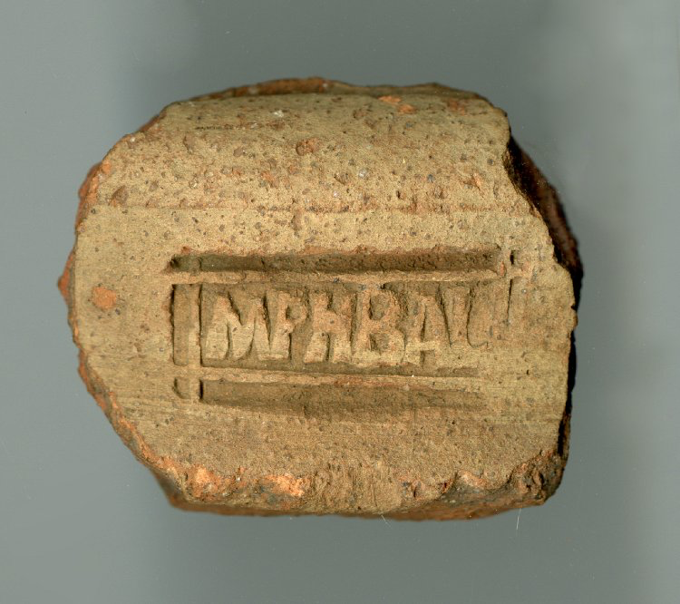
Stamped Tripolitanian amphora sherd

Slide 7
R G Goodchild

Slide 8
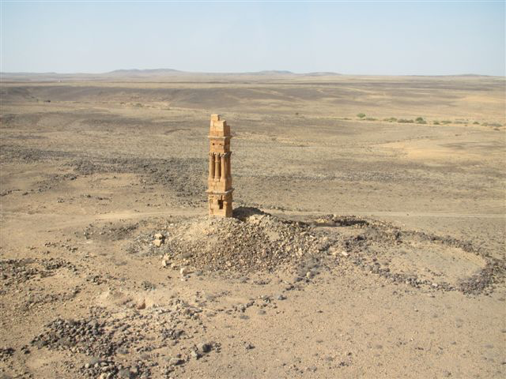

Slide 9
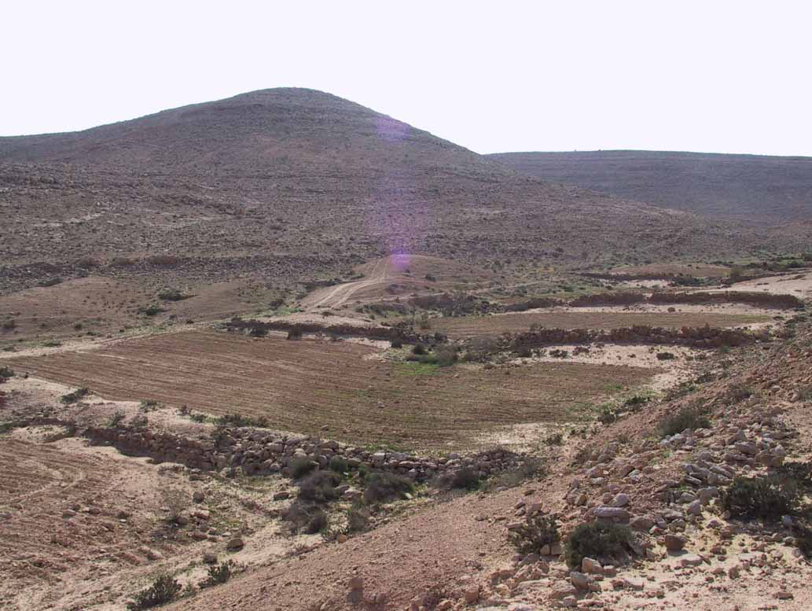
Avdat experimental farm, Negev

Slide 10
Wadi el-Amud

Slide 11
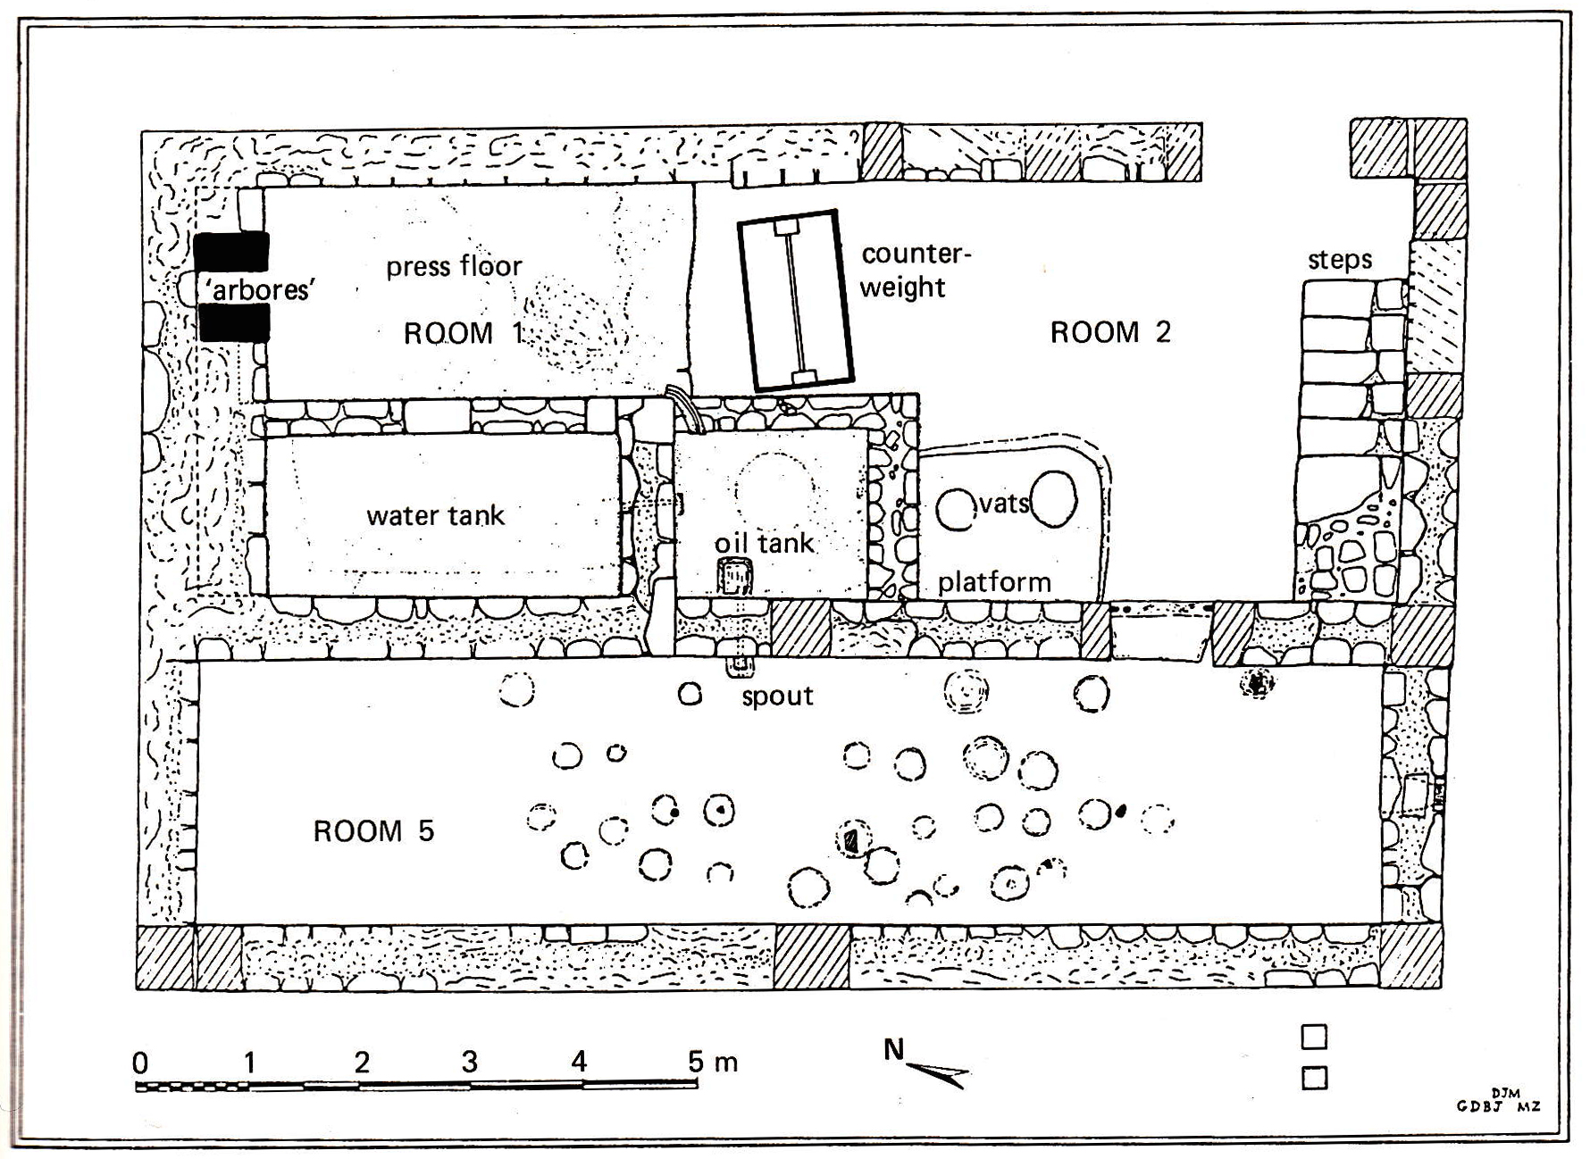

Slide 12
Late antique example: Wadi Bruza

Slide 14
Late Roman fortified farm complex on edge of Wadi Bruza, complete with church

Slide 15
Wadi Bruza today

Slide 16
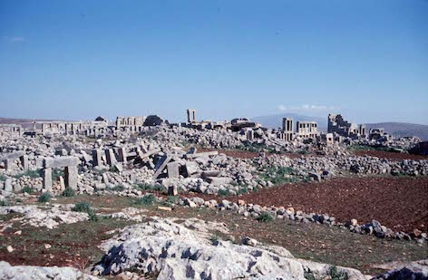
‘Dead Cities’, northern Syria

Slide 17
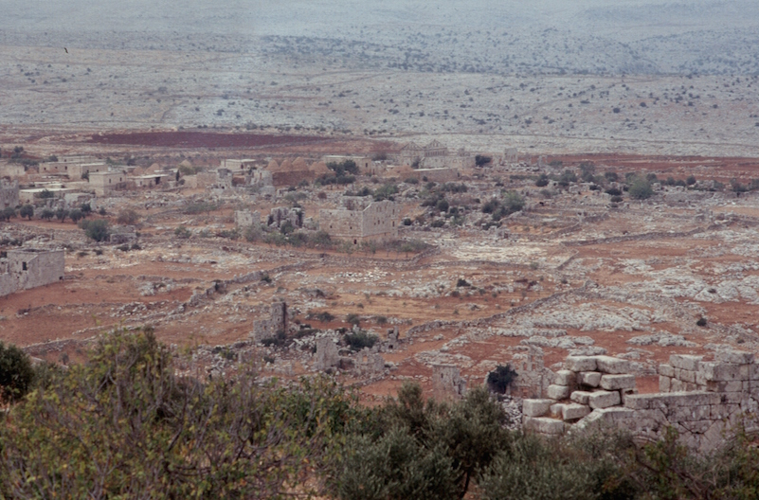
Deir Semaan

Slide 18
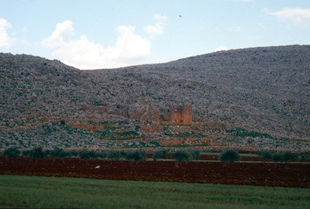
Breij

Slide 19
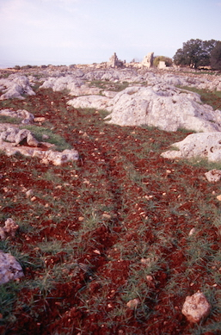

Slide 20
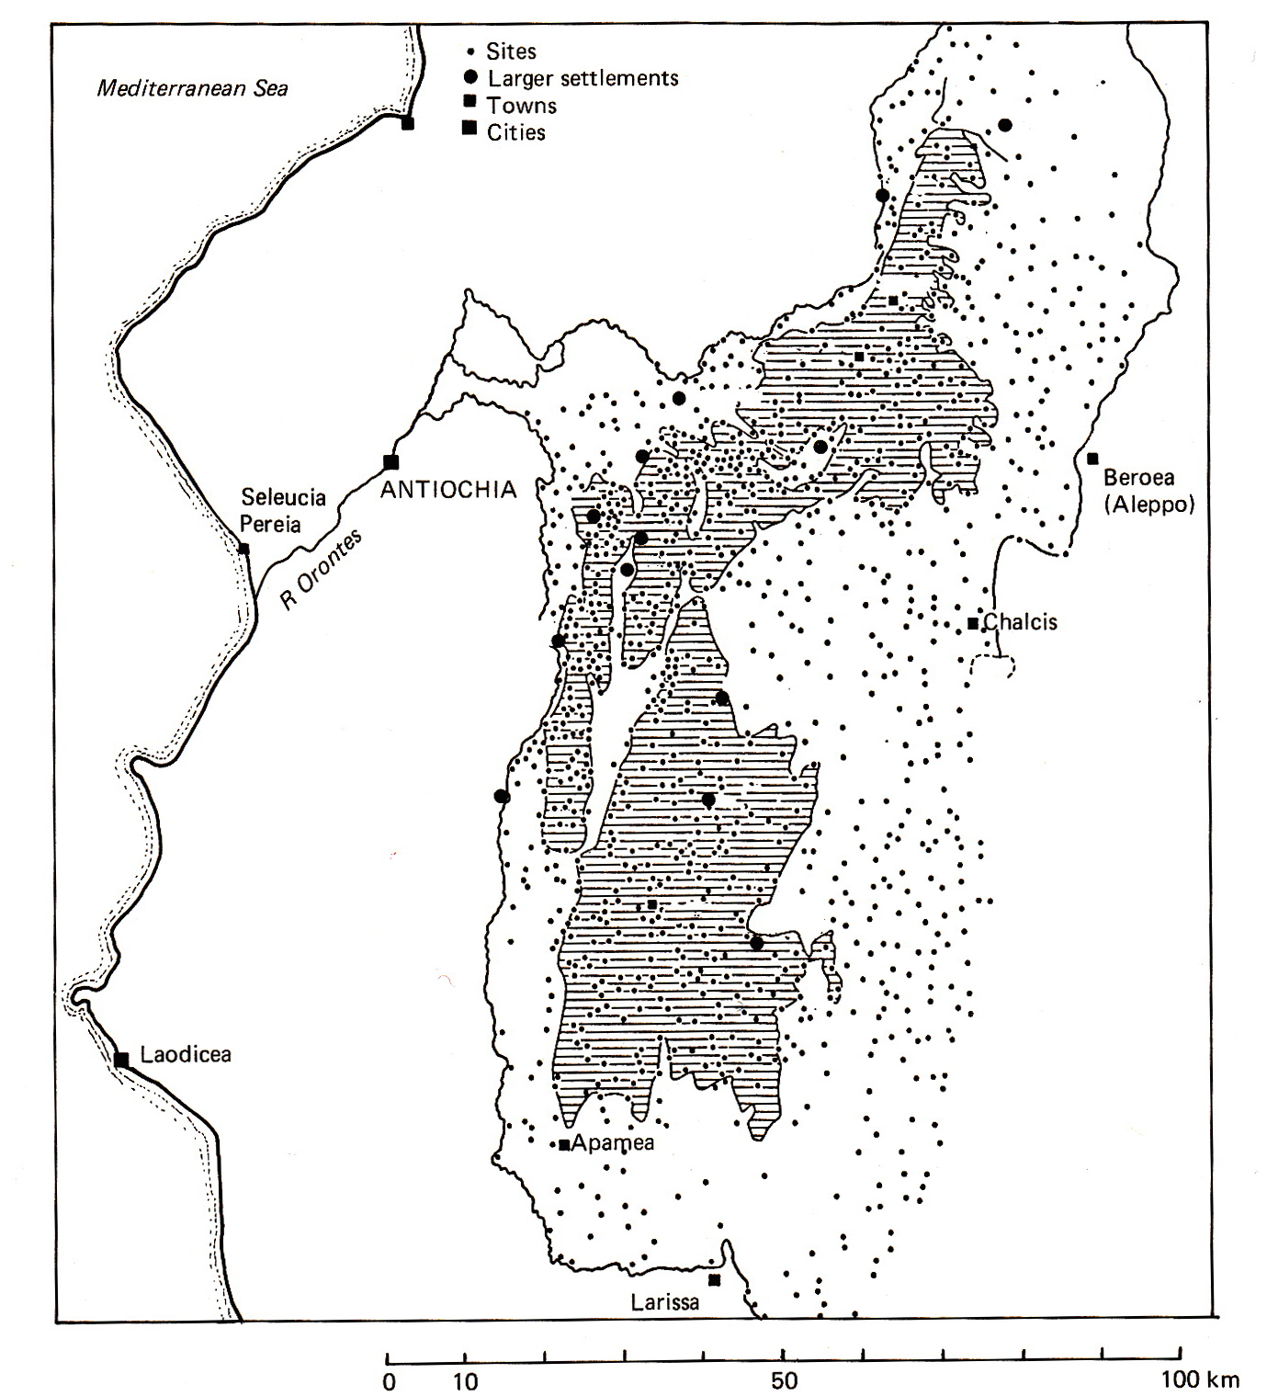

Slide 21
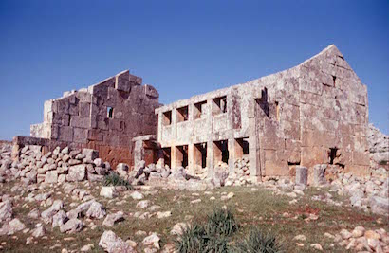
Baude

Slide 22
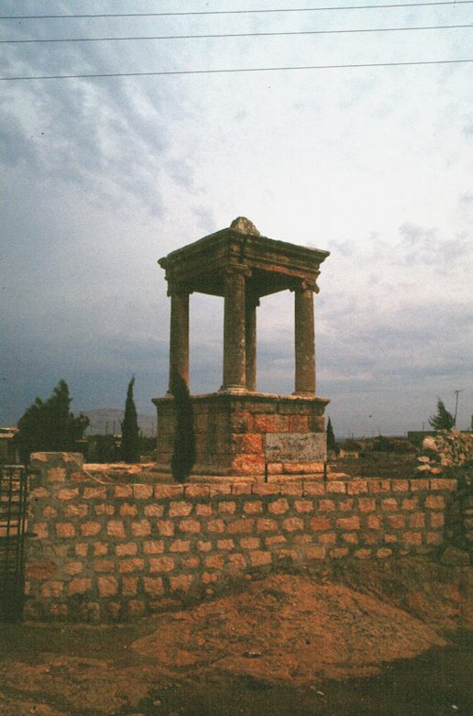
Dana

Slide 23
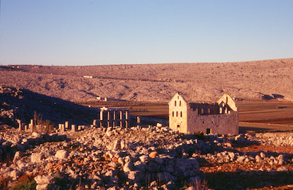
Sitt er Rum

Slide 24
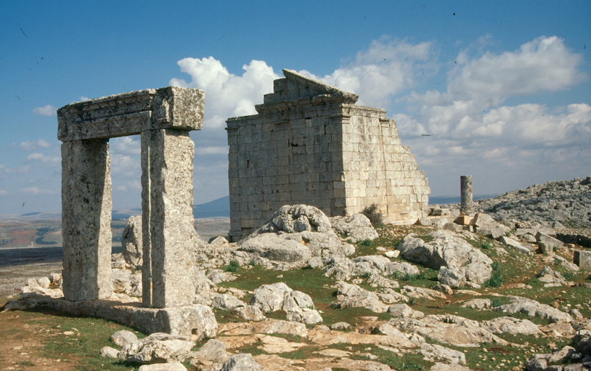
Burj Baqirha

Slide 25
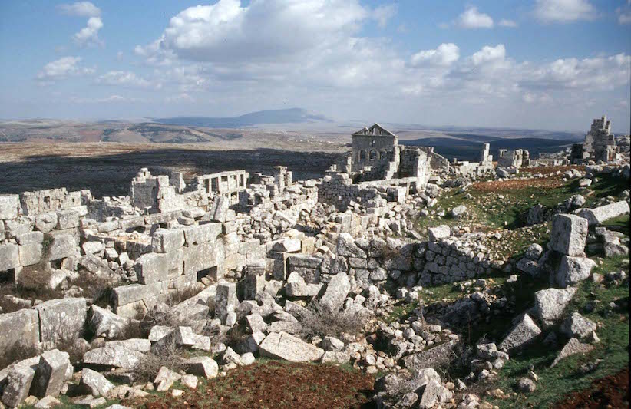
Baqirha

Slide 26
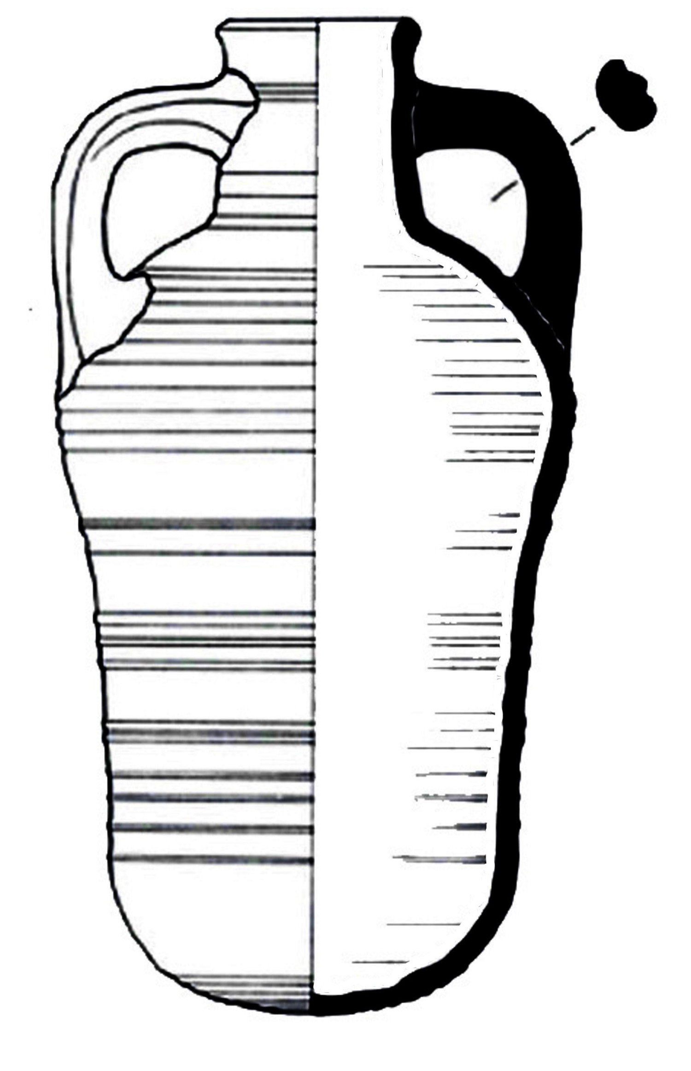
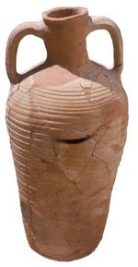
Late Roman Amphora 1

Slide 27
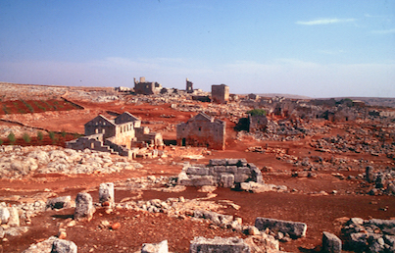
Serjilla

Slide 28
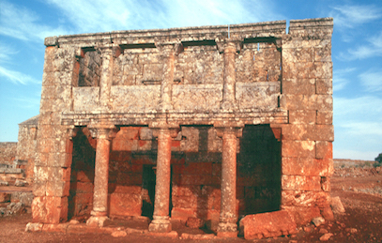
‘Andron’, Serjilla

Slide 29
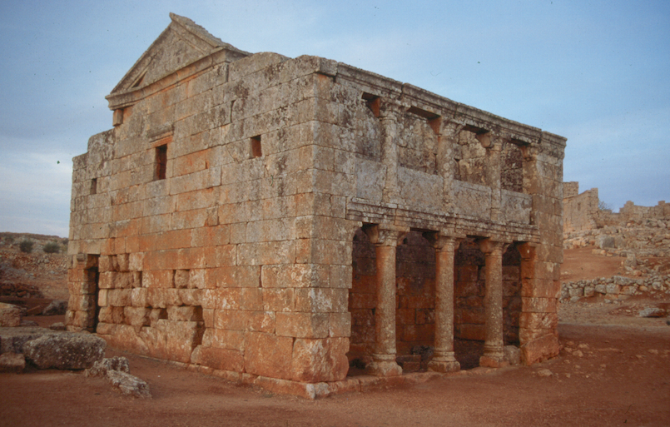

Slide 30
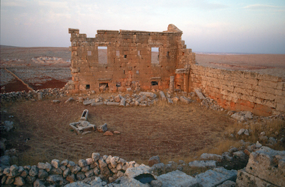

Slide 31
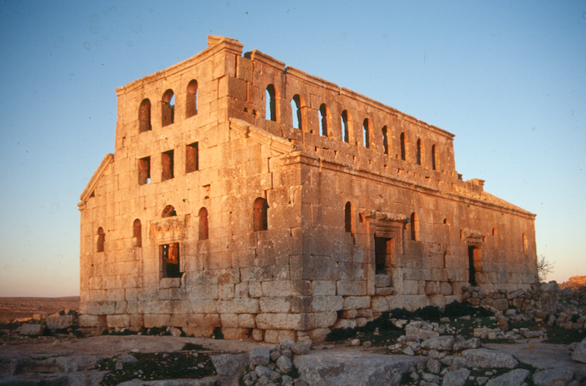
Mshabbak

