Slide 1
Baetican oil

Slide 2
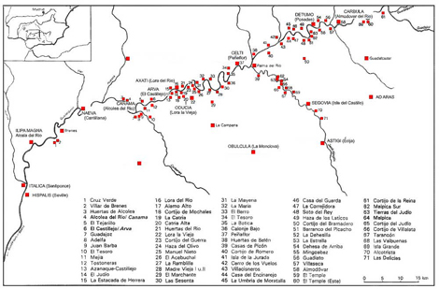
Kiln sites

Slide 3
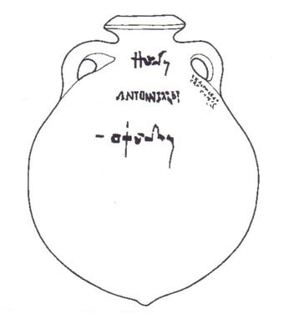
Dressel 20 amphora

Slide 4
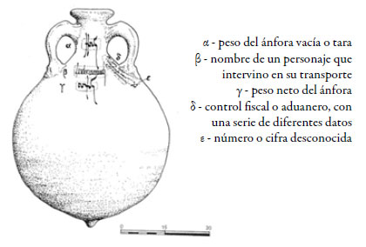

Slide 5
