Slide 1
Mining

Slide 2
Metalla
Territoria metallorum
Fines metallorum
Vipasca tablets (Aljustrel, Portugal)
Imperial control? Suetonius …
Contractors

Slide 3
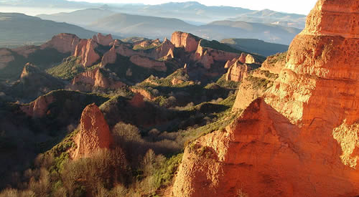
Las Médulas

Slide 4
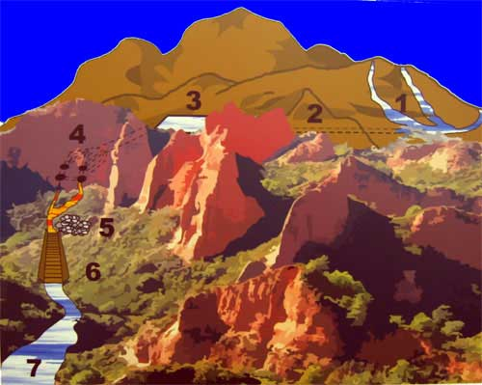

Slide 5
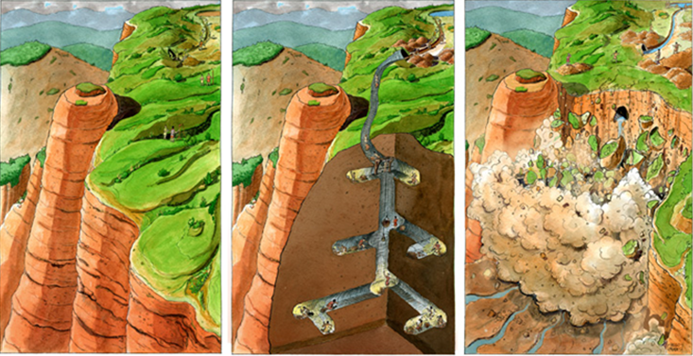

Slide 6
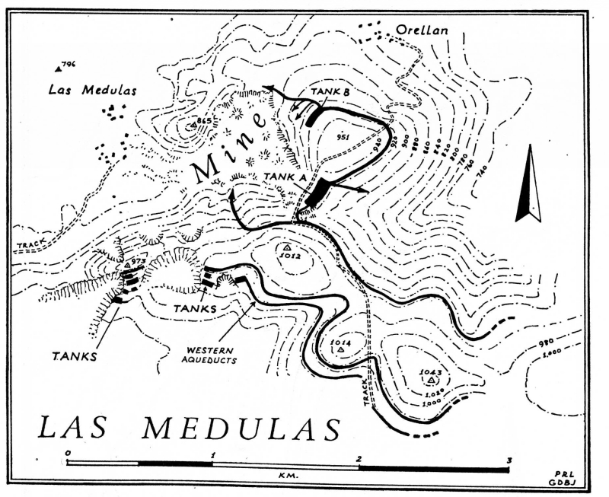

Slide 7
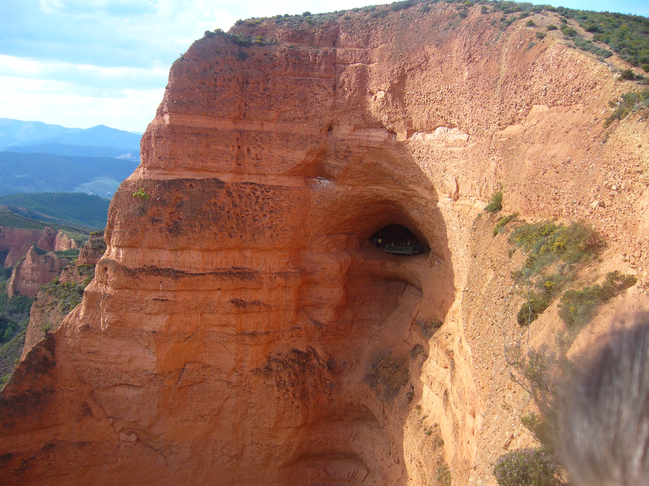

Slide 8
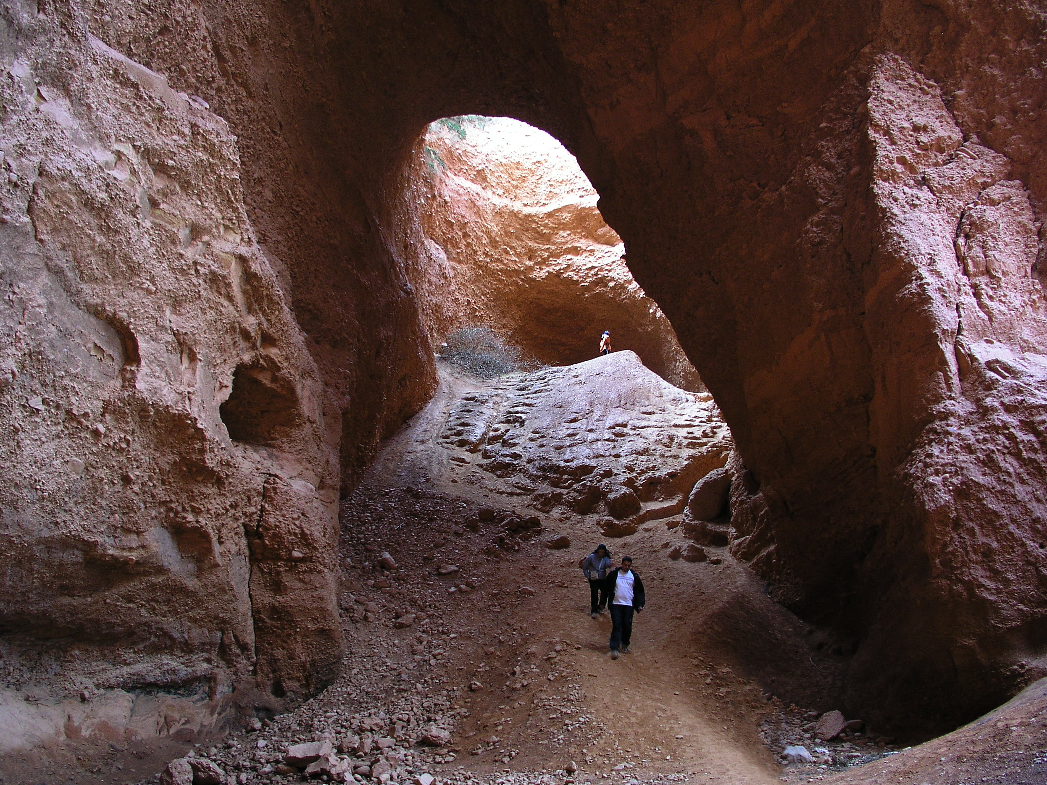

Slide 9
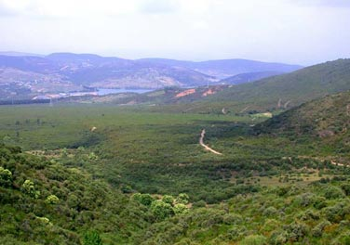
Run off into artificial lake

Slide 10
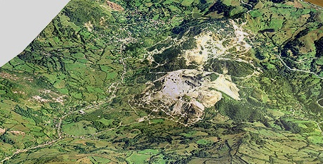
Rosia Montana

Slide 11
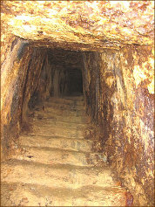

Slide 12
Vipasca tablets
Lex metallis Vipascensis (matters pertaining to regulations in the mining community)
Lex metallis dicta (regulations concerning the mines themselves – the metallum Vipascense)

Slide 13
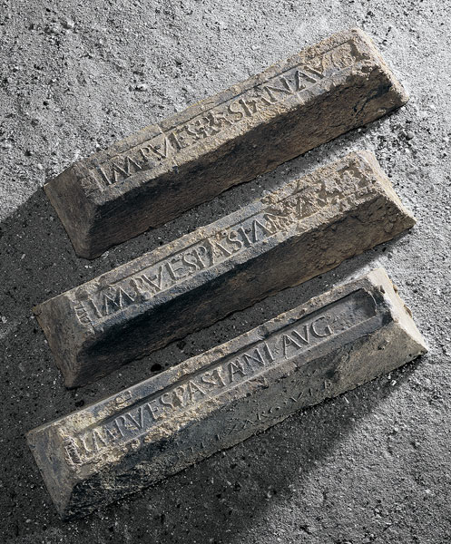
Ingots

Slide 14
Lead ingot found in 2016 on Somerset farm

Slide 15
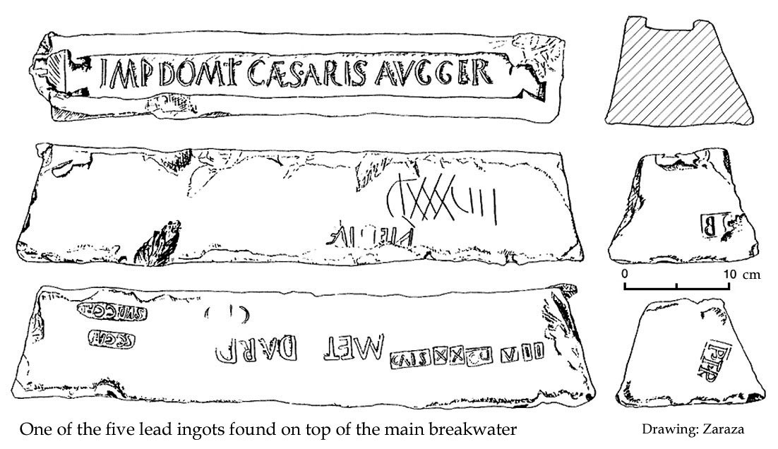
Ingot from the reign of Domitian, from Dardania (Moesia Superior). This one was found in Israel

Slide 16
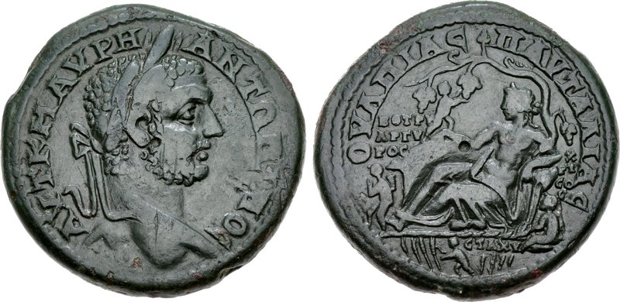
Allegory of civic mineral wealth? Pautalia, coin of Caracalla

Slide 17
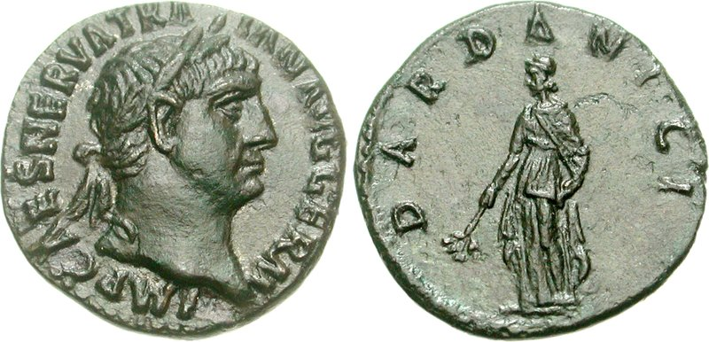
Coins of the mines

Slide 18
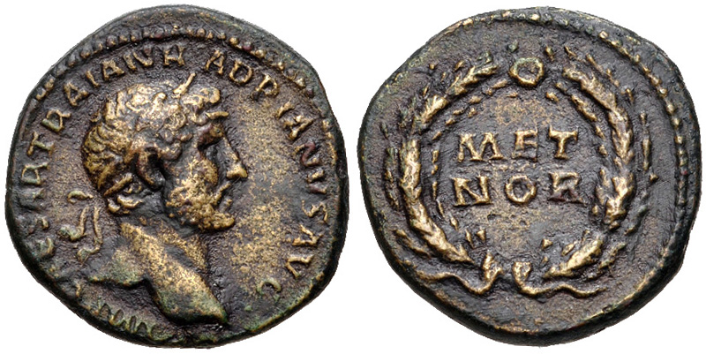

Slide 19
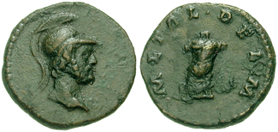
METAL DELM Mars / armour

