Slide 1
Other external trade

Slide 2
Two northwestern Indian ports not really explored:
Barbarikon
Barygaza

Slide 4
Barbarikon
Most northerly site mentioned in Greco-Roman sources. Not archaeologically investigated
Mouth of Indus, modern Pakistan
Port served royal capital of Minnagar (unlocated)
Indo-Parthians, Kushans

Slide 6
Barygaza (Bharuch)
Mentioned 29 times in Periplus
Treacherous approach – located at safe anchorage point – upriver, c. 30km from coast
The main port of the Western Satraps, who ruled from Ujjain
An important early ruler, Nahapana, is mentioned in the Periplus
Three routes: Bactria, Ganges valley, lower Krishna Valley
Long pepper, Himalayan nard, lapis lazuli, onyx, cotton cloth, as well as silks and ivory
Also manufacturing centre
Some survey work, but poorly published and a lot of medieval and modern occupation.

Slide 7
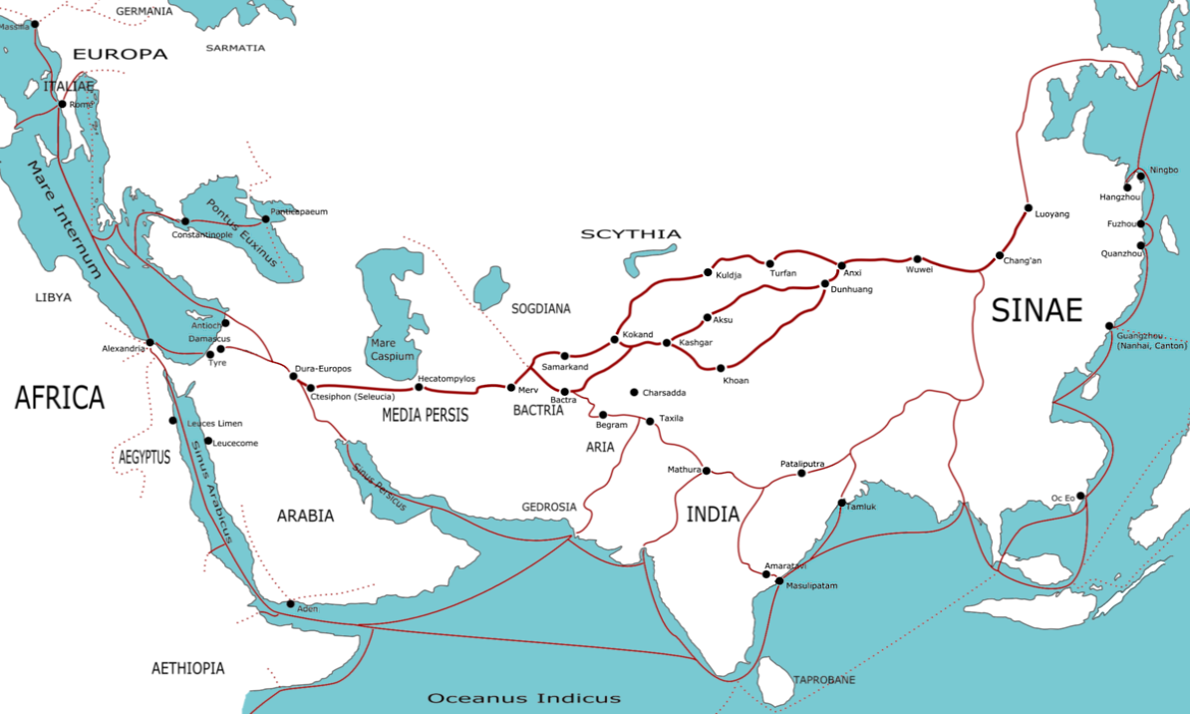
The Silk Road

Slide 8
The land route
A modern term
Seres = Silk People = Chinese?
Central Asia meeting point for major states (Seleucids + Parthians, Mauryans, Chinese)
References in Periplus and Ptolemy to Thina(e) or Sina = China?
Emperor Wu-Ti (140-87 BC); Xiongnu
Ta-Yuan = Great Ionians?
Parthian stations by Isidore of Charax
Parthian control of trade route

Slide 10
Isidore of Charax
A geographer of 1st century BC/AD, probably contemporary with Augustus
Parthian Stations/ Mansiones Parthicae
An itinerary of trade route from Antioch to India
Zeugma to Bactria on the silk route
Maes Titianus – had agents explore the route

