Slide 1
Trans-Saharan trade

Slide 2
Jarma (Garama)

Slide 5
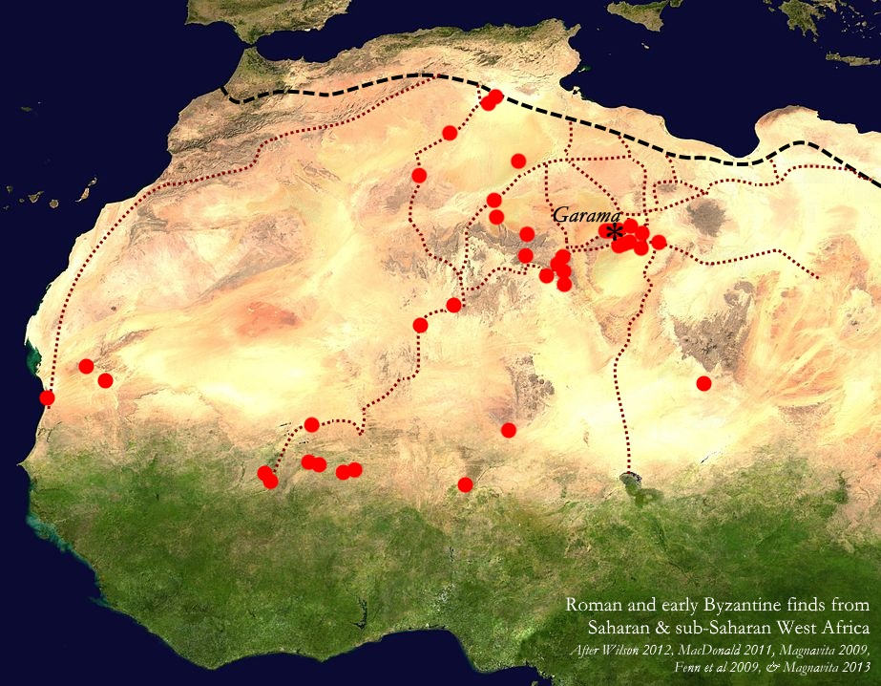

Slide 7
Aghram Nadharif

