Slide 1
Shipwrecks and trade

Slide 2
Parker’s graph

Slide 3
Roman barrel from Bar Hill on the Antonine Wall

Slide 4
Vatican obelisk, brought to Rome under Caligula

Slide 5
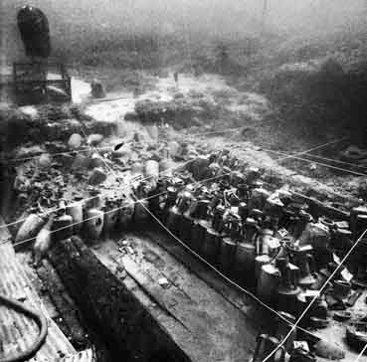
Madrague de Giens

Slide 6
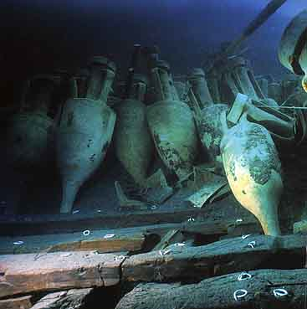
Dressel 1B

Slide 7
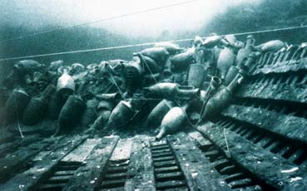

Slide 8
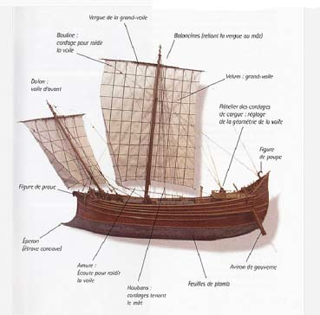
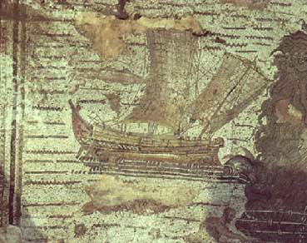

Slide 9
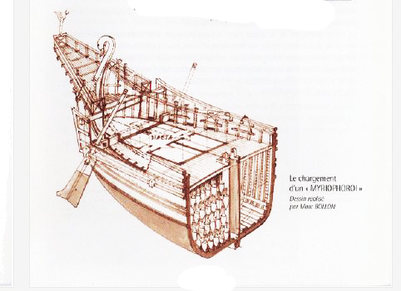

Slide 10
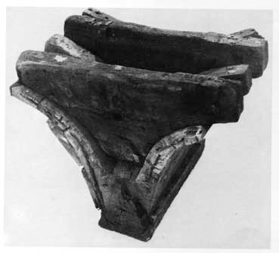
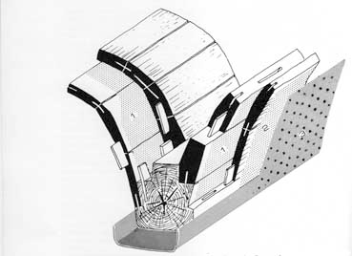

Slide 11
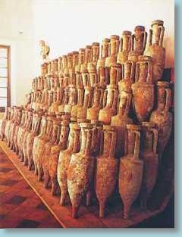
Albenga

Slide 12
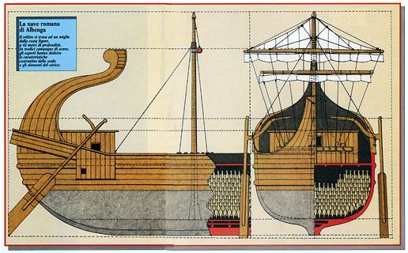

Slide 13
Skerki Bank shipwrecks

Slide 14
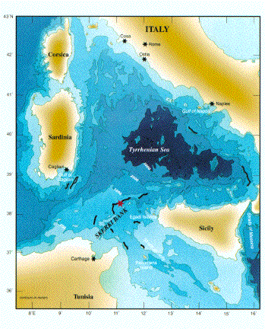

Slide 15
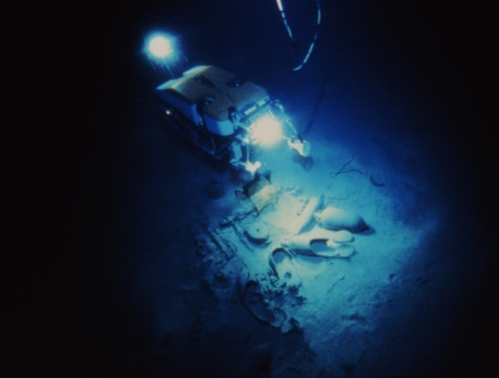
Rover JASON over the fourth century wreck nicknamed ‘Isis’

Slide 16
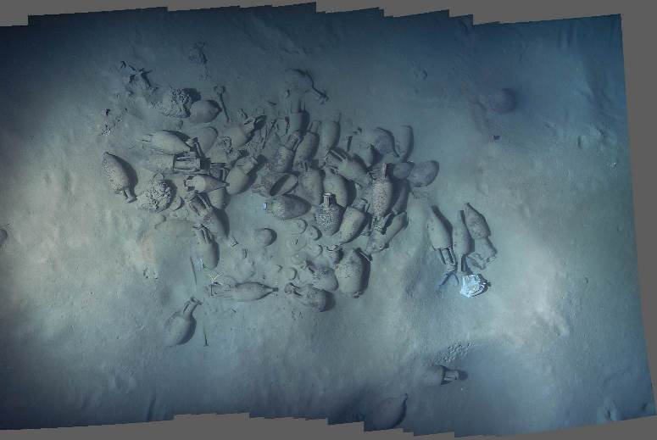
Skerki Wreck D

Slide 17
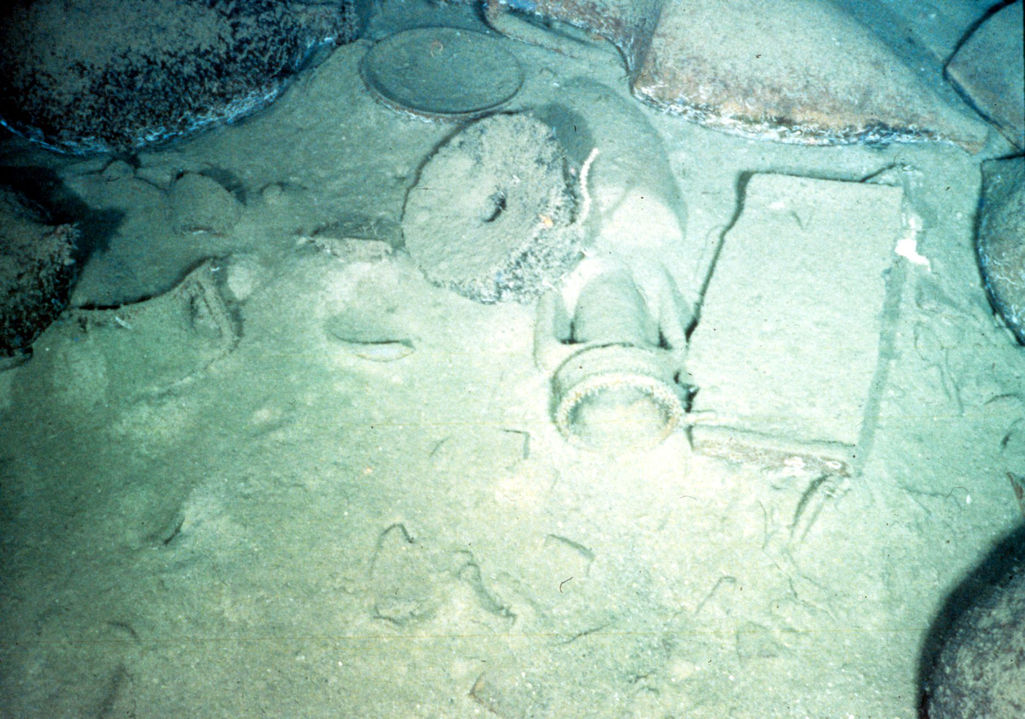
Wreck D: amphoras, mill stone and tile

Slide 18
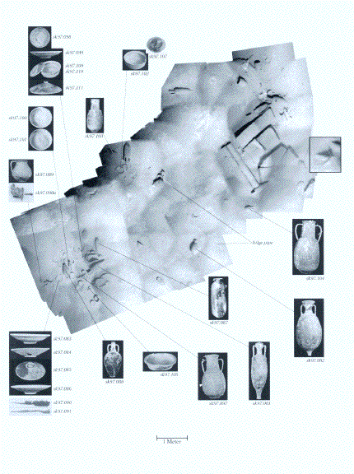
Wreck F

Slide 20
