Slide 1
The end of the Roman Near East

Slide 2
Sasanian dominion over the region produced a political and military discontinuity
Appeared to some contemporaries that the Apocalypse was near: Slav and Avar invasions of the Balkans, pillaging of Jerusalem, religious strife

Slide 3
The rise of Islam
During the period of the Persian wars, the followers of the Prophet Muhammad established themselves at Medina, gained control of Mecca and expanded religious and political dominance in the Arabian peninsula
In 629 Heraclius negotiated the Sasanian withdrawal from the Near East; a period of instability ensued
The same year a ‘Saracen’ army was defeated east of the Dead Sea
In 630 Heraclius restored the remains of the True Cross to Jerusalem, but Roman control of the south was not consolidated
The same year, Muslim control was established in former Roman bases and with the peoples around the Gulf of Aqaba; the Romans would probably have wanted to reestablish control here
Under the first Caliph, Abu Bakr, attacks on the southern part of the Roman Near East began
A Roman army defeated near Gaza, and Bostra surrendered to a force that had crossed the Syrian desert

Slide 4
The Battle of Yarmuk, AD 636
The Muslim forces then moved on to take Damascus and defeated a Ghassanid army
Heraclius mustered an army at Antioch
After numerous skirmishes the final battle came north of the Wadi Yarmuk on 20 August 636
The Roman defeat was absolute
Heraclius decided to evacuate the Near East and consolidated a boundary along the Taurus mountains

Slide 5
The end of Roman Mesopotamia
Coastal ports remained in Roman hands for a while, but after about five years most had surrendered
The Roman governor in Mesopotamia reached an agreement with the Muslim armies that they would not invade if he paid them tribute, but Heraclius refused to accept
The Muslim forces then took Mesopotamia between 638 and 640 and moved on to Armenia
Heraclius died in 641

Slide 6
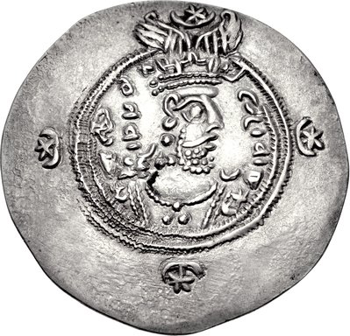
The end of the Sasanian empire
After Khusrau’s defeat the empire plunged into crisis
Without the Lakhmids to fight for them, Muslim armies overwhelmed the Sasanian army at al-Hira in 637 and lost Iraq
The last Sasanian king, Yazdgard III, fled to Iran but was defeated again and assassinated
Muslim armies established control over much of the Sasanian empire

Slide 7
Other factors in the conquest
Sixth century plagues, earthquakes, famines
Some cities only partly restored after earthquakes: erosion of traditional civic government? But some restoration took place
Sasanians deported some of the population to their own empire
The Justinianic plague broke out several times in the sixth and seventh centuries, further reducing the population (but was this only short term?)
Two civil wars: Phocas against Maurice; Heraclius against Phocas
Army units reluctant to campaign away from home

Slide 8
Pressure from powerful local elites to devolve control to regional interests, which did not always operate in the interests of Constantinople
Sectarian conflicts: From Justinian onwards a strong drive to Christianise the empire, with persecutions of Jews, pagans, heretical Christian sects
The lack of resistance to Muslim forces from the cities: evidence that the inhabitants no longer strongly identified with the empire?
The Arab tribes, although Christian, had other cultural things in common with the Muslim forces

Slide 9
Economic factors?
Tradional studies have emphasised looting and booty, but the old economic centres do not have appeared to have suffered
The nomadic peoples of Arabia had depended on the economy of the settled areas by participating in the long-distance trade in luxuries
The decline of cities decreased demand, causing an economic crisis among these peoples
Islam gave these peoples a cohesion that enabled them to gain control of the economic centres
By appropriating these centres they could attempt to revitalise them

Slide 10
Continuity
The Syrian navy employed by the Muslim forces gained mastery of much of the eastern Mediterranean
The Umayyad dynasty established in 661, with its political capital at Damascus
Cities of Umayyad Syria seem to have prospered, in contrast to Roman cities in Asia Minor
The countryside remained productive and densely populated
In the desert the Umayyads developed the Roman techniques of irrigation

Slide 11
But the Umayyads also borrowed from Sasanian traditions, with whom many of their values converged (tradition of warrior kings and nobles, court poetry)

