Slide 1
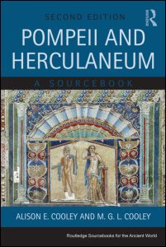
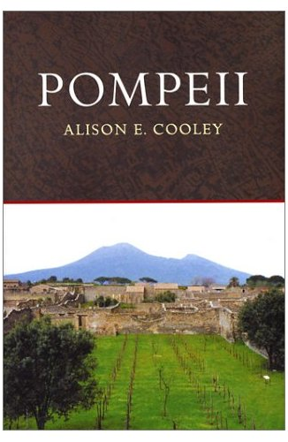
The stones of Pompeii tell tales
Warwick Classics Network – Ancient Worlds Study Day
Prof Alison Cooley, University of Warwick

Slide 2
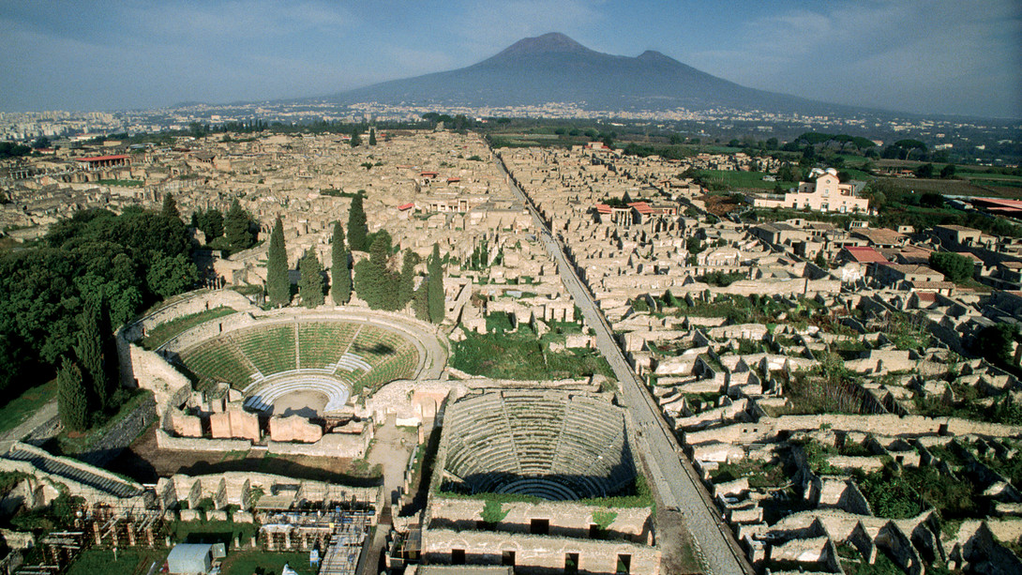

Slide 3
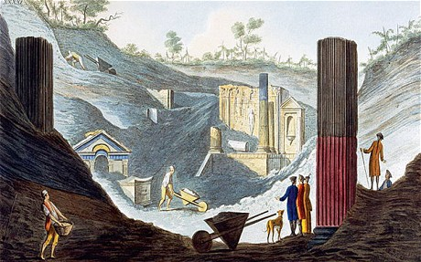
Excavation of the
Temple of Isis in the 18th century

Slide 4
The political career of Marcus Holconius Rufus

Slide 5
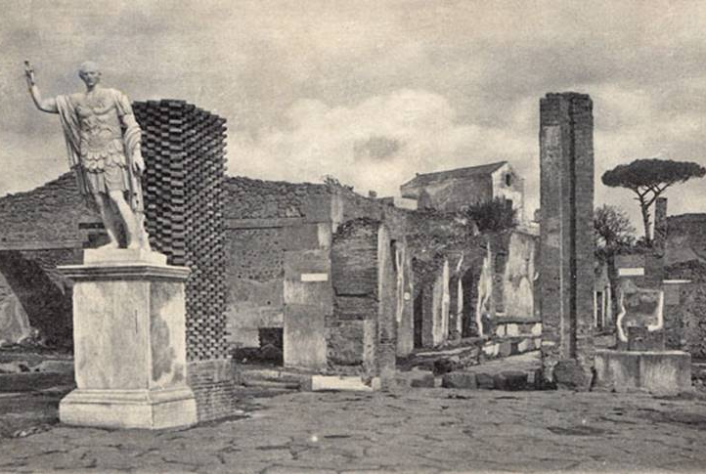
Statue outside Stabian Baths, c.1900

Slide 6
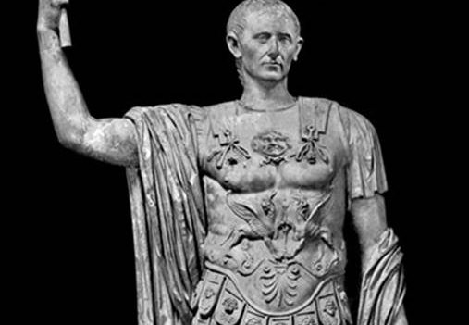

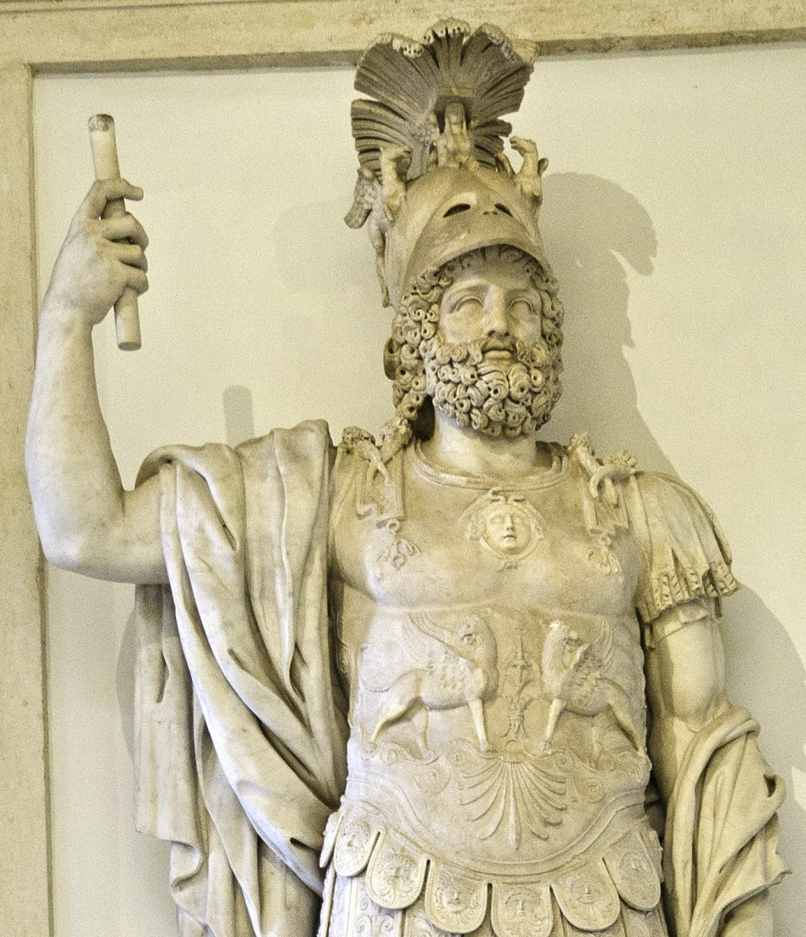
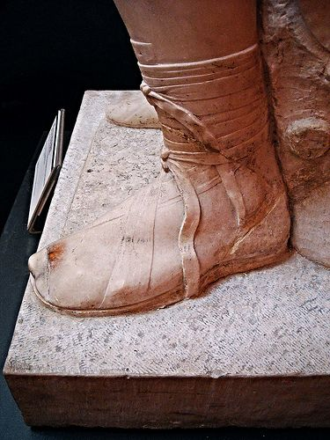

Slide 7
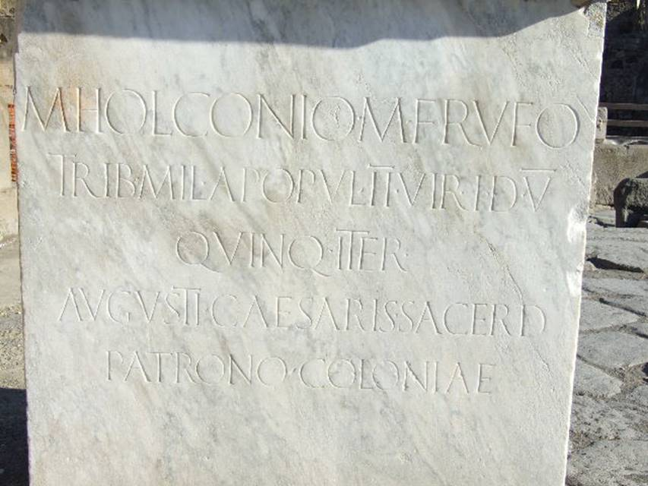
Marcus Holconius Rufus
[CIL X 830: Cooley + Cooley sourcebook F93b]
To Marcus Holconius Rufus, son of Marcus, military tribune by popular demand, duumvir with judicial power five times, quinquennial twice, priest of Augustus Caesar, and patron of the colony.

Slide 8
Modifications to Temple of Apollo
CIL X 787 = Cooley and Cooley Sourcebook E1
Marcus Holconius Rufus, duumvir with judicial power for the third time and Gnaeus Egnatius Postumus, duumvir with judicial power for the second time, in accordance with a decree of the town councillors paid 3,000 sesterces for the right to block off light, and saw to the building of a private wall belonging to the colonia Veneria Cornelia as far as the roof.

Slide 9
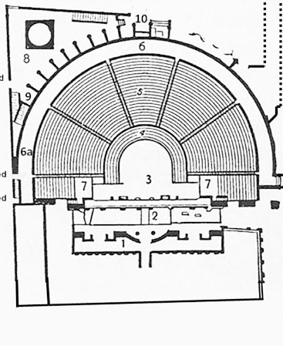
Redesigning the Theatre
Marcus Holconius Rufus and Marcus Holconius Celer built at their own expense the crypt, boxes and theatre seating
[CIL X 833-34; Cooley & Cooley, Sourcebook D54]

Slide 10
The priestess Eumachia

Slide 11
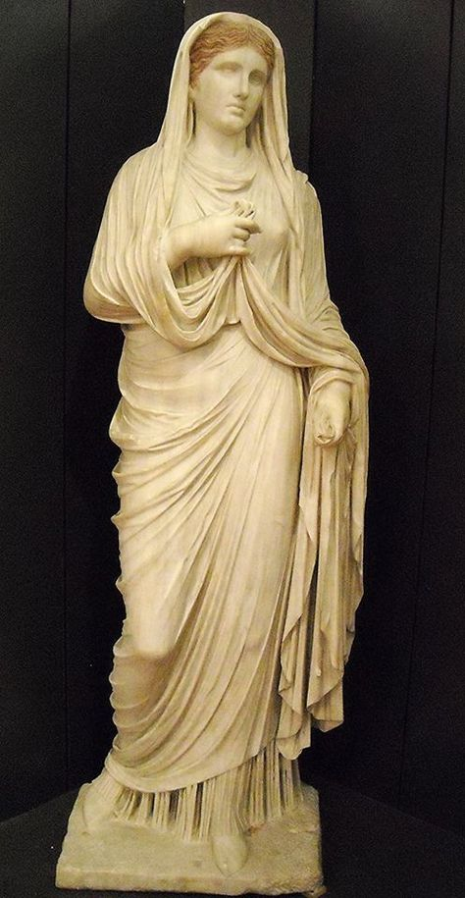
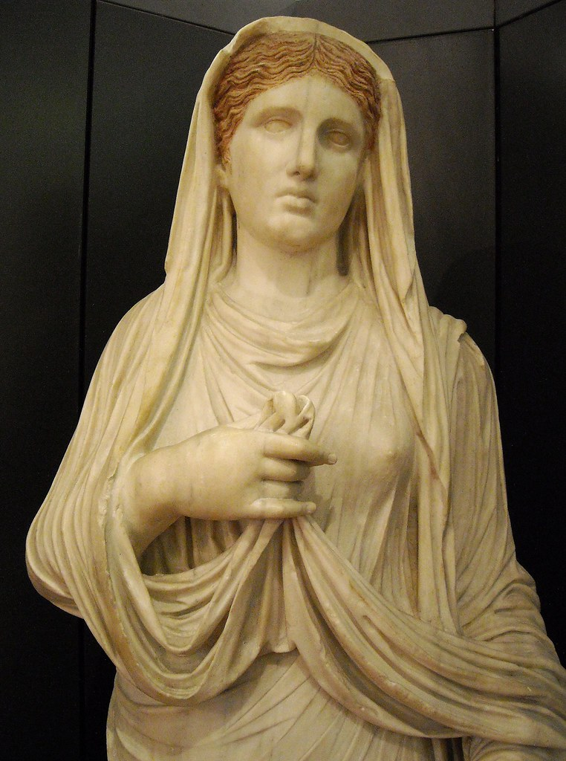

Slide 12
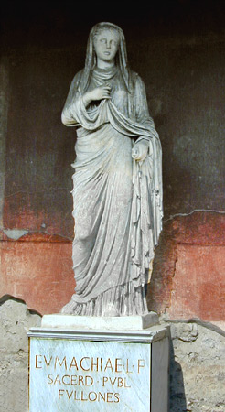
Statue of Eumachia
[CIL X 813; Cooley and Cooley, Sourcebook E57]
To Eumachia, daughter of Lucius, public priestess; the fullers set this up.

Slide 13
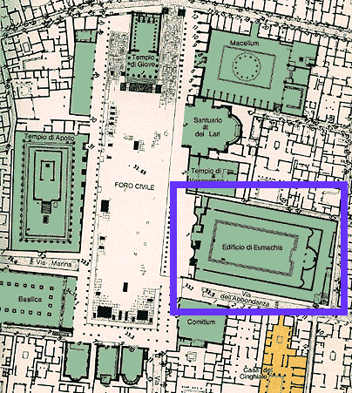
Pompeii - Forum
Notes:
http://www.indiana.edu/~leach/c414/net_id/pompeii/forum/eumachia.gif

Slide 14
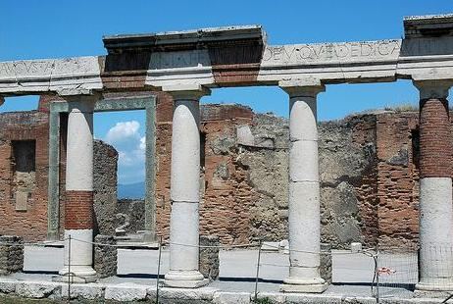
Eumachia’s Building, from forum

Slide 15
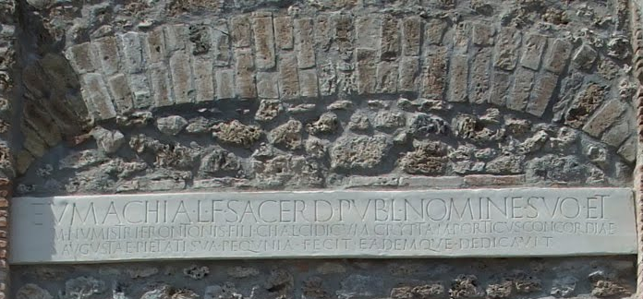
Dedicatory inscription, rear entrance
Eumachia, daughter of Lucius, public priestess, in her own name and that of her son, Marcus Numistrius Fronto, built at her own expense the chalcidicum, crypt and portico in honour of Augustan Concord and Piety and also dedicated them.

Slide 16
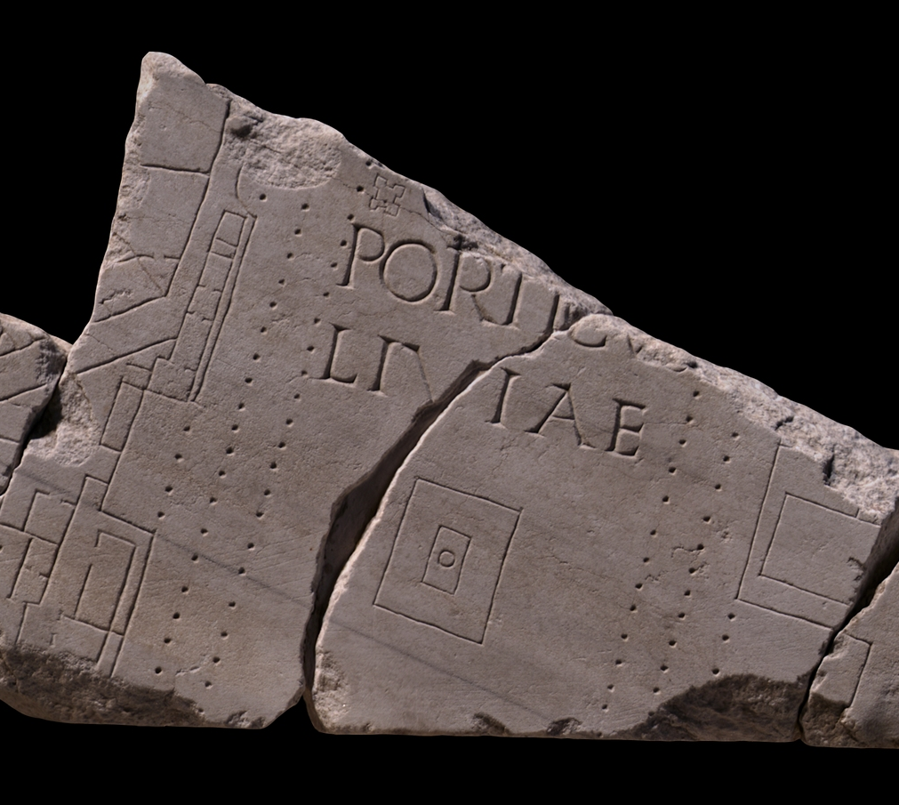
Eumachia’s Building: Porticus Liviae

Slide 17

The Umbricii and their commercial enterprise

Slide 18
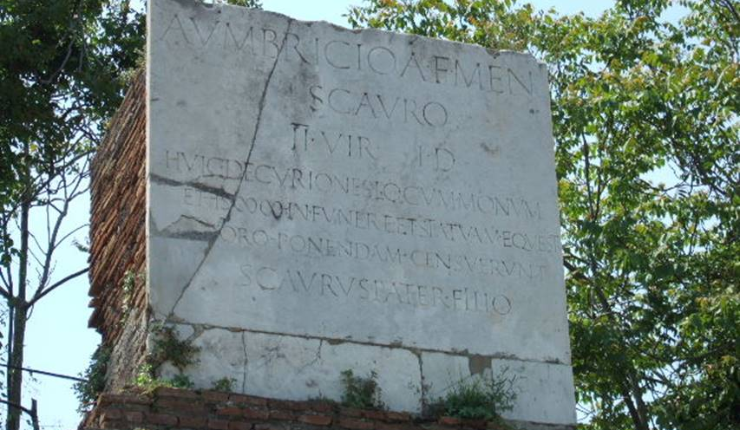
Tomb of Umbricius Scaurus
[CILX 1024, Cooley & Cooley Sourcebook F107]
To Aulus Umbricius Scaurus, son of Aulus, of the Menenian voting-tribe, duumvir with judicial power. The town councillors voted for him a site for his monument, 2,000 sesterces for his funeral, and an equestrian statue to be set up in the forum. His father, Scaurus, dedicated this to his son.

Slide 19
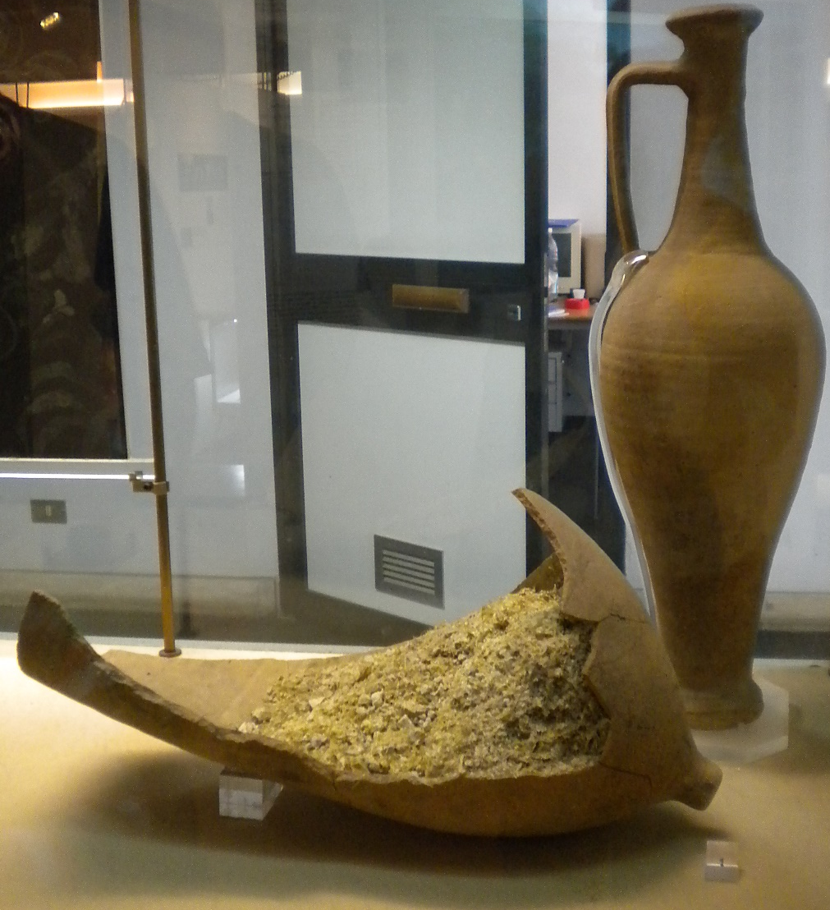
Garum jar

Slide 20
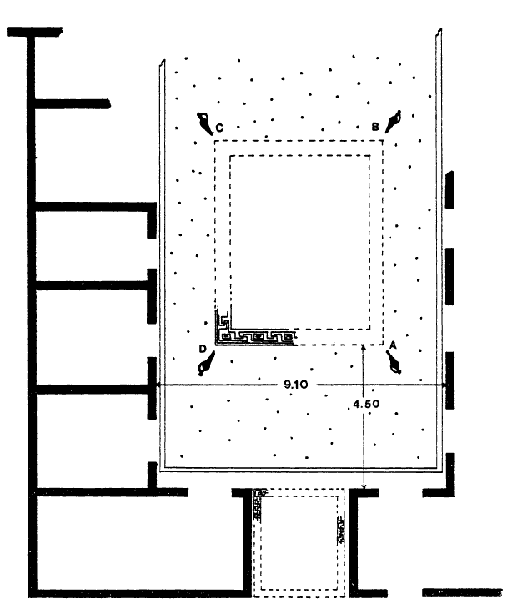
House of Umbricius Scaurus
atrium
impluvium
Mosaics
Notes:
Curtis p.560

Slide 21
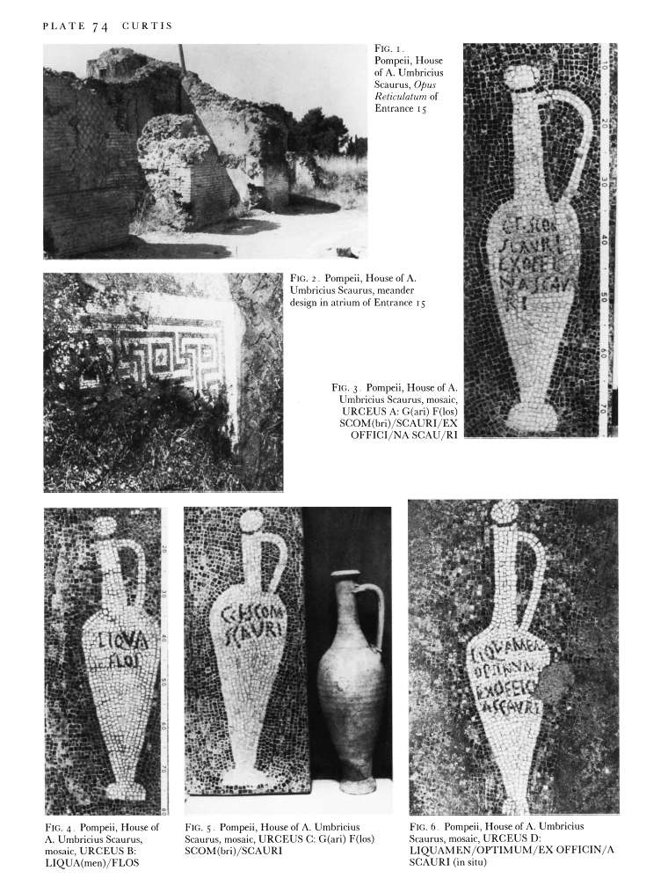
Mosaic adverts

Slide 22
A new life-story

Slide 23
New tomb outside Stabian Gate
New tomb outside Stabian Gate
Discovered in 2017
Stabian Gate
M. Tullius

Slide 26
Inscription from Stabian Gate tomb
This man, on the day he assumed his adult toga, gave a banquet to the people of Pompeii on 456 dining-couches in such a way that 15 people reclined on each couch.
He gave a gladiatorial show that was on such a large scale and so splendid that it ought to have been bestowed by someone from Rome upon the most distinguished colony, as one might expect when he had 416 gladiators in his training-school.
And since his gladiatorial show had coincided with a shortage of grain, on account of which he fed them for 4 years, his concern for his fellow citizens was stronger than that for his patrimony; for when a measure of wheat was valued at 20 sesterces, he bought it up and made it available to the people for 6 sesterces and, so that this generosity of his should reach everyone, he distributed to the people individually through his own friends a weight of baked bread worth up to 6 sesterces.

Slide 27
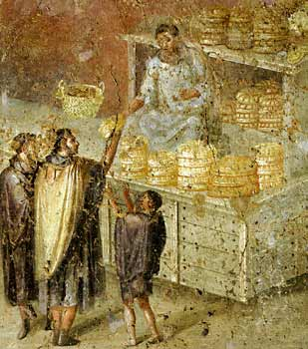
Bread distribution

Slide 28
Inscription from Stabian Gate tomb
In the gladiatorial show of his that he put on before the resolution of the senate, on all the days of the preliminary bouts and on the day of the pairing of the gladiators, he provided beasts of all kinds without distinction for the wild beast hunts.

Slide 29
Riot in the Amphitheatre
D39 A narrative of the riot
At around the same time, there arose from a trifling beginning a terrible bloodbath amongst the inhabitants of the colonies of Nuceria and Pompeii at a gladiatorial show given by Livineius Regulus, whose expulsion from the senate I have recorded previously. Inter-town rivalry led to abuse, then stone-throwing, then the drawing of weapons. The Pompeians in whose town the show was being given came off the better. Therefore many of the Nucerians were carried to Rome having lost limbs, and many were bereaved of parents and children. The emperor instructed the senate to investigate; they passed it to the consuls. When their findings returned to the senators, the Pompeians were barred from holding any such gathering for ten years. Illegal associations in the town were dissolved; Livineius and the others who had instigated the trouble were exiled.
Tacitus, Annals 14.17

Slide 30
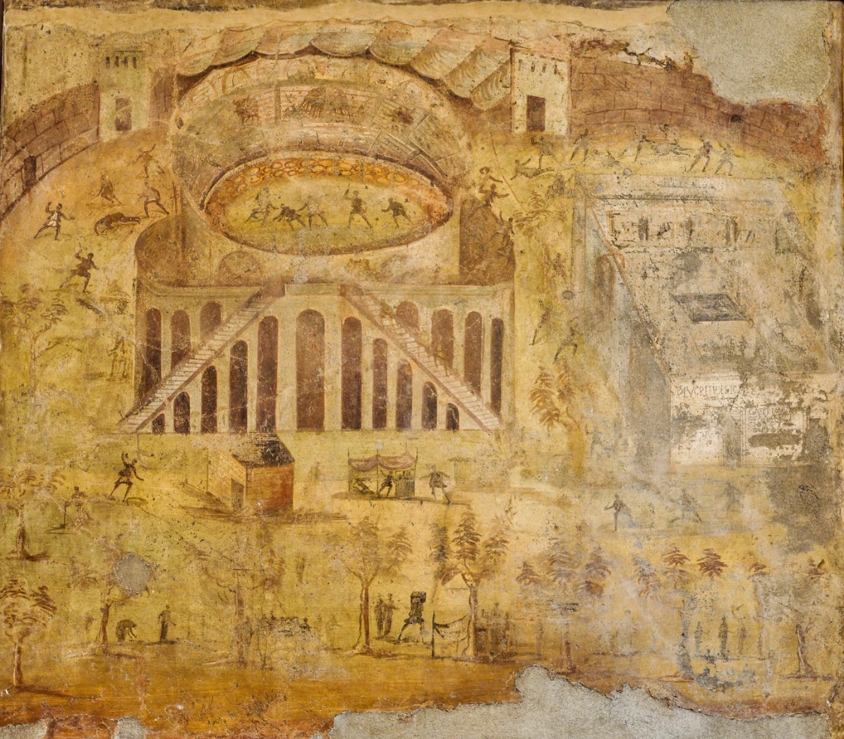
Riot in the Amphitheatre

Slide 31
Inscription from Stabian Gate tomb
And when Caesar had ordered that they remove all their gladiatorial troupes beyond the 200th milestone from the City, to this man alone he granted permission to bring back his own troupe to his hometown of Pompeii.
The same man, on the day he married his wife, gave to each town councillor 50 sesterces, to the people he gave 4 sesterces each, for the Augustales and pagani 20 sesterces each.
Twice he produced largescale games without any financial burden to the community.
Because of these deeds, with the people demanding it, when the entire town council agreed that he should be co-opted as a patron and the chief magistrate was making the formal proposal, he himself intervened as a private citizen, saying that he would not bear the idea that he be a patron of his own fellow citizens.

Slide 32
The gladiatorial troupe of Alleius Nigidius Maius
D28 Games for the well-being of the imperial family, AD 70-79
For the well-being of the [emperor Vespasian] Caesar Augustus and of his children, [and on account of the] dedication of the altar, [the gladiatorial troupe] of Gnaeus [All]eius Nigidius Maius, priest of Caesar Augustus, will fight at Pompeii, without delay, on 4th July. There will be a hunt and awnings.

