Slide 1

The wow of narrative Dr. David Fearn
Lyric Snapshots

Slide 2
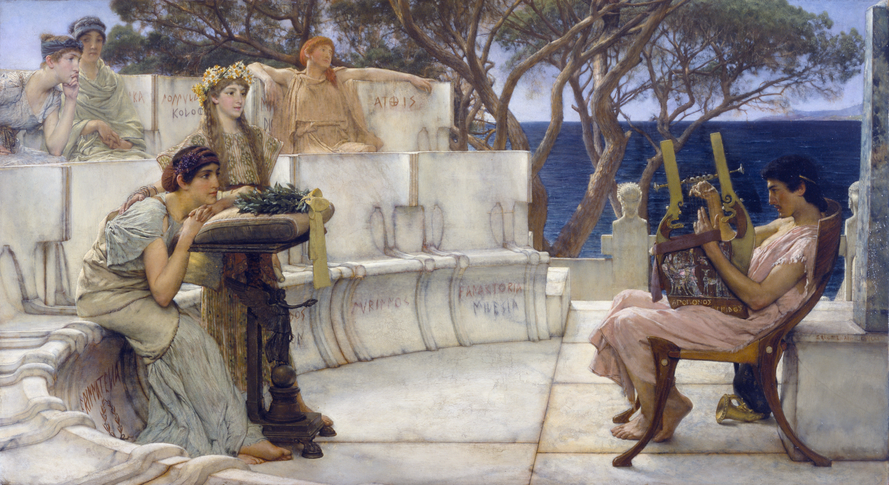
]βλα ̣[
]εργον, ̣ ̣ λ’α ̣ ̣[
]ν ῤέθοϲ δοκιμ̣[
]ηϲθαι
]ν̣ αὐάδην χ ̣[
δ]ὲ μή, χείμων[
] ̣οιϲαναλγεα ̣[
]δε
̣] ̣ε ̣[ ̣ ̣ ̣ ̣] ̣[ ̣ ̣ ̣ κ]έλομαι ϲ’ ἀ[είδην
Γο]γγύλαν [Ἄβ]ανθι λάβοιϲαν ἀ ̣[
πᾶ]κτιν, ἆϲ ϲε δηὖτε πόθοϲ τ ̣[
ἀμφιπόταται
τὰν κάλαν· ἀ γὰρ κατάγωγιϲ αὔτα[ϲ ϲ’
ἐπτόαιϲ’ ἴδοιϲαν, ἐγὼ δὲ χαίρω·
καὶ γὰρ αὔτα δήπο[τ’] ἐμεμφ[ετ’ ἄγνα
Κ]υπρογέν[ηα
ὠς ἄραμα[ι
τοῦτο τὦ[ποϲ
β]όλλομα[ι
]
]work
]face
]
]
if not, winter
]no pain
]
]I bid you sing
of Gongyla, Abanthis, taking up
your lyre as (now again) longing
floats around you,
you beauty. For her dress when you saw it
stirred you. And I rejoice.
In fact she herself once blamed me
Kyprogeneia
Because I prayed
this word:
I want
(Trans. Anne Carson, If Not, Winter: Fragments of Sappho)
If Not, Winter: Sappho fragment 22 Snapshots of desire

Slide 3
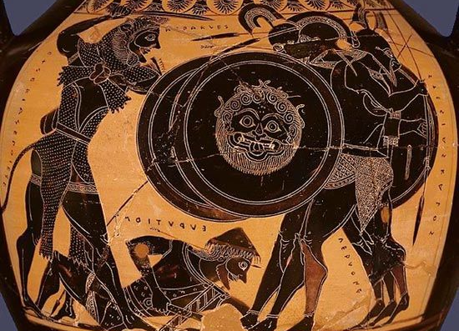
Stesichorus, Geryoneis fragment 19.31–47
]ων̣ στυγε[ρ]οῦ
θανάτοι]ο τ̣έ̣[λος
κ]ε̣φ[αλ]ᾶι πέρι̣ [ ] ἔ̣χων, πεφορυ-
[γ]μένος αἵματ[ι ]ι̣ τε χολᾶι,
<——————>
ὀ̣λεσάνορος αἰολοδε[ίρ]ου 35
ὀδύναισιν Ὕδρας· σιγᾶι δ’ ὅ γ’ ἐπι-
κλοπάδαν [ἐ]νέρεισε μετώπωι·
διὰ δ’ ἔσχισε σάρκα [καὶ] ὀ̣[στ]έ̣α δαί-
μονος αἴσαι·
διὰ δ’ ἀντικρὺ σχέθεν οἰ[σ]τ̣ὸς ἐπ’ ἀ- 40
κροτάταν κορυφά̣ν,
ἐμίαινε δ’ ἄρ’ αἵματι πο̣ρ̣φ̣[υρέωι
θώρακά τε καὶ βροτό̣ε̣ντ̣[α μέλεα.
——————
ἀπέκλινε δ’ ἄρ’ αὐχένα Γ̣α̣ρ̣[υόνας
ἐπικάρσιον, ὡς ὅκα μ[ά]κ̣ω̣[ν 45
ἅτε καταισχύνοισ’ ἁπ̣α̣λ̣ὸ̣ν̣ [δέμας
αἶψ’ ἀπὸ φύλλα βαλοῖσα̣ ν̣[
A poppy spoiled; an epic narrative transformed
(Heracles attacks Geryon): the effect of the arrow
... (the arrow, bringing) the end that is frightful death, with (doom) on its tip, stained with (bitterest?) blood and gall …,
with the agonies of the man-slaying, writhing-necked Hydra. In silence and through stealth (the arrow) forced its way through his forehead, and it split through the flesh and bones, according to divine dispensation. The arrow went straight through to the very top of the head, and stained with crimson blood his breastplate and gory limbs;
and Geryon drooped his neck to one side, like a poppy spoiling its delicate body suddenly sheds its petals…

Slide 4
The wow of narrative Prof. Victoria Rimell
Martial’s
‘On Spectacles’

Slide 5
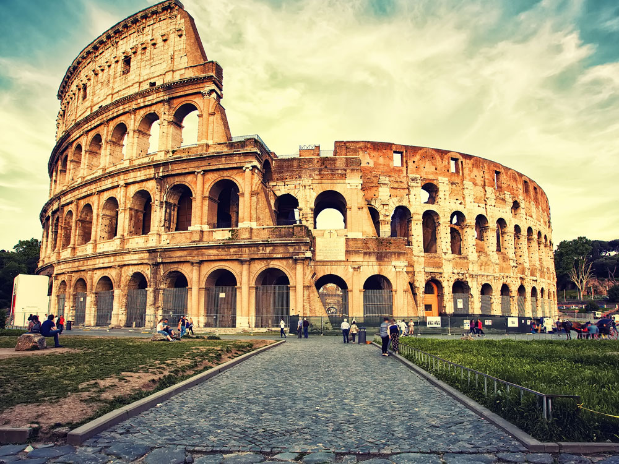
De spectaculis
Martial’s debut ‘little book’ (libellus), composed to accompany the opening of the Colosseum in 80AD

Slide 6
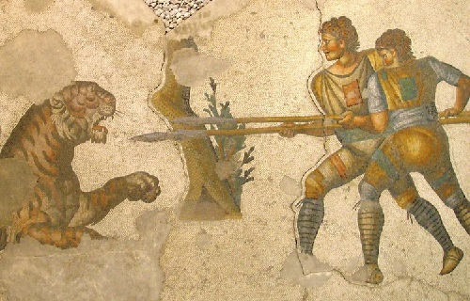
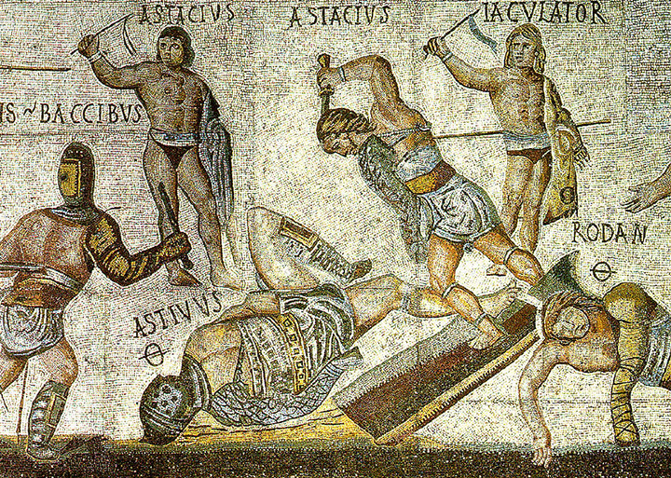
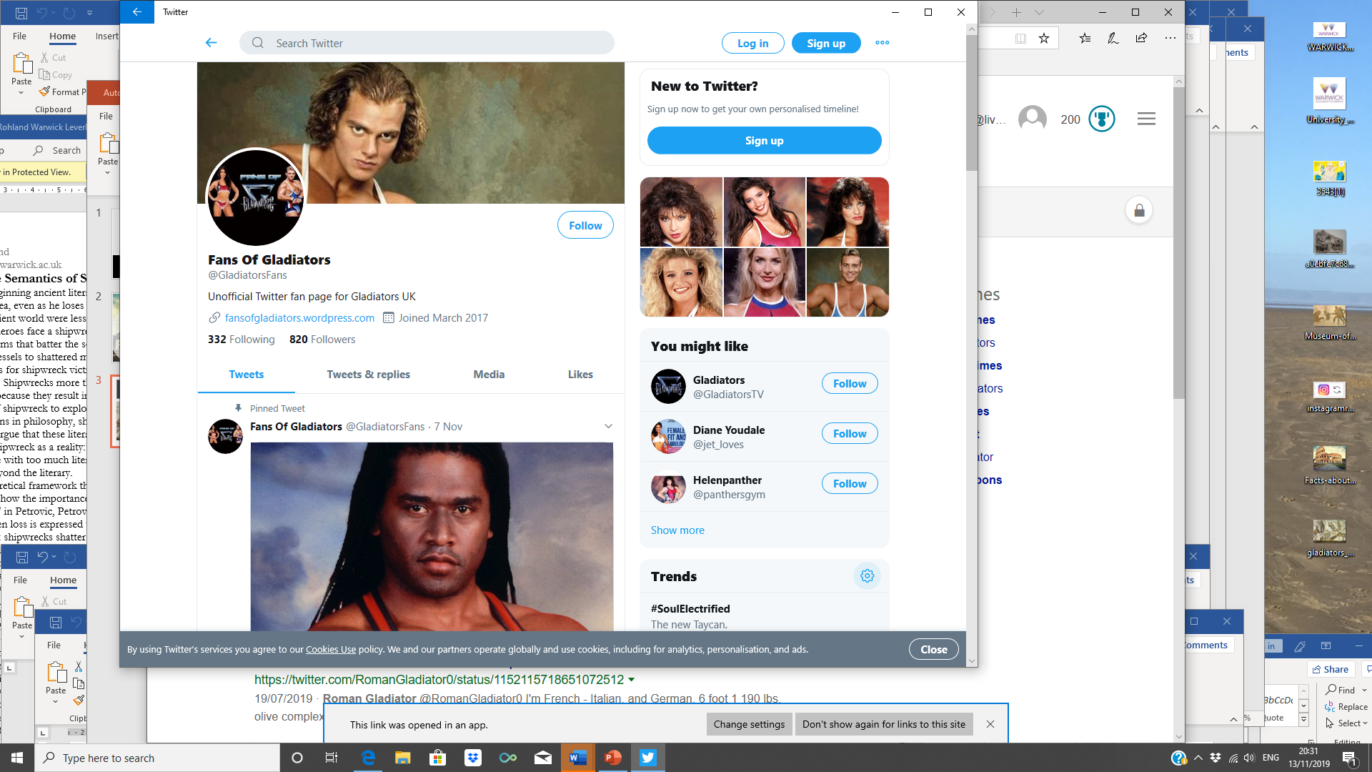
‘What was once a story became a punishment’

Slide 7
Prostratum uasta Nemees in ualle leonem nobilis Herculeum fama canebat opus. Prisca fides taceat: nam post tua munera, Caesar, hoc iam feminea uidimus acta manu.
The lion, laid out flat in Nemea’s huge valley - noble fame
used to sing of this, the work of Hercules.
But let ancient testimony be silent: for after your shows, Caesar,
we have now seen such things done by a female hand.
de spectaculis 8

Slide 8
As Prometheus, bound on the Scythian rock,
fed the tireless bird with his too-abundant chest,
so did Laureolus, hanging on no fake cross,
offer up his guts to a Caledonian bear.
His torn limbs lived on, dripping gore,
and in all his body, body there was none.
In the end, he got the punishment he deserved; he’d
stuck a sword into the neck of his father or master,
or he’d robbed a temple of its secret gold,
or laid a cruel torch to you, Rome.
The villain had outdone the crimes of ancient tales,
and what was once a story became an punishment.
de spectaculis 9
Qualiter in Scythica religatus rupe Prometheus adsiduam nimio pectore pauit auem, nuda Caledonia sic uiscera praebuit urso non falsa pendens in cruce Laureolus. Viuebant laceri membris stillantibus artus inque omni nusquam corpore corpus erat. Denique supplicium dignum tulit: ille parentis uel domini iugulum foderat ense nocens, templa uel arcano demens spoliauerat auro, subdiderat saeuas uel tibi, Roma, faces. Vicerat antiquae sceleratus crimina famae, in quo, quae fuerat fabula, poena fuit.

