Slide 1
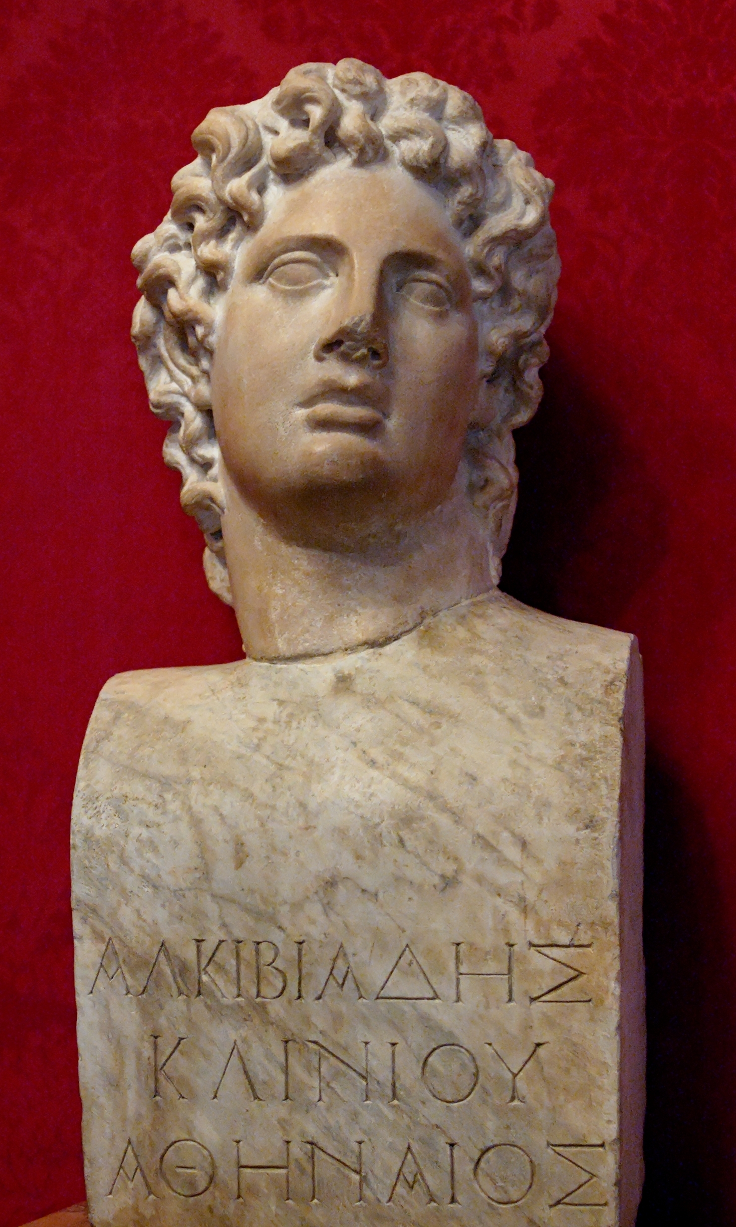


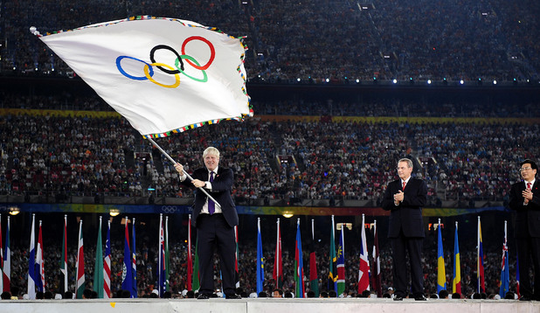
Athletic politics - Alcibiades and Athenian performance culture
Professor David Fearn
JUMPING THE SHARK IN 416BC?

Slide 2
• The history of competitiveness
Homer, Iliad: 6.208 (Glaucus to Diomedes) = 11.784 (Nestor about Achilles):
aei aristeuein kai huperokhon emmenai allôn: ‘Always to excel and to surpass all others’

Slide 3
• Specific details about fifth-century BC competition, success, and celebration
• Focusing on the relation between individuals, wealth, and Athens as a democracy
• Centering around Alcibiades
• and Athenian rhetoric
• and Athenian material culture
To investigate: what do we learn from the 416 Olympics?

Slide 4
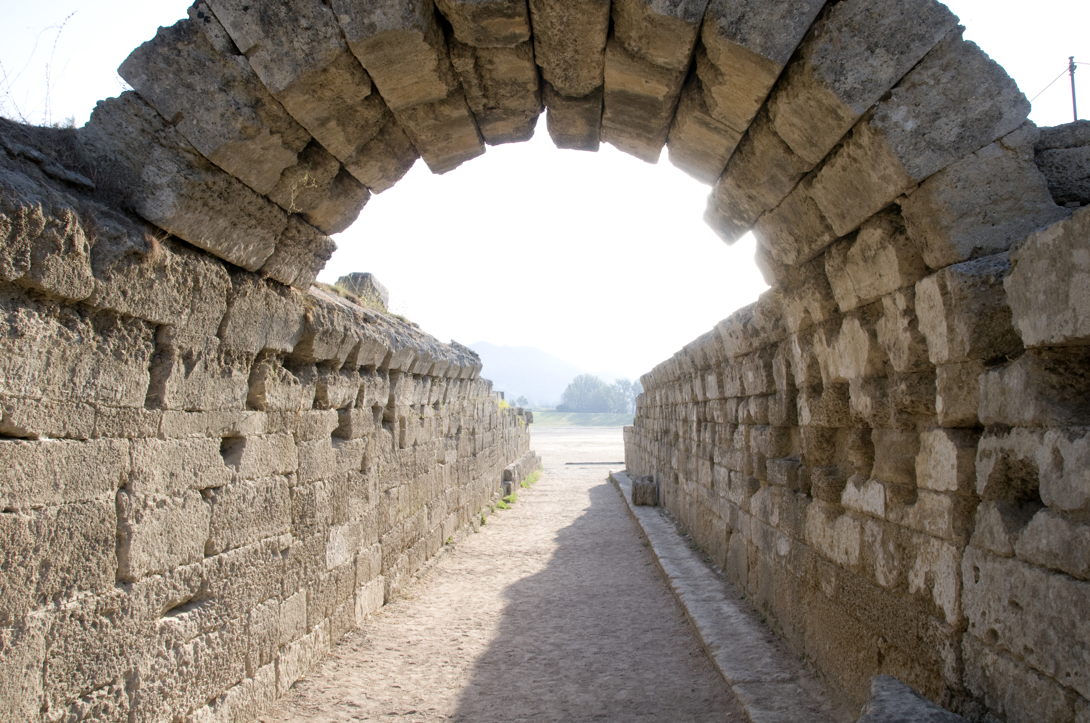
• Olympia
Notes:
Olympia. MENTION SPORTING EVENTS

Slide 5
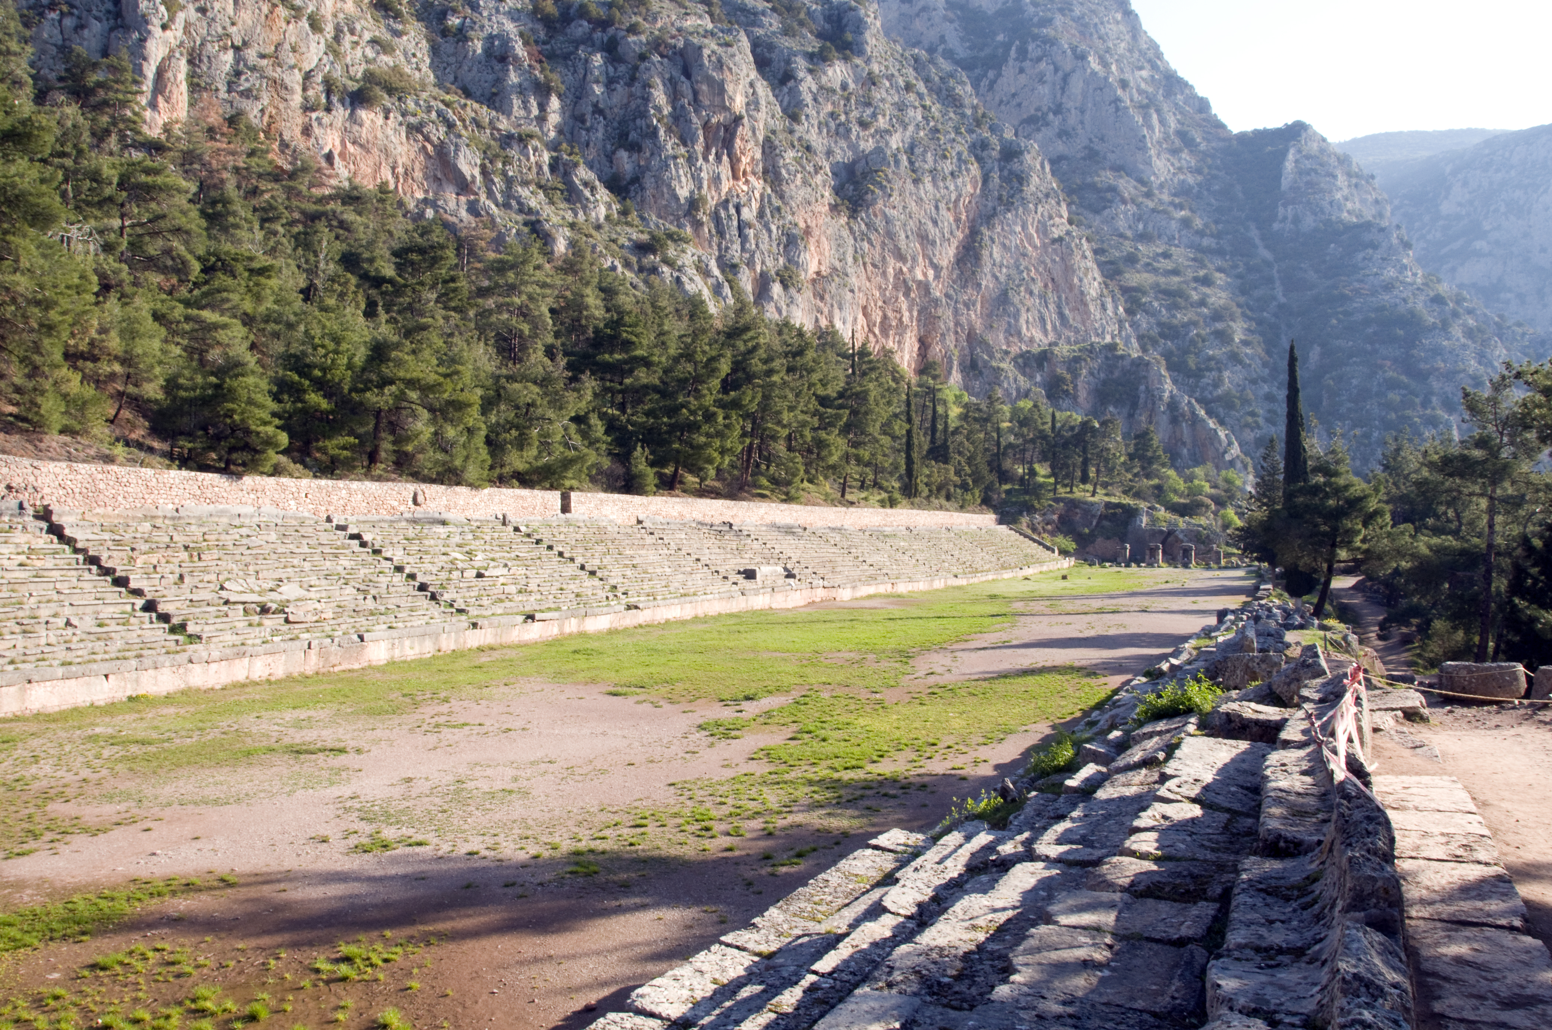
Delphi

Slide 6
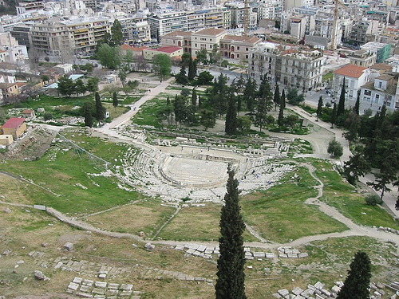
• Theatre of Dionysus, Athens

Slide 7
Some Key Terms
followed by timelines interspersed with evidence
Tethrippon - four-horse chariot team
Liturgy (leitourgia) - public service performed by wealthy individual in democratic Athens
Including, among others:
Chorêgos - private sponsor of state choruses
Architheôros - private sponsor of state pilgrimages to religious sanctuaries like Olympia
Choregic monument - monument in Athens erected at private expense to display the tripod won in choral competitions following the birth of democracy.

Slide 8
Timeline
486 BC
Megacles of Athens, maternal grandfather of Alcibiades, ostracised, but then victorious in Delphic four-horse chariot race (tethrippon), celebrated by Pindar in Pythian 7
c. 451 BC
Birth of Alcibiades, Athenian statesman and general
448-420BC
Spartan dominance in Olympic four-horse chariot race
431-404 BC
Peloponnesian War between Athens and Sparta (and respective allies)

Slide 9
Evidence, in chronological order
Pindar, Pythian 7
For Megacles of Athens, winner, tethrippon, 486BC
The great city of Athens is the fairest prelude
To lay down as a foundation for songs to honour
The mighty race of the Alcmaeonids for their horses.
For what fatherland, what house can you inhabit and name
With a more illustrious
reputation in Greece?
None, for among all cities travels the report
About Erechtheus’ citizens…. (lines 1-10)

Slide 10
Timeline
421-414BC
so-called ‘Peace of Nicias’, a Cold War cessation of formal hostilities between Athens and Sparta
420 BC
though Sparta officially banned from competing at Olympics, Lichas entered and won tethrippon as a private citizen using the Boeotians’ ‘public chariot’
416 BC
Alcibiades enters 7 teams in the Olympic tethrippon, and comes 1-2-3 (Euripides), or 1-2-4 (Thucydides); celebrations inc. a victory ode by ?Euripides (if original)
? 415
[Andocides] 4, ‘Against Alcibiades’, Athenian private prosecution speech attacking Alcibiades for his public and private failings

Slide 11
Euripides’ victory ode: fr. 755 PMG
(if genuine and contemporary)
I wonder at you, son of Clinias.
Fine is the victory, but the finest is,
which no other of the Hellenes has achieved,
to run first and second and third with
the chariot, and to go effortlessly, crowned with
Zeus’ olive, to give the shout to the herald.
[+ possible additional lines:
‘for a happy man it is necessary in the first place to have a city of noble renown.’]

Slide 12
[Andocides] 4, ‘Against Alcibiades’
[29]. In order to make it clear, however, that Alcibiades was insulting (hubrizôn: also with a sense of outrageous violence beyond usual norms) Athens as a whole in addition to Diomedes, he asked the Athenian architheôroi to lend him the processional vessels, alleging that he intended to use them for a celebration of his victory on the day before the sacrifice; he then abused the trust placed in him and refused to return them, as he wanted to use the golden basins and censers next day before Athens did so. Naturally, when those strangers who did not know that they belonged to us saw the state procession taking place after that of Alcibiades, they imagined that we were using his vessels…
[30] For Alcibiades the people of Ephesus erected a Persian pavilion TWICE AS LARGE as that of our official delegation (diplasian tês dêmosias).
TWO RELEVANT CLAIMS HERE:
1) confusion between Alcibiades’ personal ritual acts and Athenian state ones at Olympia;
2) Alcibiades’ Olympic pavilion twice the size of the Athenian state one

Slide 13
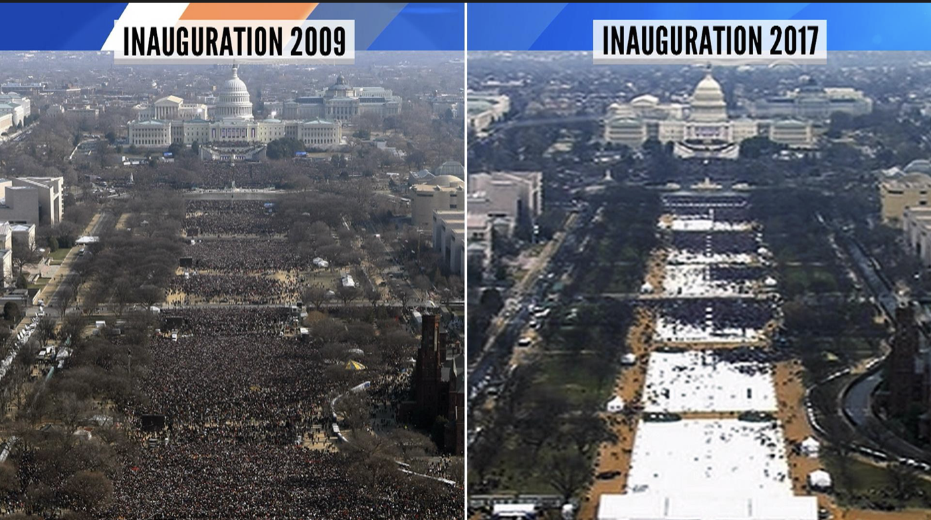
Even if we don’t trust rhetoric about public performances 100%, its existence is interesting…

Slide 14
Timeline
Last years of C5 BC
Thucydides, History of the Peloponnesian War
404 BC
Alcibiades murdered in Phrygia
c397 BC
Isocrates 16, ‘Concerning the Team of Horses’
inc. detailed account of Alcibiades’ role in Athens’ imperial demise in Peloponnesian War / doomed Sicilian expedition
Defence speech for Alcibiades’ son (also named Alcibiades) defending his father’s posthumous reputation against the claims of the prosecution (Tisias seeking 5 talents’ compensation for his unpaid role in the 416 success) ~ cost of 7 chariot-teams = 35 talents?? (wealth of Hipponicus, richest man in Greece, father of Alcibiades’ wife Hipparete - note the horse-y names… - estimated at 200 talents)

Slide 15
Thucydides on Alcibiades
Thucydides 6.15 & 16 (415BC: the debate about the, in retrospect doomed, Sicilian expedition)
6.15 The most ardent supporter of the Sicilian expedition was Alcibiades, the son of Clinias. He wanted to oppose Nicias, with whom he had never seen eye to eye in politics and who had just now personal attack on him in his speech. Stronger motives still were his desire to hold the command and his hopes that it would be through him that Sicily and Carthage would be conquered – successes which would at the same time bring him personally both wealth and honour. For he was very much in the public eye and his enthusiasm for horse-breeding (hippotrophias) and other extravagances went beyond what his fortune could supply. This, in fact, later on had much to do with the downfall of the city of Athens. For most people became frightened at a quality in him, which was beyond the normal and showed itself both in the lawlessness of his private life and habits, and in the spirit in which he acted on all occasions. They developed hostility towards him as an aspiring tyrant (hôs turannidos epithumounti polemioi kathestasan). Although in a public capacity his conduct of the war was excellent, his way of life made him objectionable to everyone as a person; thus, they entrusted their affairs to other hands and built before long ruined the city. [Be careful what you wish for in politics, then!?]
6.16 (Alcibiades speaking in favour of the expedition, against Nicias)
… There was a time when the Hellenes imagined that our city had been ruined by the war, but they came to consider it even greater than it really is, because of the splendid show I made as its representative at the Olympic Games, when I entered seven chariots for the chariot race (more than any private individual has entered before) and took the first, second, and fourth places, and saw that everything else was arranged in a style worthy of my victory. It is customary for such things to bring honour, and the fact that they are done at all must also give an impression of power. Again, though, it is quite natural for my fellow citizens to envy me for the magnificence with which I have done things in Athens, such as providing choruses and so on, yet to the outside world, this also is evidence of our strength. Indeed, it is no useless folly (ouk akhrêstos anoia), when a man should spend his own money not only to benefit himself but his city as well. …
(trans. modified combination of Warner (Penguin) and Lattimore (Hackett))

Slide 16
~ Elon Musk, only $100m of personal wealth into SpaceX at launch, a much smaller fraction of his wealth than Alcibiades’ outlay, for which it is very likely that he received further funds from elsewhere, beyond Athens… (so also Musk in due course, for instance).
Incidentally (?), what is the relation between Elon Musk’s use of private and corporate wealth and US democracy? What does this tell us about democracy?

Slide 17
Isocrates 16, ‘Concerning the Team of Horses’
[32] … my father, seeing that the festival assembly at Olympia was beloved and admired by the whole world and that in it the Greeks made display (epideixin) of their wealth, strength of body, and training, and that not only the athletes were the objects of envy, but that also the cities of the victors became renowned, and believing moreover that while the public services performed in Athens redound to the prestige, in the eyes of his fellow-citizens, of the person who renders them, expenditures in the Olympian Festival, however, enhance the city's reputation throughout all Greece, [33] reflecting upon these things, I say, although in natural gifts and in strength of body he was inferior to none, he disdained the gymnastic contests, for he knew that some of the athletes were of low birth, inhabitants of petty states, and of mean education, but turned to the breeding of race-horses, which is possible only for those most blest by Fortune and not to be pursued by one of low estate, and not only did he surpass his rivals, [34] but also all who had ever before won the victory. For he entered a larger number of teams in competition than even the mightiest cities had done, and they were of such excellence that he came out first, second and third. Besides this, his generosity and the sacrifices and in the other expenses connected with the festival with so lavish and magnificent (megaloprepôs) that the public funds of all the others were clearly less than the private means of Alcibiades alone. And when he brought his mission to an end he had caused the successes of his predecessors to seem petty in comparison with his own and those who in his own day had been victors to be no longer objects of emulation, and to future breeders of racing-steeds he left behind no possibility of surpassing him. [35] With regards to my father’s services here in Athens as khoregos and gymnasiarch and trierarch I am ashamed to speak; for so greatly did he excel in all the other public duties that, although those who have served the state in less splendid fashion sing their own praises thereof, if anyone should on my father's behalf ask for a vote of thanks even in recognition of services as great as his, he would seem to be talking about petty things.

Slide 18
Timeline
C2 ad
Plutarch active, writer of Life of Alcibiades, source for Alcibiades’ victory ode and further circumstantial details.

Slide 19
Plutarch, Life of Alcibiades
§§ 11–12 with (again) Euripides fr. 755 PMG (also Plut. Demosthenes 1 for an addition, reconstructed)
11. His breeds of horses were famous the world over, and so was the number of his racing-chariots. No one else ever entered seven of these at the Olympic games – neither commoner nor king (basileus) – but he alone. And his coming off first, second and fourth victor (as Thucydides says; third, according to Euripides), transcends in the splendour of its renown all that ambition can aspire to in this field. The ode of Euripides to which I refer runs thus:
I wonder at you, son of Clinias.
Fine is the victory, but the finest is,
which no other of the Hellenes has achieved,
to run first and second and third with
the chariot, and to go effortlessly, crowned with
Zeus’ olive, to give the shout to the herald.
[additional line: ‘for a happy man it is necessary in the first place to have a city of noble renown.’]
12. Moreover, the splendour of his at Olympia was made even more conspicuous by the emulous rivalry of the cities in his behalf. The Ephesians equipped him with a tent of magnificent adornment; the Chians furnished him with provender for his horses and with innumerable animals for sacrifice; the Lesbians with wine and other provisions for his unstinted entertainment of the multitude. However, a grave calumny – or malpractice on his part – connected with this rivalry was even more in the mouths of men.
It is said [see [Andocides] 4], namely that there was at Athens one Diomedes, a reputable man, a friend of Alcibiades, and eagerly desirous of winning a victory at Olympia. He learned that there was a racing-chariot at Argos which was the property of that city, and knowing that Alcibiades had many friends and was very influential there, got him to buy the chariot. Alcibiades bought it for his friend, and then entered it in the racing list as his own, bidding Diomedes go hang. Diomedes was full of indignation, and called on gods and men to witness his wrongs. It appears also that a law-suit arose over this matter, and a speech was written by Isocrates for the son of Alcibiades “Concerning the Team of Horses.” In this speech, however, it is Tisias, not Diomedes, who is the plaintiff [see Isocrates 19].

Slide 20
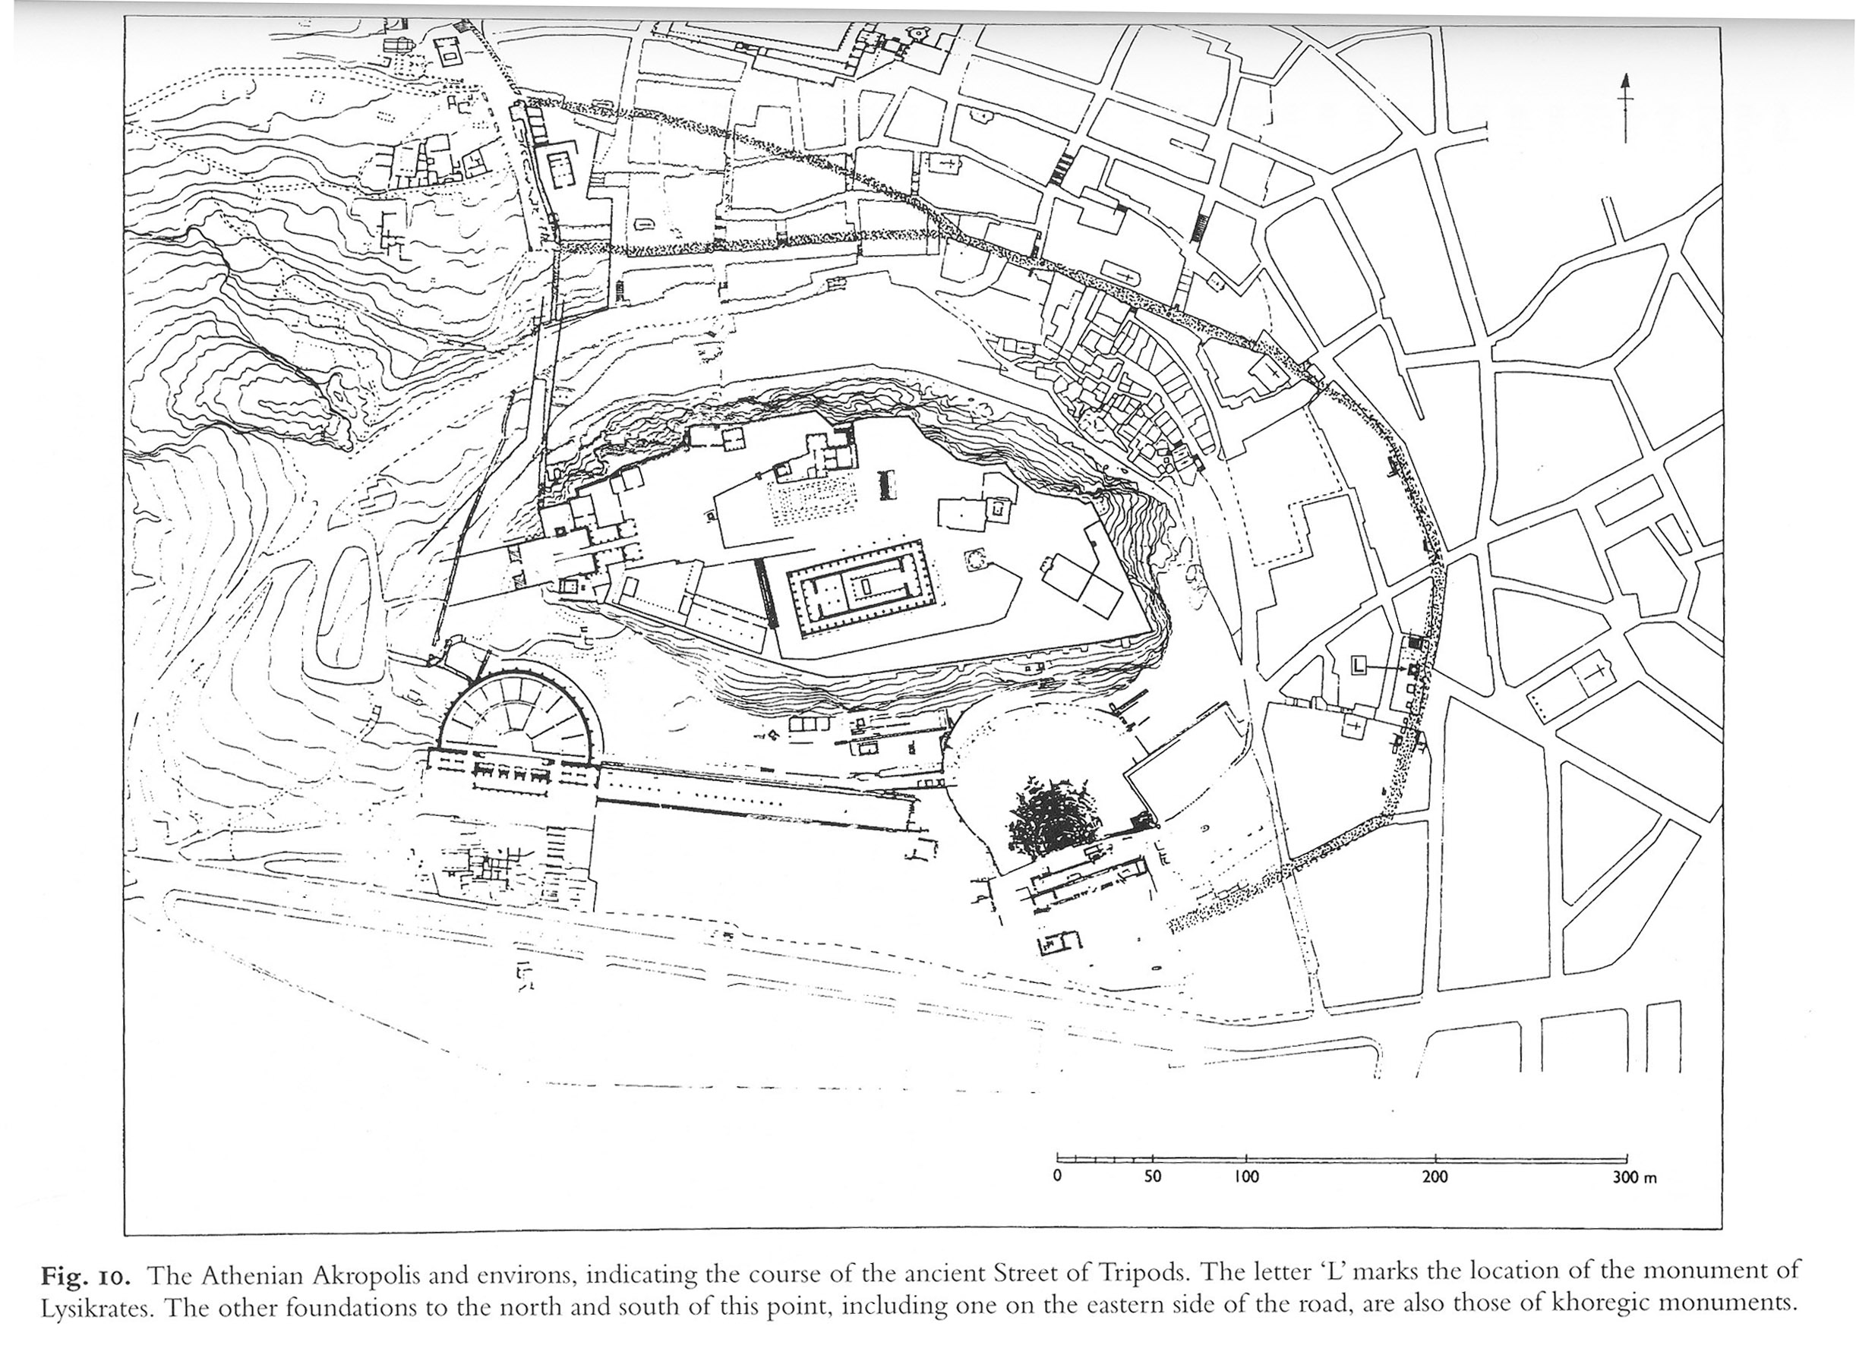
Material Culture: Choregic Monuments

Slide 21
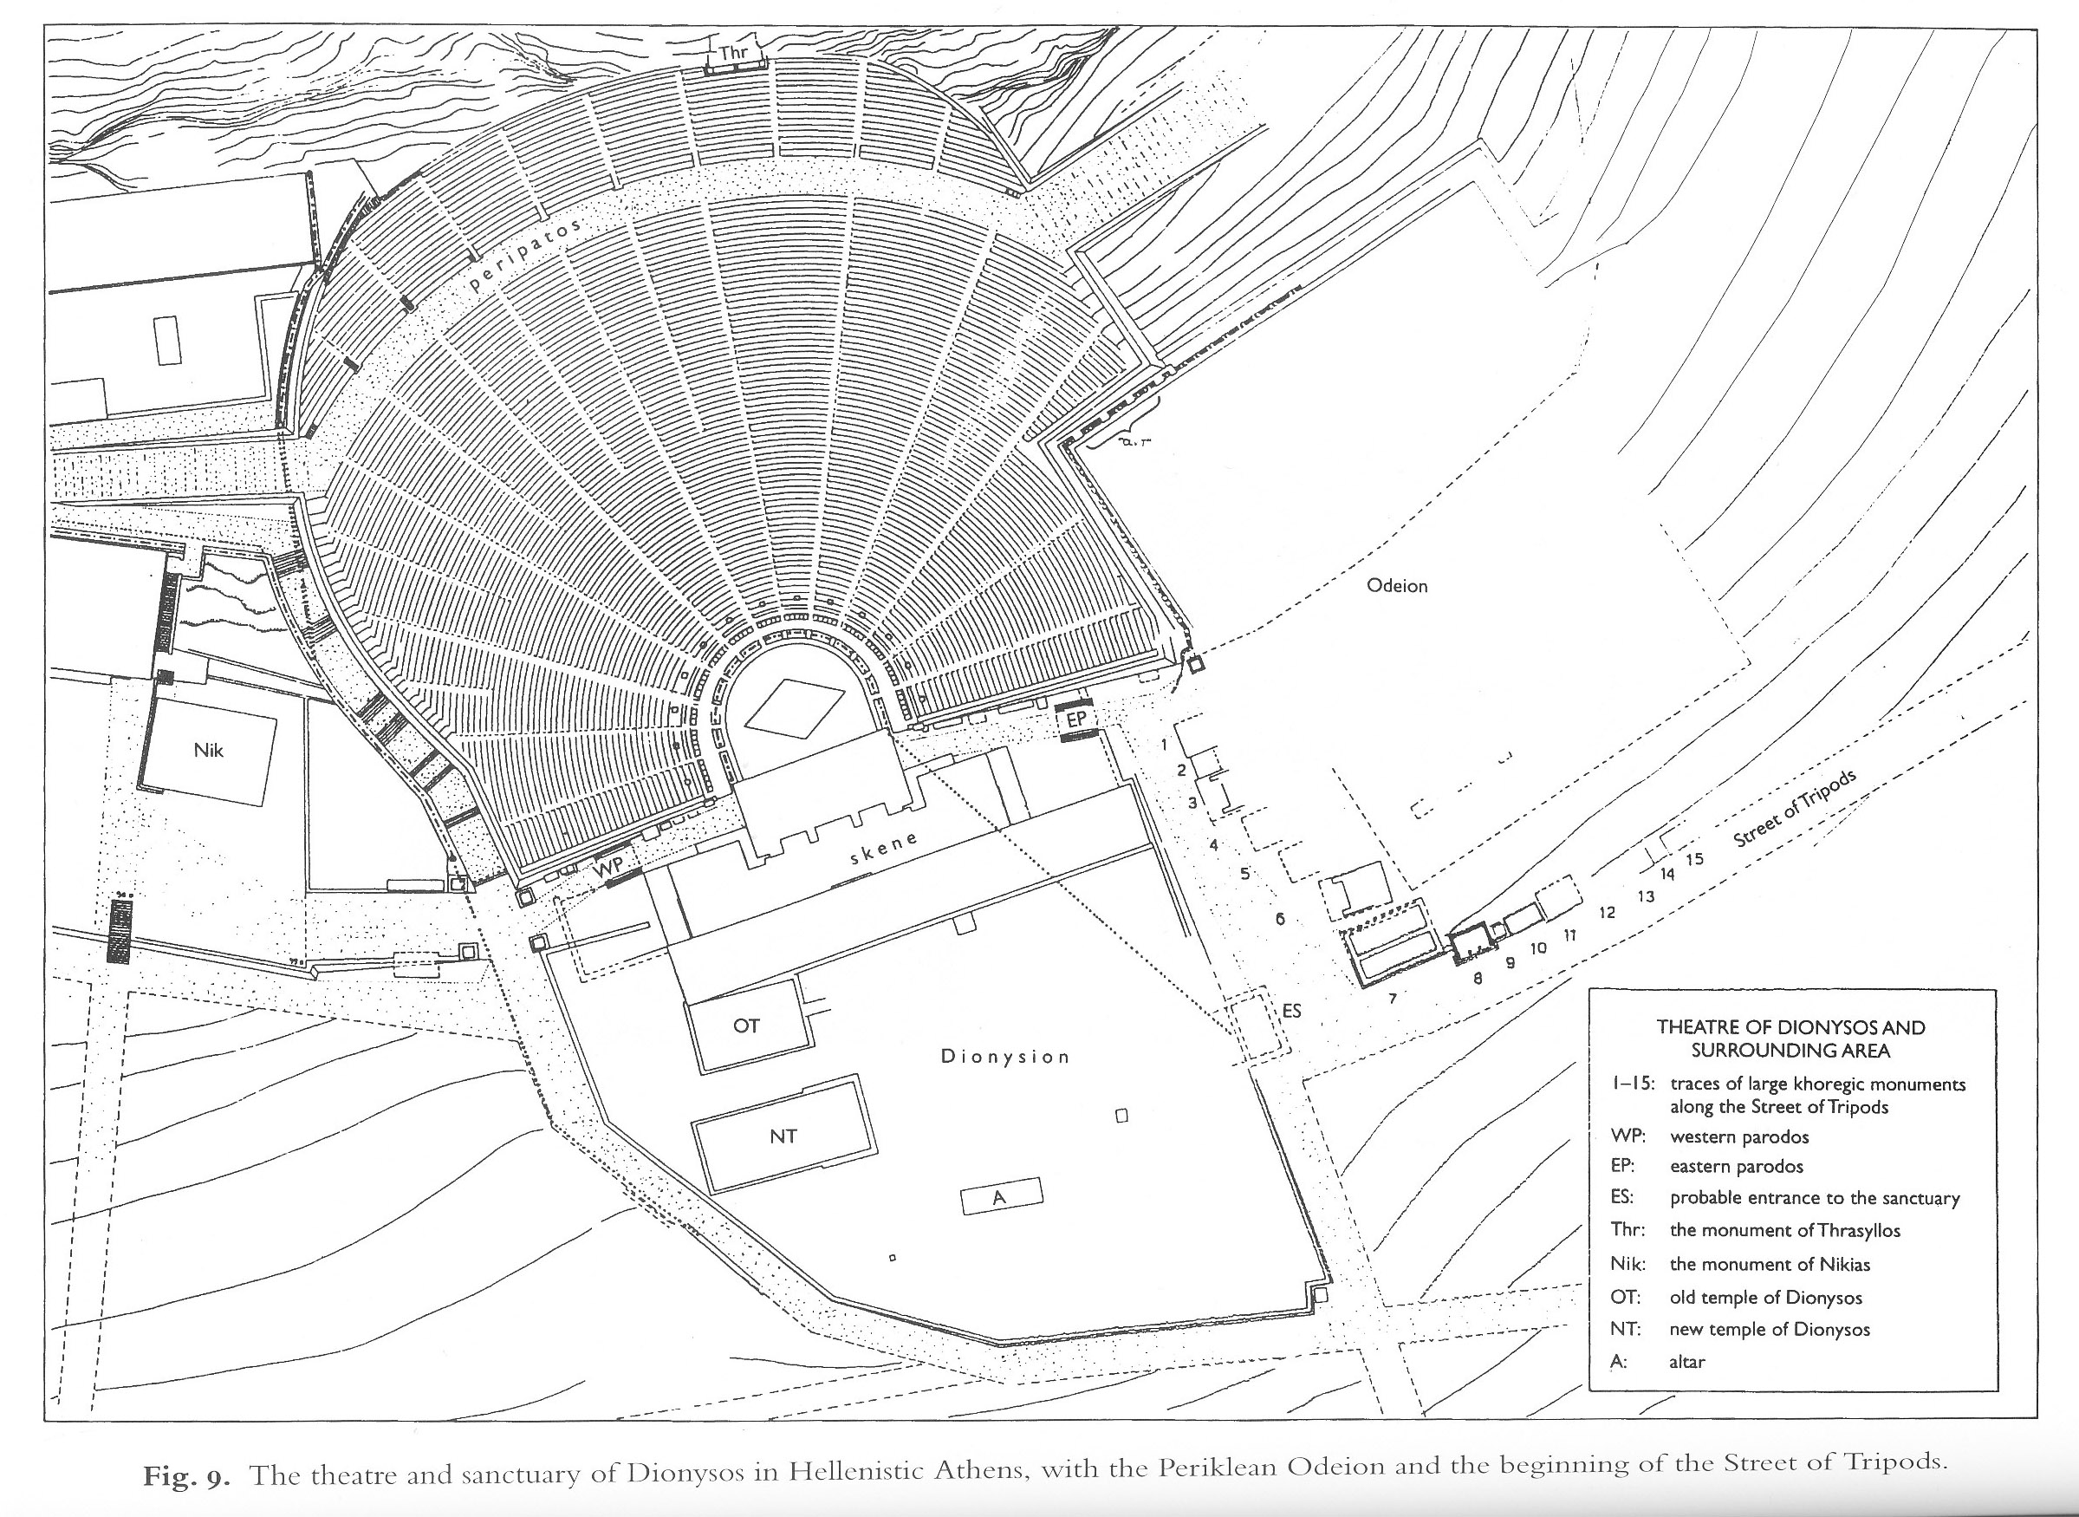

Slide 22
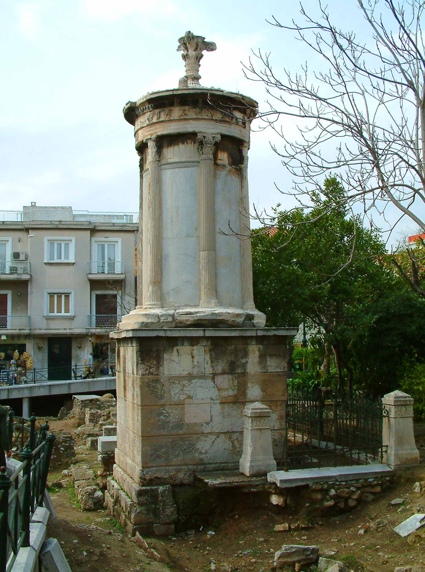
Choregic Monument of Lysicrates: 335/4BC
Notes:
Lysicrates: 335/4BC

Slide 23
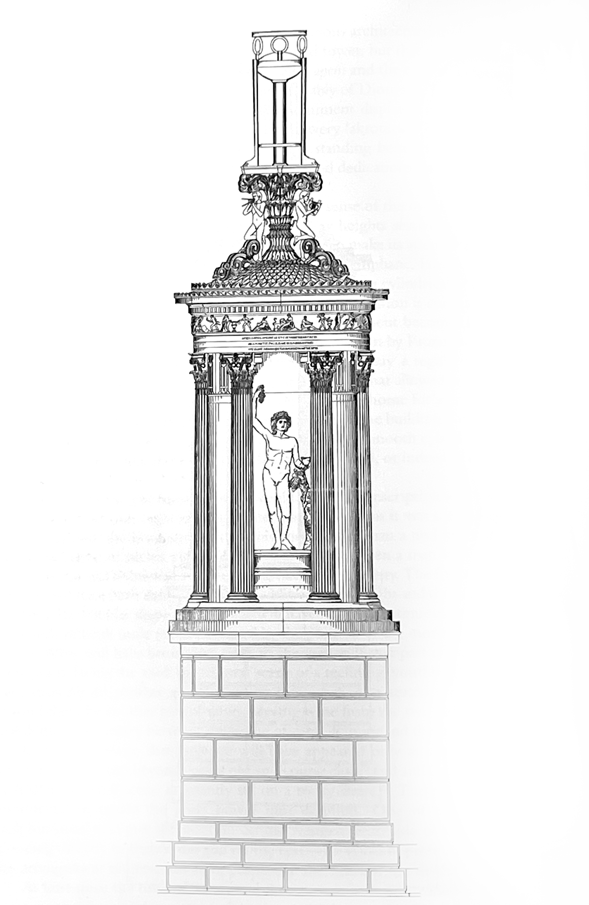
One reconstruction, with tripod on top

Slide 24
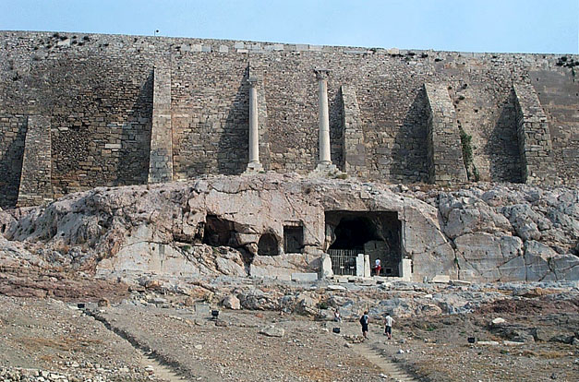
Top of Athenian Theatre of Dionysus, with remains of choregic monument of Thrasyllus (square cavern; 320/19BC), and two further columnar choregic monuments above.
Notes:
Thrasyllus: 320/19BC

Slide 25
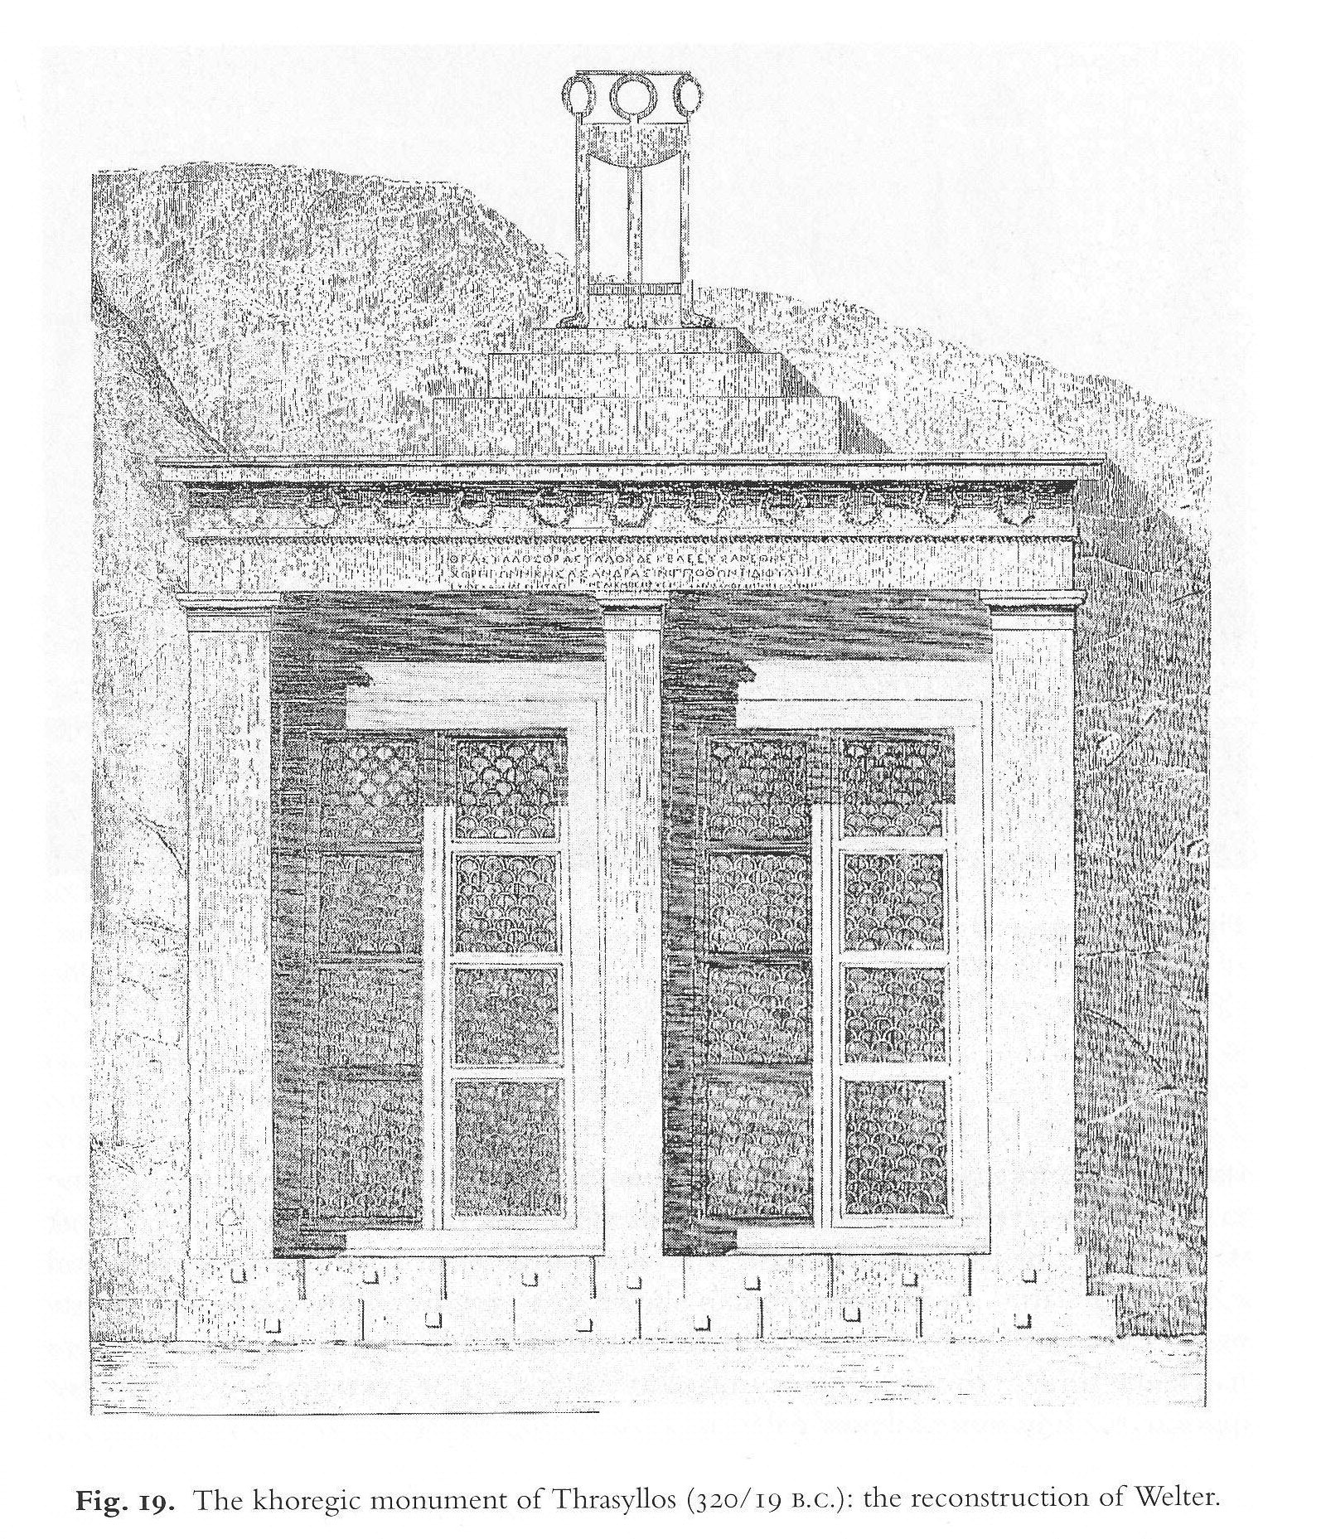
One reconstruction, with tripod on top

Slide 26
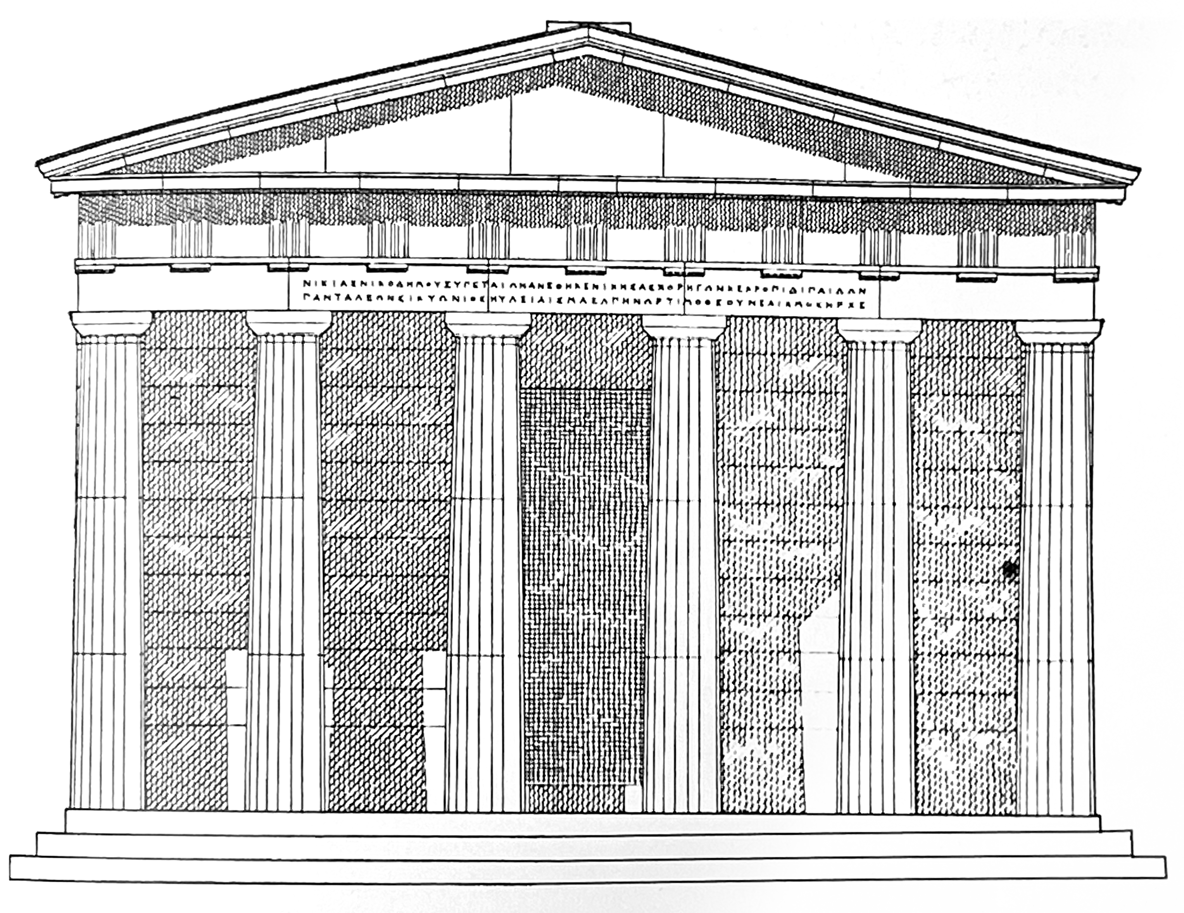
Choregic monument of Nicias (320/19BC), in form of hexastyle Doric temple
(foundations: 16.68mx11.79m: not small!)
Inscription (IG ii²3055): ‘Nicias, son of Nicodemus, of the deme Xypete, dedicated this after being victorious as chorêgos with the tribe Cecropis in the boys’ contest. Pantaleon of Sicyon played the aulos. The song: the Elpenor of Timotheus. Neaichmos was Archon.’
By this time NB Athens under sway of Macedon and being controlled by an oligarchic regime; note also how is listed not simply as the sponsor (chorêgos) but also the victor here.
Notes:
16.68x11.79m foundations. Tripod almost certainly placed within the momument: a temple to Nicias’ victory.

Slide 27
Take-home messages:
Sport has always been political (the ‘Corinthian spirit’ is a Victorian invention!)
Olympia is a cultural centre whose use / appropriation by both states and individuals throughout its history is political history as well as cultural history
The place of sport & celebration within the history of (Athenian) democracy, including public and private wealth and (corporate) finance, is itself an ongoingly fascinating and controversial subject for politics as well as culture
How we Classicists figure out how to understand this is complex, requiring facility with a variety of different kinds of sources (literary/rhetorical, archaeological, material-cultural)

Slide 28
Remaining Questions
Do what extent do we think Alcibiades ‘jumped the shark’ in 416? Is there a sense in which, as such, Alcibiades at Olympia is a desperate (and indeed anti-democratic) throw-back? From whose perspective? With what implications?
And/or, to what extent do we think the 416 Olympics were simply a symptom of contemporary realities, as well as a harbinger of things to come?
Thus: broader question of how (and how far) we contextualize.
Answer is probably a bit of both. And:

Slide 29
Further Reflections
It’s complicated, but a balance or intersection:
Between
• prominence of personal narratives / motivations (as demonstrated in all the textual sources here, and in more traditional narrative accounts within modern historiography)
And broader structures/dynamics:
Incremental changes within and threats to democracy as a social structure (cf. contemporary USA); geopolitical context (Peloponnesian war); developments in economic history of Greece – changes likely in terms of sources of wealth (mining, for instance, in the case of Hipponicus)
• Importance of long view:
not satisfactory simply to focus on 416 and backwards, but also on potential continuities into fourth century and external impingements upon Athenian democracy and beyond
(thus Plutarch’s perspective is actually quite insightful too).

Slide 30
THANK YOU!
Some Bibliography
https://en.wikipedia.org/wiki/Jumping_the_shark 😝
Davies, J. K. 1971. Athenian Propertied Families 600-300 BC. Oxford.
Golden, M. 1998. Sport and Society in Ancient Greece. Cambridge.
Goldhill, S. D. 1999. ‘Programme notes’, in Goldhill and Osborne (eds.), Performance Culture and Athenian Democracy, 1-29. Cambridge.
Gribble, D. 2012. ‘Alcibiades at the Olympics: performance, politics and civic ideology’, Classical Quarterly 62: 45–71.
Harris, J. P. 2009. ‘Revenge of the nerds: Xenophanes, Euripides, and Socrates vs. Olympic victors’, American Journal of Philology 130: 157–94.
Hornblower, S. 2004. Thucydides and Pindar: Historical Narrative and the World of Epinikian Poetry. Oxford.
Macleod, C. M. 1983. ‘Thucydides and tragedy,’ In Collected Essays, 140–58. Oxford.
Martin, R. P. 1989. The Language of Heroes: Speech and Performance in the Iliad. Ithaca, NY.
Wilson, P. J. 2000. The Athenian Institution of the Khoregia: The Chorus, the City, and the Stage. Cambridge.

