Slide 1
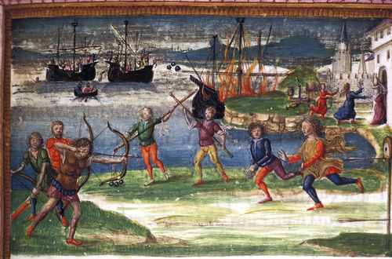
Epic Athletics Anchises’ Funeral Games Aeneid 5
Dr Elena Giusti
Associate Professor in Latin
E.Giusti@Warwick.ac.uk

Slide 2
Middles
Aen. 5.1-2
Interea medium Aeneas iam classe tenebat certus iter...
Meanwhile Aeneas, without slackening in his resolve, kept his fleet on course in mid-ocean...

Slide 3
Themes
Generation
Parenthood
Masculinity
War
Foundation
Identity
Loss
History
Aetiology

Slide 4
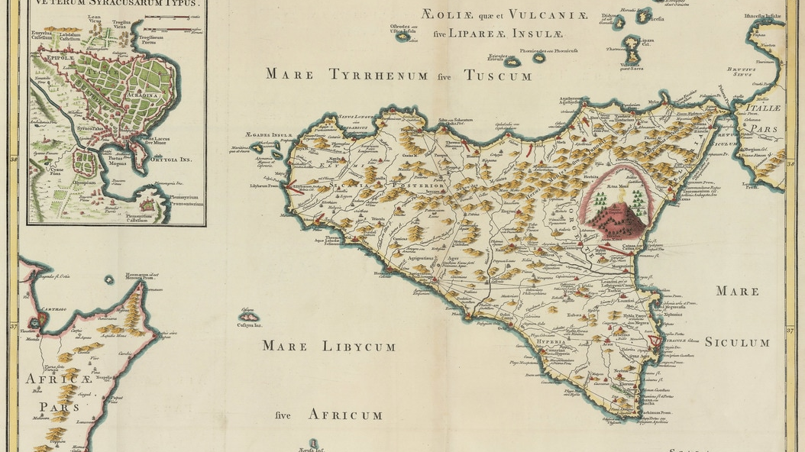

Slide 5
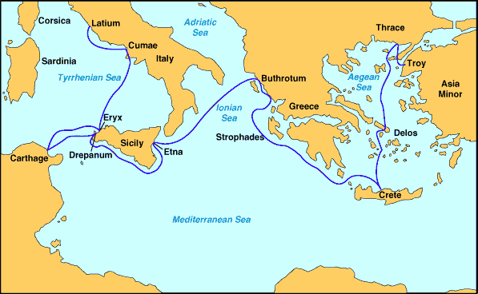

Slide 6
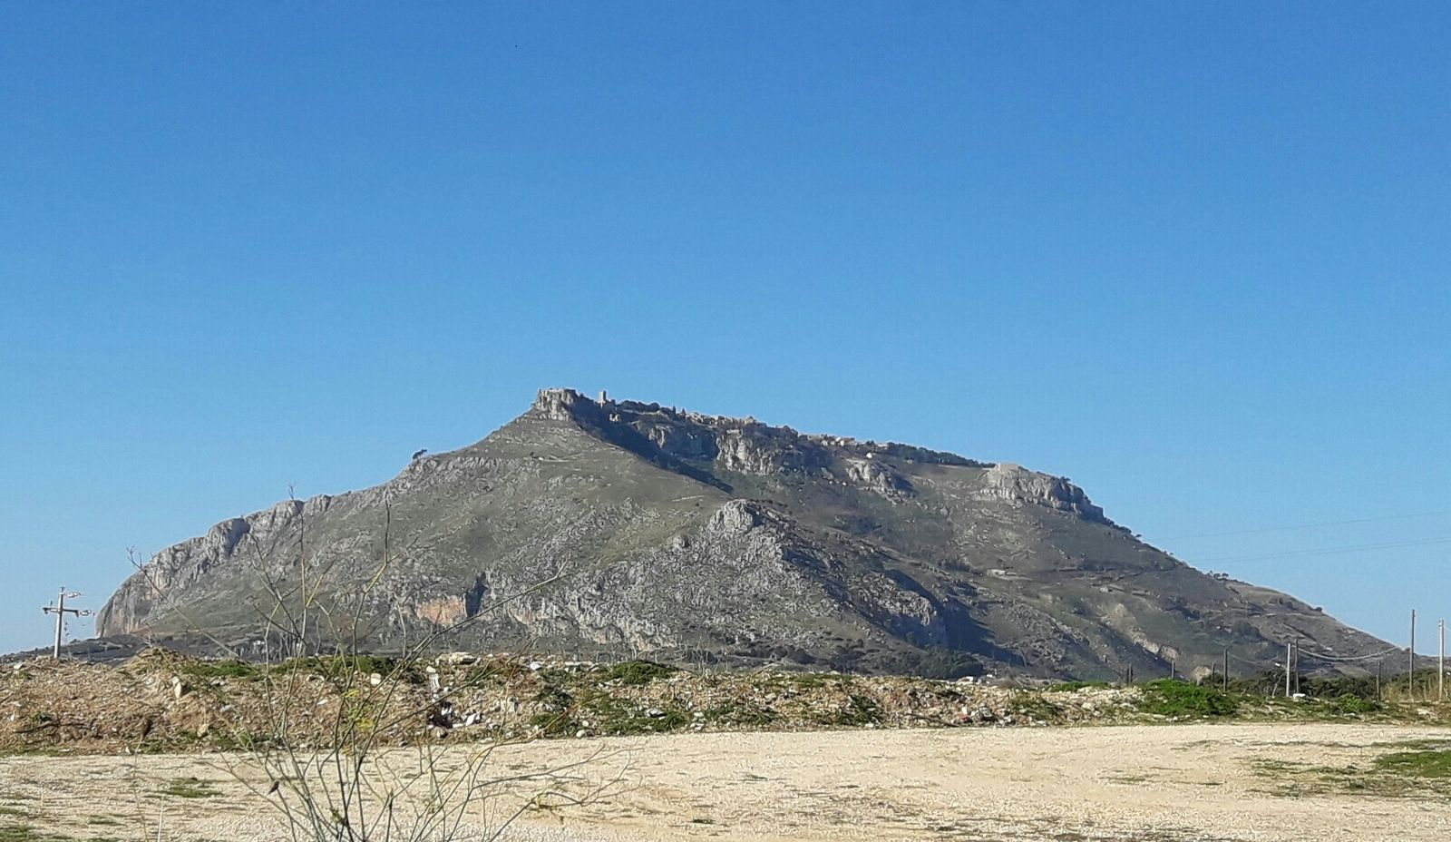

Slide 7
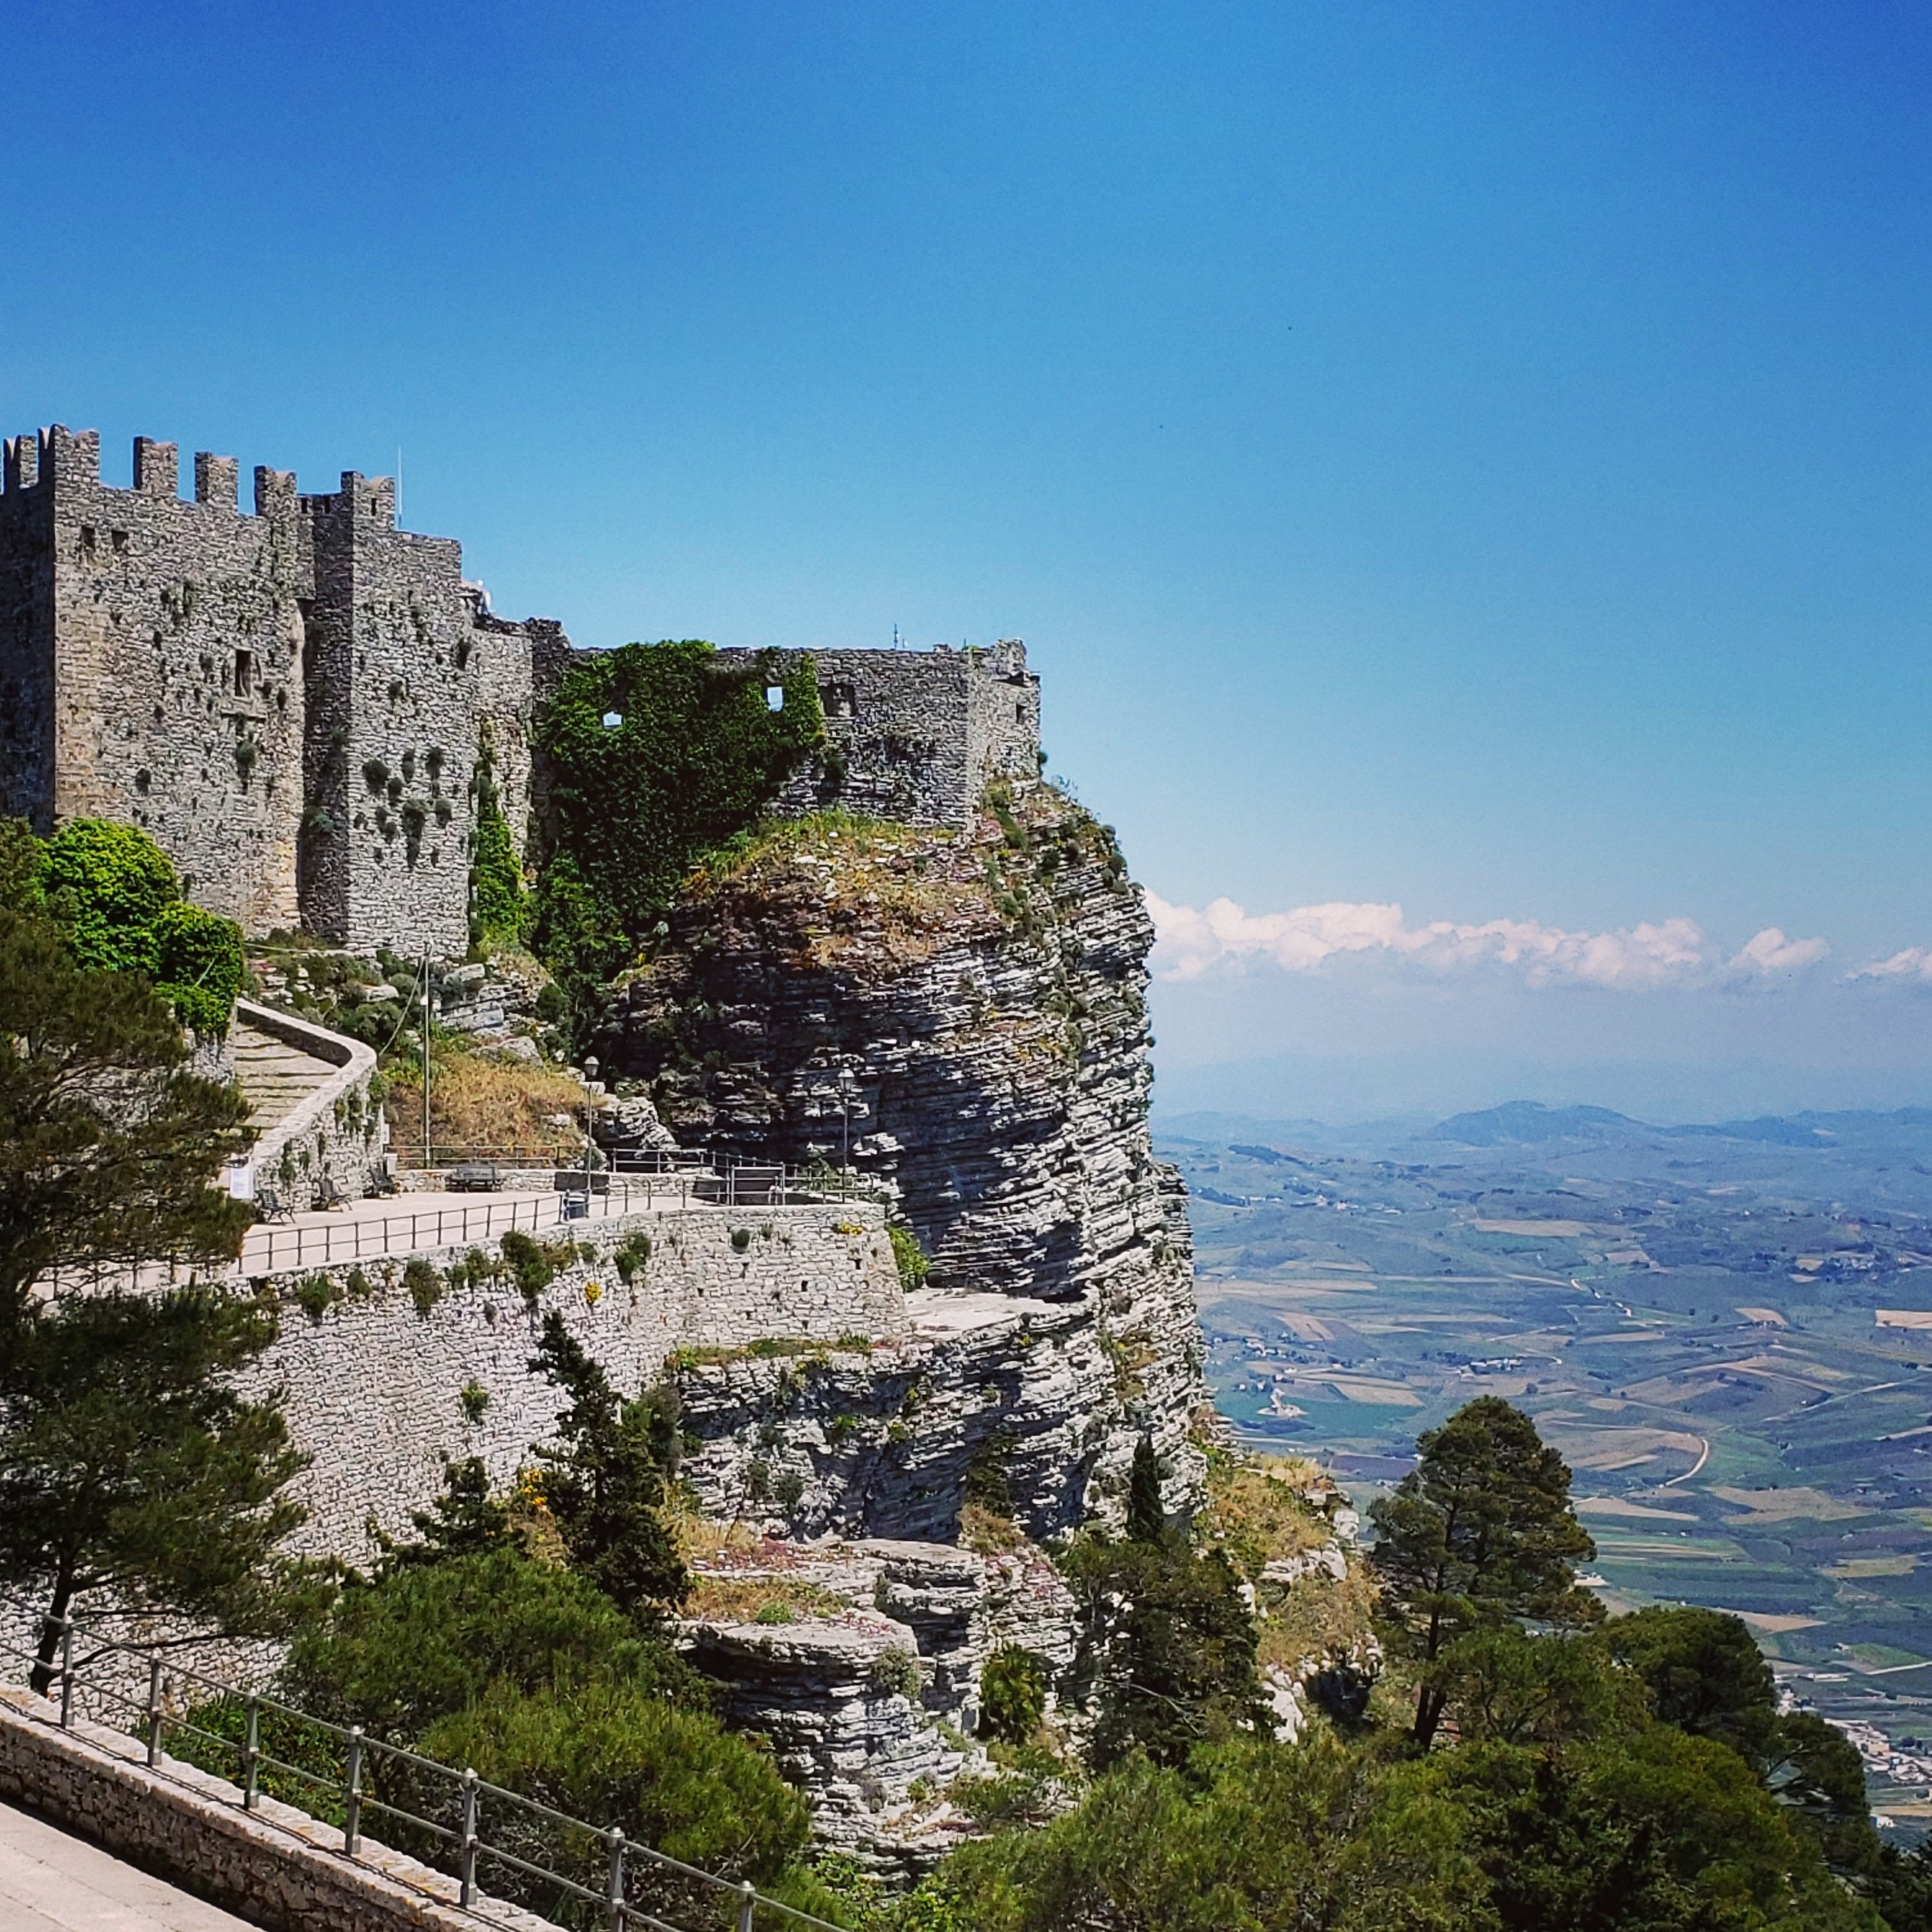
fraterna litora
(5.23-4)

Slide 8
Structure of Book 5
1-34 Voyage from Libya to Sicily (death of Dido; storm)
35-103 Acestes’ welcoming and funeral rituals
104-285 The Boat Race
286-361 The Foot Race
362-484 The Boxing Match
485-544 The Archery Contest
545-603 The lusus Troiae
604-761 The Burning of the ships
762-871 Vojage from Sicily to Italy (death of Palinurus)

Slide 9
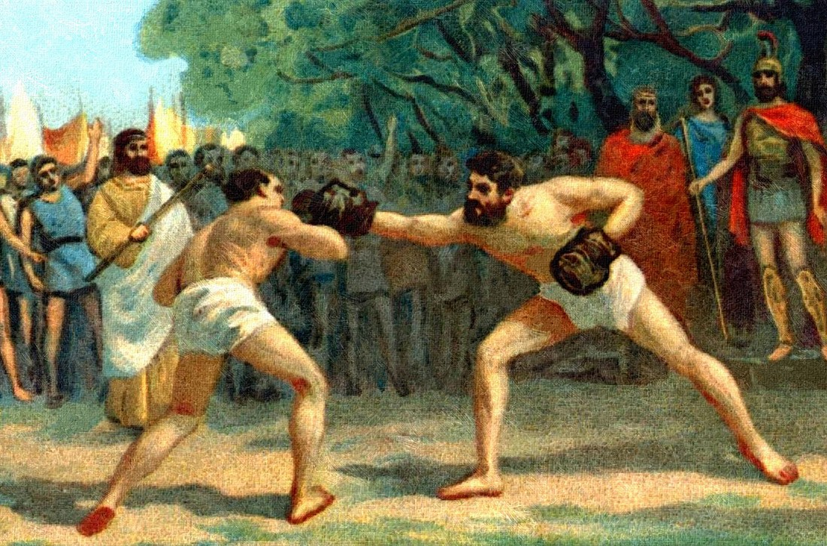
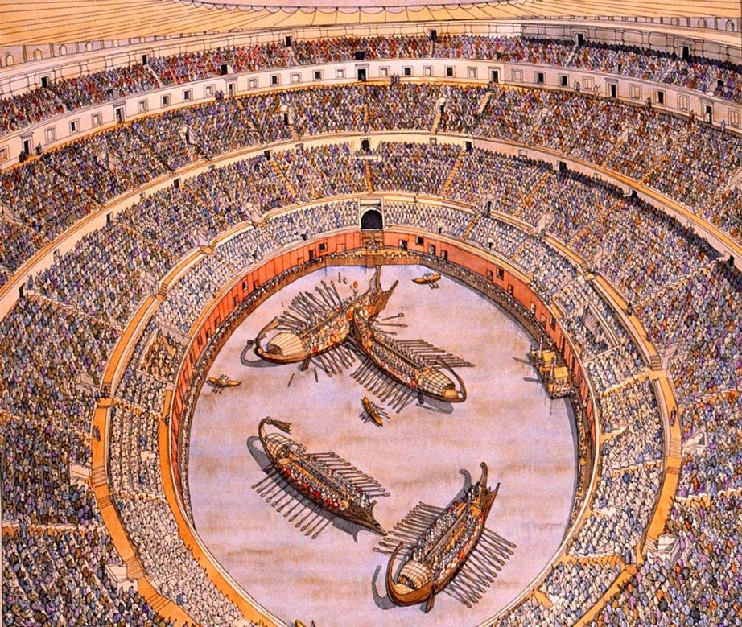
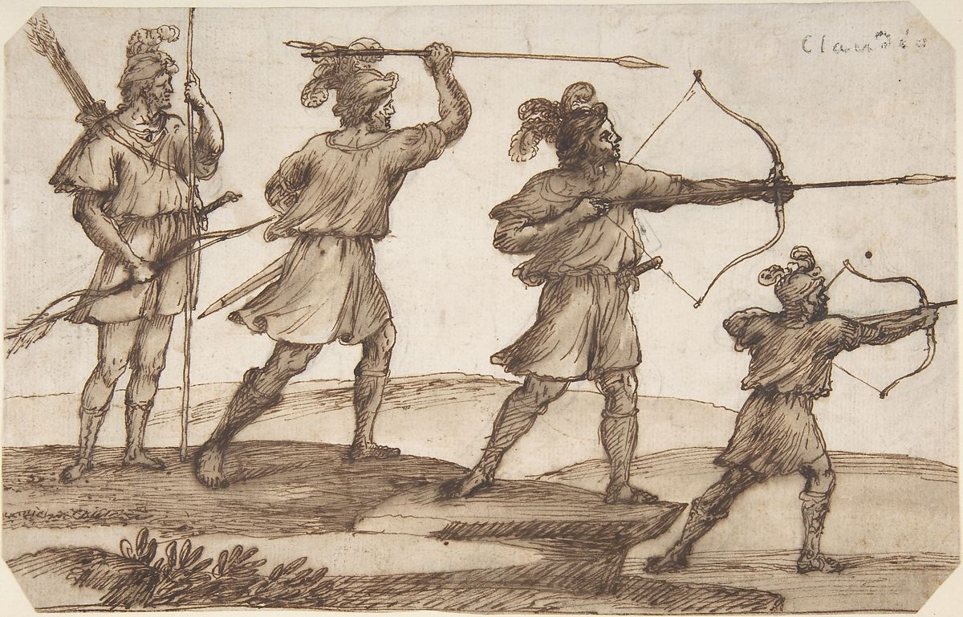
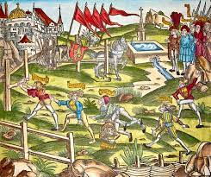

Slide 10
Models
Homer Iliad 23, the Funeral Games for Patroclus
Homer Odyssey 8, the Games at the court of Alcinous

Slide 11
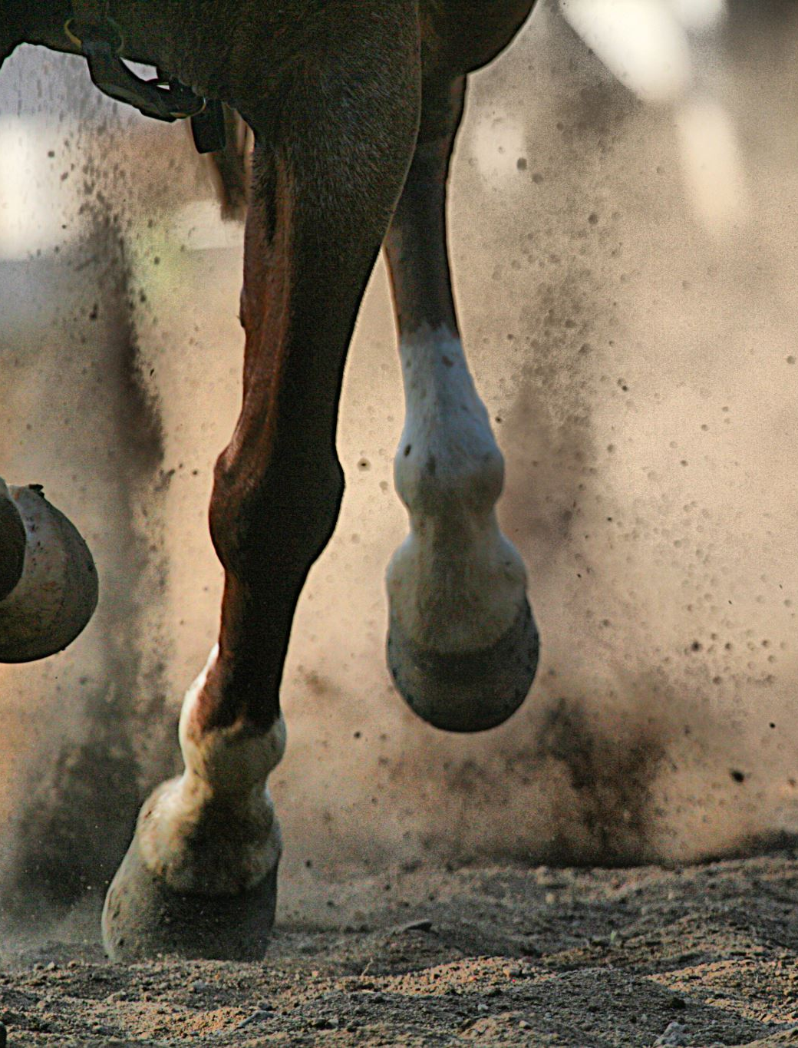
A Poetic Race
Aen. 5.144-50 (tr. Shadi Bartsch)
Not even speeding chariots, springing
from their stalls, devour racetracks with such speed,
when the drivers strike their team with rippling reins
and lean forward to snap the horses with the lash.

Slide 12
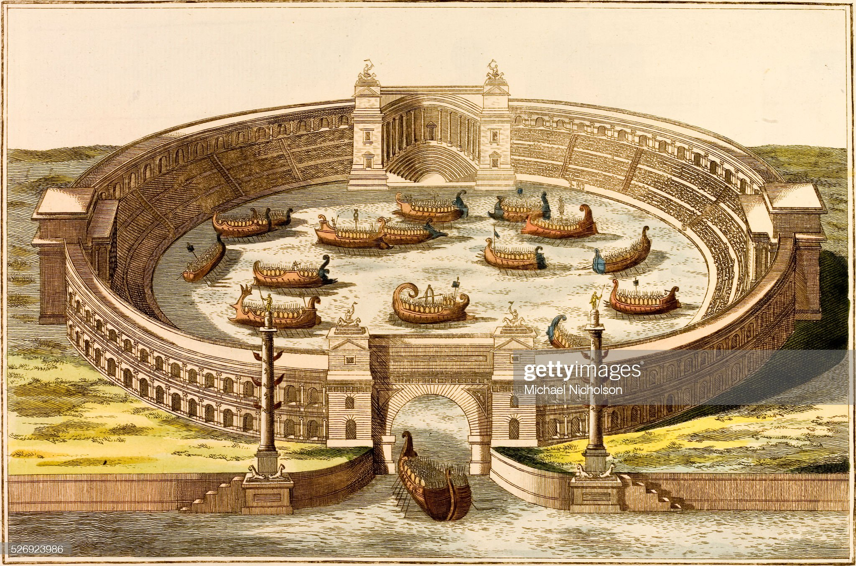
RGDA 23
I gave to the people a spectacle of a sea battle on the other side of the Tiber, in the place where the Caesars’ grove now is, once land had been removed, 1,800 feet in length, 1,200 in breadth. On it thirty ships with rams – triremes or two-banked ships – and many smaller boats did battle. In this fleet fought about 3,000 men, discounting the rowers.

Slide 13
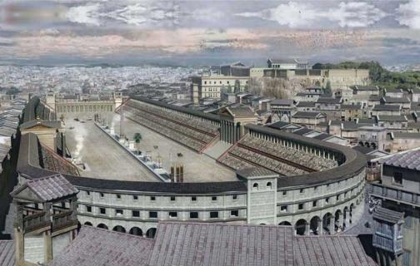
Aen. 5.288-9
mediaque in ualle theatri / circus erat
All around it stood wooded hills and in the middle of the valley there was a circle for a theatre

Slide 14
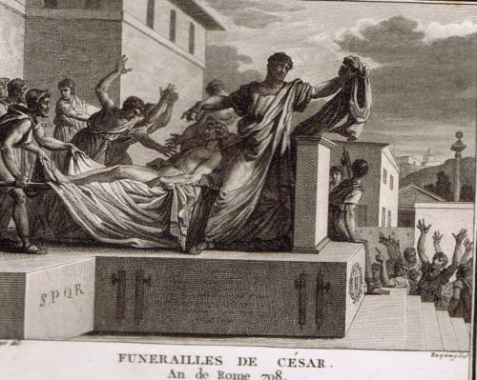
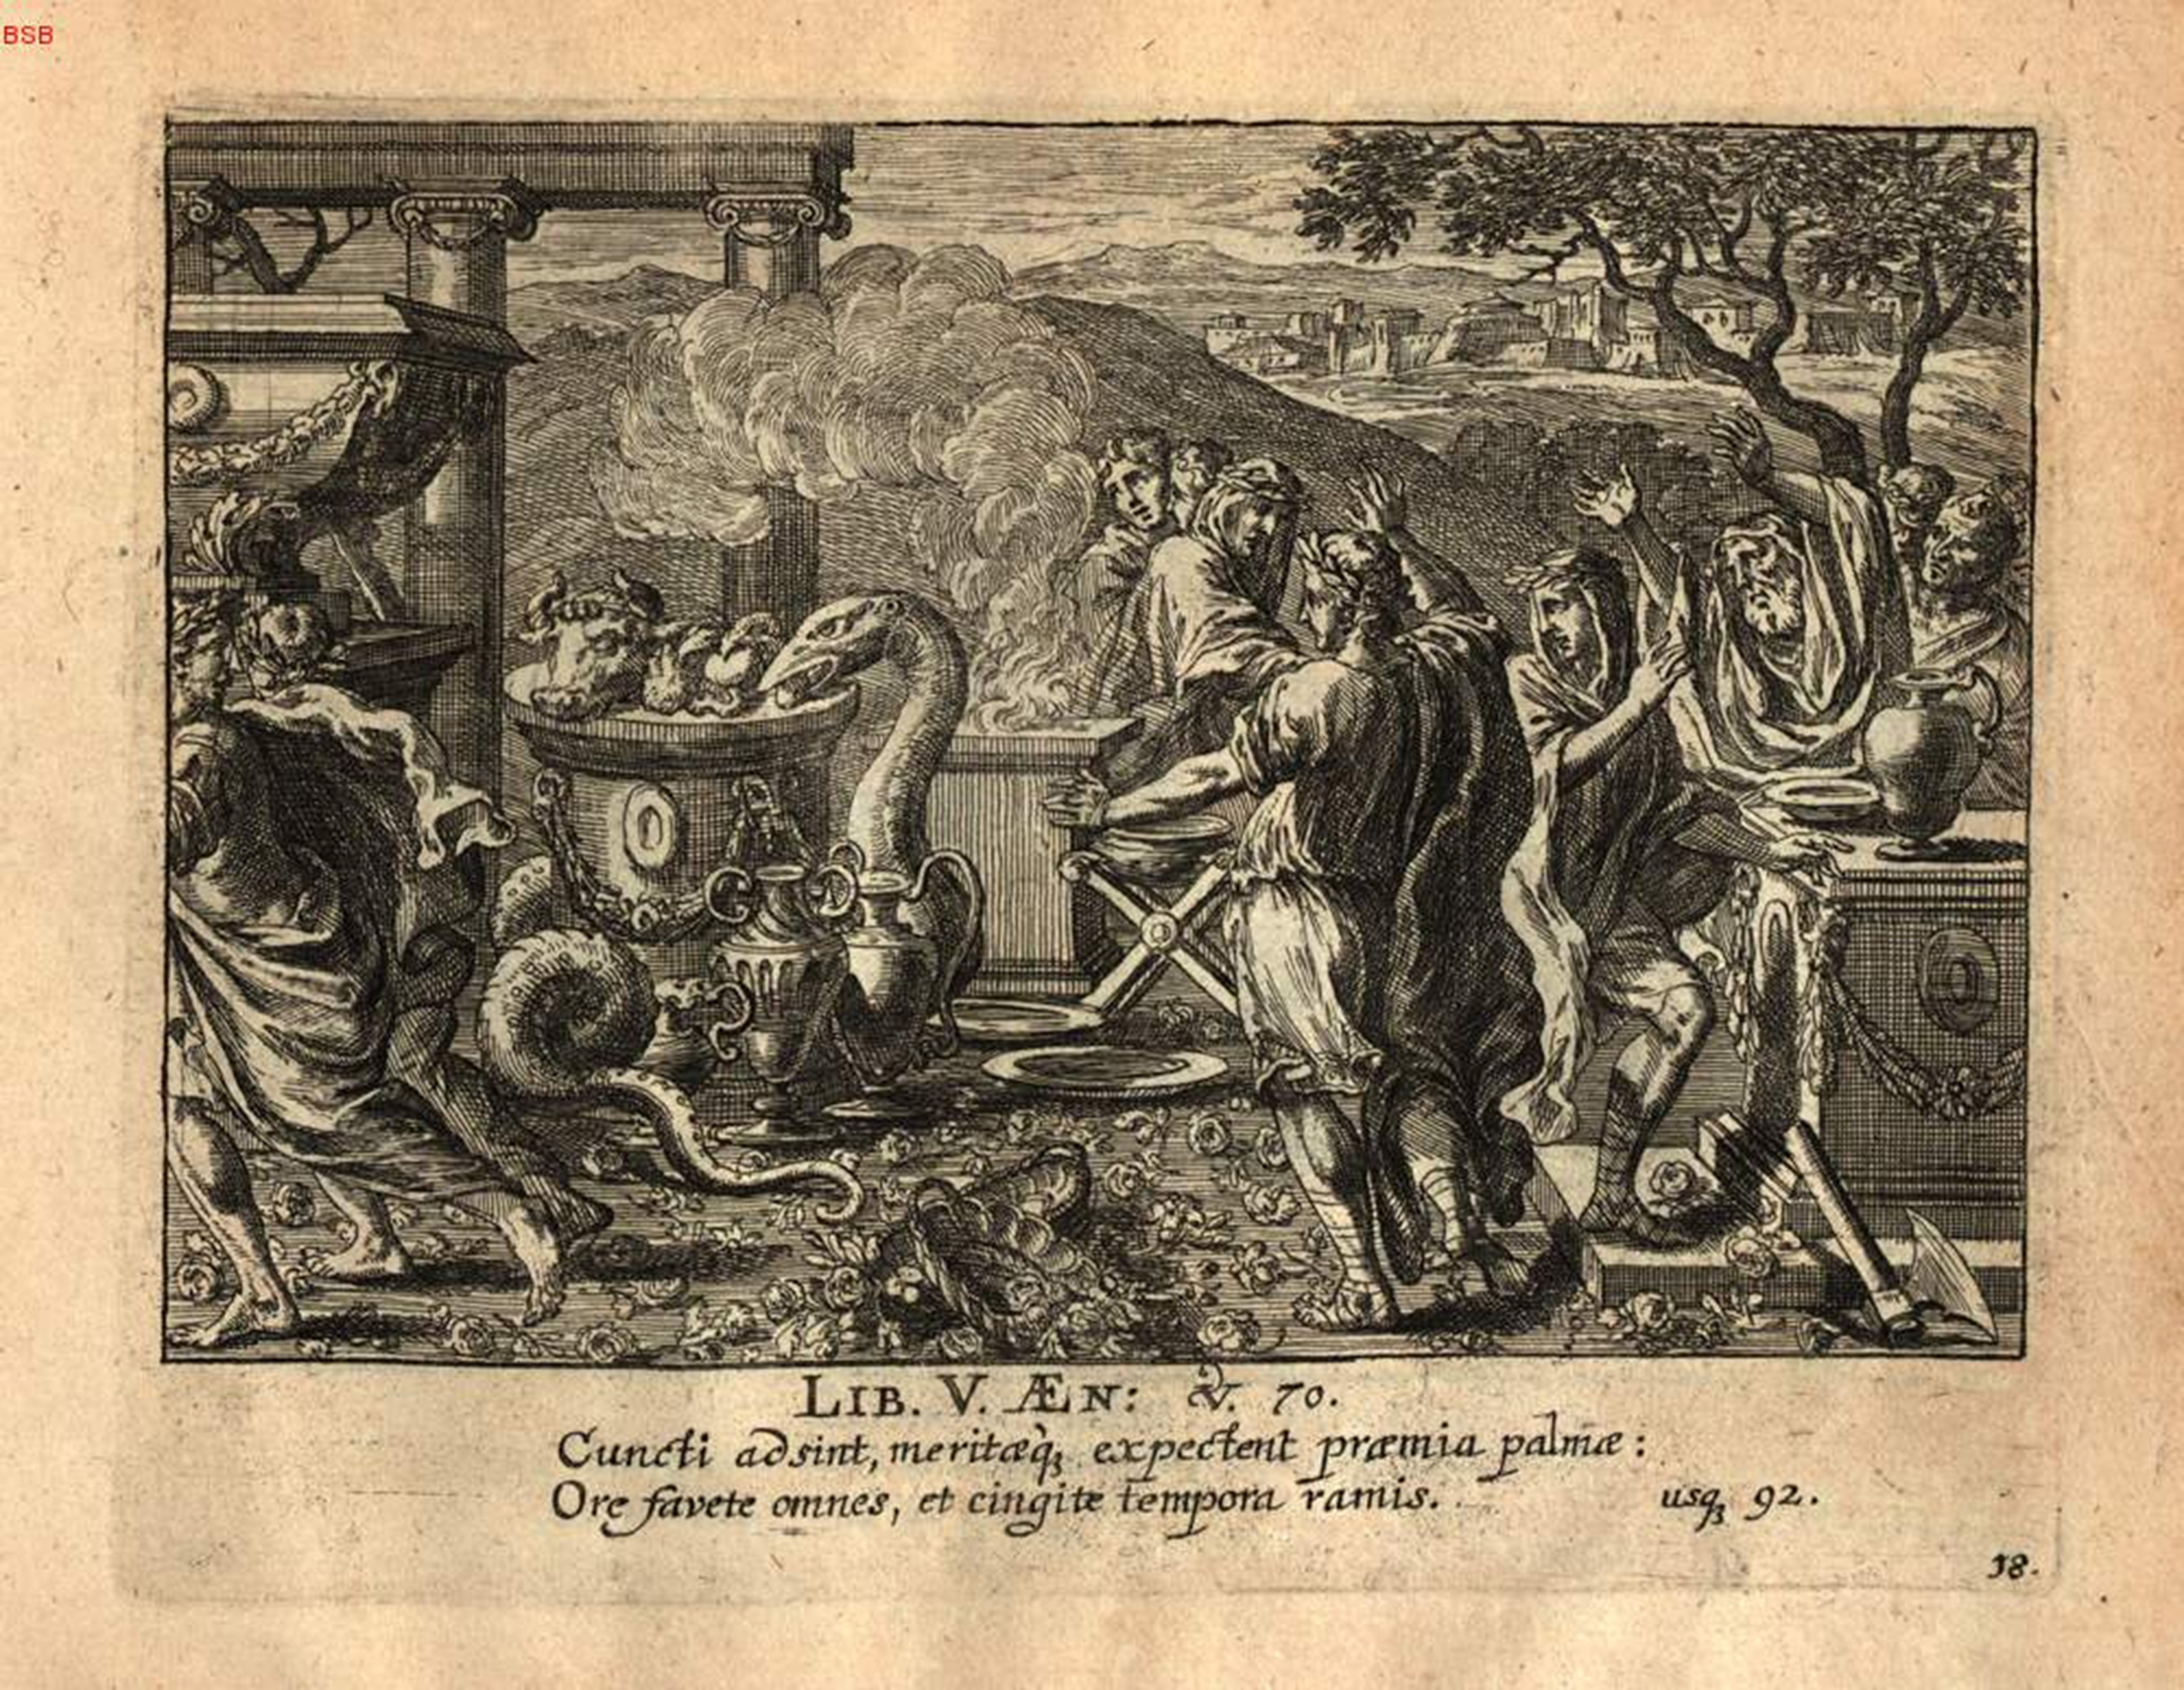

Slide 15
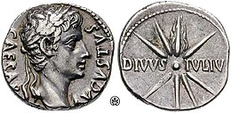
Aen. 5.522-528
And then, a sudden miracle took place, important
in the future – as its fulfillment showed
when stern prophets at last knew its meaning.
Soaring through the empty sky, the arrow
blazed a flaming path, then vanished in the breeze,
like a shooting star falling from the heavens
that draws its shining trail across the sky.

Slide 16
Further Voices in the Ludi
Monsters in the Boat Race
Deaths of the Youth
Rebellious Women

Slide 17
Boat Race Competitors
Mnestheus on the Pristis (Bartsch’ Kraken) – Memmi
Gyas on the Chimaera – Geganii
Sergestus on the Centaurus – Sergii
Cloanthus on the Scylla - Cluenti

Slide 18
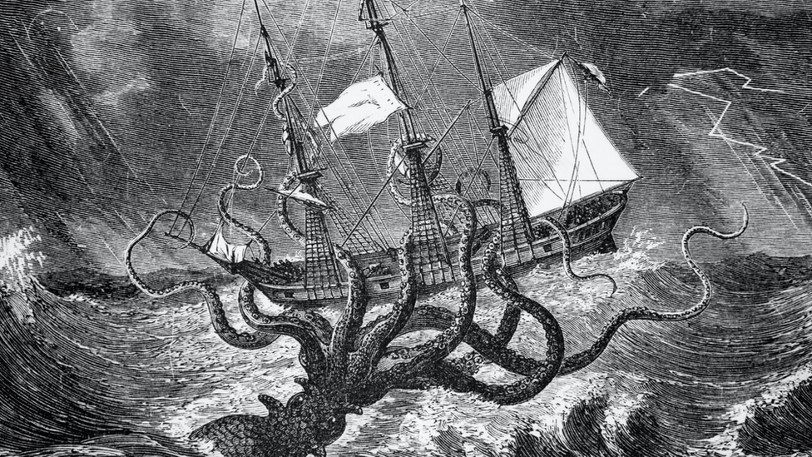
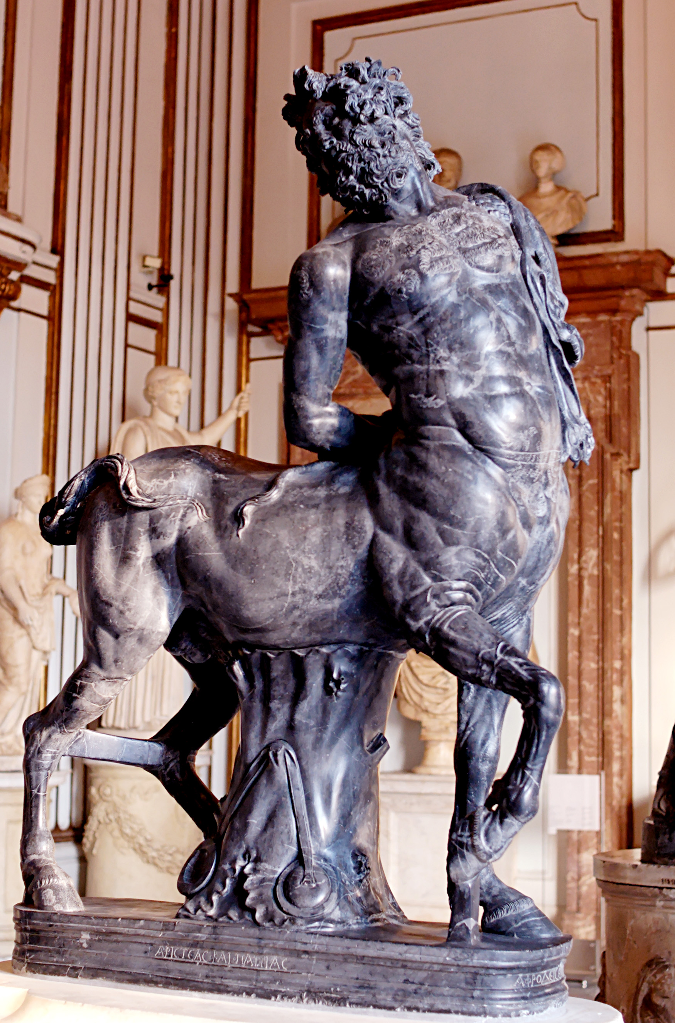
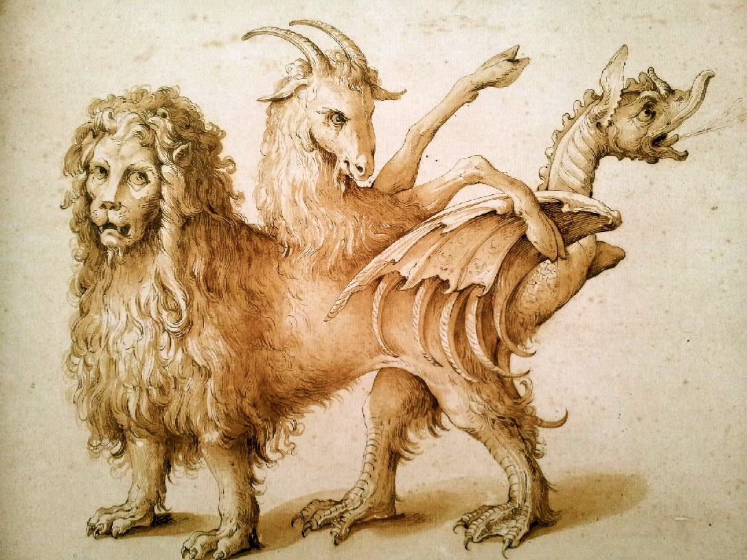
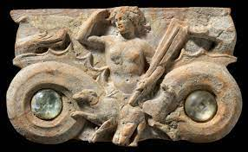

Slide 19
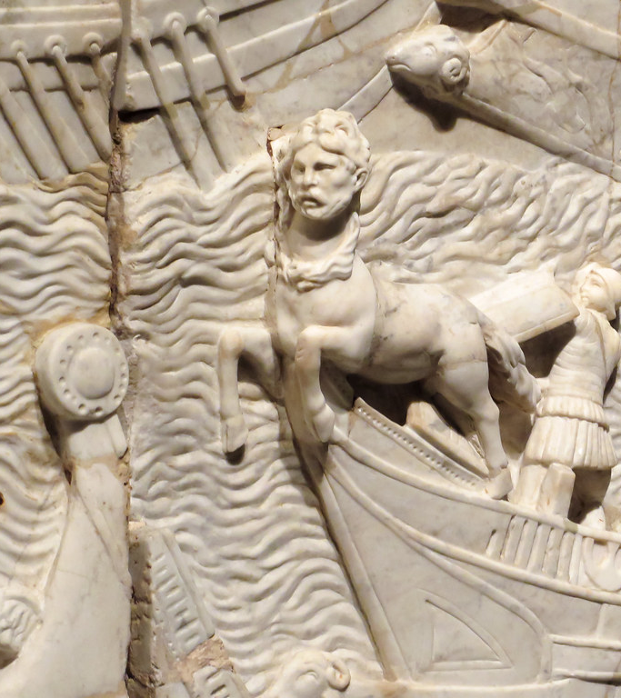
Battle of Actium
Propertius 4.6.49
quotue uehunt prorae Centauros saxa minantis
all the Centaurs threatening to throw rocks, borne by their prows

Slide 20
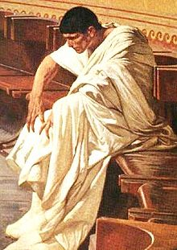
Aen. 5.202-4
Sergestus succumbed to lunacy and drove
his boat still closer to the rocks and into danger.
Unhappy man – his boat rammed onto jutting reefs.
Aen.8.668-9
Catilina minaci / pententem scopulo
Catiline, hanging from a thereatening cliff

Slide 21
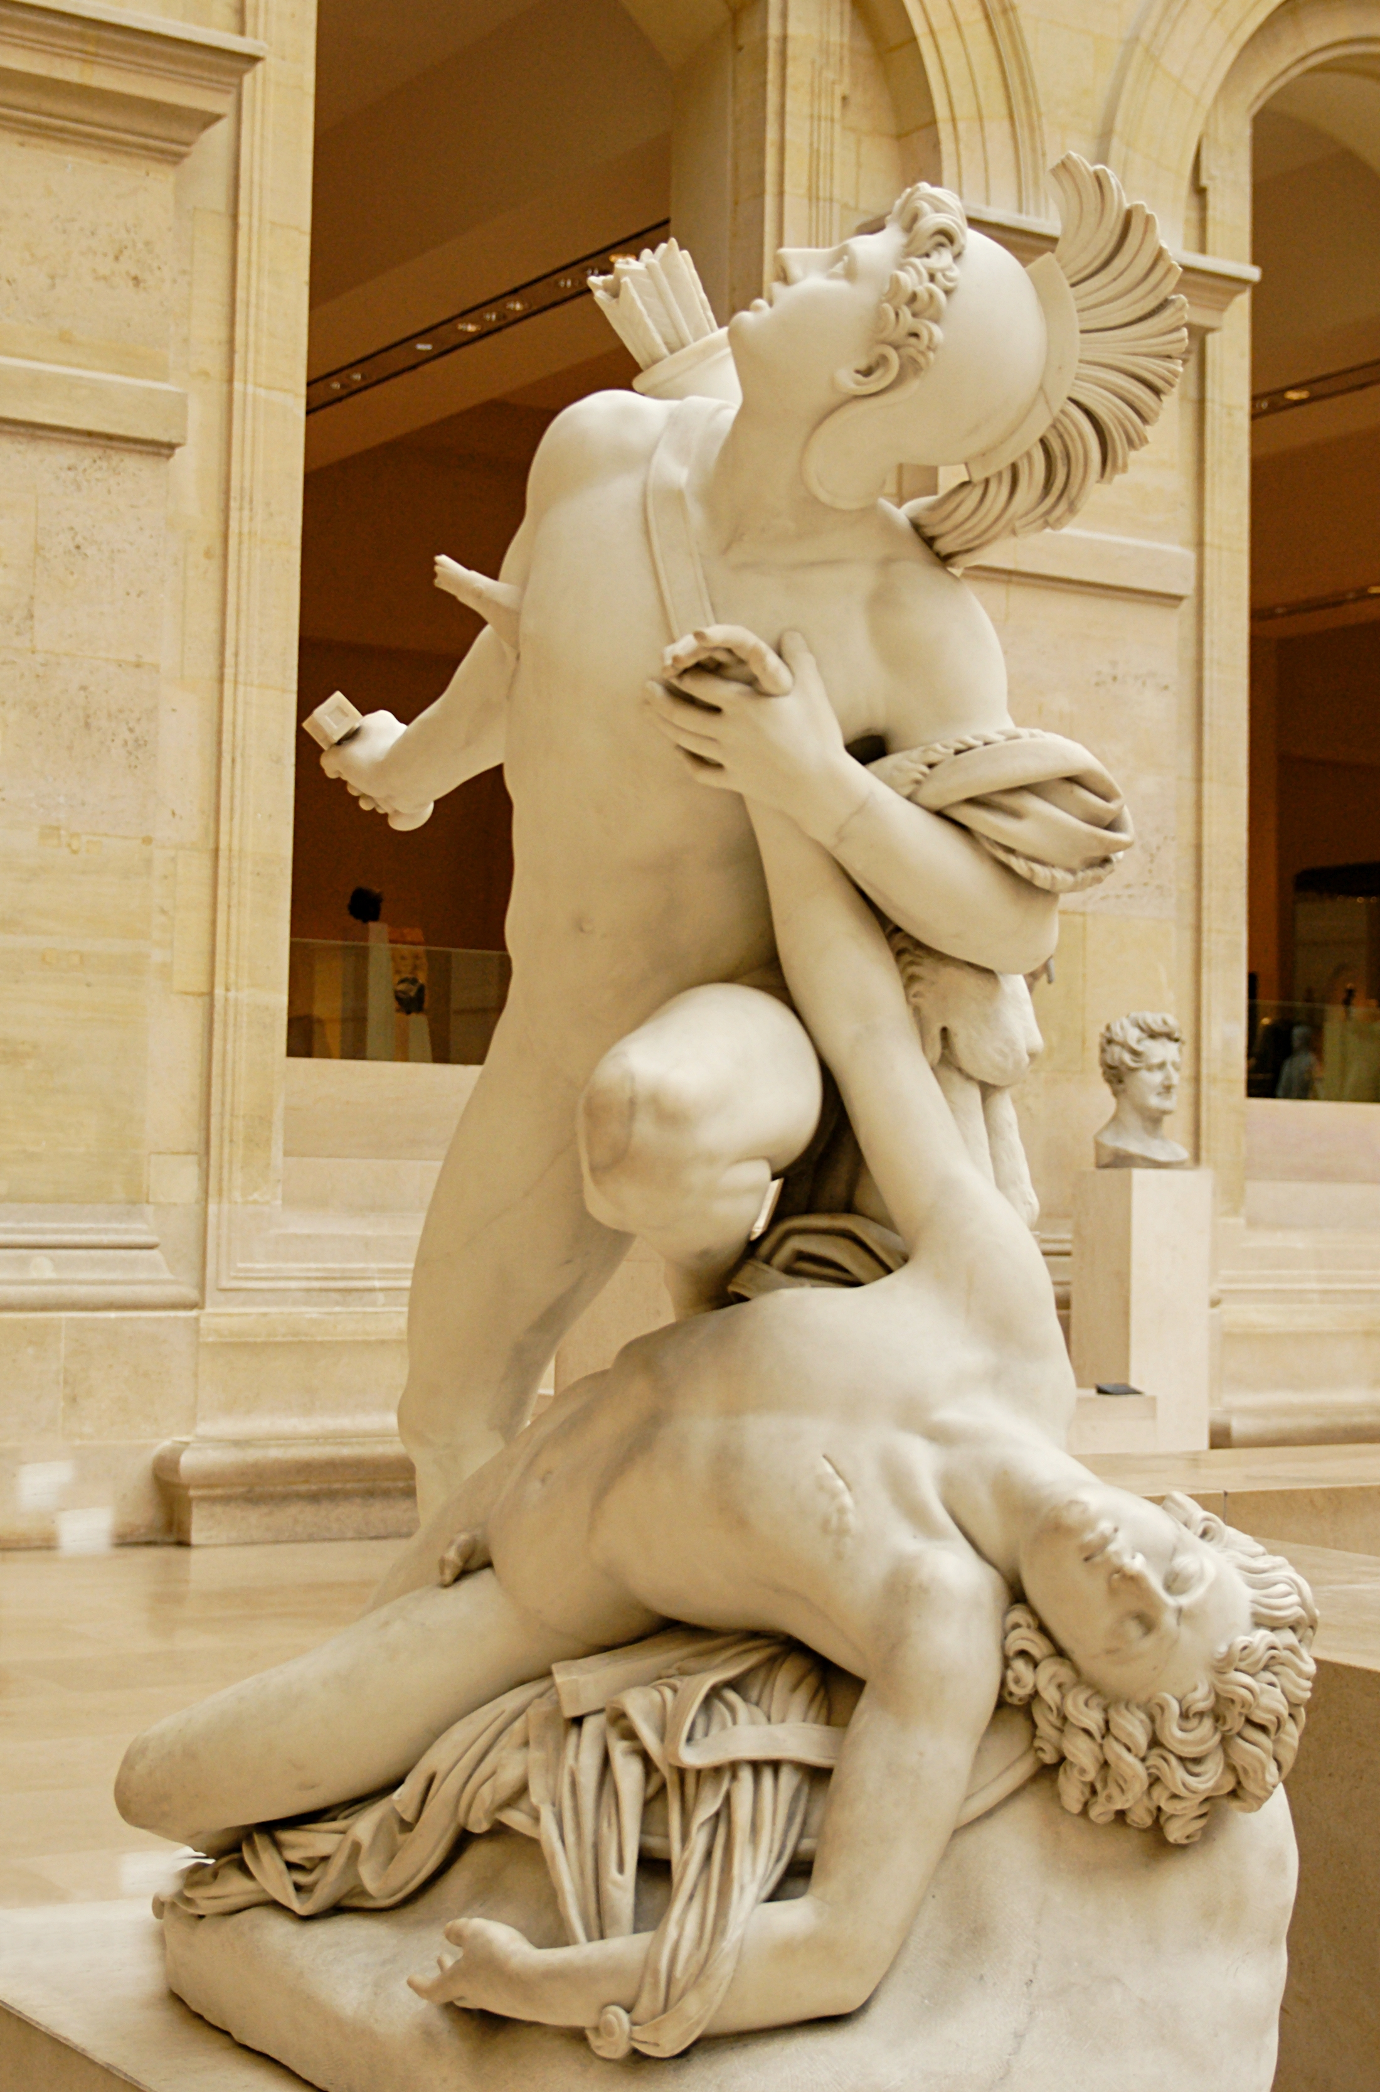
Euryalus and Nisus

Slide 22
Tibicines (Half-lines)
Aen. 5.294-6
Nisus et Euryalus primi,
Euryalus forma insignis uiridique iuuenta,
Nisus amore pio pueri
First Nisus and Euryalus,
the latter marked by beauty and green youth,
Nisus by his pious love for him.
Aen. 9.467
multo clamore sequuntur
Euryali et Nisi
5.321-2
spatio post deinde relicto
Tertius Euryalus

Slide 23
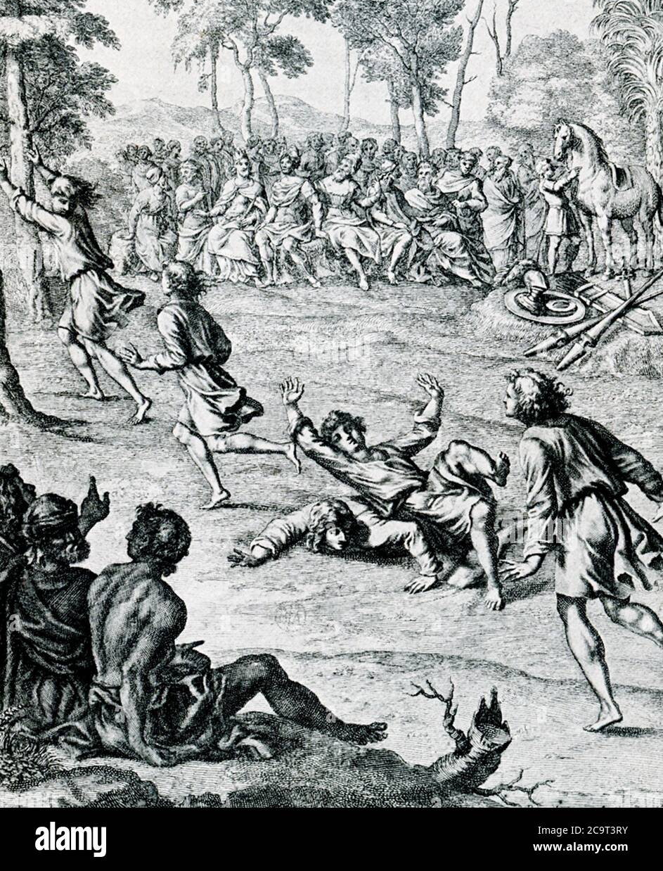
Aen. 5.329-336
Nisus skidded in a pool of slippery blood
where bulls slaughtered for a sacrifice
had soaked the ground and lush green grass with gore.
He was already relishing his victory
when he fell, going down face-first.
He lay there in the filthy dung and sacred gore.
Even so, he remembered his love for Euryalus.
Cf. Il. 23.771-86 Athena causes Ajax to slip in some dung so that Odysseus is able to win

Slide 24
Ante ora parentum
Aen. 5.553 (the Troia)
incendunt pueri pariterque ante ora parentum the boys advanced before their parents’ eyes
Cf. Aen. 1.95-96
quis ante ora patrum Troiae sub moenibus altis all you who died by Troy’s high walls under
contigit oppetere your fathers’ gaze
Aen. 6.308
impositique rogis iuuenes ante ora parentum sons placed on the pyre before their parents’ eyes

Slide 25
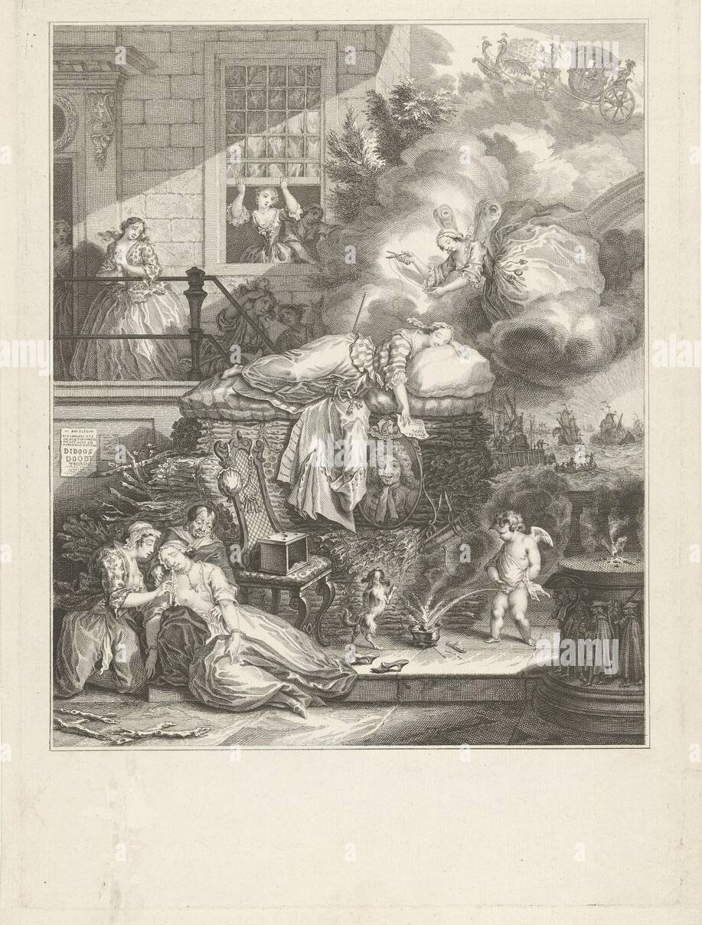
Aen. 5.1-7
Aeneas and his crew sailed out to sea.
Resolute, he cut through waters dark with wind,
gazing back at city walls lit up by flames –
poor Dido’s pyre. No one knew what caused the blaze,
but they knew the great grief of a love betrayed
and what a woman’s passion could unleash.
Their hearts were somber with foreboding.

Slide 26
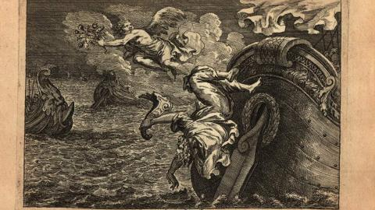
unum pro multis dabitur caput (5.815)

Slide 27
The Trojan Women

Slide 28
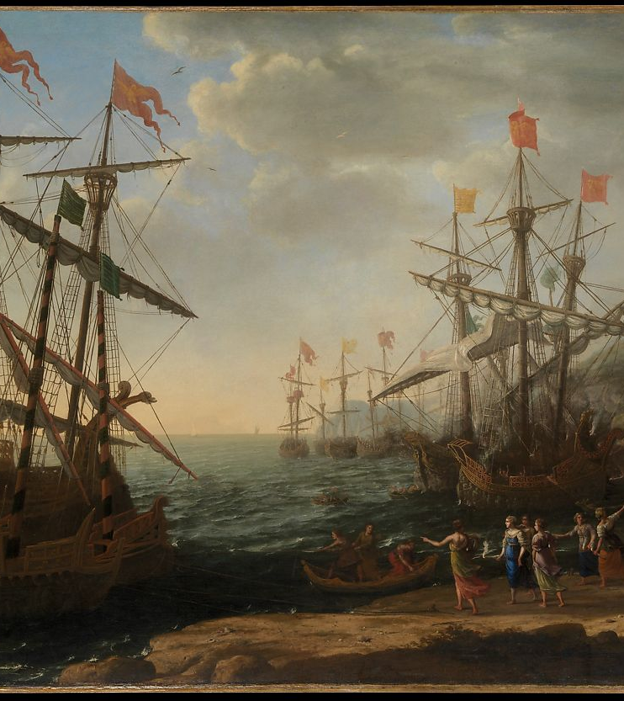
5.615-6
heu tot uada fessis
et tantum superesse maris, uox omnibus una
Aen. 5.613-7
On the empty beach, the Trojan women
wept for lost Anchises, looking at the ocean
through their tears. They deplored the many reefs
and voyages that faced their weary people still.
Sick of sea and hardship, they longed to settle.

Slide 29
Georgia Nugent (1992) ‘Vergil’s “Voice of the Women” in “Aeneid” V’, Arethusa 25.2, 255-92
”The Trojan women – Vergil tells us – speak as one: Vox omnibus una (616). But it is important to realize that in fact no woman ever speaks in this voice and no man ever hears it.”
”Vergil tells us that there is a collective voice of the Trojan women. But I shall stress here an understanding of the women’s voice in the Aeneid less as a representation of female experience than as a useful narrative tool for the poet’s manipulation. “The women” as a collective (most often characterized in the Aeneid as matres “mothers”) may be used by Vergil as the bearer of certain meanings, as an empty space to be filled by authorial desire and design. Viewed in this way, the alleged colelctive voice of women in Aeneid V may come to seem more a particularly useful kind of silence.”

Slide 30
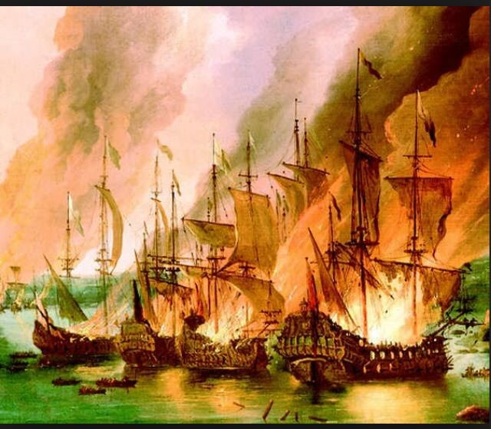
Thank you for Listening!
E.Giusti@Warwick.ac.uk

